Slide 1
Automatic functional tests for EPC’s UNICOS-CPC applications
Maria del Mar Gomez-Jordana Mañas (Technical Student)
David Carvalho, Jose Manuel de Paco Soto
SY-EPC-CCS October 20th , 2021

Slide 2
Motivation
  Early detection of bugs:
    Detect errors introduced during development or modifications
  Replace manual testing:
    Long and repetitive task
    Leads to human errors
    Exhaustive test can only be done once before commissioning
  Increase test coverage:
    Tests can be done at any time
    No use of human resources
  Verified code to be deployed in production
    Some modifications cannot be tested in the real plant
    Modifications can break critical functionalities
10/19/2021
Maria del Mar Gomez-Jordana
2

Slide 3




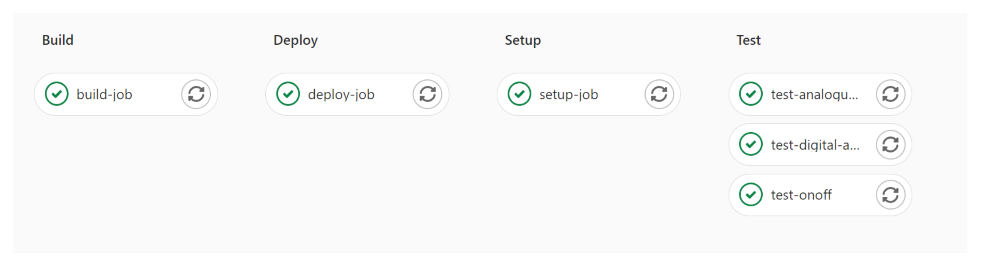
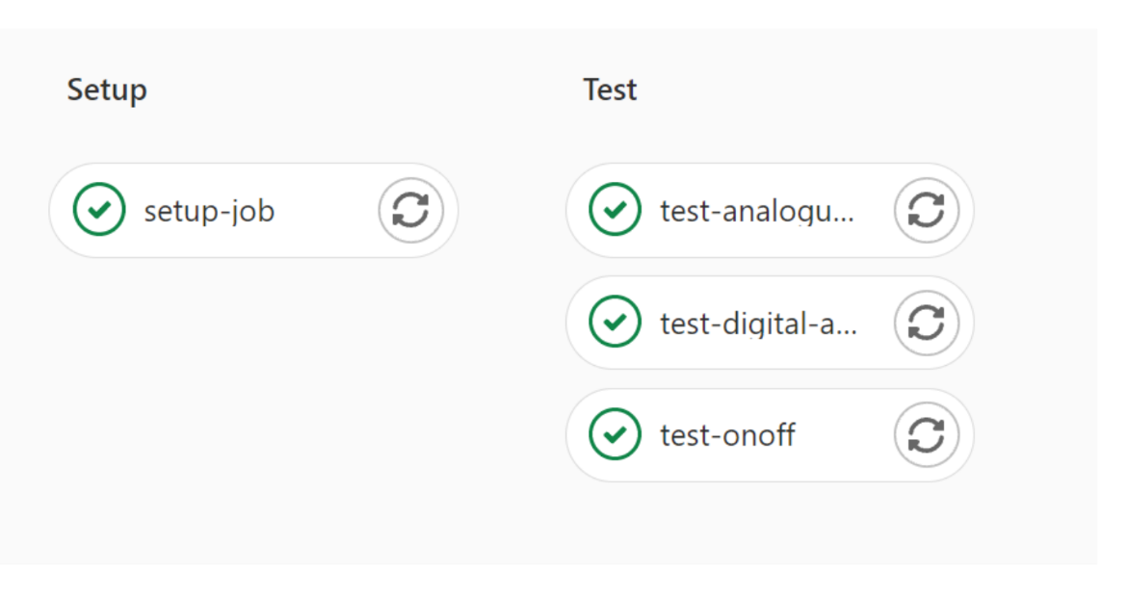




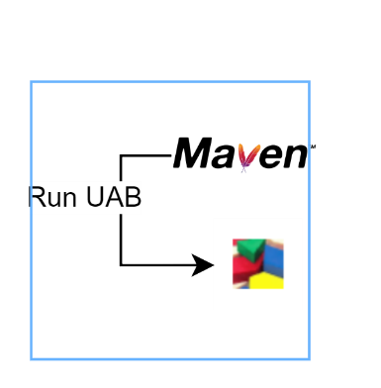

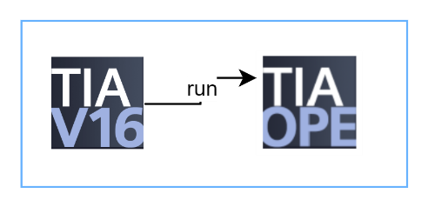












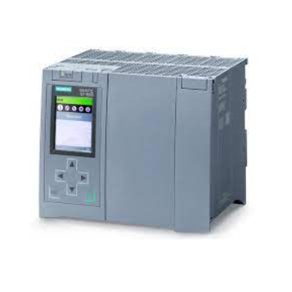


Integration of tests in Gitlab CI pipeline
Specifications document
Pipeline
commit
PyPLC
test
report
Files to be deployed
git
Create
application
Initial
conditions
Test config
files
generated
tests
Specs
Templates
Deploy application
Run test
Base
project
User
files
Lab PLC
New application
simulator
10/19/2021
Maria del Mar Gomez-Jordana
3
Notes:
Add report and deployment, animate it
3

Slide 4
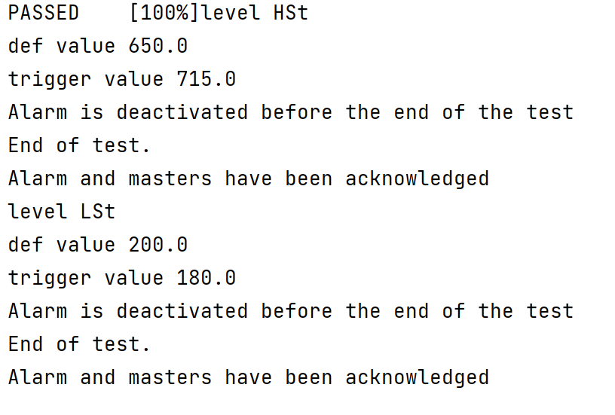

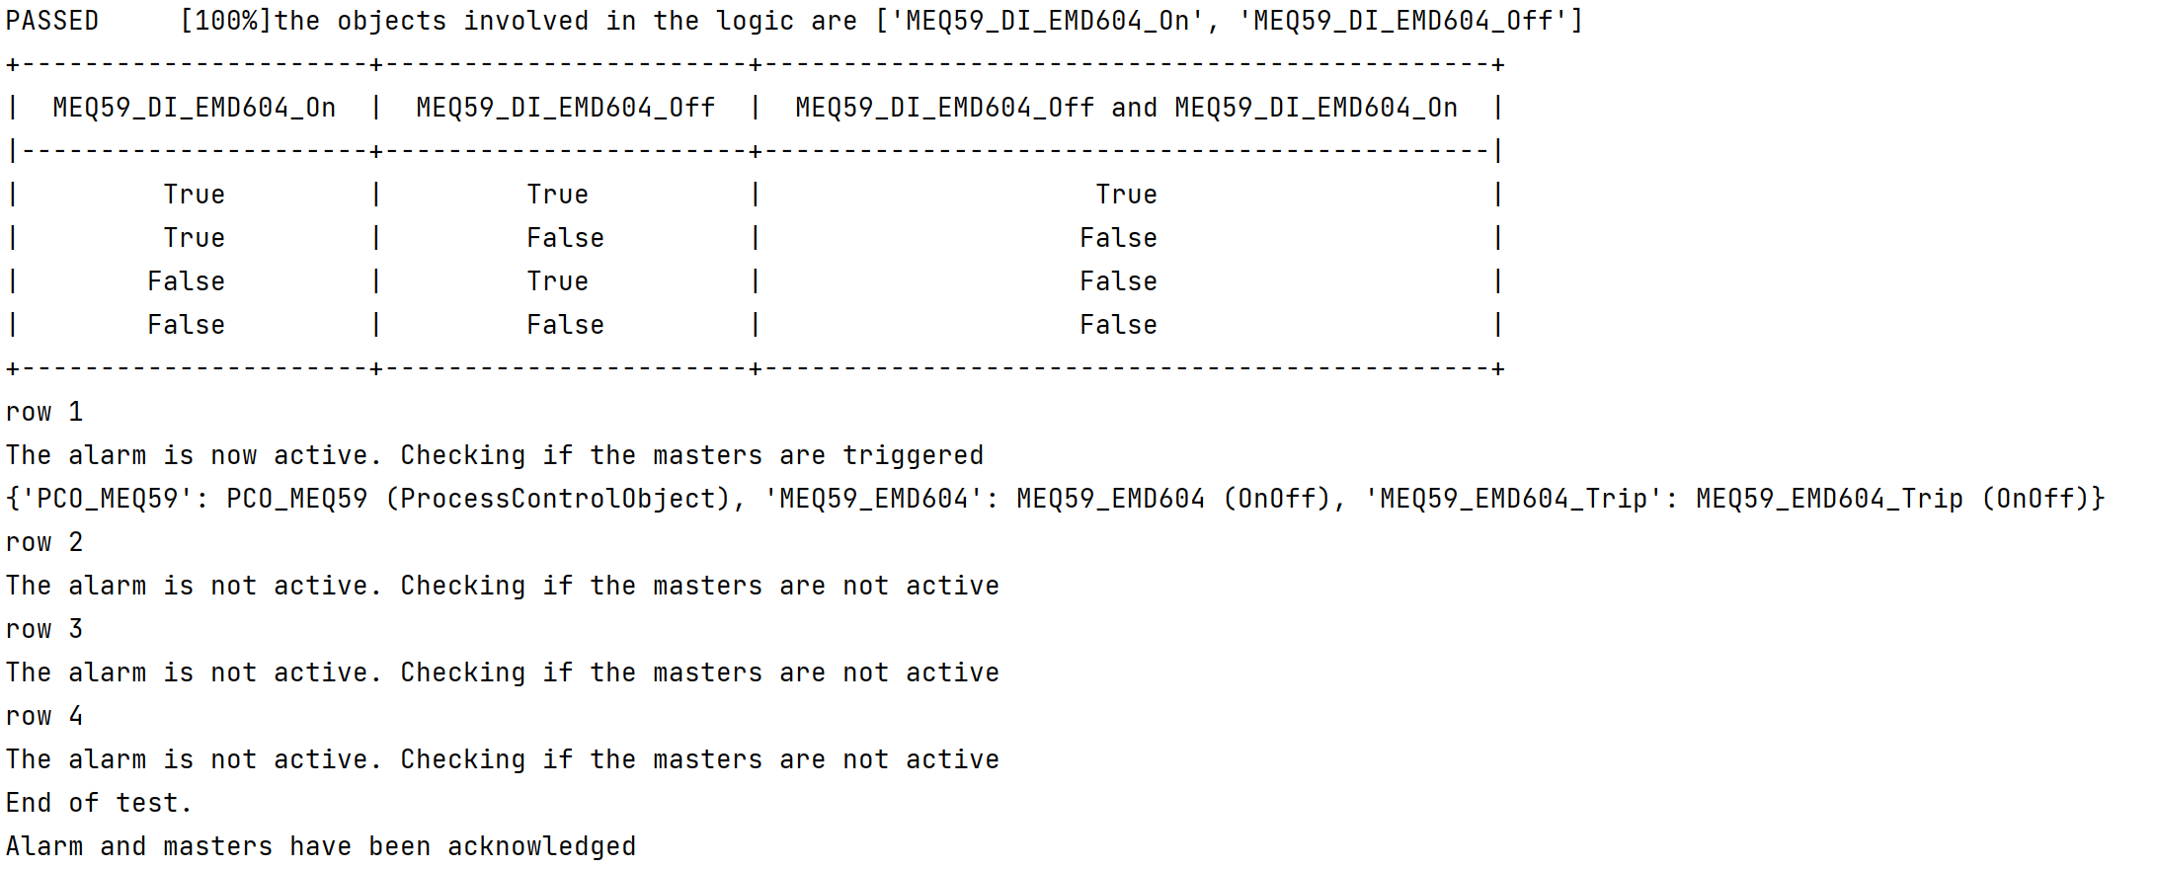
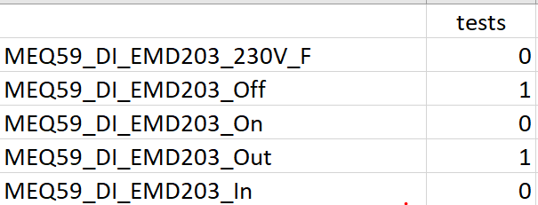
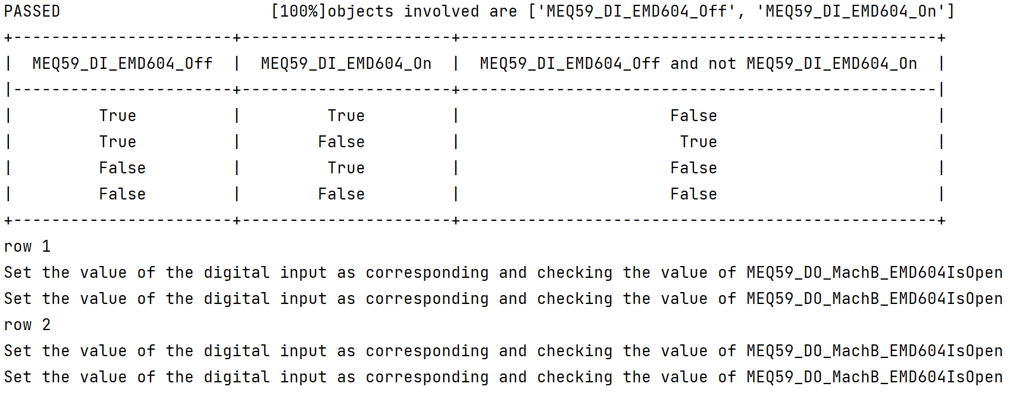

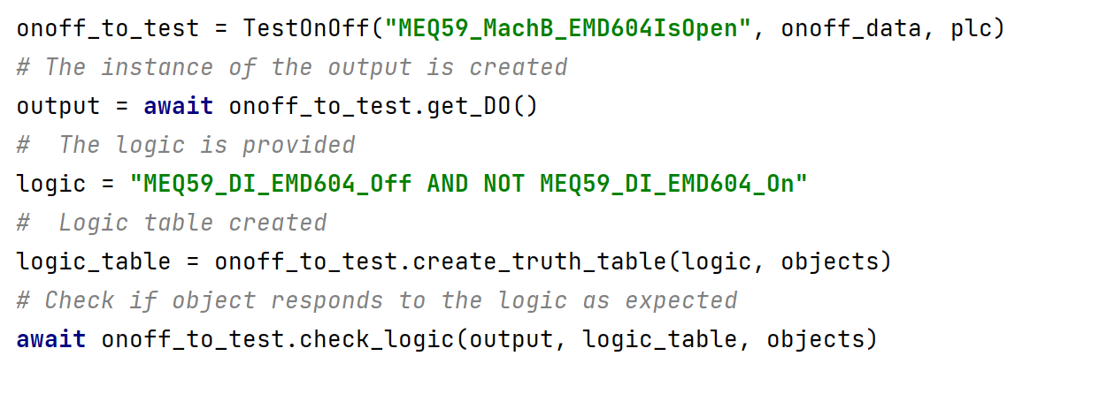
Automatic functional tests
Analog Alarm
Automatic generated test
+
Specs
Digital alarm
Initial conditions
+
Automatic generated test
Specs
OnOff
Specifications document
Manually generated test
+
Desired logic
10/19/2021
Maria del Mar Gomez-Jordana
4
Notes:
4

Slide 5
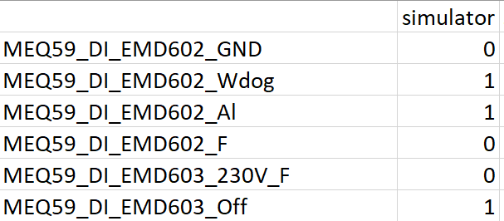
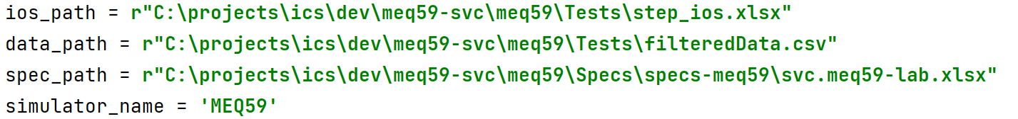
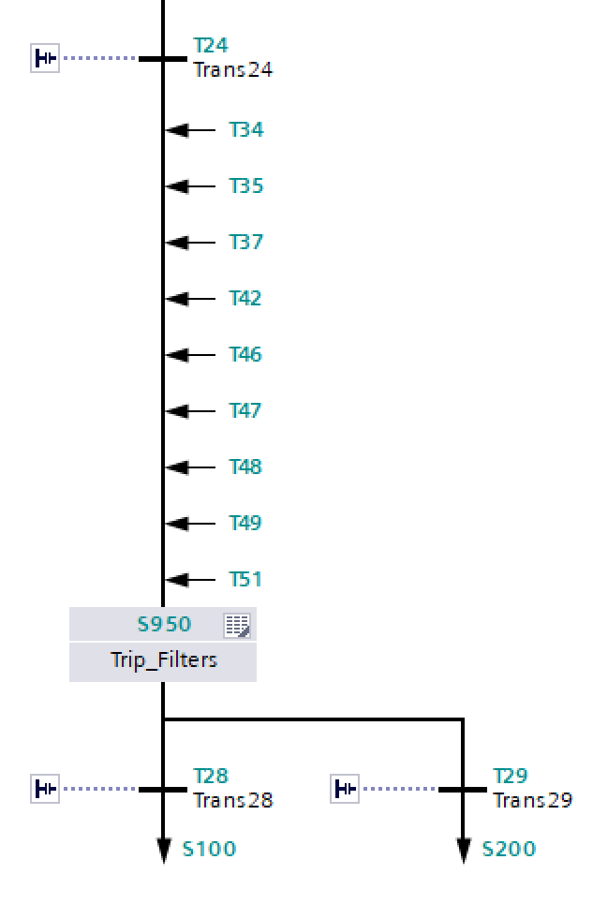
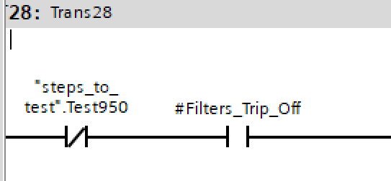
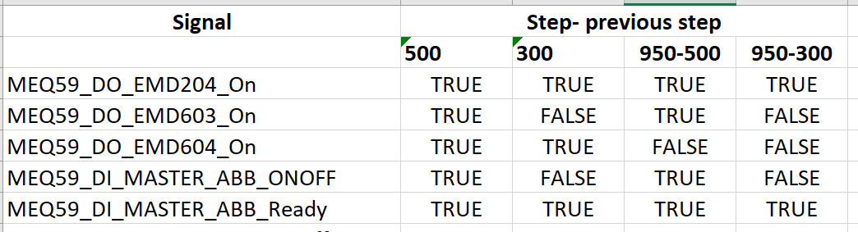
Automatic functional tests. With simulator
Read output
Automatically generated
simulator
Set inputs
Sim devices
+
+
Initial conditions
Specs
Configuration file
SVC controllers,
Breakers,
Power converters…
Assert DOs state
+
Step test
Initial conditions
per test
Tests configuration file
Check plant response
Test interlocks
10/19/2021
Maria del Mar Gomez-Jordana
5
Notes:
5

Slide 6
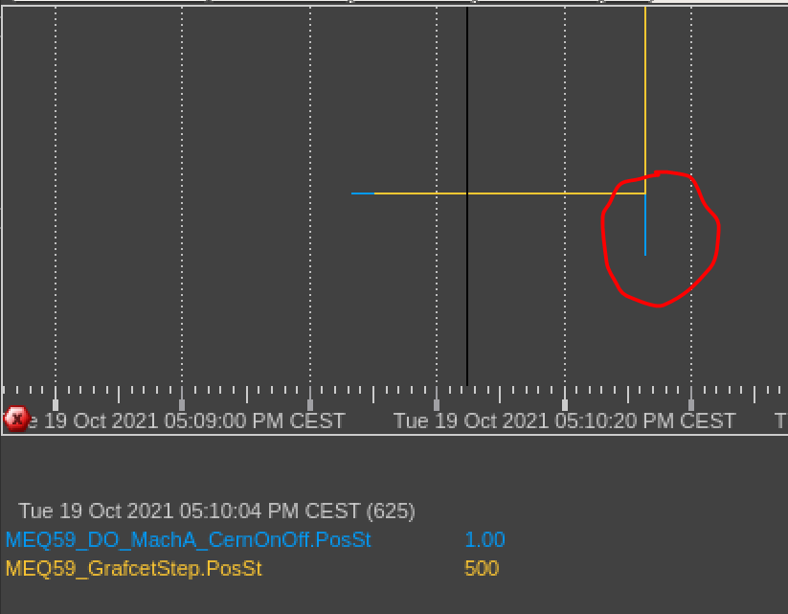
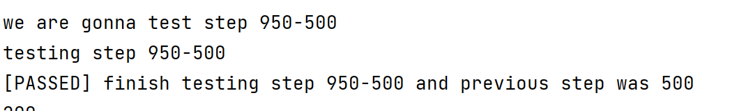
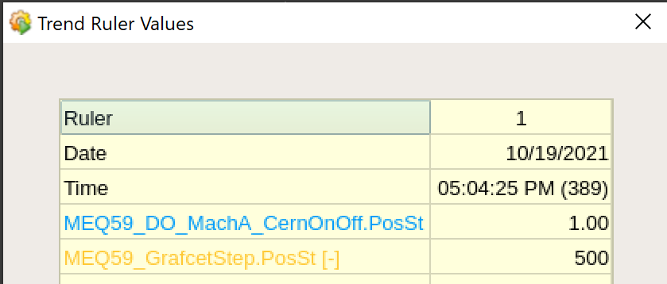
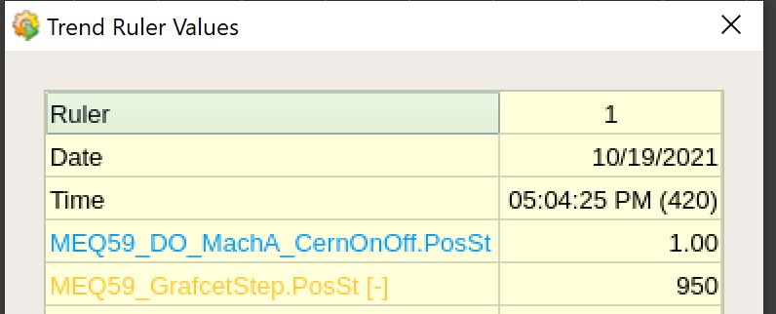
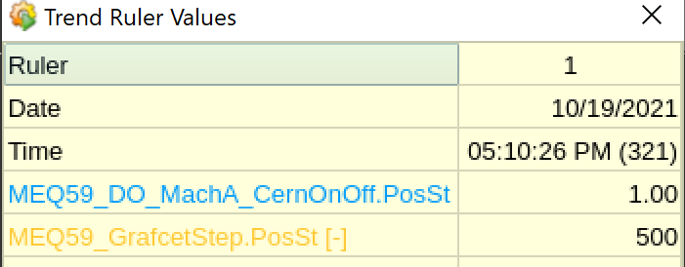
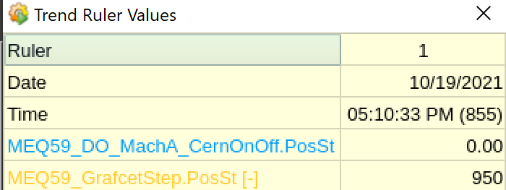
Use case. Automatic functional tests for MEQ59 SVC
Real case. Bug found, fixed and tested for deployment
10/19/2021
Maria del Mar Gomez-Jordana
6
Notes:
6

Slide 7
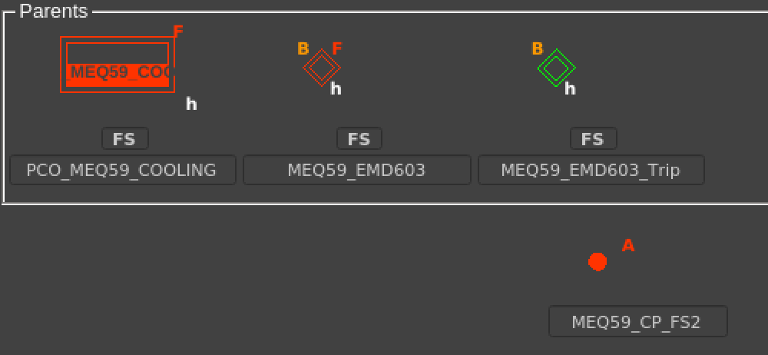
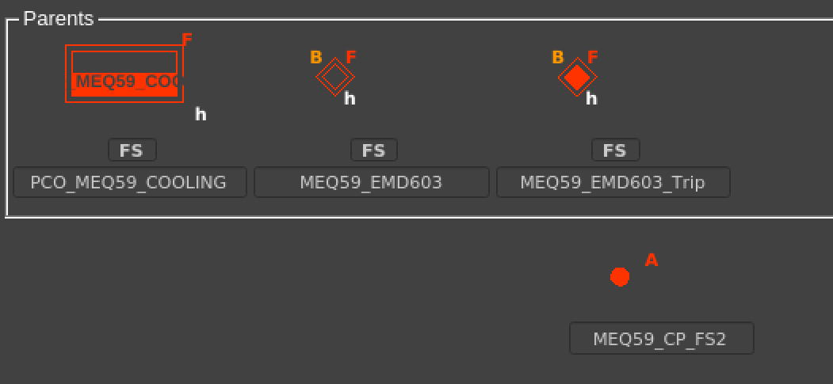
Use case. Automatic functional tests for MEQ59 SVC
  Real case: error in the spec file
10/19/2021
Maria del Mar Gomez-Jordana
7
Notes:
7

Slide 8
Limitations and challenges
Limitations:
  Performance: some tests can take up to 30’’. Testing MEQ59 application takes 45 minutes
  Latency/delays: timeouts are triggered. Must be blocked in simulated tests
  System integration cannot be automatically tested
  Full test coverage is never possible
Challenges:
  Working with asyncIO
    Harder to debug
    Pytest cannot be used with the simulator
    Harder to work with concurrent processes
  Display meaningful error messages in GitLab
10/19/2021
Maria del Mar Gomez-Jordana
8
Notes:
8

Slide 9
Future work
  Implement continuous deployment
  Develop more types of tests
  Optimize tests performance
  Use of simulation module for peripherals
  Integrate other EPC applications
  Add more device types to the simulator
  Have a flexible and scalable computer infrastructure
  Use of the framework in EPC development cycle
10/19/2021
Maria del Mar Gomez-Jordana
9
Notes:
9

