Slide 1

Continuous Integration in the cryogenics control systems
in TE-CRG-IC section
Instrumentation Control
Section leader:
Marco Pezzetti
On behalf on the controls team: Sebastian Róg

Slide 2




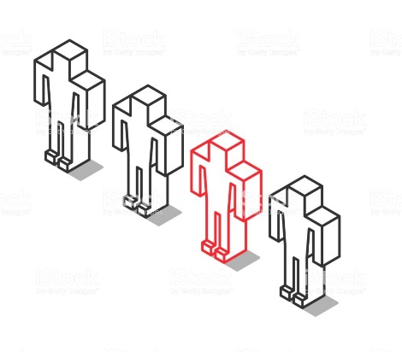


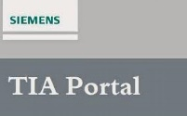
Continuous Integration in TE-CRG-IC:
history
2000
2014 (LS1)
2018
2020
2021
Pre-UNICOS era -
manual programming
UNICOS Framework - object-based system modelling and unified methodology
Building and testing automation with CI system (the LHC Tunnel) - the first CI for PLC projects at CERN
All of the CI projects are built automatically
in Jenkins
Transfer from Jenkins to GitLab-CI (In use by all projects, except the LHC Tunnel)
String Projects in GitLab CI

Slide 3
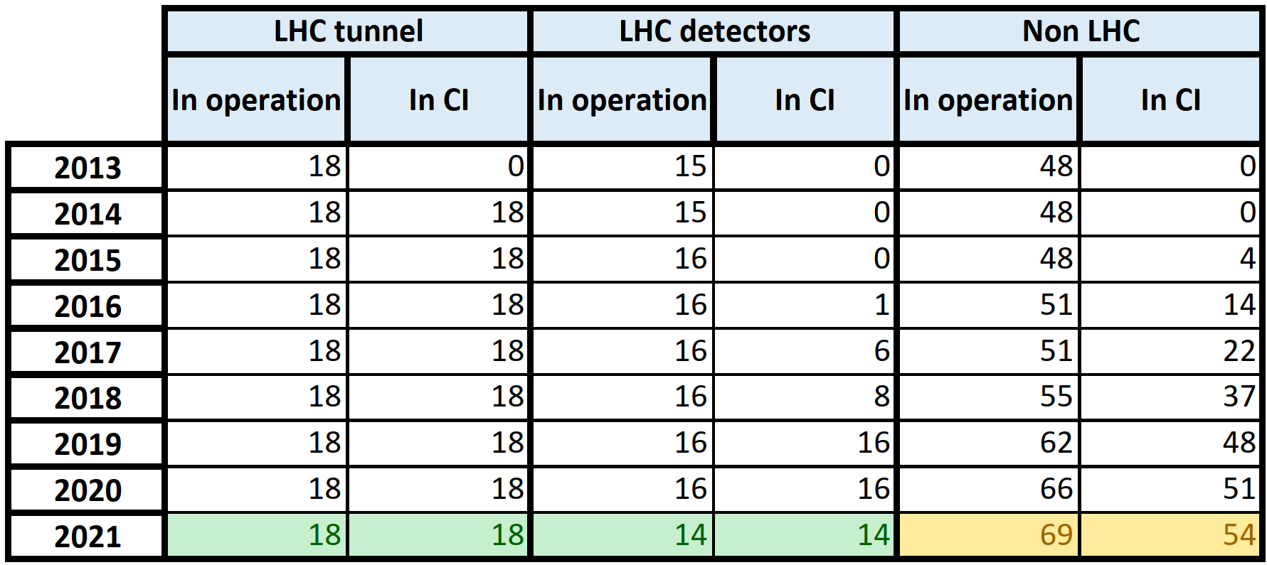
Continuous Integration in TE-CRG-IC:
overview
Current applications/PLCs:
Total 101 applications (86 in CI).
Main domains:
LHC Tunnel: 18 (18 in CI)
LHC Detectors: 14 (14 in CI)
Non-LHC: 69 (54 in CI)
Technologies:
Schneider: 34 in CI
Step 7: 49 in CI
TIA: 3 in CI
An innovative approach for the design of cryogenic electrical and process control systems at CERN:
the cryogenic Continuous Integration project.
Thomas Barbe, Marco Pezzetti, Simon Martin, Antonio Tovar-Gonzalez, Czeslaw Fluder - CEC/ICMC 2021

Slide 4
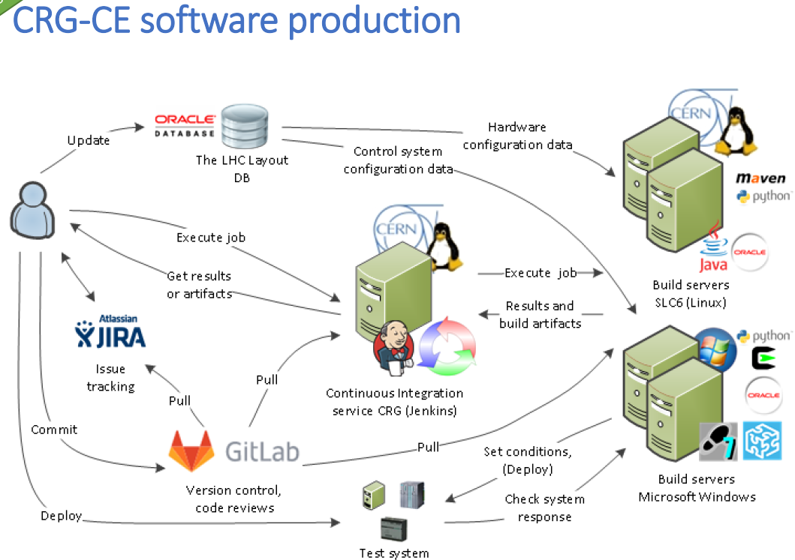
Continuous Integration in TE-CRG-IC:
workflow
AUTOMATION OF THE SOFTWARE PRODUCTION PROCESS FOR MULTIPLE CRYOGENIC CONTROL APPLICATIONS
C. Fluder, V. Lefebvre, M. Pezzetti, A. Tovar-Gonzalez, CERN, Geneva, Switzerland, P. Plutecki, T. Wolak, AGH University of Science and Technology, Kraków, Poland

Slide 5
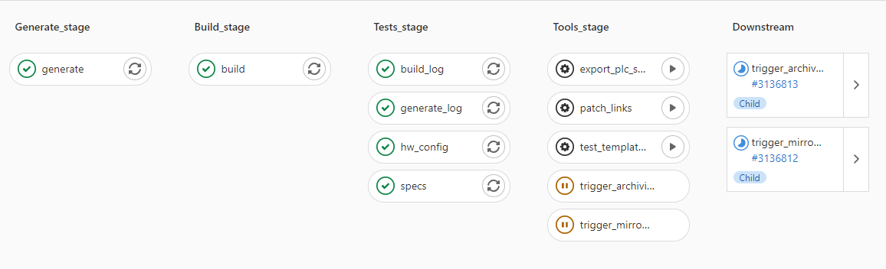
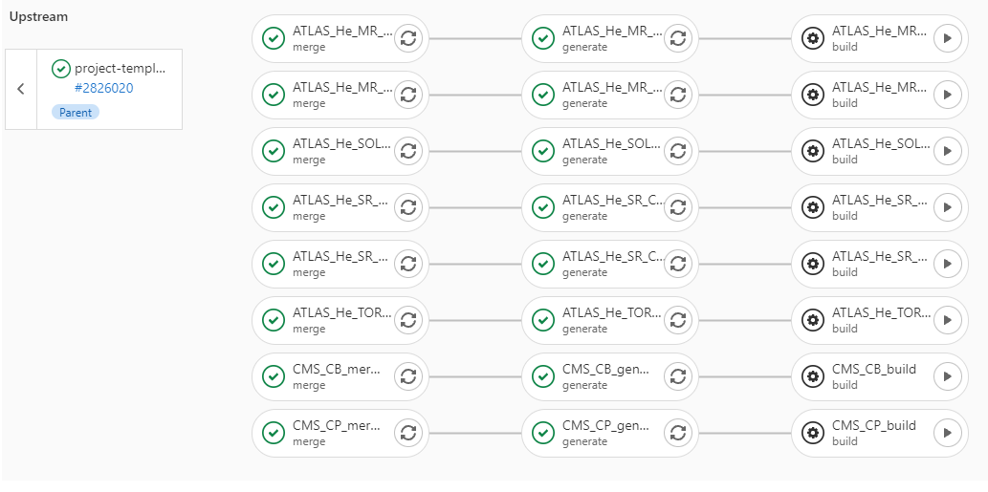
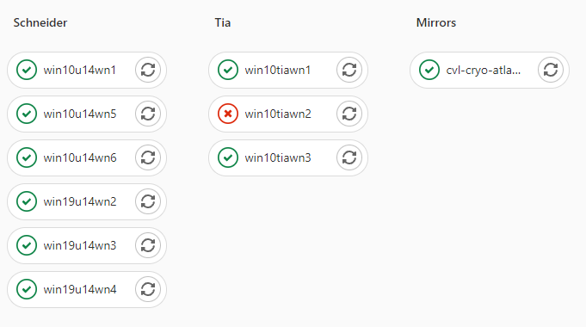
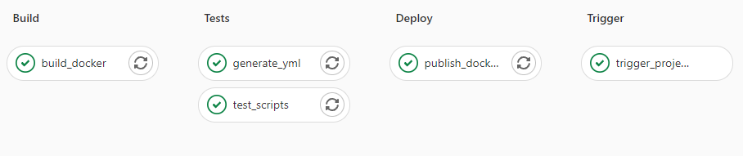
Continuous Integration in TE-CRG-IC:
GitLab CI pipelines examples
Project-centered jobs:
Generate and Build – main project pipeline
Tests – static checks performed on artifacts
Tools - Manually callable jobs and
sub-pipelines
Additional tools pipelines:
Runners VMs diagnostics
Changes propagation
Docker images publishing
Etc…

Slide 6



Continuous Integration in TE-CRG-IC:
status
CryoJenkins2
(https://cryojenkins2.cern.ch/jenkins/)
Projects:
Building the LHC Tunnel projects (with LS2 updates)
Tools
Infrastructure:
service: 1 VM (Linux / CC7)
worker node VMs:
    4 Linux / CC7 with Maven (UAB), Python etc.
    2 Linux / CC7 and WinCCOA
    6 Windows Server 2016 with Simatic Step7
Gitlab-CI
(http://gitlab.cern.ch/cryo-controls/)
Projects:
LHC-Detectors,
Non-LHC-Detectors, Test facilities, others
A working prototype of building the LHC Tunnel projects
Infrastructure:
Docker images in CERN’s registry
  image with Maven / UAB
  images for testing and / or executing tools
worker node VMs (Windows Server 2019)
  6 with Simatic Step7
  6 with Unity / Control Expert

Slide 7
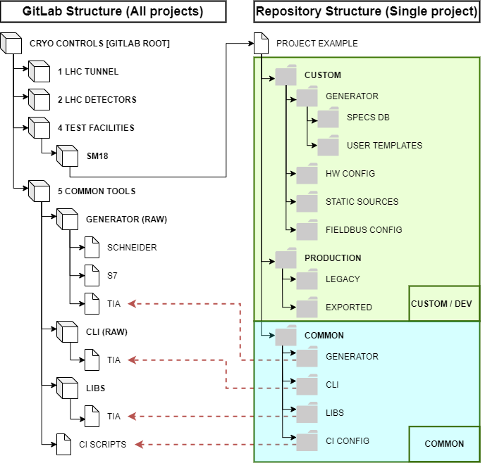
Continuous Integration in TE-CRG-IC:
future development
New, common project structure
Main features:
Common and custom (project-unique) code separation
Sources modularity by using submodules
Systematized and clear repositories structure/hierarchy
Main advantages:
Homogenous structure for all domains and technologies
Increased reusing of sources
Easier to propagate/marge changes in code shared by projects
Easier for cross-competence and for newcomers
Current status:
Minimal working examples prepared for Schneider (LHC detectors) and for TIA (Test Facilities)
New projects start development using new structure (F2SCLink_QLFF2)
Simplified
version

Slide 8

Continuous Integration in TE-CRG-IC:
conclusion
During last years CI has become a central part of our systems development and it is crucial to maintain and develop cryogenics control applications
We have many years of experience with highly automated CI processes and pipelines
Currently we are improving our CI by unification solution for all domains and technologies
It could be a synergic collaboration as a part of the CCTB by both:
  Contributing our knowledge and experience
  Using existing tools, approaches and frameworks developed by other sections
In that way, one, more common solution can be shared among all teams
Also we avoid reinventing the wheel

