Slide 1
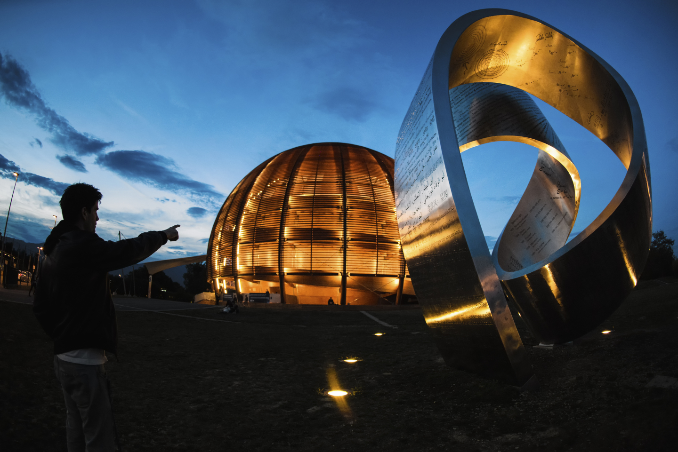
Continuous Integration and the Automatization of the PLC
Update Process
Vacuum Group – Interlocks Controls and Monitoring
Rodrigo Ferreira | rodrigo.ferreira@cern.ch

Slide 2
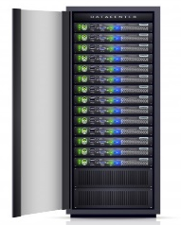
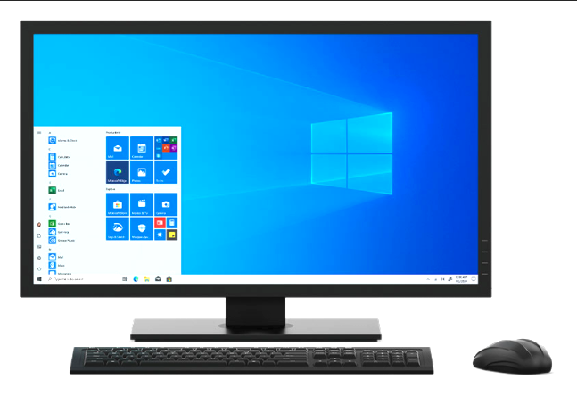
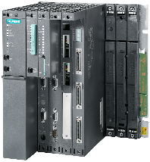
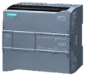
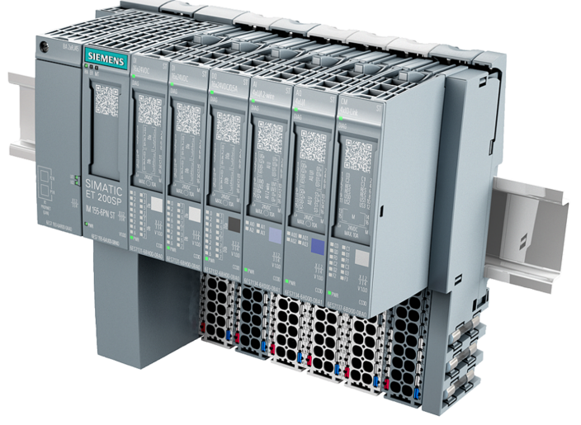
The Vacuum Control System
(PLC Architecture of the LHC Vacuum ICS)
SCADA
Servers
User
Terminals
Technical Network
Master PLC
(S7-400 x 35)
Profibus (fixed)
LSS Gauge
Reading PLC
(ET200-SP x 18)
Arc Gauge
Reading PLC
(ET200-SP x 16)
VPG PLC
(S7-1200 x 220)
Profibus (mobile)
Sector Valves
Mobile
Devices
Pumping
Group
LSS Insulation Vacuum Gauges
Arc Insulation Vacuum Gauges
Bypass
Valves
NEG + Ion Pumps
LSS Beam Gauges
Penning + Pirani Gauges
Cryogenic
Interlocks
Arc Beam Vacuum Gauges
Cryogenic
Interlocks
( … )
Siemens PLCs exclusively.
Global architecture updated during LS2 (only S7-400s remain from old ICS).
S4-400 PLCs will be replaced during LS3.
S7-400 projects are still SIMATIC Manager. All the rest are TIA Portal.
 | LHC | SPS | CPS + EXP
No. of PLCs | 292 | 21 | 29
Number of Vacuum PLCs per Machine
(EDMS 1576467)
Notes:
Demonstrating accountability
- Parts of project under my responsibility
- Give credit for deployment + commissioning to ICM team
Working in teams
Show that the renovation was a process that the whole section was working towards

Slide 3
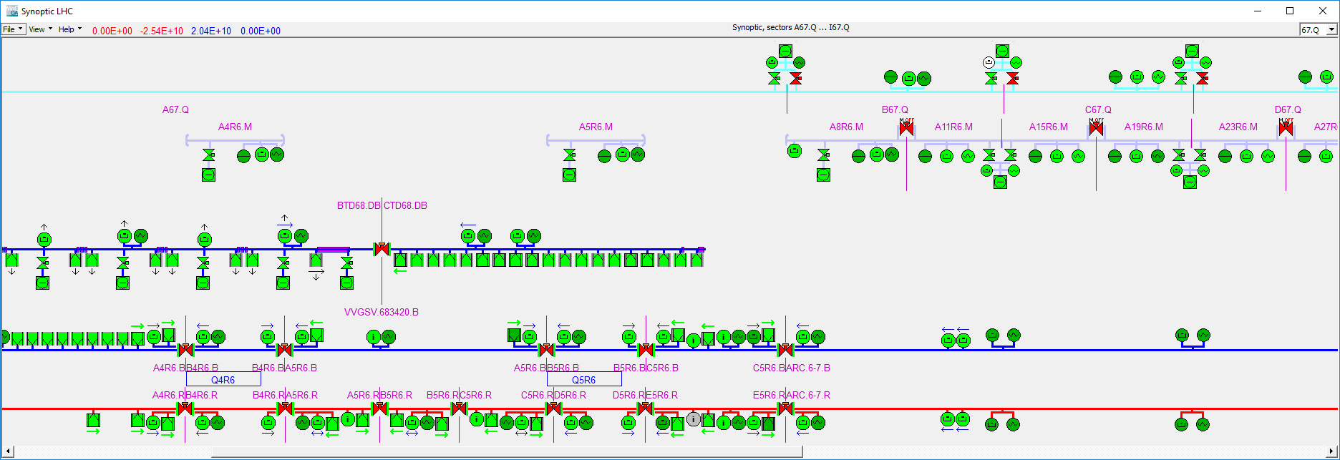
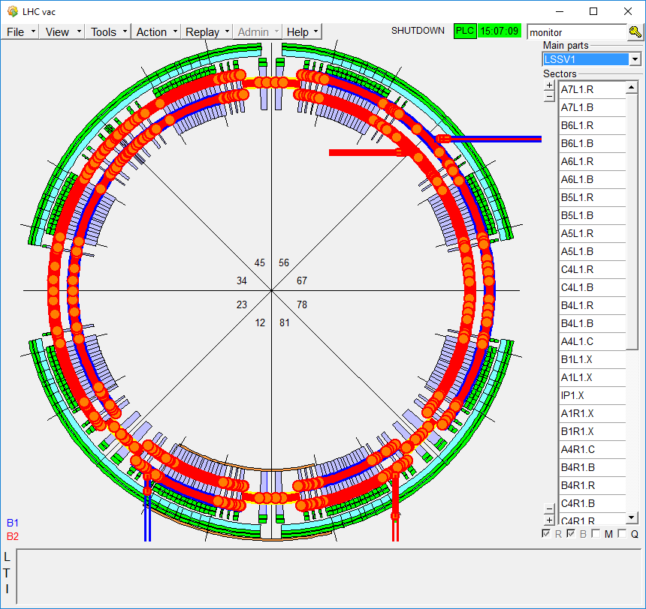
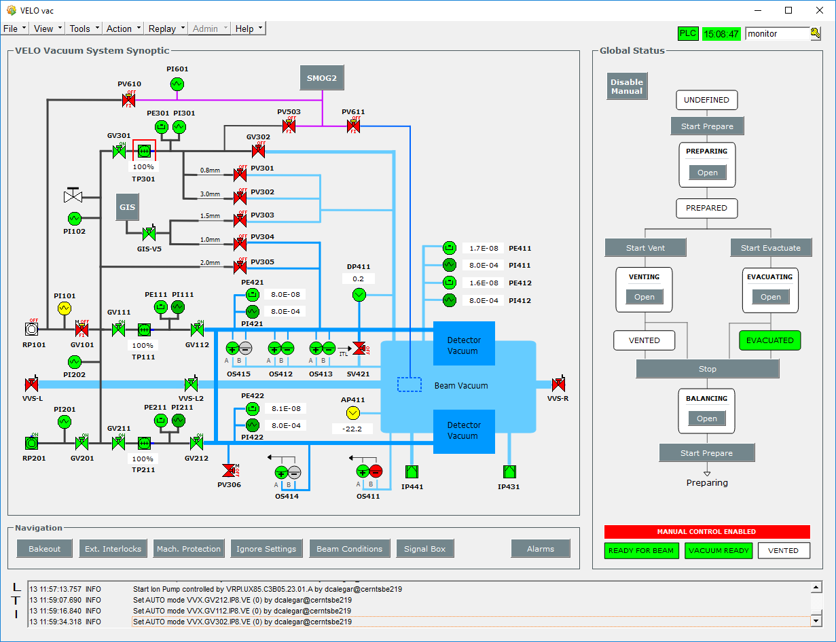
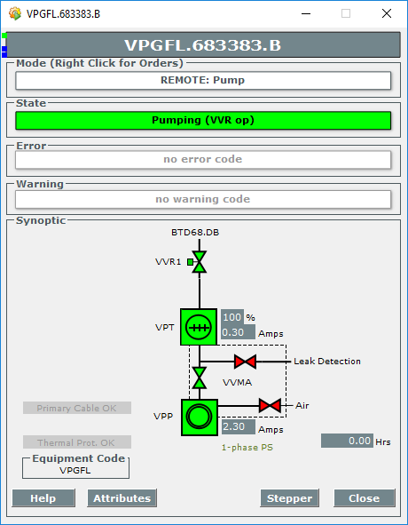
The Vacuum Control System
(Vacuum SCADA Applications)
(EDMS 1576467)
Notes:
Demonstrating accountability
- Parts of project under my responsibility
- Give credit for deployment + commissioning to ICM team
Working in teams
Show that the renovation was a process that the whole section was working towards

Slide 4
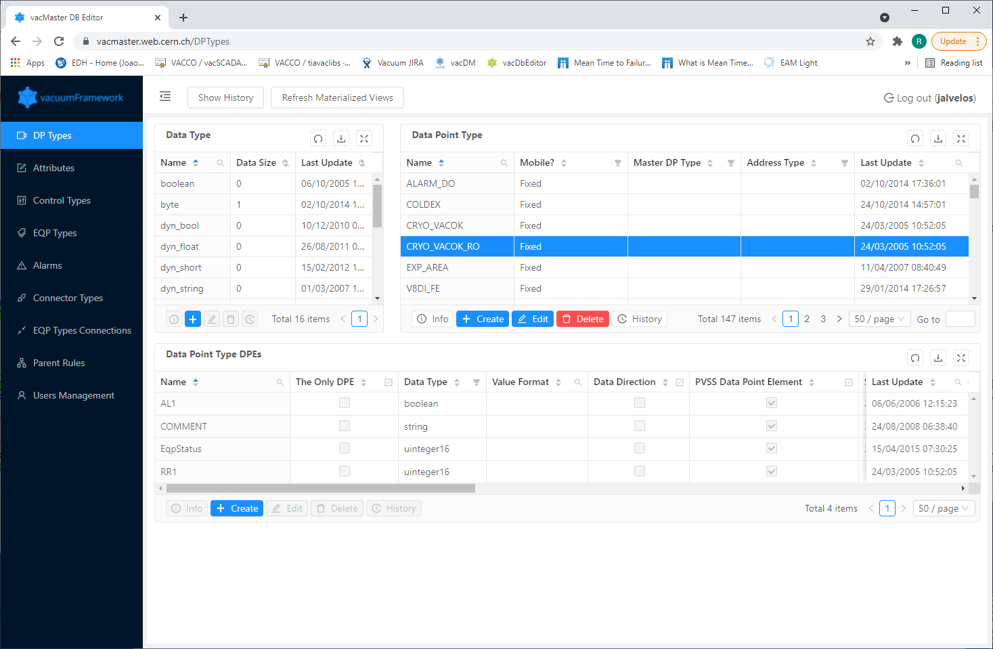

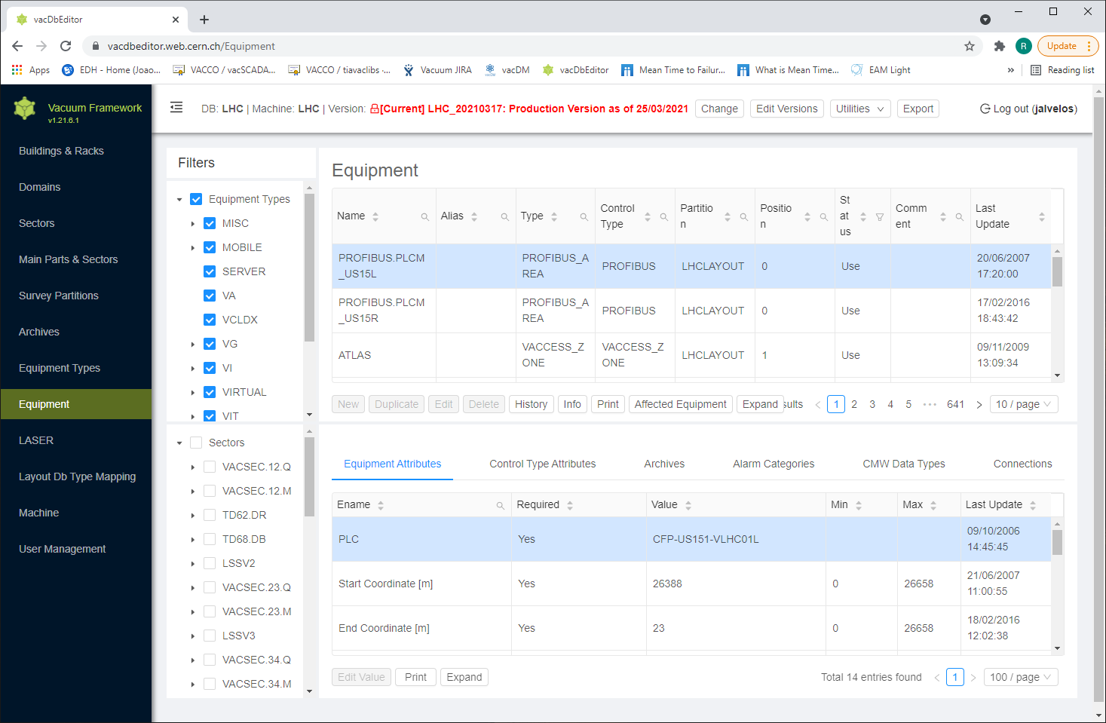


The Vacuum Control System
(Vacuum Framework)
SCADA Configuration Files
Machine Geometry (synoptic generation)
Equipment instances
PLC Connections
Datapoint + DIP Configurations
…
PLC Configuration Files
VacMaster
(WebApp)
Master DB
Equipment definitions
Export
Process
Equipment Instances
(Instance + Global DBs)
DB Renumbering Lists
(DB Name <-> Number link)
VacDBEditor + Exporter
(WebApp)
Machine DBs
Machine Geometry
Equipment instances + Config
PLC Configuration
…
Equipment Calling Functions
(FCs)
PLC Summary
(Global overview of PLCs)
(EDMS 1576467)
Notes:
Demonstrating accountability
- Parts of project under my responsibility
- Give credit for deployment + commissioning to ICM team
Working in teams
Show that the renovation was a process that the whole section was working towards

Slide 5





Vacuum Framework
(Updating PLCs)
VacPLC
Repository
Vacuum Framework
Baseline Project
Copy Baseline
(if required)
Export
Find correct sources
Import into Project
Compile DBs + FCs
Renumber Blocks
Deploy
Machine
DB
PLC
Sources
PLC Project
(TIA Portal)
Updated PLC Project
Production PLC
Checkout Production
PLC Projects
Commit
Update time per PLC : 5~7 minutes
Complete LHC Update: > 3 FTE for 1 day
Repetitive, frustrating work
Hard to finish full update in a day
Will become worse with system growth
ICMDev
Repository
(Production PLC Projects)
Notes:
Managing self
Taking initiative to solve a problem
Solving Problems
Achieving results
Learning and sharing knowledge / Working in teams
- Code is open-source, available, and being used by BE/ICS)
Demonstrating flexibility
- Going for a new solution

Slide 6
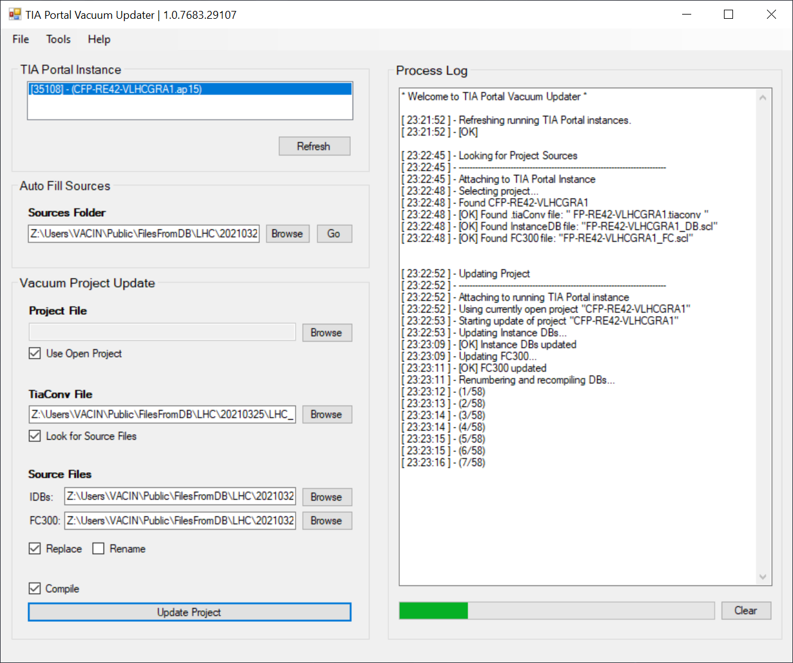
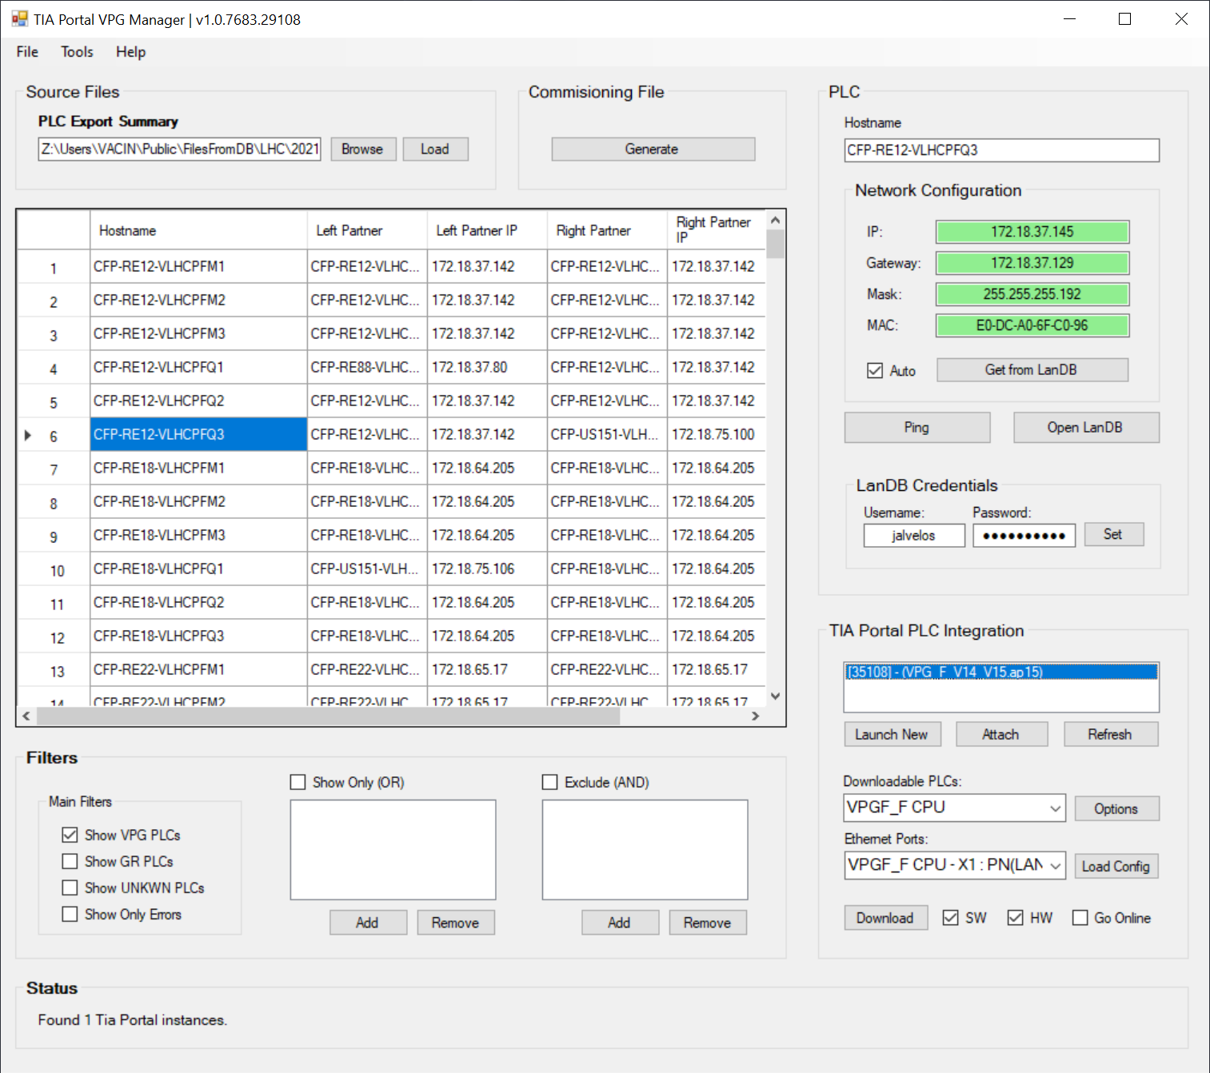

Automating Control System Updates
(Freeing resources and avoiding repetitive work)
Available in CERN
repositories
TIA Portal Vacuum Updater
(Generic PLCs)
Automates all the main phases of a PLC update.
TIA Portal VPG Manager
(LHC VPG PLCs)
Integrates with CERN LanDB to configure VPG projects.
Live Demo
(Applications + Implementation)
Notes:
Managing self
Taking initiative to solve a problem
Solving Problems
Achieving results
Learning and sharing knowledge / Working in teams
- Code is open-source, available, and being used by BE/ICS)
Demonstrating flexibility
- Going for a new solution

Slide 7





Continuous Integration
(Proposed Architecture)
PLC Compilation Server
Windows 10
OpenStack VM
Request project updates
MS .NET Webservice
Orchestrates update procedure.
(REST)
Trigger Update
Functionality exists, but we don’t intend on automating deployment at this time.
User
VacDBEditor + Exporter
(WebApp)
PLC Sources
Deploy
Shared Folder
SMB, dfs, CERNbox (TBD)
TIA Portal
(no UI)
Production PLC
Production
PLC Projects
Vacuum Framework
Baseline
(exported to xml)
Notes:
Managing self
Taking initiative to solve a problem
Solving Problems
Achieving results
Learning and sharing knowledge / Working in teams
- Code is open-source, available, and being used by BE/ICS)
Demonstrating flexibility
- Going for a new solution

