Slide 1
HL-LHC INTEGRATION MEETING
New cryogenic cabinet configuration: DFHX and DFHM area
M. Curylo, J. Fleiter
HL-LHC WP6A – 08/12/2021

Slide 2
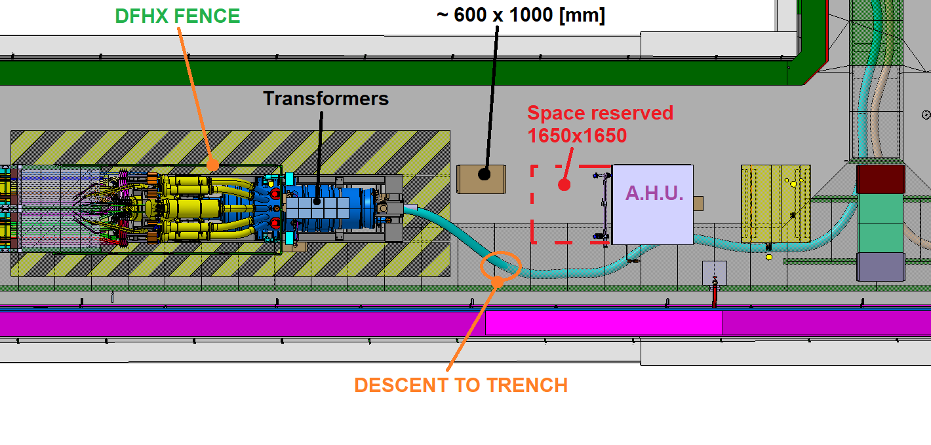
DFHX AREA (UR55): current situation

Slide 3
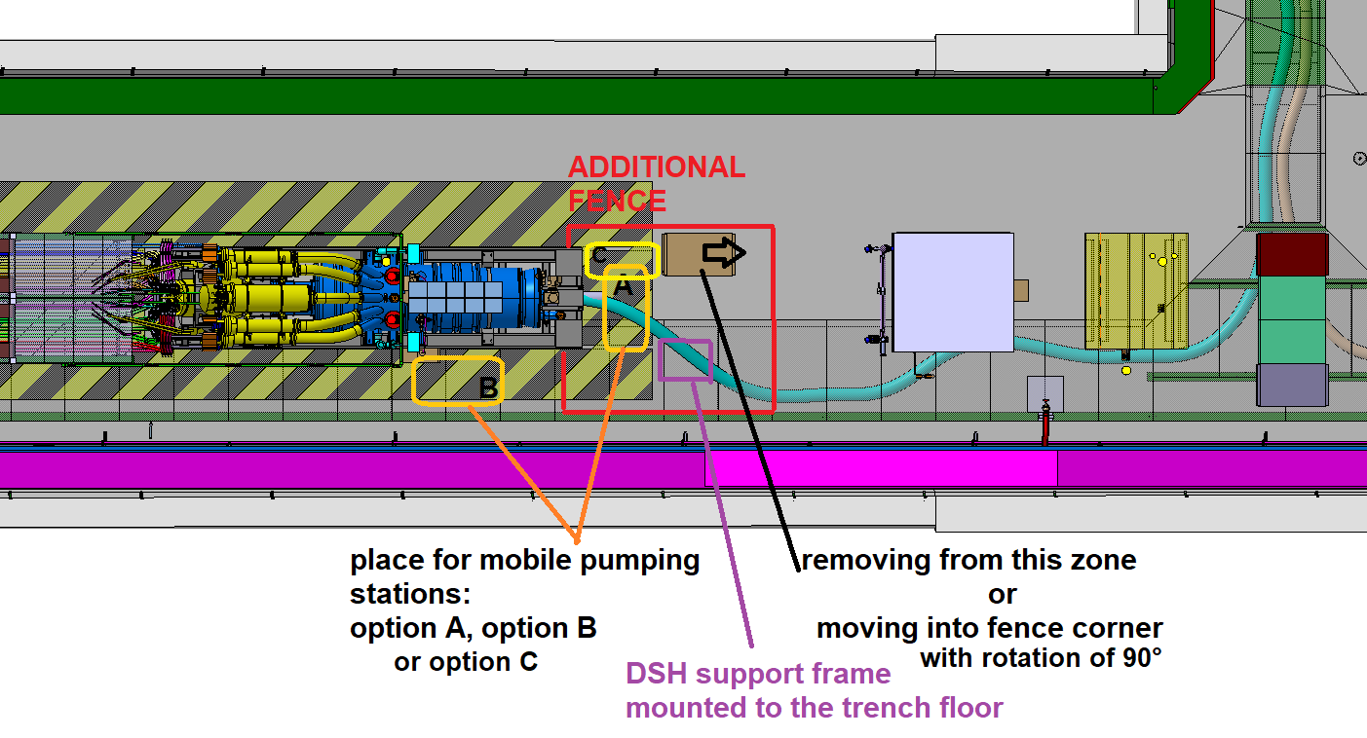
DFHX AREA (UR55): to discuss

Slide 4
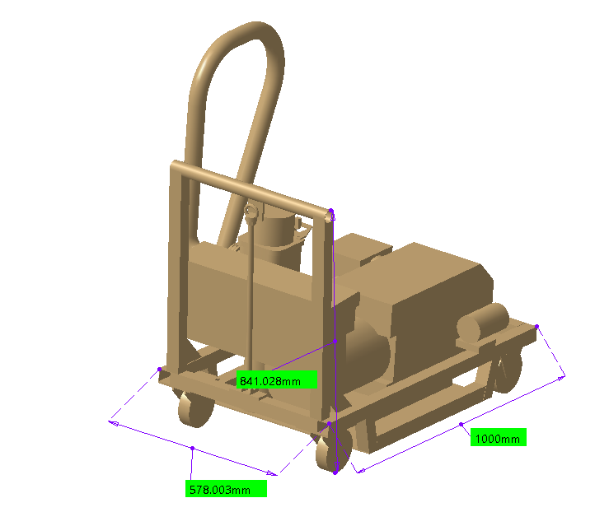
Mobile pumping station
Source:
CDD:
LHCVPGMA0007

Slide 5
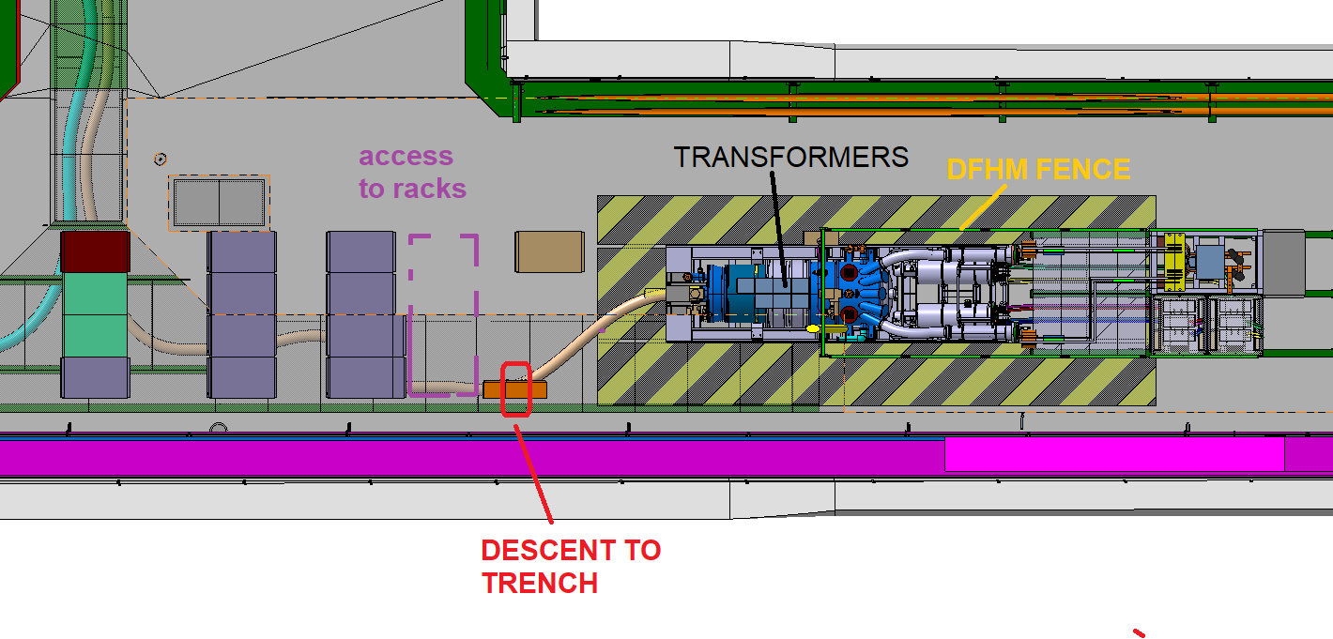
DFHM AREA (UR55): current situation

Slide 6
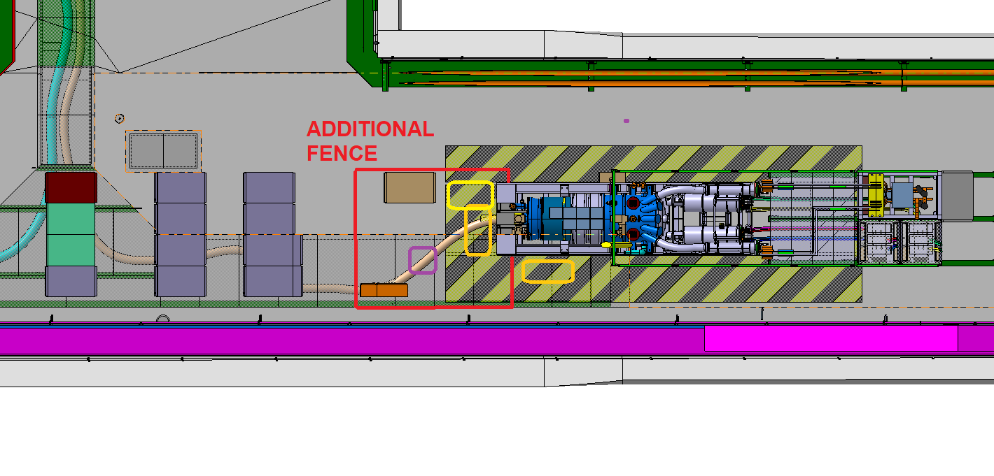
DFHX AREA (UR55): to discuss

Slide 7
Creating a new fenced zone near the DSH descent to trench
+ remarks due to position of rack close to DFH
The DFH has a 'no-stay' boundary due to electrical and cryogenic hazards. Repositioning a control rack at the very limit of the zone doesn't move in the direction of improving safety.
Protection against mechanical damage of the DSH system
Two trench covers can be permanently dismantled during operation: access to this zone protects new fence.
No rack in DFH zone gives flexibilities of handling DSH and shaping of supporting structures

Slide 8
Backup slides

Slide 9
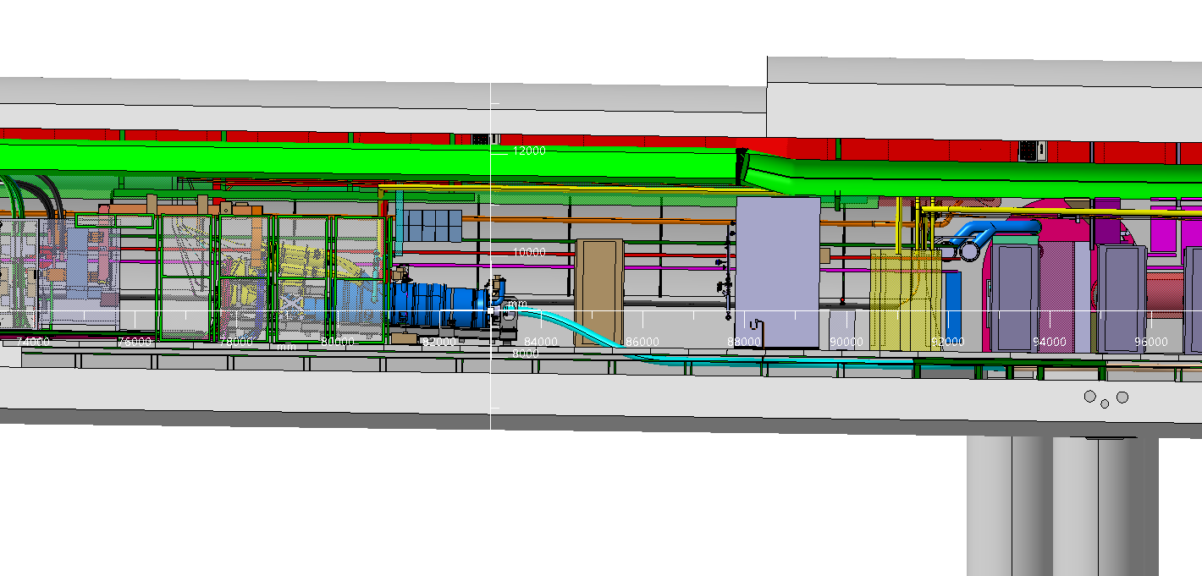
DFHX area: side view

Slide 10
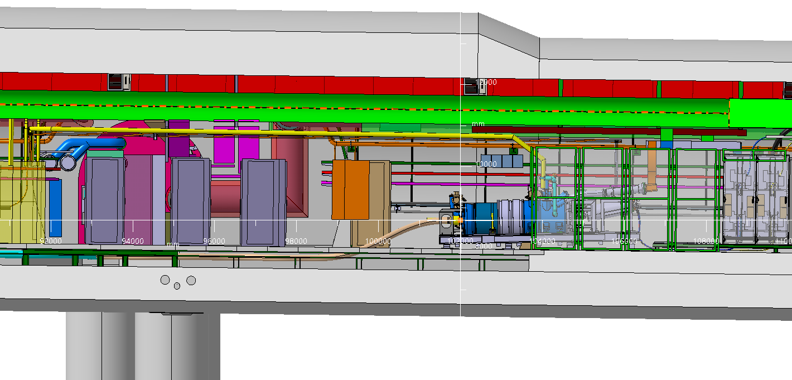
DFHM area: side view

