Slide 1
Introduction to the 1st WP7 Meeting (accelerator and gantry design)
WP7 Coordinator: Maurizio vretenar, CERN
Deputy Coordinator: ELENA BENEDETTO, SEEIIST

Slide 2
TIMING AND MOTIVATION FOR THIS MEETING
WP7 activities are structured by Task (= the Tasks are doing the real work!) and Tasks have they regular meetings and communication structure organised by the Task Leaders.
Twice per year (October/November and April/May) we will get together at WP level, to:
Exchange information and discuss topics at interfaces between Tasks;
Check the advancement of the contractual documents (Deliverables and Milestones);
Provide information in preparation for the Project Meetings.
Next HITRIplus meeting: 7 December
Additional participant for our WP meetings: Sandra Muhr, KT officer for HITRI+

Slide 3
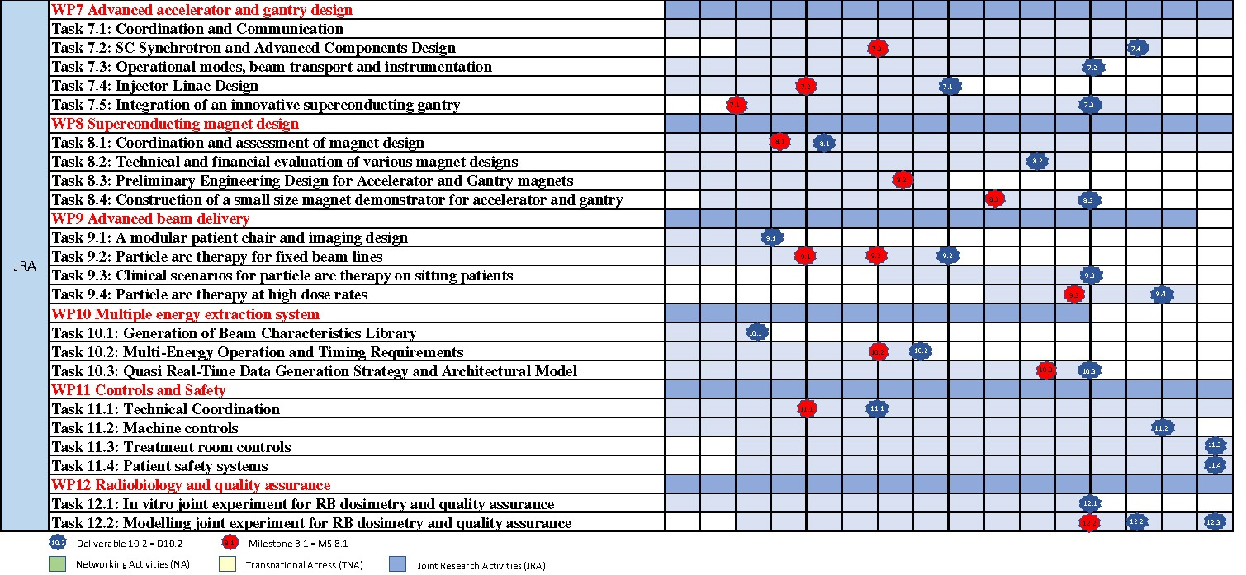
Reminder: WP7 Structure, Timeline, Partners
Y1 Y2 Y3 Y4
7 partners:
CERN: WP Coordination, contribution to synchrotron, gantry and linac design
SEEIIST: Task leader for synchrotron design and beam transport, contribution to linac and gantry design
CNAO: Task leader for gantry design, contribution to synchrotron and beam transport design
Bevatech GmbH: Task leader for linac design
MedAustron: contribution to synchrotron, beam transport, and gantry design
Riga Technical University: contribution to gantry mechanical design
GSI: internal communication and support to coordination
PR1 PR2 PR3

Slide 4
WP 7 – Management structure
WP Coordinator: M. Vretenar, CERN
Deputy WP Coordinator: E. Benedetto (SEEIIST)
Task Leaders:
 | Task | Task Leader
7.1 | Coordination and communication | M. Vretenar, CERN
7.2 | SC Synchrotron and advanced components design | E. Benedetto, SEEIIST
7.3 | Operational modes, beam transport and instrumentation | M. Sapinski, SEEIIST
7.4 | Injector linac design | U. Ratzinger, Bevatech
7.5 | Integration of an innovative superconducting gantry | M. Pullia, CNAO

Slide 5
WP 7: Ambitions (from proposal)
 | Technology | Present state of the art | Objectives (Technological breakthroughs)
1 | Lattice for superconducting synchrotron | Preliminary designs were developed, using ideal magnets. | Define a complete layout with injection, extraction, acceleration, based on magnets with ≥3 T dipole field and 1 T/s ramp rate, which can accelerate 10¹⁰ carbon ions to 430 MeV/u.
2 | Techniques for high-intensity operation | Present ion therapy centres operate with maximum 10⁹ carbon ions per pulse. | Develop multi-turn and/or charge exchange injection schemes that can be applied to normal conducting and superconducting synchrotrons to increase the ion intensity by an order of magnitude.
3 | Beam transport and instrumentation | Different beam transport lines are built with limitations in size or performance. | Define an optimised beam transport layout with minimum length that allows achieving the required beam parameters at irradiation point. Define and standardise the instrumentation required.
4 | Injector linac | A common injector linac design at 7 MeV/u exists, developed in the 90’s. | Design a new linac injector with higher accelerating gradient (3-4 MeV/m) and lower cost than the standard design, which can operate at 10% duty cycle for parallel production of therapeutic radioisotopes.
5 | Superconducting ion gantry | Only one SC gantry developed in Japan, some studies in Europe. | Develop the integrated design (mechanical drawings) of a superconducting gantry with weight lower than 100 tons and length below 16 metres.

Slide 6
WP7: 4 Deliverables and 3 Milestones
M7.1 | Choice of conceptual design and basic parameters of the innovative superconducting gantry | 7 | 6 | Report
M7.2 | Selection of basic linac design: frequency, layout | 7 | 12 | Report
M7.3 | Definition of key parameters for the superconducting synchrotron, including magnet field and type | 7 | 18 | Report
September 2021
March 2022
September 2022
The first Milestone is already late (need a summary report from Task 5)
The next Milestone is on basic linac design in March 2022
A Milestone Report can be very short (min. of 2-3 pages including some summary tables)
March 2023 - Bevatech
March 2024 - SEEIIST
March 2024 - CNAO
July 2024 - SEEIIST

Slide 7
Recent issues and problems at WP level
M. Sapinski (Leader of Task 4) has moved from SEEIIST to PSI on 1 November, keeping for 6 months (till end of April) a 10% work for SEEIIST.
We congratulate Mariusz for his new professional opportunity, and we thank him for his commitment to minimise the impact on HITRIplus and his collaboration in identifying solutions for the remaining work.
• Sub-Task 7.3.1, Operational modes: identification of specific requirements and challenges in operation due to switching between therapy and research operation modes (for the sources, injector linac, ring and transfer lines) → might be covered by SEEIIST
• Sub-Task 7.3.2, Beam transport lines: definition of improved layouts of the transport lines to the experimental and clinical treatment areas, with special attention to safety due to switching between the 2 modes, e.g. beam-dump, shielding → should be covered by a new person (e.g. post-doc paid by SEEIIST)
• Sub-Task 7.3.3, Beam instrumentation and QA: identification of advanced beam instrumentation options and of their possible application to present and future medical synchrotrons → has been already partly covered by Mariusz, who agrees to take care of this part of the final deliverable.

Slide 8
Recent issues and problems at Project level
The collaboration between the SEEIIST Steering Committee (political body, where all member countries are represented by 2 delegates) and the SEEIIST Association (executive arm, with a separate Board and chair, receiving funding from the EC for specific research activities including HITRIplus) is increasingly difficult.
The SEEIIST Association is asking for additional funding from the member states for its functioning, which is not likely to come. In such conditions, some people is proposing to close the association before the end of HITRIplus.
In this case, the solution discussed with the Coordinator will be to ask for an Amendment to the Grant Agreement with the EC, moving the remaining work and remaining budget of SEEIIST to another partner with some flexibility in attributing short-term contracts – e.g. CNAO – who will recuperate the work and the personnel of SEEIIST.
In this case HITRIplus will continue as foreseen, but it will be the end of all EU funding to SEEIIST…

Slide 10
Task 7.2 - SC Synchrotron and Advanced Components Design (SEEIIST, CERN, CNAO, MEDA) – Task Leader: E. Benedetto
Sub-Task 7.2.1, Lattice for a SC synchrotron: definition of an appropriate lattice using the SC magnet design defined in WP8, including modelling of magnets and particle tracking for long-term stability (SEEIIST, CERN).
Sub-Task 7.2.2, Multi-turn injection in resistive and SC synchrotrons: conceptual design of the multi-turn injection of 10¹⁰ ions per pulse into a reference synchrotron with resistive magnets, and in the SC synchrotron (SEEIIST, CERN, CNAO).
Sub-Task 7.2.3, Extraction and beam transport: conceptual design of slow and fast extraction for different treatment options and for experimental research, in coordination with beam transport and delivery teams, for a synchrotron with resistive magnets and with SC magnets (SEEIIST, CERN, CNAO).
Sub-Task 7.2.4, Longitudinal and transverse beam dynamics studies and assessment: preliminary analysis of acceleration, collective effects, space charge, intra-beam scattering and collimation (SEEIIST).

Slide 11
Task 7.3 - Operational modes, beam transport and instrumentation (SEEIIST, CERN, CNAO, MEDA) – Task Leader: M. Sapinski
Sub-Task 7.3.1, Operational modes: identification of specific requirements and challenges in operation due to switching between therapy and research operation modes (for the sources, injector linac, ring and transfer lines) (SEEIIST, CNAO, MEDA).
Sub-Task 7.3.2, Beam transport lines: definition of improved layouts of the transport lines to the experimental and clinical treatment areas, with special attention to safety due to switching between the 2 modes, e.g. beam-dump, shielding (SEEIIST, MEDA, CNAO).
Sub-Task 7.3.3, Beam instrumentation and QA: identification of advanced beam instrumentation options and of their possible application to present and future medical synchrotrons (SEEIIST, MEDA).

Slide 12
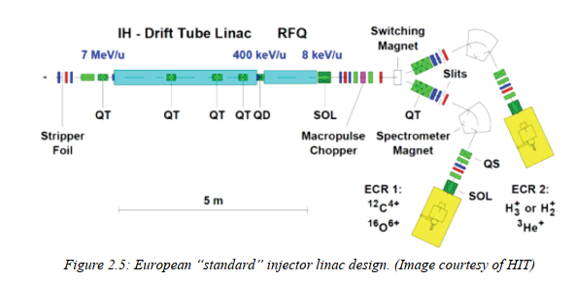
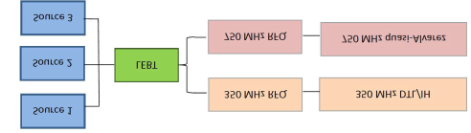
Task 7.4 - Injector Linac Design (BEVA, CERN, SEEIIST).
Task Leader: U. Ratzinger
analysis of heavy ion source options for high ion intensity and selection of new designs to improve performance of present and future ion therapy and research infrastructures;
conceptual design of a 325 MHz 10 MeV/u multiple ion injector: stripping energy optimisation, RFQ energy, RF system design, accelerating structure design and preliminary beam optics design. Comparison with layout, cost and performance of a 217 MHz injector with improvements against the existing standard injector;
detailed design of the preferred option (325 MHz or 217 MHz), with final beam optics design and overall design of RF accelerating structures, of amplifier system, and of instrumentation layout. Analysis of the impact on the design of a double operation mode, for injection into the synchrotron and using additional beam pulses for production of experimental radioisotopes for imaging and therapy.

Slide 13
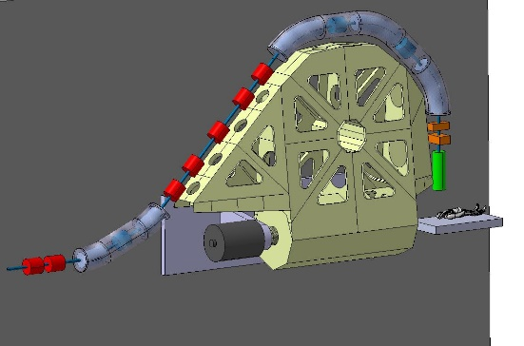
Task 7.5 - Integration of an innovative superconducting gantry: optics, mechanics, beam delivery (CNAO, CERN, SEEIIST, MEDA, RTU). Task Leader: M. Pullia
The «SIGRUM» SC gantry
Examination and comparison of the different existing conceptual gantry designs and selection of the most promising option.
Sub-Task 7.5.1, Basic structure and mechanical design: After having identified the baseline conceptual design, the mechanical structure and the technical solutions of the beam transport and the magnets will be investigated in detail. This sub-Task will start from a general mechanical and optics design of the gantry to integrate actual magnet designs, beam instrumentation, dose delivery, cryogenics aspects, etc. into a detailed mechanical design. (CNAO, RTU, CERN).
Sub-Task 7.5.2 Simulation of optics, scanning techniques: Global simulation and optimisation of the gantry considering optics, magnets, power converters, beam diagnostics, mechanics, dose delivery. The design shall be flexible enough to adapt the gantry optics to the existing and future facilities, and to be easily industrialised and reproduced in several units.

