Slide 1
SPS machine report
H. Bartosik for the SPS team

Slide 2
Summary of the last 7 days
SFTPRO rather stable
  Improved spike at the start of spill by optimizing tune and slight delay spill start
  Investigations ongoing on hump seen by NA62 – could be aperture restriction
AWAKE
  Some issues seen with 3e11 p/b on Monday, could not be reproduced yesterday
LHC pilot run
  Very successful so far, only few issues that had to be sorted out on SPS side
  Reduced duty cycle for NA and AWAKE, mainly during the day
Main faults:
  Access system trips (the usual problem)
  Access system trip in BA2 due to issue with fibre link – temporary cable installed
  Issues with cooling tower tripped splitter magnet on Tuesday

Slide 3
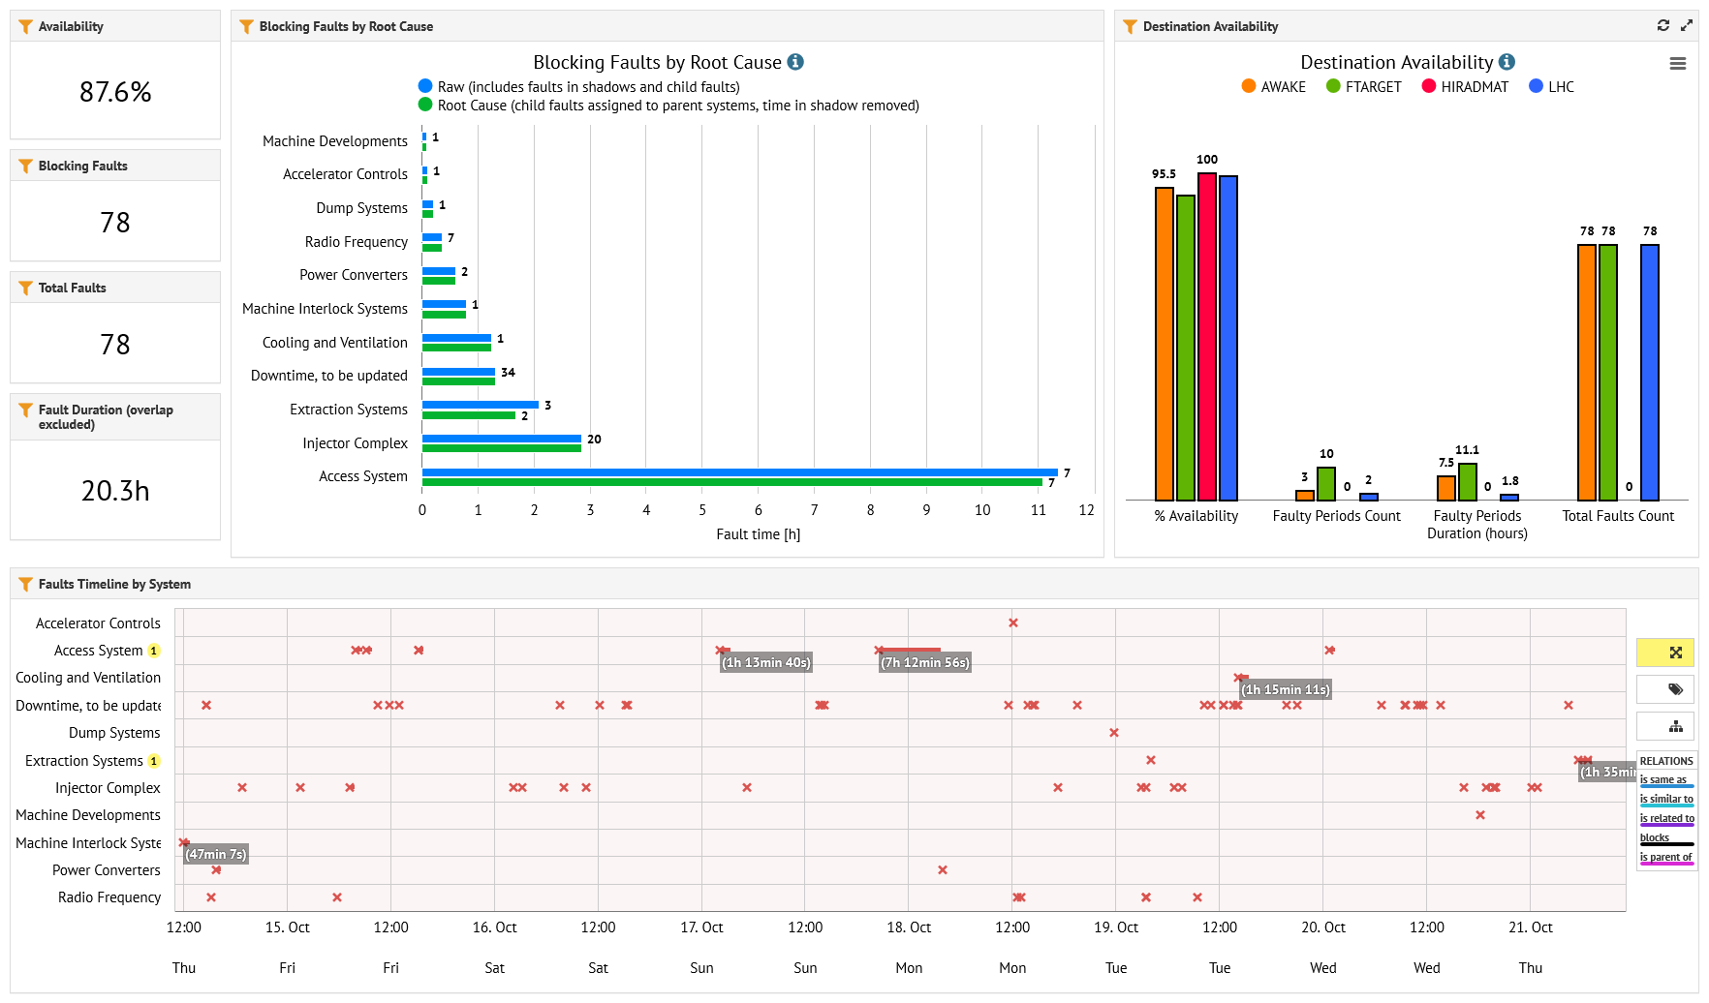
Availability

Slide 4
SFTPRO stats

Slide 5
Upcoming
SFTPRO
  Intensity increase on T4 later today
AWAKE run
  Until the end of the week
LHC pilot test continuing until end of next week
  Reduced duty cycle, mainly during the day
Ion beam commissioning
  Next week

