Slide 1
EN-EL activities during YETS 21/22
Bruno SAINT SULPICE, on behalf of EN-EL
2021-10-26
EATM

Slide 2
Maintenance of EN-EL equipment
Maintenance of high voltage substations (400KV & 66KV)
Maintenance of 20KV, 18KV & 3.3KV installations
Transformer maintenance
Maintenance of ~ 60 Low Voltage switchboards
Maintenance of 260 48V chargers
Ongoing planning with EN-ACE
Maintenance of 310 UPS (Uninterruptible Power Supplies)
Ongoing planning with EN-ACE

Slide 3
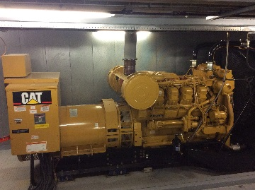
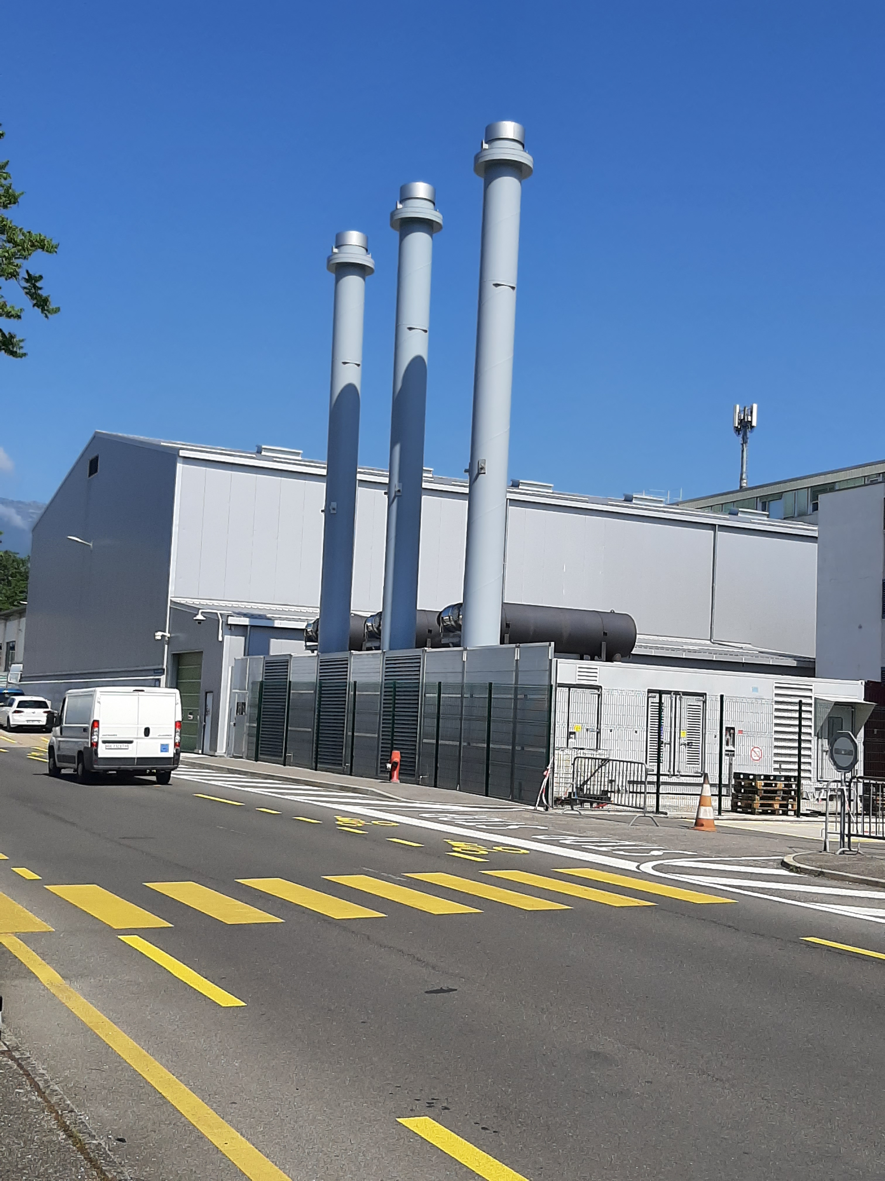
Normal / Secured test
Objective
  Verify the operation of the :
    16 generators
    17 Normal/Secured automations (PLC)
  Carryout a power balance of the safety network
Constraints on the electrical networks
  Powercut of the secured networks & General Service
  1 powercut per year from 6:00 to 6:10

Slide 4
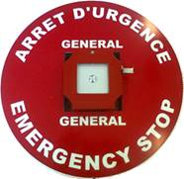
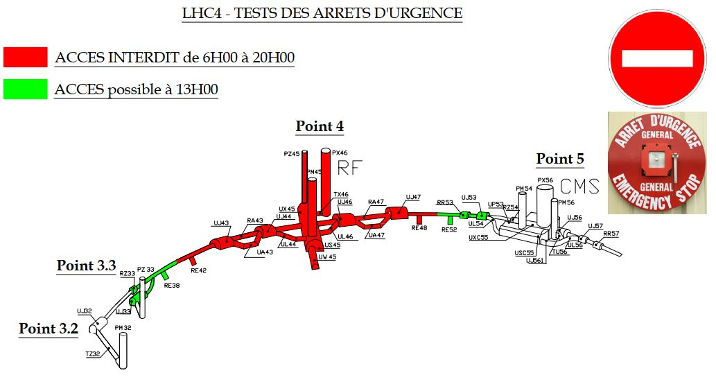
AUG tests
Objective
  Test All CERN’s AUG chains annually (IS5)
  23 AUG tests through out the CERN sites
    3 on Meyrin site,
    7 on SPS,
    3 on North Area,
    9 on LHC,
    1 on Prévessin site.
Constraints on the electrical networks
  Powercut of the Secured, General Service & Machine networks
  1 day per test - from 6am to 8pm

Slide 5
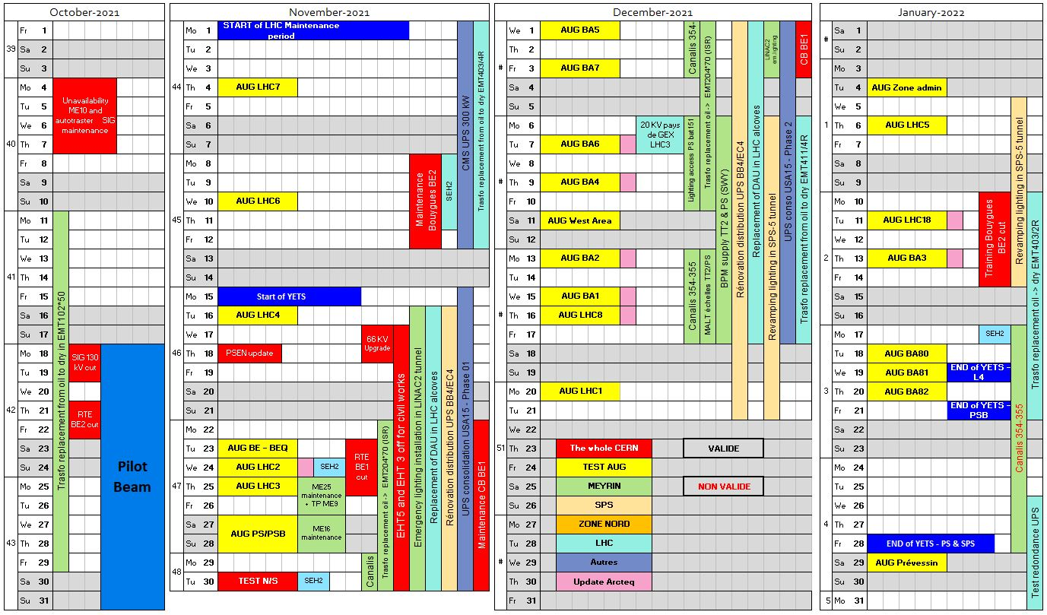
EN-EL Calendar of activities for the YETS

Slide 6
EN-EL activities on the Meyrin site
Manoeuvre impacting the whole of CERN
  4-5-6/10/21 – Power cut of ME10 (SIG) for maintenance (4h return time) Done
  18-19/10/21 – Power cut of ME10 (SIG) for swiss grid operation (2h return time) Done
  22/11/21 to 03/12/21 – Power cut of BE1 for RTE (transfert on BE2 without interruption)
  30/11/21 - Test Normal/Secured (6h to 6h10)
Test AUG
  AUG test PS/PSB (Cryo & LINAC 4 ask to postpone this test)
  AUG West Area
  AUG Zone Administrative
Works
  12-29/10/21 – Replacement transformer EMT102*50 (SY-EPC test area)
  22/11 to 10/12/21 – Replacement transformer EMT204*70 (ISR)
  16/11 to 03/12/21 – Emergency lighting installation in LINAC2
  18 to 21/11/21 – Maintenance ME16 & ME25
  06/12 to10/12/21 – Lighting access PS (bat 151)

Slide 7
EN-EL activities on SPS sites
Manoeuvre impacting the whole of CERN
  4-5-6/10/21 – Power cut of ME10 (SIG) for maintenance (4h return time) Done
  18-19/10/21 – Power cut of ME10 (SIG) for swiss grid operation (2h return time) Done
  22/11/21 to 03/12/21 – Power cut of BE1 for RTE (transfert on BE2 without interruption)
  30/11/21 - Test Normal/Secured (6h to 6h10)
Test AUG
  AUG test BA1 AUG test BA2
  AUG test BA3 AUG test BA4
  AUG test BA5 AUG test BA6
  AUG test BA7
Works
  16/11 to 21/12 – Rénovation distribution UPS BB4/EC4
  06/12 to 21/12 – Revamping lighting in SPS-5 tunnel

Slide 9
EN-EL activities at the LHC sites
Manoeuvre impacting the whole of CERN
  4-5-6/10/21 – Power cut of ME10 (SIG) for maintenance (4h return time) Done
  18-19/10/21 – Power cut of ME10 (SIG) for swiss grid operation (2h return time) Done
  22/11/21 to 03/12/21 – Power cut of BE1 for RTE (transfert on BE2 without interruption)
  30/11/21 - Test Normal/Secured (6h to 6h10)
Test AUG
  AUG test LHC1 - LHC18 - LHC2 - LHC3 - LHC4 - LHC5 - LHC6 - LHC7 - LHC8
Works
  01/11 to 12/11/22 – Replacement transformer EMT403/4R
  16/11 to 17/12/22 – Replacement of DAU in LHC alcoves + Upgrade SCADA
  06/11 to 10/12/21 – Replacement transformer EMT411/4R
  10/01 to 21/01/22 – Replacement transformer EMT403/2R

Slide 10
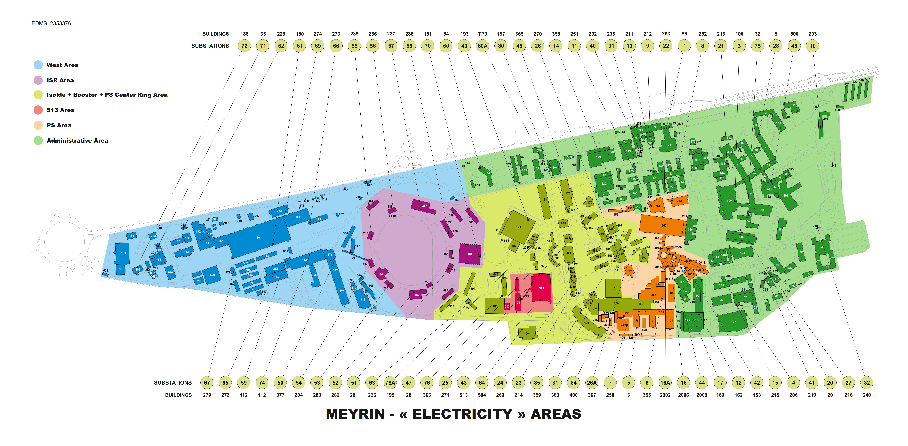
Zone AUG de Meyrin

