Slide 1
YETS Important dates
134th EATM 26th of October 2021
Bastien Rae

Slide 2
AD Important dates
Task Name | Duration | Start | Finish | Groups
Commissioning
ELENA acces and DSO test | 1 day | Wed 16.02.22 13:00 | Thu 17.02.22 12:00 | EN-AA
Protons on AD target 2022 | 0 days | Mon 14.03.22 08:00 | Mon 14.03.22 08:00 | BE-OP
AD target + ring acces and DSO tests | 1 day | Fri 11.03.22 08:00 | Mon 14.03.22 08:00 | EN-AA
AD target commissioning with beam | 1 day | Mon 14.03.22 08:00 | Mon 14.03.22 17:00 | BE-OP
AD ring commissioning with beam | 3 wks | Tue 15.03.22 08:00 | Mon 04.04.22 17:00 | BE-OP
ELENA commissioning with beam | 1 wk | Tue 05.04.22 08:00 | Mon 11.04.22 17:00 | BE-OP
Start of physics 2022 | 0 days | Mon 11.04.22 17:00 | Mon 11.04.22 17:00 | BE-OP

Slide 3
East Area Important dates
Task Name | Groups | Duration | Start | Finish
Stop ED B.355 | EN-CV | 1 day | Fri 19.11.21 08:00 | Fri 19.11.21 17:00
Start ED B.355 | EN-CV | 1 day | Fri 28.01.22 08:00 | Fri 28.01.22 17:00
PS Closure | BE-OP | 0 days | Fri 28.01.22 08:00 | Fri 28.01.22 08:00
PS beam start | BE-OP | 0 days | Mon 14.02.22 08:00 | Mon 14.02.22 08:00
Power converters restart and tests | SY-EPC | 1 day | Fri 18.02.22 08:00 | Fri 18.02.22 17:00
Magnet Commissioning | TE-MSC | 1 day | Mon 21.02.22 08:00 | Mon 21.02.22 17:00
DSO Tests EA1&EA2 | BE-EA,BE-OP,DSO,EN-AA | 1 day | Fri 11.02.22 08:00 | Fri 11.02.22 17:00
DSO Tests secondary beam lines | BE-EA,DSO,EN-AA | 1 day | Tue 22.02.22 08:00 | Tue 22.02.22 17:00
East Area Beam commissioning | BE-EA | 2 wks | Mon 28.02.22 08:00 | Fri 11.03.22 17:00
Start East Area physics 2022 (TBC) | BE-OP | 0 days | Mon 14.03.22 08:00 | Mon 14.03.22 08:00

Slide 4
North Area
Task Name | Groups | Duration | Start | Finish
Cooling tower degrade mode | EN-CV | 15 days | Mon 15.11.21 08:00 | Fri 03.12.21 17:00
Cooling tower off for maintenance | EN-CV | 20 days | Mon 06.12.21 08:00 | Fri 14.01.22 17:00
Cooling tower degrade mode | EN-CV | 10 days | Mon 17.01.22 08:00 | Fri 28.01.22 17:00
Magnet leak Inspection | EN-CV,TE-MSC | 1 wk | Mon 17.01.22 08:00 | Fri 21.01.22 17:00
Decablage EHN1 (NA-CONS) (TBC) | EN-EL | 4 wks | Mon 24.01.22 08:00 | Fri 18.02.22 17:00
Test Damaged DC cables | EN-EL | 1 day | Mon 15.11.21 08:00 | Mon 15.11.21 17:00
Test alim NA | SY-EPC | 4 wks | Mon 31.01.22 08:00 | Fri 25.02.22 17:00
Test Magnets | TE-MSC | 3 wks | Mon 28.02.22 08:00 | Fri 18.03.22 17:00
DSO tests BA80 + BA81 (North Transfert) | BE-ASR | 1 day | Wed 23.02.22 13:00 | Thu 24.02.22 12:00
DSO tests EHN1 + EHN2 (BA82) + TCC8 + ECN3 (TBC) | BE-ASR | 2 days | Fri 04.03.22 13:00 | Tue 08.03.22 12:00
BA80 + BA81 closed (TDC2/TCC2 Closed) | BE-OP | 0 days | Mon 14.03.22 13:00 | Mon 14.03.22 13:00
NA setup | BE-OP | 13 days | Mon 28.03.22 13:00 | Thu 14.04.22 12:00
NA physique | BE-OP | 5.5 mons | Mon 11.04.22 13:00 | Tue 20.09.22 12:00

Slide 5
AUG tests
Meyrin (East & AD)
  Saturday 27th & Sunday 28th of November 2022
North Area
Task Name | Groups | Duration | Start | Finish
Tests AUG BA80 (no access) | EN-EL | 1 day | Tue 18.01.22 08:00 | Tue 18.01.22 17:00
Tests AUG BA81 (no access) | EN-EL | 1 day | Wed 19.01.22 08:00 | Wed 19.01.22 17:00
Tests AUG BA82 (no access) | EN-EL | 1 day | Thu 20.01.22 08:00 | Thu 20.01.22 17:00

Slide 6
Bocking point
De-cabling of EHN1 → Power converters tests a the same time
  Follow up by NA-CONS
EHN1 Gallery ventilation Renovation → overlap with De-Cabling
  Need more detail planning (can work with Power converter powered ?)
TT82-TT83 CV work → part of the work at the same time that HW commissioning
  Detail planning received → can be done with power converter test ?

Slide 7
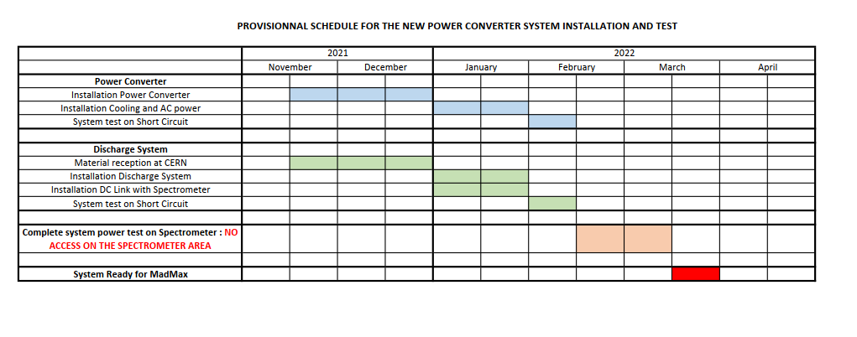
MADMAX
demin water needed
1w
~22 d
demin water needed
Needs magnet @ 4K
~ 2 w
New period
Water cooling
restarted
(delay for availability?)
New period
CRG equipt
ready
Magnet @4K

Slide 8
Experimental Areas Planning Gantt view

