Slide 1
FCC Accelerator
Timeline and Goals
Tor Raubenheimer
ABP Day, December 2, 2021

Slide 2
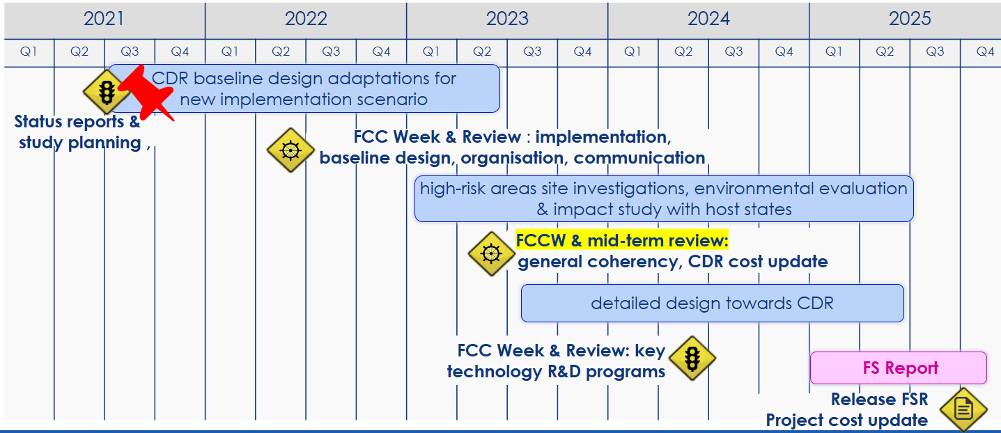
Goals for the FCC
The FCC CDR was developed for the 2020 European Strategy (ESPP)
Now push the design further with detailed placement options to a pre-TDR level for the next ESPP in 2026.
Focus on the FCC-ee to address Z, W, Higgs, and t-tbar before an FCC-hh

Slide 3
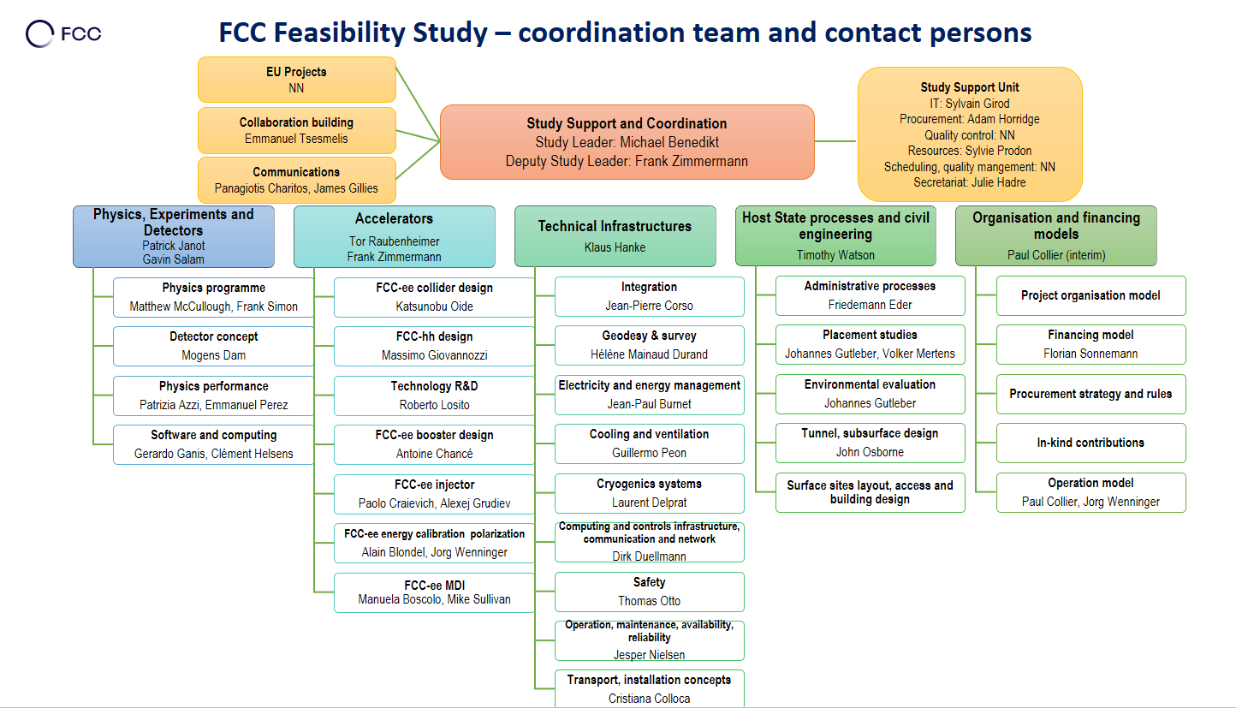
FCC-ee Design Study Contacts

Slide 4
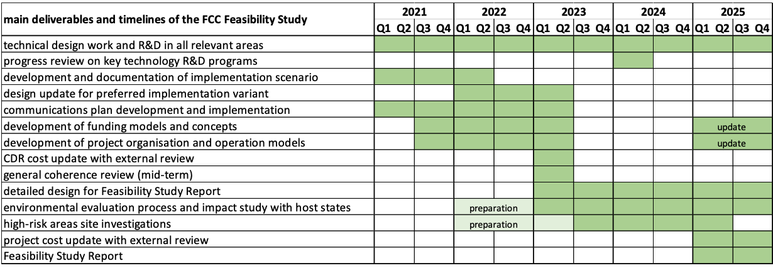
FCC FS overall timeline and main deliverables
Pre-decision on placement of the ring (geology, surface areas, etc.): mid-2022
High-risk area site investigations for selected placement: mid-2023 to mid-2025
Design update for preferred placement scenario: mid-2023
General coherence review across all work packages: mid-2023 (FS mid-term review)
Cost reviews with external expert review committee: 2023 and 2025

Slide 5
Accelerator Development Goals and Timeline
Self-consistent Baseline configuration for Feasibility Study by end of 2025
Support mid-term and final costing exercises in June 2023 and December 2025
  Complete beam optics aligned to the present tunnel placement and initial component specification by January 2023 to allow cost development through May 2023 for mid-term FCC review in June 2023
    Optics specifications with correction elements, RF, collimation and injection systems
    Beam dynamics calculations to include initial studies: tuning and correction; dynamic aperture with errors; beam-beam with errors; collective effects.
    FCCee Injector and Booster optics and layouts completed with tradeoff studies documented
    FCChh optics layout in consistent layout
    Technology R&D specification with milestones
Iterate to support the Feasibility Study costing exercise from January 2025 through December 2025

Slide 6
FCC Accelerator Status
Placement updated with slightly smaller footprint (91 km) and 8 accesses
Updating main ring optics for 4 IPs with new placement for 4 energies
Selected baseline high-level parameters (mostly)
Working on MDI, RF layout, collimation, and injection/extraction
Many outstanding physics and tuning questions
Developing Booster and Injector configurations
Working to ensure compatibility with FCC-hh
Technical R&D program is beginning to prioritize tasks
Energy calibration and polarization studies beginning
Need to develop tools and simulations

Slide 7
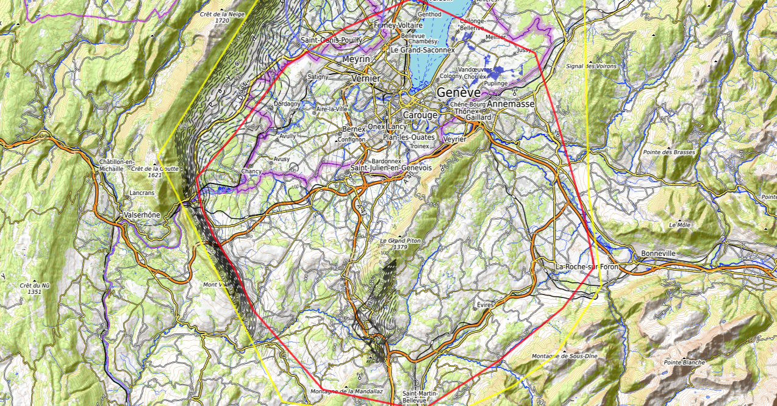
Constraints
Placement studies (1 / 2)
J. Gutleber, V. Mertens
Discouraged due
to likely oppositions
Densely urbanized
and agriculture/nature
Strict landscape protection
and re-naturalization areas
Jura limestone
Protected forest
Densely urbanized
and emerging areas
Densely urbanized
Clustered residential
areas and farm areas
Terrain difficult to
access and water
reservoirs
Known water reservoirs and
protected nature in CH
(legal + technical reasons)
Water protection and
natural zones without
developed access
Densely urbanized
and emerging areas
(some spots possible)
Water protection zones,
landscape protection zones,
altitudes
High mountains (900 m)
north of Fillière river valley
Vuache limestone
and faults
Likely major opposition:
local urbanistic planning
for traffic calming &
nature protection
High altitudes
Densely populated

Slide 8
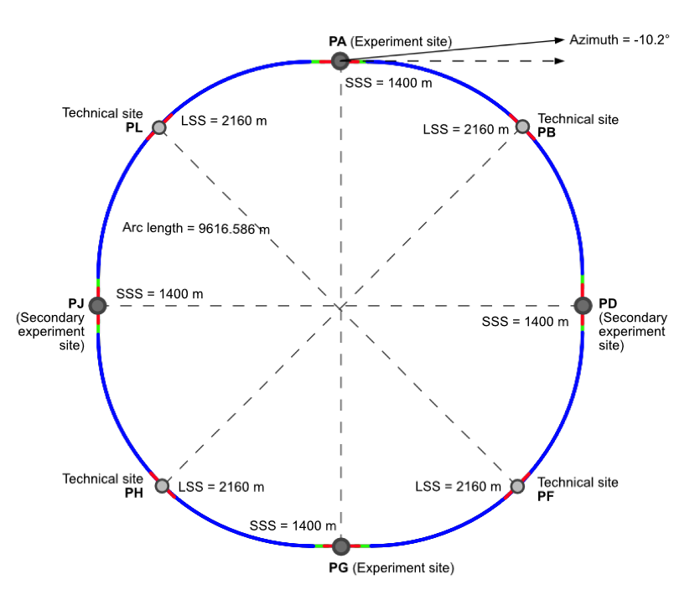
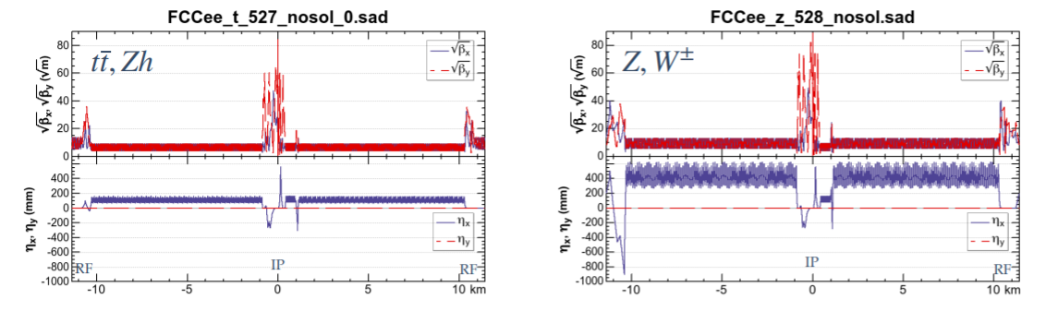
Placement Studies (2 / 2)
Looked in detail at placement options.
Access points are challenging to find
→ layout with slightly smaller (91 km)
circumference and 8 access points
2 main optics configurations: Z, W and Zh, ttbar

Slide 9
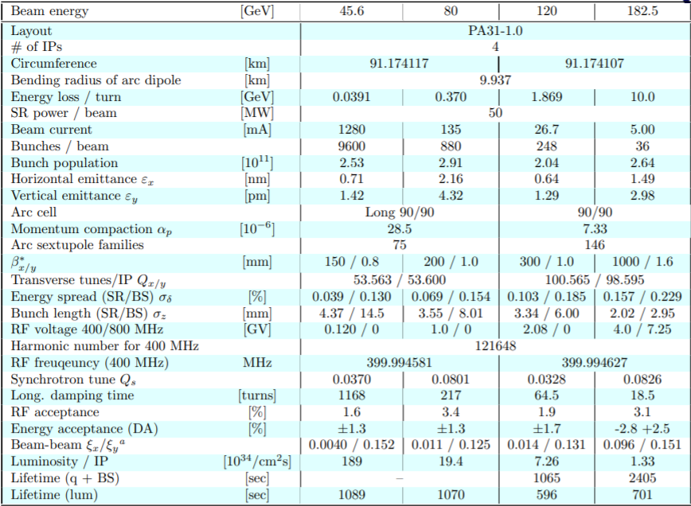
Parameters

Slide 10
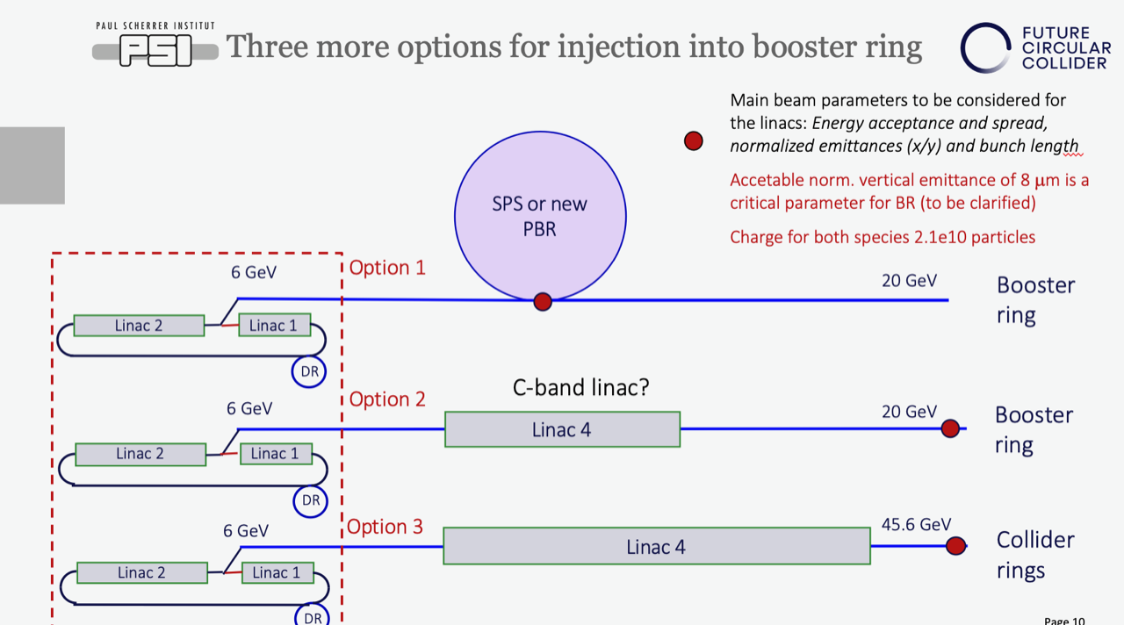
Subsystem Definitions
Along with the main ring placement, major subsystems are being defined and layouts started:
RF, injection/extraction, beam collimation, polarization meas/control, …..
Booster, Injector, Transfer lines
Need iterations on all of these by
June 2022 to understand the
preliminary civil and infrastructure
requirements

Slide 11
Accelerator Baseline Philosophy and Options
Develop accelerator ‘baseline’ model using relatively conservative accelerator physics and technology choices wherever possible
Cross-reference technological/physics choices to operating facilities where possible and identify all areas where baseline requires extrapolation
Start accelerator modeling with established simulation/modeling tools but develop optimized tools for the completion of the Feasibility Study → code workshop, Winter/Spring 2022
In parallel, develop a list of Alternate options that could potentially lead to a significant improvement in performance or cost
  Develop the Alternate options in parallel with main project and move them into the baseline as the options mature with an established down select process → schematic
    Examples might be HTS arc quadrupole/sextupole magnets, the SPS as a pre-booster, positron target using crystal channeling, advanced cooling tower design, etc.

Slide 12
Suggested FCC-ee Design Milestones and Deliverables
Major milestones/deliverables:
  FCCee Parameter update October, 2021
  Specification of RF Baseline configuration, October, 2021
  Collider arc cell and main optics configuration, November, 2021
  Tuning and Simulation tool workshop, Winter, 2022 → broaden to physics modeling
  Tuning, Diagnostic, Tolerance and stability spec → requirements, June 2022
  Collimation system specification, June 2022
  Infrastructure requirements, June 2022
  Tunnel cross-section, June 2022
  Energy calibration update, June 2022
  Civil infrastructure requirements, September 2022 → Major deliverable
  Document baseline for costing exercise, December 2022 → Major deliverable
  Begin iteration of parameters, June → December, 2023
  Update Baseline calculations and specifications using new tools over next 1.5 years
  Document Baseline for Feasibility Study costing exercise, June 2025
  Start Feasibility Study baseline documentation, June 2025
Deliverable, January 2022
Major Deliverable

Slide 13
Suggested FCC-hh, Tech R&D, and FCC-ee Injector/Booster Design Milestones & Deliverables
Major milestones FCChh and FCCee Injector systems:
  FCC-hh parameter update December, 2021
  FCC-hh specification of RF Baseline configuration, December, 2021
  FCC-hh collider main optics configuration, June, 2022
  FCC-hh civil infrastructure requirements, September 2022
  FCC-hh injection/extraction optics, December, 2022
  Prioritize technical R&D items, March, 2022 → Reviewed regularly → list of deliverables
  Technical R&D having many parallel programs with established milestones
  FCCee Booster parameter update, December, 2021
  FCCee Booster optics update with main ring injection, June 2022
  FCCee Tunnel cross-section, June 2022 (with main ring)
  FCCee Pre-Injector update, June 2022
  FCCee Booster → Main ring injection, September 2022
  Document baseline for costing exercise, December 2022
  Parameters Iteration, June 2023
  Start Feasibility Study baseline documentation, June 2025
May be early winter

Slide 14
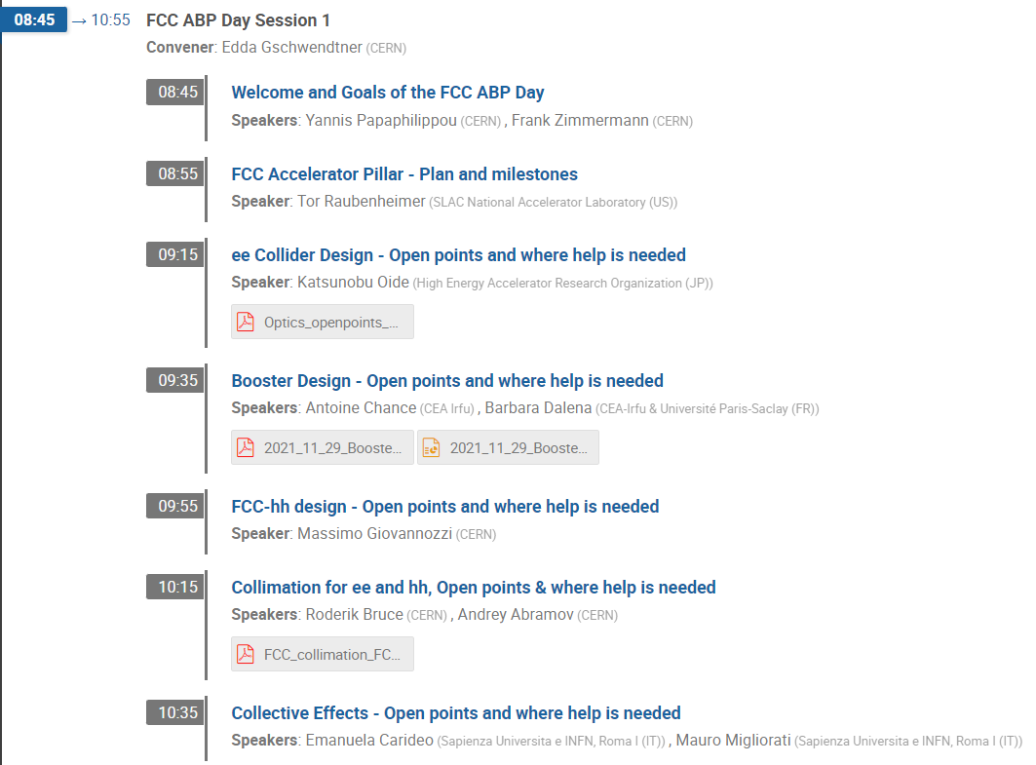
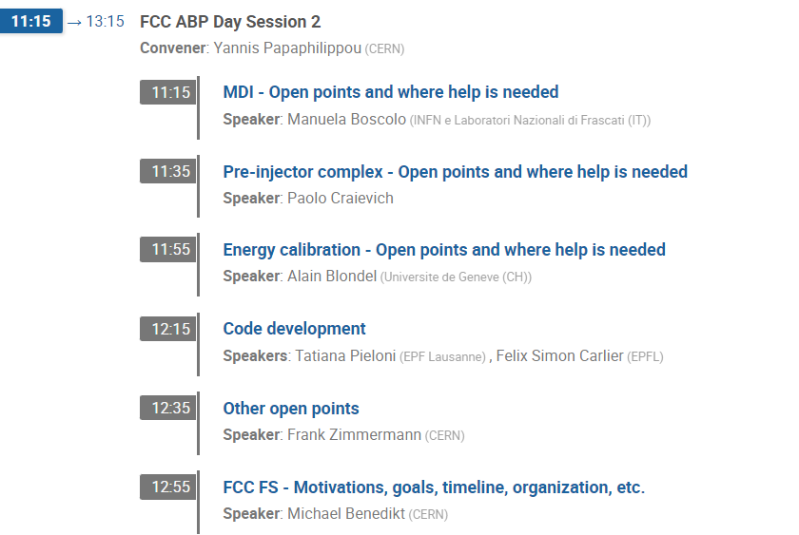
Agenda

Slide 15
Summary
FCC-ee will address the Higgs/EW physics that has been endorsed worldwide and is very a strong candidate as the next large accelerator in particle physics
The accelerator will operate in a new regime with very high luminosity at high energy (a merger of the B-factories and LEP) with new physics challenges
Detailed studies are beginning to understand the placement, infrastructure, and civil engineering as well as the beam physics and accelerator components
Very exciting time with lots to do to define this new collider!

