Slide 1
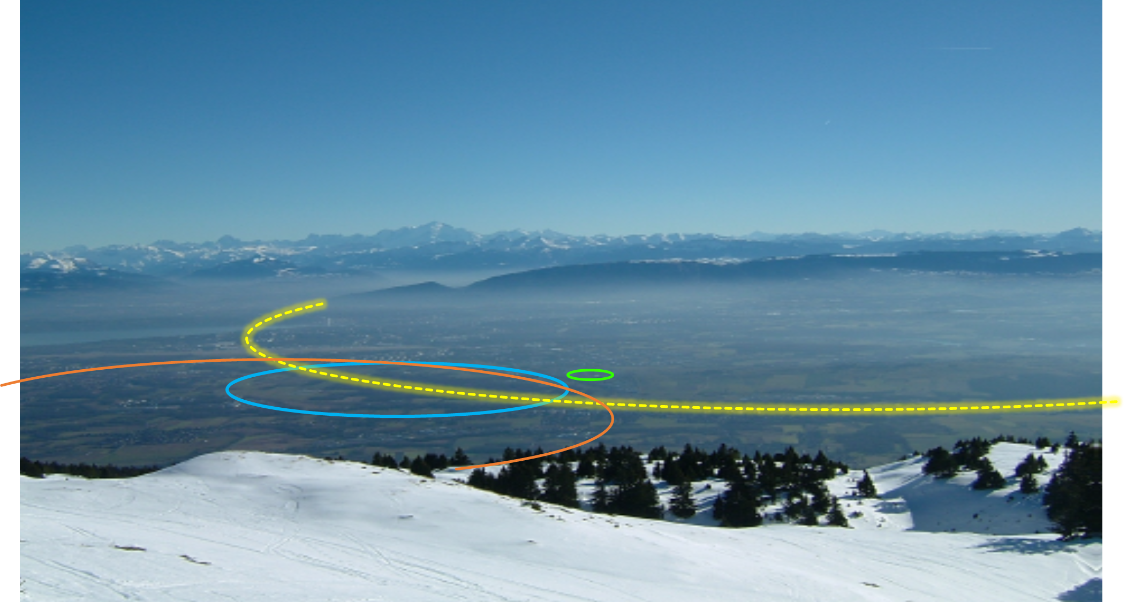
FCC-hh design - Open points and where help is needed
Massimo Giovannozzi
CERN, BE Department
FCC Accelerators and Beam Physics Day
2 December 2021
PS
LHC
FCC
SPS
Work supported by the European Commission under the HORIZON 2020 projects EuroCirCol, grant agreement 654305; EASITrain, grant agreement no. 764879; ARIES, grant agreement 730871, FCCIS, grant agreement 951754, and E-JADE, contract no. 645479
photo: J. Wenninger

Slide 2

Outline
The CDR baseline
Current activities
A non-baseline option
Outlook
Acknowledgements: A. Abramov, W. Bartmann, M. Benedikt, R. Bruce, J. Gutleber, V. Mertens, T. Risselada, F. Zimmermann

Slide 3
Outline
The CDR baseline
Current activities
A non-baseline option
Outlook

Slide 4
FCC-hh layout
Two high-luminosity experiments (A & G)
Two other experiments combined with injection (L & B)
Two collimation insertions
  betatron cleaning (J)
  momentum cleaning (F)
Extraction insertion (D)
Clean insertion with RF (H)
Compatible with LHC or SPS as injector
circumference: 97.75 km

Slide 5
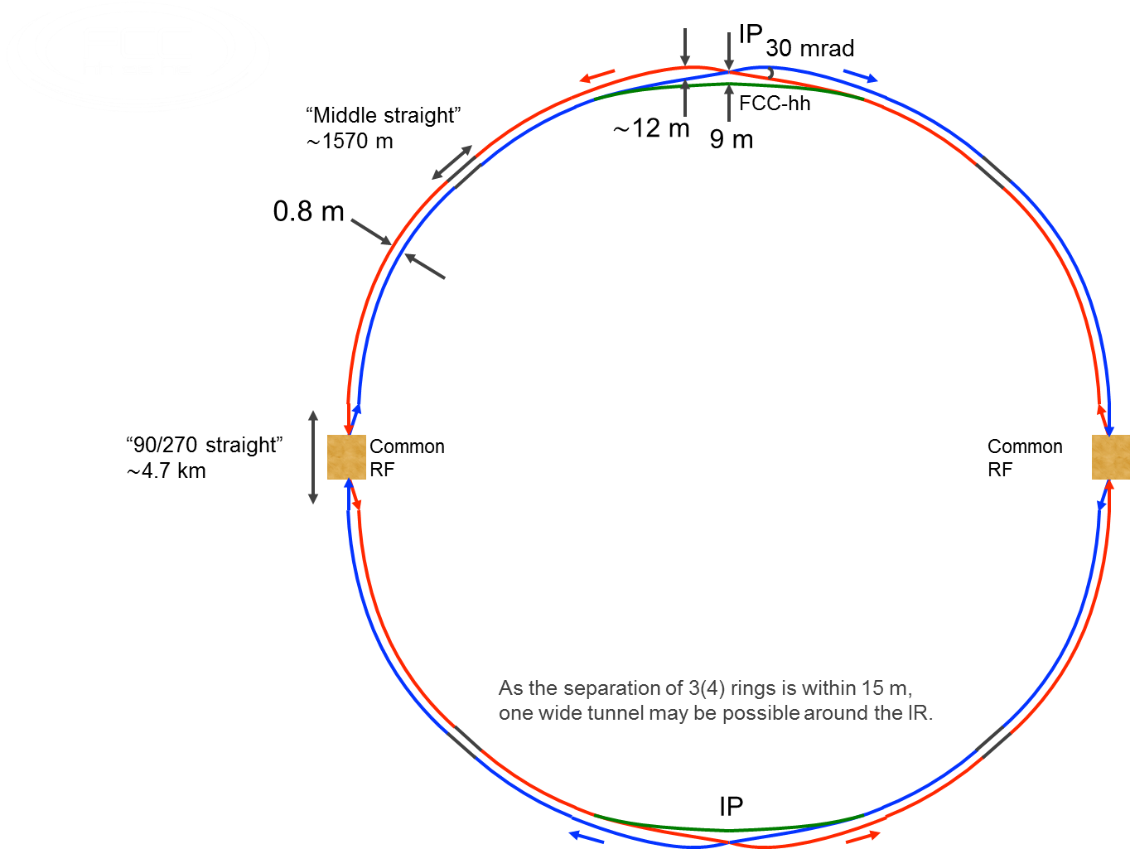
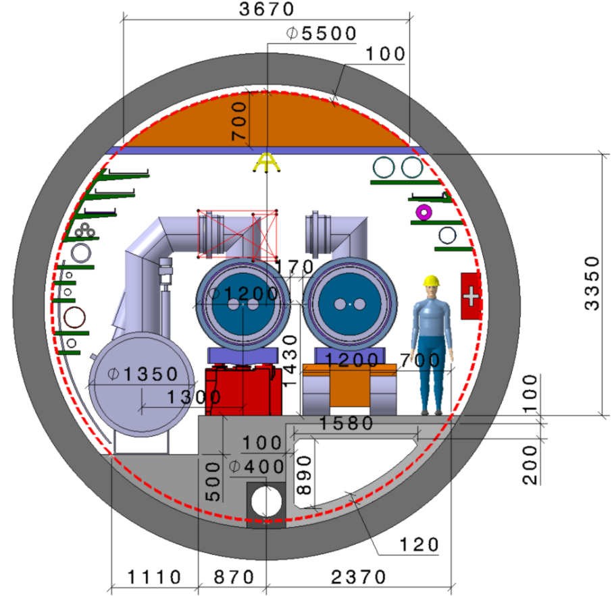
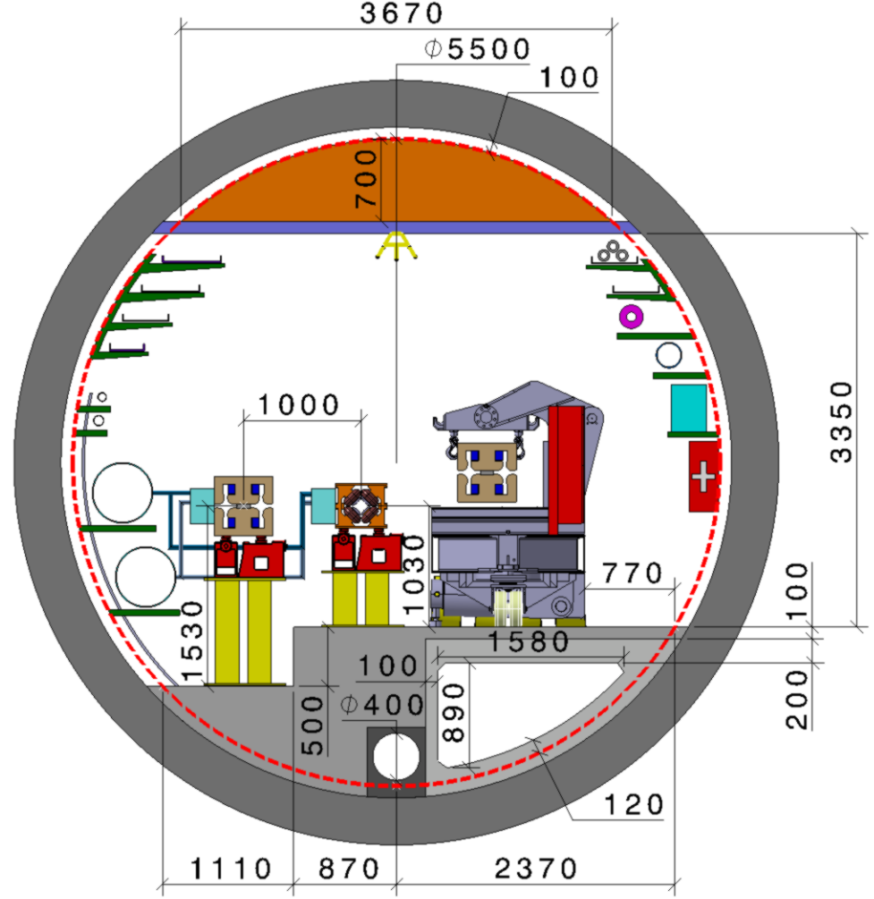
FCC consistent machine layouts
FCC-hh
FCC-ee 1, FCC-ee 2,
FCC-ee booster (FCC-hh footprint)
9 m off-centred IPs
wrt. hh IPs
Optics solutions for full ring for both machines available

Slide 6
Outline
The CDR baseline
Current activities
A non-baseline option
Outlook

Slide 7
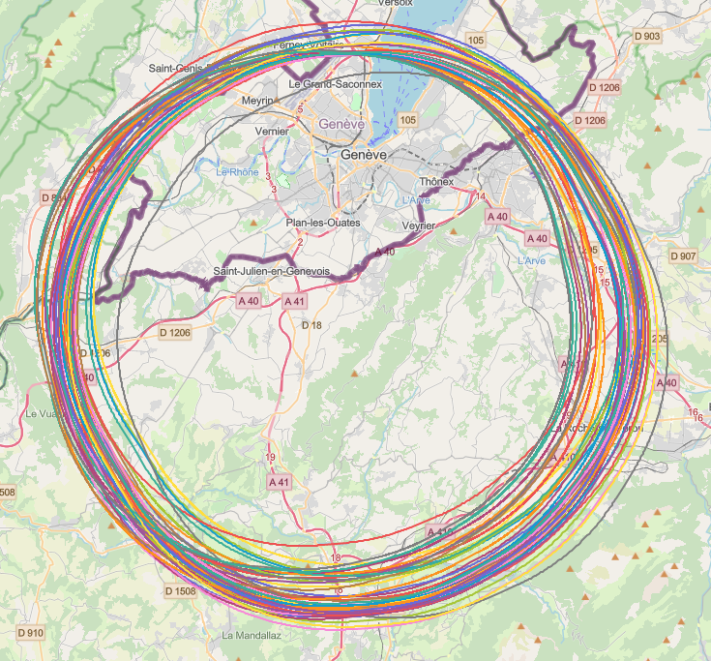
Collider placement optimisation
Overall layout and placement optimisation process across both host states
Following the "avoid-reduce-compensate" directive of European and French regulatory frameworks
Process integrates diverse requirements and constraints:
  performance permitting world-leading scientific research
  technical feasibility of civil engineering and subsurface constraints
  territorial constraints on surface and subsurface
  nature, accessibility, technical infrastructure, and resource needs & constraints
  economic factors including development of benefits for, and synergies, with the regional developments
  …
Collaborative effort of technical experts at CERN, consultancy companies and government notified bodies

Slide 8
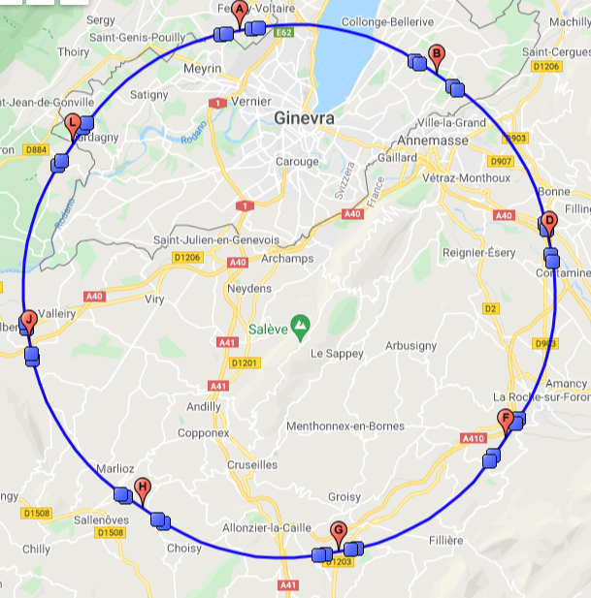
Layout following placement studies
Constraints of the layout:
  Experimental points in A, D, G, J
This implies starting (almost) from zero to define the functionalities of the remaining straight sections.
The length of the non-experimental straight sections has been reduced (from 2800 m to 2160 m).
Injection is separated from the experimental insertions.
This gives us the chance to try and introduce innovations in the layout.

Slide 9
Activities following placement studies
Layout and optics of the various non-experimental insertions to be reviewed.
Combinations of functionalities to be reviewed.
Current views:
  B: injection and dump
  L: injection and RF
  H, F: collimation
  The last part of the transfer lines should be in the ring tunnel: this should be carefully studied (also in terms of integration).
Other options to be considered
  Can we combine betatron and momentum collimation?
  We shall try and implement all improvements studied for HL-LHC betatron-collimation insertion in the FCC-hh insertion.
All these studies imply optics studies and validations studies.

Slide 10
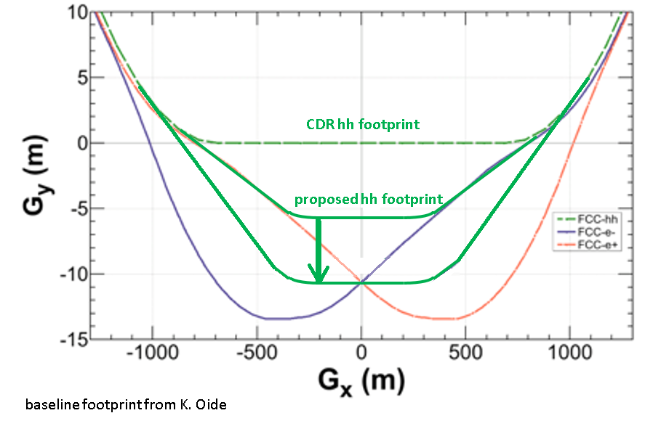
Layout optimisation of high-luminosity insertions
F. Zimmermann
CDR
  FCC-hh footprint compatible with FCC-ee injector
Implementation of an improved layout with FCC-ee and FCC-hh IPs with same transverse positions
Advantages
  Size of detector cavern reduced
  Possibility to re-use FCC-ee detector for FCC-hh
  Tunnel width reduced over 2 x 500 m
(m)
T. Risselada
(m)

Slide 11
Other activities
In parallel with the activities to re-build a sound baseline for the FCC-hh ring, we should explore innovative approaches to the beam dynamics in FCC-hh, namely
  Numerical simulation tools to include synchrotron radiation effect. Strong synergy with FCC-ee activities!
  Tracking studies using nonlinear magnetic imperfections and synchrotron radiation.
  Halo manipulation (crystal collimation, Hollow Electron Lens)
  Nonlinear beam manipulations
  Non-baseline optics
  High-field magnets technology
  Advanced beam screens (HTS coatings)
  Novel materials for collimator’s jaw
  …
Ideal topics for collaborations (with ABP or with external institutes)

Slide 12
Outline
The CDR baseline
Current activities
A non-baseline option
Outlook

Slide 13
A combined-function optics for FCC-hh?
In collaboration with E. Todesco
The use of combined-function (dipole-quadrupole) might be an interesting option for FCC-hh.
Possible advantages
  Increase filling factor
  Simplify production (a single magnet type for the arcs)
Nominal FCC-hh FODO cell
FCC-hh combined-function cell

Slide 14
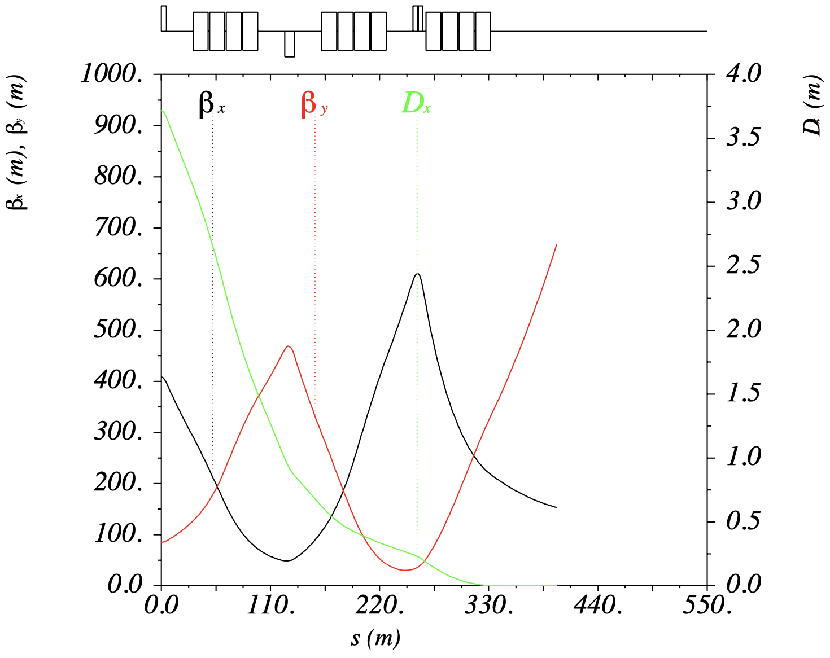
A combined-function optics for FCC-hh?
In collaboration with E. Todesco
Some advantage of the combined-function cell with respect to the FODO one in terms of optical parameters.
No issue for designing superconducting combined-function magnets (already in use in JPARC transfer lines, and will be used in D2 separation dipoles in HL-LHC).
Possibility to optimise the cell layout: 16 dipoles seems a very appealing option!
High filling factor very interesting: actual gain to be quantified.
Dispersion suppressor based on combined-function magnets has been designed.
Example of dispersion suppressor
Ratio of optical functions

Slide 15
A combined-function optics for FCC-hh?
In collaboration with E. Todesco
Next steps
  Study correctors systems for combined-function cell in view of modularity
    Orbits
    Tunes
    Chromaticities
    Linear coupling
    Field quality
    Landau damping
  Optimise interconnection length
  Study beam dynamics in the presence of damping and combined-function magnets

Slide 16
Outline
The CDR baseline
Current activities
A non-baseline option
Outlook

Slide 17
Outlook
A big programme of studies for FCC-hh is ahead of us.
Help is very much needed!
As a first priority for
  Optics design
  Beam dynamics studies
  Tools development
As a second priority for
  Collective effects
As a third priority for
  Optimisation of the chain of injectors

Slide 18
Thank you for your attention!

