Slide 1
WP 11.2
“High-Efficiency Klystron Industrial Prototype”
I.FAST Open Steering Committee
15-16 November -2021
N. Catalan-Lasheras & O. Brunner /CERN

Slide 2
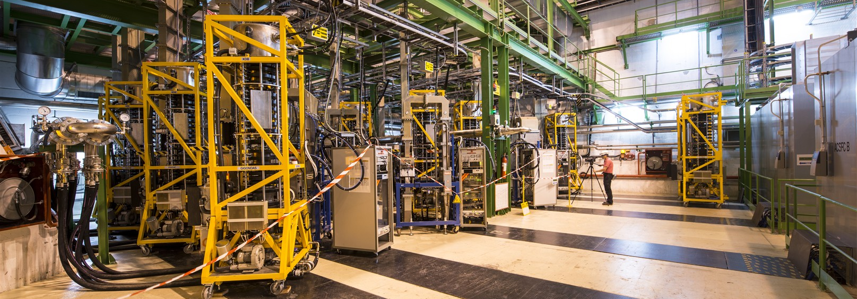
Scope
Fabrication and tests of industrial prototypes of High Efficiency Klystron for LHC.
Refurbishment of the existing LHC klystron “TH2167”; this allows to re-use the existing infrastructure and subassemblies of the existing tubes.
Expected gain in DC to RF conversion efficiency: + 10 - 15 %
The LHC cavern UX45 with the klystron gallery.

Slide 3
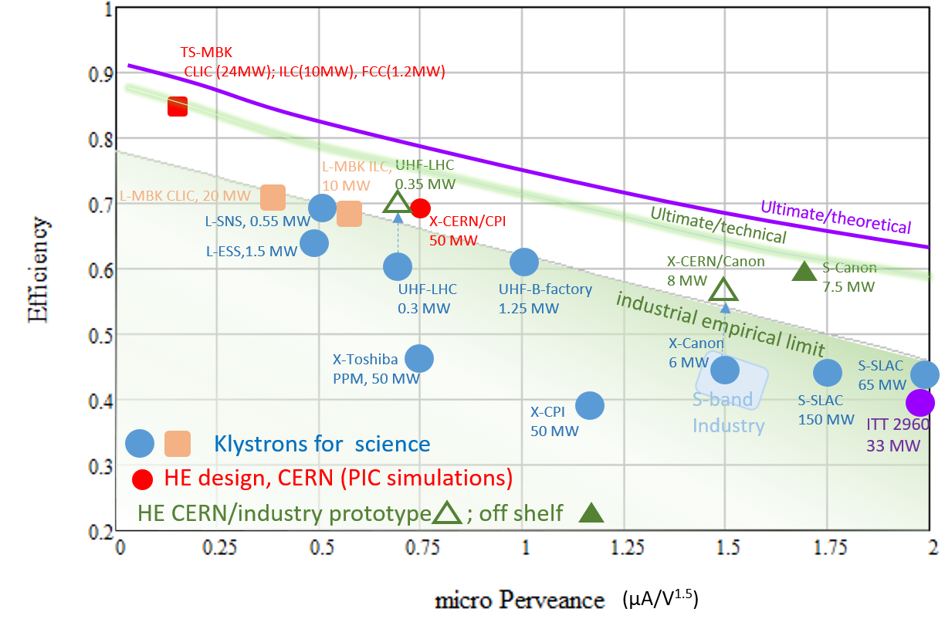
Higher energy efficiency is a must
Also to all future accelerator projects.
Impressive progress in High efficiency klystron technologies in recent years.
The HE-LHC klystron will be the flagship demonstrator -> I.FAST 11.2.
  demonstrate the performance in operation in LHC
  reduce the electricity bill and the environmental impact
  increase the operational margin when operating with higher intensities (“HL-LHC”).
I. Syratchev

Slide 4
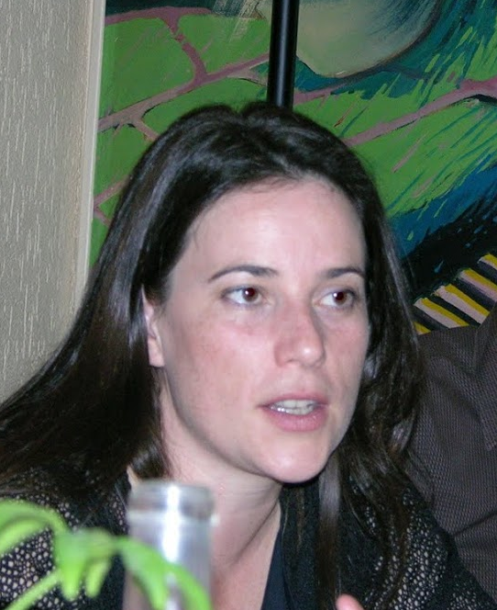
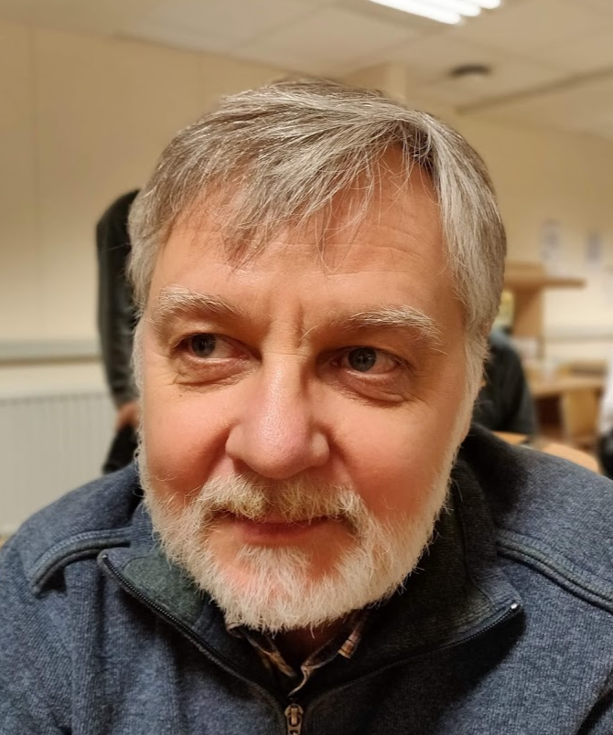
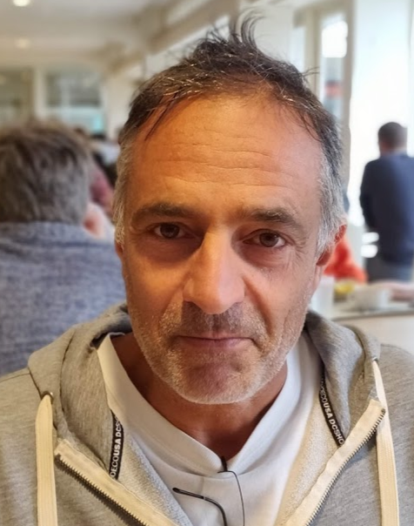

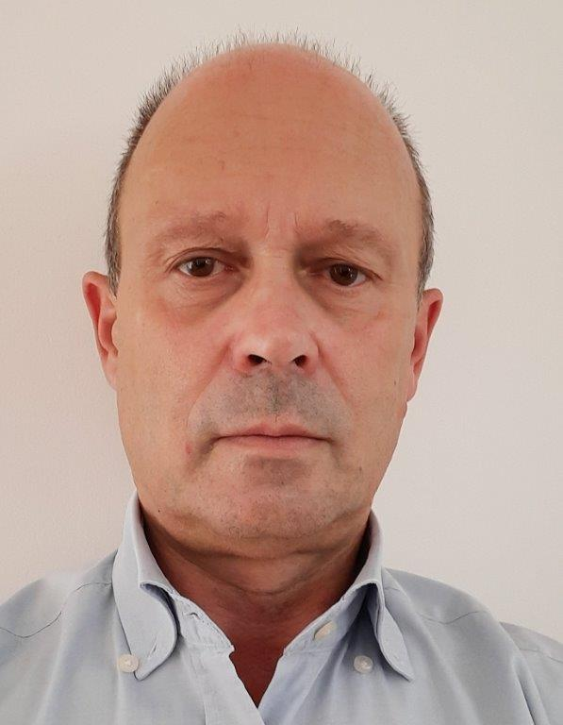


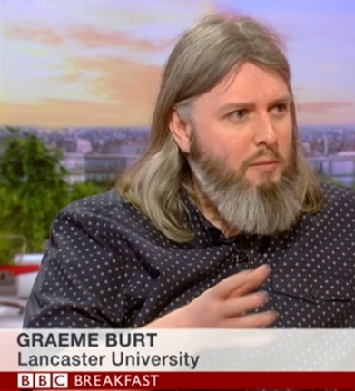
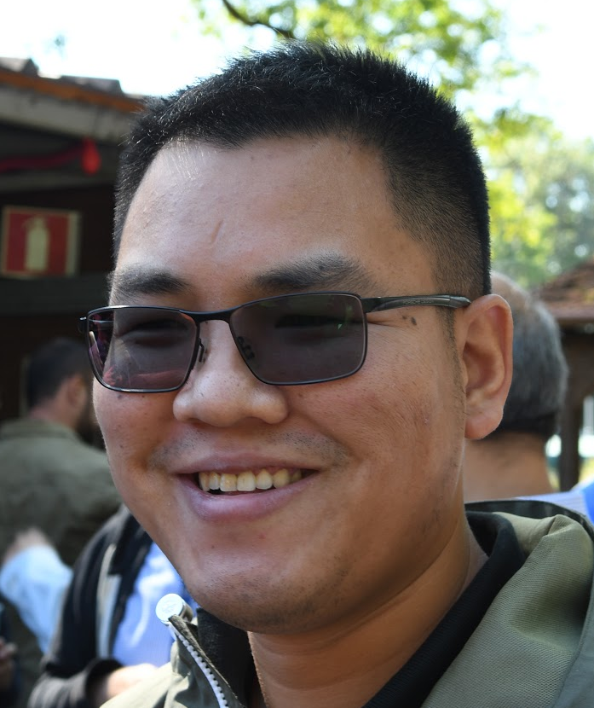
The teams
CERN (N. Catalan, I. Syratchev, O. Brunner)
  Igor is the driving force for HE Klystron.
  Nuria is leading the HE klystron effort @ CERN.
Thales AVS France SAS (A. Beunas, O. Mielle, G. Batto…)
  Thales is the only European supplier for high-power klystrons
University Lancaster (G. Burt, J. Cai)
  University of Lancaster, part of the Cockcroft Institute, is a productive and reliable partner - Graeme (Associate Director and Professor),
  Jinchi (formerly CERN fellow) has developed an advanced klystron simulation code (KLyC) and is key player in the HE klystron development.
Nuria Catalan
Igor Syratchev
Olivier Brunner
Armel Beunas
Jinchi Cai

Slide 5
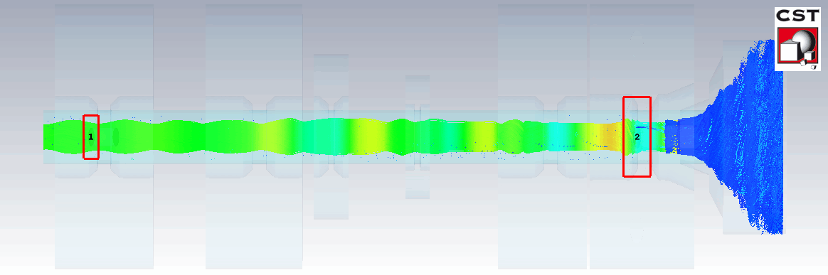
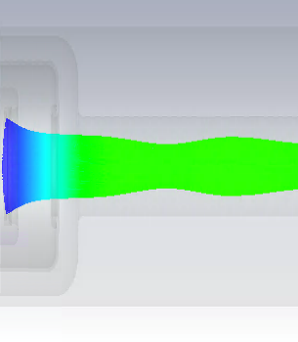
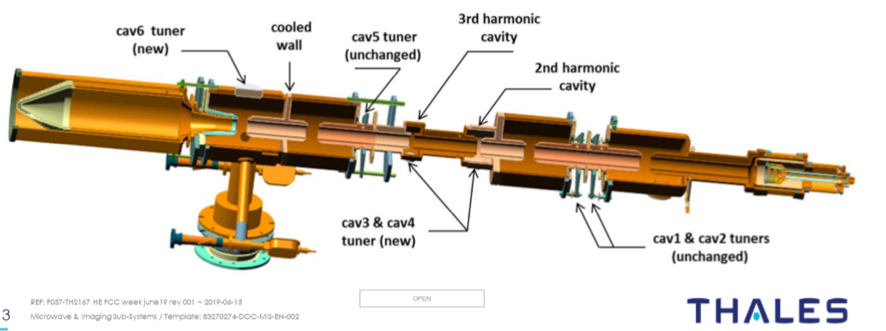
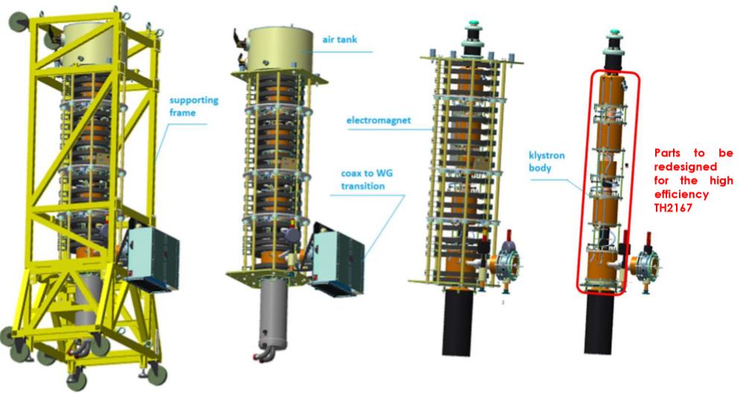
Retro-fit of the LHC klystron -> η+10%
Replacement of the interaction region (3D PIC full tube (cathode +solenoid + RF circuit + collector) simulations)
 | LHC/CSM | LHC/Thales
Frequency, GHZ | 0.4 | 0.4
Beam power, MW | 0.5 | 0.5
Perveance, | 0.72 | 0.72
RF power, MW | 0.35 | 0.30
Efficiency, % | 70 | 60
Re-used housing, electron gun and solenoid (also efficient!)
Cut-off view of the LHC CSM klystron

Slide 6
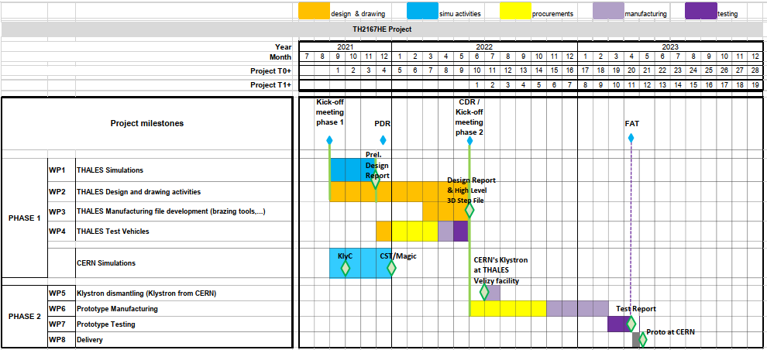

Where do we stand?
A collaboration agreement*) CERN/Thales was elaborated and signed – goes beyond the scope of I.FAST
The HE LHC Klystron Kick Off Meeting took place on the 2nd of September 2021

Slide 7
I hope this was efficient !
Thanks!

