Slide 1
WP7 Task 2: ultra low emittance rings
I-FAST steering committee: 16th November 2021
Riccardo Bartolini, DESY

Slide 2
WP7: High brightness accelerator for light sources
Scope:
WP7 pursues the R&D on new technical solutions for the design and construction of accelerator-based light sources, exceeding the performance of present machines. The research embraces both storage ring based synchrotron light sources and free electron laser driven by Linacs.
Task 7.1: Coordination and communication (R. Bartolini, DESY)
Beneficiaries: DESY
Task 7.2: Enabling technologies for ultralow emittance rings (A. Mochihashi, KIT)
Beneficiaries: DESY, CERN, SOLEIL, DLS, INFN, KIT, PSI, KYMA
Task 7.3: Variable dipole for the upgrade of the ELETTRA storage ring (Y. Papaphilippou, CERN)
Beneficiaries: CERN, CIEMAT, ELETTRA, KYMA
Task 7.4: Very high gradient RF gun operating in the C-band RF technology (D. Alesini, INFN)
Beneficiaries: INFN, COMEB, PSI, VDL-ETG
Task 7.5: CompactLight prototype accelerating structures (G. D’Auria, ELETTRA)
Beneficiaries: ELETTRA, CERN, INFN, VDL-ETG, COMEB, TMD
NETWORK
PROTOTYPE

Slide 3
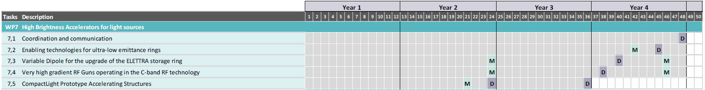
WP7: Milestones and deliverables

Slide 4
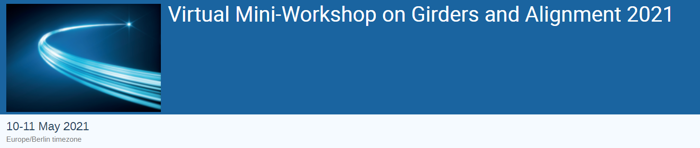
Task 7.2: Enabling technologies for ultra low emittance rings
(A. Mochihaschi, KIT)
Scope:
Strengthening the networking activity in the accelerator community on topics related to the major technological challenges faced in the design, construction and operation of ultra-low emittance rings.
Monthly regular meetings via zoom (update from facilities, share info, organization of activities). Regular attendance from CERN, DESY, DLS, INFN, KIT, KYMA, PSI, SOLEIL
Organise general and topical workshops on the technology enabling the design and construction of future ultra-low emittance rings
support exchange of staff for visits and common experiments and produce progress reports
first workshop partially supported by I-FAST – 99 delegates !
https://indico.desy.de/event/30022/

Slide 5
Task 7.2: Ultra low emittance rings
Networking and knowledge sharing within Task 7.2 :
  Online presentations and discussions:
  Chris Burrows (Diamond), Introduction to the R&D Beamline and activities at Diamond (11.June 2021)
  Ian Martin (Diamond), Preparation for Diamond-II relevant to IFAST WP7.2 (11.June 2021)
  Laurant Nadolski (SOLEIL), About ongoing studies on the machine with a multipole injection kicker (15.July 2021)
  Giovanni Franzini (INFN), An overview of the bunch by bunch feedback at DAFNE (13.October 2021)
Plan for experimental tests:
  Discussion about the possibility of
  experimental tests for the XBPM system at KARA – multibunch feedback system at DAFNE
Notes:
Company for XBPM system (diamond/PSI): now build a new XBPM system (for IDs) in beamline in KARA – spectra simulations for KARA wiggler

Slide 6
Task 7.2: Ultra low emittance rings
Workshop planning (working title):
  Beam diagnostics and dynamics in ultra-low emittance rings
    Expansion of our strong network dealing with ultra-low emittance rings,
    with a focus on beam diagnostics (e.g. on the hardware side) and beam dynamics (e.g. on the software side).
    Planned venue and date: KIT (Karlsruhe, Germany), May 2022
  Permanent magnet technologies and beam dynamics
    exchanging and sharing knowledge for permanent magnet and related technologies (e. g., mechanical structures, girders etc.) and beam dynamics related to the ultra-low emittance rings. Link to Task 11.3. Potential cooperation with PERMALIC in LEAPS
    Planned venue and date: CERN (Geneva, Switzerland), July 2022
Notes:
Steering commitee under preparation
Planning at KIT started –
Yannise PM

Slide 7
Task 7.2: Ultra low emittance rings
Workshop planning (continue):
  NEG coating vacuum systems
    Exchanging and sharing knowledge and information about NEG coating vacuum systems, which are now part of the mainstream of vacuum systems for the ultra-low emittance rings.
    This topic is strongly related to beam dynamics because of the impedance problem. Therefore, we are considering a joint event with the workshop with beam dynamics (possible joint event of Task 7.2 and Task 10.5 is currently being discussed).
  Beam dynamics for ultra-low emittance rings
    Review of latest ultra-low emittance lattice design developments.
    Optimisation tools, experimental tests of optimization. Model vs Machine studies.
    Discussion at ALBA: G. Benedetti. (virtual / in person – 2022)
Notes:
NEG from RB – Task 10.5 - Matthew Cox – WP10.5 beam dynamics link – and workshop

Slide 8
Task 7.2: Ultra low emittance rings
Workshop planning (continue):
  General workshop for the ultra-low emittance rings
    Sharing a wide range of topics on ultra-low emittance rings,
    allowing us all to further strengthen our ULER network.
    Planned venue: TBD, date: after October 2022.
Mainitaing the tradition of the General Workshop for Ultralow Emittance Rings
started with the CLIC/ILC collaboration in 2010 and supported by EuCARD2, ARIES and now IFAST
Notes:
NEG from RB – Task 10.5 - Matthew Cox – WP10.5 beam dynamcis link – and workshop
General workshop October 2022

Slide 9
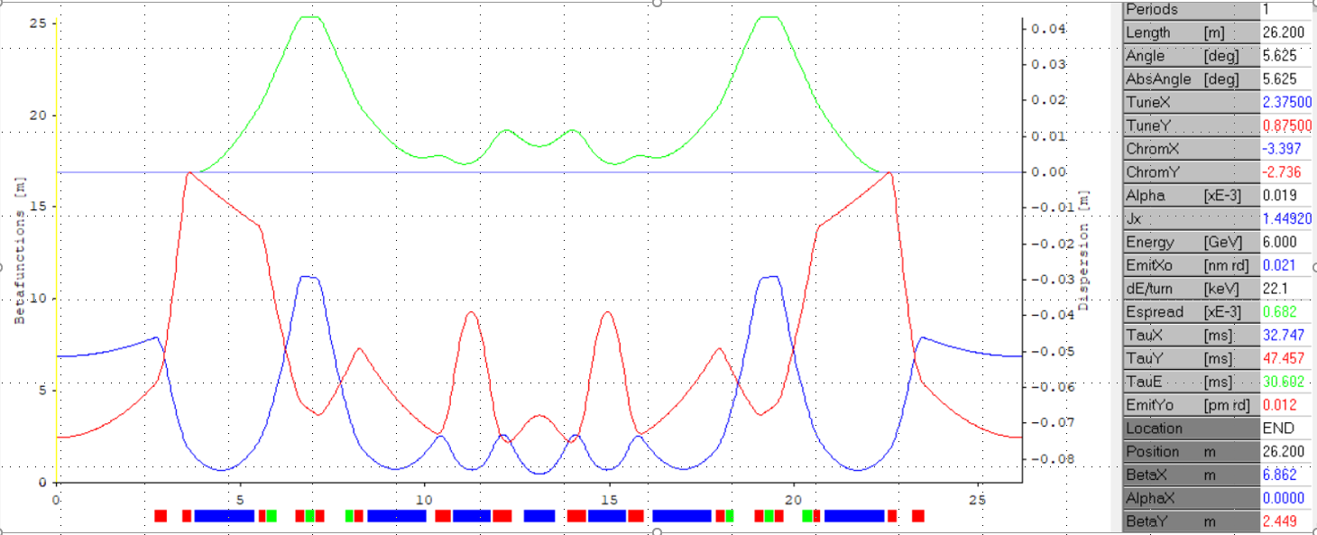
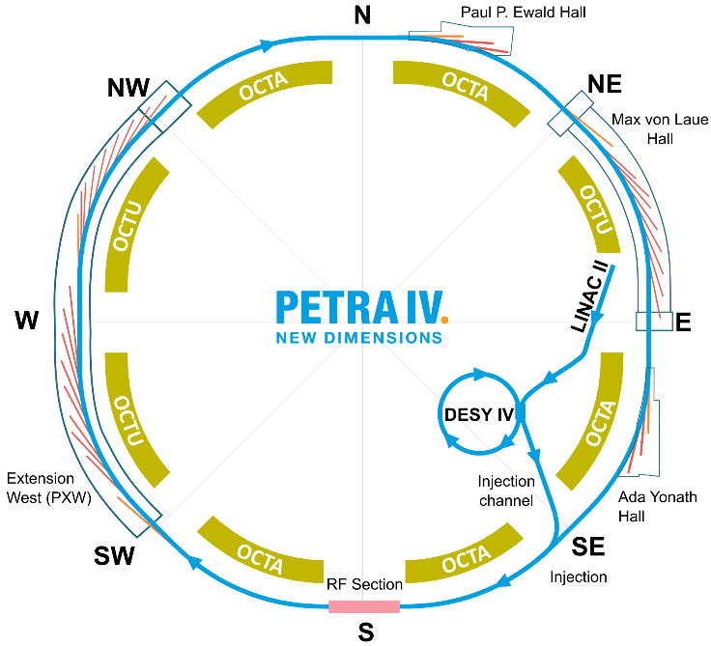
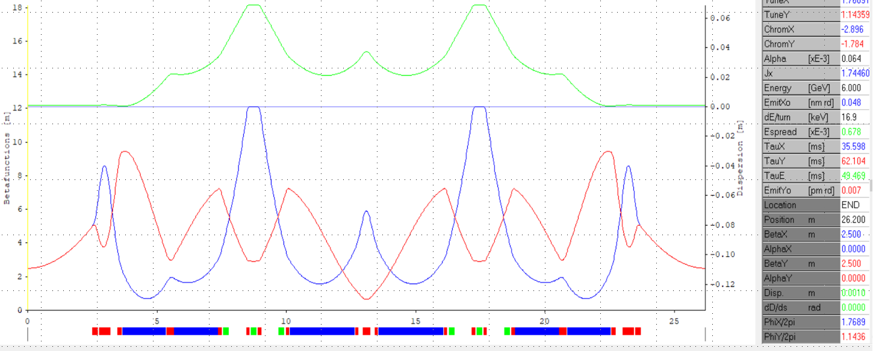
Task 7.2: new lattice at PETRA-IV
New H6BA cell:
4 DLs and 3 central DQs substituted with
2 DLQs and 4 PM DQs
combi
Relaxed emittance in the arcs 43 pm and
extensive use of damping wigglers in 5 octants (OCTA) for emittance damping to 20 pm and control. Undulator beamlines in 3 octants (OCTU)
DA and MA for bare lattice are remarkably larger.
H6BA

Slide 10
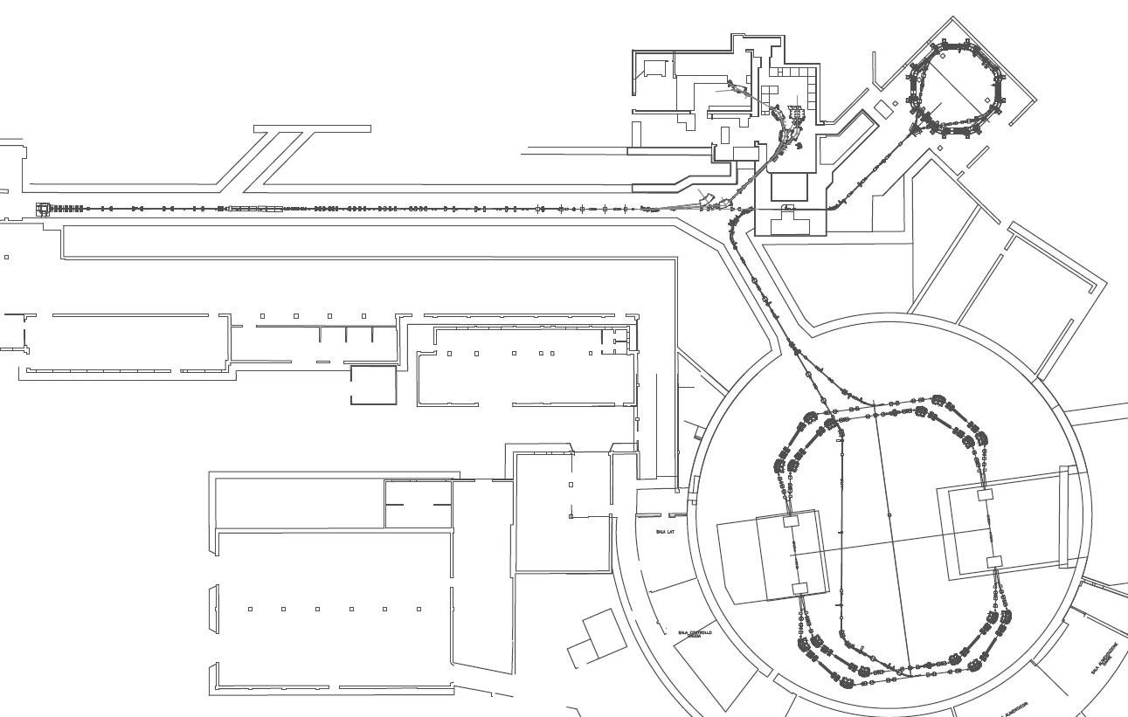
Task 7.2: diagnostics and feedback (INFN-LNF G. Franzini)
    Contribution to Task 7.2 at INFN-LNF is the sharing of measurement results and ideas for possible upgrades for the bunch by bunch feedback system of DAΦNE
DAΦNE is an electron-positron collider in operation at INFN-LNF for physics experiments since 1999.
It operates with (usually) 90 bunches at 510 MeV,
with a time interval of 2.71 ns between each other.
Typical stored currents are in the range of 1 A / 2 A
Bunch-by-bunch longitudinal and transverse feedback systems were installed in each DAΦNE ring and became operational since 1999.
An extensive review on the system is ongoing. Measurement campaign in order to evaluate and minimize any possible source of noise and interferences, and to find better solutions for the analog /digital treatments of the signals involved in the system. Extension to ultralow emittance rings
LINAC
ACCUMULATOR
e-
e+
DAΦNE

Slide 11
Summary
Activities in Task 7.2 have started: several workshops under planning
No issues (…so far)
Looking forward to progress with upcoming activities, milestone and deliverables

