Slide 1



Very high gradient RF Guns
(Task 7.4)
David Alesini, coord.
INFN-LNF (Frascati, Italy)
On behalf of the INFN-PSI Very High Gradient C band gun group

Slide 2
OUTLINE
Goals, Responsibilities and Timeschedule of task 7.4 on Very high gradient RF Guns
Update on SW GUN Activities
Update on TW GUN Activities
Bunker Status@PSI for high power test

Slide 3
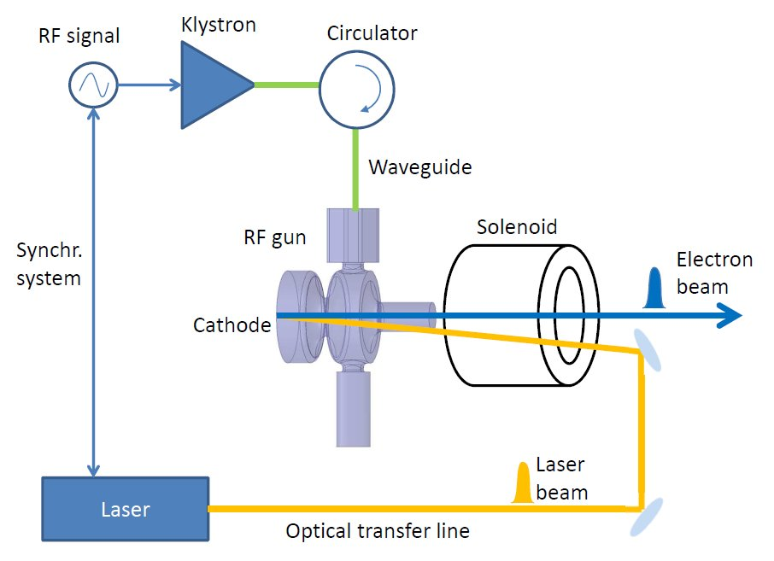
RF PHOTO-GUNS
RF Photo-injectors are widely used in FEL, as very low-emittance and high-brightness electron sources.
A laser pulse hits a cathode and the electrons are immediately accelerated by an intense RF E field (60-120 MV/m)
RF technology mostly used is the L or S-band (f=1.3 or 3 GHz).
The higher the peak electric field on the cathode, the better the quality of the beam emerging from the Gun.
The frequency step-up from L/S-band to C-band can provide higher achievable cathode peak field as high as 160-180 MV/m.
Because of its higher efficiency a C-band RF Gun is also suitable for application requiring repetition rates in the 200 Hz÷1 kHz range.
The availability of a new state-of-the-art, electron injector would bring benefits to a large accelerator user community, (FEL radiation sources, Thomson/Compton photon sources and plasma based accelerators)

Slide 4

GOALS AND TIMSCHEDULE OF TASK 7.4
Design, realization and high power test of two different C-band (5.712 GHz) RF electron guns operating at very high gradient cathode peak field (>160 MV/m): a Standing Wave (SW) gun and a Travelling Wave (TW) gun.
Comparison of the performances.
Beam dynamics simulations to exploit the device potentialities
Research Institutions involved: INFN (IT), PSI (SW);
Private Companies involved: VLD (NE), COMEB (IT)
SW GUN
TW GUN
Detailed Gantt well defined

Slide 5
RESPONSABILITIES
INFN: coordination, design and low power test SW Gun, solenoid design and procurement, design of the module to test the gun, providing the RF circulator.
COMEB: mechanical construction SW gun, mechanical supports and movable screen with magnetic corrector.
SW GUN
PSI: design, assembly, brazing and low-power characterization of the TW Gun, hosting and setting up the high-power test.
VDL: Machining of the cups and couplers of the TW gun.
INFN and PSI: A comprehensive study and optimization of the beam dynamics aspects, to fully exploit the devices potentialities, will be led by
TW GUN

Slide 6
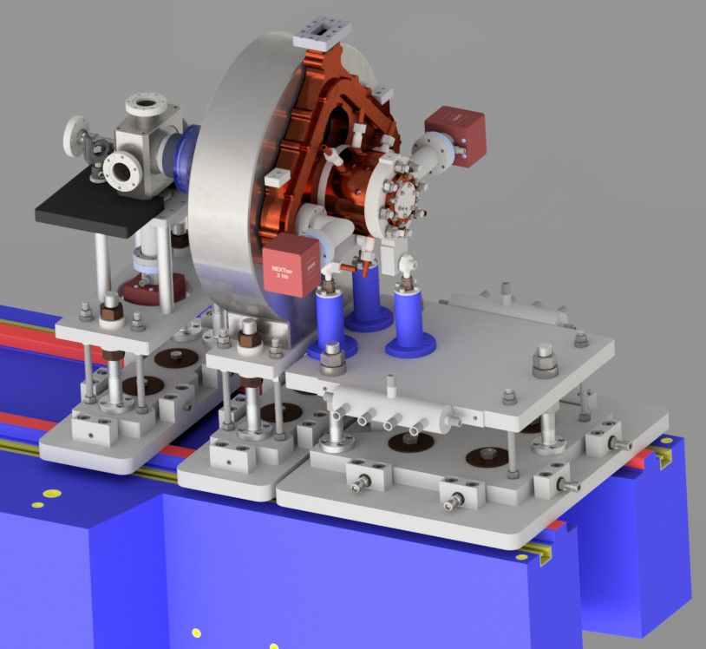
SW GUN STATUS
e.m. design completed
Mechanical design: almost completed
Laser injection chamber
New technology w/o brazing for RF gun realization (clamping and special gaskets)
Laser injection chamber
solenoid
RF gun

Slide 7
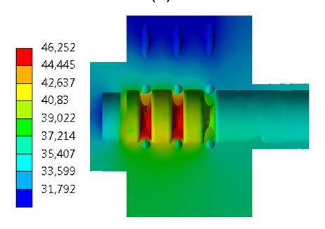
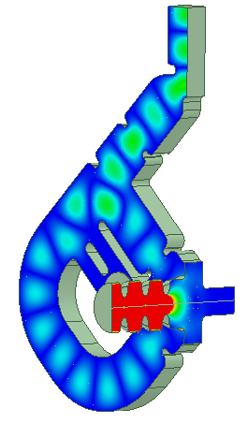
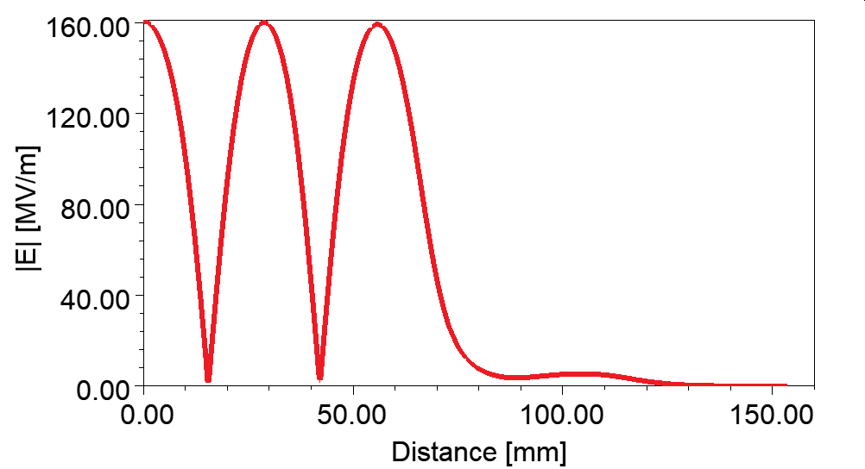
SW GUN: STRATEGY, PARAMETERS
2.5 cell
Powered with very short rf pulses (300 ns) of few tens of MW to reduce the pulsed heating (∼√τ), BDR (∼τ⁵) and average dissipated power (allowing the high rep. rate operation);
Cathode peak field (E_{cath})> 160 MV/m
4-port mode launcher (no quadrupole components, no pulsed heating)
New technology for its realization w/o brazing: hard copper
(Commercial) circulator is necessary: order done
Design compatible with 1 kHz rep. rate;
Parameter | value
Frequency [GHz] | 5.712
E_{cath}/√P_{diss} [MV/(m⋅MW^{0.5})] | 51.4
Peak input power [MW] | 18 | 23
Cathode field [MV/m] | 160 | 180
Cathode type | copper
Rep. rate [Hz] | 1000 | 100
Quality factor | 11900
Filling time [ns] | 166
Coupling coefficient | 3
RF pulse length [ns] | 300
E_{surf}/E_{cath} | 0.96
Mod. Poy. Vect. [W/μm²] | 2.5 | 3.1
Pulsed heating [ºC] | 16 | 20
Av.diss. Power [W] | 2300 | 300
Longitudinal electric field profile
RF gun
Mode launcher

Slide 8
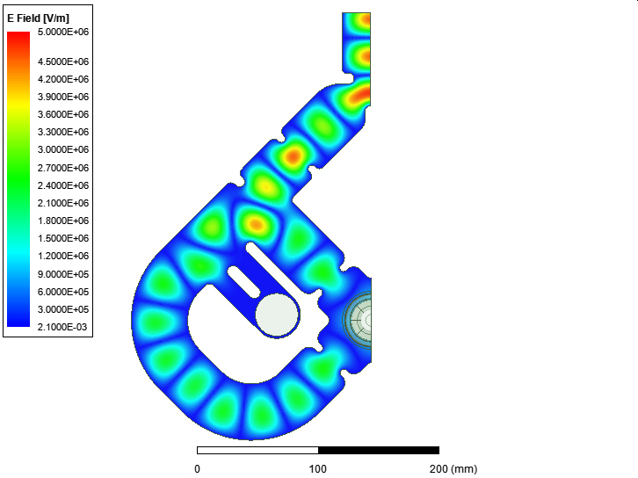
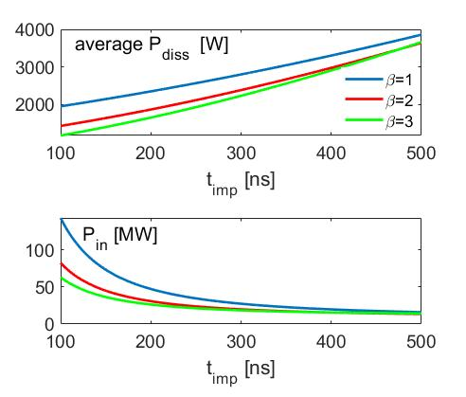
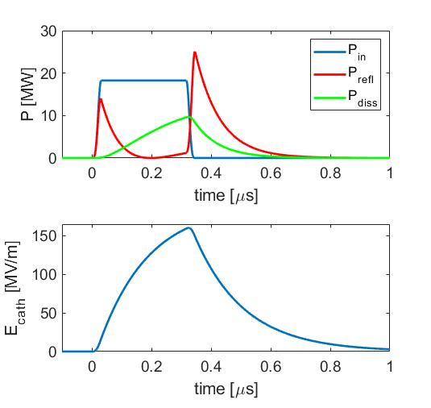
SW GUN: MAIN FEATURES
4 port mode launcher for quadrupole compensation and low pulsed heating
Coupling coefficient for short rf pulses
Dark current studies in progress;

Slide 9
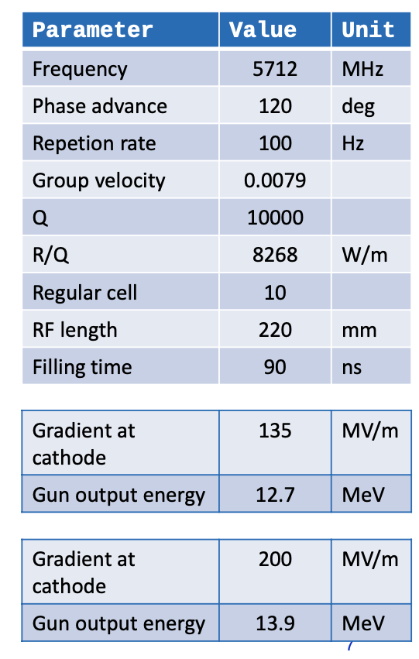
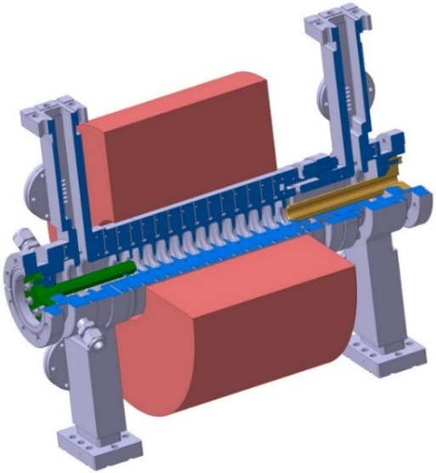
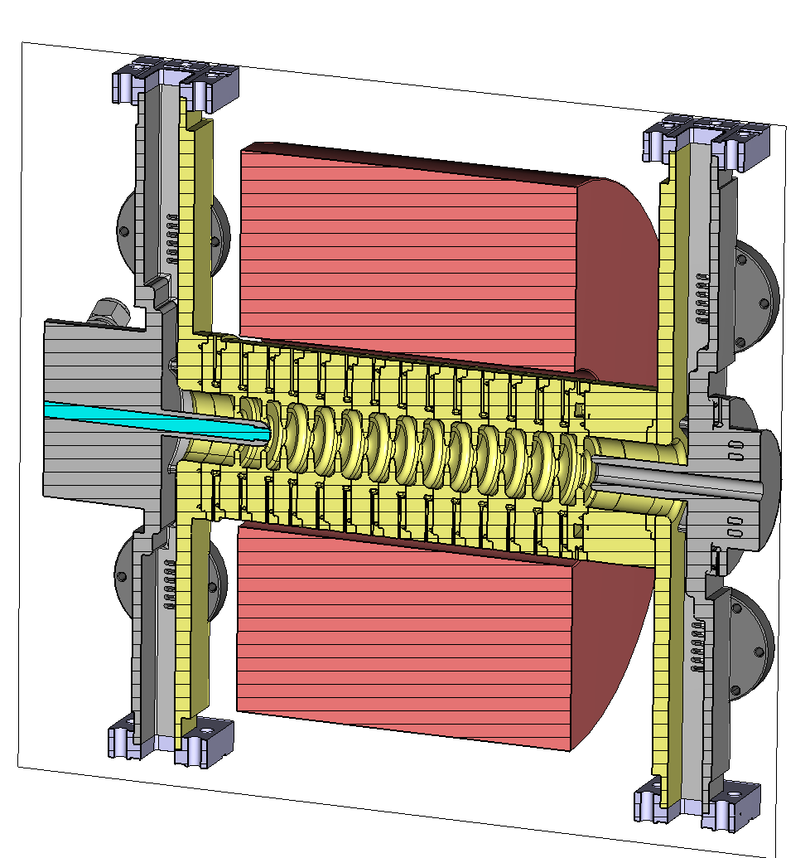
TW gun RF gun Design:
NEW DESIGN
Started with the design by M Schaer (PR-AB19, 072001 (2016)).
Tolerance Studies demonstrated tight tolerance requirements for the cathode.
Concerns over chokes for the possibility of multipacting.
A new design was conceived based on tolerance studies.
A rigid (brazed) inner conductor on the coaxial couplers and a cathode threaded through the inner conductor which is removable.
All chokes were removed to prevent multipacting.
Misalignment in brazing can be fixed with a phase shift and adjustment of the cathode in z.
Courtesy T. Lucas
David Alesini– Task 7.4: Very high gradient RF Guns – Open Steering Committee 15-16 Nov 2021

Slide 10
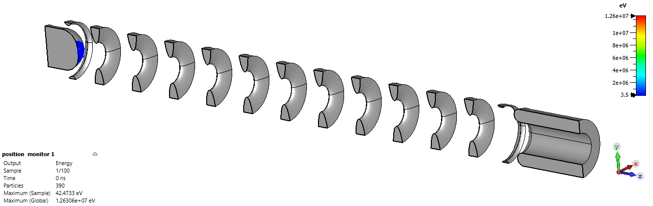
TW GUN: Dark Current Simulations
Simulations of dark current performed in CST.
Values of A_{e} and β taken from measurements of SwissFEL gun.
Dark current production less than 1 nC per RF pulse at 200 MV/m.
New design not expected to change this.
Courtesy T. Lucas
Field Enhance-ment Factor (β) | Effective area (A_{e}) [um^2] | Cathode Gradient [MV/m] | Charge arriving downstream (per 90ns RF pulse) [pC] | Capture Ratio | Total Field emitted charge (per 90ns RF pulse) [pC] | Peak Energy [MeV]
70 | 0.01 | 135 | 5.9 | 0.31 | 19.0 | 13.0
70 | 0.01 | 200 | 160.3 | 0.29 | 552.8 | 19.2
70 | 0.1 | 135 | 65.8 | 0.31 | 212.3 | 13.0
David Alesini– Task 7.4: Very high gradient RF Guns – Open Steering Committee 15-16 Nov 2021

Slide 11
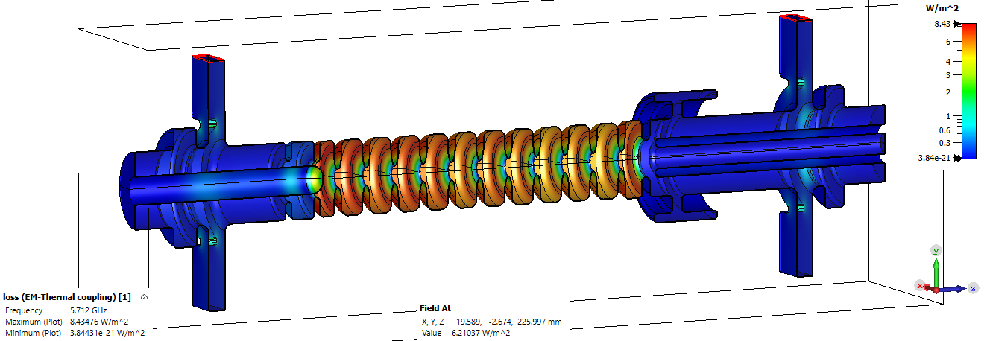
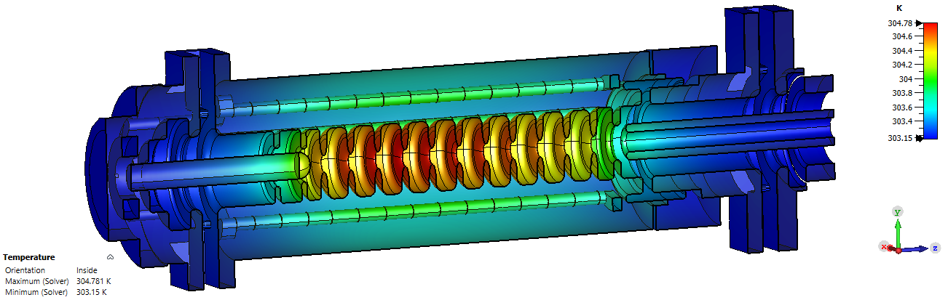
TW GUN: Thermal Simulations
Thermal Simulations performed in CST by coupling EM solver to Thermal Solver.
Heating from surface currents.
Convection coefficient for cooling water applied using empirical model.
No significant heating issues observed.
New design expected to perform better with a better thermal connection between end of cathode and cooling channels.
Courtesy T. Lucas
TW GUN: SHORT TERM TIMELINE
David Alesini– Task 7.4: Very high gradient RF Guns – Open Steering Committee 15-16 Nov 2021

Slide 12
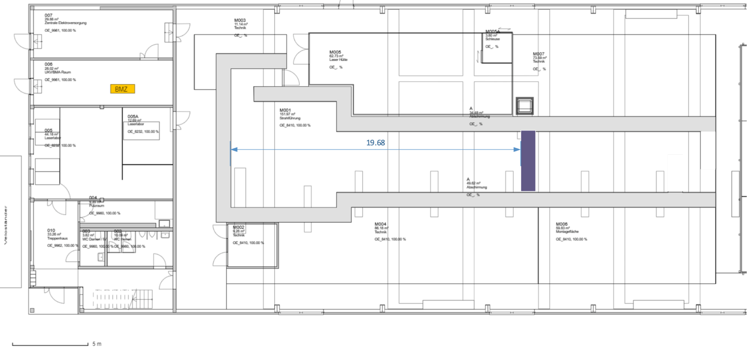
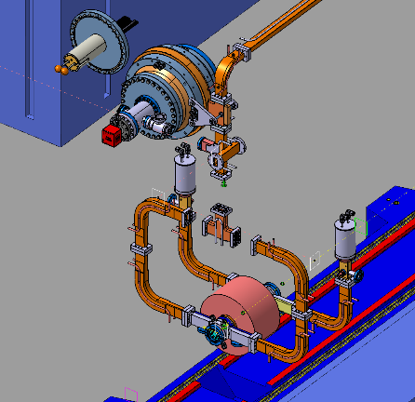
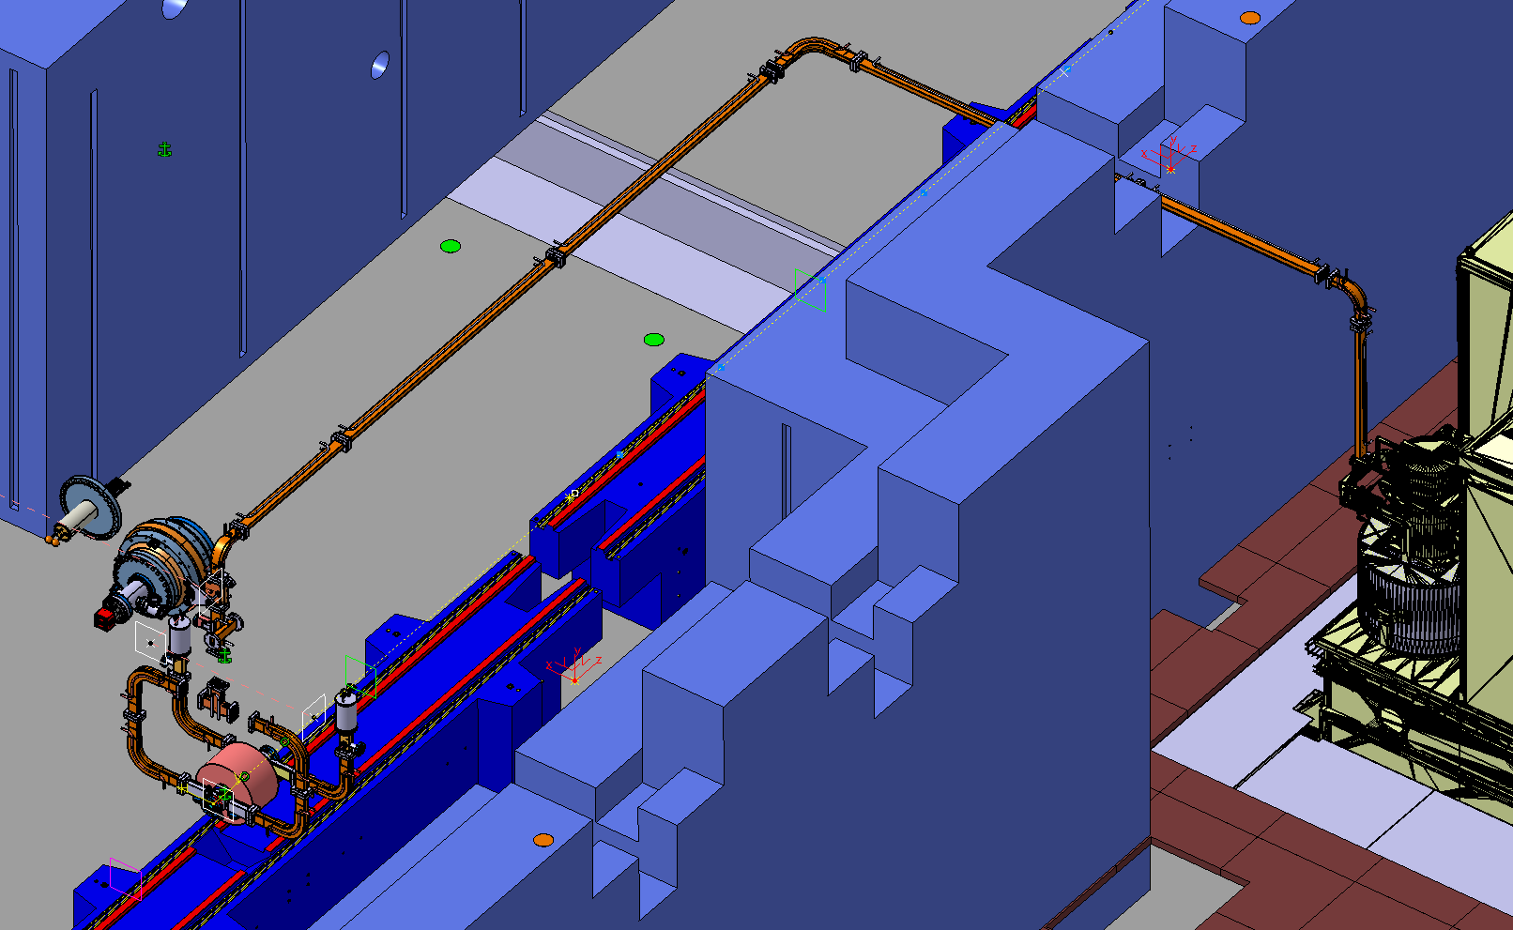
BUNKER@PSI: Status
Courtesy P. Craievich
HV klystron modulator is routinely running on C-band PSI loads (max power 50 MW)
Closure of the bunker: documents under preparation to get permission from BAG
Waveguide network: C-BOC and most of the RF components already at PSI
The bunker will be closed approximately at 19 m from the wall to ensure that he bunker meets safety standards with respect to emergency exits.
The bunker already has all water and electrical facilities installed
David Alesini– Task 7.4: Very high gradient RF Guns – Open Steering Committee 15-16 Nov 2021

Slide 13

CONCLUSION
TIMESCHEDULE for SW, TW and BUNKER preparation well defined
DESIGN activities on both SW and TW guns started according to the established GANTT
NEXT STEPS:
    SW GUN: Concluding the mechanical design, solenoid design and its order
    TW GUN: Concluding the e.m. design and proceed with the mechanical one
    BUNKER: waiting for the authorizations (BAG) and work in parallel on control access, waveguides, etc…
THANK YOU FOR YOUR ATTENTION
MAIN CONTRIBUTORS
INFN-LNF: F. Cardelli, G. Di Raddo, A. Vannozzi, A. Giribono, L. Faillace, A.Gallo, L. Pellegrino (support on project management tools)
INFN-ROMA1: L. Ficcadenti, G. Pedrocchi, G. Castorina
PSI: P. Craievich, T. Lucas, R. Fortunati, R. Zennaro, M. Pedrozzi, F. Marcellini, W. Tron
This project has received funding from the European Union’s Horizon 2020 Research and Innovation programme under GA No101004730.
David Alesini– Task 7.4: Very high gradient RF Guns – Open Steering Committee 15-16 Nov 2021

