Slide 1
IFAST WP7_Task 7.5: CompactLight Prototype Accelerating Structure
I.FAST Steering Committee, 15-16 November, 2021
Gerardo D’Auria, Elettra - Sincrotrone Trieste

Slide 2






Task 7.5: CompactLight Prototype Accelerating Structures
Objective:
Build and test, at low and high RF power, two prototypes of the X-band (12 GHz) accelerating structure designed for the CompactLight (XLS) project, a new class of linac-driven FEL facilities, based on a Horizon 2020 Design Study.
Task 7.5 Partners:
ELETTRA-ST, CERN, INFN, VDL-ETG, COMEB, TMD

Slide 3
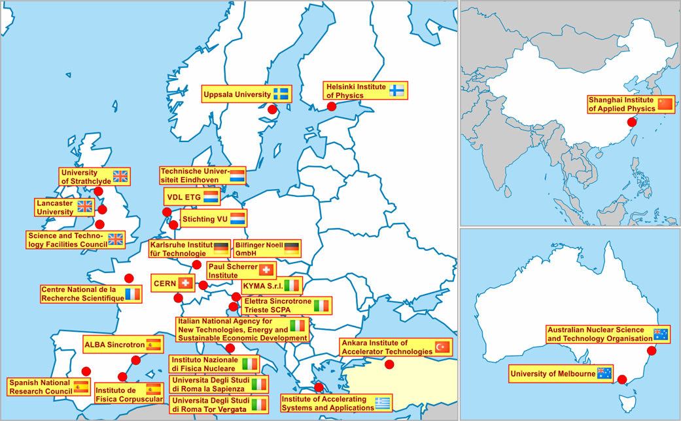
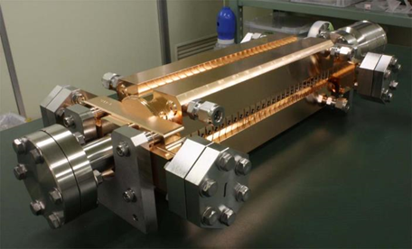
The CompactLight (XLS) design study
The CompactLight Project (XLS) is an EU funded design study aimed at promoting the construction of the next generation FEL based photon sources with innovative accelerator technologies.
The objective is the design of a 5.5 GeV X-band linac, based on the CLIC technology, to drive a FEL facility with soft and hard X-ray options.
http://www.CompactLight.eu
26 Partners:
23 International Laboratories and Universities
3 Private Industries.
CLIC accelerating structure

Slide 4
Activities and Deliverables
The two prototypes will be used to get a full validation of the XLS accelerating structure at two RF operating regimes:
a) high gradient/low pulse repetition rate (60 MV/m @100Hz);
b) low gradient/high pulse repetition rate (30 MV/m up to 1KHz).
Two deliverables:
D7.5: Construction of the XLS accelerating structure pre-prototype.
Development of production process and RF tests of the pre-prototype (@TRL 6/7)_M24
D7.6: Construction of the XLS accelerating structure full prototype.
Production process analysis and validation, RF tests of the full prototype (@TRL 7/8)_M36

Slide 5
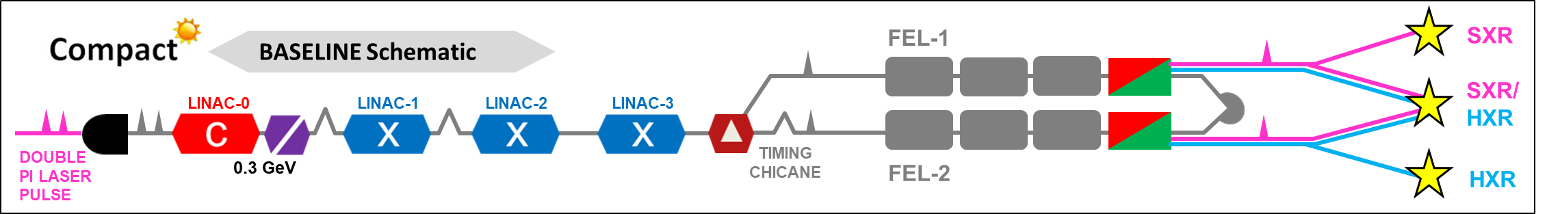
CompactLight Linac layout
X-band linac
10 MW, 1.5 μs, @1 KHz
50 MW, 1.5 μs, @100 Hz

Slide 6
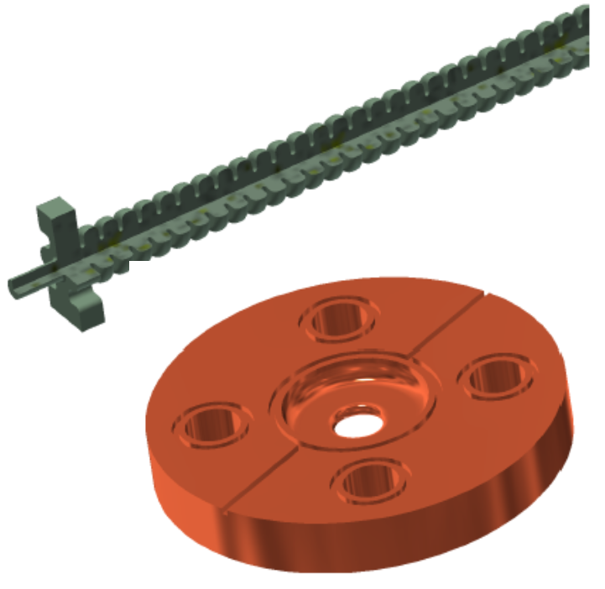
Accelerating structure RF operating parameters
Courtesy M. Diomede

Slide 7
Thermo-mechanical design
Optimization of the cooling geometry
Iteration with RF on the deformation
Choice for 4 cooling channels with a diameter of 6 mm (similar to CLIC)
Cooling channels slightly asymmetrical to match the RF couplers
Courtesy M. van den Berg

Slide 8
Time plan
 |  | 2021 |  |  |  |  |  |  |  | 2022 |  |  |  |  |  |  |  |  |  |  |  | 2023 |  |  |  |  |  |  |  |  |  |  |  | 2024
# | Activity | 1 | 2 | 3 | 4 | 5 | 6 | 7 | 8 | 9 | 10 | 11 | 12 | 13 | 14 | 15 | 16 | 17 | 18 | 19 | 20 | 21 | 22 | 23 | 24 | 25 | 26 | 27 | 28 | 29 | 30 | 31 | 32 | 33 | 34 | 35 | 36
 |  | M | J | J | A | S | O | N | D | J | F | M | A | M | J | J | A | S | O | N | D | J | F | M | A | M | J | J | A | S | O | N | D | J | F | M | A
1 | Technical drawings for prototype production
2 | Thermo-mechanical analysis and temperature stabilization at different operating regimes
3 | Structure thermal simulations (INFN)
4 | Brazing tests (three disks) at TMD
5 | Brazing procedure
6 | Production process analysis and optimization
7 | First prototype fabrication
8 | RF characterization
9 | High power RF tests and validation
10 | Post-mortem characterization
11 | Review of metrology data and test results
12 | Second prototype fabrication
13 | RF characterization
14 | High power RF tests and validation
15 | Post-mortem characterization
Preparatory
phase for
structure
fabrication

Slide 9
Unexpected problems
Unfortunately, in mid-August, we were informed that our colleague, Mathieu Breukers, one of the founding fathers of the ultra precision machining activities at VDL-ETG, responsible for the XLS structure manufacturing, passed away.
For this reason, all the activities to prepare the disks manufacturing, the structure brazing, etc. have been stopped to allow VDL to review their work plans and to determine the way forward without the expertise and experience of Mathieu.

Slide 10
Modified schedule
 |  | 2021 |  |  |  |  |  |  |  | 2022 |  |  |  |  |  |  |  |  |  |  |  | 2023 |  |  |  |  |  |  |  |  |  |  |  |  |  |  |  | 2024
# | Activity | 1 | 2 | 3 | 4 | 5 | 6 | 7 | 8 | 9 | 10 | 11 | 12 | 13 | 14 | 15 | 16 | 17 | 18 | 19 | 20 | 21 | 22 | 23 | 24 | 25 | 26 | 27 | 28 | 29 | 30 | 31 | 32 | 33 | 34 | 35 | 36 | 37 | 38 | 39 | 40 | 41 | 42 | 43 | 44
 |  | M | J | J | A | S | O | N | D | J | F | M | A | M | J | J | A | S | O | N | D | J | F | M | A | M | J | J | A | S | O | N | D | J | F | M | A | M | G | J | A | S | O | N | D
1 | Technical drawings for prototype production
2 | Thermo-mechanical analysis and temperature stabilization at different operating regimes
3 | Structure thermal simulations (INFN)
4 | Brazing tests (three disks) at TMD
5 | Brazing procedure
6 | Production process analysis and optimization
7 | First prototype fabrication
8 | RF characterization
9 | High power RF tests and validation
10 | Post-mortem characterization
11 | Review of metrology data and test results
12 | Second prototype fabrication
13 | RF characterization
14 | High power RF tests and validation
15 | Post-mortem characterization
Activities started
in May and
carried out
up to mid of July
Activities that need to be continued as soon as possible
Extension

Slide 11
Thank you!

