Slide 1
ILC-CLIC collaboration on detectors
Report of the working group on general issues of detector cooperation
Lucie Linssen
On behalf of the WG members

Slide 2
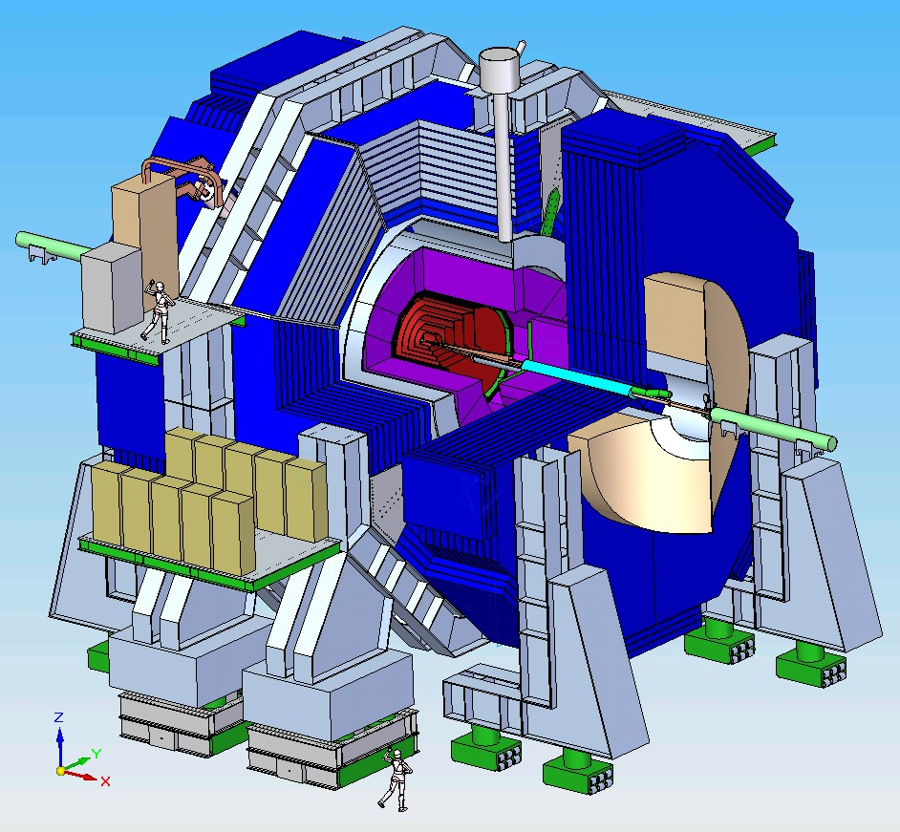
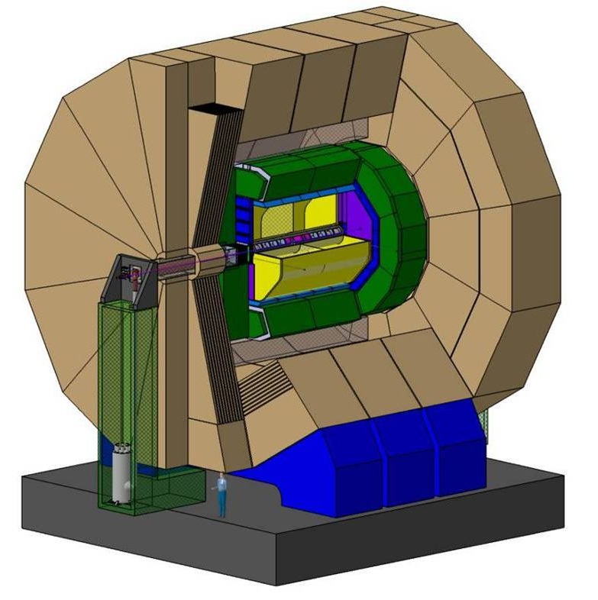
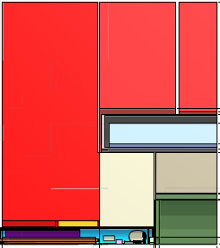
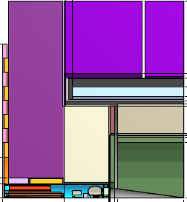
SiD LoI
ILD LoI
CLIC_SiD
CLIC_ILD

Slide 3
ILC-CLIC WG on general issues
Membership:
Marcel Demarteau, Lucie Linssen (co-chair), Francois Richard, Felix Sefkow, Marcel Stanitzki, Mark Thomson, Sakue Yamada (chair)
Three meetings were held so far: 30/3/2010, 14/6/2010, 13/8/2010
General observation:
Good “formal and informal” contacts in general between the ILC validated concepts (ILD and SiD), the LC technology collaborations (in particular CALICE, LC-TPC, FCAL, EUDET/AIDA) and “CLIC detector study”
Actual participation of ILC members to the CLIC study is mostly taking place on an individual basis
Top-down support for ILC-CLIC collaboration is important (e.g. through meetings like today)

Slide 4
Format and targets of the WG group
Bi-monthly phone meetings
Maintain a “light form” of overview of ongoing collaboration (excel list)
Initiate further collaboration in the form of targeted actions:
  E.g. targeted expert workshops to initiate collaboration on specialized subjects and create synergy
  Facilitate collaboration, e.g. through coordinated test beam requests and sharing of test beam infrastructures

Slide 5
Collaboration overview
Extracted from the excel list:
Ongoing collaboration in the following areas:
Core software development
  Frameworks, geometry description, tracking, PFA, event overlays, GRID tools
Beam-induced background studies
Detector performance studies and detector optimisation for high energies (3 TeV, 1 TeV)
Event generation and physics benchmarking
Engineering studies and cost assessment
Solenoid studies and conductor R&D
Electronics developments
HCAL beam tests

Slide 6
Targeted actions for collaboration
The following list of opportunities for collaboration was established by the WG
Software workshops
  Two ILD/SiD/CLIC workshops held so far => led to common actions in software development
Common data group and event generation
  Active collaboration since summer 2010
Power delivery and power pulsing
  Some synergy with LHC powering R&D
  Will probably have a dedicated LC power workshop soon
Experimental area issues, including push-pull
  Ongoing collaboration on informal basis

Slide 7
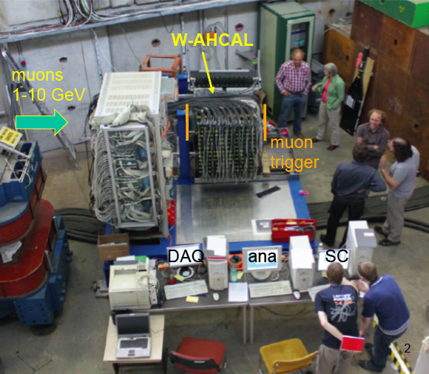
Thank you

