Slide 1

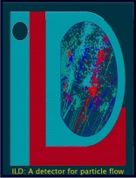



ILD and SiD
Detector Concepts for CLIC
International Workshop on Linear Colliders, Geneva
October 21, 2010
Christian Grefe
CERN, Bonn University
Notes:
1

Slide 2
Outline
Required changes
  Vertex detectors and forward region
  Calorimeters
  MDI
Status of detector models
  CLIC_ILD
  CLIC_SiD
Detector models presented are not yet fully finalized for the CDR

Slide 3
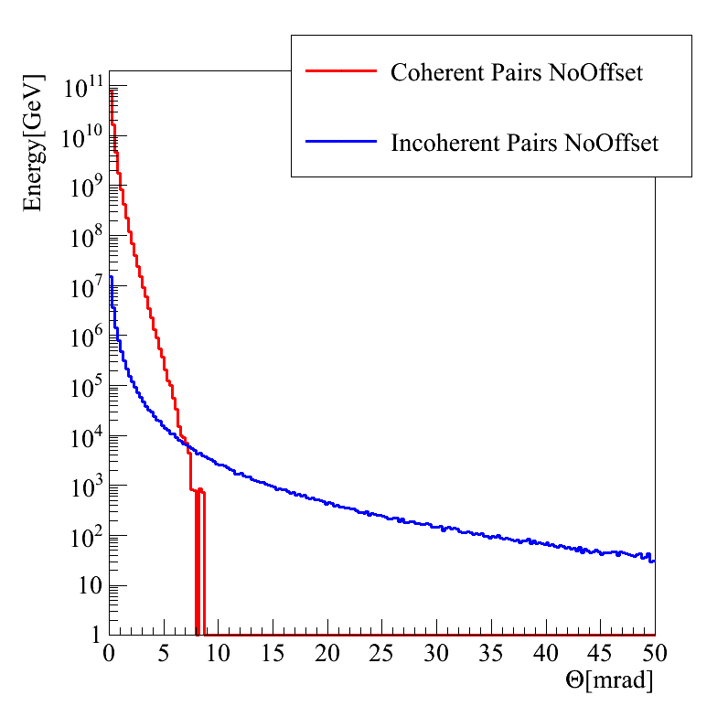
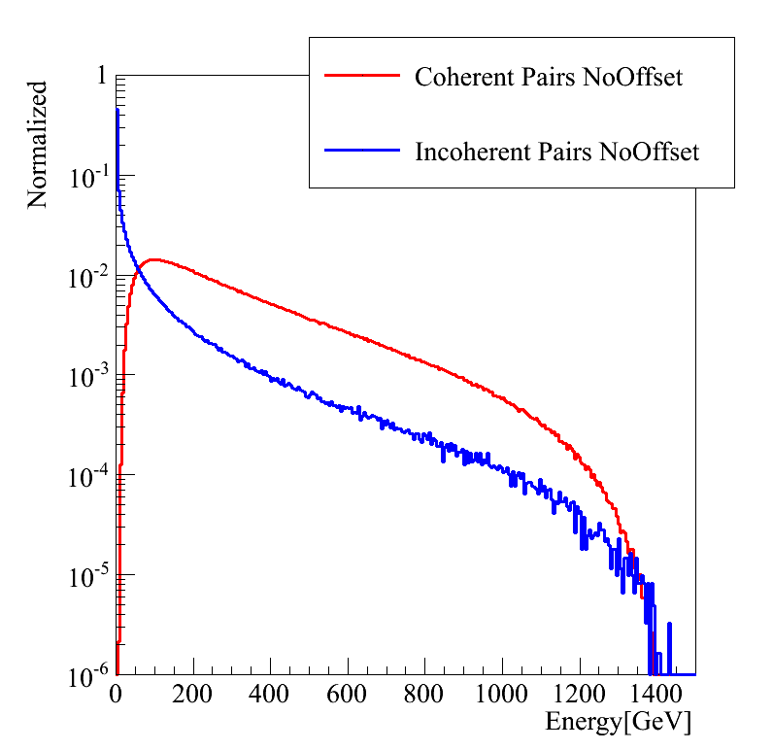
Vertex Detector & Forward Region
Crossing angle: 20mrad (14 mrad @ ILC)
Beam-beam interactions produce photons and e⁺e⁻ pairs
  coherent pairs with high energies and low angles, can be confined by magnetic field and leave the through the beam pipe
  incoherent pairs with high angles and low energies per particle (~300k per BX)
Move beam pipe and first vertex layer to ~30 mm to reduce direct hits from pair background
Increase outgoing beam pipe radius to 10 mrad (r_{min} BeamCal)
Allow space for intra-train-feedback-system and kickers between BeamCal and QD0
André Sailer

Slide 4
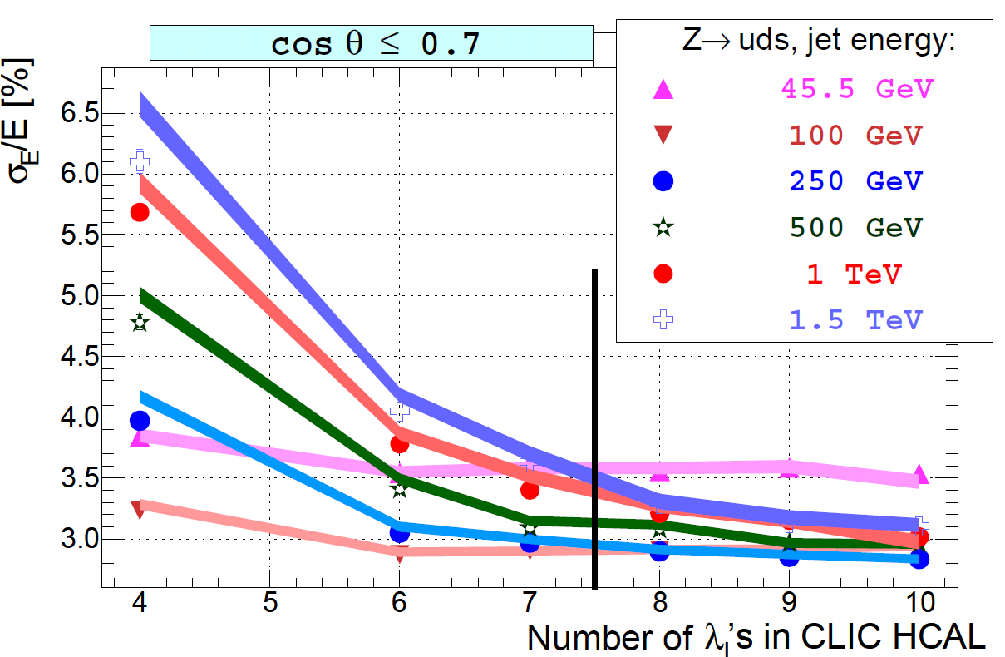
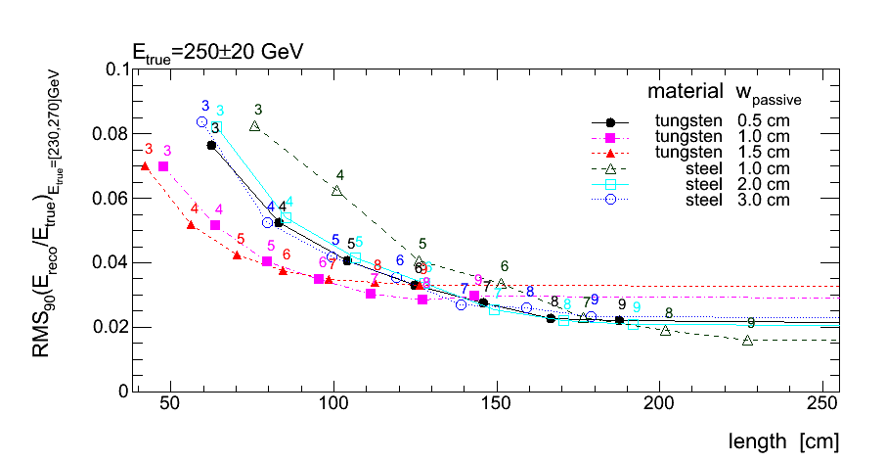
Calorimeters
Need good jet energy resolution up to TeV jets
  increase HCal depth to contain energetic showers
  keep coil size reasonable (cost & feasibility)
tungsten HCal
Optimization of sampling fractions in steel or tungsten HCal
(see talk by Peter Speckmayer)
HCal depth studies with Pandora PFA
(see talk by Angela Lucaci-Timoce)
~7.5 λ_{i} in HCal, barrel: 75*1cm W, endcap: 60*2cm steel

Slide 5
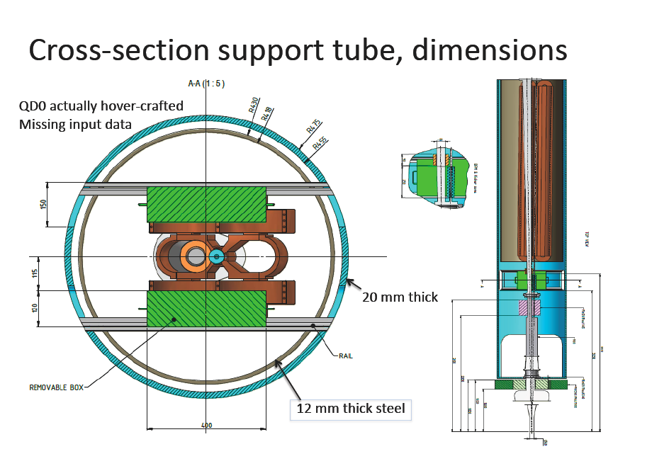
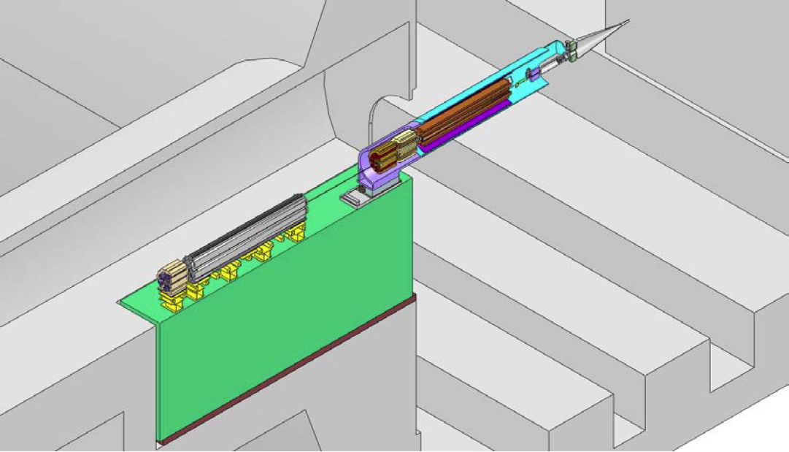
MDI
QD0 has to be stabilized with nm precision at CLIC
Has to be as close as possible to IP to gain maximum luminosity
Support QD0 from tunnel with a stable support tube
Hubert Gerwig
  Significant cut into acceptance of HCal and Muon system:
    r_{min} HCal: ~50cm (support tube)
    r_{min} Muon System: ~70cm (support tube + anti solenoid)

Slide 6
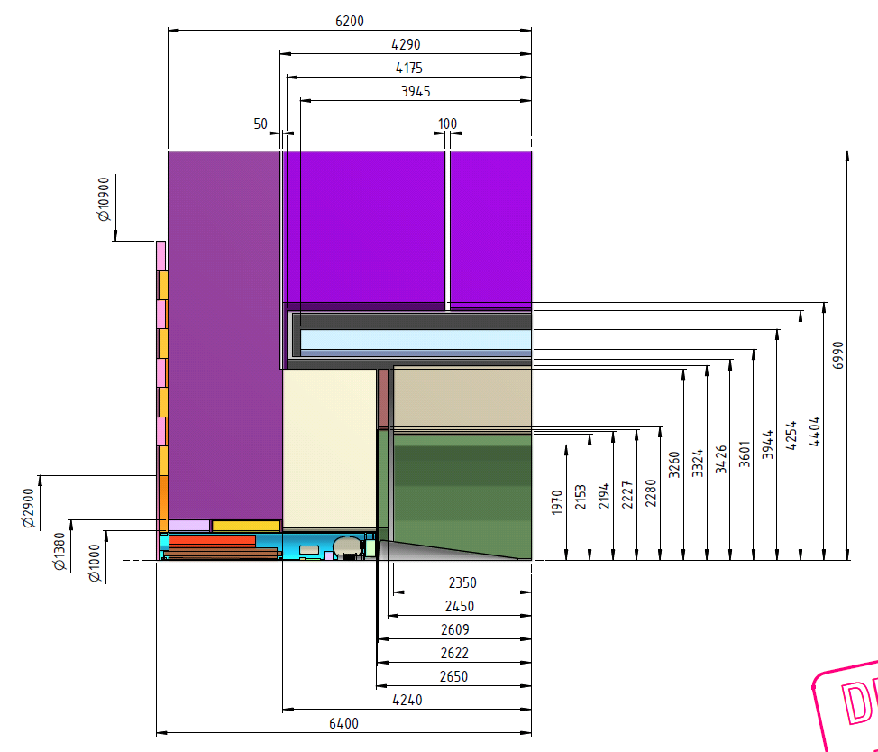
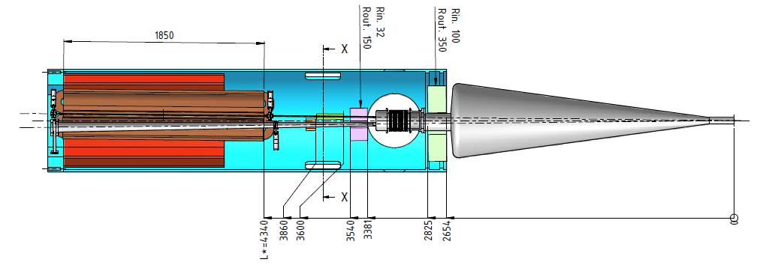
CLIC_ILD Numbers
Nicolas Siegrist

Slide 7
CLIC_ILD in Mokka
available with next Mokka release as CLIC_ILD_CDR
André Sailer

Slide 8
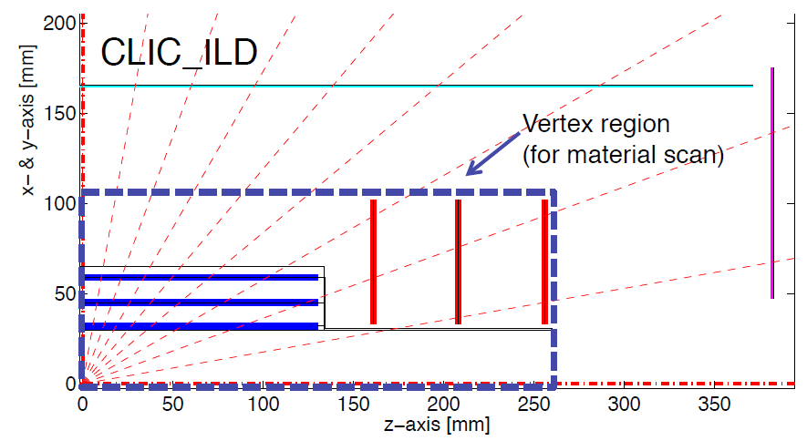
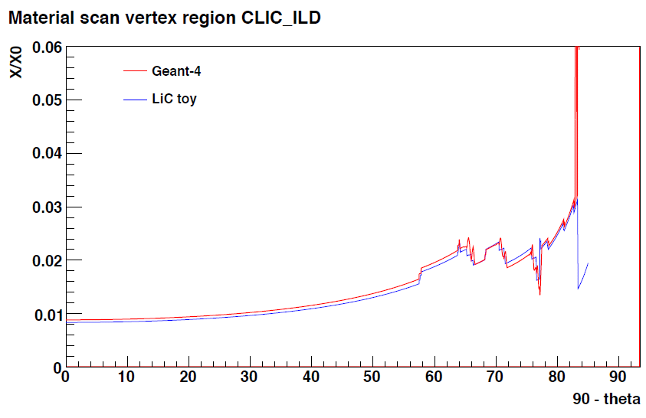
CLIC_ILD Vertex Detector
0.6 mm Be beam pipe with r_{max} = 30 mm
3 double pixel layers in barrel z_{max} = 100 mm
3 double pixel disks in endcap
20*20 µm² pixels with analog readout (σ = 2.8µm )
2*50 µm Si + 134µm Carbon support per double layer (0.18% X₀)
Talk on optimization study for CLIC vertex and forward tracking region by Dominik Dannheim

Slide 9
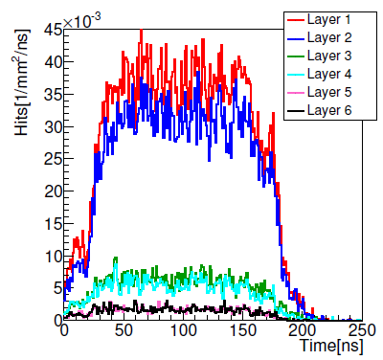
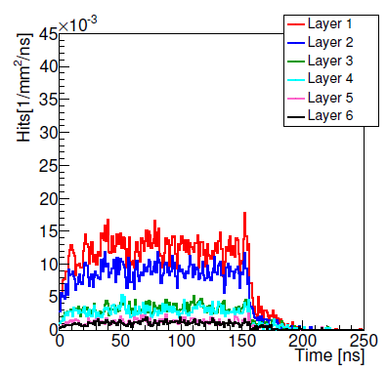
CLIC_ILD Forward Region
Moved LumiCal behind ECal and increased radius to avoid gap, increased to 40 layers
Removed LHCal
Moved BeamCal as close as possible to the IP to allow for kickers and intra-train-feedback-system, increased to 40 layers
Pair background levels in Vertex Barrel
Anti Solenoid
ECal
HCal
BeamCal
QD0
LumiCal
introduce more material into conical beam pipe
Preliminary!
see talk on beam-beam-background @ CLIC by André Sailer

Slide 10
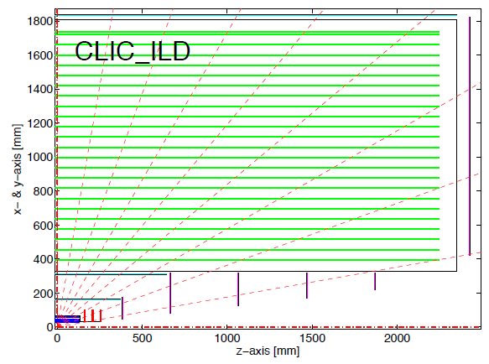
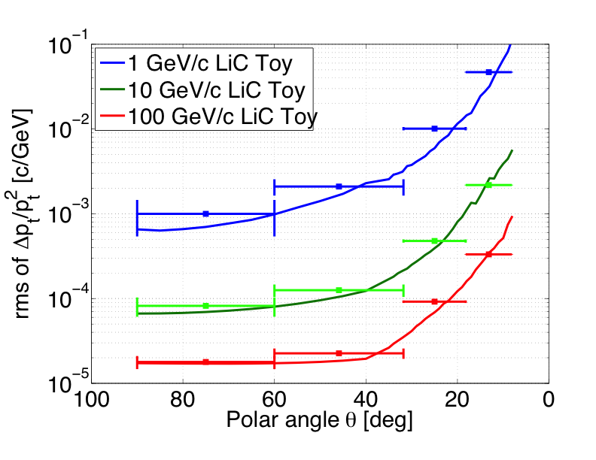
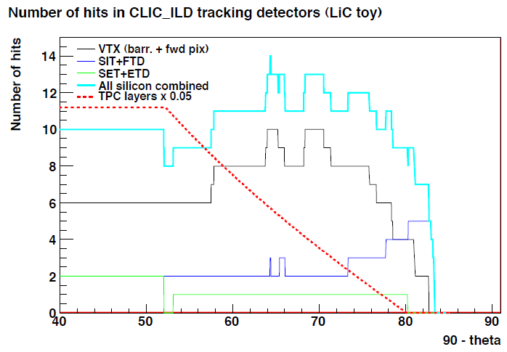
CLIC_ILD Tracker
4T solenoid field
TPC as main tracking device
  changed cathode: removed air gap and use 100 µm Mylar + 10 µm copper on each side
Si strip layers inside and outside of the TPC (2 layers SIT & SET, σ_{r-φ} = 7µm, σ_{z} = 50µm )
Si strip layers behind TPC endcap (ETD, σ_{x,y,z} = 7µm )
5 forward tracking disks (FTD, Si stereo strips, σ_{r-φ} = 7µm, σ_{r} = 50µm )
Points with error bars: Mokka
Dominik Dannheim

Slide 11
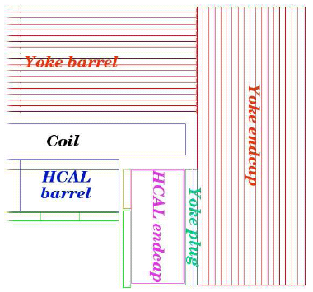
CLIC_ILD Calorimeters
ECal (8 sides)
  Absorbers:
    20*2.1 mm tungsten absorber layers
    10*4.2 mm tungsten absorber layers
  Active:
    3.15 mm gap size (0.3 mm Si + Air, Copper Capton), 5*5 mm² readout
HCal (8 sides inside, 16 sides outside)
  Barrel: 75*10mm tungsten
  Endcap: 60*20mm steel
  Active: 6.5 mm gap size (5 mm polystyrene + 1.5 mm air), 3*3 cm² cell size
Analog readout for the HCal was chosen as a baseline for mass production
Alternative technologies will be investigated in dedicated studies and presented in the CDR

Slide 12
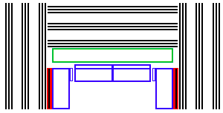
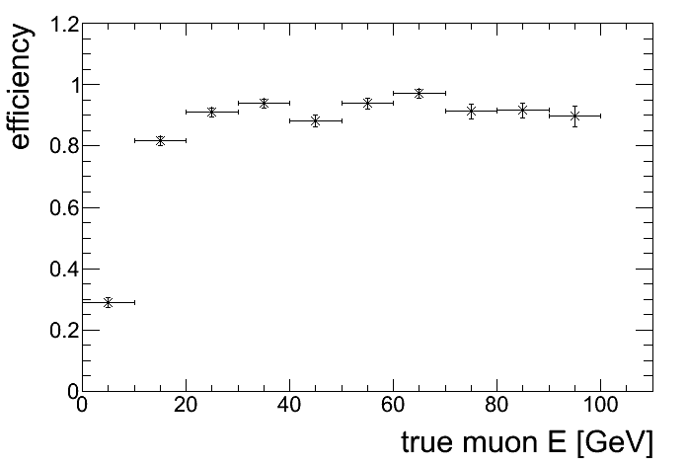
CLIC_ILD Muon System & Yoke
Yoke (8 sides)
  Absorber: 15*10 cm steel
  Active: 4cm gap size (RPC 3*3 cm²)
  Barrel: 20 cm steel layer after first active layer to take stresses
Yoke Plug (12 sides)
  Introduced in order to align start of yoke in the endcap with end of the conductor
  Instrumented with first muon chamber: 15 cm steel + 4 cm RPC + 9 cm steel
Choose active layers during digitization
  First 3 layers are used as a tail catcher
  Simulations indicate that two additional sets of 3 layers provide good Muon ID
solenoid
hcal
|θ| > 0.081
Muons inside b-jets (Z‘ -> bb @ 1.5 TeV)
talk on Muon ID using PandoraPFA by Erik van der Kraaij

Slide 13
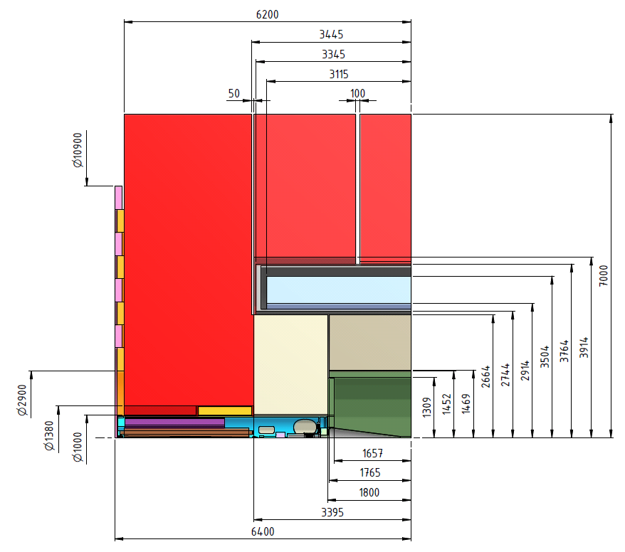
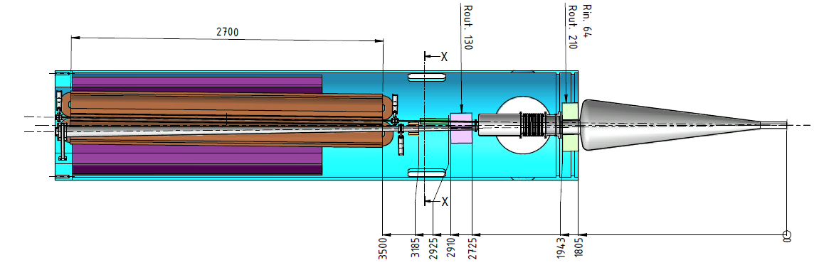
CLIC_SiD Numbers
Nicolas Siegrist

Slide 14
CLIC_SiD in SLIC
Based on sidloi3
Latest version: http://www.cern.ch/lcd-data/software/detectors/clic_sid_cdr_a.zip

Slide 15
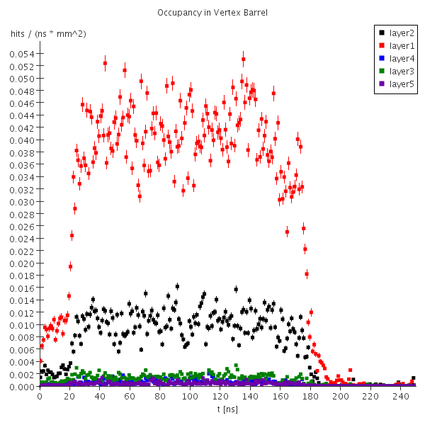
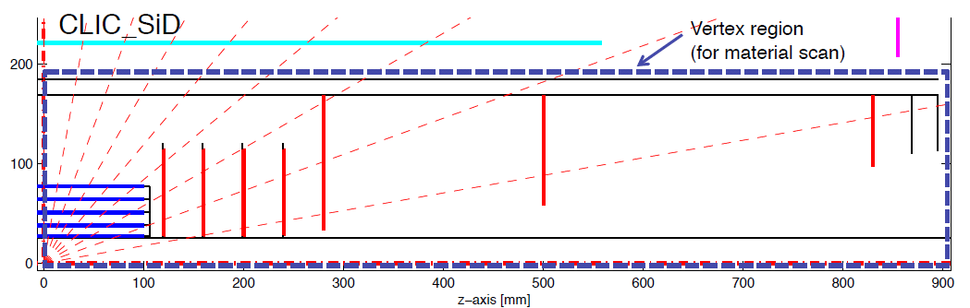
CLIC_SiD Vertex Detector
0.5 mm Be beam pipe with r_{max} = 25 mm
removed titanium coating inside beam pipe
5 pixel layers in barrel (z_{max} = 100 mm)
7 pixel disks in endcap and forward
20*20 µm² pixels with digital readout
50 µm Si + 130µm Carbon support per double layer (0.12% X₀)
first pair background simulations in agreement with results from detailed studies in CLIC_ILD
Dominik Dannheim

Slide 16
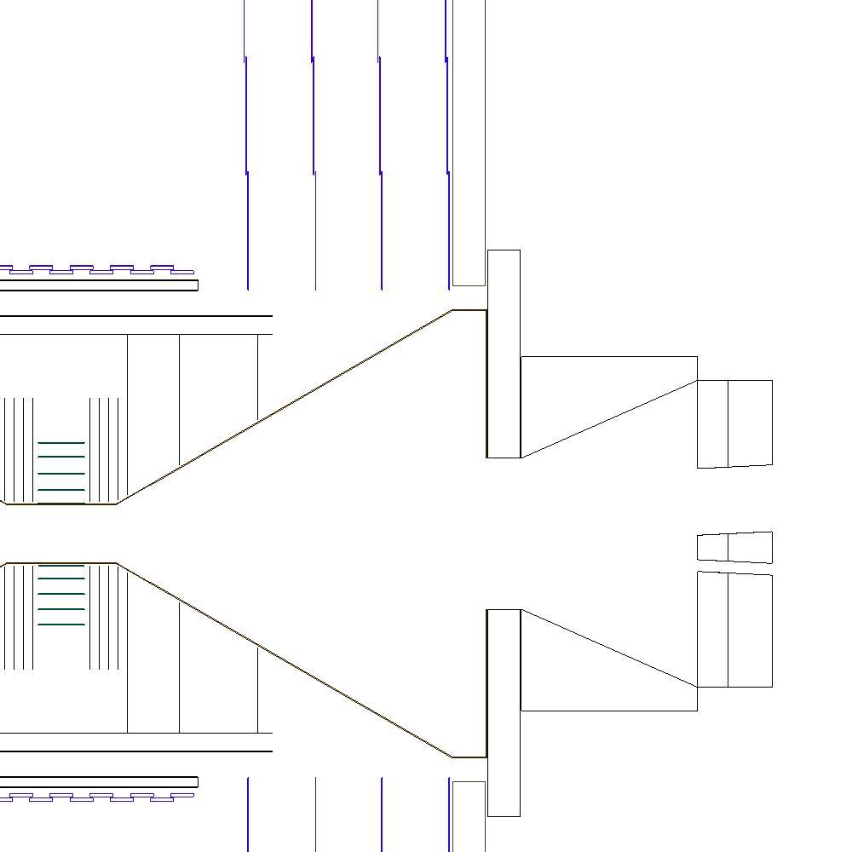
CLIC_SiD Forward Region
“almost” pointing beam pipe to avoid passing material in a shallow angle
LumiCal:
  implemented like ECal
  20*2.7 mm + 10*5.4 mm layers tungsten
  1 mm gap size (0.3 mm Si + Air, Copper Capton), 3.5*3.5 mm² readout
  moved LumiCal behind ECal to avoid gap
BeamCal:
  50*2.7 mm tungsten + 1mm gap size
  increase outgoing beam pipe opening to 10 mrad
  ~50 cm space for kicker and intra-train-feedback between BeamCal and QD0 (L*=3.5 m)
ECal
Tungsten Cone
Mask
LumiCal
BeamCal

Slide 17
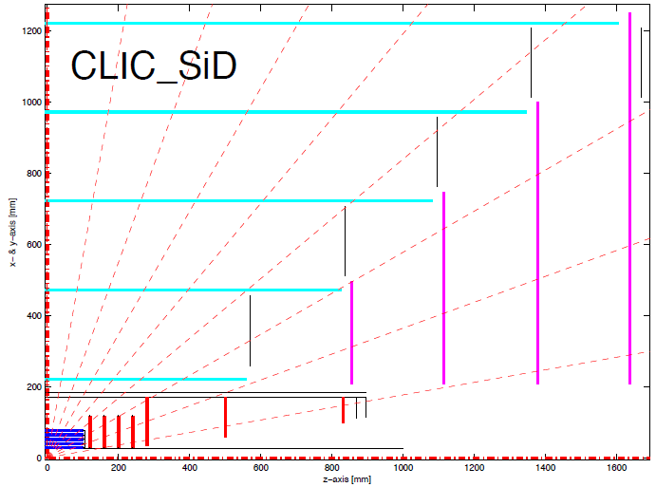
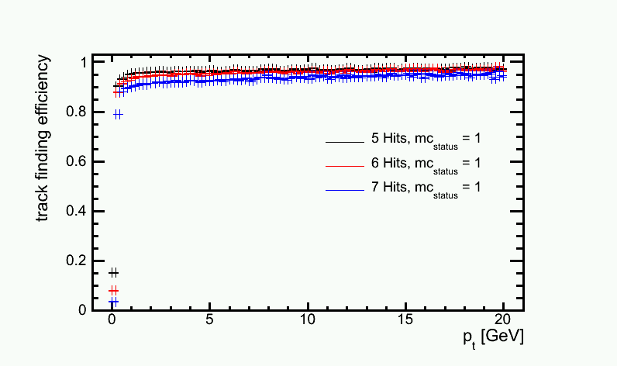
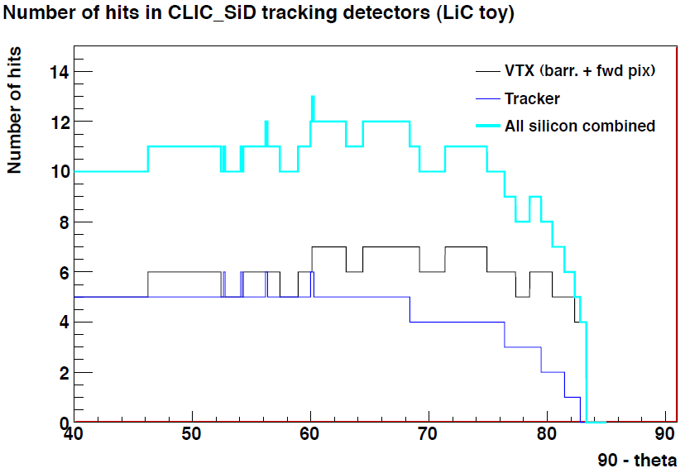
CLIC_SiD Tracker
5T solenoid field
5 barrel strip layers (10cm * 25µm with 50µm digital readout)
4 endcap stereo strip layers (10cm * 25µm with 50µm digital readout)
Z ->qq (uds) @ 3TeV, θ > 8°
talk on SiD tracking performance @ CLIC by Blai Pié i Valls

Slide 18
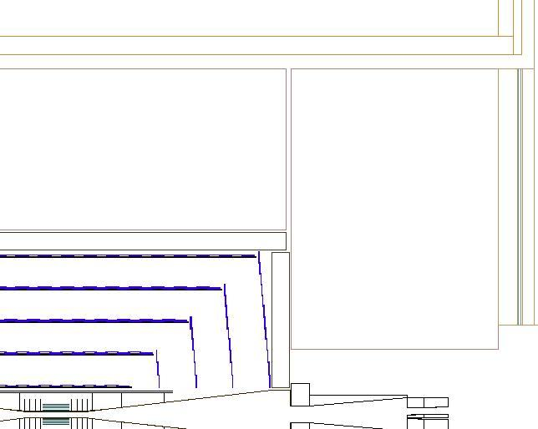
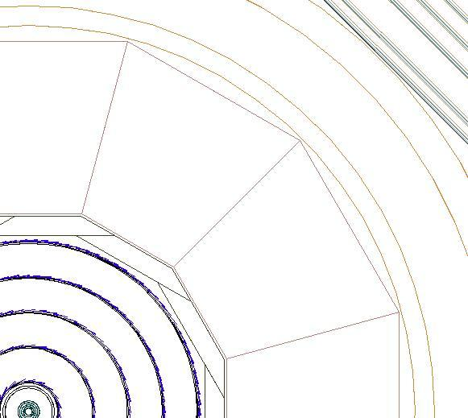
CLIC_SiD Calorimeters
ECal (12 sides)
  Absorbers:
    20*2.5 mm tungsten absorber layers
    10*5.0 mm tungsten absorber layers
  Active:
    1.25 mm gap size (0.3 mm Si + Air, Copper Capton), 3.5*3.5 mm² readout
HCal (12 sides)
  Barrel: 75*10mm tungsten
  Endcap: 60*20mm steel
  Active: 6.5 mm gap size (5 mm polystyrene + 1.5 mm air), 3*3 cm² cell size
HCal
ECal
LumiCal
BeamCal
HCal
Coil
Analog readout for the HCal was chosen as a baseline for mass production
Alternative technologies will be investigated in dedicated studies and presented in the CDR
ECal

Slide 19
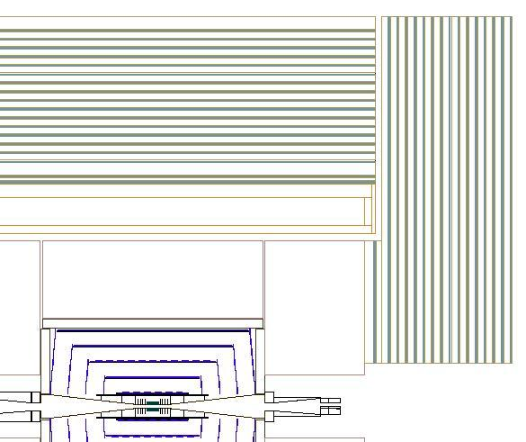
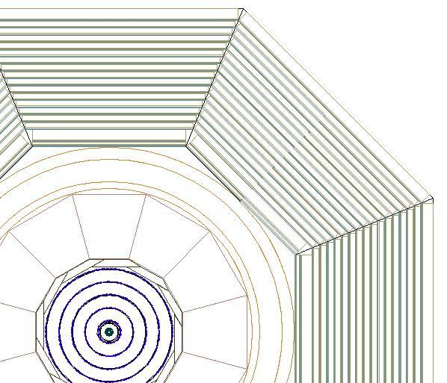
CLIC_SiD Muon System & Yoke
Yoke (8 sides)
  Absorber: 15*10 cm steel
  Active: 4cm gap size (RPC 3*3 cm²)
  Barrel: 20 cm steel layer after first active layer to take stresses
Yoke Plug (12 sides)
  Introduced in order to align start of yoke in the endcap with end of the conductor
  instrumented with first muon chamber: 15 cm steel + 4 cm RPC + 9 cm steel
Number of actually used layers defined during digitization
  3 sets of 3 active layers (see above)
Yoke
Coil
HCal
Yoke Plug
Yoke
HCal
Coil

Slide 20
Conclusions
The two detector models CLIC_ILD and CLIC_SiD for the CDR simulations are almost finalized but might still change a bit
Thorough testing of all subdetectors is ongoing
Reference for detector parameters: https://twiki.cern.ch/twiki/bin/view/CLIC/ClicCDRNumbers
Detector models for full simulation (currently latest version)
  CLIC_ILD_CDR available in next Mokka release (or trunk)
  CLIC_SiD: http://www.cern.ch/lcd-data/software/detectors/clic_sid_cdr_a.zip

