Slide 1

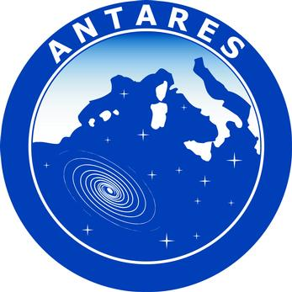
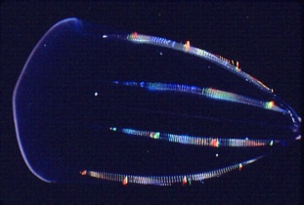
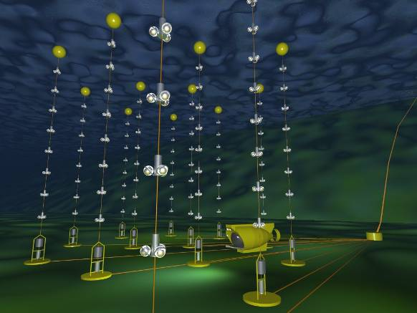
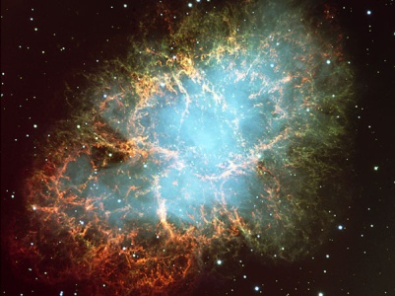
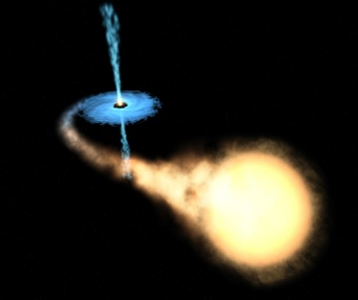

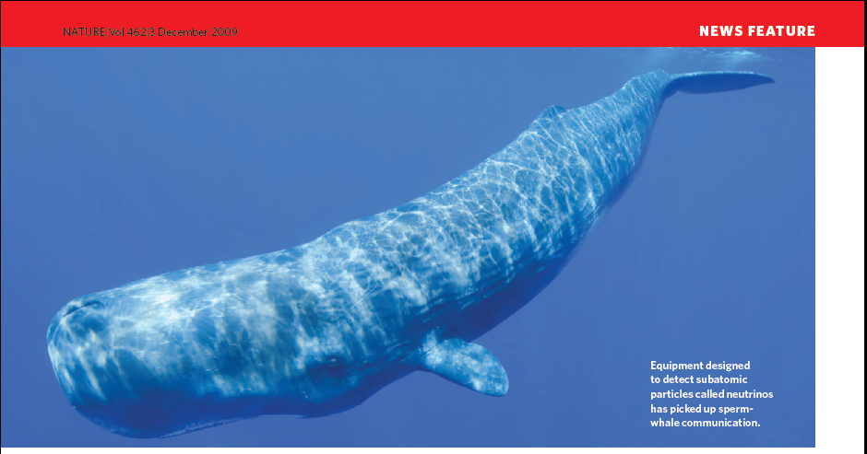
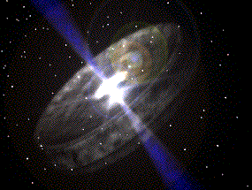
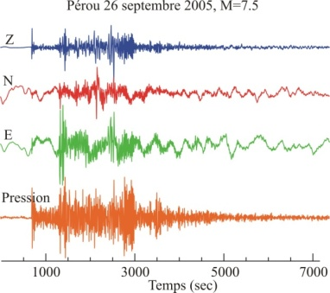
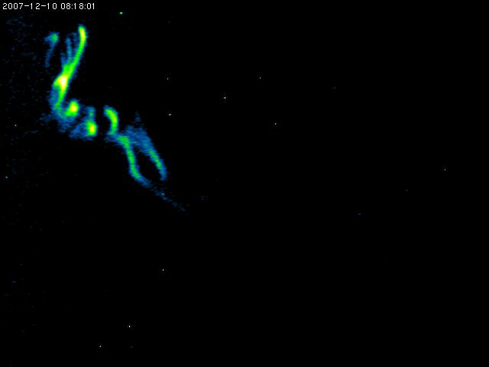
Sea and Earth Science
With the ANTARES
Deep Sea Observatory
Geosphere to the Cosmos
1st Dec 2010
?
Paschal Coyle
Centre de Physique des Particules de Marseille-CNRS

Slide 2


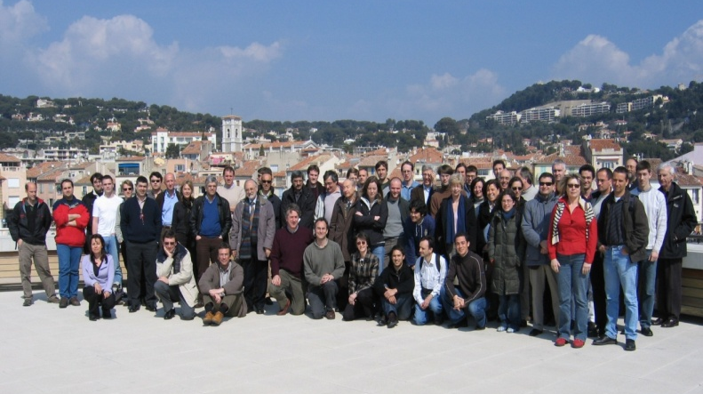
The ANTARES Collaboration
NIKHEF,
Amsterdam
Utrecht
KVI Groningen
NIOZ Texel
University of Erlangen
Bamberg Observatory
ITEP,Moscow
Moscow State Univ
ISS, Bucarest
IFIC, Valencia
UPV, Valencia
UPC, Barcelona
7 countries
29 institutes
~150 scientists+engineers
CPPM, Marseille
DSM/IRFU/CEA, Saclay
APC, Paris
LPC, Clermont-Ferrand
IPHC (IReS), Strasbourg
Univ. de H.-A., Mulhouse
IFREMER, Toulon/Brest
C.O.M. Marseille
LAM, Marseille
GeoAzur Villefranche
University/INFN of Bari
University/INFN of Bologna
University/INFN of Catania
LNS – Catania
University/INFN of Pisa
University/INFN of Rome
University/INFN of Genova
2
Notes:
M. Spurio- ANTARES
2

Slide 3
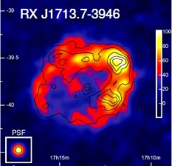
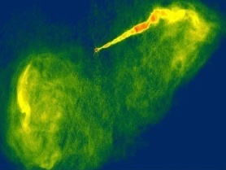
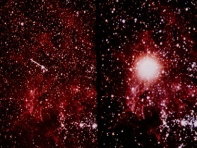
Science with Deep Sea Neutrinos Telescopes
High energy neutrino astrophysics:
galactic: SN, SNRs, μ-quasars, molecular clouds, etc...
extra-gal: AGNs, GRBs, dark-GRBs, GZK, etc....
Search for New Physics:
Dark matter (Sun, GC), Monopoles, ??
Earth-Sea Science:
oceanography, sea biology, seismology, environmental monitoring...
SN oscillations dark matter SNR AGN/GRB
~MeV | GeV-100 GeV | GeV-TeV | TeV-PeV | PeV-EeV | > EeV

Slide 4
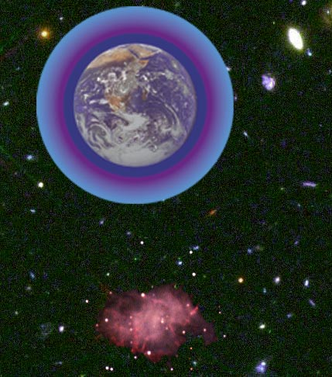
Detection Principle
3D PMT
array
p, α
ν_{μ}
μ
p
Cherenkov light
from μ
ν_{μ}
ν_{μ}
42°
Sea floor
μ
The reconstruction is based on local coincidences compatible with the Cherenkov light front
ν_{μ}
interaction
- Main detection channel: ν_{μ} interaction giving an ultra-relativistic μ (νe and νtau also)
Energy threshold ~ 10 GeV - 24hr operation, more than half sky coverage

Slide 5
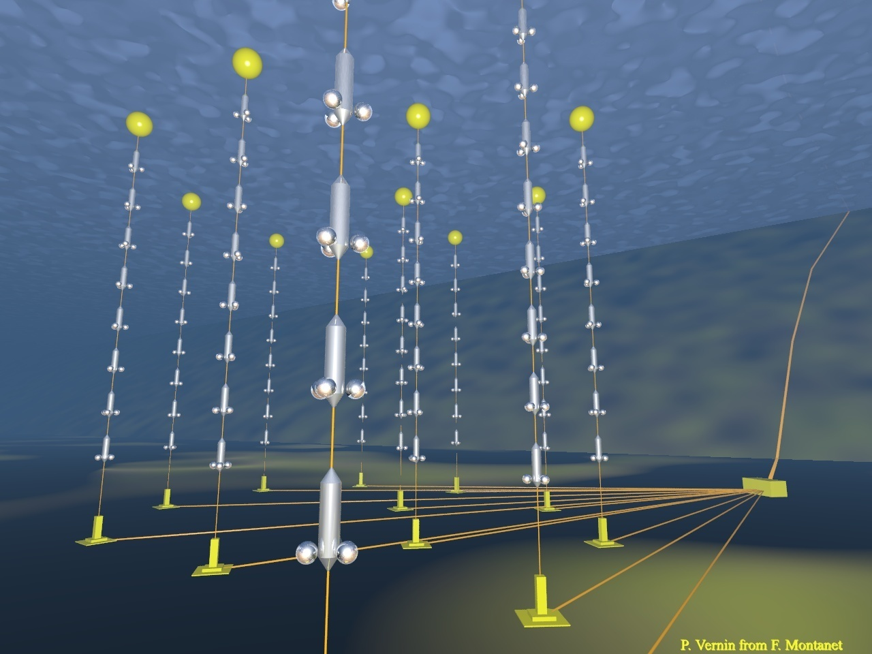
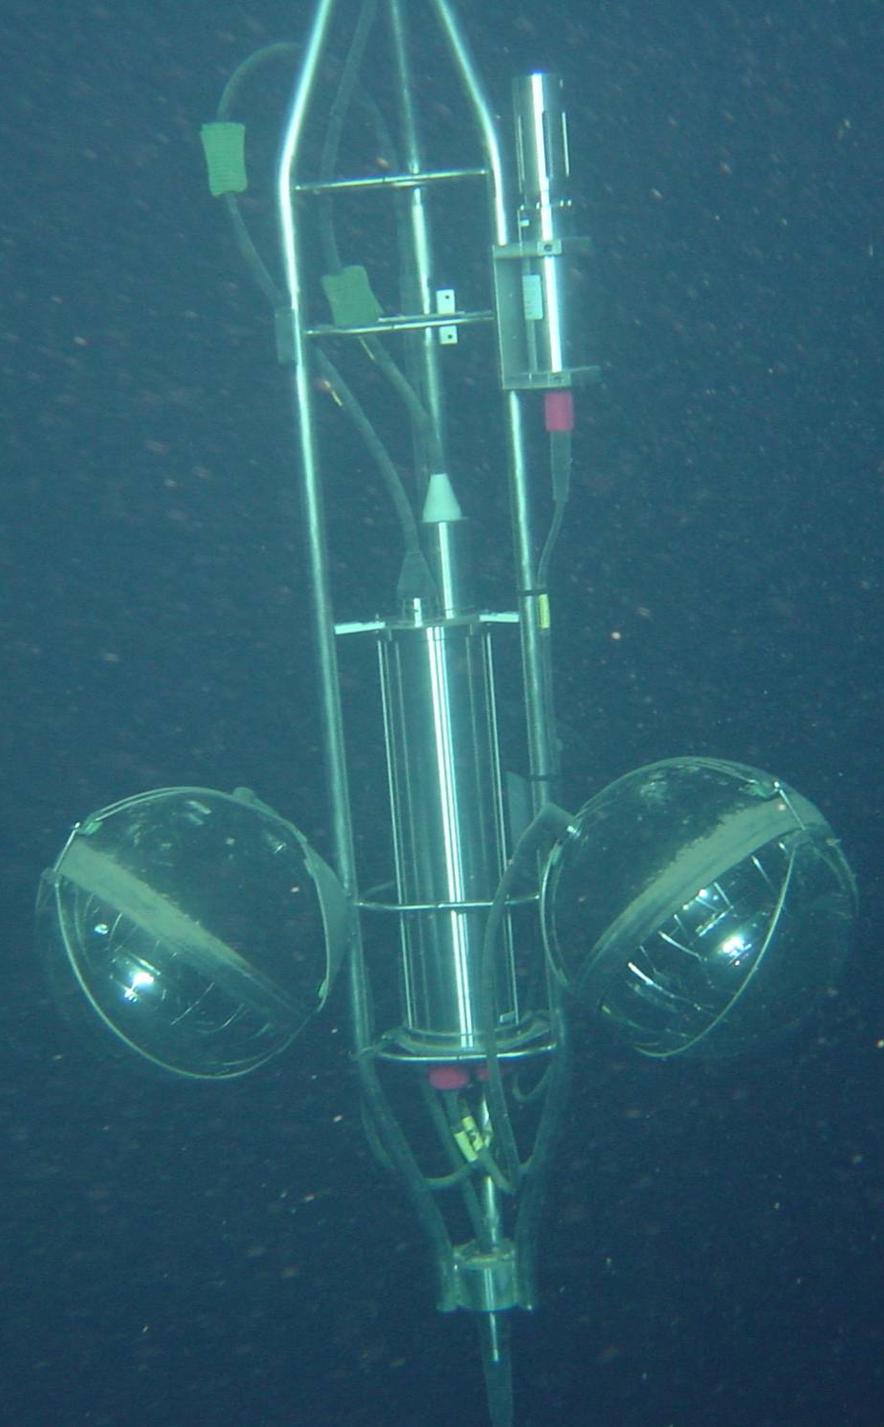
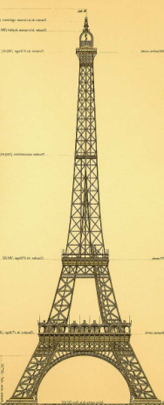
The ANTARES Detector
900 PMTs
12 lines
25 storeys / line
3 PMTs / storey
2500m
40 km to
shore
450 m
Junction
Box
70 m
Interlink cables

Slide 6
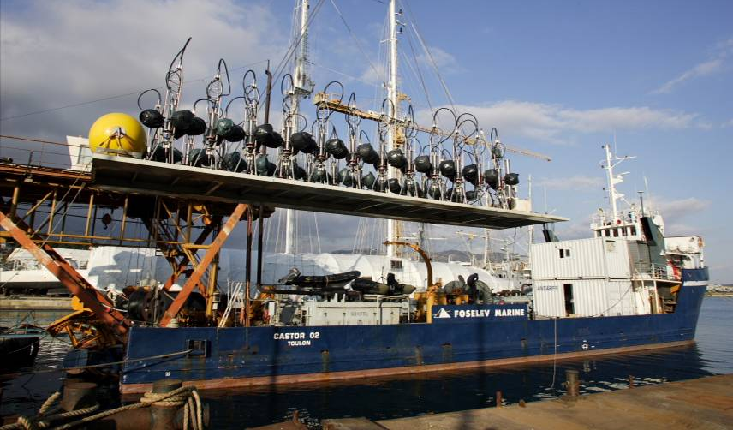
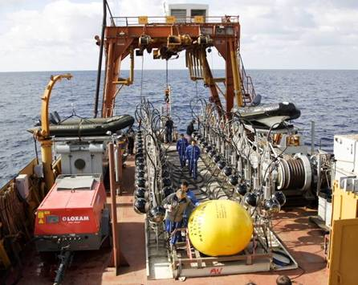
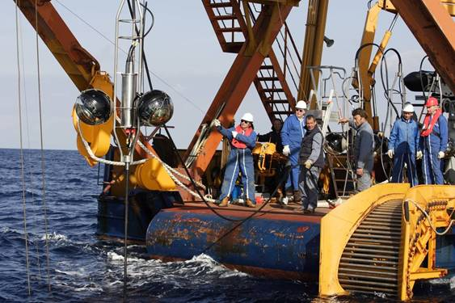
Deployment of Lines
Loading line on boat
Ready for deployment
Installed within a few meters of the desired position
deployment
6
Notes:
M. Spurio- ANTARES
6

Slide 7
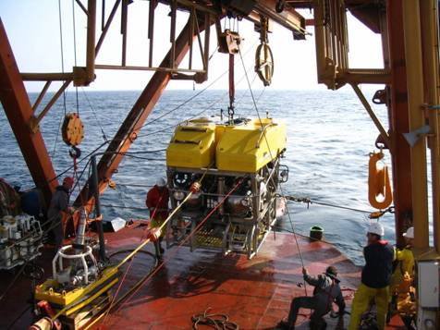
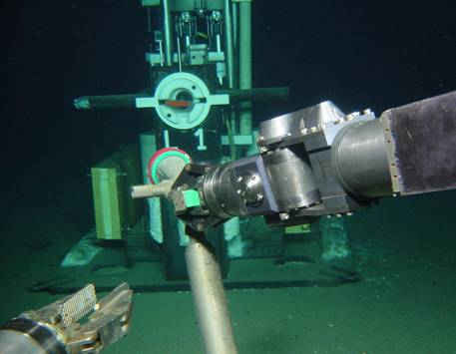
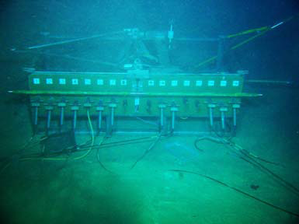
Line Connections
IFREMER ‘VICTOR6000’: Remotely Operated Vehicle (ROV)
7
Notes:
M. Spurio- ANTARES
7

Slide 8
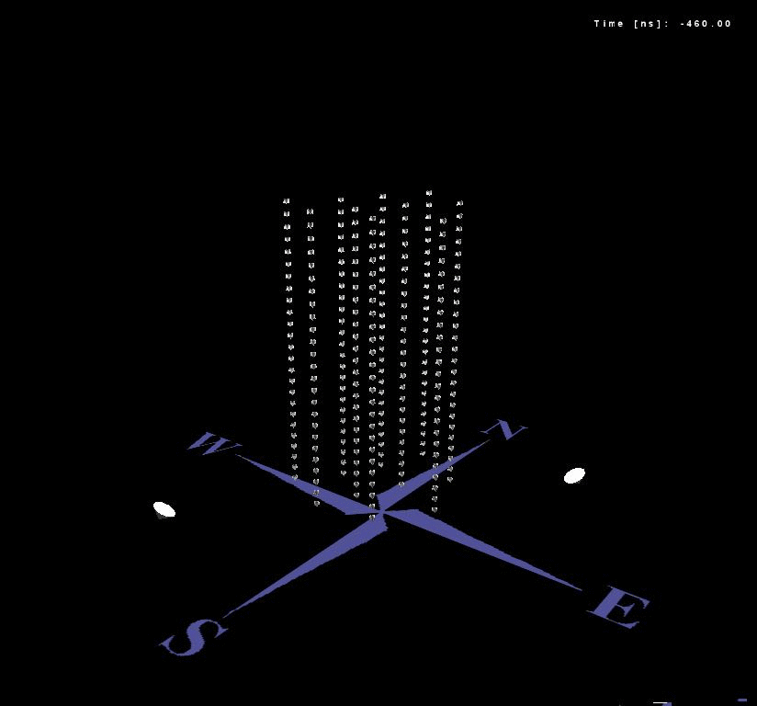
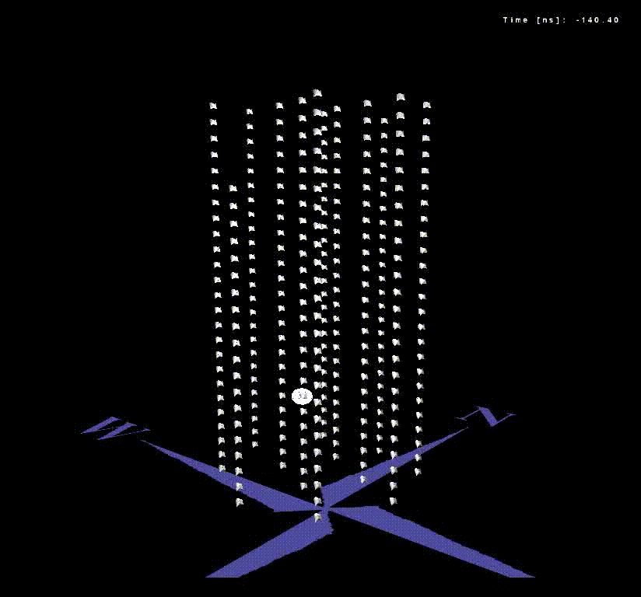
Event Displays
reconstructed up-going neutrino:
detected in 6/12 detector lines:
reconstructed down-going muon: detected in all 12 detector lines:

Slide 9
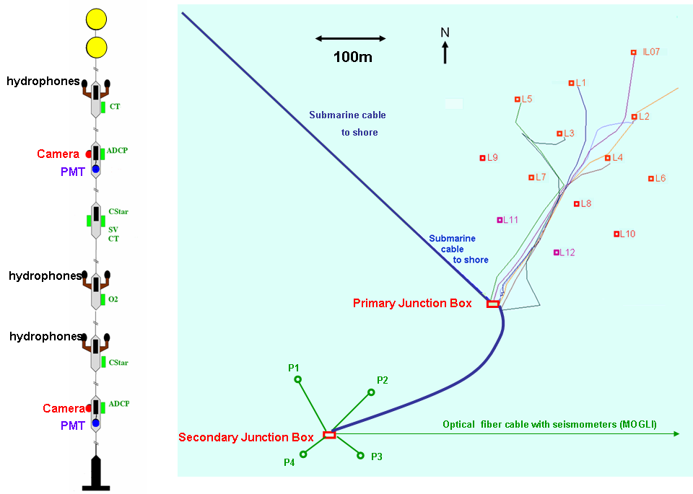
The ANTARES Infrastructure
Connected
30 Oct 2010
DeepSeaNeT: optical fibre cable with seismographs
Notes:
M. Spurio- ANTARES
9

Slide 10
ANTARES: Instrumentation Line
Monitoring of environmental parameters since 2007
IL 07
  CSTAR light transmission
  CT = Conductivity-Temperature
  SV = sound velocity
  ADCP = Current meter
  GURALP seismometer
  2 Optical Modules
  Acoustic positioning
  Oxygen meters
  2 video cameras
  3 storeys of UHE neutrino
  acoustic detectors
  Oceanography
  Bioluminescence
  Seismology
  Acoustic monitoring
  Environmental
  Monitoring
hydrophones
CT
14.5m
Camera
ADCP
OM
80m
C-Star
SV
CT
14.5m
hydrophones
O₂
14.5m
hydrophones
C-Star
80m
Camera
OM
ADCP
hydrophone
98m
RxTx

Slide 11
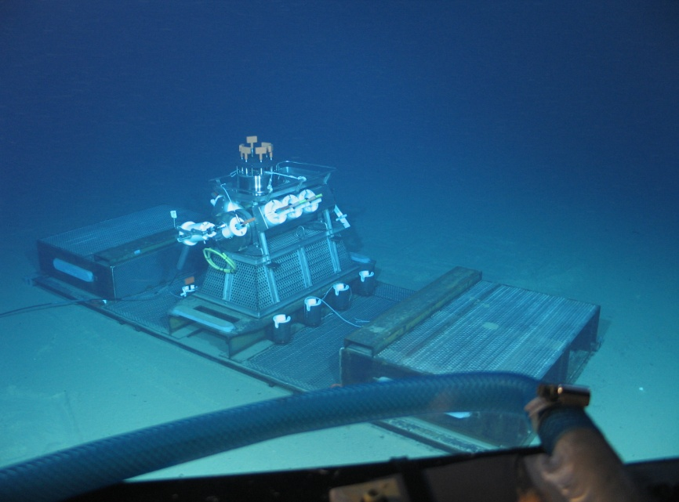
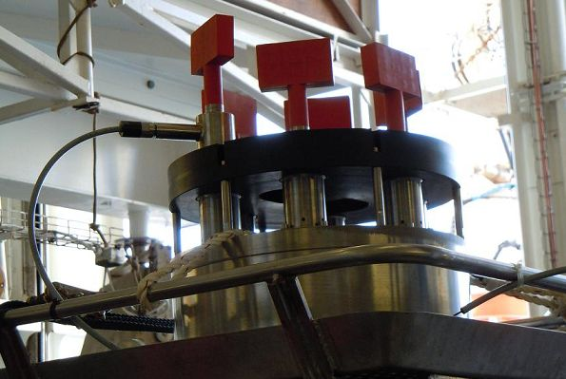
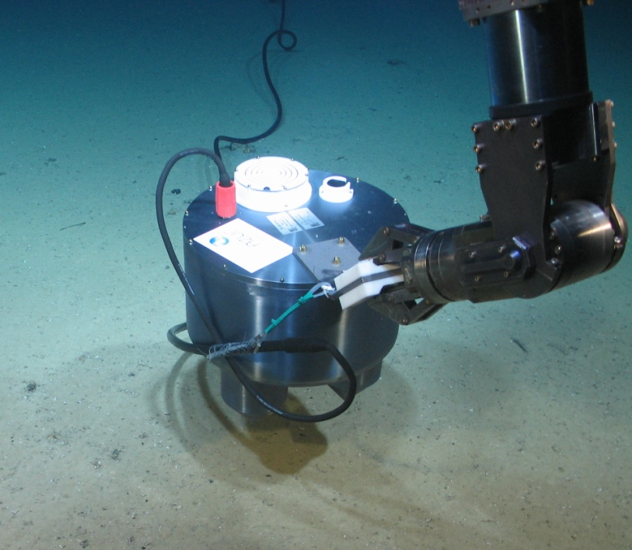
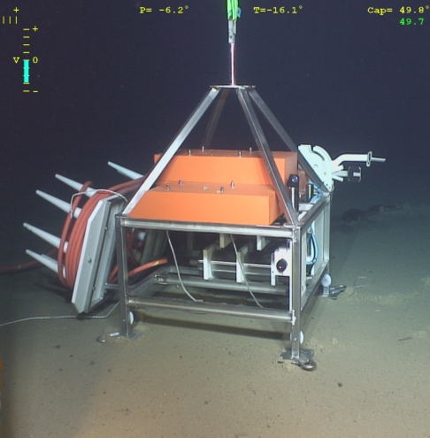
Secondary Junction Box
SJB
Connected
30 oct 2010
DeepSeaNeTprototype
Instrumentation module
Seismograph

Slide 12
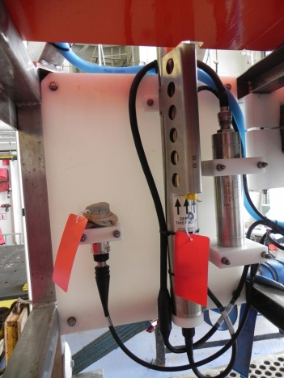
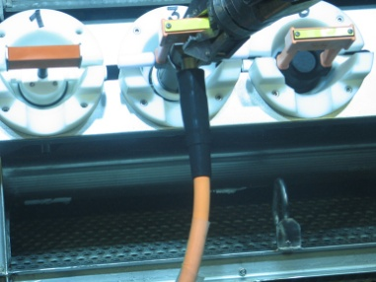

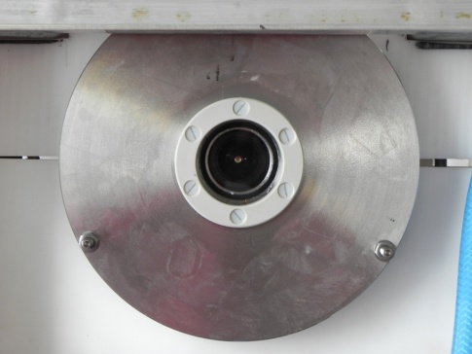
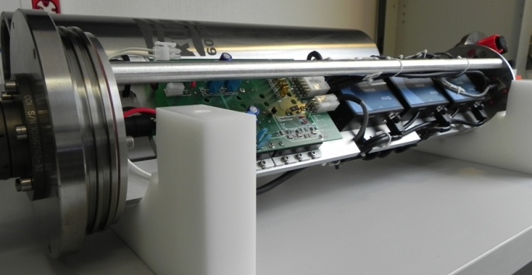
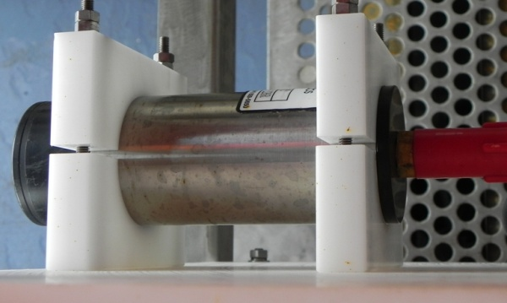
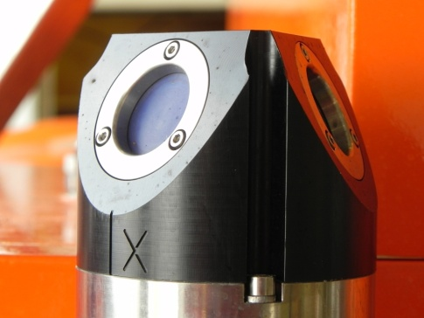
Instrumention Interface Module
CDC Connector for extension
Interlink Cable
O2, CTD, P
BioCam
Electronic Container
Turbidity
Courantometer

Slide 13
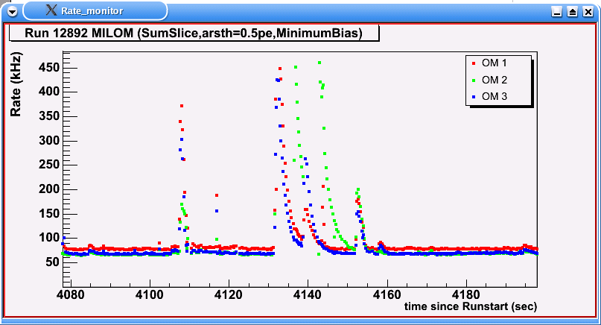
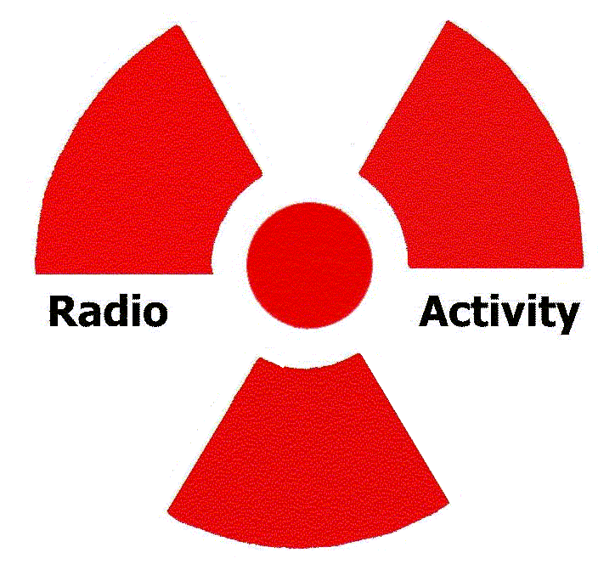
Counting Rates on Optical Modules
2 min
Continuous baseline:
Radioactivity in the sea (⁴⁰K)
+ bioluminescent bacteria?
Bursts:
bioluminescence from
Macroscopic organisms
⁴⁰K

Slide 14
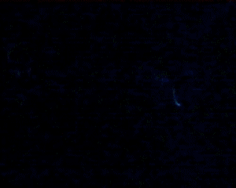
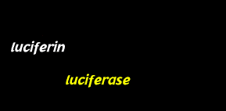
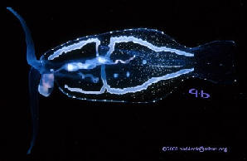
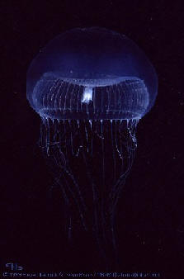
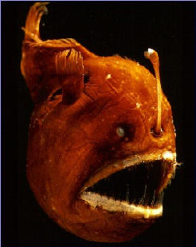
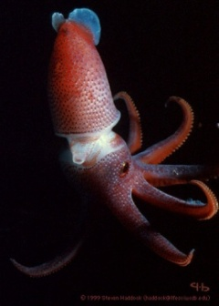
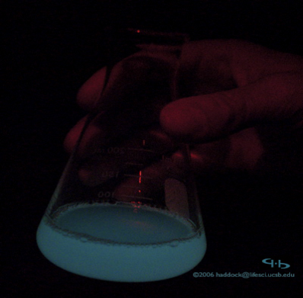
Bioluminescence
Macro organisms
http://www.lifesci.ucsb.edu
90% of deep sea organisms:
Communication
Attract prey
Repel predators
Bacteria

Slide 15
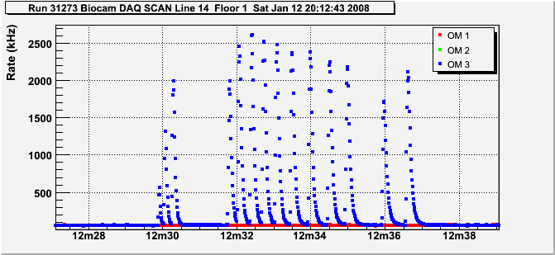
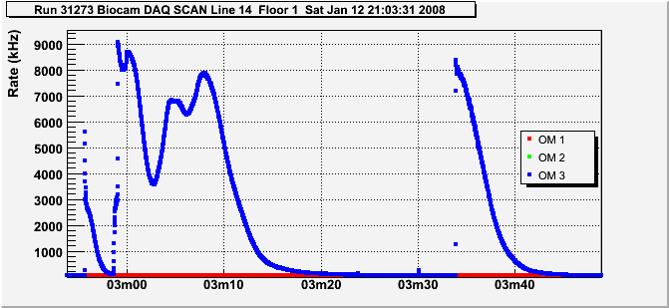
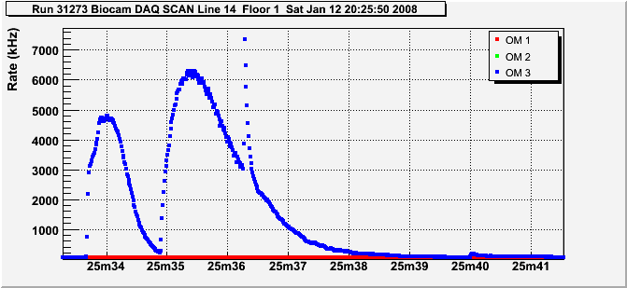
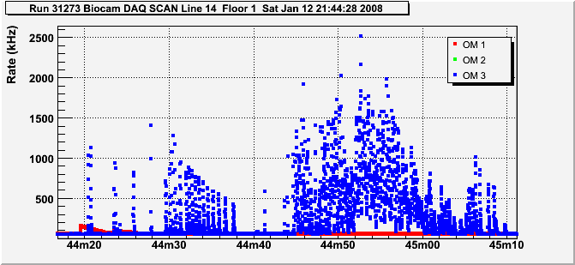
Examples Events Observed on PMTs
versus literature

Slide 16
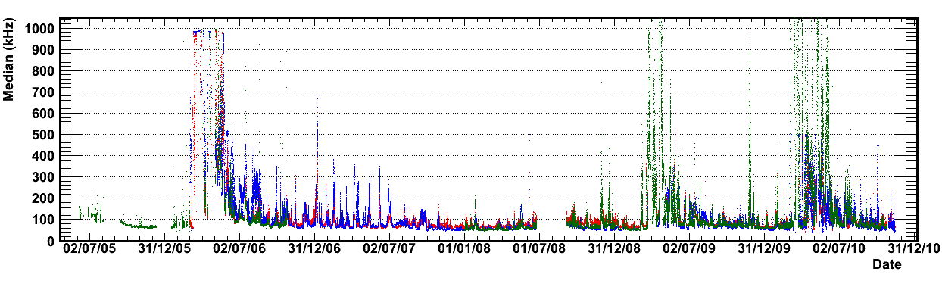

Seasonal Variations in Counting Rates
2005
2006
2007
2008
2009
2010
6 years
Burst fraction correlated
with sea current –
bioluminscence induced by
Impact/turbulence of structure
‘Spring’ effect –observed in 2005, 2006, 2009, 2010

Slide 17



Dense water formation in the Gulf of Lion
Tramontane
Mistral
Satellite chlorophyll maps
Heat loss
Brings neutrients/biology to
the deep sea layers
increased biological activity
(bioluminescence)
Open-Sea
Convection

Slide 18
Deep Water Formation Anomalies in the Gulf of Lion
1970
1980
1990
2000
2010
1971-72
1980-81
1988-89
1999-00
2005-06
2009-10
Quasi-decadal recurrence of intense events, contributing to the renewal of deep western Mediterranean water.
Pairs of extreme events. Preconditionning of the second winter is probably favoured by the strong cooling occuring during the first winter, hence allowing formation of dense water even with milder forcings

Slide 19


Real Time Video Cameras
Floor 1
Floor 5
Camera
Camera
AXIS221 vidéosurveillance
Sensistivity: 0.1 lux
Field of view: up to 90 degrees
Self triggering
Infra red night vision
ADCP
OM
OM

Slide 20
Early image 2sec exposure

Slide 21






3 sequences of 2 images: 100msec exposure each
time

Slide 22

Passing object illuminated in IR light

Slide 23

Small bright object

Slide 24

Extended object

Slide 25

Unknown object on floor 5

Slide 26


Slide 28



French Riviera- Zone Seismic
1887, M=6.2, more than 600 people died
16 October 1979, catastrophic event occurred
at Nice airport. One effect of this land slide was
the rupture of telecommunication cables
100 km from Nice, in 2500 m water depth
Antibes, 1979

Slide 29







Seismology
In laboratory
deployment
Buried at site Antares
(gain 20 dB of noise)
PEROU
SAN REMO
The seismograph ANTARES is part of seismic monitoring network, complementary to
the terrestrial stations.
Collaboration with Laboratoire Géosciences Azur

Slide 30

New Seismograph Online
Nov 9th, 2010: Magnitude=3.6-4.2

Slide 31


ANTARES: Long Term Oceanographic Parameters
Part of hydrochanges
Mediterranean network
Member of Eurosites

Slide 32




The Breathing Planet
CO₂ and O₂ atmospheric trends
Planet earth : A living organism

Slide 33
Processes Influencing O₂ Distribution
Redrawn from R. Hamme

Slide 34




In-situ Oxygen Dynamics Auto-Sampler
2 O₂ optode sensors: 1 external and 1 internal
2040m depth
Notes:
34
34
A dynamic approach for monitoring oxygen concentration has been developed within the framework of the ANR POTES project. A new tool, the In situ Oxygen Dynamic Auto-sampler (IODA₆₀₀₀) is moored since June 2008 at the top of the ANTARES line L12

Slide 35



Temperature, Salinity, O₂ time-series (IL07)
Evolution trend of in situ dissolved oxygen : -5.1 µmol O₂ dm⁻³ a⁻¹
Raw data not validated
Electro-optical cable
out of order
Electro-optical cable down

Slide 36



AMADEUS: Acoustic Detection of Neutrinos
neutrino
Hydrophone Array
Cascade
Acoustic Pressure Waves

Slide 37







Acoustic Source Direction Distribution
Direction reconstruction from
one storey on L12
All types of transient signals included,
sea mammals, ships etc.
0º
-60º
-90º
90º
120º
Notes:
37
37
37

Slide 38


http://www.listentothedeep.com

Slide 39

LISTEN TO ANTARES LIVE
http://www.listentothedeep.org/
(click on “Enter the bioacoustics page”, then “Ligurian Sea”)
Notes:
39

Slide 40

Dense series of ultrasonic clicks,
(biosonar) from beaked whales or dolphins
Biosonar clicks
Dolphin whistle

Slide 41


Echolocation clicks from sperm whales

Slide 42


Slide 43


Cetaecean Detections with ANTARES
Next step
trajectory
tracking
Notes:
Noise measurement and presence of sperm whales

Slide 44







KM3NeT

Slide 45

The Three Neutrino Telescope Sites
Antares (1/50 km³)
Toulon, France
-2500m
Nestor
Pylos, Greece
-4000m
Nemo
Capo Passero, Italy
-3350m

Slide 46






Effort in the Mediterranean
Antares (1/50 km³)
Toulon, France
-2500m
Since 2000
R&D
∼ 80 members
Nestor
Pylos, Greece
-4000m
Since 1996
Data taking
for science
∼150 members
Since 1990
R&D
∼ 50 members
Nemo
Capo Passero, Italy
-3500m

Slide 47


Slide 48

Summary
ANTARES- neutrino telescope + unique, pioneering deep-sea observatory
High-power, real-time, continuous, high-bandwidth data transmission
from deep-sea sensors has the potential to revolutionise the marine sciences:
Acoustic monitoring,
Oceanography,
Seismology,
marine biology
Important societal implications for monitoring of climate change,
global warming, tsunami alerts, etc.
The expertise of the astroparticle community has been essential to address the tremendous technical challenges of the deep sea
Catalysing and federating a fragmented marine sciences community
KM3NeT the next step in the adventure

Slide 50


Reminder: Acoustic Signals from Neutrinos
ν
Temperature
hadronic cascade
≈10m
Instantaneous heating, followed by slow cooling
≈1km
E_{casc}= 1 EeV @ 1km
Adapted from arxiv/0704.1025v1 (Acorne Coll.)
Notes:
50
50
50

Slide 51

Automated detection of dolphin whistles illustrated on 30 minutes of acoustic data from the Antares observatory. Detection is performed on segments of ~17 seconds.
detector output
High detector outputs produced by dolphin whistles
Threshold to automatically tag segments that contain whistles
Baseline level of detector output, when no whistles are present
Notes:
Detection of whistles is presented as an example of how long term data is automatically processed and tagged.

Slide 52

Detector Status, Nov 2010
Full detector operational since May 2008
780/885 PMTs giving data

Slide 53
audio data stream
Segment 1
Segment 2
Segment 3
Segment 4
Segment 5
Segment 6
Noise Measurement
Discard sea noise
Assign broad categories
Classifier 1
Classifier 2
...
Real-Time Mitigation
Long term assessment and Control of the effects of anthropogenic sources on marine organisms (i.e. whales) ...
Sperm whales
Beaked whales
Pilot whales
Dolphins
Ships
Sonar
...
FM-tonals
Impulses (1-20 KHz)
Impulses (all)
...
Public outreach
Education
End users
Administration
Localisation
Tracking
Bearing, Position
Trajectory, …
Stage 1
Stage 2
Stage 3
Notes:
The objectives of LIDO in terms of acoustic and bioacoustics data management is the long term monitoring and assessment of the anthropogenic sources on marine organisms, specially cetaceans, implying the detection, classification and tracking of the sources. This is illustrated here by Phase 3. To achieve this objective, it was necessary to develop a rigorous and versatile protocol that we have separated in two previous steps: Phase 1 and 2. Here, one has to keep in mind that the overall process is conducted in RT or close to RT.
The concept of automatic detectors is the following:
In undersea recordings background noise is always present (sea noise). Most of the time this sea-noise presents little interest but fills terabytes of unnecessary storage. The challenge is here to be able to find a reliable set of filters or detectors able to extract the interesting information that would be superimposed to this background-noise, like dolphin calls, sperm whale clicks, noise produced by ship engine). A detector is an algorithm that accepts a segment of audio as input and gives a single number as output. The output number is usually designed such that (1) It is equal or close to zero if only sea-noise is present in the segment (2) it takes larger values if an additional signal is present.
By applying a threshold on the output number, the detector can take a decision, that is: automatically label the segments as "sea-noise-only" vs "presence of interesting signal".
The concept of the broad categories returned by Phase 1 is to narrow the amount of data supplied to the more sophisticated algorithms of phase 2. These phase-two algorithms will be a little bit slower. Hence, narrowing the input in quantity alleviates the slowness and will improve the overall robustness by having a well-defined input. ⏏
Note: the localisation/tracking will most probably be applied on several consecutive segments (not shown on slide for simplicity)

Slide 54

Point Source Flux Limits
ANTARES 2007+2008
295 days, preliminary
ANTARES (295 days)

Slide 55

European Multidisciplinary Seafloor Observatory

Slide 56


Slide 57


Slide 58



Slide 59


NEW: 2007+2008 SkyMap
Preliminary
visibility
2040 candidates

