Slide 1
H→bB Experience from SiD LoI and MC requests
Tomas Lastovicka
(FZU AV CZ, Prague)
WG6 meeting 13/10/2010
Notes:
1

Slide 2
Outlook
Experience from SiD LoI (√s = 250GeV)
  Physical Review D82 (2010)
What do we need for 3TeV CLIC
Samples for LCFI package optimisation

Slide 3
Higgs Branching Ratios – SiD LoI
  Higgsstrahlung e⁺e⁻ → ZH @ √s = 250GeV
We have studied 3 branching ratios
  H→cC
  H→bB
  H→gluons
In two channels
  Fully hadronic decay
  Neutrino channel ← (2jets + missing energy, our case)
The results were combined.

Slide 4
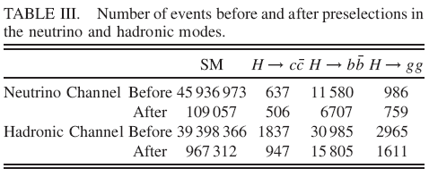
Higgs Branching Ratios – SiD LoI
Events are separated into the two channels based on
  Visible energy cut
  # leptons cut
Then a sequence of cuts is applied to suppress the background
  Thrust, angles between jets, di-jet invariant mass, highest reconstructed photon energy, p_{T}, y_{min}, …
Final selection is performed by two combined Neural Nets

Slide 5
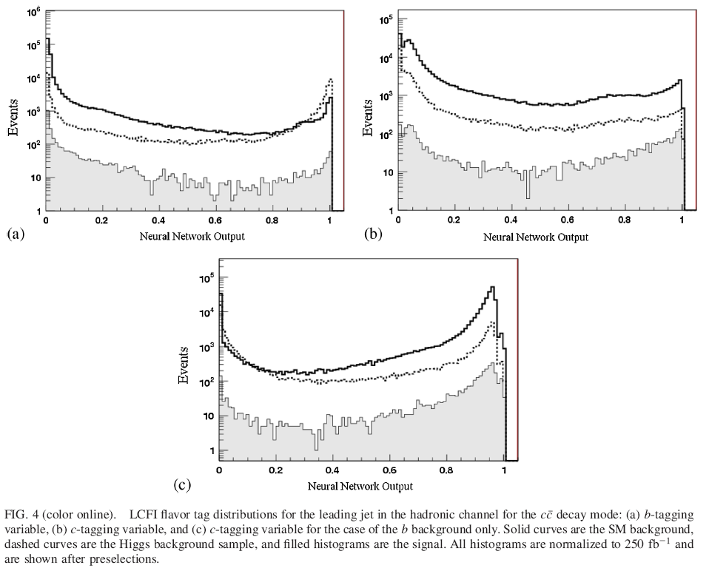
Jet Tagging
b-tag
c-tag
SM
Higgs bkg.
signal
c(b)-tag
Hadronic channel, 4-jets
cC mode

Slide 6
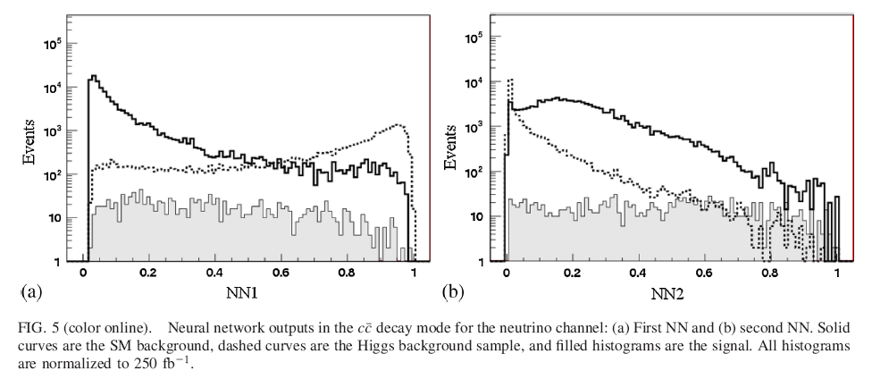
Final Selection with Neural Nets
Two neural nets – identical inputs but trained differently
  Inclusive Higgs vs SM Background
  Higgs Signal vs Higgs background (SM bkg ignored during training)
SM
Higgs bkg.
signal
Example: cC in neutrino channel

Slide 7
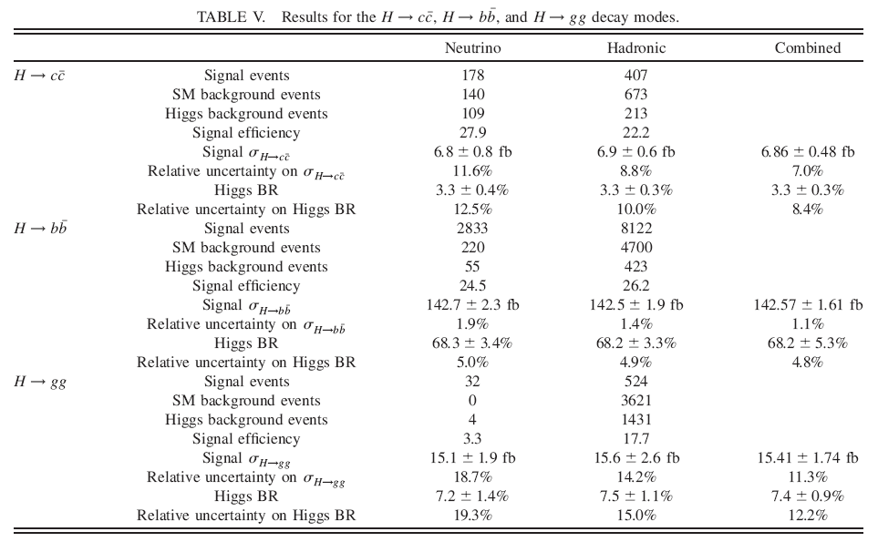
Final Results (SiD @ 250GeV)
3.5%

Slide 8
Significant Backgrounds for Neutrino Channel
Two fermion events
ZZ
  especially decaying to neutrinos and hadrons
WW
  esp. decaying to neutrino and lepton (undetected) and hadrons
  Fully hadronic WW and ZZ suppressed by cut on y_{min}
ISR was ON, 2-photon background included

Slide 9
Standard Model Background Sample for SiD LoI
Weighted samples for various channels produced weighted and mixed accordingly to files
  i.e. each file contains a “proper” mix of weighted events.
  about 7M events for √s = 500GeV
Generated events for √s = 250GeV, for example:
channel | events | weight
n2e2du | 46442 | 3.571429
uddu | 116787 | 3.571429
bb | 347388 | 10
ftp://ftp-lcd.slac.stanford.edu/ilc2/ILC250/LOI_SM_Sample/stdhep/inv_ab_stdhep_files_LOI_SM_ecm250_80L_30R

Slide 10
Bkg and Signal Samples for h→bB for CLIC CDR
To start discussion:
Background Channel | Events
WW | 200k
ZZ | 20k
ff | ?
WWνν | 50k (generated)
ZZνν | 50k (generated)
Signal Channel | Events
hνν, h→bB | 50k
hνν, h→cC | 50k

Slide 11
Background Samples for h→bB for CLIC CDR
Before submitting final numbers, I would like to discuss this question with someone from theory
  namely Sasha Belyaev
    involved in SiD LoI, sbottom production analysis
  this week

Slide 12
Samples for LCFI Package Optimisation
Should be independent from all signals and backgrounds used in analyses
  To avoid jet tagging bias.
  Large enough to split in test and train samples
  In ILC times we typically used 3x50k (e⁺e⁻ →{uds,c,b}) di-jet events typically
In principle we could rather use e.g. ZZ events: ννqq channels
  or even Higgs signal events.

