Slide 1
WP7 HFM task 1
Gijs de Rijk & Francois Kircher
26th November 2010
Genève

Slide 2
Task 1 Activities in the last 6 months
18 months report October 2010
  Task report accepted, some question asked by JPK
Collaboration meeting preparation
Get the common issues WG dipole-insert working

Slide 3
Task 1 Activities for the near future
Re-make a full WP schedule for the next 3 years
Call a design review in Dec-Jan, together with task 3

Slide 4
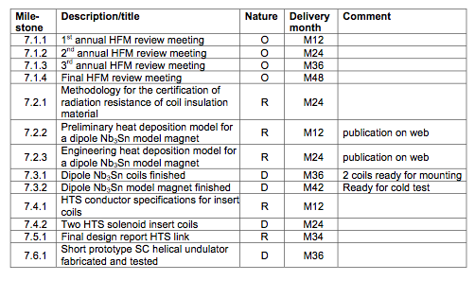
Deliverables
4

