Slide 1

Round Robin Test for I_{c} measurements of Nb-Ti and YBCO conductors
(EUCARD WP7 task 4)WP7
CERN, EUCARD WP7-Task4
Jerome Fleiter (CERN, University of Grenoble)

Slide 2
Laboratories involved
  INFN-LASA (Milano)
  UNIGE (Geneva)
  CEA (Saclay)
  CNRS (Grenoble)
  CERN (Geneva)
2 Samples measured at 4.2K
  Nb-Ti LHC strand mounted on a LHC barrel at CERN.
  YBCO tape from SuperPower, mounted on a barrel at INFN- LASA.

Slide 3
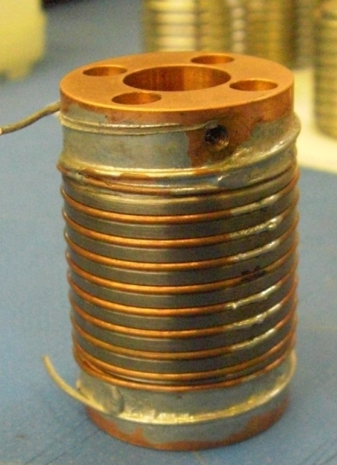
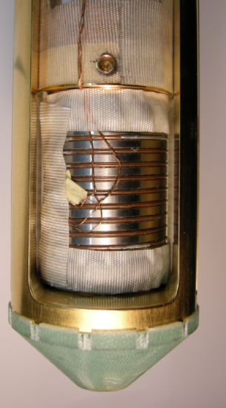
Nb-Ti @ 4.2K
32 mm
  No correction of field
  No correction of temperature

Slide 4
Nb-Ti @ 4.2K
  Without temperature correction, measurements are already within 4%.

Slide 5
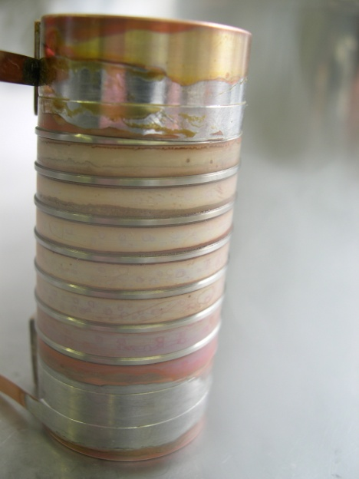
YBCO @ 4.2K
  No correction of field
  Engineering Critical current density at 19T is 2400 A/mm² (B//ab plane)

Slide 6
YBCO @ 4.2K
  n-values are high. Sharp transition takes place.

Slide 7
Large spread of I_{c} within same spool (SP-20100108-1) for YBCO tape
YBCO @ 4.2K

Slide 8
Conclusions
Critical current I_{c} measurements of Nb-Ti strand and YBCO tape performed at 3 different laboratories are in good agreements.

