Slide 1
Pulsed DC System Update

Slide 2
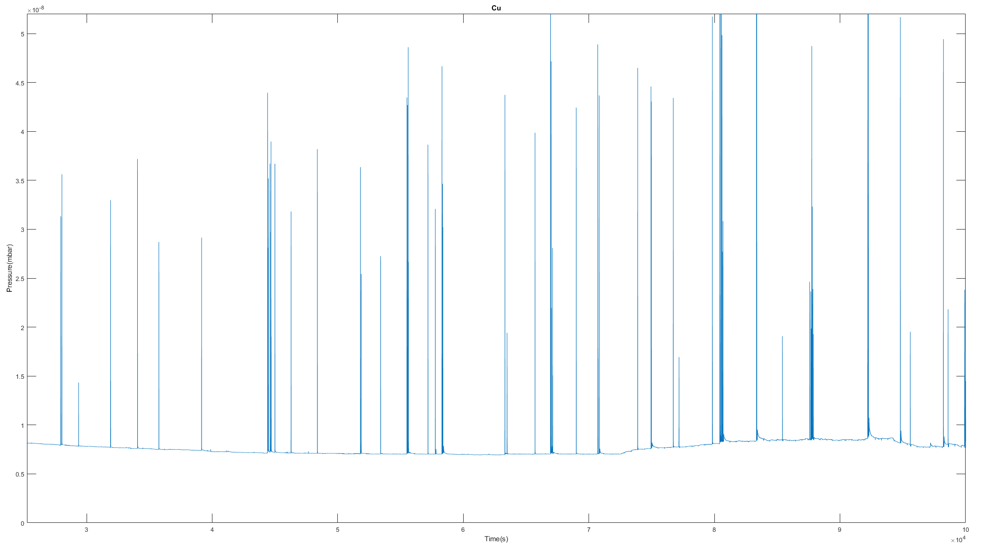
CuCrZr Pressure

Slide 3
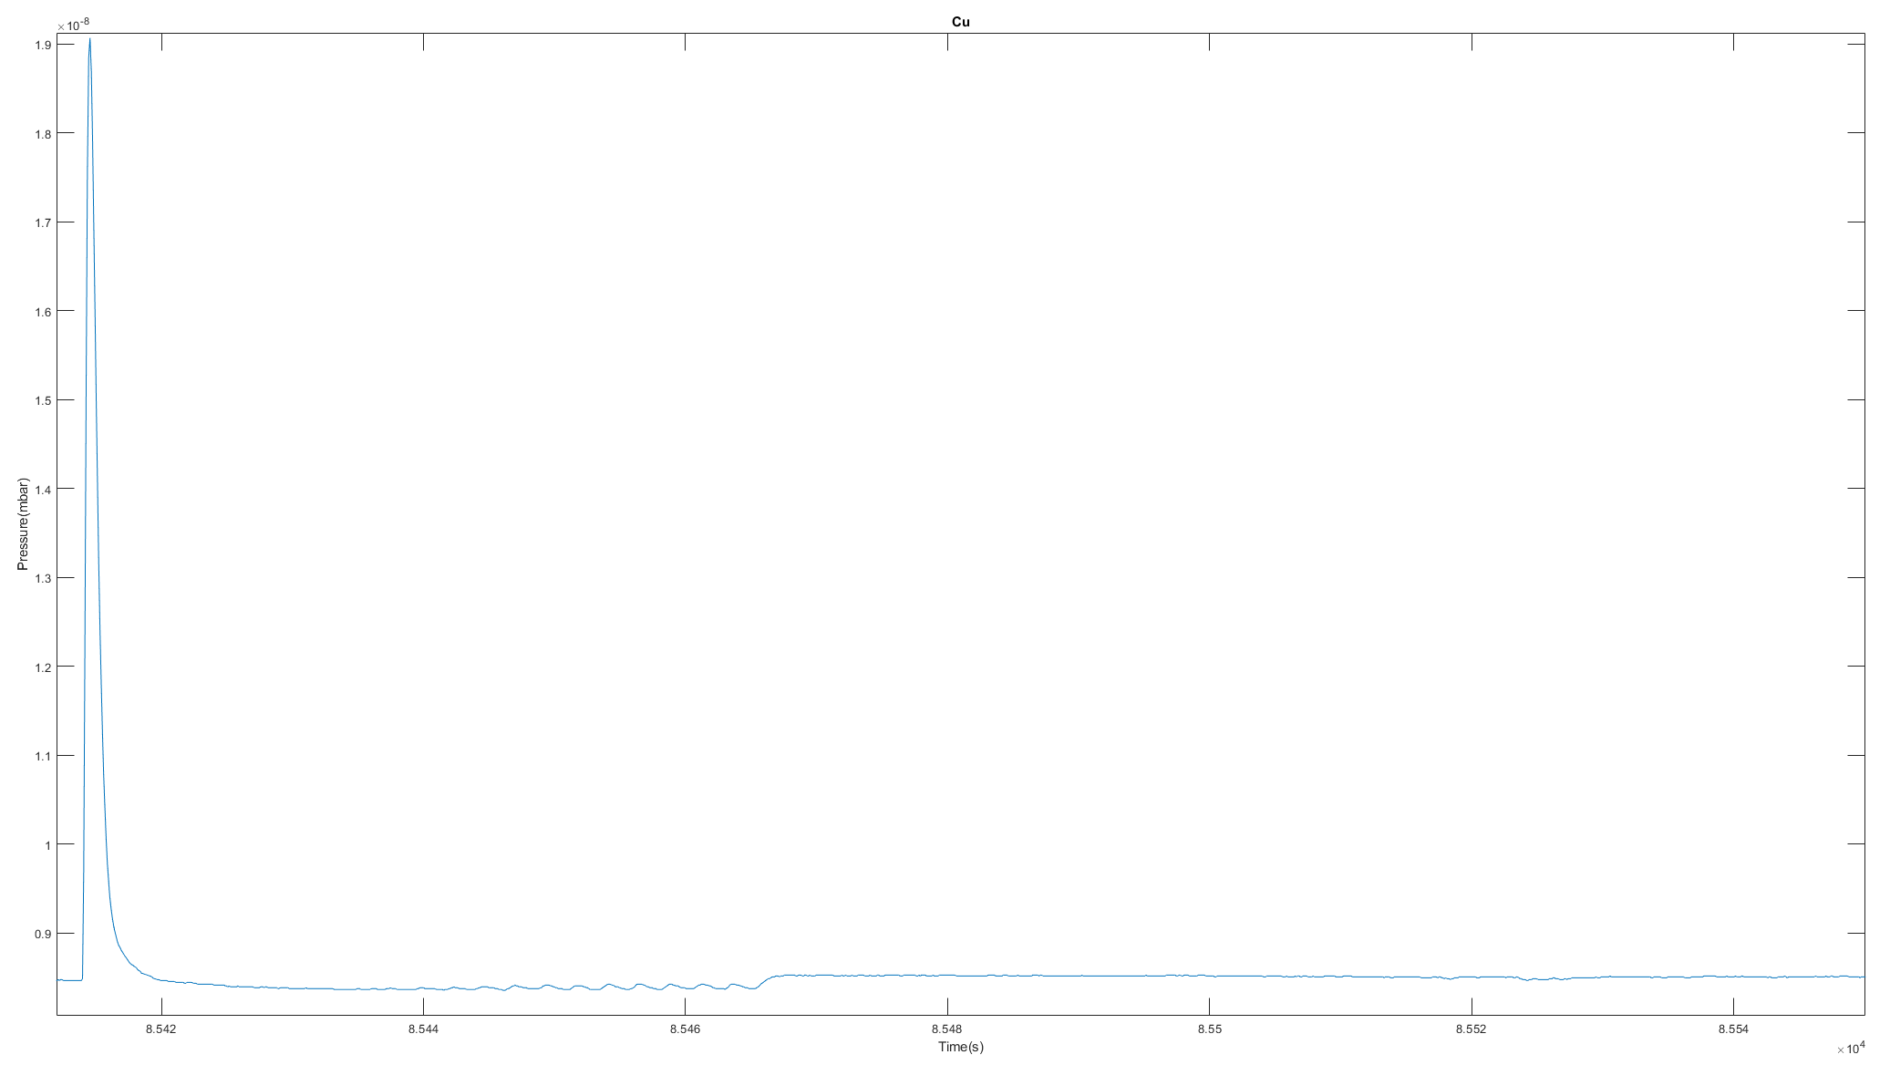
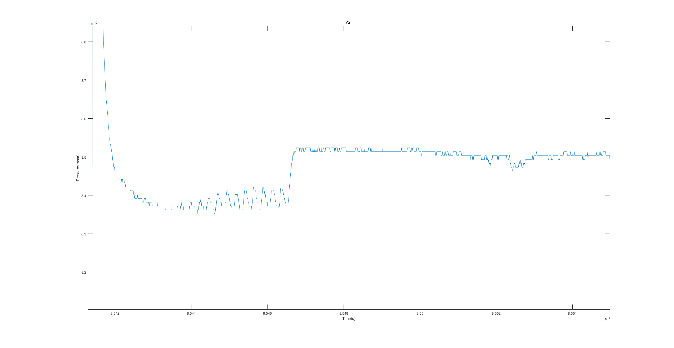
CuCrZr Pressure

Slide 4
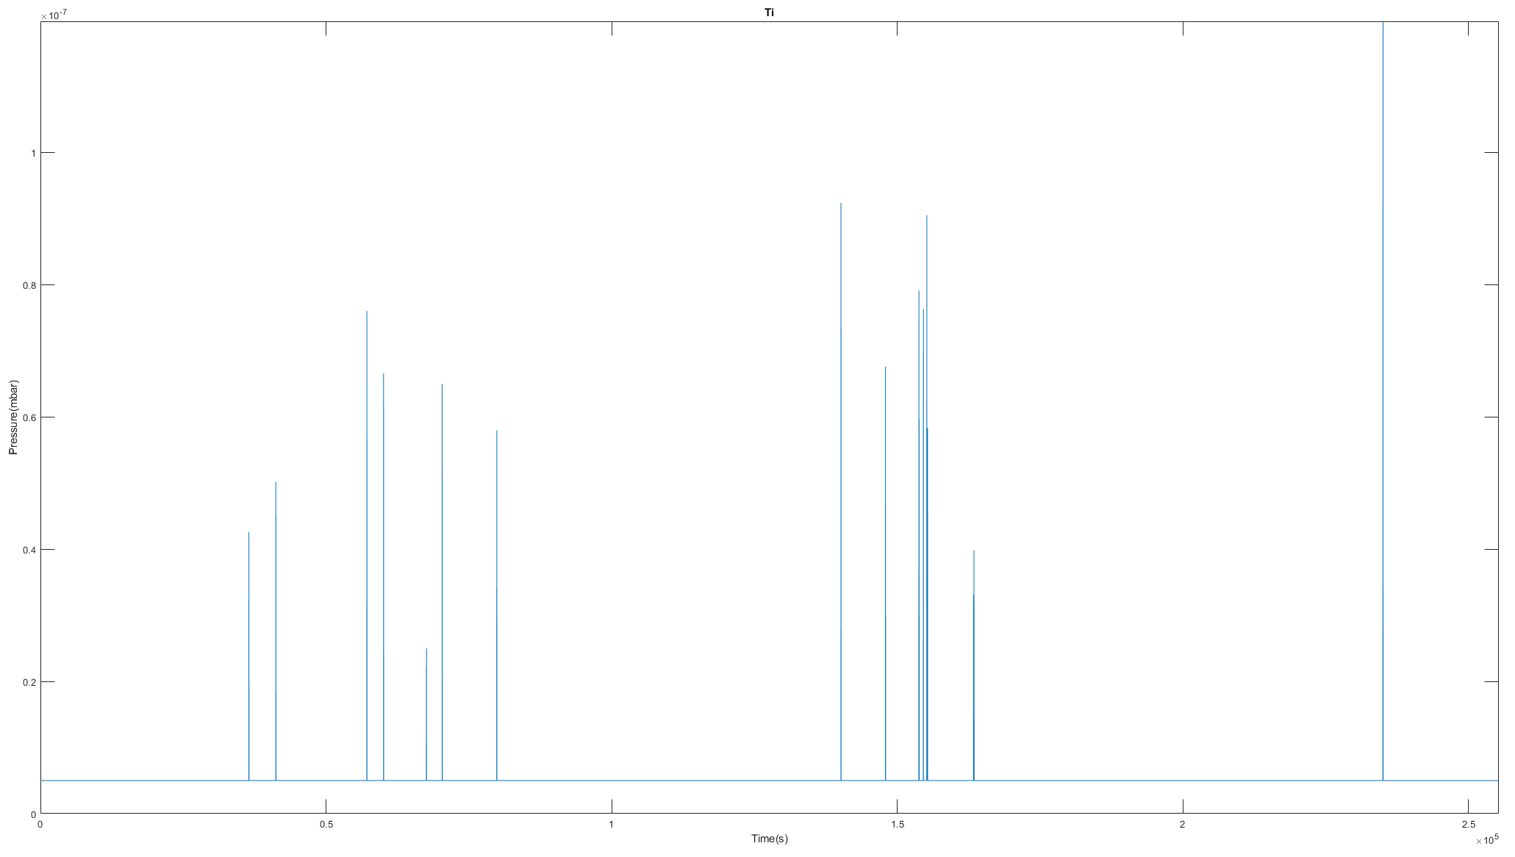
TiAl6V4 Pressure

Slide 5
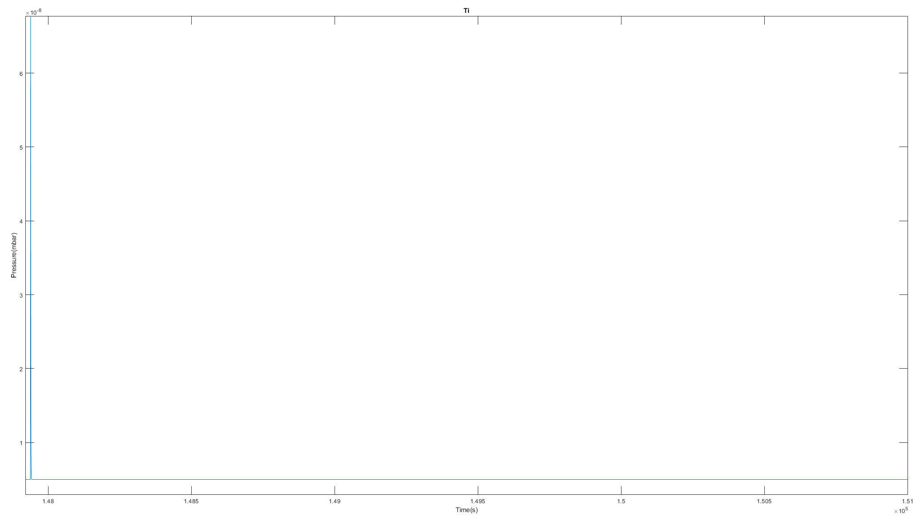
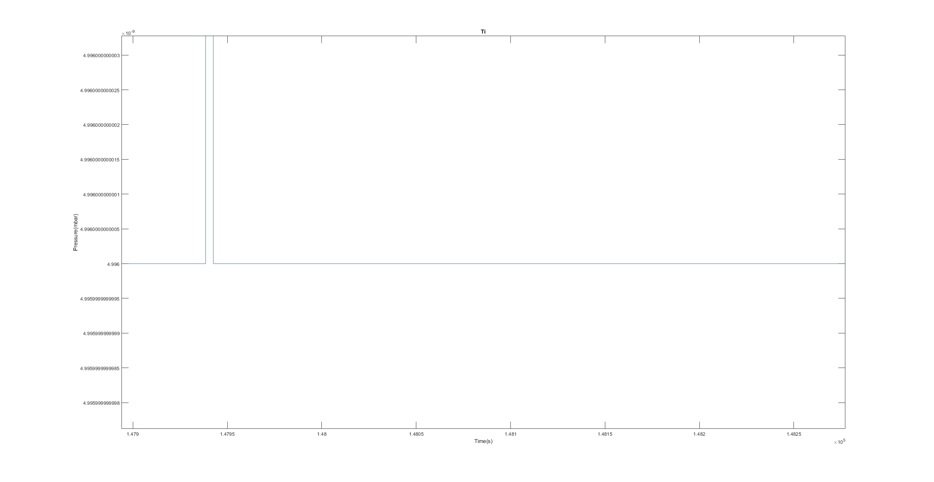
TiAl6V4 Pressure

Slide 6
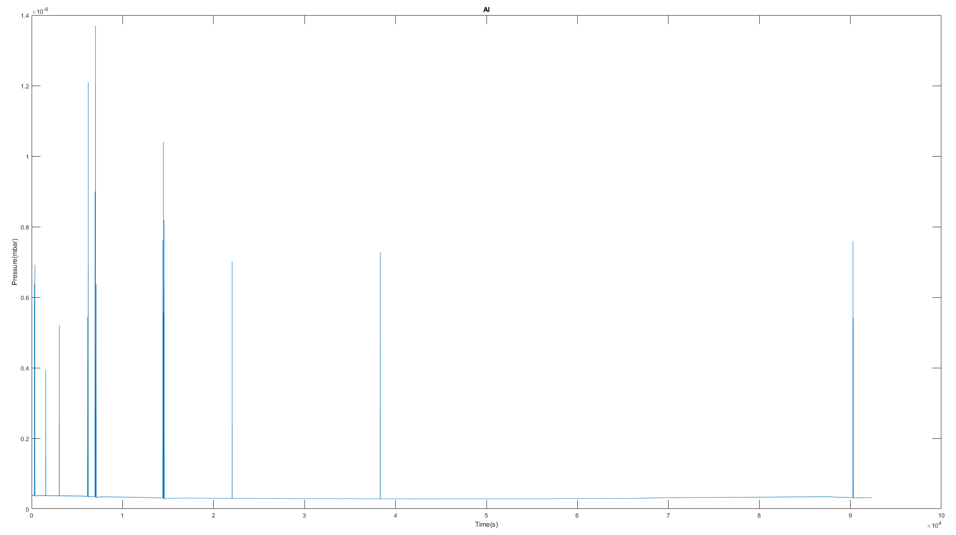
AlMgSi1 Pressure

Slide 7
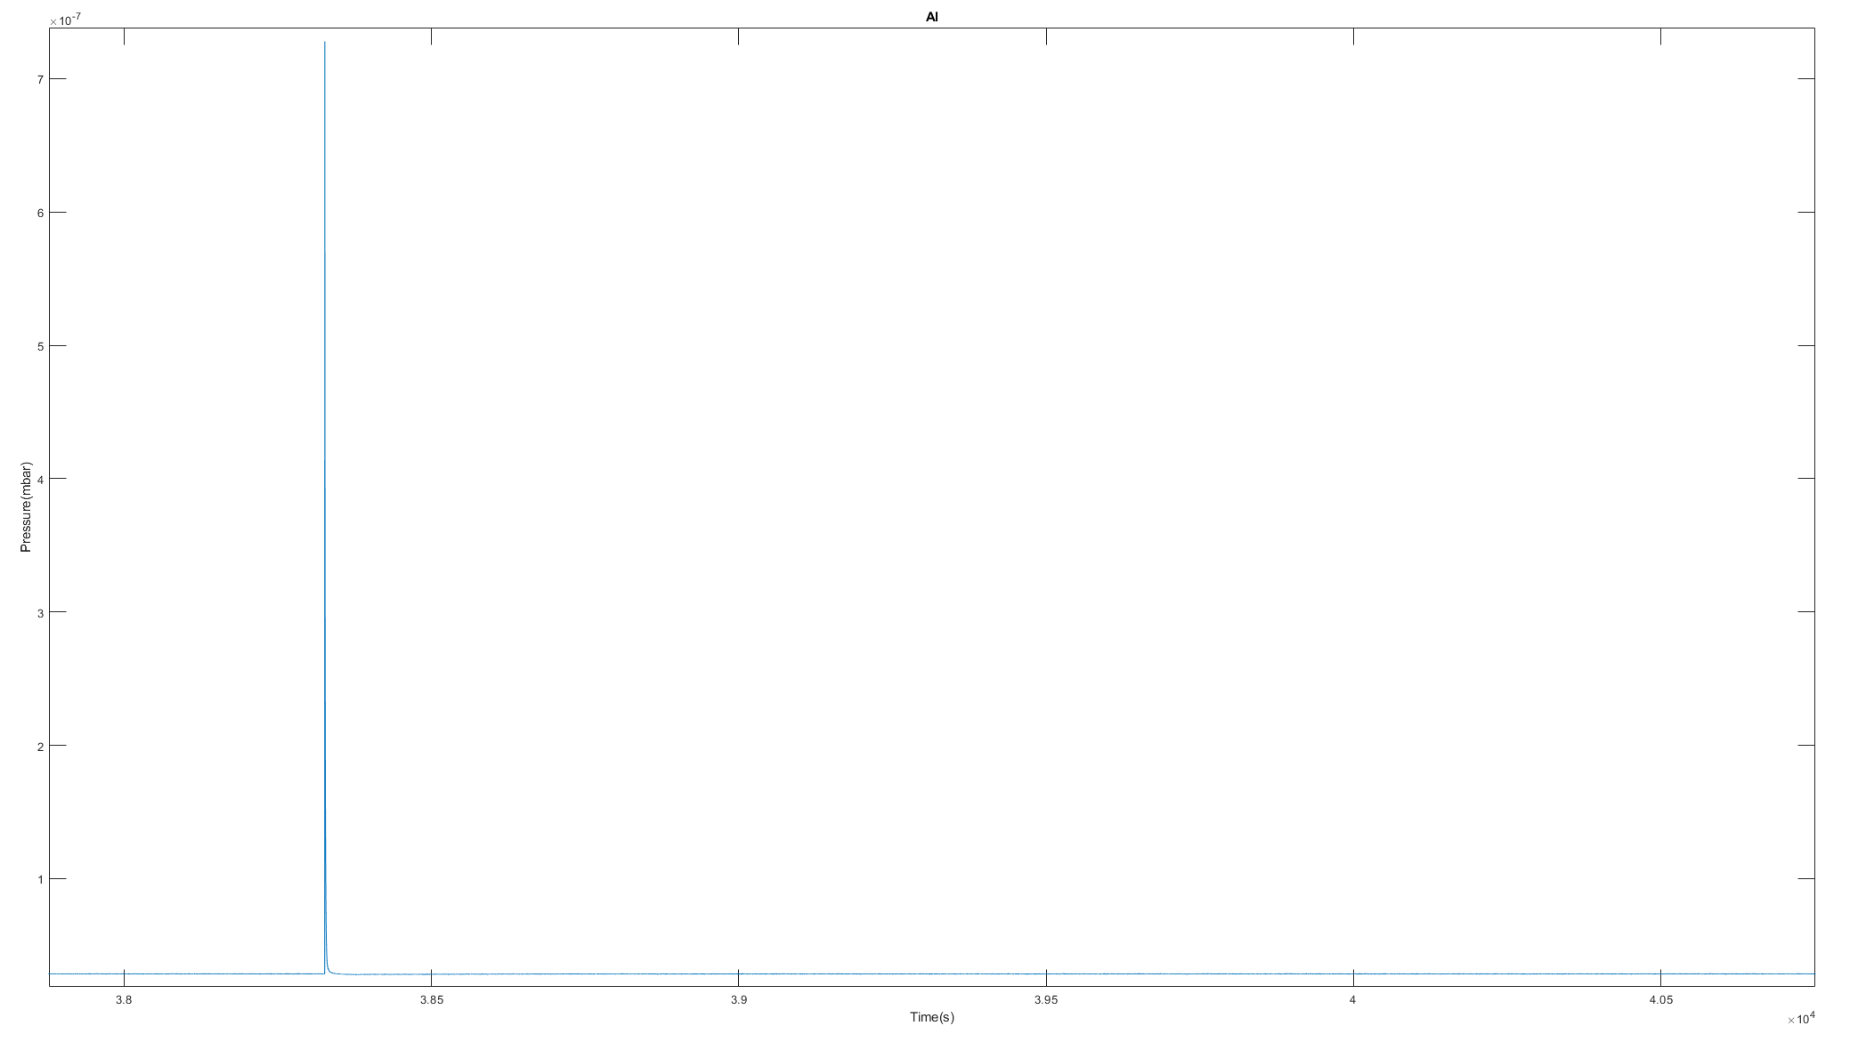
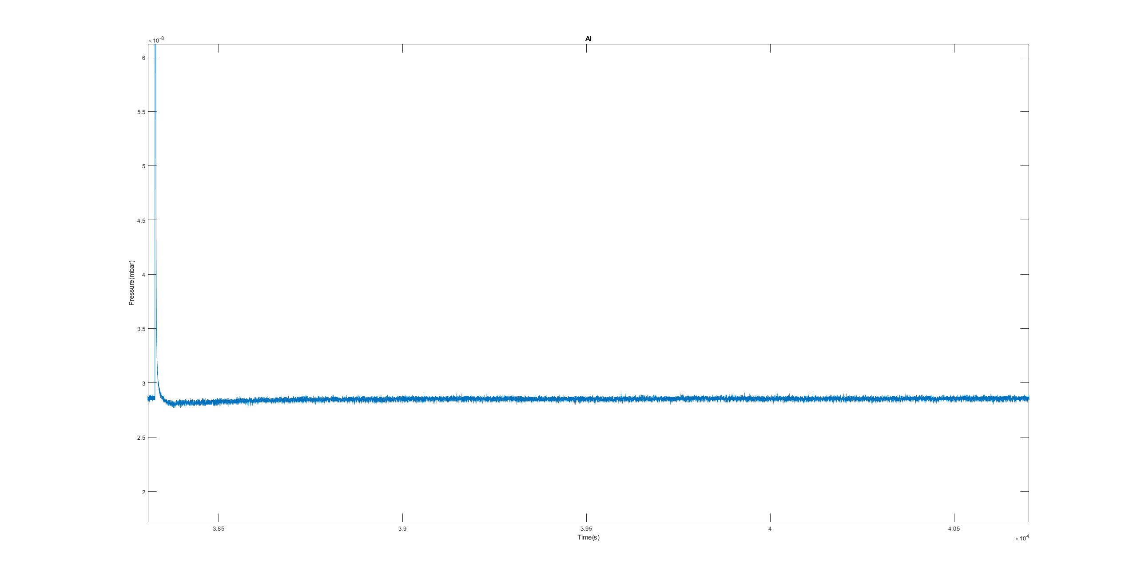
AlMgSi1 Pressure

Slide 8
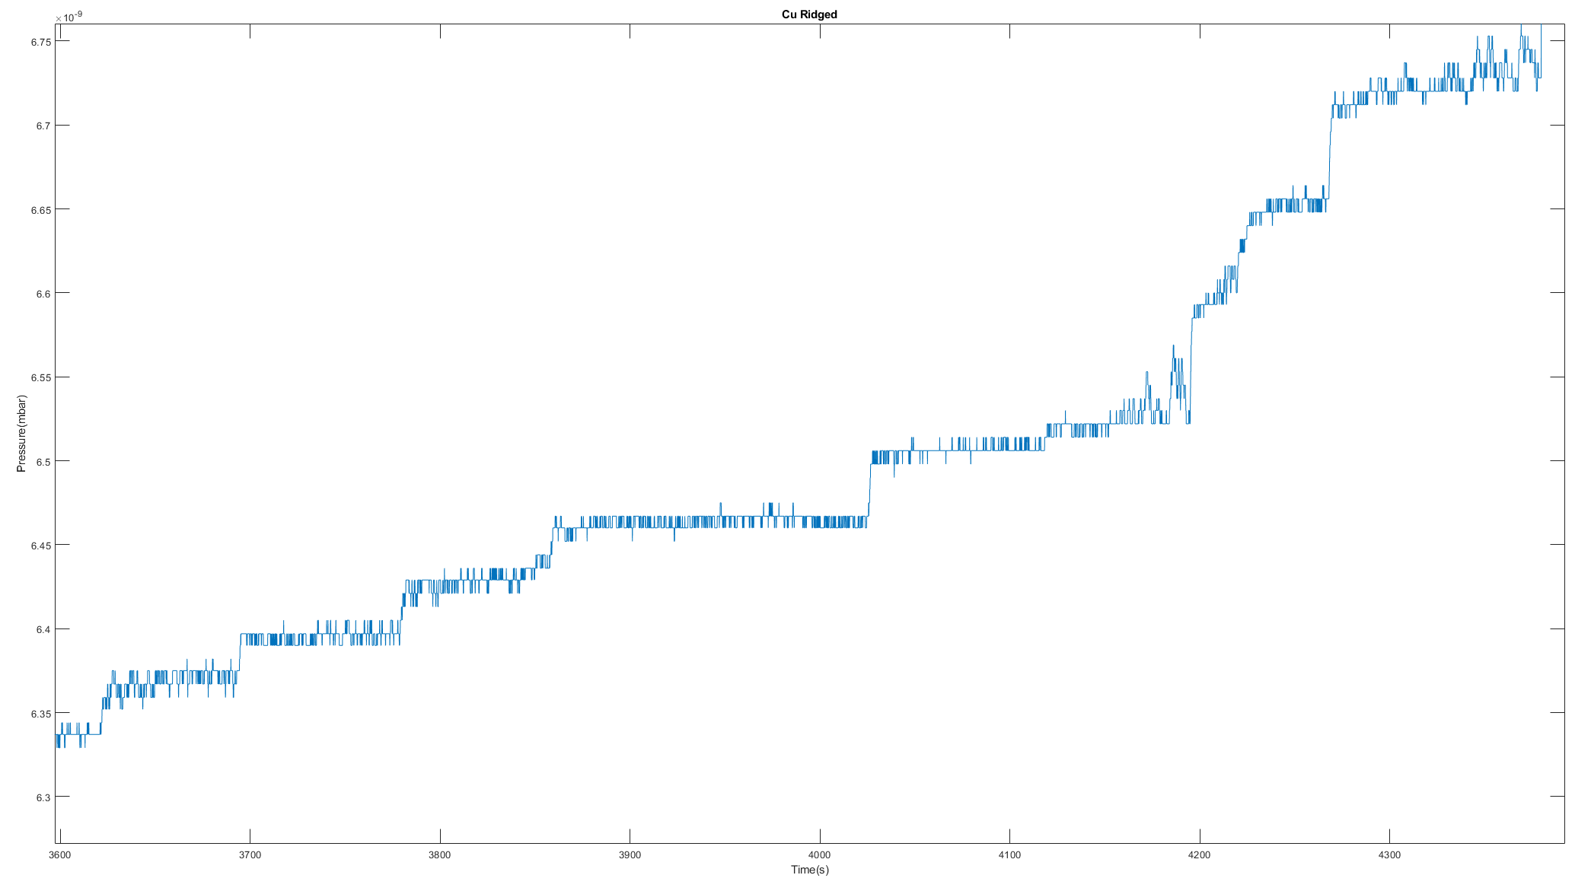
Constant DC Measurements

Slide 9
Field Emission

Slide 10
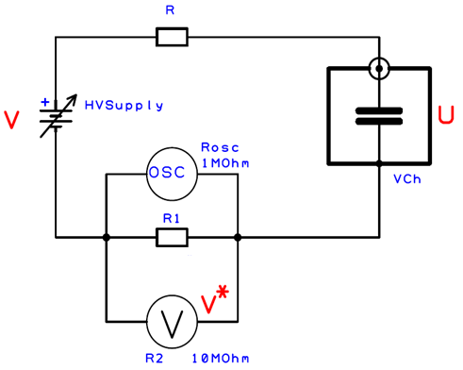
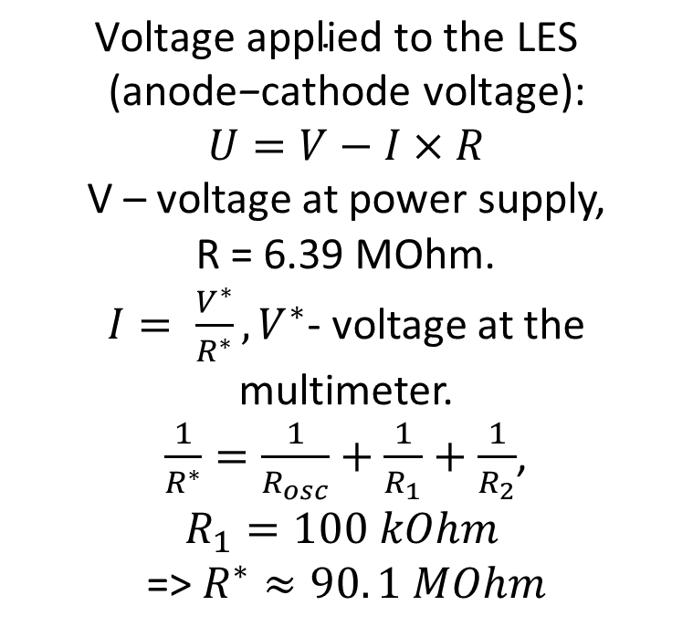
Field Emission Box
$$\text{Voltage} \text{applied} \text{to} \text{the} \text{LES} \text{ (}\text{anode}\text{−}\text{cathode} \text{voltage}\text{):}$$
$$U=V−I×R$$
V – voltage at power supply, R = 6.39 MOhm.
$I= \frac{V^{∗}}{R^{∗}}, V^{∗}$- voltage at the multimeter.
$\frac{1}{R^{∗}}=\frac{1}{R_{osc}}+\frac{1}{R_{1}}+\frac{1}{R_{2}}$,
$$R_{1}=100 kOhm$$
=> $R^{∗}≈90. 1 MOhm$

Slide 11
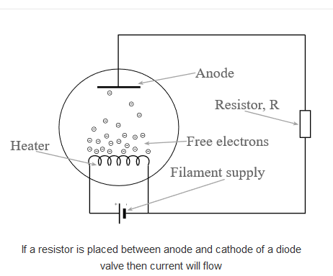
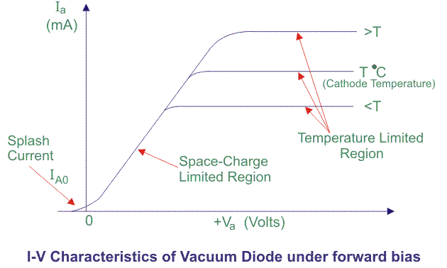
Space charge with series resistance

