Slide 1
WP4 Coordination Meeting
Test of Crab Cavity CryoModule (CCCM) in M7 bunker
O. Pirotte (TE-CRG) on behalf of TE-CRG team
https://indico.cern.ch/event/1091900/

Slide 2
Content
Introduction
PIDs & Mechanical interface / integration
CCCM instrumentation & control system
Project organization
Summary and next steps

Slide 3
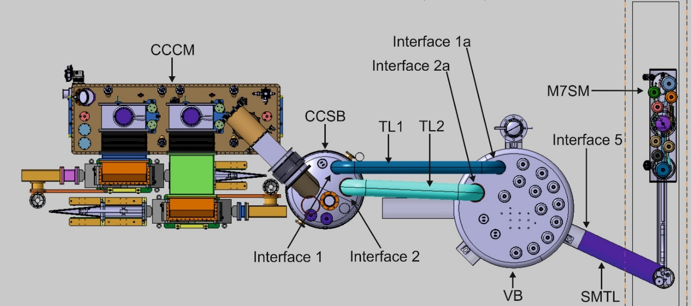
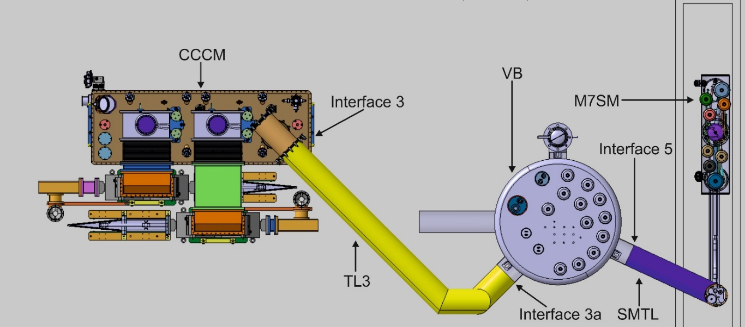
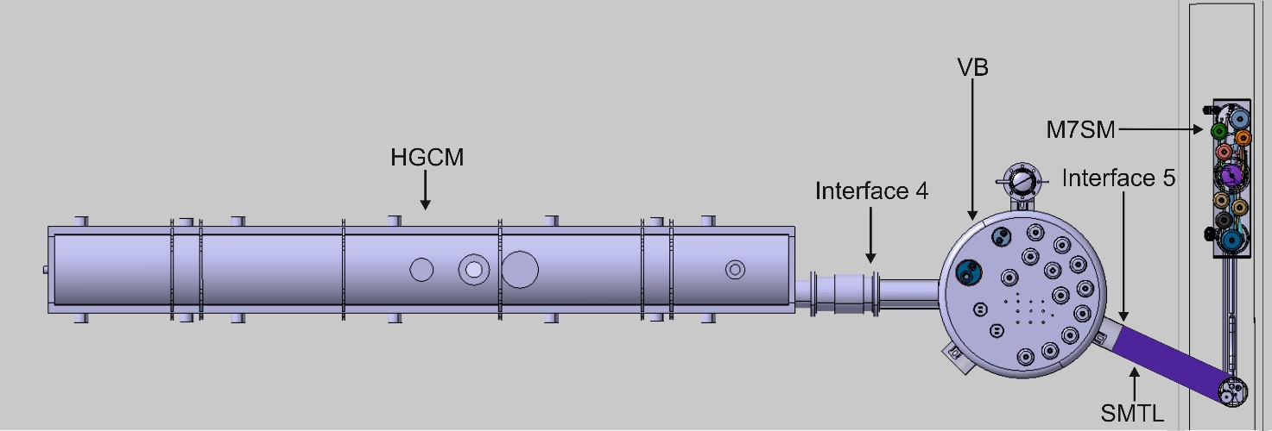
M7 RF Test Stand Configurations (status of 2016-2017)
Tests scheduled from June 2022 till 20xx
Test configuration 1 – VB connected to SB and CCCM
Test configuration 2 – VB connected directly to CCCM
No. | Component | PID
1 | M7SM & RF Infrastructure | CRNLSQLJ0001
2 | Valve Box (VB) | CRNLSQLJ0053
3 | Test configuration 1 – CCCM & CCSB | CRNLSQLJ0054
4 | Test configuration 2 – CCCM | CRNLSQLJ0055
5 | Test configuration 3 – HGCM | CRNLSQLJ0056
Test configuration 3 – VB connected directly to HGCM
PIDs for SM18 M7 RF test stand

Slide 4
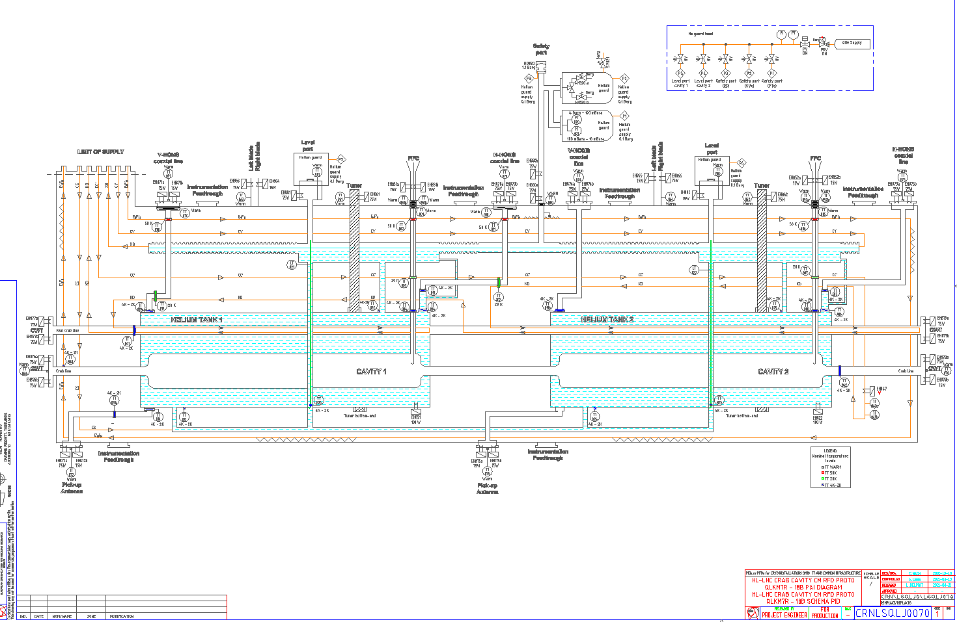
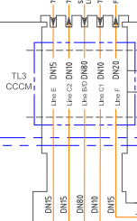
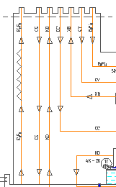
M7 RF Test Stand : Interface compatibility
Interface 3 for the test configuration 2 with a standalone CCCM was defined according to SPSQUXDA0002
May 2021 : new PID LHCLSQLS0070 for CCCM RFD proto where original interface 3 is no longer matching : 7 circuit connections versus 5 previously (addition of BS circuit CC’ and KD).
PID CRNLSQLJ0070
Interface from CRNLSQLJ0055
Interface from CRNLSQLJ0070

Slide 5
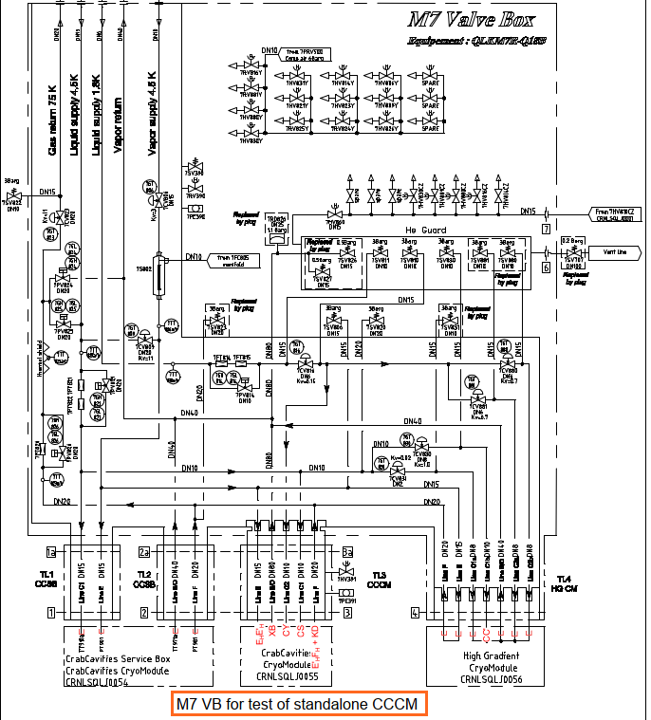
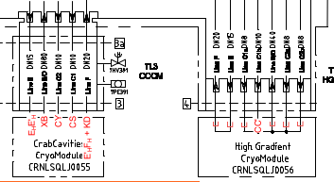
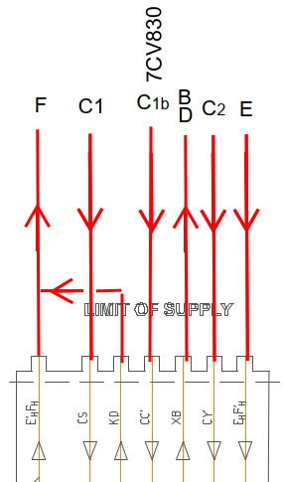
Interface compatibility – proposal 1: TL3 + TL4
Proposal to use interface 4 (HG CM) to supply CC’ via DN 8 valve 7CV830 on TL4 interface and connect KD and F (cold return 4.5K)
=> Regulation at the inlet and T with 50 K gas and bypass 7CV809 (to be studied)
=> TL3 to be modified

Slide 6
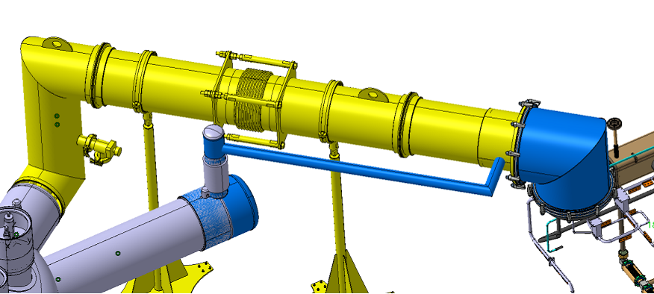
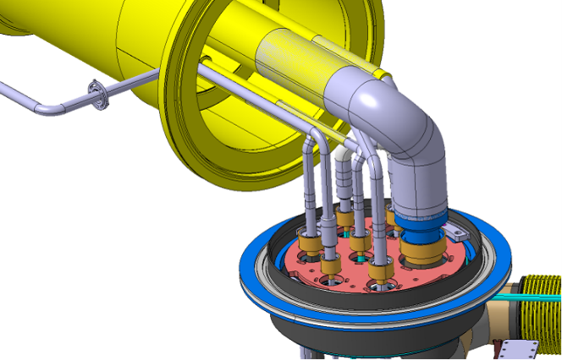
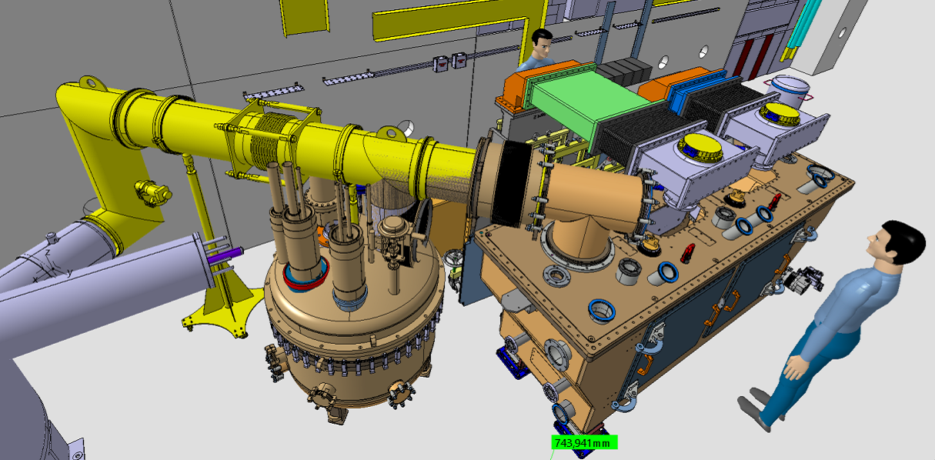
Preliminary study for proposal 1 : TL3 & Mechanical I/F
TL3
Interface 3 (2016)
Preliminary study
TL4
Interface 3 (2016)
TL3
Issue to connect with CCCM
  No room foreseen for a sleeve
  What about pipes flexibility and possible forces ?
Integration and coord. meeting to assess I/F and scope / responsibilities
New TL3 ?
Service Box / Interface in 2017, bellows allowing the connection

Slide 7
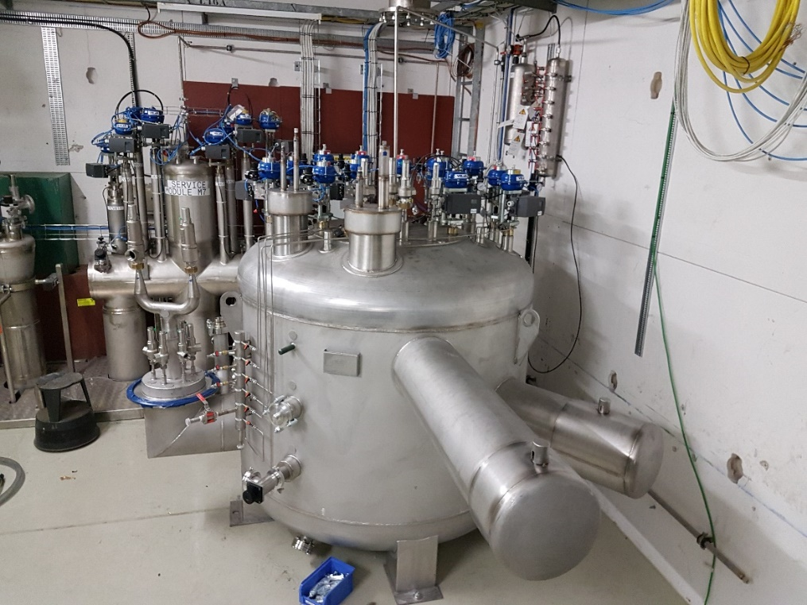
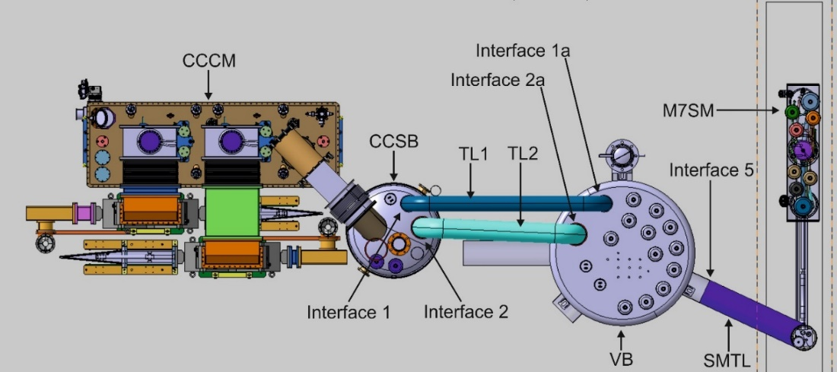
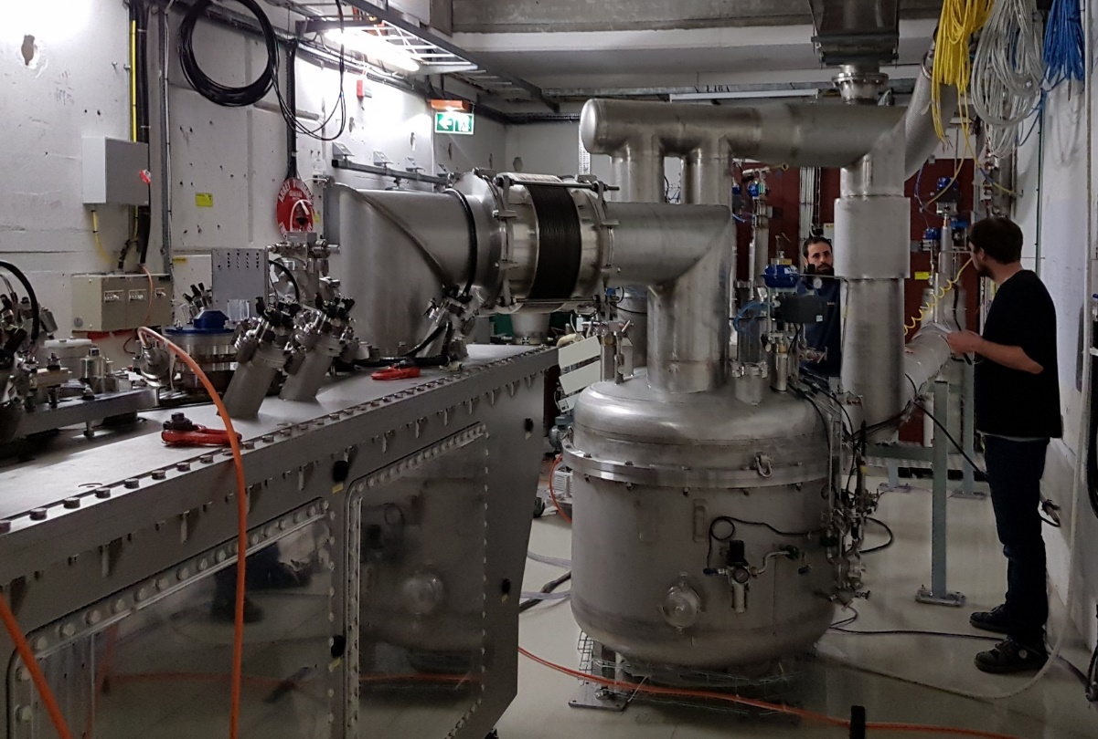
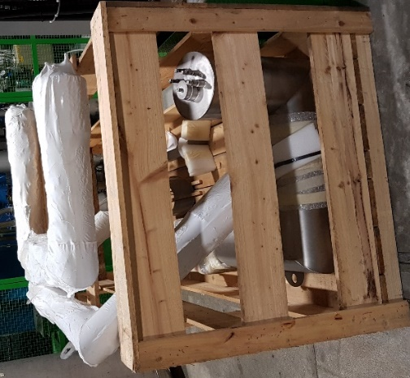
TL3 & Mechanical I/F
Test in 2017 with SB : adapted I/F with CCCM
VB installed in M7 bunker
TL1 TL2
Compressible bellows
TL4
TL3
Storage of TL1, TL2 & TL3 for the three test configurations in M7 bunker

Slide 8
Interface compatibility – proposal 1 : TL3 + TL4
Valves missing to separate CS and CC’ circuits
Proposal to use interface 4 (HG CM) to supply CC’ via DN 8 valve 7CV830 on TL4 interface and connect KD and F (cold return 4.5K)
=> Regulation at the inlet and T with 50 K gas and bypass 7CV809 (to be studied)
=> TL3 to be modified

Slide 9
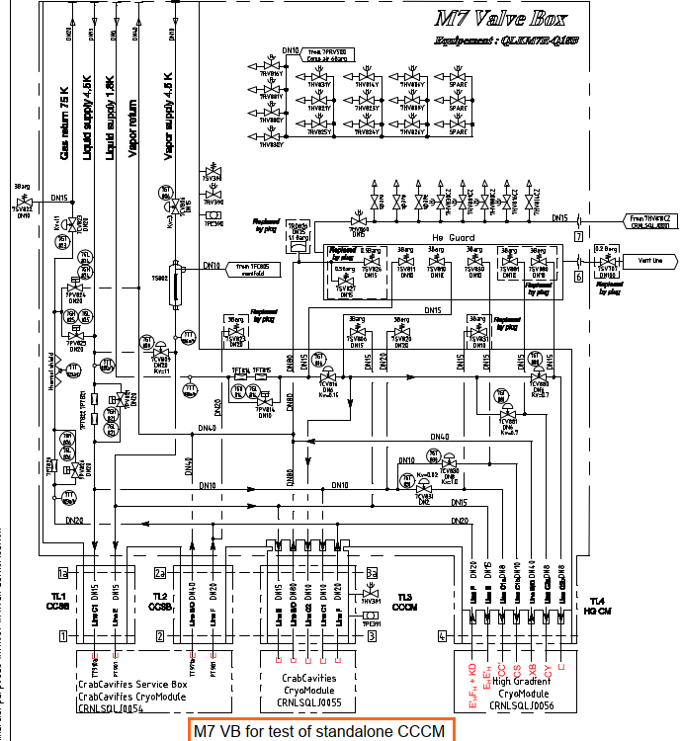
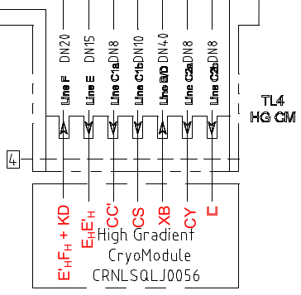
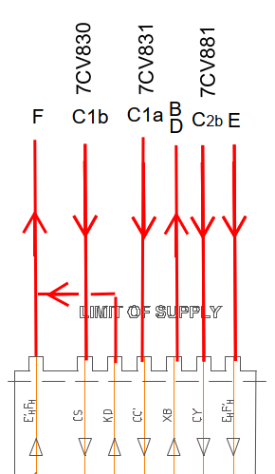
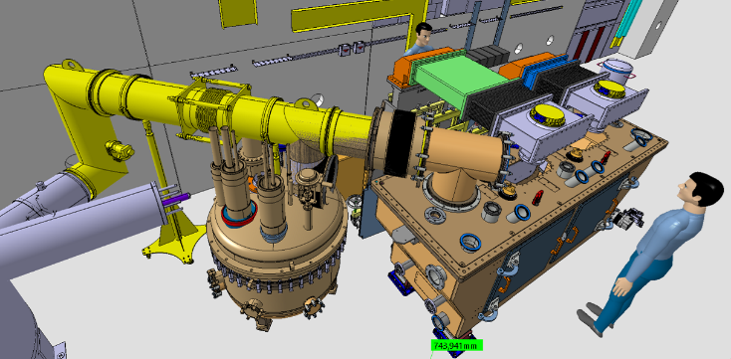
Interface compatibility – proposal 2 : TL4
Valves available on TL4
Valve sizes too small
-> upgrade plugs and seats
XB size (pressure drop & safety) : TL3 DN80 -> TL4 DN40. OK as safety devices are on CCCM.
CC’ supply via 7CV831 (DN 2) valve on TL4 interface and connect KD and F (cold return 4.5K). CS supply via 7CV830
New TL4
Study to define new and fixed interface (I/F) between TL4 and various CCCM
Integration in M7.
TL4

Slide 10
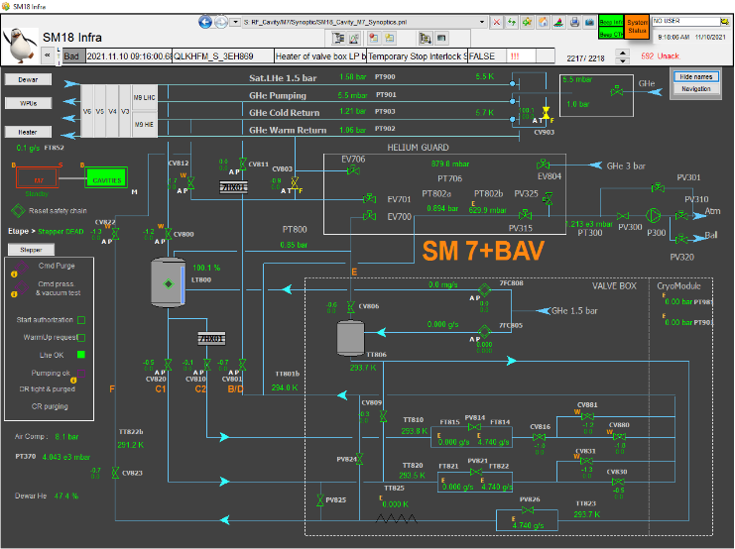
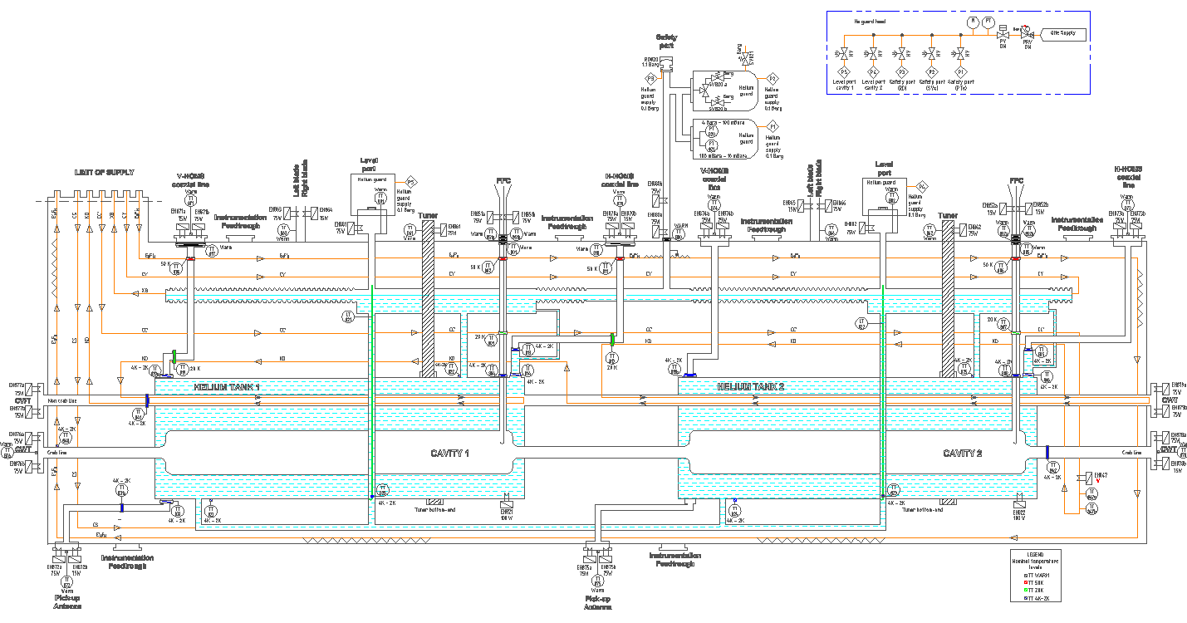
CCCM instrumentation & control system
For the test of DQW CCCM end of 2017, all the instrumentation infrastructure (crates, …) was moved to SPS-BA6 with the tested equipment (SB+CCCM)
Considering that ten tests of CCCM are scheduled, M7 shall be equipped with a fixed infrastructure for the CCCM instrumentation -> budget impact
Control system : control logic and synoptic to be updated

Slide 11
TE-CRG Project Organization
CRG M7 Coordination Project Management
O. Pirotte
WP4 CRG Coordinator & Management
K. Brodzinski
Design & integration
TE-CRG-ME O. Pirotte E. Miquet-Sage
Manufacturing & installation
TE-CRG-ME TBD
Instrumentation & connectors, cabling
TE-CRG-CE N Vauthier B Ivens
Controls
TE-CRG-CE T. Barbé M Pezzetti
Commissionning & Operation
TE-CRG-ML JP Lamboy

Slide 12
Summary & Next steps
A solution to test the CCCM with the present infra M7 is possible with the TL4 interface but requires changes :
  Mechanical I/F between M7 cryo infra and CCCMs : TE-CRG / SY-RF / EN-MME / EN-ACE
  Final integration in M7, incl. cabling and racks : TE-CRG / SY-RF / EN-MME / EN-ACE
The CCCM instrumentation (supply and infra in M7) is coordinated by TE-CRG-CE and SY-RF
Control logic : update functional specification : TE-CRG
Budget estimation : 200 kCHF (150 kCHF for M7 DAQ + ctrl syst, + 50 kCHF for infra M7 incl. new TL4)
Planning

