Slide 1
Survey :
Proto TCM0
Test Bunker (SM18)
2022
Vivien RUDE
2021-11-16

Slide 2
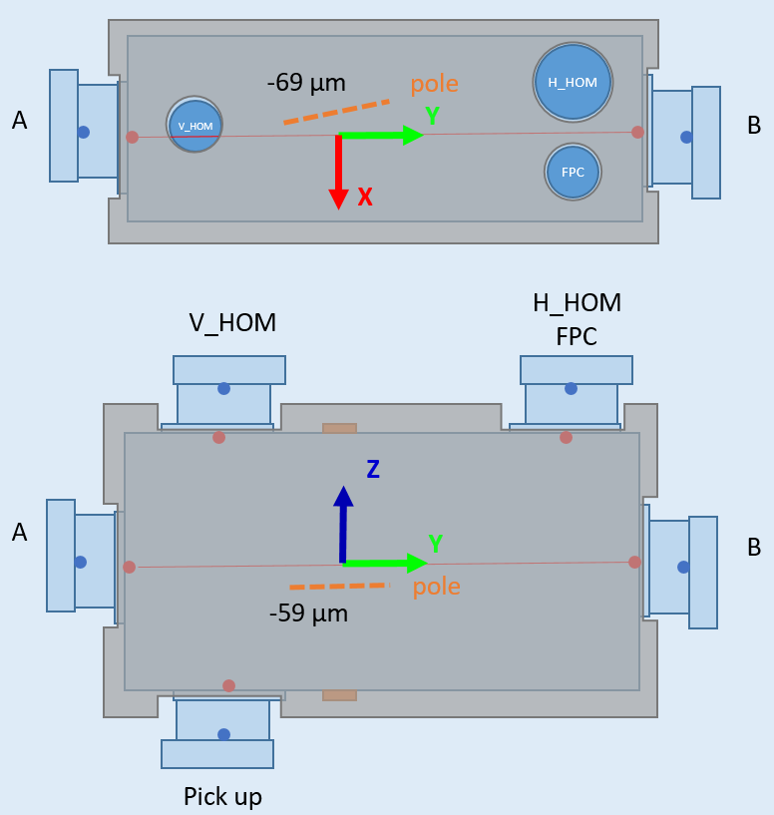
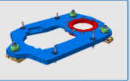
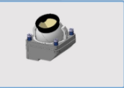
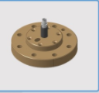
Version : 2021-11-08
PROTO RFD
Q4
2021
Q1
2022
Q2
2022
Q3
2022
Q4
2022
Q1
2023
Sept.
Jan.
UK
CERN SM18
SPS
Nov / Dec 2021:
Fiducialisation (TANK)
(analyze of CMM)
∼March 2022:
Alignment ISO 5
Alignment below top plate
Test of adjustment system (Step 6)
∼ April 2022:
Fiducialisation
Installation of FSI targets (Step 8)
Aug 2022:
SM18 Preparation
(FSI system, optical fibers, floor marking, jacks)
Dec 2022 :
SPS : uninstallation DQW
Sept 2022:
Reception : Measurement after transport
Connection (optical fibers)
Test of adjustment system
Jan 2023 :
SPS : installation RFD
Oct 2022:
Impact of vacuum (3 cycles) → Tomography ? → photogrammetry
Cooling down / warm up (3 cycles)
∼ May 2022:
Installation of FSI system
Installation of FSI heads (Step 13)

Slide 3
Thank you
for your attention

Slide 4
SPARE

Slide 5
Version : 2021-11-08
PROTO RFD : survey milestones
Q4
2021
Q1
2022
Q2
2022
Q3
2022
Q4
2022
Q1
2023
Sept.
Jan.
UK
CERN SM18
SPS
Dec. 2021 : Definition of mechanical axis of Dressed cavities
April 2022 : 18 supports + targets + Orientation tools + procedure
May 2022 : 18 FSI heads calibrated (after vacuum test)
May 2022 : 18 Optical fibers
May 2022 : 1 FSI system
August 2022 : 18 protection of FSI heads
Sept. 2022 : 2 inclinometers + interface
Sept 2022 : 2 Gimsa ??

