Slide 1
Crab Cavities
HPRF power tests in SM18
eric.montesinos@cern.ch
20211116

Slide 2
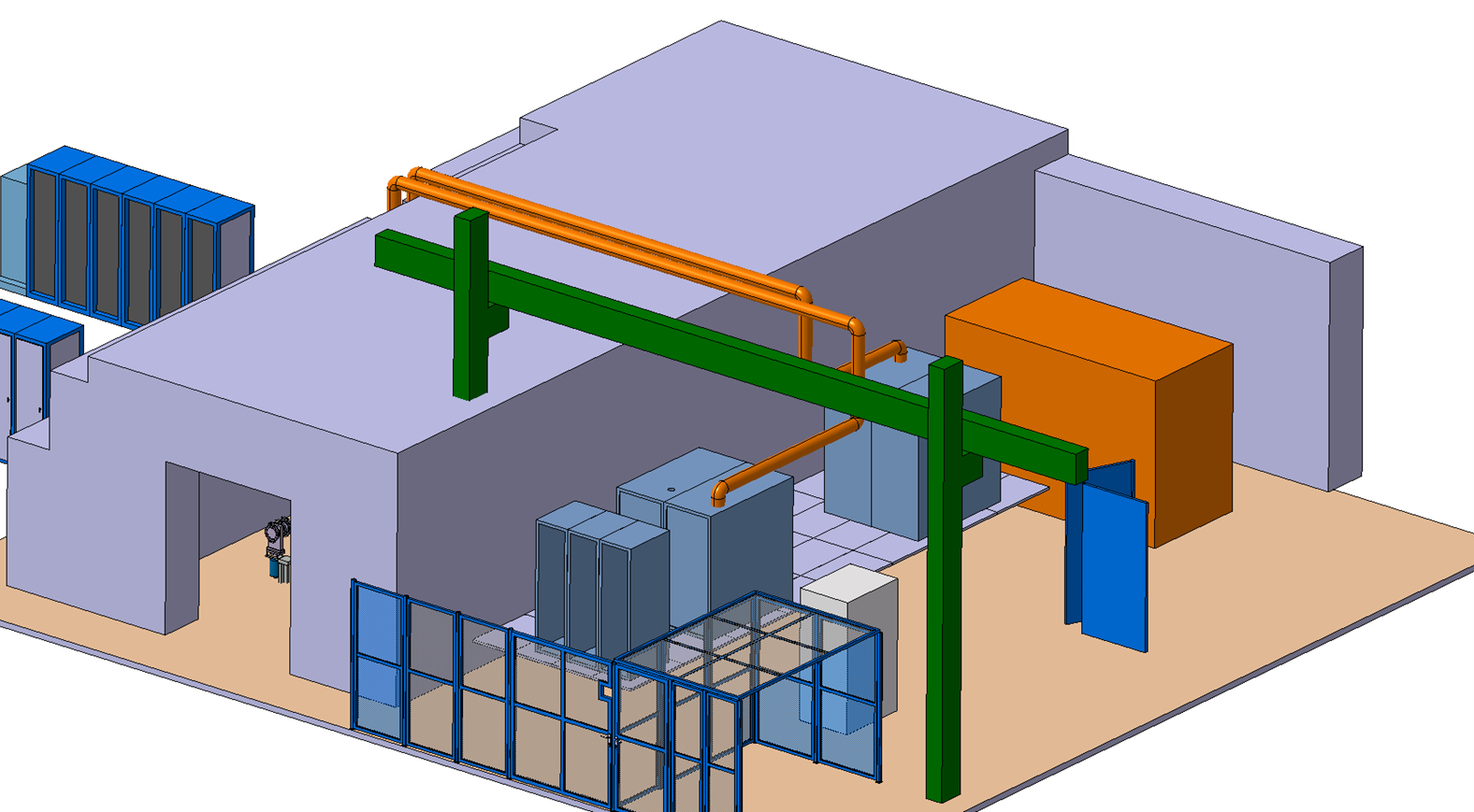
HPRF 20 kW cw + 20 kW cw
Services
  Inlet 2 x 400 VAC 250 A
  Water cooling
  Inlet pressure maximum 5 bars
  Outlet pressure maximum 2 bars
  Flow minimum 4 m³/h
FPC WG system
6-1/8” output to bunker WR2300HH
Generator from LLRF +10 dBm
First amplifier = IOT, 4 months from t0
Second amplifier = IOT or SSPA, 18 months from t0
Coaxial lines
HPRF2
Local controls
HPRF1

Slide 3
Cable list (all cables already there since 2015)
Name | Type | Qty | From |  | To
Power Driver | 3/8’’ | 2 + 1 | SSPA | Control Room | Power Amplifier | RF Area
Power Amplifier | 6-1/8’’ | 2 + 1 | Power Amplifier | RF Area | Circulator | Bunker
Driver Fwd Output signal | CD50B | 2 + 1 | SSPA | Control Room | RF Power Control Rack | Control Room
Driver Rev Output Signal | CD50B | 2 + 1 | SSPA | Control Room | RF Power Control Rack | Control Room
Amplifier Fwd Output Signal | CD50B | 2 + 1 | Power Amplifier | RF Area | RF Power Control Rack | Control Room
Amplifier Rev Output Signal | CD50B | 2 + 1 | Power Amplifier | RF Area | RF Power Control Rack | Control Room
Circulator In Fwd Signal | CD50B | 2 + 1 | Circulator | Bunker | RF Power Control Rack | Control Room
Circulator In Rev Signal | CD50B | 2 + 1 | Circulator | Bunker | RF Power Control Rack | Control Room
Circulator Load Fwd Signal | CD50B | 2 + 1 | Circulator | Bunker | RF Power Control Rack | Control Room
Circulator Load Rev Signal | CD50B | 2 + 1 | Circulator | Bunker | RF Power Control Rack | Control Room
Coupler Fwd Input Signal | CD50B | 2 + 1 | Coupler | Bunker | RF Power Control Rack | Control Room
Coupler Rev Input Signal | CD50B | 2 + 1 | Coupler | Bunker | RF Power Control Rack | Control Room
Transmitter PS 400 V – 250 A | 3PH + N + T | 2 + 1 | EL | SM18 | Transmitter IOT | RF Area
Transmitter PS 400 V – 32 A | 3PH + N + T | 2 + 1 | EL | SM18 | Transmitter IOT | RF Area
Transmitter PS 230 V – 16 A UPS | PH + N + T | 2 + 1 | EL | SM18 | Transmitter IOT | RF Area
Control Rack PS 230 V – 16 A UPS | PH + N + T | 2 + 1 | EL | Control Room | RF Power PLC Control Rack | Control Room
Blower Coupler - WG | 4*2.5² (400 V) | 2 + 1 | RF Power PLC Control Rack | Control Room | Near table | Bunker
Pump Coupler | 4*2.5² (400 V) | 2 + 1 | RF Power PLC Control Rack | Control Room | Near table | Bunker
Interlocks, Cmd & measures Coupler & Circulator | NE48 | 4 + 1 | Coupler | Bunker | RF Power PLC Control Rack | Control Room
Interlocks, Cmd & measures Amplifier | NE48 | 4 + 2 | Transmitter IOT | Control Room | RF Power PLC Control Rack | Control Room
PLC bus | VE2R | 2 + 1 | Transmitter IOT | Control Room | RF Power PLC Control Rack | Control Room
Ethernet |  | 6 |  |  | Transmitter IOT RF Power PLC Control Rack RF Power Control Rack | RF Area Control Room Control Room

