Slide 1
Vertical Test Cryostat and possibility to test
Dressed Crabs
Vittorio Parma
CERN – SY/RF Group
26th WP4 Coordination Meeting
CERN, 16 November 2021

Slide 2
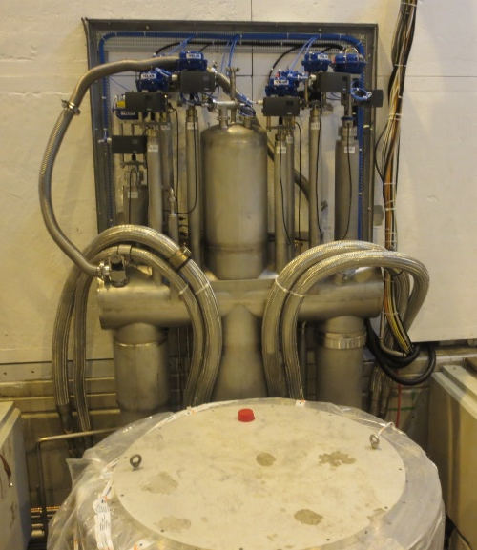
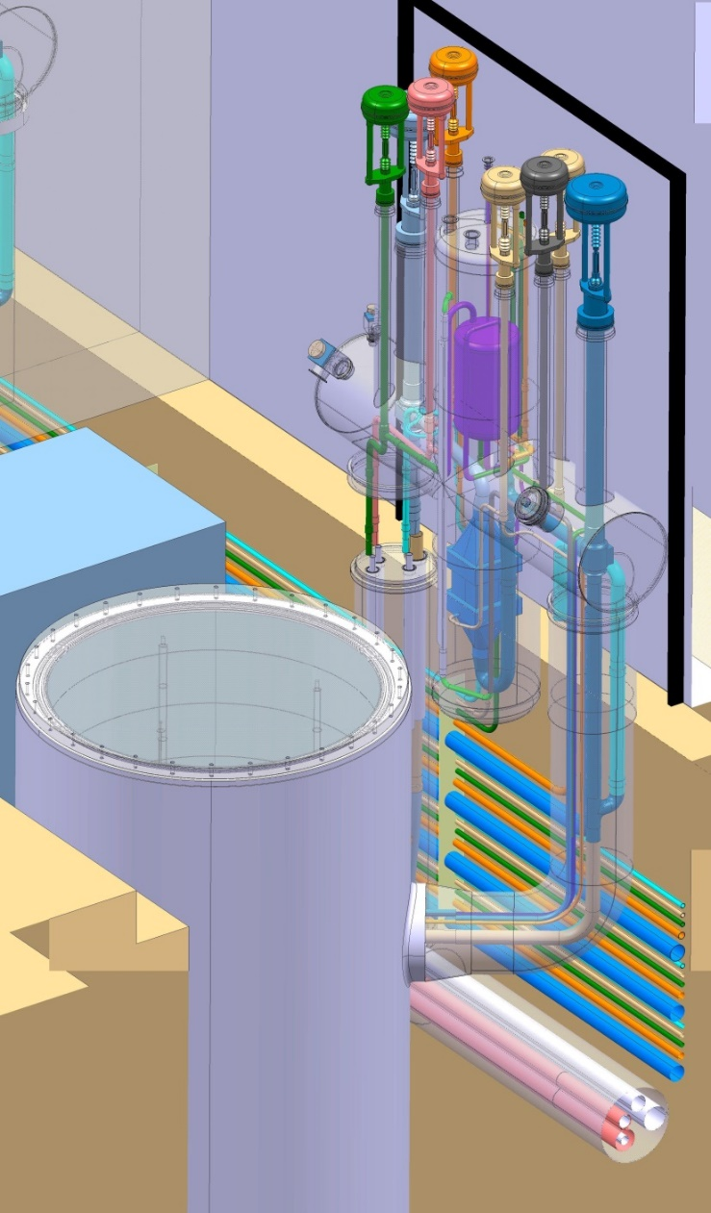
Vertical test stations
Old design (LEP era):
Conduction-cooled shield
Cryo supply from top plate
  Bayonets
Newer design:
Actively cooled shield
Side cryo supply
  Permanent (faster, more reliable)
  Better performance (no bayonet losses)

Slide 3
Renewal strategy of vertical test cryostats
SRF test program in coming years relies on intense use of V3 (not only for Crabs), V4 for smaller cavities
V5 remains available for HIE Isolde cavities and new cavities (SWELL), but performance limitations need to be assessed
V6 (cryostat from the LEP era), remained in place for LHC cavities, now also can be tested in V3
→ Upgrade of V6 decided in July, replace with a new V3 (long cryostat) to mitigate demands on V3
Order placed in single-source (for standardisation) to original manufacturer of V3 (contractual supply date: end of February 2022)
Contract follow-up by CRG (O.Pirotte) with me as deputy

Slide 4
Dressed Crab in vacuum
Vertical testing in vacuum: use helium tank as vacuum vessel → most convenient solution
Introduce a (minimal) modification of the new V6 so that it can operate in dual mode (standard or under vacuum) requiring limited reconfiguration time/effort → ask the manufacturer to make the modification on V6 (not discussed yet)
Build a new insert with cryo ancillaries (helium tank, level gauges, etc.) (similar to V5 insert for HIE Isolde cavities)
New V6 (as V3 and V4): cryogenics supplied from the side → new insert needs to be connectable at (or after) insertion
Conceptually doable, but study needed → design study undergoing by MME (P.Minginette)

Slide 5
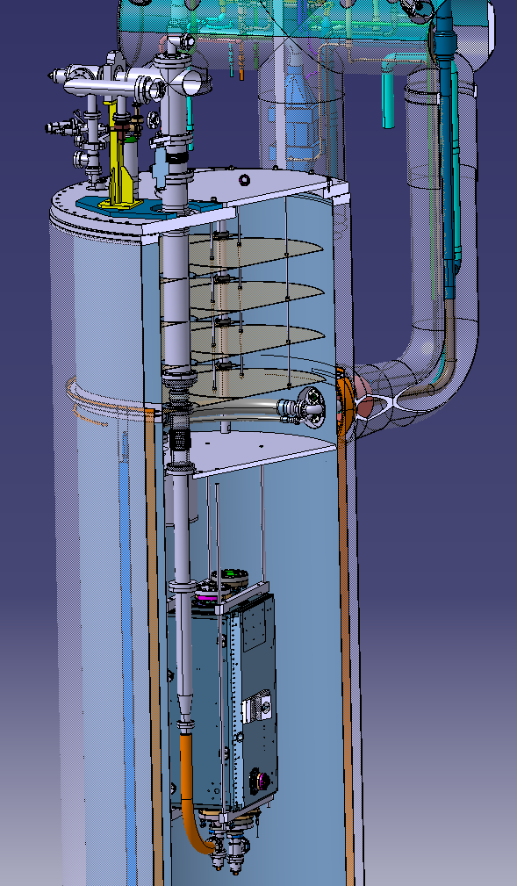
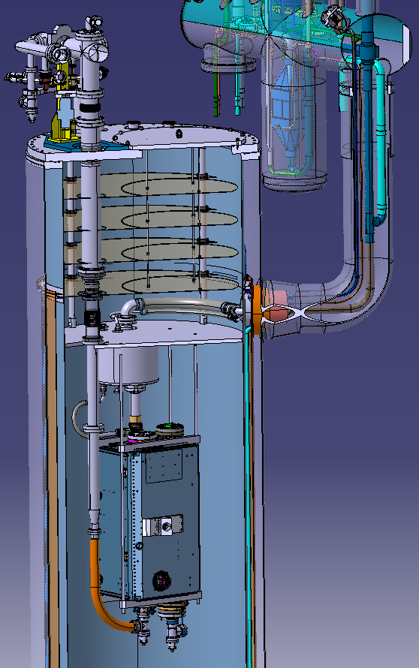
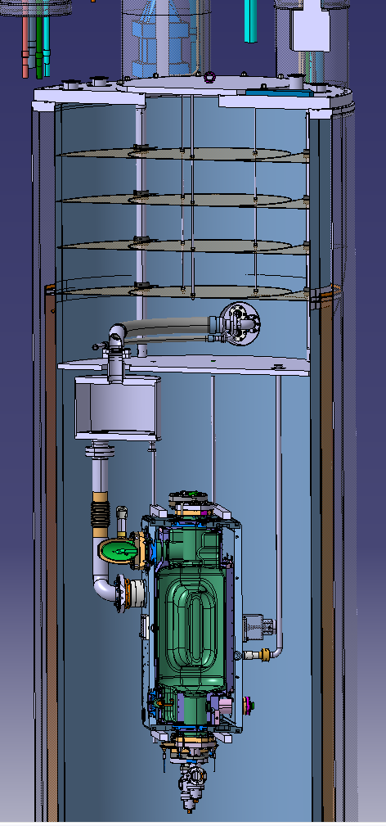
Preliminary study (RFD)
P.Minginette, EN-MME

Slide 6
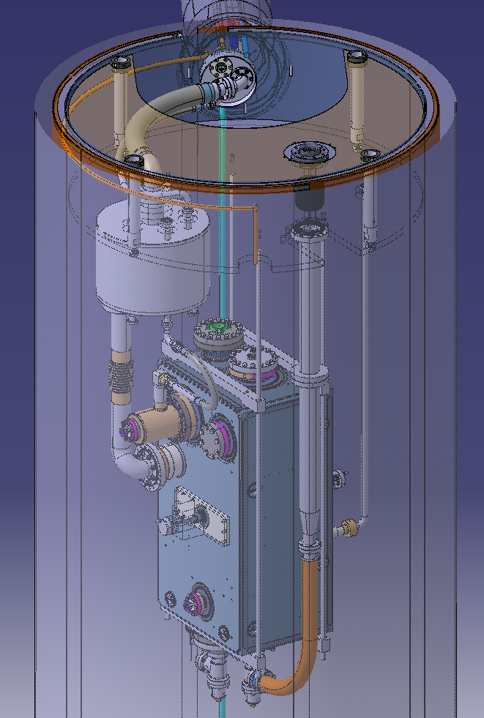
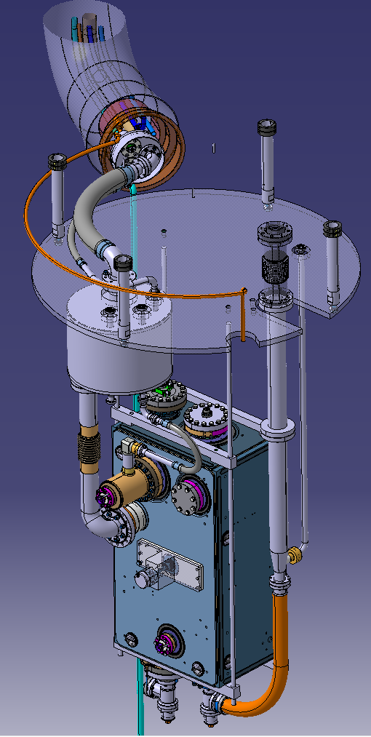
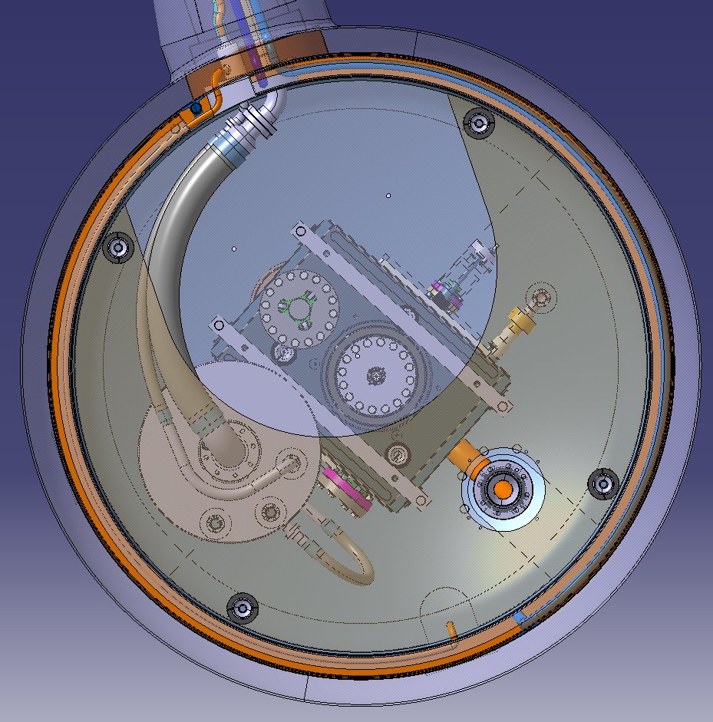
Preliminary study (RFD) (cont.d)
P.Minginette, EN-MME

Slide 7
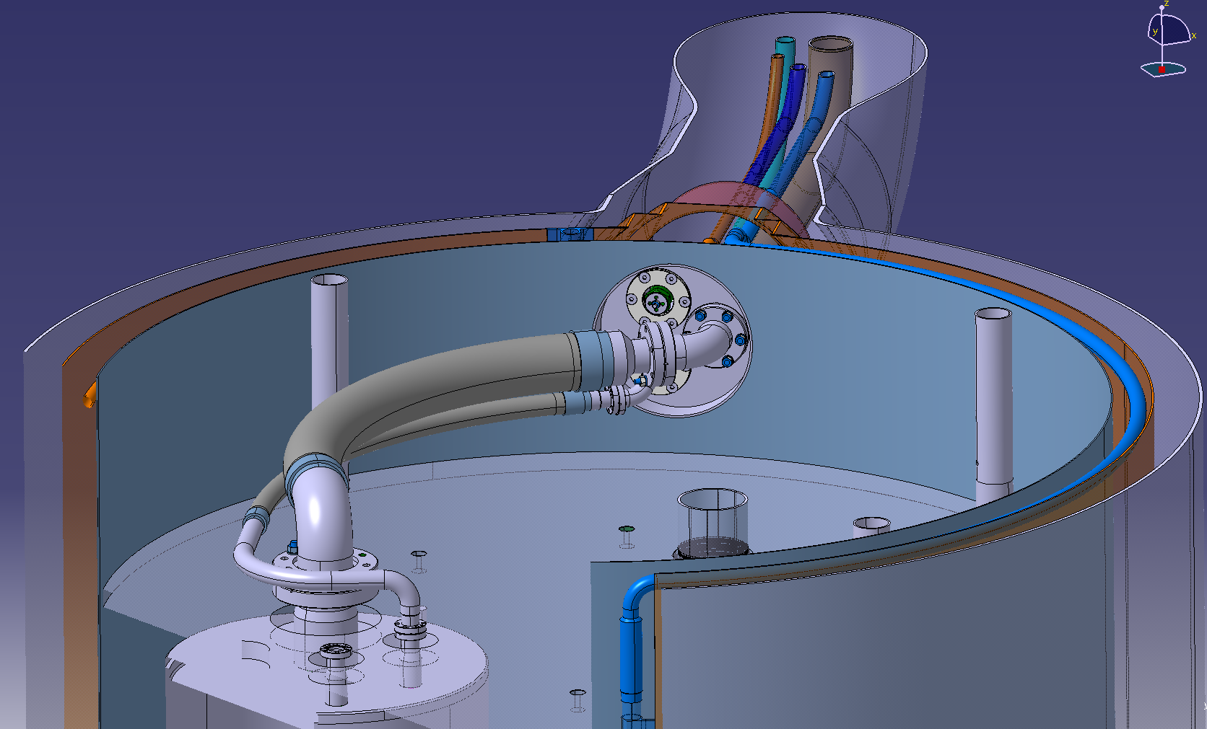
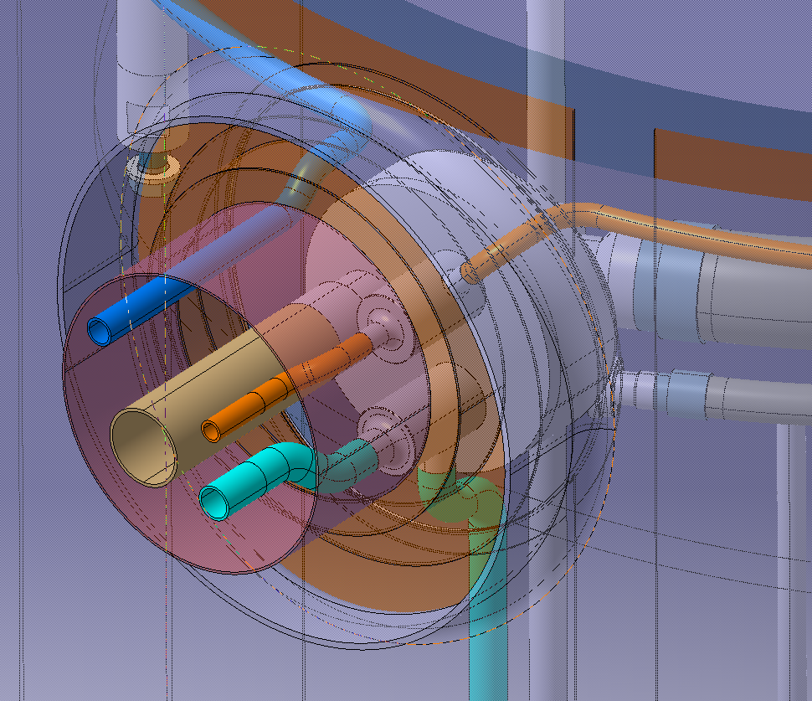
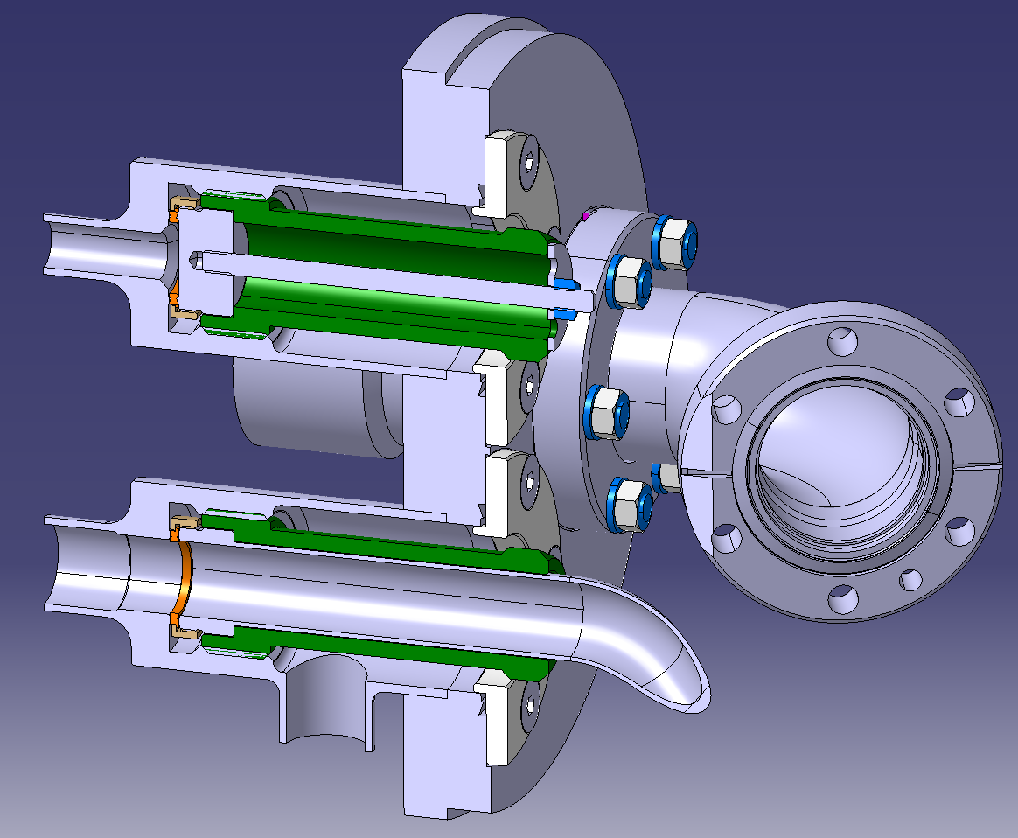
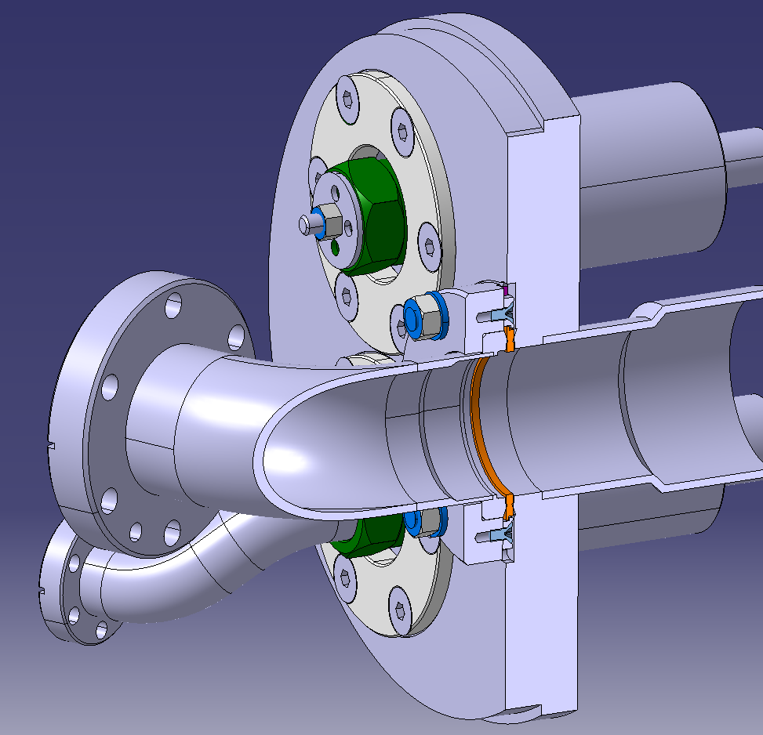
New V6 helium vessel adaptor flange
P.Minginette, EN-MME

Slide 8
Summary
From the preliminary study, the accessibility for connection to the side cryo supply is doable but quite complex: requires an operator to access from the top plate and do the connections (CF flanges) with little visibility
The adaptation flange which needs to be assembled to the new V6 would need to be made available in time with the manufacturing calendar at the company (to be checked with CRG)
Backup options to be studied:
  Test on V5, with new insert (with bayonets):
    Not considered so far as 2 K operation appears to be limited (HIE Isolde experience). Is it a hard limit ? (discussion this week with CRG)
  Design of a dedicated vacuum tank on a new insert : → this is a much bigger and costly effort ! Last option.
A new insert needs to be constructed in all cases
Goal remains to have a testing solution by mid of next year

