Slide 1




n_TOF
Report, Week 41-42
21/10 – 28/10/2021
On behalf of the n_TOF Collaboration
Javier Praena
Prof. Universidad de Granada (Spain)
CERN Scientific Associate (EP/SME) n_TOF Physics Coordinator
1

Slide 2



Summary of the week
Issue on Module fault from Monday to Tuesday, BE team was able to provide beam with this issue →Thank you very much to Frank Tecker and all the PS and BE team.
Variations on the beam size, maybe a problem for the target because of the lower dimensions. No problem from the “Physics” size. Interlock already setup. Thanks
Present week is as expected from the average intensity (140-160e10 p/s).
Present week is very good in terms of number of high (8.5e12ppp) and low (2e12ppp) intensity pulses.
Timing is an issue that is already under studied by BE and PS team. We have to continue working on it. Next week a meeting with Elisabeth Renner.
EAR1: physics program ¹⁷⁶Yb(n,γ)¹⁷⁷Yb→¹⁷⁷Lu, for production of ¹⁷⁷Lu for cancer therapy.
EAR2: physics program ^{94,95,96}Mo(n,γ) for astrophysics.
NEAR: commissioning of the neutron flux (outside the bunker)
    R2E irradiations (outside the bunker)
    R2M irradiations (inside the bunker)
Javier Praena – U. Granada – CERN (EP/SME)
PS/SPS Meeting, 28/10/2021

Slide 3
Beam stops
Beam stops:
  Monday 01/11/2021, from 5:00 to 12:30.
    Changing setup in EAR2
    Changing setup in NEAR (cooling time)
  Depending on the result of the new setup in EAR2 we could need another stop on Tuesday 02/11/2021. I will report to PS coordinator and BE.
Javier Praena – U. Granada – CERN (EP/SME)
PS/SPS Meeting, 28/10/2021

Slide 4
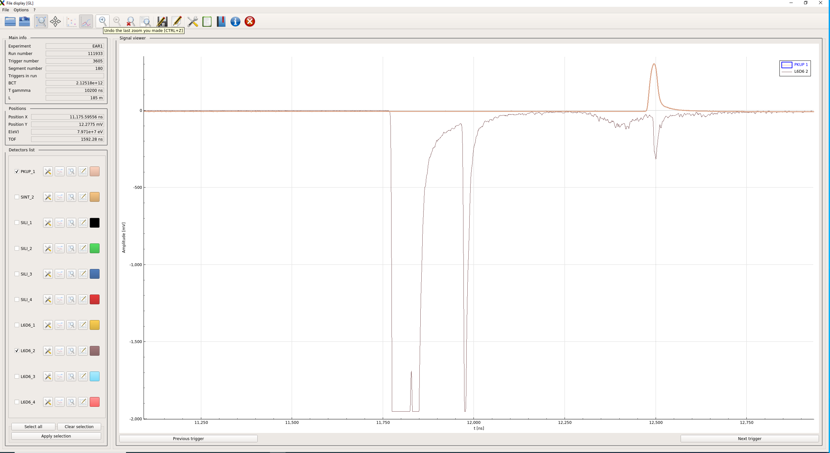
Timing issue: “good” pulse (low intensity)
Javier Praena – U. Granada – CERN (EP/SME)
PS/SPS Meeting, 28/10/2021

Slide 5
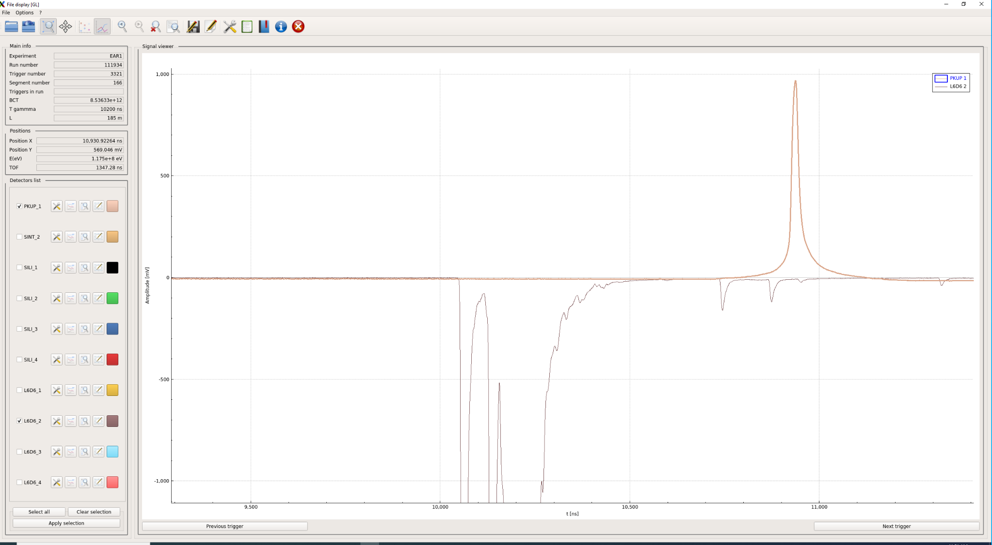
Timing issue: “bad” pulse (high intensity)
Javier Praena – U. Granada – CERN (EP/SME)
PS/SPS Meeting, 28/10/2021

Slide 6
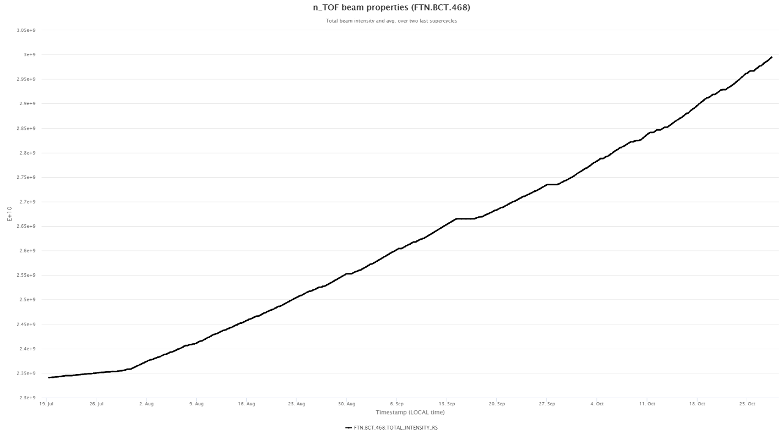
Number of protons up to now
Total number = 64e17
In the campaigns previous to the LS2 the average number of protons per day 1e17 (including only days with beam, beam stops….).
The present year 2021:
  25e17 for the target commissioning, up to 13/09/2021.
  13/09/2021-28/10/2021 = 38 days
  We expected 63e17 protons and we have received 64e17 (“one day more”). Specially because the present we could get more beam than previous weeks.
Javier Praena – U. Granada – CERN (EP/SME)
PS/SPS Meeting, 28/10/2021

Slide 7

Javier Praena
Universidad de Granada (Spain)
CERN Scientific Associate (EP/SME) n_TOF Physics Coordinator
Thank you
7

Slide 8
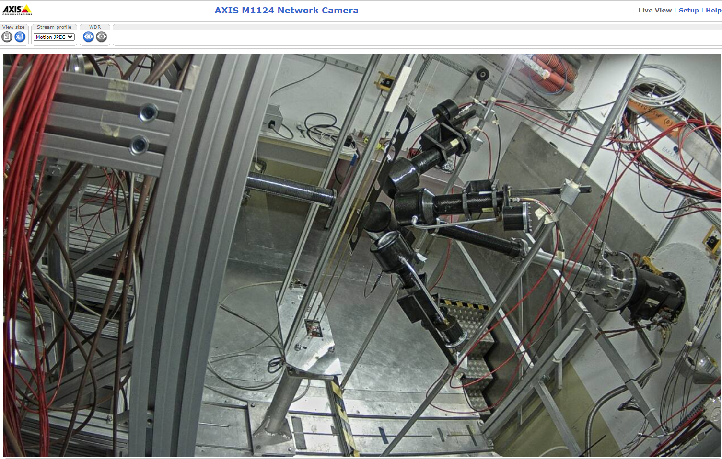
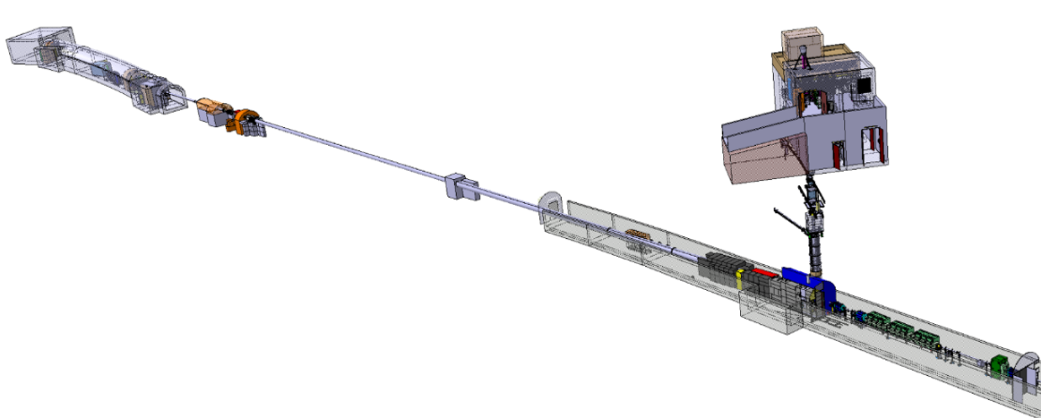

EAR1: continue commissioning time-to-energy conversion.
EAR1
@ 185 m
Neutrons
20 GeV
PS Protons
8
Javier Praena – U. Granada – CERN (EP/SME)
PS/SPS Meeting, 14/10/2021

Slide 9
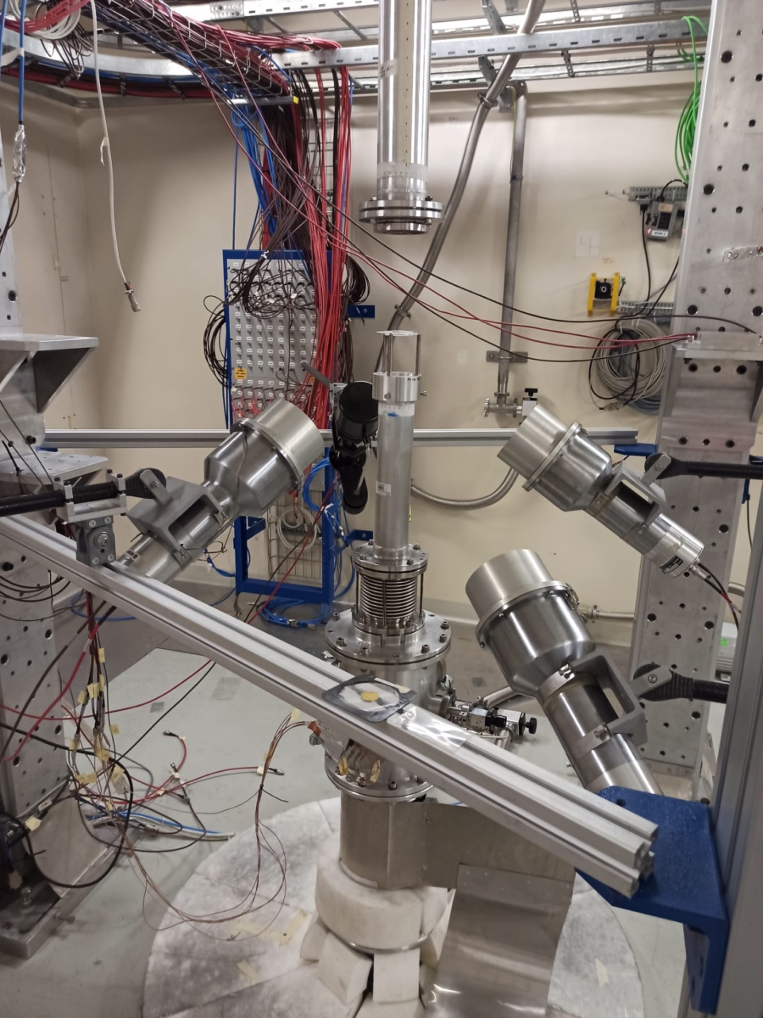
EAR2: start of Physics Measurements before expected
^{94,95,96}Mo(n,γ) with application to astrophysics
EAR2
@ 20 m
Neutrons
Neutrons
Neutrons
20 GeV
PS Protons
9
Javier Praena – U. Granada – CERN (EP/SME)
PS/SPS Meeting, 21/10/2021

Slide 10
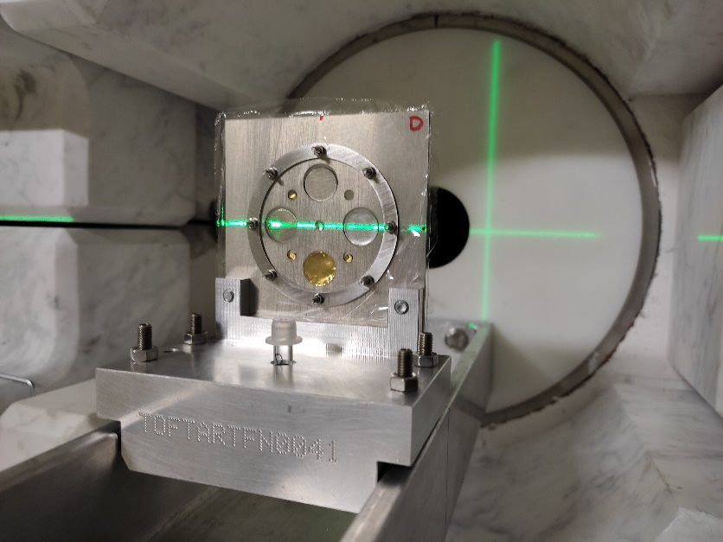
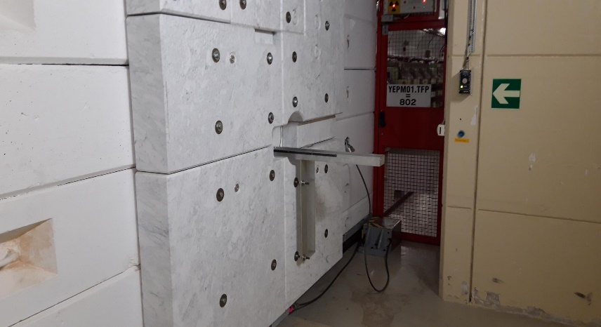
NEAR: multiactivation characterization of the neutron flux
EAR1
@ 185 m
NEAR:
N_TOF
R2M
R2E
20 GeV
PS Protons
10
Javier Praena – U. Granada – CERN (EP/SME)
FOM Meeting, 12/10/2021

Slide 11
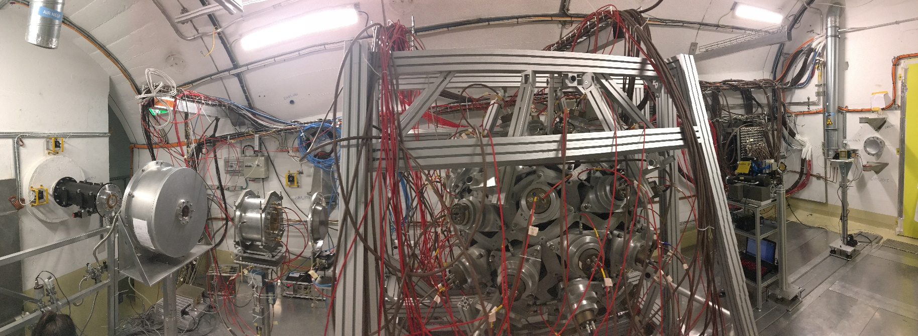
EAR1: previous setup.
EAR1
@ 185 m
PPAC1
(2x²³⁵U, gas
On-beam)
C₆D₆ and iTED
Neutrons
PTB (10x²³⁵U,gas
on-beam)
Simon1
(4 Si detectors off-beam)
Timepix1.2
(Si detector
On-beam)
MGAS1 (²³⁵U and 2x¹⁰B
(Gas Ionization on-beam)
20 GeV
PS Protons
11
Javier Praena – U. Granada – CERN (EP/SME)
PS/SPS Meeting, 30/09/2021

Slide 12
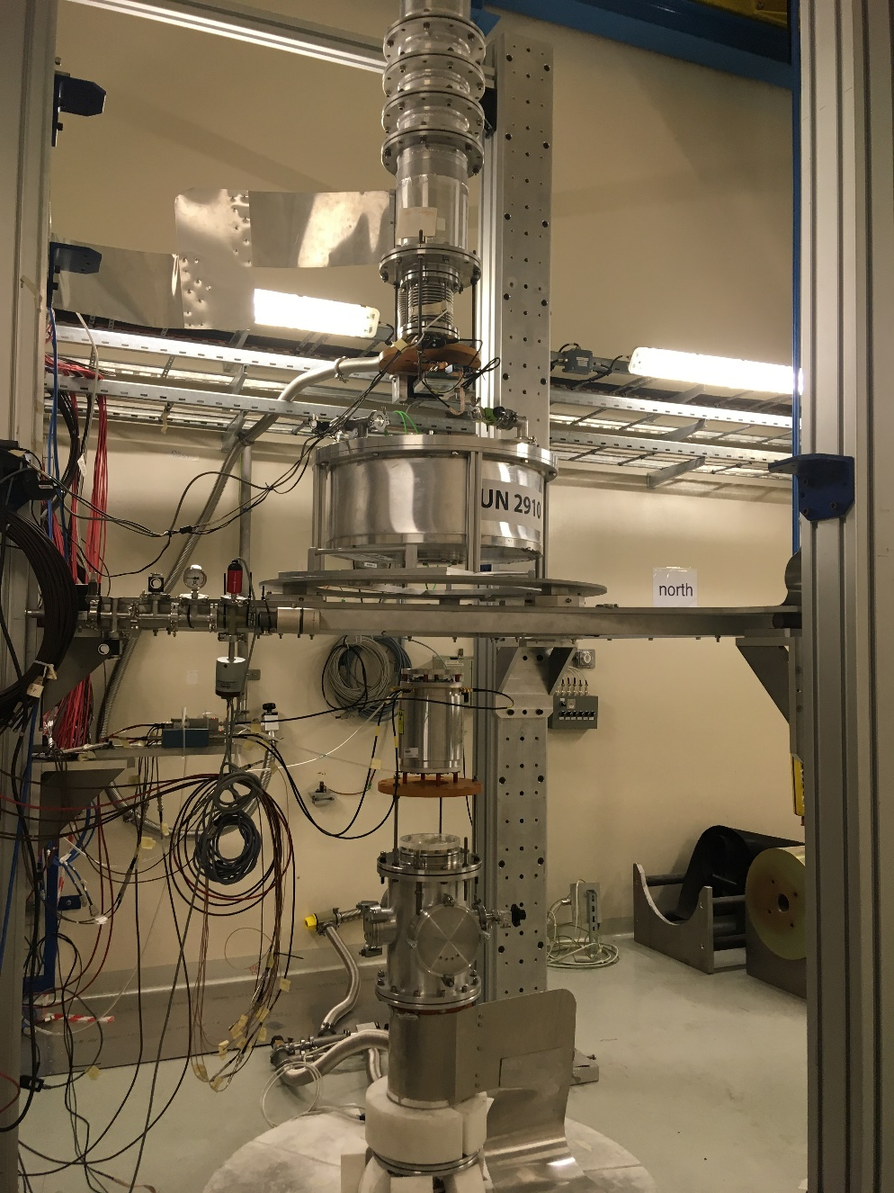
EAR2: previous setup
Neutrons
PPAC1
(²³⁸U, ²³⁷Np gas, on-beam)
EAR2
@ 20 m
Neutrons
MGAS2 (²³⁵U, ¹⁰B, gas on-beam)
Simon2
(4 Si detectors off-beam)
20 GeV
PS Protons
Neutrons
12
Javier Praena – U. Granada – CERN (EP/SME)
PS/SPS Meeting, 30/09/2021

Slide 13
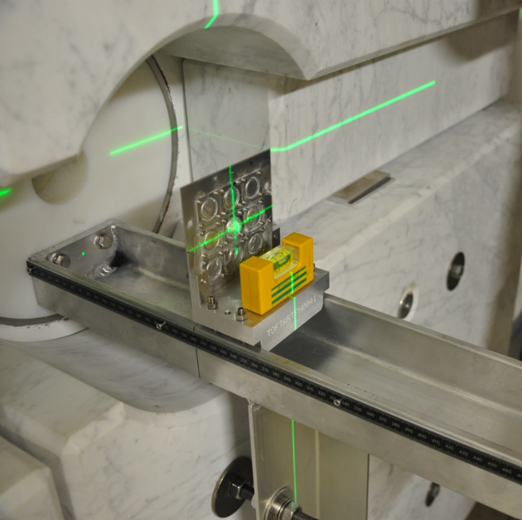
NEAR: change of the setup for multiactivation
EAR1
@ 185 m
EAR2
@ 20 m
NEAR:
N_TOF
R2M
R2E
20 GeV
PS Protons
13
Javier Praena – U. Granada – CERN (EP/SME)
PS/SPS Meeting, 30/09/2021

