Slide 1
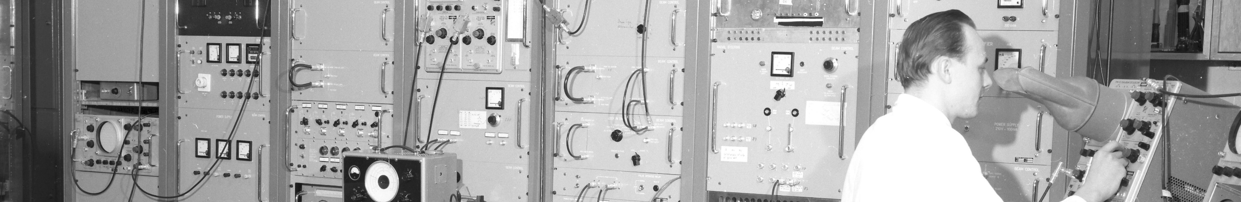
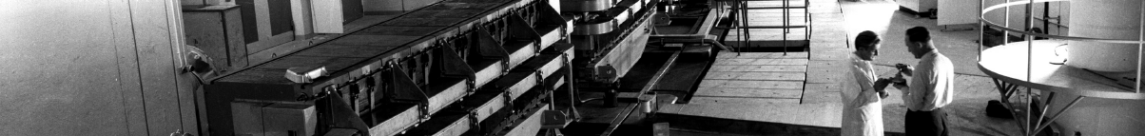
PS Report W42-W43
F63.BHZ04
  tri
Many thanks to the PS operations and coordination team
as well as all related equipment and support teams
Many thanks to Alexander Huschauer as the previous coordinator!

Slide 2
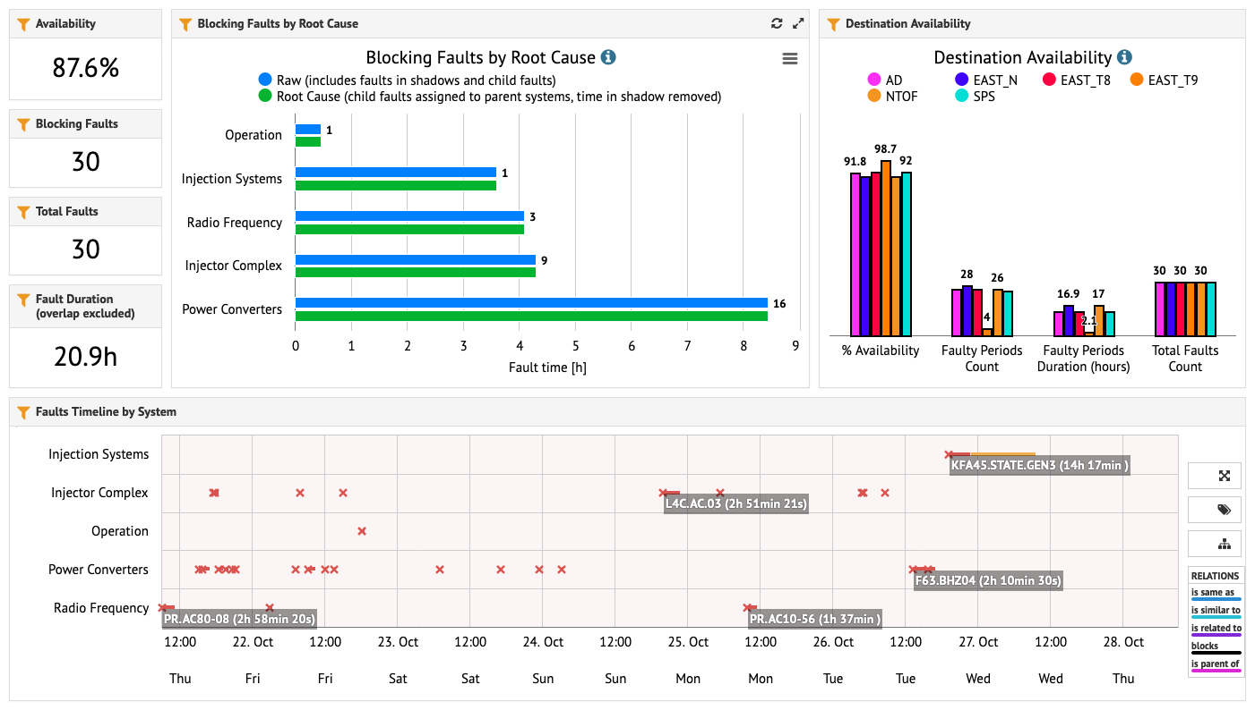
Accelerator Fault Tracking (AFT)
FGC62 upgrade

Slide 3
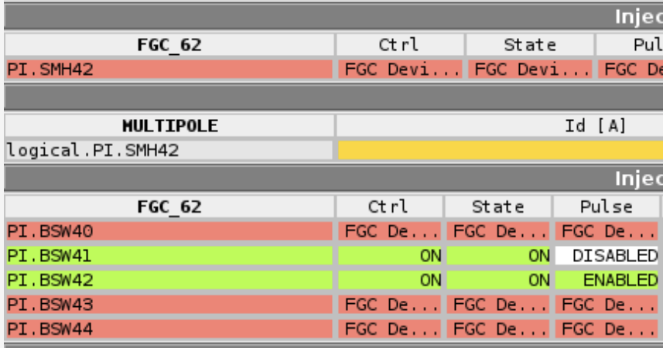
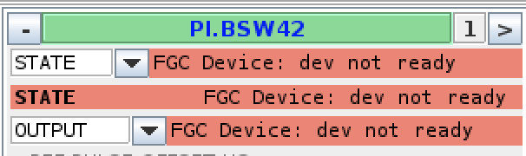
Main Issues
EAST area waterflow issues
  Access on Wednesday morning, but issue occurred again on Sunday morning
Amplifier repair of PA.AC80-08
  Required access, which was performed on Thursday morning
  Linac4 intervention in parallel
  PE.SMH57 condensation checked as well → no issues observed
  About 3 h downtime
Update of the FGC_62 class during the access on Thursday morning
  Update of 18 devices in the PS introduced major problems on the injection and extraction bumper magnets and the injection septum
  Communication to these elements frequently lost during the
  afternoon

Slide 4
Main Issues
Update of the FGC_62 class during the access on Thursday morning (cont.)
  PI.BSW44, PE.BSW14 and PE.BSW22 suddenly pulsed at different values (despite the same reference and only on certain users), depending on the setting of the pulse delay
  Mostly solved by a rollback to the previous class version in the evening
    Configurations had to be resent for extraction power converters
    AQN of PI.BSW44 is still different from reference, some trips of PI.BSW42 still observed
F63.BHZ04
  tripped twice (3h23 downtime for EAST_N), +1/2 hours for follow-up repair
Patrol lost in IRRAD yesterday => Patrol done

Slide 5
Main Issues
F63.BHZ03
  settings change by 75A to center beam
  when EAST_N is played directly after EAST_T8, the beam is to the very right on TMMTV0009
  missing setting for power converter T8.BHZ03 economy mode
    pulsing on wrong cycle => fixed
PI.KFA45
  Module 3 fault => kick for TOF could not be provided (larger than for other users), EAST_T8 degraded
  Operator took up injection steering from the PSB and managed to set up injection with smaller kick!!!
  repaired next morning

Slide 6
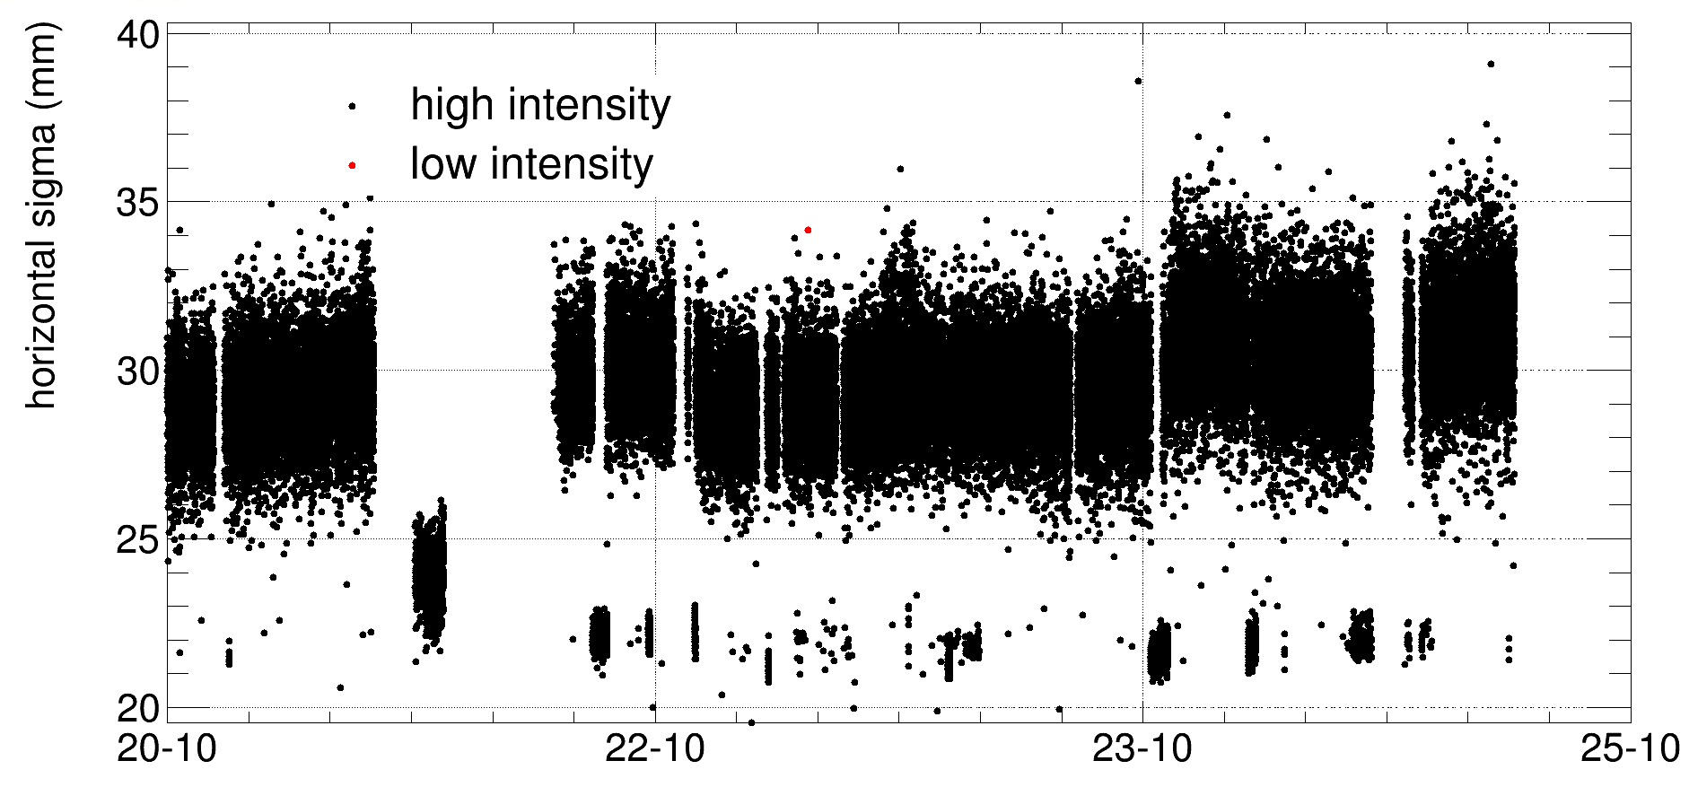
Main Activities and status of beams
  TOF:
  Variations of beam size and position for some (short) periods
  Understood to be related to a trip of a 10 MHz cavity
  SIS task in place to monitor position and beam size on the target
  Threshold set to 25 mm
ION beams
  Improved injection and
  extraction transmission
  of NOMINAL beams
High demand of beams
=> not always possible to
satisfy all users
Michael Bacak

Slide 7
Status of operational beams
Fixed target beams | Status | Comment
SFTPRO (MTE 5 turn extraction) | Operational | Up to ~2 ∙ 10¹³ p/p delivered to SPS
AD | Operational | 1.55 ∙ 10¹³ p
TOF | Operational | Delivered at 8.5 ∙ 10¹² p/b with pre-LS2 optics
EAST | Operational | Extraction up to 60e10 p/p to EAST dump, T8 (slow and fast), T9 and T10/11 Fast and slow extracted ions to EAST dump
LHC-type beams | Status | Comment
LHCPROBE, LHCINDIV | Operational
LHC25 (72b) | Operational | Polished up to 1.3 ∙ 10¹¹ ppb; set up up to > 2.6 ∙ 10¹¹ ppb ε_{h} / ε_{v} (FT) ≈ 1.2 / 1.1 mm mrad (for 1.3 ∙ 10¹¹ ppb)
LHC25 (12 to 48b) | Operational | Settings synchronized with HI variant
LHC25 BCMS (48b) | Operational | Available up to 1.3 ∙ 10¹¹ ppb (3 basic periods)
AWAKE | Operational | 3 ∙ 10¹¹ ppb
Ion beams | Status | Comment
EARLY | Operational | ~1.5 ∙ 10¹⁰ p/p
NOMINAL | Operational | 8 ∙ 10¹⁰ p/p

Slide 8

PS Supervisor of week 43 – Frank Tecker week 44 – Heiko Damerau
Questions and Comments
8:45 Daily Zoom meeting during beam commissioning
Web address: https://cern.zoom.us/j/9372114100?pwd=L29BcmlHUENCdFBRSytXYVcrM1B4Zz09
Meeting ID : 937 211 4100
Passcode: 525463

