Slide 1
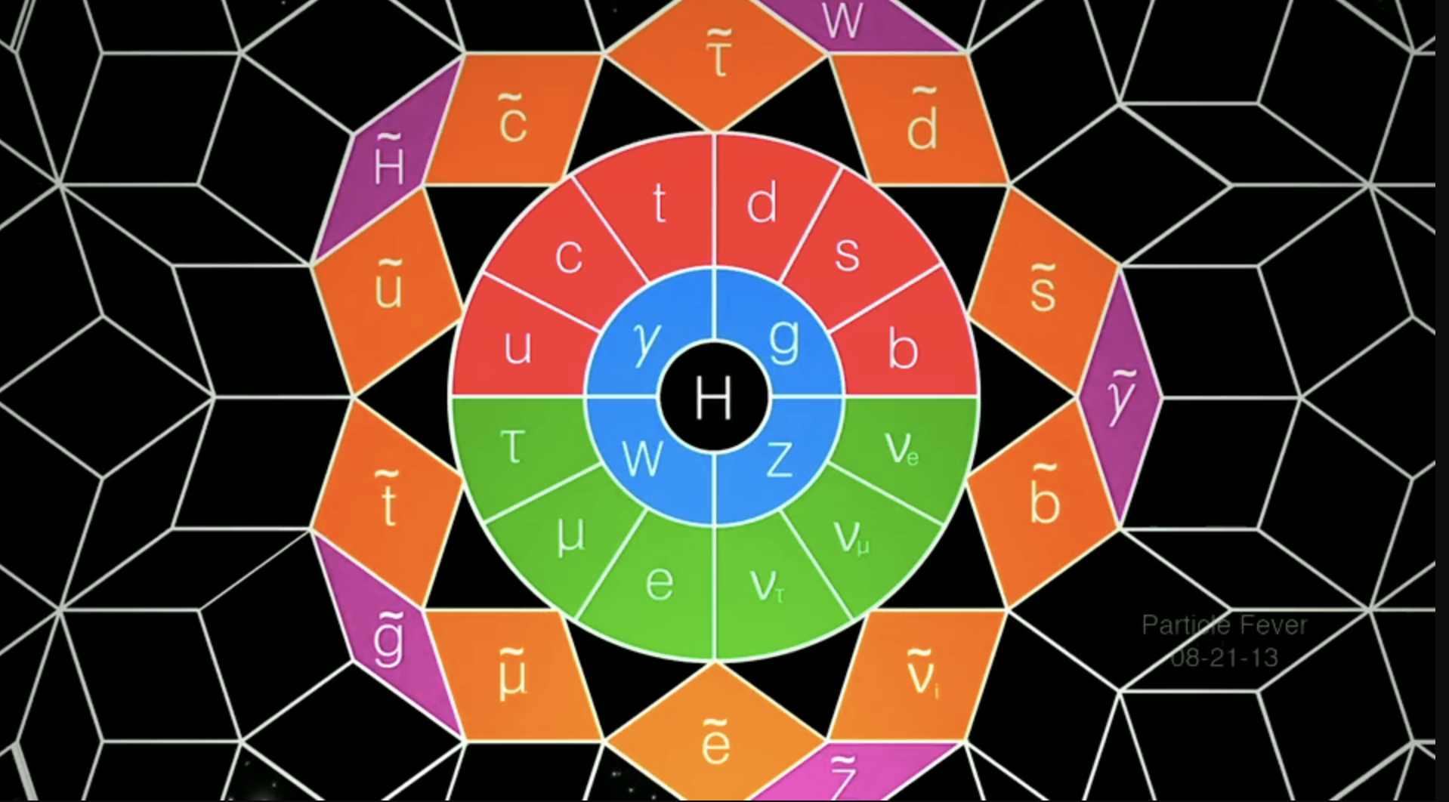


SUSY in
Electroweak & Higgs Sector
“Particle Fever” – The movie
Nausheen R. Shah
ATLAS/CMS Run 3 SUSY Workshop:
New Directions for SUSY Searches with LHC Run 3 Data
Monday Nov 15, 2021

Slide 2
Notorious Supersymmetry
“Particle Fever” – The movie

Slide 3
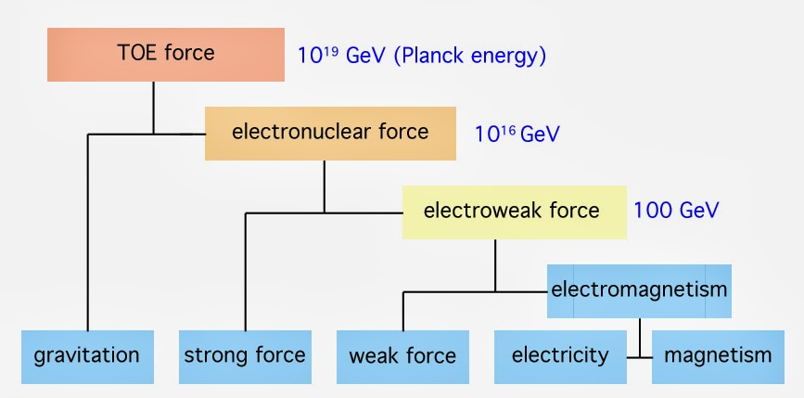
Big Picture
✓
why?
???
✓
What is Dark Matter?

Slide 4
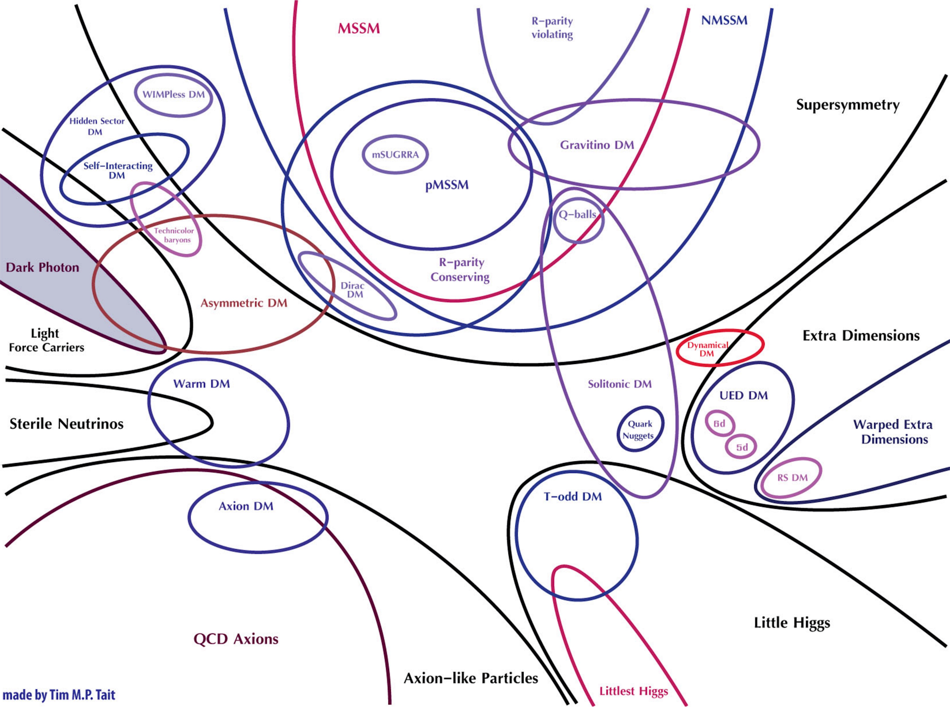
???

Slide 5
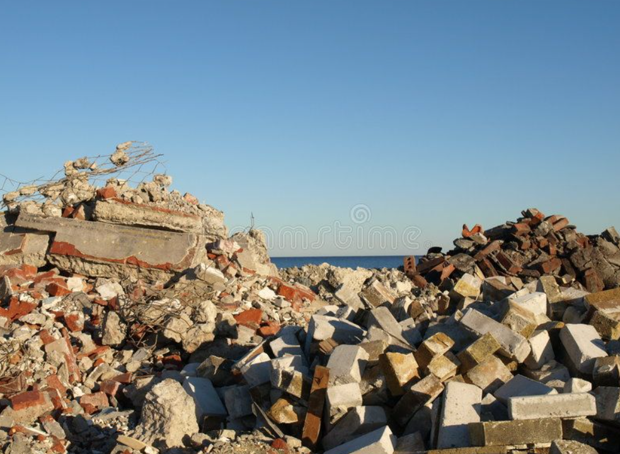
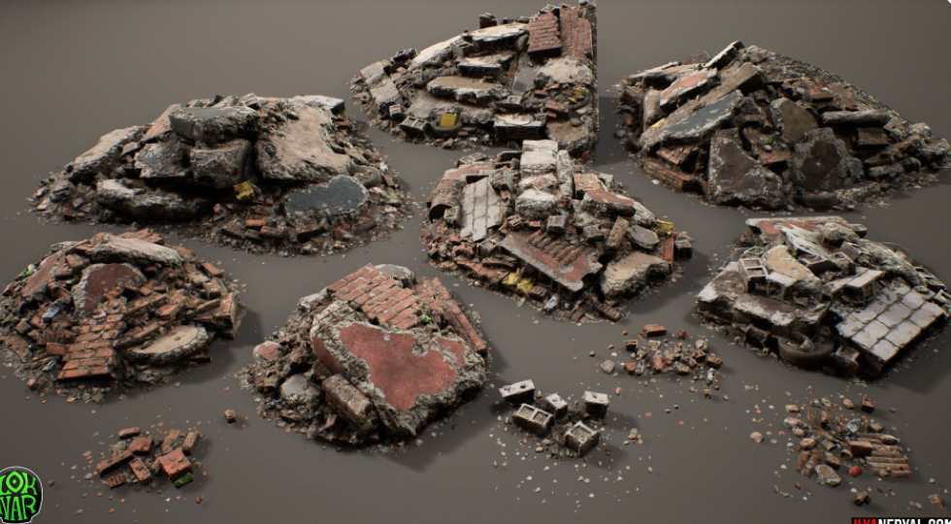
https://www.pinterest.com/pin/304978206018018128/
https://www.pinterest.com/pin/334744184798019537/?d=t&mt=login

Slide 6

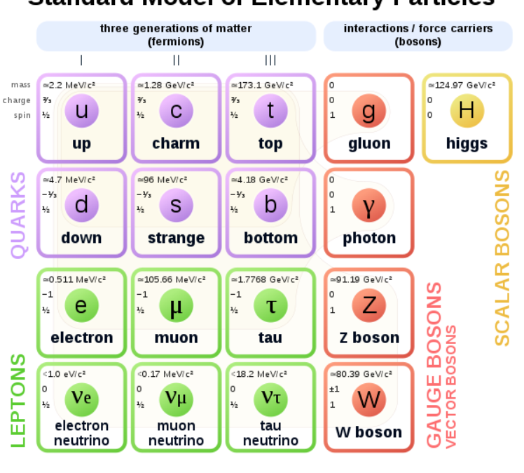
The Beloved Beautiful (& Unnatural)
Standard Model
3 generations of matter
SU(3)_{C} x SU(2)_{L} x U(1)_{Y}
WHY????
https://en.wikipedia.org/wiki/Elementary_particle
Notes:
Emprical

Slide 7
The Beloved Beautiful (& Unnatural)
Standard Model
No Dark Matter!
Non-Minimal
Unnatural
Arbitrary Content
Arbitrary Masses
Arbitrary Mixings
Arbitrary Higgs Mechanism
https://en.wikipedia.org/wiki/Elementary_particle

Slide 8
The Beloved Beautiful (& Unnatural)
Standard Model
Only Left handed fermions charged under the weak SM gauge group.
Fermion and gauge boson masses
FORBIDDEN by symmetry.

Slide 9
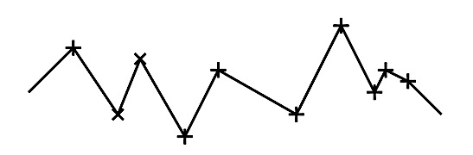
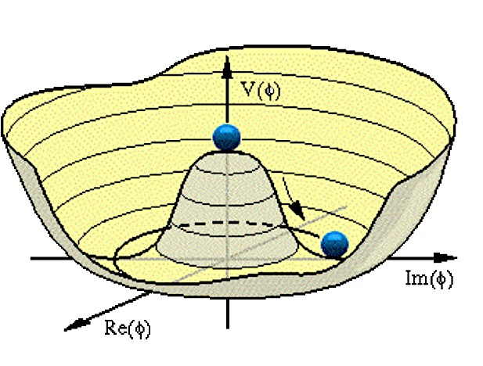
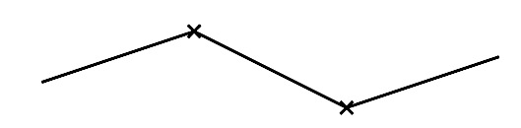
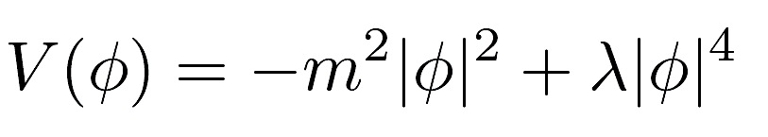
Whatever gives rise to fundamental particle masses has to break electroweak symmetry (EWSB).
The Higgs Mechanism.
Spontaneous Breakdown of the symmetry:
SU(2)_{L} x U(1)_{Y} → U(1)_{EM}
Vacuum becomes source of energy
= a source of mass
< H⁰> = v
A scalar (Higgs) field is introduced. The Higgs field acquires a nonzero value to minimize its energy.
Masses of fermions and gauge bosons proportional to their couplings to the Higgs field:
M_{Z,W} = g_{Z,W} v
m_{t} = h_{t} v
m_{h}² = λ v²
v = 246 GeV

Slide 10
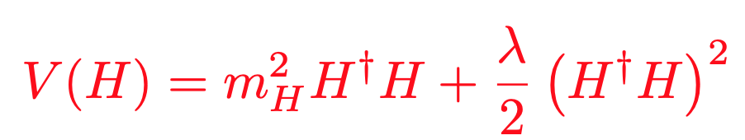
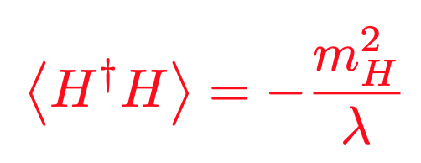
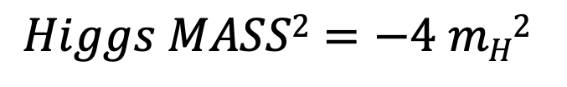
Only know location of minimum (vev)
Only know local curvature (mass)
S
$$Higgs MASS2=−4 mH2$$
y_{s}
H
H
NEGATIVE mass parameter (m_{H}²).
NO additional symmetry if Higgs massless.
NOTHING protects Higgs Mass: UNSTABLE under quantum corrections!!

Slide 11
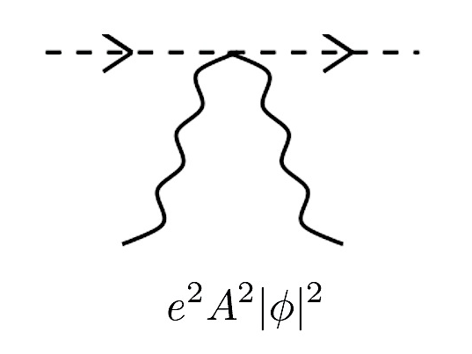
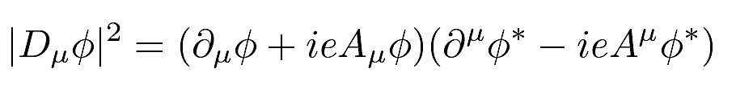
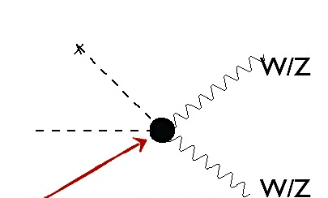
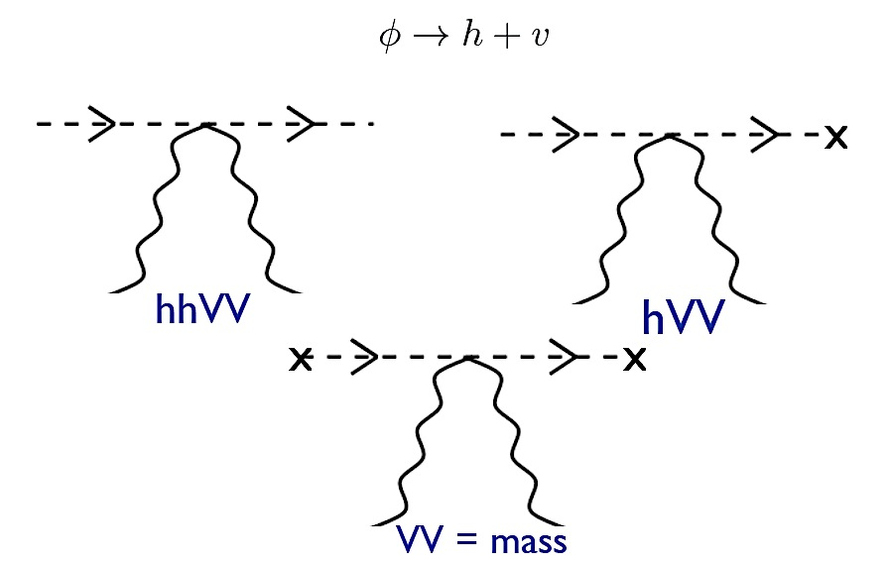
Is it THE Higgs?
How do scalars interact with gauge bosons?
v
h
h
h
h
v
W/Z
W/Z
W/Z
W/Z
We have seen that the
Higgs couples to W/Z, with approximately the right strength!!
v
v
W/Z
W/Z

Slide 12
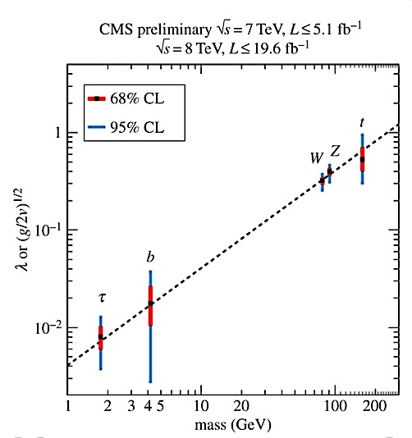

SM-Like Higgs!
Higgs generates masses
of the SM particles!
P. Higgs:
“My first paper was rejected because it was not relevant for phenomenology”

Slide 13
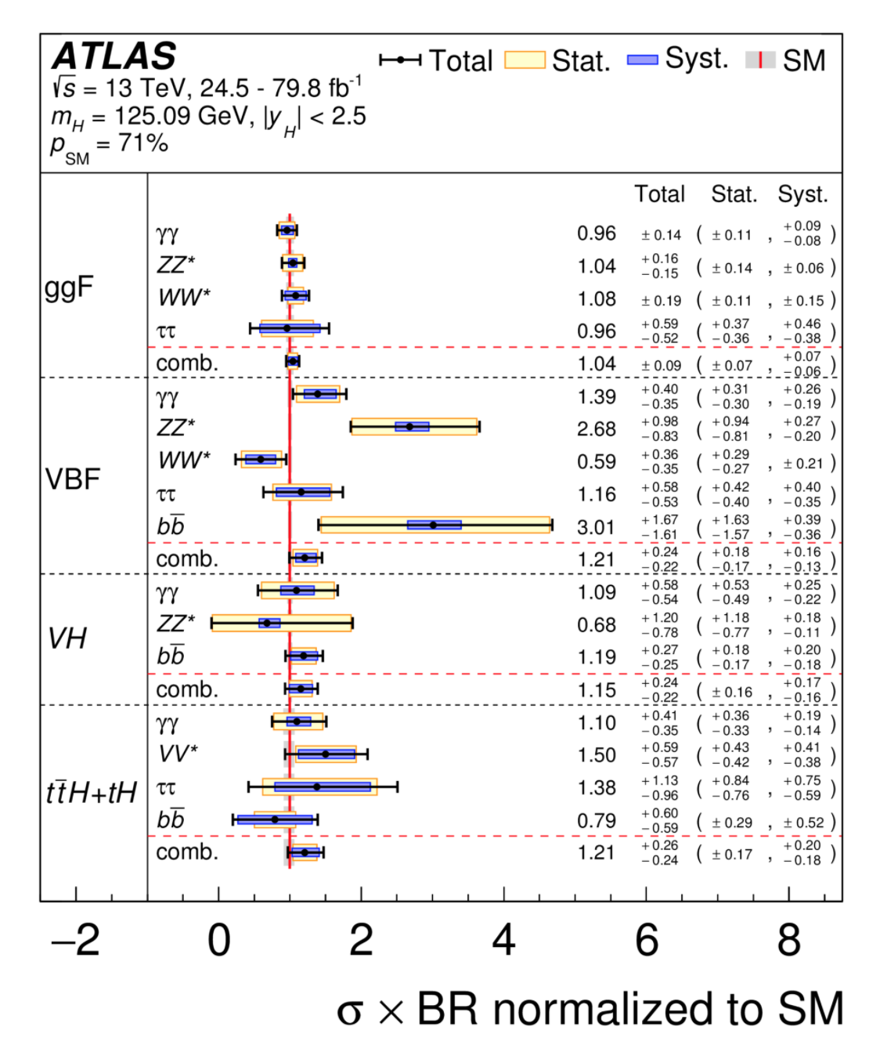
Still large uncertainties in couplings…
but compatible with SM expectations.
Observed Higgs
Production x Branching Ratios
as a ratio to SM expectation

Slide 14
SUSY
and
the Higgs.

Slide 15
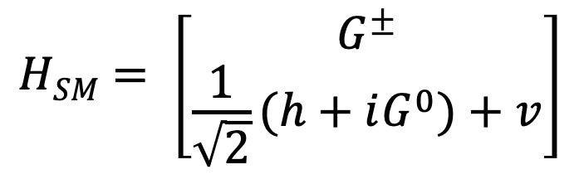
SM Higgs is a Doublet
The Higgs FIELD is a two component weakly charged doublet.
h is the neutral particle we think we have observed at the LHC: h₁₂₅
v is the SM vev: 174 GeV.
G^{+/-} and G⁰ are “eaten” by the W and Z gauge bosons to give them mass.
$$HSM= \left[{G^{±} \atop \frac{1}{\sqrt{2}}(h+iG^{0})+v}\right]$$
But SUSY has
MORE!!

Slide 16
But we
SEE
a SM-like Higgs!

Slide 17
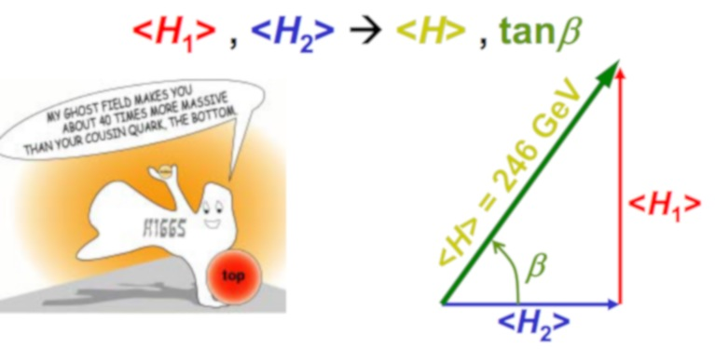
2 Higgs Doublet Model (2HDM).
In SUSY Need 2 Higgs doublets:
H_{u} – Couples only to up-type quarks
H_{d} – Couples only to down-type quarks and leptons.
m_{A} ~ m_{H}
tan β = v_{u} /v_{d}
5 Physical Higgs bosons:
CP-Even: h, H
CP-Odd: A
Charged Higgs: H^{+,-}

Slide 18
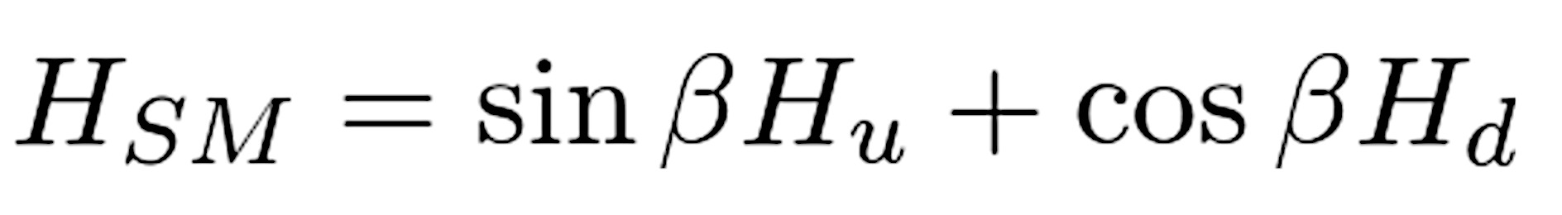
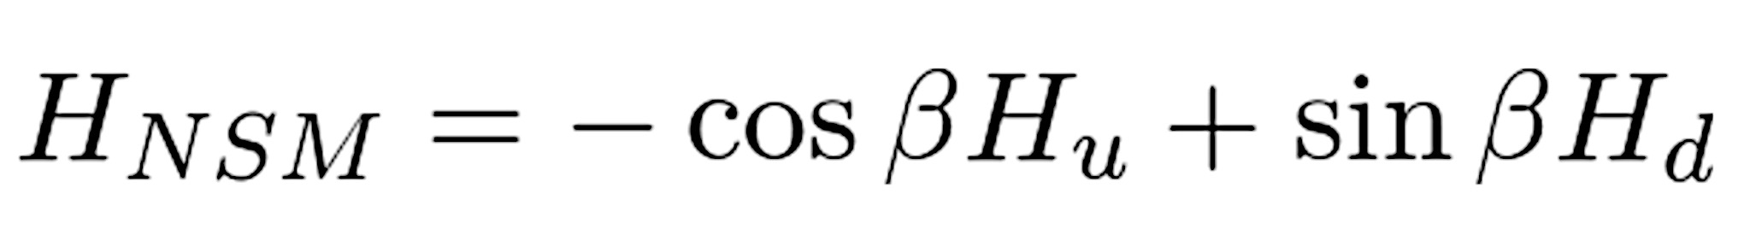
SM-Like Higgs.
246 GeV
v sin² β
<H>
<h> ~ <H_{SM}>
v cos² β
SM: Only 1 Higgs which then acquires a vev and leads to EWSB.
<H_{d} > = v cos β
<Η_{u} > = v sin β
⇒ <H_{SM}> = v
<H_{NSM}> = 0
This is what we want!
Lighter (h) is 125 GeV SM-like Higgs.
Additional states can exist!
SM-like HIGGS
Additional States can be light!
ALIGNMENT
Haber and Gunion, ‘03, M. Carena, I. Low, N.R.S. & C. Wagner, ‘13, A. Delgado, G. Nardini & M. Quiros, ‘13, N. Craig, J. Galloway & S. Thomas,‘13, P. Dev, A. Pilaftsis ‘14, M. Carena, H. Haber, I. Low, N.R.S. & C. Wagner ‘14 & ’15
etc ....

Slide 19
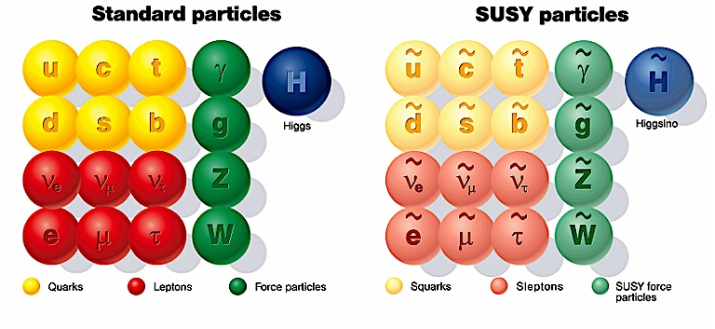

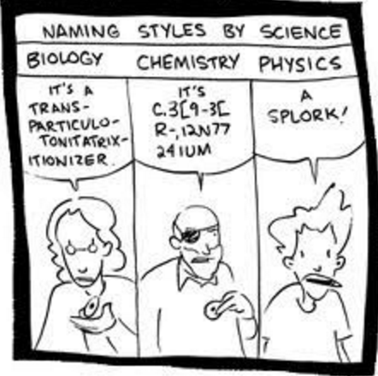
Minimal Supersymmetric SM (MSSM).
For every fermion there is a boson of equal mass and couplings and visa versa.
‘s’particles and ‘inos
No new couplings.
SUSY has to be broken.
Soft masses:
Parametrize our Ignorance.

Slide 20


Higgs Mass = 125 GeV.
λ_{i}
H. Haber and J. Gunion, ‘03
Quartics without quantum corrections related only to SM couplings.
Higgs mass bounded by m_{Z} at tree-level.
91 125
Need large radiative corrections.

Slide 21
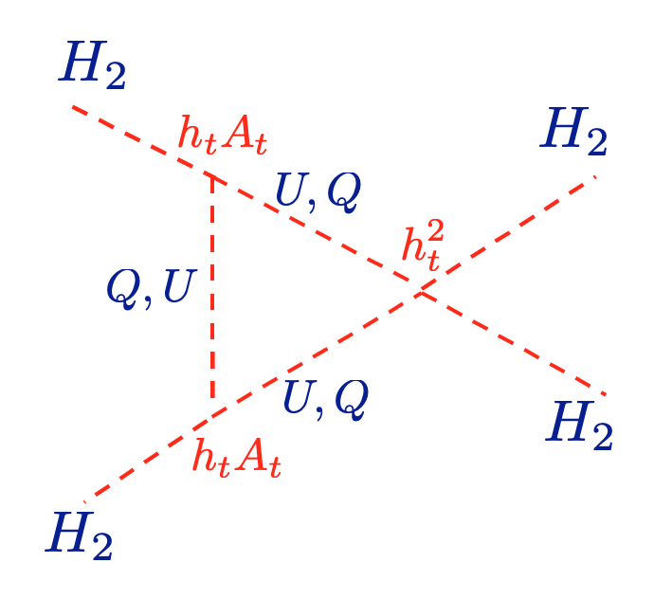
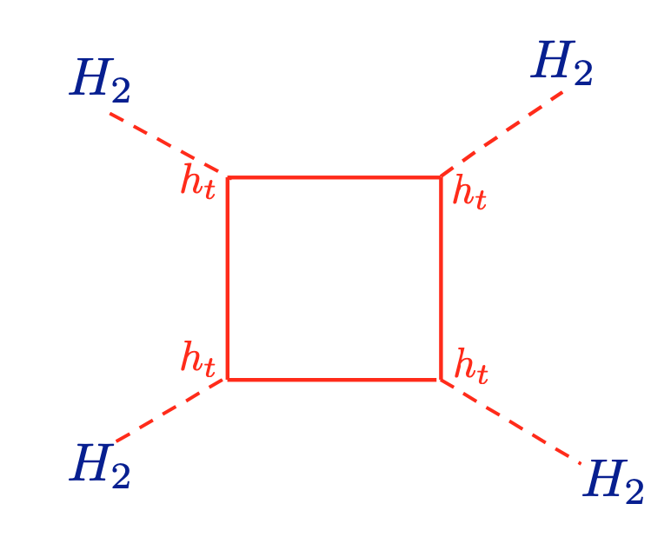
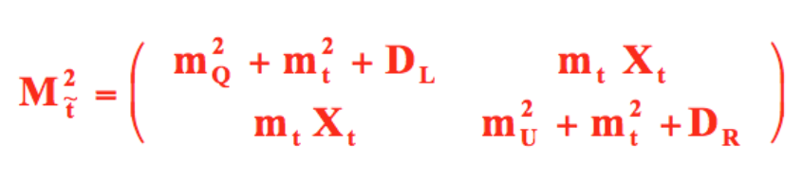
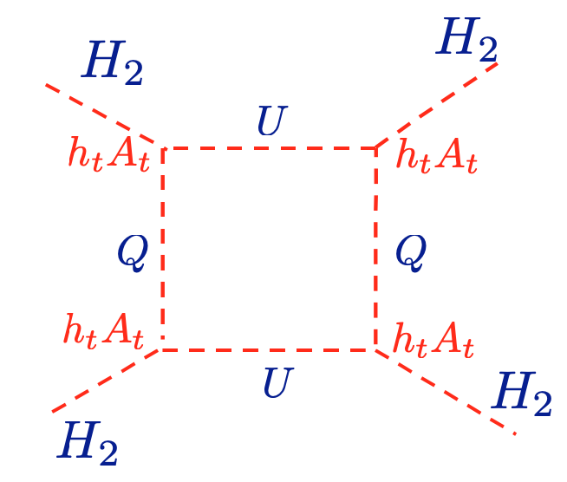

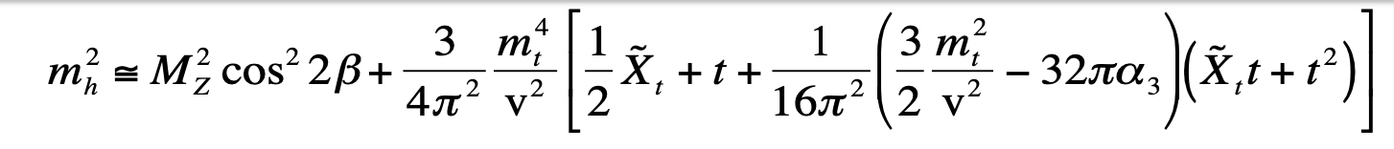
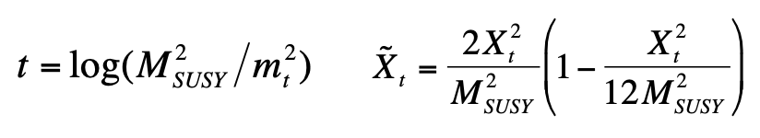
Stop + top Quartic Contributions!
Carena, Espinosa, Quiros, Wagner, ’95,96

Slide 22
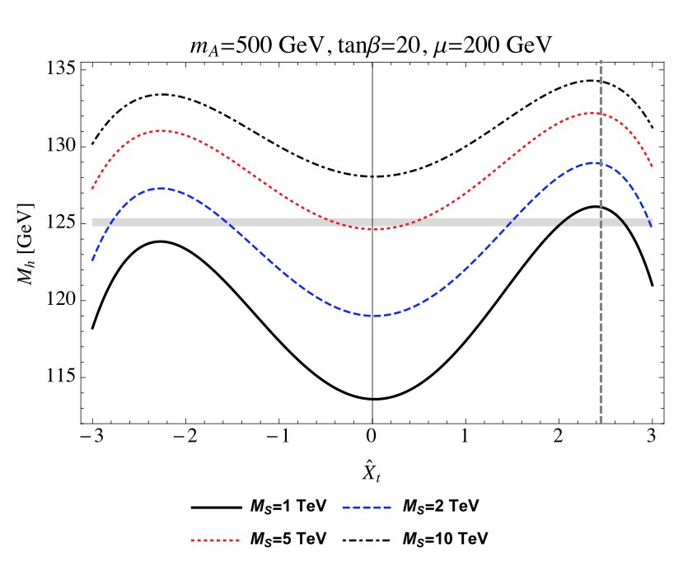
Fine Tuned or Not??
Stop masses ~ few TeV
Lighter Stops demand large splitting between left- and right-handed stops.
G. Lee, C. Wagner, ‘15

Slide 23
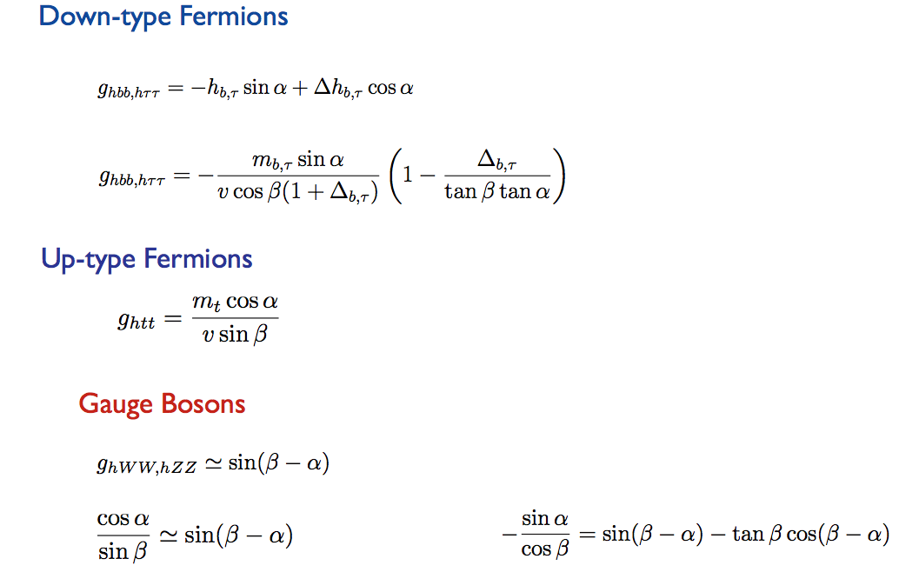
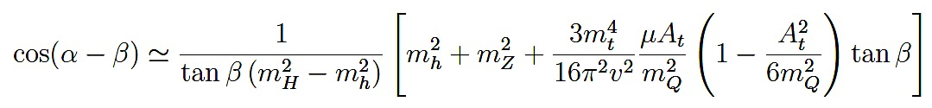
Alignment? cos (β-α) = 0
Approximately for t_{β} larger than a few, and m_{H} > 200 GeV:
If μ A_{t}/ m_{Q}² small (-> decoupling):
cos(α-β) t_{β} ~ Const / (m_{H}² - m_{h}²)
If μ A_{t}/ m_{Q}² relevant:
Can have cos(α-β) ~ 0
INDEPENDENT OF M_{A}
Obtain
ALIGNMENT
for small tan β
LARGE A_{t} /m_{Q}
LARGE μ / m_{Q}
Would make it difficult to test low m_{A} and t_{β} via Higgs coupling measurements
Relevant parameters for Higgs Sector: A_{t} /m_{Q} , μ / m_{Q} , m_{A}, t_{β}
Only Log dependence on squark masses, m_{Q} (relevant for m_{h}~125 GeV)

Slide 24

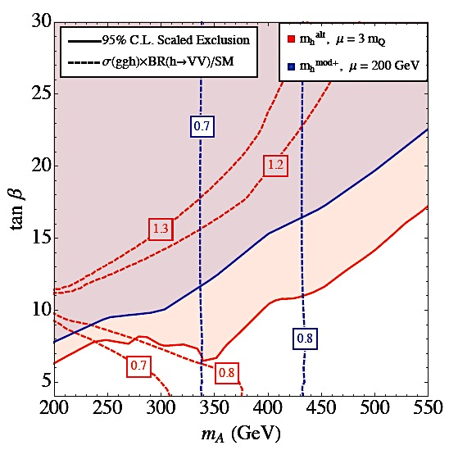
Heavy Higgs Searches: A / H → τ τ
Precision Higgs Physics: h → W W/Z Z
M. Carena, H. Haber, I. Low, N.R.S. & C. E. M. Wagner, ‘14
No Alignment (Decoupling):
H/A Direct searches Weaker
h₁₂₅ Precision measurements Stronger
Alignment w/o Decoupling:
H/A Direct searches Stronger
h₁₂₅ Precision measurements Weaker
Complementarity for probing MSSM Higgs sector.

Slide 25
Higgs Mass = 125 GeV.
λ_{i}
H. Haber and J. Gunion, ‘03
Quartics without quantum corrections related only to SM couplings.
Higgs mass bounded by m_{Z} at tree-level.
91 125
Need large radiative corrections.
…Or something else?

Slide 26
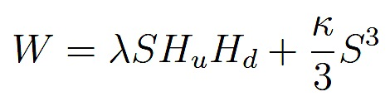


Something else: NMSSM Higgs Sector
2 Doublets (H_{u}, H_{d}) + Singlet (S)
Singlet couples only to Higgs Sector.
vevs: (H_{u}, H_{d,}, S ) =( v_{u}, v_{d}, v_{S} =μ/ λ)
3 CP-Even Higgs bosons:
  Mixing between all three (H_{u}, H_{d} and S).
2 CP-Odd Higgs bosons:
  Mixtures of “MSSM” m_{A} and singlet.
Charged Higgs bosons
Singlino mass: 2 κ μ/λ
m_{A}
m_{a}/m_{hS}

Slide 27
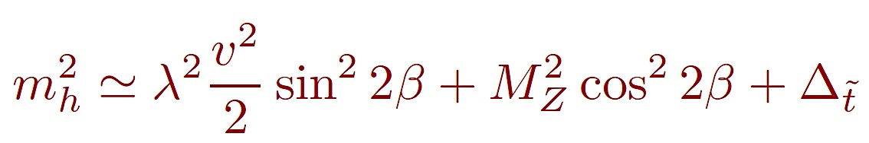
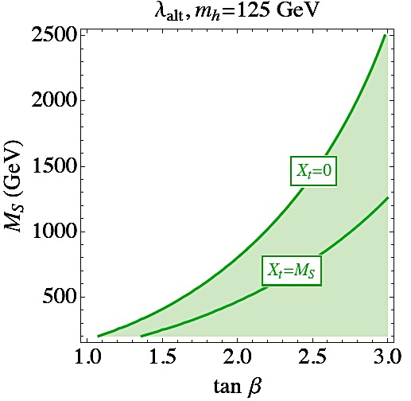
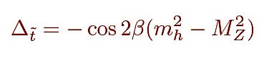
NMSSM:
125 GeV Higgs Naturally!
M. Carena, H. Haber, I. Low, N.R.S., C. Wagner, ’15
Alignment (No-Mixing):
Well Known
125 GeV Higgs
  Tree-level contribution to Higgs mass from λ.
  λ ~ 0.65-0.7
Low tanβ
Light Stops

Slide 28
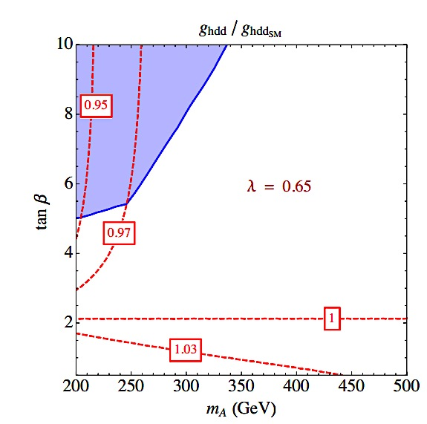
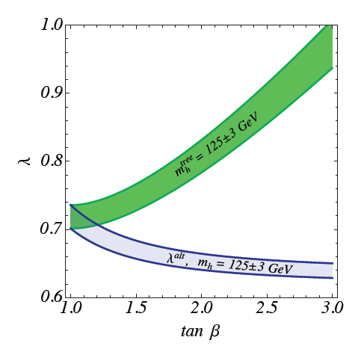
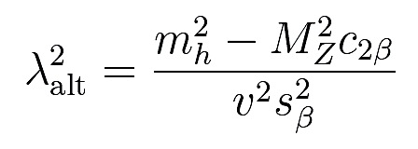
SM-Like Higgs Naturally!
Perturbative up to GUT scale.
  λ_{max} ~ 0.7, κ_{max} ~ λ/2
Not so well known:
Excellent Alignment (very little mixing)
M. Carena, H. Haber, I. Low, N.R.S., C. Wagner, ’15
M. Carena, I. Low, N.R.S, C. Wagner, ‘13
Originate dynamically from Higgs
compositeness at the GUT scale?
N. Coyle, C. Wagner, ‘19

Slide 29
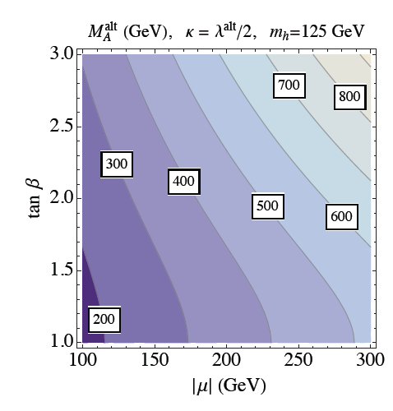
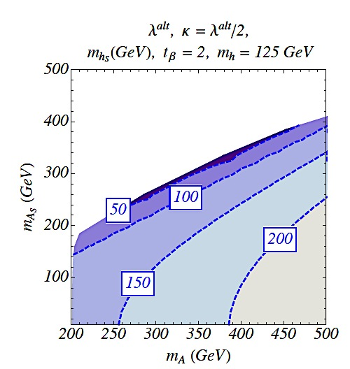

Singlet Alignment
M. Carena, H. Haber, I. Low, N.R.S., C. Wagner, ’15
CP-even/odd singlet
masses anti-correlated
h₁₂₅ = H_{SM}
LIGHT SPECTRUM
Singlino: 2 κ μ/λ ~ < μ

Slide 30
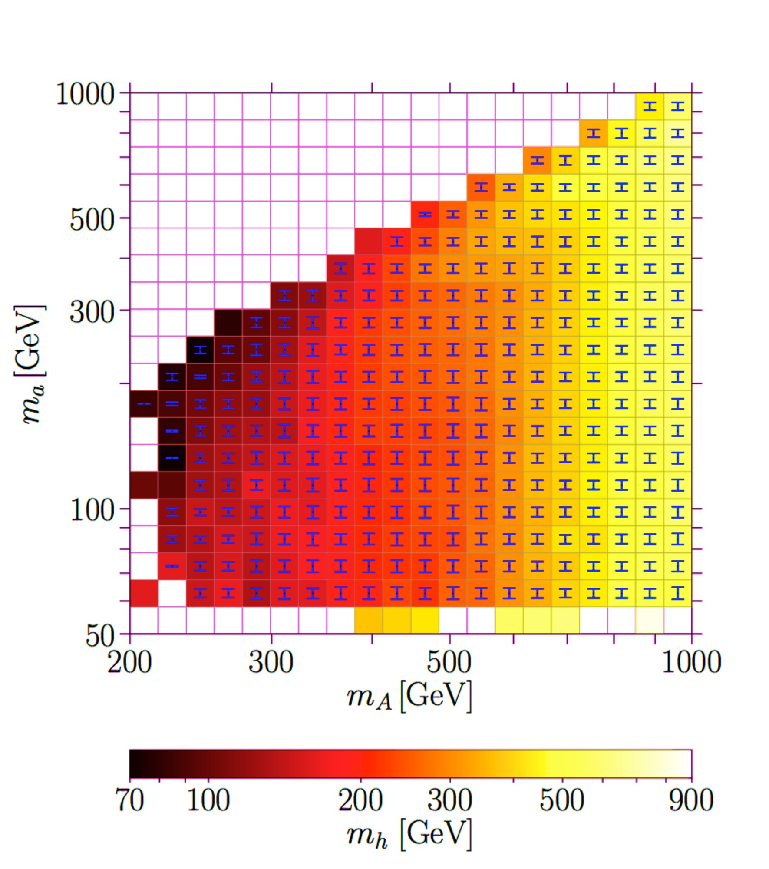
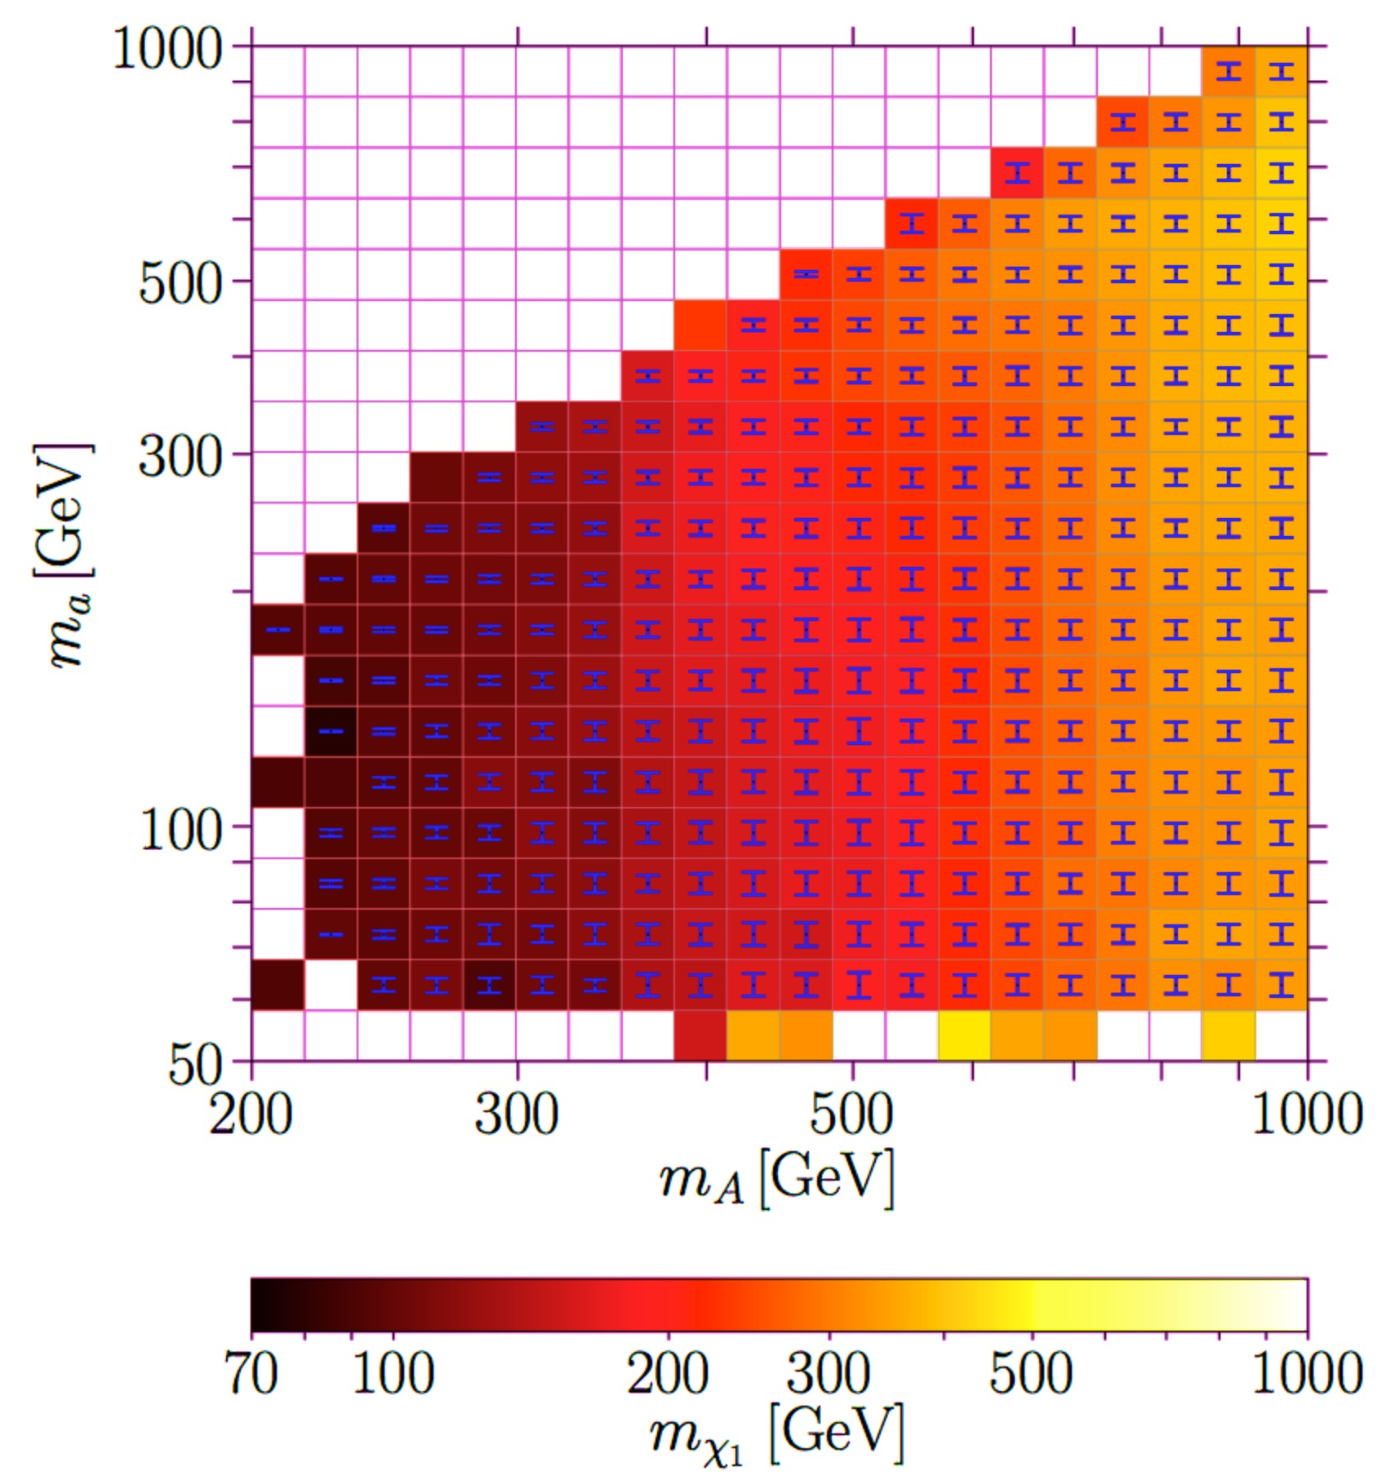
SM - like h₁₂₅: Mass Correlations!
S. Baum, N.R.S, K. Freese, ‘19
NMSSMTools scan with consistent h₁₂₅ pheno

Slide 31
How about neutralino WIMPS for
Dark Matter?
So …
…
Neutral Superpartners of Higgs, Z, γ

Slide 32
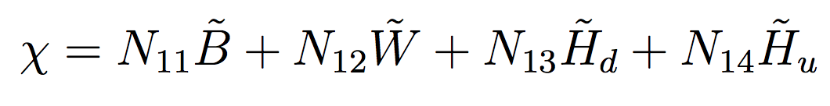
Charginos/Neutralinos & Sleptons...
SM Gauge Bosons, Higgs (2HDM in SUSY) and leptons Superpartners
Bunch of weakly coupled scalars, neutral Majorana fermions, lightest stable due to R-parity: WIMP!
B: SU(2) singlet
Bino M₁ g₁
{W⁰, W¹, W²}: SU(2) triplet
Winos M₂ g₂
1 neutral, 2 charged
{H_{u} H_{d}}: SU(2) doublets
Higgsinos μ Yukawas etc
2 neutral, 2 charged
{e, μ, τ }
Selectron, smuon, staus M_{μL,R} etc SM couplings
MSSM: 4 neutral “Neutralinos”, mixtures of interaction states (Also 2 charged “Charginos”
mixtures of wino and Higgsinos).
(Also Singlino for NMSSM)

Slide 33
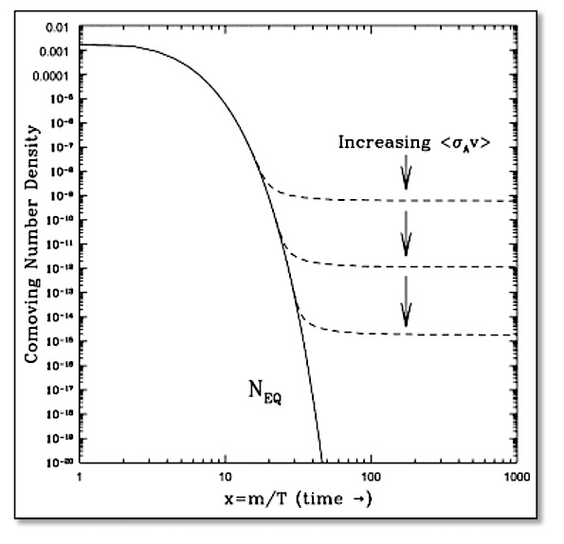
Thermal Relic?
What sets the abundance of the
Dark Matter observed?
Annihilations try to maintain thermal equilibrium.
Universe is Expanding!
At some point a DM particle can’t “find” another DM particle to annihilate with: FREEZE-OUT.
LARGER annihilation rate means LOWER number density.
Hooper, 09
WIMPs
Weakly Interacting Massive Particles

Slide 34
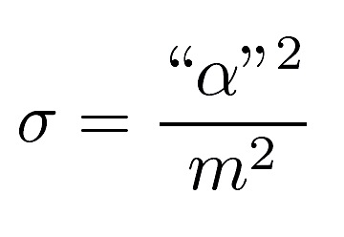
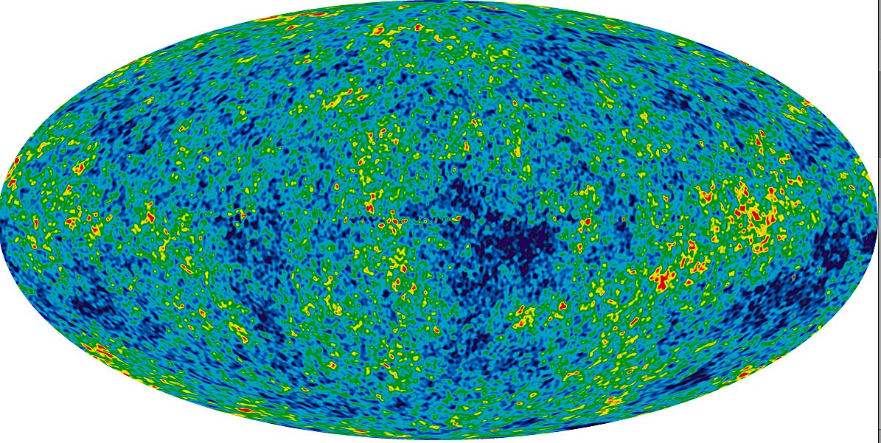

The WIMP Miracle.
Planck 2015
Weak scale couplings and masses (100 GeV) !
<σν> $⟹$ observed Ω_{DM}
NATURALLY !

Slide 35










Break it!
Annihilation
Scattering
Shake it!
Collider
Make it!

Slide 36

SI DD + Ωh² ??
χ
χ
SI DD
φ_{i}
Ωh²
χ
SM
φ_{i}
SM
SM
χ
SM
XENON1T arXiv:1805.12562
m_{χ} ~ few 100 GeV
Break the Connection!
Multiple mediators for destructive interference
Co-annihilation/Resonance
ALL consistent with extended Higgs sectors!!

Slide 37


Relic Density: Annihilations
Light Binos or Singlinos (SM singlets) excellent candidates for Dark Matter.
Cheung, Papucci, Sanford, NRS, Zurek ‘14, Freese Lopez, NRS, Shakya ‘15, Carena, Osborne, NRS, Wagner ’19, etc…
s-channel Resonance:
DM close to half of mediating particle mass.
Constrained but possible for h_{125,} Z, & additional Higgs bosons.
t-channel annihilation with light stau.
Happens in a natural way at large tanβ.
NRS, Pierce, Freese’13

Slide 38

Relic Density: Co - Annihilations
When DM can annihilate against other rapidly annihilating particles.
Ibarra, Pierce, NRS, Vogl ‘15, Pierce, NRS, Vogl ‘18, Baum, Carena, NRS, Wagner ’18, ’21 etc
Mass difference of Dark Matter with the other weak scale weakly interacting particles must be of the order of a few tens of GeV.
Naturally leads to compressed spectrum −> reduced sensitivity at the LHC.
Some relevant channels in the case of sleptons or Winos (too light Higginos/ small μ leads to large SD cross sections).

Slide 39

Relic Density: Co - Annihilations
S. Baum, M. Carena, N.R.S, C. Wagner, ‘17
Thermal production via co-annihilation of Bino with singlino or resonance
NMSSM: (‘well-tempered’) Bino DM

Slide 40




Direct Detection
Cheung, Hall, Ruderman ‘12,
Huang, Wagner ‘14,
Cheung, Papucci, NRS, Stanford, Zurek ‘14,
Han, Liu, Makhapadhyay, Wang ‘18.
Small SI DD can easily be obtained via blind spots.
Negative values of (μ x M₁) :
Much weaker spin-independent direct detection bounds
SD DD mediated only by Z!
May be probed in the near future.
Carena, Osborne, NRS, Wagner, ‘18
NMSSM: similar, but different signs.

Slide 41

But isn’t SUSY already ruled out below the TeV scale ??

Slide 42
Strong Physics
Guinos:
  If decay directly to 3rd generation squarks, gluinos must be heavier than about 1.5 to 2.2 TeV
  Cascade decays into intermediate chargino/neutralino states and compressed spectrum present the weakest limits, and the bound falls short of 2 TeV for non-compressed spectrum. Bound of 2.2 TeV in the most extreme case.
  Hard to evade the TeV bound.
Stops:
  Higgs mass implies stops masses heavier than ~ 1 TeV
  Combining all searches, in the simplest decay scenarios, it is hard to avoid the constraints 600 GeV - 1.2 TeV for stops.
  We are just starting to explore the mass region suggested by the Higgs mass!

Slide 43
All that Weak stuff?
Situation here is far less well defined than in the strongly interacting sector.
Sleptons, in particular staus, are only weakly constraint beyond the LEP limits.
Winos as NLSP’s are the strongest constrained particles.
Sensitivities in the search for these particles will increase only at high luminosities, but bounds on Higgsinos will remain weak.
In general, a SUSY scenario with large cascade decays with light electroweakinos is the most natural one and the least constrained so far.

Slide 44


LHC ?
Interesting cascade decays of the additional Higgs bosons in the NMSSM
  Eg: H_{NSM} ➔ h_{S} H_{SM} or H_{NSM} ➔ a_{S} Z
H_{NSM} ➔ WW/ZZ/H_{SM} H_{SM} or A ➔ Z H_{SM} suppressed due to alignment
Can have visible and invisible decays of h_{S}/a_{S}

Slide 45

LHC All Searches: 3000 fb⁻¹ NMSSM Higgs Sector
Optimistic scenario shown!
S. Baum, N.R.S, K. Freese, ‘19
Expect ~50% scanned region with m_{A} < 1 TeV probed.
~90% if improvements by 1 order of magnitude wrt our projections, & 2 orders of magnitude in conventional search channels wrt current limits.

Slide 46

Generic NMSSM: Explore 2HDM + S!!
S. Baum & N.R.S., ‘18
If either m_{a} or m_{h} > 350 GeV, can decay predominantly to tt.
Could be hidden in h₁₂₅ tt?

Slide 47


Max Misalignment Scenario: H → h₁₂₅ h₁₂₅
S. Baum & N.R.S., ‘19
Compare to CMS/ATLAS limits (2019) in bbbb, bbγγ final states.
Gray shaded regions excluded by (H → h₁₂₅h₁₂₅) searches. Black dashed lines label cross sections a factor two smaller, and hence may be probed with 300 fb⁻¹ of data. Red [orange] shaded area denote regions ruled out by current (H → WW) [(H → ZZ)] LHC searches

Slide 48
MUCH MORE to Explore!
?
Stops and gluinos > TeV
Higgs & Electroweak Sector Tangled
DM + (g-2) (S. Heinemeyer talk)
+ Alignment + Higgs Mass (CPV?!)
Experimental Simplified Model Analysis Limits $√$
Naïve Reinterpretation to Exclude $×$
Bottle neck:
Data + Search strategies for compressed spectra
NOT Energy!

Slide 49
Snowmass - EF08: Model Specific Explorations
Convenors: Elliot Lipeles, Nausheen Shah, Jim Hirschauer
We are looking for people to take on specific (but manageable) responsibility for individual EF08 summary plots for the Snowmass report (current list of plots below). The work would involve:
Reviewing corresponding European Strategy plot and documenting source of all numbers/lines in plots. We hope to have this done in the next few weeks. Specifically, we'd like to fill out spreadsheets that look like this:
Machine |  |  | ES Report |  |  |  |  |  |  | Snowmass
Collider | Energy | L (ab-1) | Presented Number/Line | Figure/Table in ES Report | Number/Line in figure | Reference | Fig | Comment on Number Source | Comment method | Update Priority | Group(s) | Status
HL-LHC | 14 | 6? | at 3 ab-1, to light quarks | 8.6 | 3.2 TeV | https://arxiv.org/pdf/1812.07831.pdf | 2.1.1 | LHC fig, 2 sigma at mX=0 | Delphes
 |  |  | at 3 ab-1, to light quarks compressed | 8.6 | 1.5 TeV | https://arxiv.org/pdf/1812.07831.pdf | 2.1.1 | LHC fig, 2 sigma on diagonal | Delphes
 |  |  | at 3 ab-1, to light top quarks | 8.6 |  | https://arxiv.org/pdf/1812.07831.pdf | 2.1.6 |  | CMS official
 |  |  | at 3 ab-1, to s top quarks | 8.6 |  | unclear?
FCC-hh | 75 | 30 | at 30 ab-1, to light quarks | 8.6 |  | https://link.springer.com/article/10.1140%2Fepjc%2Fs10052-019-6904-3 | 9.1 |  | FCC
 |  |  | at 30 ab-1, to light quarks compressed | 8.6 |  | "extrapolated from FCC-hh prospects"
 |  |  | at 30 ab-1, to s top quarks | 8.6 |  | https://link.springer.com/article/10.1140%2Fepjc%2Fs10052-019-6904-3 | 9.1 |  | FCC
FCC-hh | 100 | 30
FCC-hh | 150 | 30
https://docs.google.com/spreadsheets/d/1KxxcOpF2PgrAe8p_3QVD910hwGHrYqRFmAIG3xEWSao/edit?usp=sharing
More Machine (e+e-, muon, e-h…)

Slide 50
Snowmass - EF08: Model Specific Explorations
Convenors: Elliot Lipeles, Nausheen Shah, Jim Hirschauer
The work would involve (con’t...):
2) Identify new numbers/lines to include. Similarly in the next few weeks.
3) Identify changes to plots large or small with a target to have big picture changes
defined by end of calendar year.
4) In 2022: track results needed, collect results in appropriate formats,
and ultimately assemble the plots.
Of course, we'd also like contributions to the specific results identified in (3).
Current list of plots essentially the same as the European Strategy (Suggestions welcome for additions):
Gluino
Light squarks
Stop squark
High-Delta M electroweak (not necessary Wino-Bino, to be discussed)
Compressed electroweak
We could potentially sub-divide the task for a plot for example into hadron and lepton colliders if you are interested.
If you want to volunteer to coordinate a plot or set of lines in a plot (e.g. all e+e-), let us know: lipeles@sas.upenn.edu, jhirsch@fnal.gov, nausheen.shah@wayne.edu

Slide 51

Thank You!
SM & DM beautiful & EMPIRICAL…
Electroweak sector heart of the puzzle.
SUSY (may?) be the answer!
LHC: Strong constraints on strong sector…
What are the right questions?
LHC: Electroweak sector -> Need more data!
Higgs/Electroweak???
Data + Theory:
Where to look next!
Absence of Evidence != Evidence of Absence
Flavors of SUSY -> Wildly different Pheno -> Much to explore!
“May we live
in interesting times.”

Slide 52
BACk up slides

Slide 53





Fine Tuning?
Top quark contribution:
Complex scalar contributions:
Need to CANCEL LARGE contributions to produce physical Higgs mass
of 125 GeV!!

Slide 54
Fine Tuning:
SUSY Cancelations!
Top quark contribution:
Complex scalar (STOP) contributions :
Quadratic divergences CANCEL if EQUALITY of couplings.
Residual (mass dependent) logarithmic contributions remain

Slide 55
CP-Even Higgs Bases
Interaction basis: (H_{u}, H_{d}, S)
  H_{u}: Couples only to up-type fermions
  H_{d}: Couples only to down-type fermions
  S: Only couples to Higgs
<H_{u}> = v_{u}
<H_{d}> = v_{d}
t_{β} = v_{u}/v_{d}
<S> =μ/λ

Slide 56
CP-Even Higgs Bases
Interaction basis: (H_{u}, H_{d}, S)
  H_{u}: Couples only to up-type fermions
  H_{d}: Couples only to down-type fermions
  S: Only couples to Higgs
“Extended” Higgs basis: (H_{NSM}, H_{SM}, S)
  H_{NSM}: (down, up, V) = (y_{d} t_{β}, y_{u}/ t_{β}, 0)
  H_{SM}: (down, up, V) = (y_{d}, y_{u}, g_{hVV})
<H_{u}> = v_{u}
<H_{d}> = v_{d}
t_{β} = v_{u}/v_{d}
<S> =μ/λ
Only SM state couples to WW or ZZ!!
<H_{NSM}> = 0
<H_{SM}> = v

Slide 57
CP-Even Higgs Bases
Interaction basis: (H_{u}, H_{d}, S)
  H_{u}: Couples only to up-type fermions
  H_{d}: Couples only to down-type fermions
  S: Only couples to Higgs
“Extended” Higgs basis: (H_{NSM}, H_{SM}, S)
  H_{NSM}: (down, up, V) = (y_{d} t_{β}, y_{u}/ t_{β}, 0)
  H_{SM}: (down, up, V) = (y_{d}, y_{u}, g_{hVV})
Mass basis: (H³, H², H¹)
      H^{i} = S^{i}_{NSM} H_{NSM} + S^{i}_{SM} H_{SM} + S^{i}_{S} H_{S}
<H_{u}> = v_{u}
<H_{d}> = v_{d}
t_{β} = v_{u}/v_{d}
<S> =μ/λ
<H_{NSM}> = 0
<H_{SM}> = v

Slide 58
CP-Even Higgs Bases
Interaction basis: (H_{u}, H_{d}, S)
  H_{u}: Couples only to up-type fermions
  H_{d}: Couples only to down-type fermions
  S: Only couples to Higgs
“Extended” Higgs basis: (H_{NSM}, H_{SM}, S)
  H_{NSM}: (down, up, V) = (y_{d} t_{β}, y_{u}/ t_{β}, 0)
  H_{SM}: (down, up, V) = (y_{d}, y_{u}, g_{hVV})
Mass basis: (H₃, H₂, H₁) (H, h125, h)
      H_{i} = S_{i}^{NSM} H_{NSM} + S_{i}SM HSM + S_{i}^{S} H_{S}
<H_{u}> = v_{u}
<H_{d}> = v_{d}
t_{β} = v_{u}/v_{d}
<S> =μ/λ
<H_{NSM}> = 0
<H_{SM}> = v
CP-odd mix similarly:
A_{i} = P_{i}^{NSM} A_{NSM} + P_{i}^{S} A_{S}

Slide 59


Slide 60



NMSSM: SI Direct Detection
SI Direct Detection cross section suppressed by:
Proximity to 𝘩₁₂₅ blind spot
Destructive interference between CP-even Higgs mass eigenstates
Cheung, Papucci, Sanford, NRS, Zurek, `14; Huang, Wagner, 2014, etc.
S. Baum, M. Carena, N.R.S, C. Wagner, ‘17

Slide 61

Stau searches: Bounds depend on mixing!
Weak limit at this point, we are now exploring limits beyond LEP.
Observe that this assumes degenerate stau masses.

Slide 62

Slepton Searches
Assuming all leptons are degenerate, bound can be as large as 700 GeV.
Bounds are significantly relaxed if mass difference between sleptons and neutralinos is smaller than ~100 GeV.

Slide 63

Current Electroweakino Mass Bounds
Wino NLSP, BR = 1

Slide 64


But also… The Squarks!
In evaluating these bounds the squarks have been decoupled.
But cross section depends on the squark masses due to a t and u channel contribution to them
Liu, McGinnis, Wang, Wagner arXiv:2008.11847
The resulting cross sections may differ by factors of a few!

