Slide 1
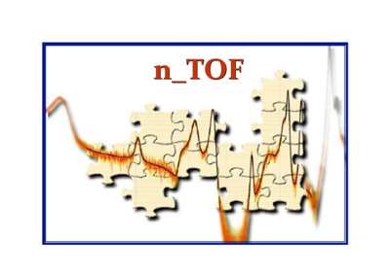


Status of the n-TOF experiment
E.Chiaveri
(EN-STI-EET)
On behalf of n_TOF collaboration

Slide 2
ITEMS
n_TOF Facility Status
Borated Water Moderator system
Preliminary results analysis on 2009/2010 measurements
Integrated protons 2010
Summary

Slide 3
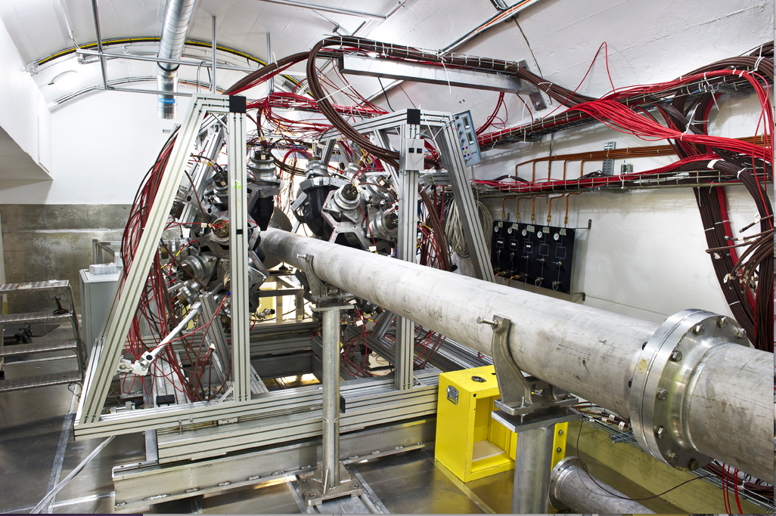
n_TOF Work Sector Type A

Slide 4
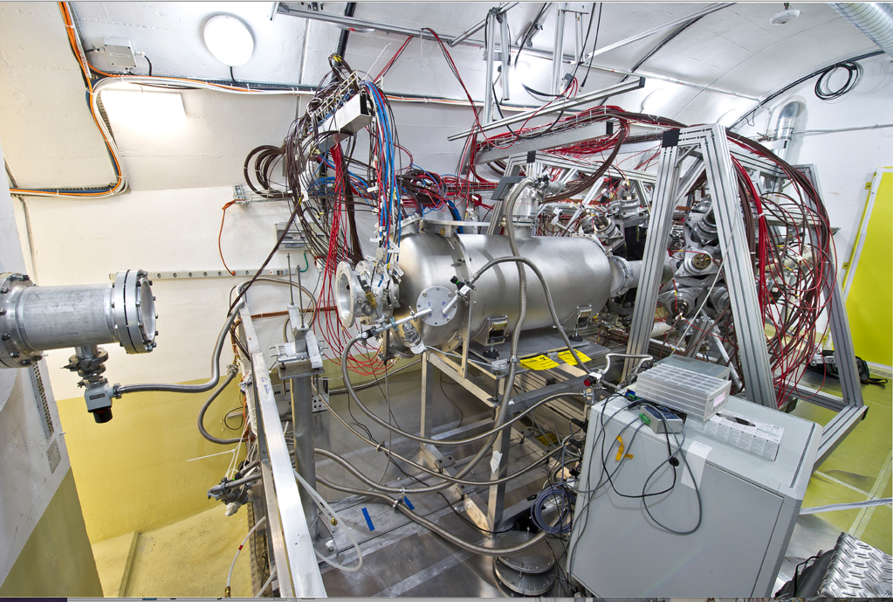
n_TOF Work Sector Type A

Slide 5
ITEMS
n_TOF Facility Status
Borated Water Moderator system
Preliminary results analysis on 2010 measurements
Integrated protons 2010
Summary

Slide 6
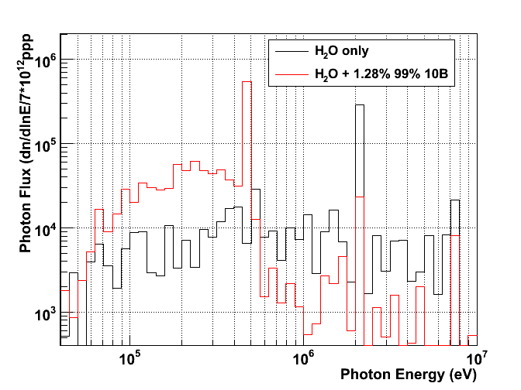
Borated water effect–
Photon Energy distribution
Effect of boric acid: → appearance of the 470 keV line + reduction of the 2.2 MeV
470 keV from ¹⁰B(n,α)⁷Li
2.2 MeV ¹H(n,γ)
7 – 7.5 MeV prompt γ on Fe, Al, Pb
511 keV e+e-

Slide 7
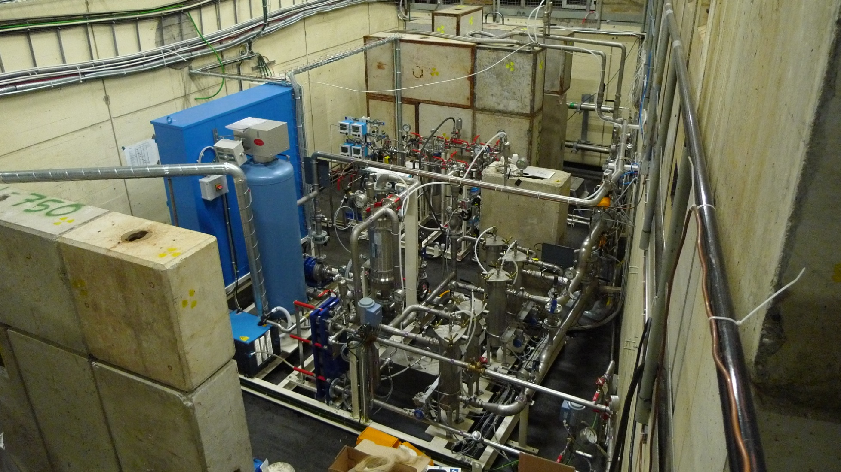


Cooling and moderator station
The target and moderator circuits are decoupled and work independently
Moderator system
Target cooling system

Slide 8
n_TOF borated water moderator circuit
The n_TOF borated water circuit is the result of a strong collaboration between different CERN groups: EN/STI, EN/CV, EN/MME and TE/VSC
Main goal: improvements of γ background conditions in the 200 m experimental area due to a decrease in the production of thermal neutrons capture in ¹H
  a great improvement for neutron-induced capture reactions with the C₆D₆ liquid scintillator!
It is the first time that a borated water moderator is operated in saturated conditions (1.28% in H₃BO₃) → initial unknown parameters in the operation!

Slide 9
n_TOF borated water moderator circuit
October 2009: design specifications set
  critical points: choice of materials and the technical implementation of the solution envisaged to keep the boric acid concentration in a stable condition
April 2010: the system has been installed, connected with the cooling circuit and tested successfully with light water.
May 2010: the system was tested successfully with beam
May-June 2010: commissioning of the new beam line and of the moderator circuit:
  reduction of thermal peak as expected from simulations
  observation of the expected reduction in the background due to delayed γ-rays reaching the EAR together with ~keV neutrons
Complex work realized in only 6 months!

Slide 10
n_TOF borated water moderator circuit
Chemical stability is an asset for the safe operation of the cooling and moderator circuit
An increase of the water conductivity was observed during operation
  regular water samples analysis showed no worries for corrosion, since conductivity was due to the presence of non-reacting sodium
Sodium was originating from the non optimized cationic resin used to filter activation products
A test bench will be realized at CERN in November 2010 in view of the 2011 n_TOF run
2011 n_TOF run will operate with an optimized resin and looks forward to a successful run

Slide 11
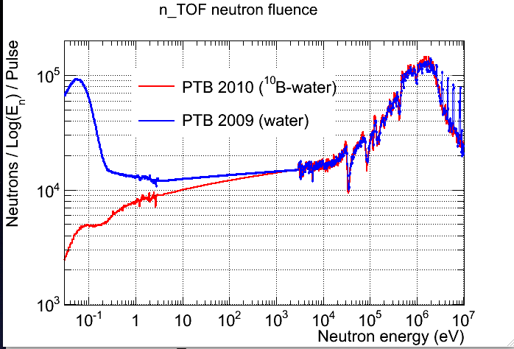

Slide 12
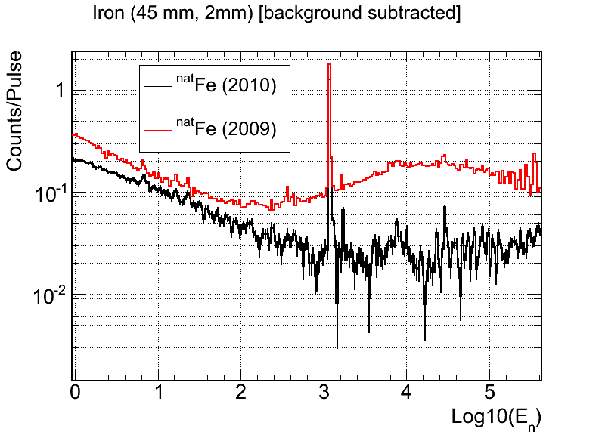

Slide 13
ITEMS
n_TOF Facility Status
Borated Water Moderator system
Preliminary results analysis on 2009/2010 measurements
Integrated protons 2010
Summary

Slide 14
Measurement of ⁶²Ni(n,γ) at n_TOF
nTOF13
Detector setup:
Pair of C₆D₆ detectors optimized for low neutron sensitivity (ε_{n}/ε_{γ}<4·10⁻⁵) [Plag et al., 2002]
Samples for ⁶²Ni measurement:
enriched Ni pellet; 2 cm Ø; 2 g
¹⁹⁷Au, 2 cm Ø, 0.6 g
^{nat}Pb, 2 cm Ø, 0.3 g
^{nat}C, 2 cm Ø, 5 g
 | ⁵⁸Ni | ⁶⁰Ni | ⁶¹Ni | ⁶²Ni | ⁶⁴Ni
sample (%) | 0.005 | 0.035 | 0.91 | 97.95 | 1.1
natural (%) | 68.08 | 26.22 | 1.14 | 3.63 | 0.93
neutrons
Claudia Lederer

Slide 15
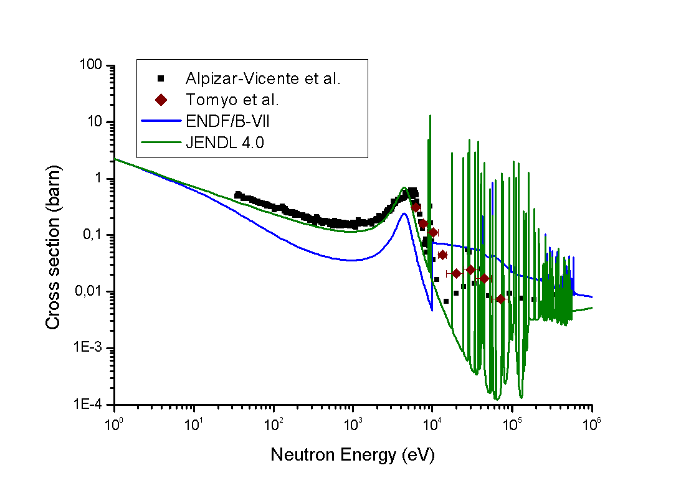
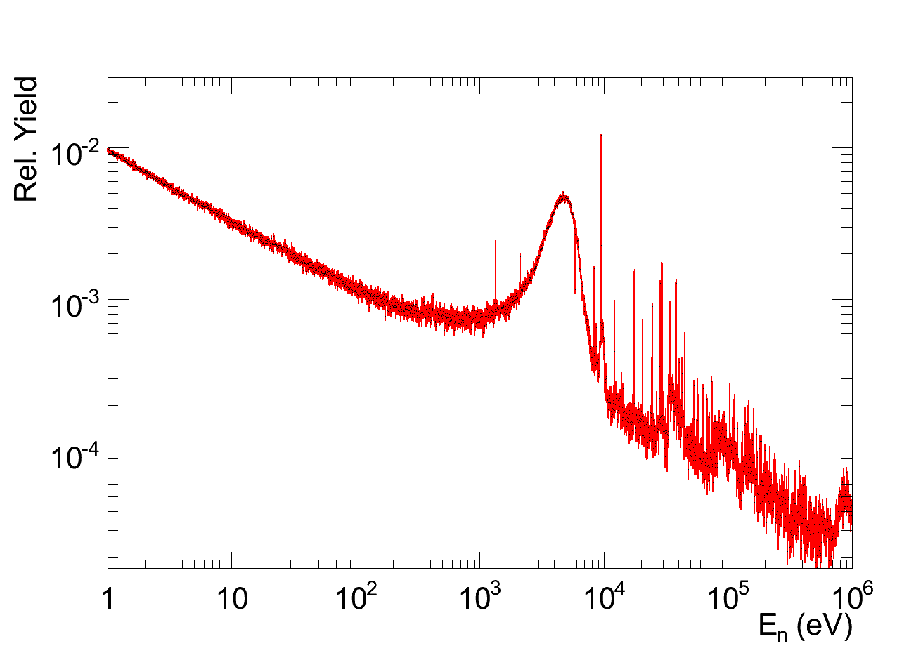
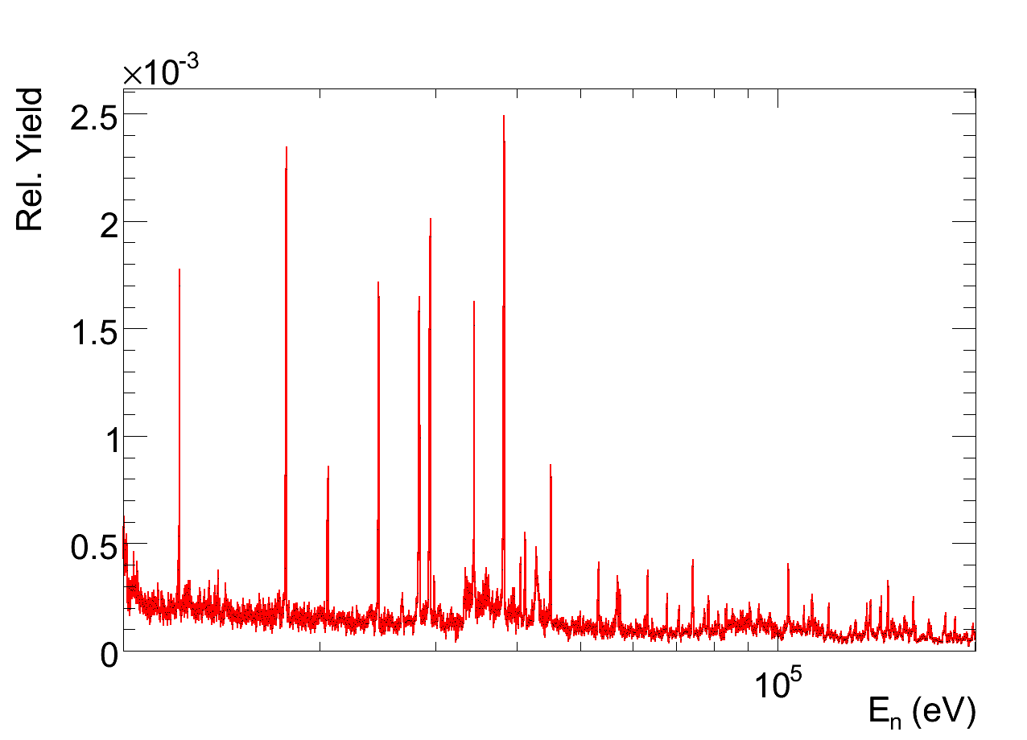
new data from n_TOF
Available experimental data compared to libraries
Claudia Lederer

Slide 16
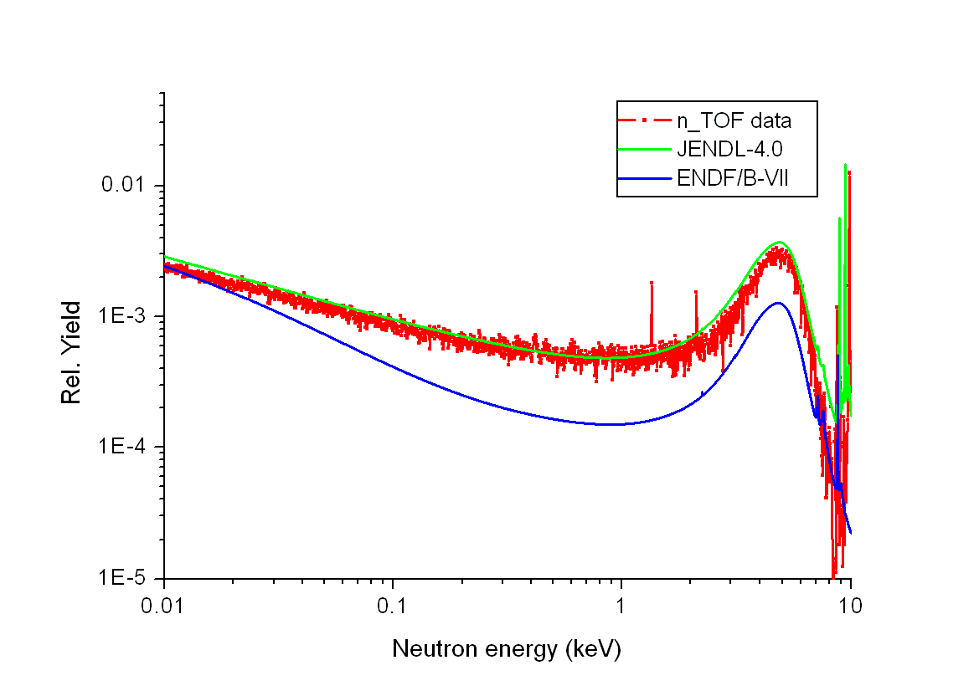
Preliminary background subtracted capture yield compared to libraries ENDF/B-7 and JENDL-4.0
Claudia Lederer

Slide 17
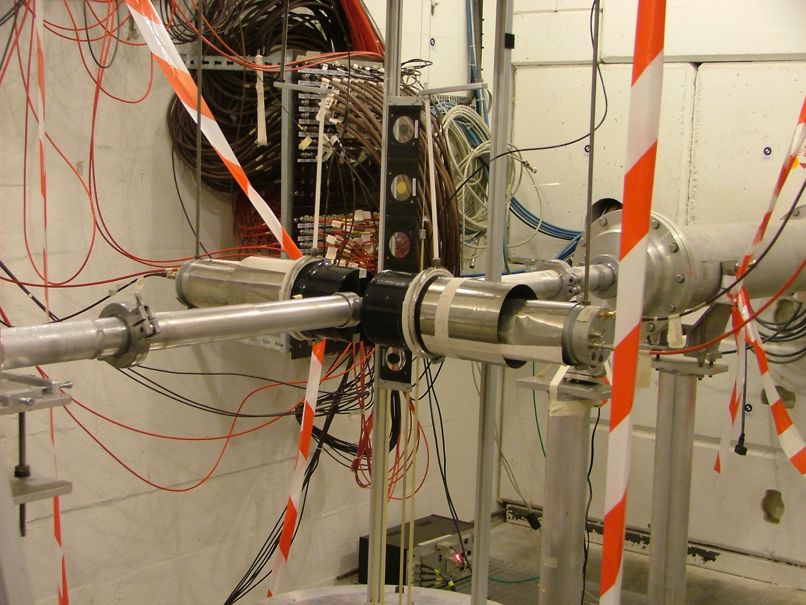
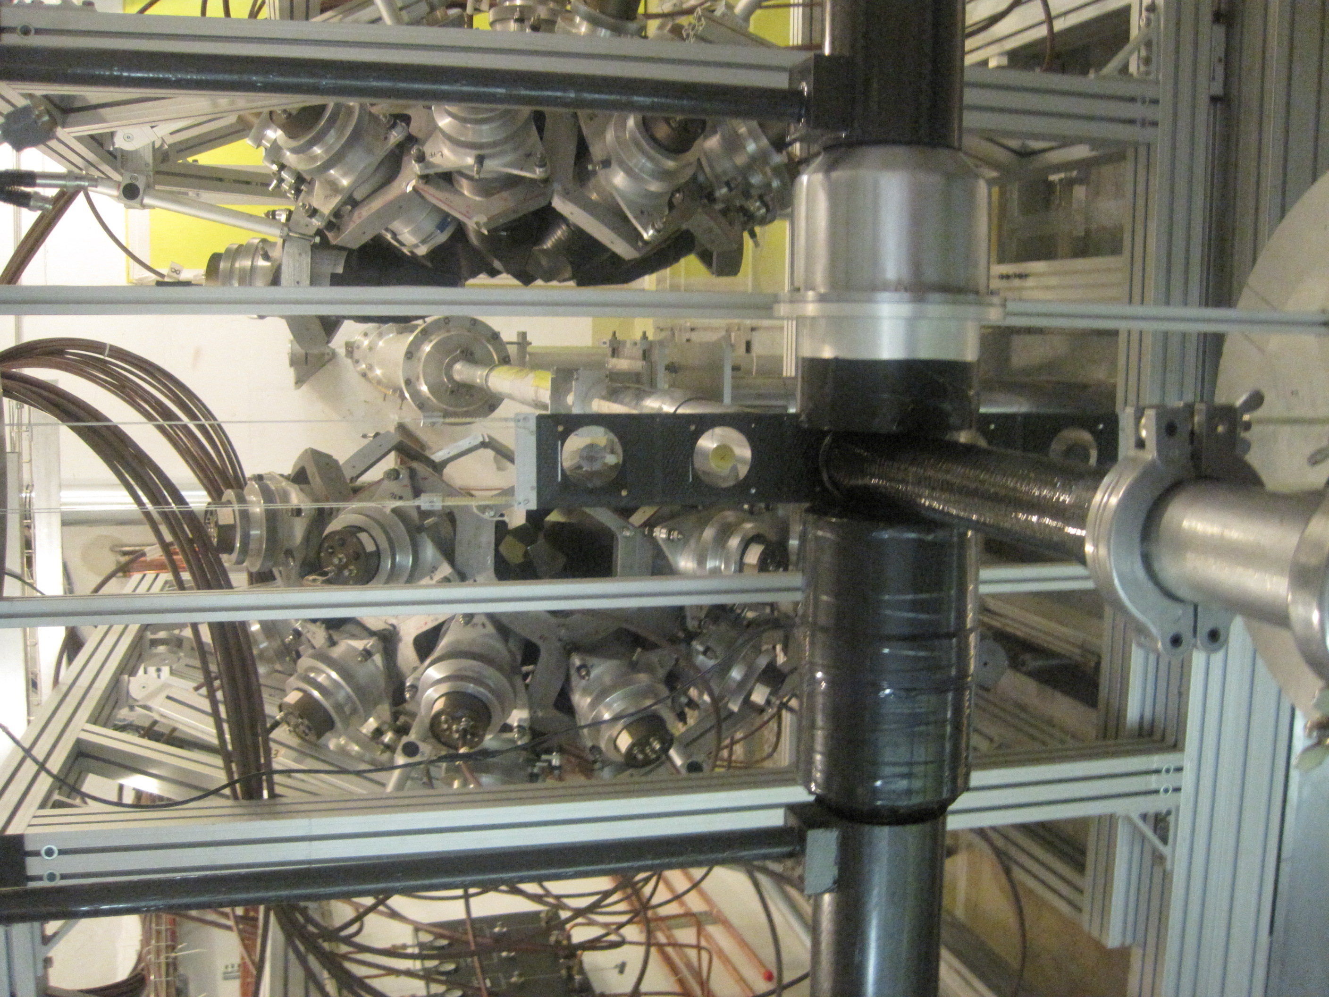
Measurement of ⁵⁴Fe,⁵⁶Fe(n,γ) at n_TOF
nTOF13
Experimental setup for Fe56
Experimental setup for Fe54

Slide 18
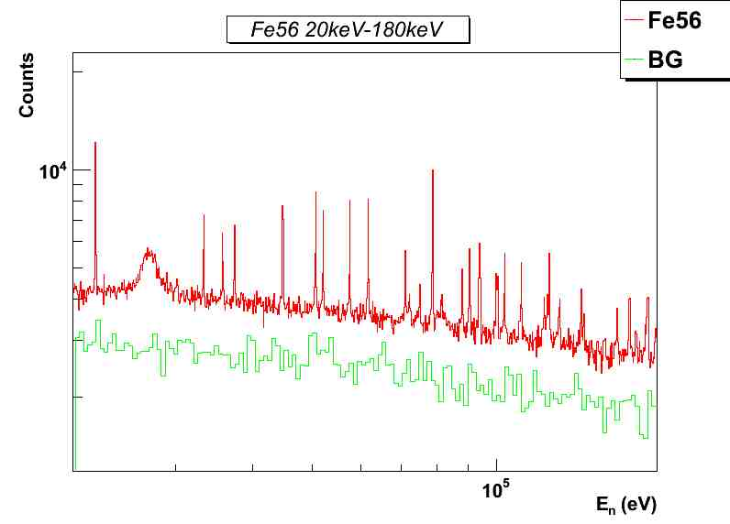
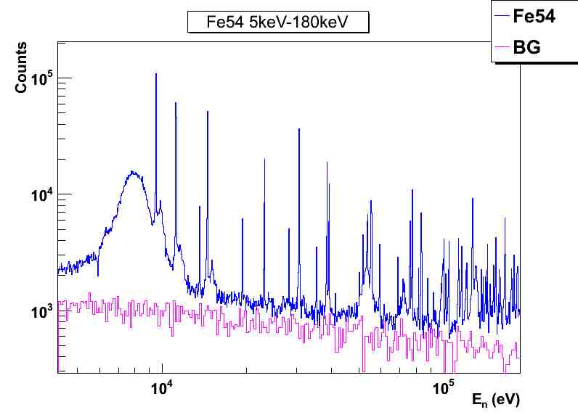
^{54,56}Fe(n,γ) cross section measurement
Both cross section have been measured in the region of astrophysical importance obtaining a good capture to background ratio that will lead to accurate cross section.
⁵⁶Fe
Measured in 2009 with water as moderator.
Reasonable (n,g)/back.
⁵⁴Fe
Measured in 2010 with ¹⁰B-water as moderator.
Excellent (n,g)/back.
G. Giubrone IFIC (Spain)

Slide 19
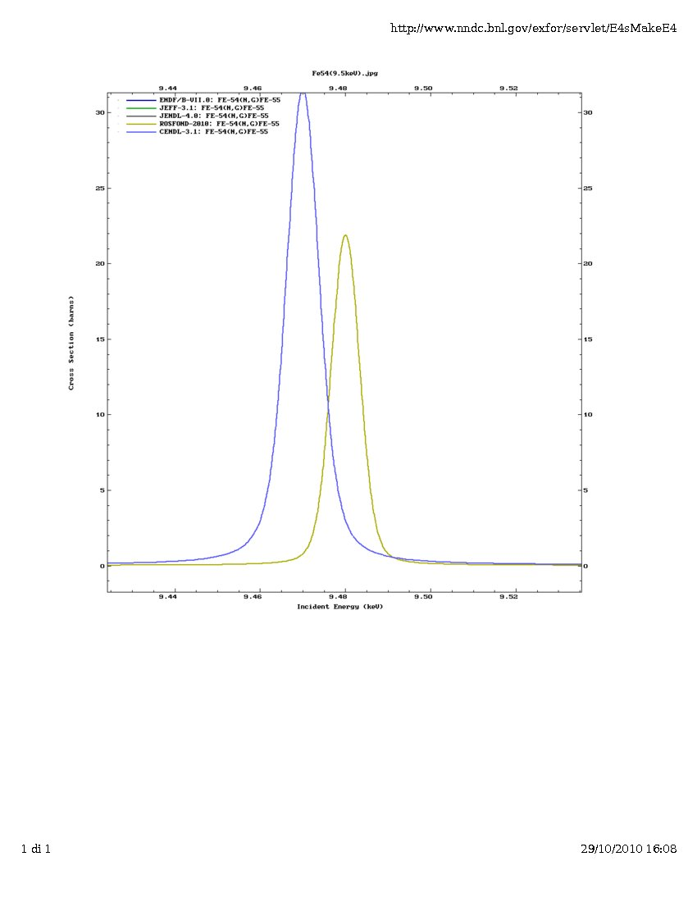
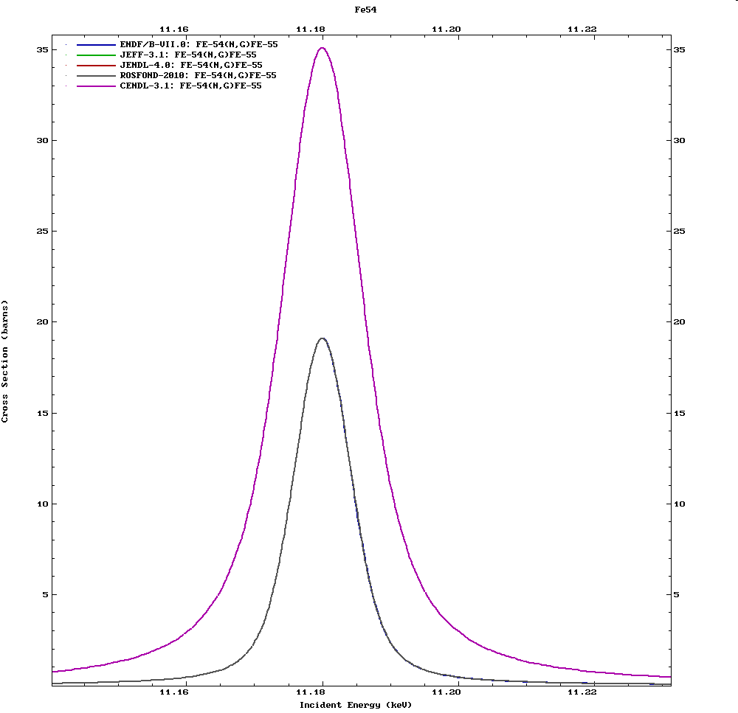
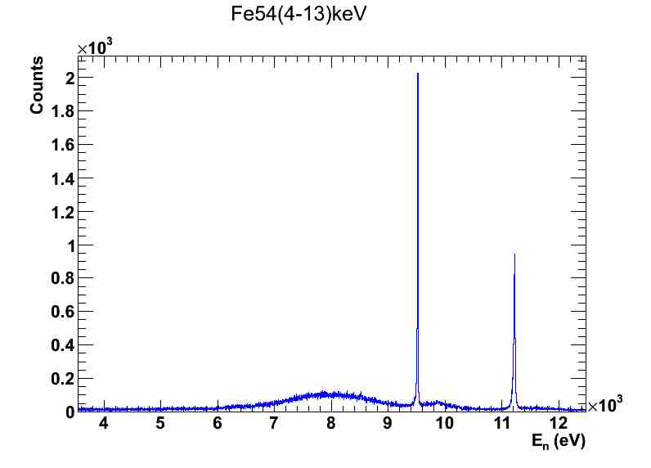
^{54,56}Fe(n,γ) cross section measurement
Differences in the actual evaluated cross sections of up to 50% in the region of astrophysical interest will be resolved with the analysis of the present data.
Evaluations
Evaluations
n_TOF data
G. Giubrone IFIC (Spain)

Slide 20
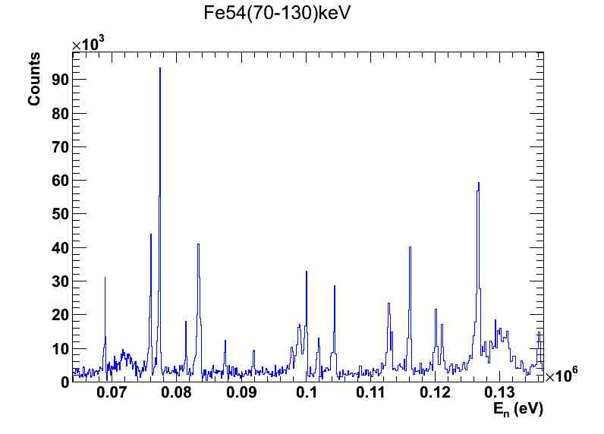
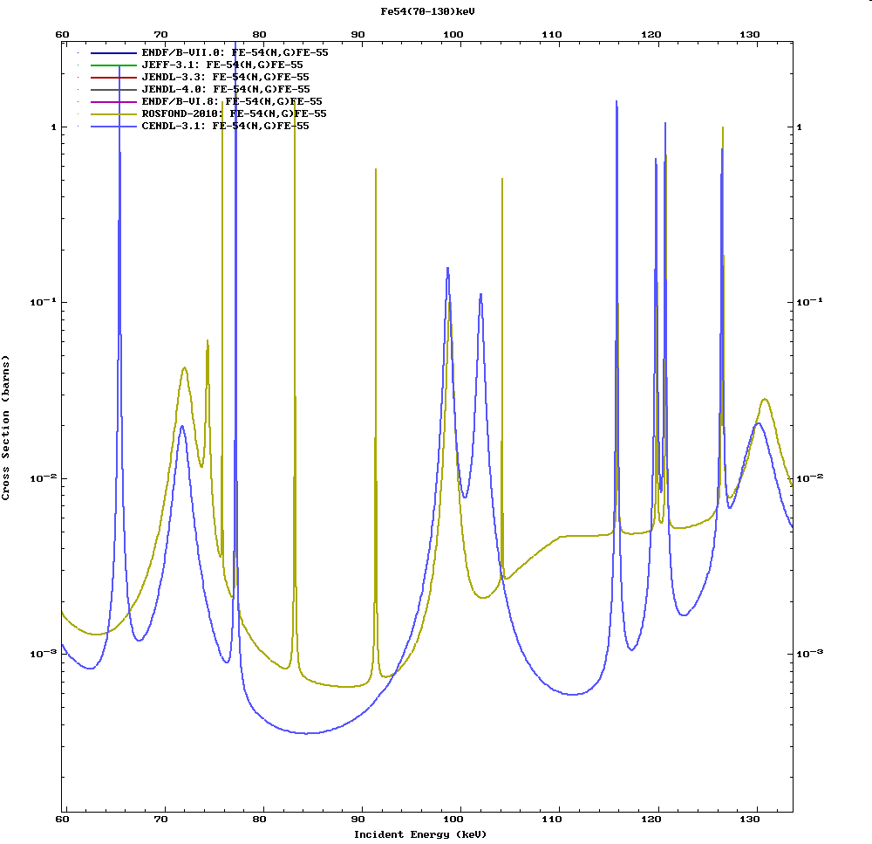
^{54,56}Fe(n,γ) cross section measurement
Differences in the actual evaluated cross sections of up to 50% in the region of astrophysical interest will be resolved with the analysis of the present data.
The high capture to background ratio will allow to identify new resonances.
Thanks to the high purity of the sample, the data will allow to solved the existing discrepancies regarding the assignation of resonances to one or another Fe isotope.
n_TOF data
Evaluations
G. Giubrone IFIC (Spain)

Slide 21
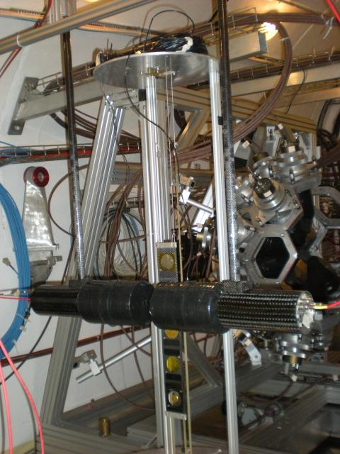
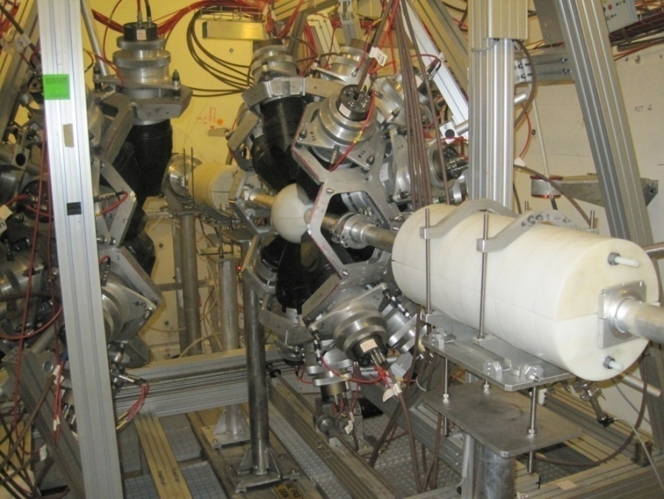
“Neutron capture cross section measurements of ²³⁸U, ²⁴¹Am and ²⁴³Am at n_TOF”, CERN-INTC-2009-025/INTC-P-269
Spokespersons: D. Cano-Ott (CIEMAT) and F. Gunsing (CEA), Technical Coordinator: V. Vlachoudis (CERN)
nTOF 15
The Total Absorption Calorimeter
Very high efficiency
Negligible background from sample activity
Source of additional info about the capture cascade (for basic nuclear physics)
~Sizable neutron sensitivity
~Limited En (<30 keV)
The C6D6
Very low neutron sensitivity (good S/B ratio)
“Unlimited” En (thermal to MeV)
~Sizable background from sample activity
~Good energy resolution
C. Guerrero et al., Nucl. Inst. And Meth. A 608 (2009) 424-433
R. Plag et al., Nucl. Inst. And Meth. A 496 (2003) 425-436

Slide 22
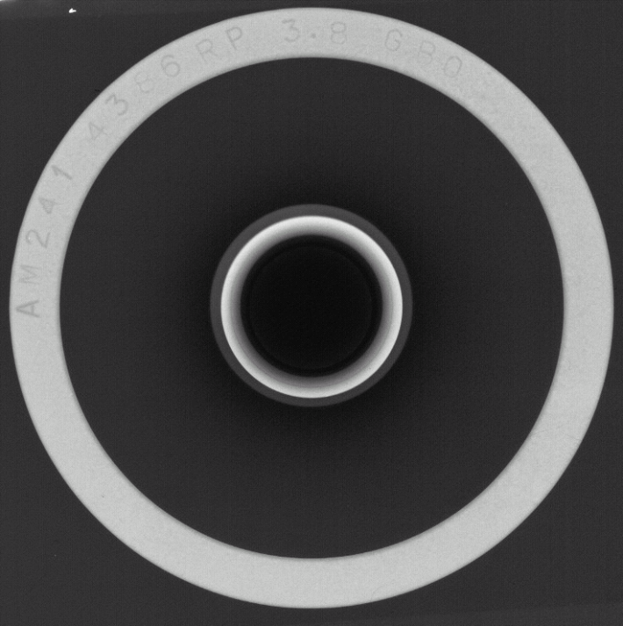
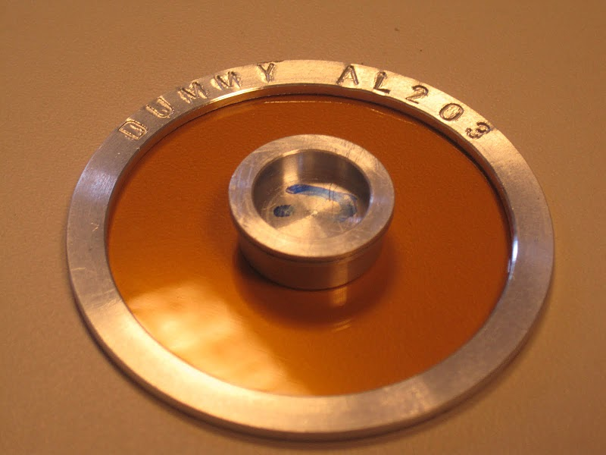
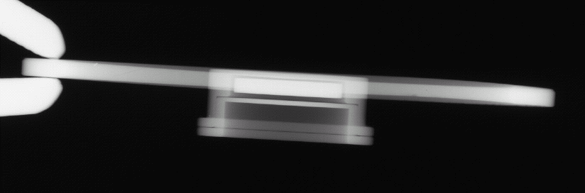
The ²⁴¹Am sample (3.8 GBq)
The sample (disk-shaped with 12.2 mm diameter) consists on 32.2 mg of ²⁴¹Am oxide embedded in a 305 mg Al₂O₃ matrix and encapsulated in a 0.5 mm thick aluminum canning.
The sample is part of a set of samples prepared for IRMM at ITU from material given by CEA for (n,γ) and (n,2n) cross section measurements.
The main actinide impurities are:
²³⁷Np = 2.1%
^{233,236,238}U <0.01 %
^{239,240}Pu <0.2%
X-Ray imaging of the ²⁴¹Am sample

Slide 23
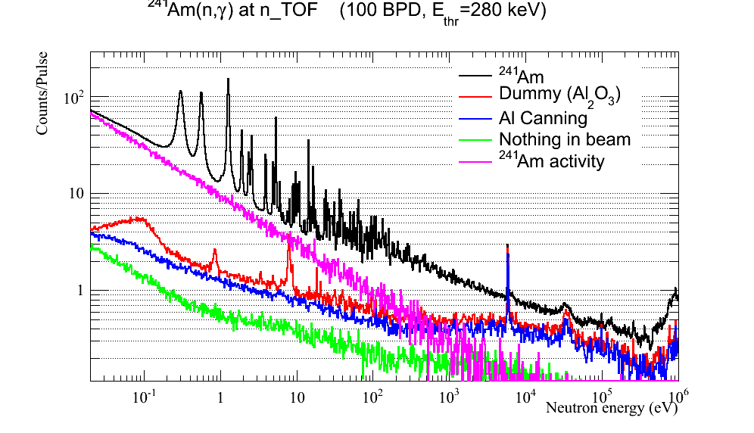
Preliminary counting rates with the C6D6

Slide 24
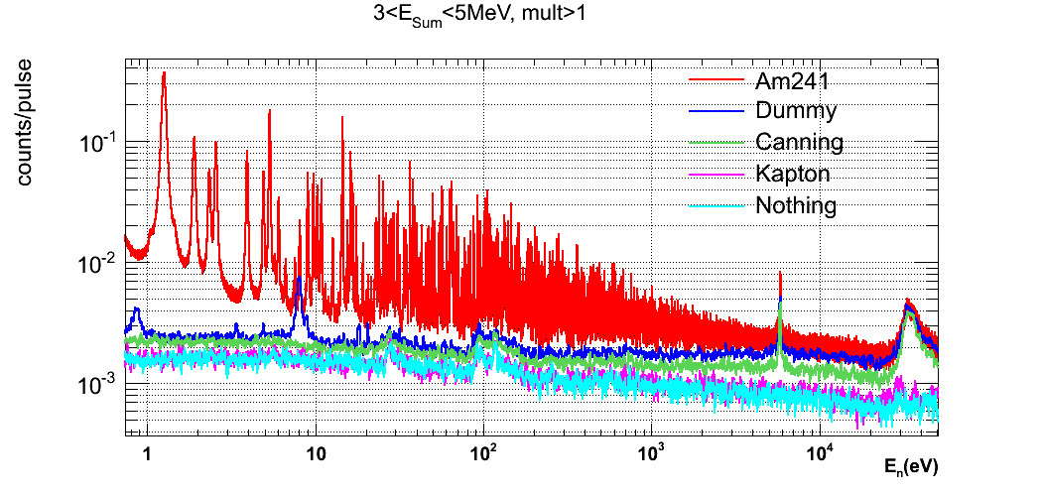
Preliminary counting rates with the TAC
Normalized counts

Slide 25
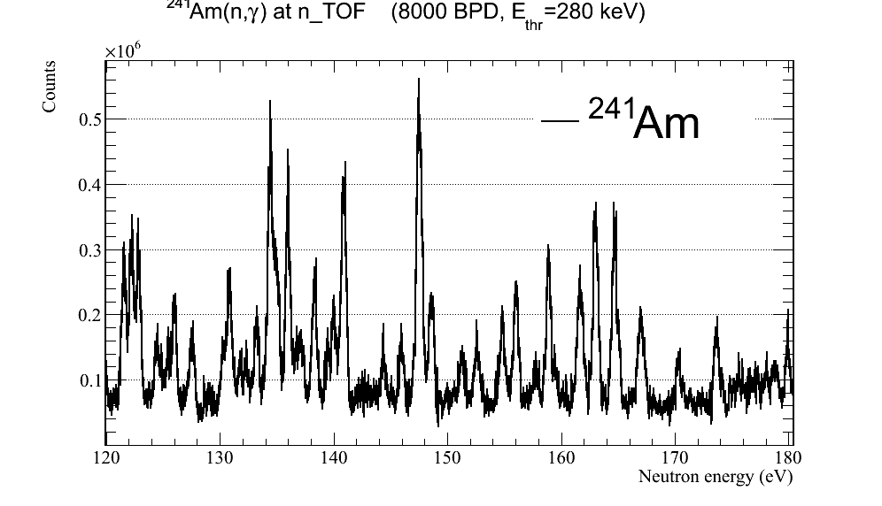
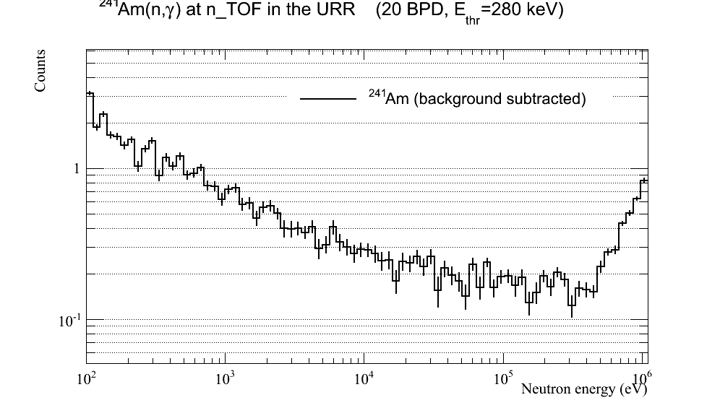
Very preliminary results
Increase of the RRR limit above 150 eV
Increase of the URR limit above 320 keV
Limit of the RRR in the evaluations

Slide 26
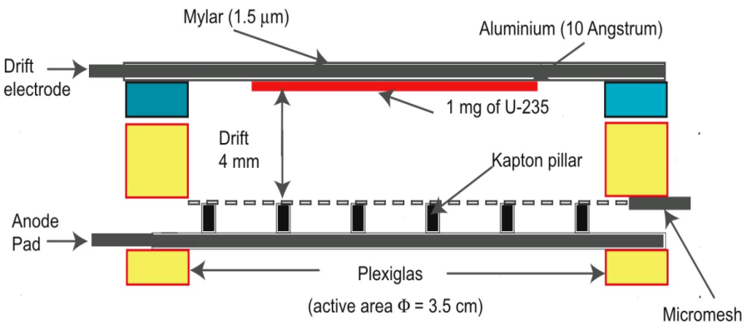
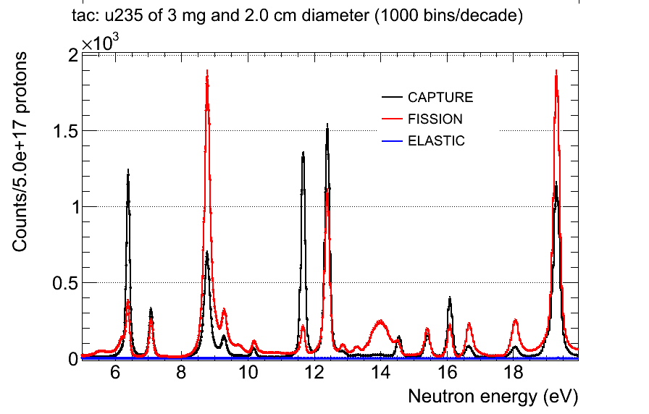
Simultaneous σ(n,γ) & σ (n,f) @ n_TOF-Ph2
LoI submitted to INTC (Nov. 2009) and accepted
The experimental set-up combines the use of the TAC (for capture) with a total of three MGAS (for fission) detectors loaded with ²³⁵U samples.
  The detectors and samples were already used in 2009 (for monitoring purposes)
  The long MGAS chamber has been designed and constructed at CERN.
TAC
HV (drift)
MGAS
Expected counting rates
Signal+Mesh
3 MGAS detectors
each equipped with a 1 mg ²³⁵U sample

Slide 27
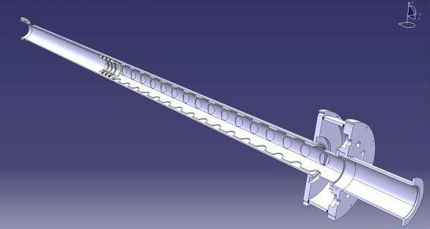
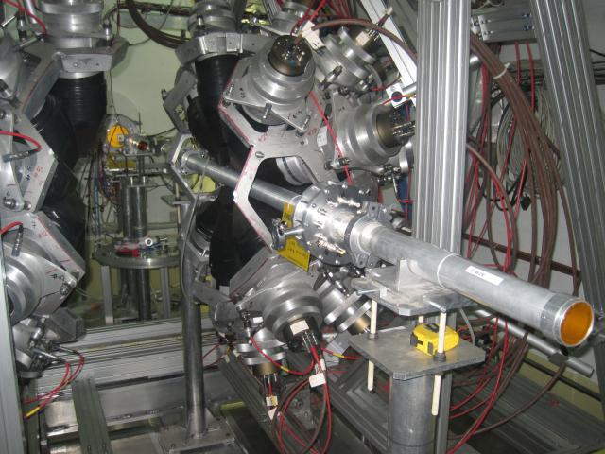
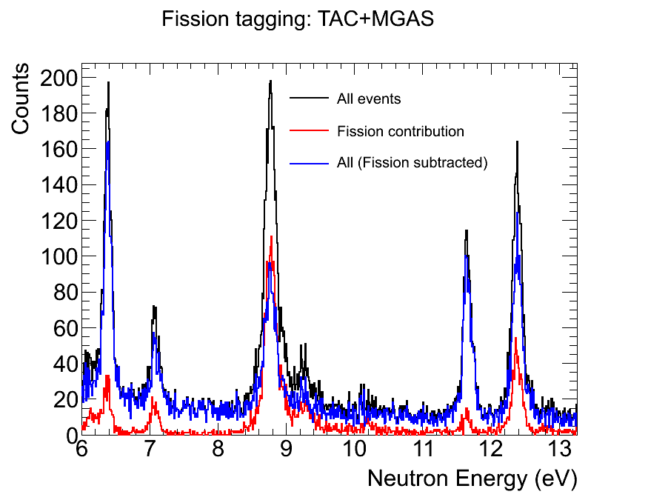
Simultaneous σ(n,γ) & σ (n,f) @ n_TOF-Ph2
Fission tagging chamber fabricated at CERN (June-August 2010)
Experiment carried out during a 7 days campaign in October 2010
The preliminary results are very promising and will lead to new proposal (INTC Feb. 2011)
Capture dominated resonances
High fission contribution

Slide 28
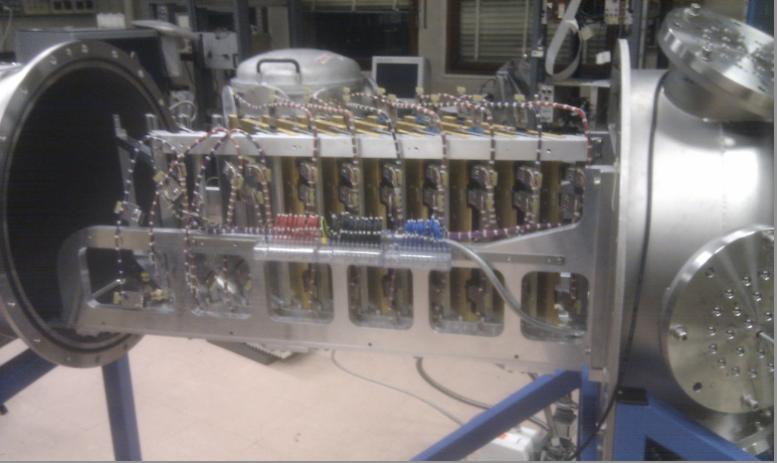
Parallel Plate Avalanche Chamber (PPAC) Detector

Slide 29
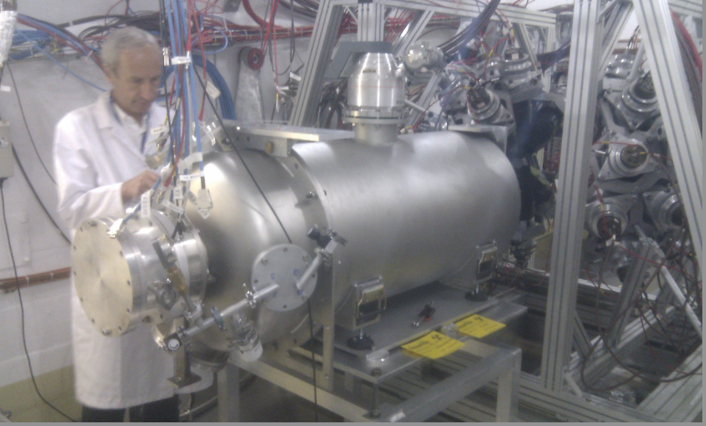
nTOF 14
Parallel Plate Avalanche Chamber (PPAC) Detector into n_TOF Experimental Area

Slide 30
U235
U238
Th232
Np237
Th232
Th232
Th232
Th232
Th232
neutrons
Experimental setup:
10 PPAC detectors with 9 targets in between (U235, U238, Np237, 6xTh232)
Fission events are identified as coincidence signals (~10 ns) in the anodes of 2 consecutive PPACs.
Segmented cathodes to study the angular distribution of fission fragments.

Slide 31
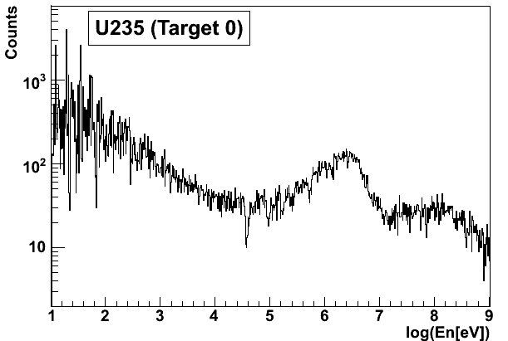
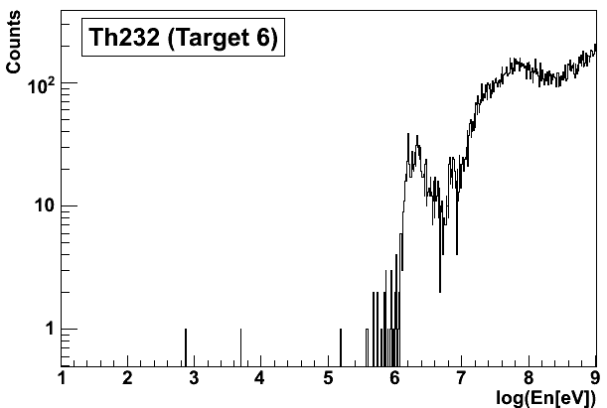
Preliminary analysis using only a few runs:
Number of fission events for U235 and Th232 in function of the neutron energy (in log).
A continuous range between 1 eV and 1 GeV is covered.
The experiment is going on as expected.

Slide 32
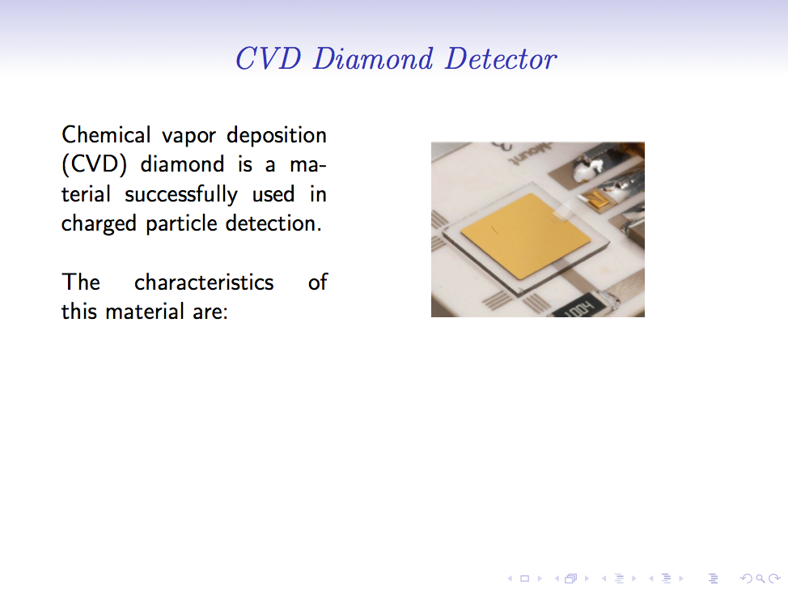
Weiss Christina, Vienna University of Technology

Slide 33
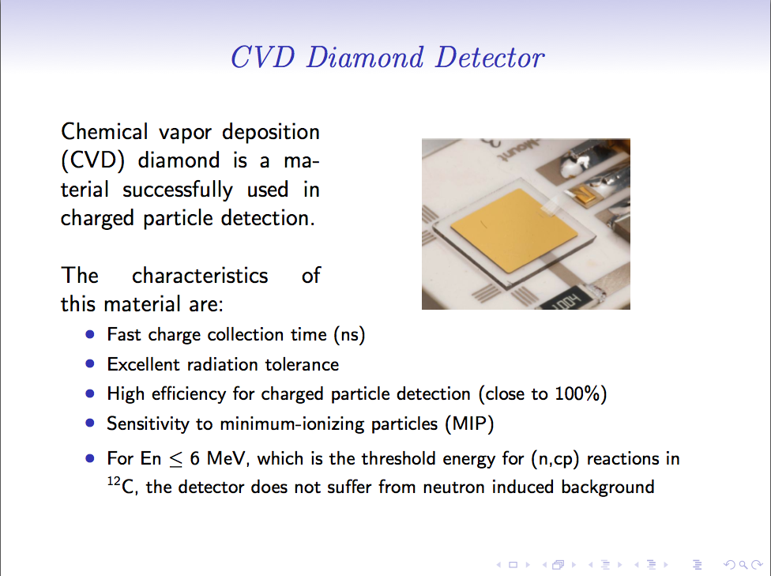
Weiss Christina, Vienna University of Technology

Slide 34
ITEMS
n_TOF Facility Status
Borated Water Moderator system
Preliminary results analysis on 2010 measurements
Integrated protons 2010
Summary

Slide 35
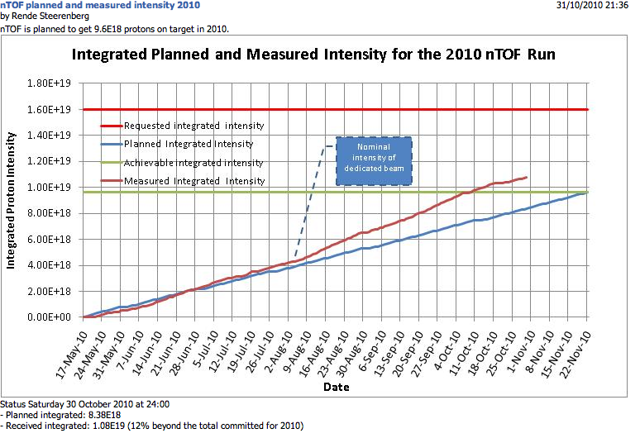

Slide 36
Summary of the n_TOF-Ph2 experimental campaign 2010
Document No | Proposal | Measurement | Detectors | # Protons | Dates
- | - | Start Up | All | 1.0E+17 | 18/5-21/5
CERN-INTC-2008-035 | n_TOF-12: New target commissioning and beam characterization | ¹⁰B water commisioning | PTB, SiMon, MGAS, XY-MGAS, C6D6 | 2.1E+18 | 22/5-27/6
CERN-INTC-2006-012 | n_TOF-13: The role of Fe and Ni for s-process nucleosynthesis … | ⁵⁴Fe(n,g) | C6D6 | 2.0E+18 | 28/6-2/8
- | Start up of the ²⁴¹Am measurementrs: RP issues, high activity on detectors, etc. | ²⁴¹Am(n,g) | C6D6 | 1.0E+18 | 3/8-18/8
CERN-INTC-2009-025 | n_TOF-15: Neutron capture cross section measurements of ²³⁸U, ²⁴¹Am and ²⁴³Am at n_TOF | ²⁴¹Am(n,g) | C6D6 | 1.3E+18 | 19/8-7/9
- | Start up of the ²⁴¹Am measurementrs: RP issues, high activity on detectors, etc. | ²⁴¹Am(n,g) | TAC | 4.0E+17 | 8/9-14/9
CERN-INTC-2009-025 | n_TOF-15: Neutron capture cross section measurements of ²³⁸U, ²⁴¹Am and ²⁴³Am at n_TOF | ²⁴¹Am(n,g) | TAC | 2.1E+18 | 15/9-10/10
CERN-INTC-2010-037 | LOI: Validation of simultaneous measurement of capture and fission reactions at n_TOF | ²³⁵U(n,g) ²³⁵U(n,f) | TAC + MGAS | 6.0E+17 | 11/10-18/10
CERN-INTC-20106-016 | n_TOF-14: Angular distributions in the neutron-induced fission of actinides | ²³²Th(n,f), ^{235,238}U(n,f) | PPAC | 2.0E+18* | 19/10-23/11
 | TOTAL 2010 |  |  | 1.16E+19 | 18/5-23/11
* Expected

Slide 37
ITEMS
n_TOF Facility Status
Borated Water Moderator system
Preliminary results analysis on 2010 measurements
Integrated protons 2010
Summary

Slide 38

n_TOF experiment Summary
Operation of a borated water moderation system
Work Sector Type A experimental area
  Converted the actual experimental area to a Work Sector Type A → no major restrictions on radioactive samples measurement
  Significant improvement in measurement capabilities
4. 2010 experimental campaign :
1. Most of the program completed and analysis ongoing
  Angular distribution of fission fragments with PPACs (TOF14)
  Capture measurements 54Fe(TOF13)
  Capture measurements on actinides 241Am
  Commissioning with borated water moderator (TOF12)
  Validation of simultaneous measurement of capture and fission reactions at n_TOF
  Diamond Detector test
20010/2015 perspectives:
1. New institutes involved in the MoU ( Manchester, York, Thessaloniki, Oak Ridge, IRMM….)
2. 13 PhD at present
3. At least 2.5 year of beam needed to fulfill the present proposals
4. New proposals to come from the new member of the Collaboration
5. Feasibility Study on Experimental Area 2 (EAR2)

