Slide 1


Study of the proton-neutron interaction around ⁶⁸Ni: Vibrational Structure of ^{72,74}Zn
Dennis Mücher
E12, TU München
for the MINIBALL collaboration

Slide 2
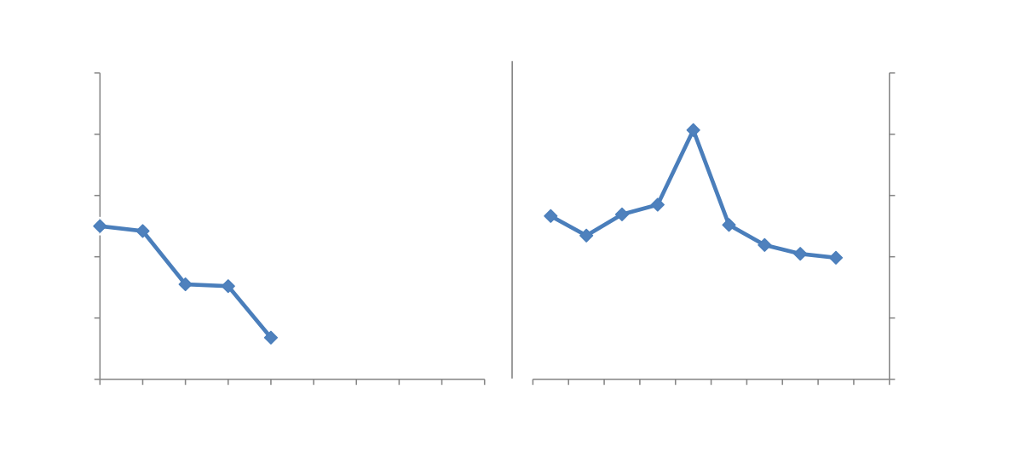
N=40 subshell closure:
M. Bernas et al., Phys. Lett. B, 113, 279 (1982)
R. Broda et al., Phys. Rev. Lett., 74, 868 (1995)
K. Langanke et al., Phys. Rev. C, 67, 044314 (2003)

Slide 3
parity-change !
In ⁶⁸Ni, there is no 1p-1h neutron-component in 2⁺ states !
A. F. Lisetskiy, B. A. Brown, M. Horoi and H. Grawe, Phys. Rev. C 70, 044314 (2004)

Slide 4
K. Langanke et al., Phys. Rev. C, 67, 044314 (2003)

Slide 5
parity-change !
The effects at and around N=40, especially the pair scattering between ν(p_{1/2} g_{9/2}), are dominated by the influence of the proton-neutron interaction.

Slide 6
J. Van Roosbroeck et al.,
Phys. Rev. C 69, 034313 (2004)

Slide 7
⁶⁸Ni + 2π or 2ν
⁷²₃₀Zn₄₂
2⁺
?
2⁺
1260
V_{pn}
2⁺
885
2⁺
652
0⁺
0
0⁺
0
0⁺
0
⁷⁰₃₀Zn₄₀
⁷⁰₂₈Ni₄₂
⁷²₃₀Zn₄₂

Slide 8
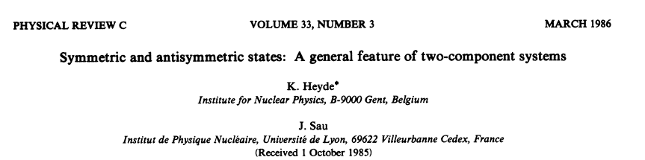
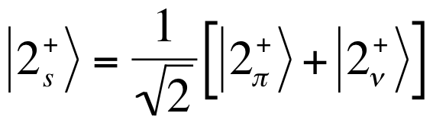
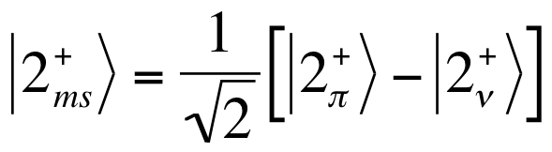

Slide 9
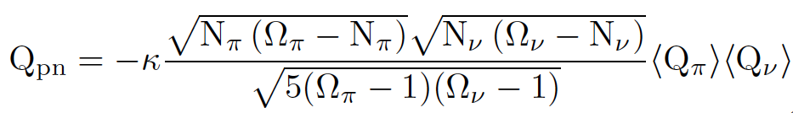
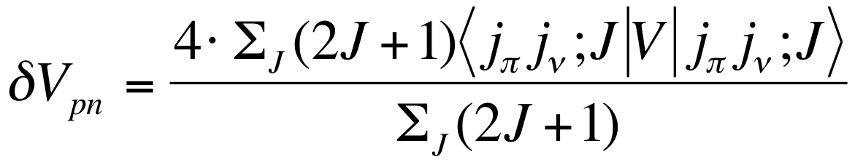
K. Heyde and J. Sau, Phys. Rev. C, 33, 1050 (1986):
R. Fossion et al., Phys. Rev. C 65, 044309 (2002):
<Q_{ρ}> almost independent of j_{ρ} for h.o. wavefunctions
Heyde et al., PRC 49, 5 (1994), 2499

Slide 11
IS423: ⁸⁸Kr on ¹²C target, 2.19 MeV/u
(old Miniball Setup, 2005)
2⁺₁->0⁺₁ (⁸⁸Kr)
prompt
random
2⁺₃->2⁺₁ (⁸⁸Kr)

Slide 12
IS423: ⁸⁸Kr on ¹²C target, 2.19 MeV/u
(old Miniball Setup, 2005)
σ(2⁺_{ms})=0.0072 mb
imagine...... ⁸⁸Kr on ¹²⁰Sn target, 2.85 MeV/u
σ(2⁺_{ms})=0.50 mb
in addition: less background, less deadtime
  EBIS slow extraction mode (important !!)
  much better beam focus/beam control
  beam dump is far away now
  variable distance Target – CD-Detektor
  thin targets
a determination of the 2⁺_{ms} in ⁸⁸Kr is now possible in a few days of beamtime at MINIBALL

Slide 13
1. Physics Case:

Slide 14
1. Physics Case:

Slide 15
1. Physics Case:
1613 keV
1613 keV state from β-decay: J. –C. Thomas et al., Phys. Rev. C 74, 054309 (2006)

Slide 16
2⁺_{ms} stronger excited in (t,p) compared to 2⁺₂ in all stable even-even zinc isotopes

Slide 17
2. feasibility: cross sections in ⁷²Zn are up to 10 x higher compared to ⁸⁸Kr
σ(1612)=1.1 mb
σ(1657)=6.3 mb
σ(2⁺₁)=9.1 mb
prompt
random
2⁺₁->0⁺₁ (⁸⁸Kr)
2⁺₃->2⁺₁ (⁸⁸Kr)
σ(2⁺₃)=0.0072 mb

Slide 18
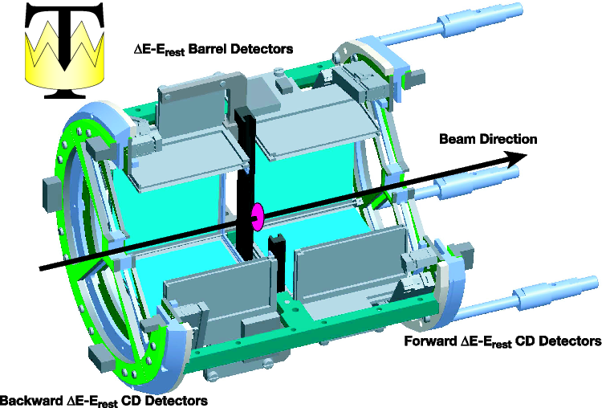
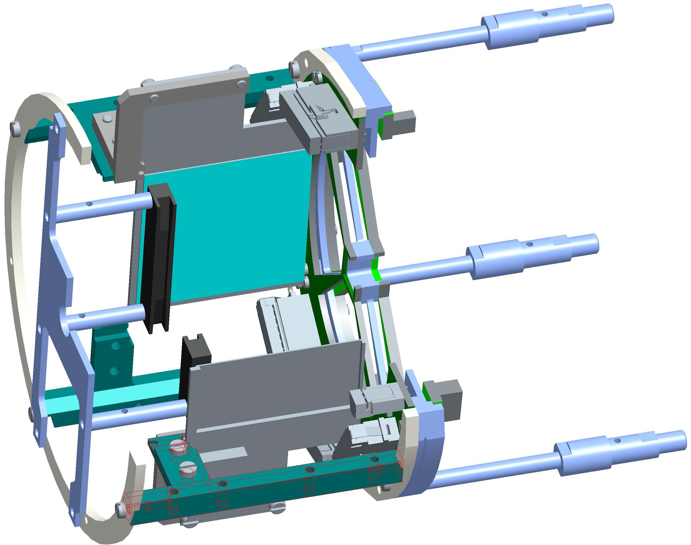
successful runs in fall 2010:
¹¹Be(d,p) (5.E06 pps at Miniball)
⁴⁴Ar(t,p)
⁷⁸Zn(d,p)
Coulex Barrel:
variable CD-distance
CD in forward and/or backward direction
high angular coverage
quick change of barrels possible
less gamma-ray efficiency

Slide 19
M1
E2

Slide 20
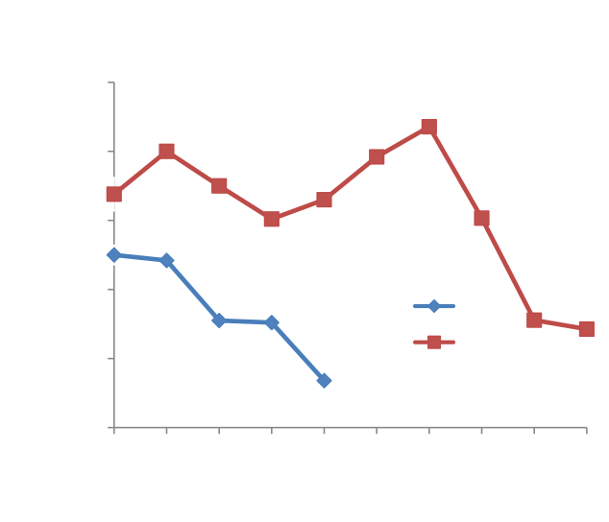
Our goals for Coulex, ⁷²Zn
Precise measurment of B(E2;2⁺₁ -> 0⁺₁), incl. quadrupole moment Q(2⁺₁)

Slide 21
Our goals for Coulex, ⁷²Zn
Precise measurment of B(E2;2⁺₁ -> 0⁺₁), incl. quadrupole moment Q(2⁺₁)
Measurement of τ(4⁺₁)
exp.
SM
K. Moschner et al., Phys.Rev. C 82, 014301 (2010)
D. Mücher et al., Phys.Rev. C 79, 054310 (2009)

Slide 22
Our goals for Coulex, ⁷²Zn
Precise measurment of B(E2;2⁺₁ -> 0⁺₁), incl. quadrupole moment Q(2⁺₁)
Measurement of τ(4⁺₁)
Identification of the 2⁺_{ms} state by measuring the direct E2 excitation for 1612+1657 states (forward detectors!)
(measurment of multipole mixing ratios for decays into 2⁺_{1,} backward detectors)

Slide 23
In case of ⁷²Zn, we are operating at (or slightly above) the Coulomb barrier, what is the optimal choice for such an experiment! Thus, there is no need to wait for HIE-ISOLDE in case of ⁷²Zn.
In contrast, HIE-Isolde is indispensable for heavier nuclei

Slide 24
2⁺_{ms} stronger excited in (t,p) compared to 2⁺₂ in all stable even-even zinc isotopes
excited 0⁺ state gets stronger and stronger: p_{1/2} strongly favored over g_{9/2} (“FRESCO“ calculations)
→ measuring the cross-section for 0⁺₂ means to directly measure the ratio of pair-scattering ν(p_{1/2} and g_{9/2})

Slide 27
Thank you !

Slide 28
E
1957.2 keV
2⁺_{ms}
E(2⁺₁) ⁵⁸Ni=1454 keV
535.2 keV
I2⁺>
ν
V_{pn}=0.54 MeV
I2⁺>
E(2⁺₁) ⁵⁸Zn=1390 keV
π
537.0 keV
2⁺_{s}
885.0 keV

Slide 30
feasibility:
σ(2⁺_{ms})=0.50 mb
⁸⁸Kr: E(2⁺_{ms})=2216 keV
⁷²Zn: E(2⁺_{ms})=1612 (1657) keV
T_{1/2}(⁸⁸Kr) = 2.84 h
T_{1/2}(⁷²Zn) = 46.5 h
σ(1612)=1.1 mb (assuming mixed-symmetry character)
σ(1657)=6.3 mb (assuming 2-phonon character)

Slide 31
K. Heyde and J. Sau, Phys. Rev. C, 33, 1050 (1986):
R. Fossion et al., Phys. Rev. C 65, 044309 (2002):
<Q_{ρ}> almost independent of j_{ρ} for h.o. wavefunctions
Heyde et al., PRC 49, 5 (1994), 2499

Slide 32
“Mixed- symmetry states are very specific to the IBA model and it was suggested that connections to other models should be looked into.“
(Minutes of the 37th meeting of the INTC)

