Slide 1
Shape coexistence in the light francium isotopes
Kieran Flanagan
University of Manchester
On behalf of the Miniball collaboration

Slide 2
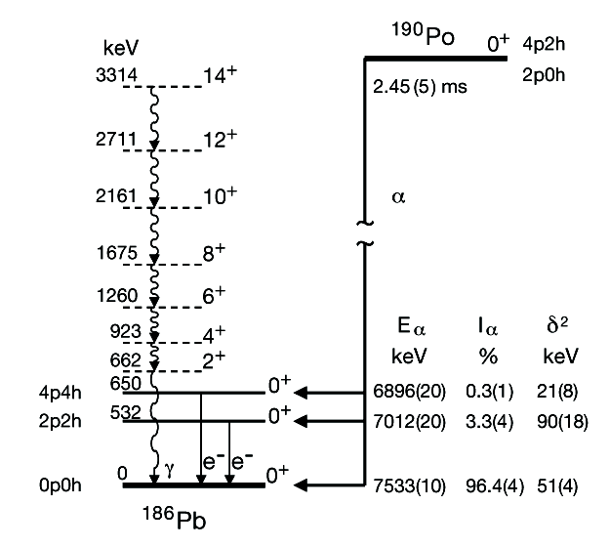
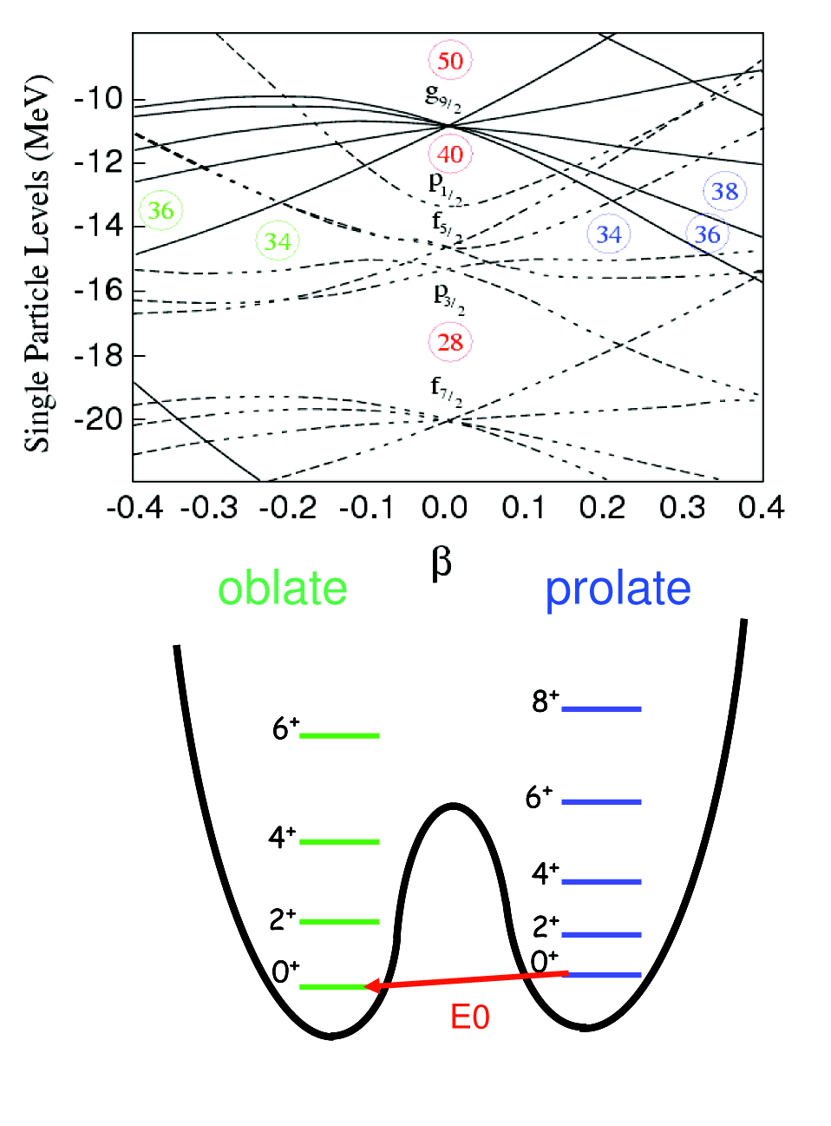
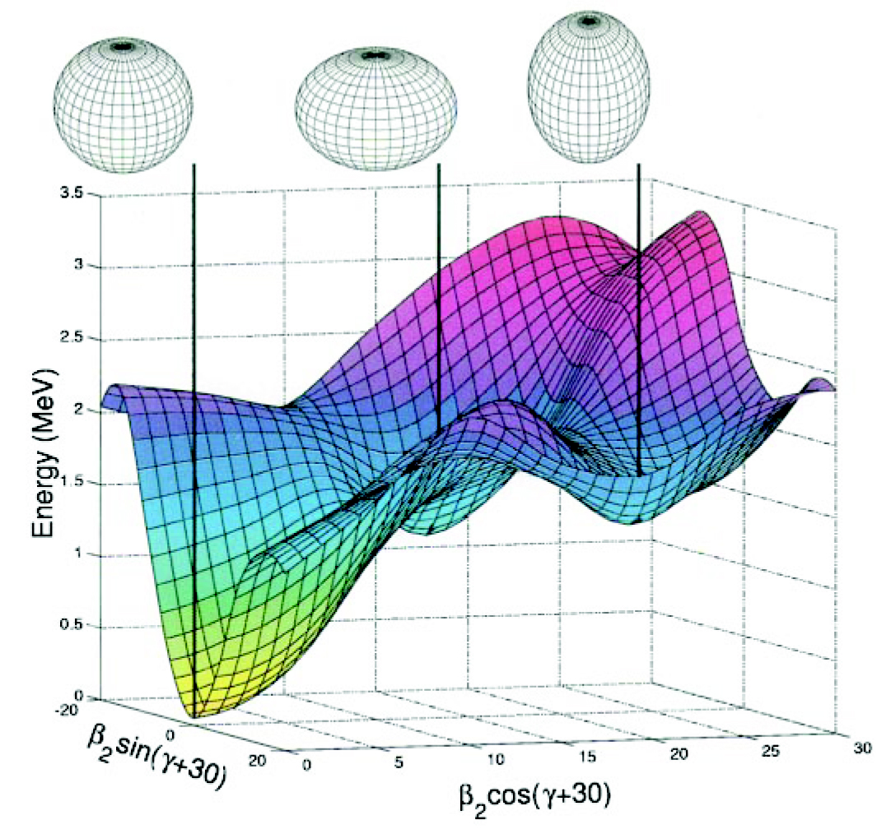
Shape coexistence
Atomic nucleus minimises its energy by adopting different deformed mean-field shapes.
A. Andreyev et al., Nature 405, 430 (2000)
Notes:
Some general introduction to shape coexistence. The region around Z=82 is of course a prominent one where you find 3 different shapes in 186Pb.

Slide 3
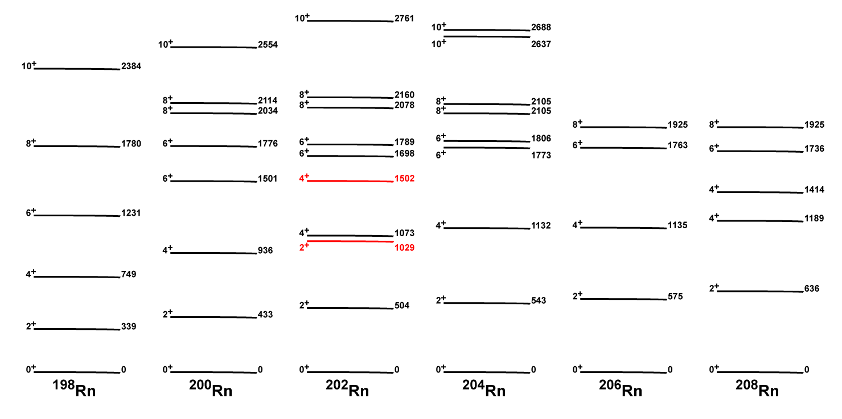
Low Lying Levels in Rn Isotopes
Notes:
You can see at a glance that something is happening in the light radon nuclei and that the 2+ level comes down. In 202Rn, non-yrast states are seen. I guess the second 2+ in 202Rn becomes the first 2+ in 198Rn.

Slide 4
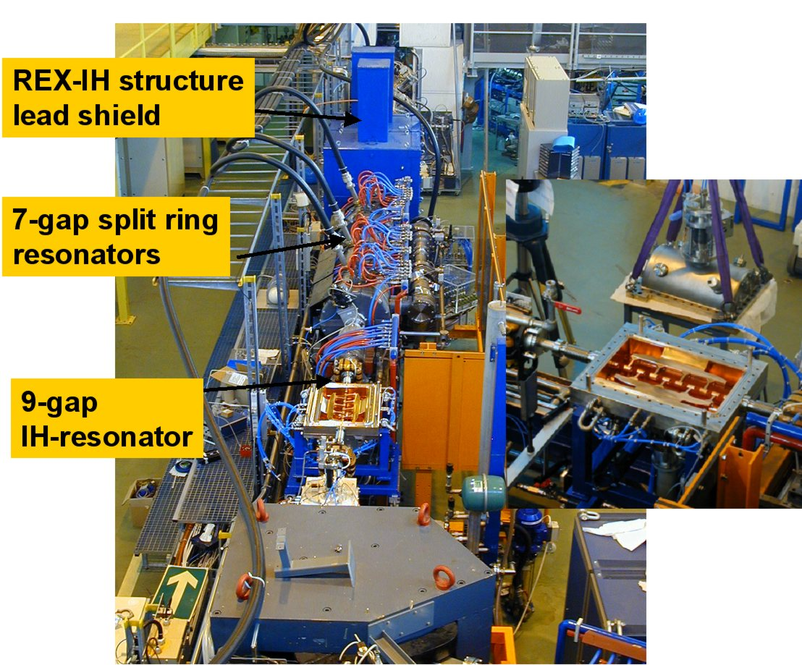
Summary of Rn experiments
Noble gas – easily purified using
Plasma cooled transfer line.
PS Booster and ThC target:
²⁰²Rn - 9 x 10⁵ ions/μC
²⁰⁴Rn - 2 x 10⁷ ions/μC
Intensity at Miniball:
²⁰²Rn – 3 x 10⁴ ions / s
²⁰⁴Rn – 2 x 10⁵ ions / s
 | Energy | Hours
²⁰⁴Rn | 2.9 MeV / u | 69
²⁰²Rn | 2.9 MeV / u | 40*
²⁰²Rn | 2.28 MeV / u | 26
Notes:
This is the details of the Rn coulex experiments – intensities and running times are given. I have asterisked the 202Rn measurement as this was the one we had to come back to finish this summer due to the failure of the 9-gap resonator in the original run. In fact, we continued running after that so got some data at a lower energy.

Slide 5
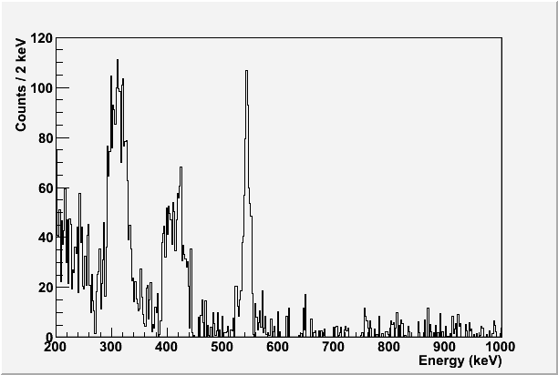
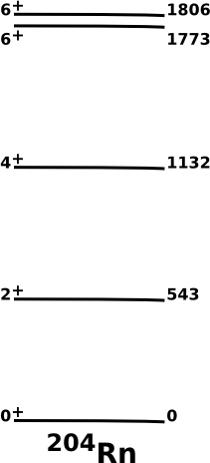
Coulomb excitation of ²⁰⁴Rn on Ag target
D.C. for Beam (²⁰⁴Rn)
²⁰⁴Rn 2⁺ ➔0⁺
589
543
D.J. Dobson et al.,
PRC 66 064321 (2002)
Notes:
This is typical on-line data for Coulomb excitation of 204Rn on a Ag target. This was the normalisation for the B(E2) of the 2+ -> 0+. Ag is readily excited and so we can compare to that. The B(E2) for the silver lines is very well-known.

Slide 6
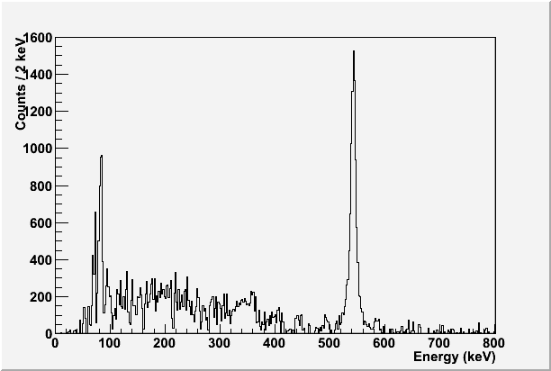
Coulomb excitation of ²⁰⁴Rn on ¹²⁰Sn target
D.C. for Beam (²⁰⁴Rn)
²⁰⁴Rn 2⁺ ➔0⁺
kα1 = 83.8 keV
kα2 = 81.1 keV
Analysis ongoing using GOSIA code to extract matrix elements.
589
543
D.J. Dobson et al.,
PRC 66 064321 (2002)
Notes:
This is the follow-up to the Ag run. Here we use a Sn-120 target. The idea is that while the Sn is poorly excited, the spectrum is very clean because the Sn line lies at high energy i.e. 1.2 MeV so you can see that there is essentially no background. This is important in this case because we want to search for transitions from non-yrast states which have been Coulomb-excited.

Slide 7
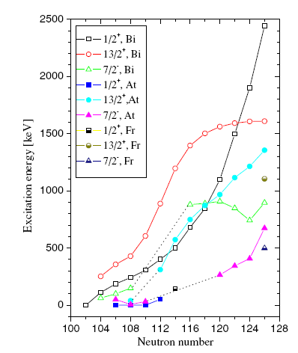
Intruder levels and large deformation in neutron deficient francium
Systematic reduction in energy of the
Deformed π(1/2+) in isotopes in
This region of the chart
7/2⁻
1/2⁺
1/2⁺
7/2⁻
π(1/2+) proton intruder state becomes the ground state in 195At and 185Bi
9/2⁻
9/2⁻
²⁰¹Fr
²⁰³Fr
The isomer shifts of ^{201,203}Fr
And their magnetic moments
will provide important
information to better
understand the evolution of
nuclear structure in this region.
Suggests that ¹⁹⁹Fr has
I=1/2⁺ ground state spin
with an associated large
oblate deformation.
Notes:
Now the discussion shifts to Francium where we have similar Physics going on but an odd proton coupled to the underlying Radon cores which we have already studied.

Slide 8

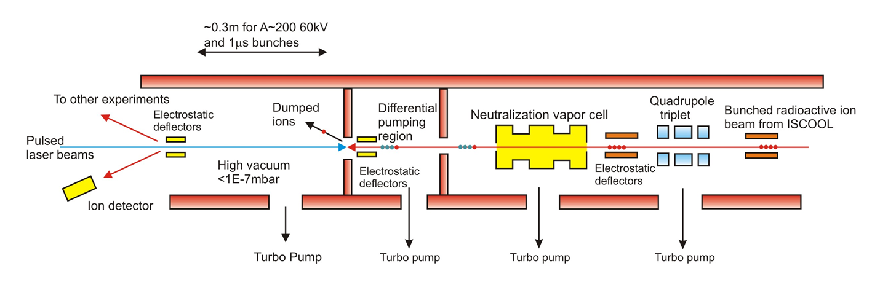
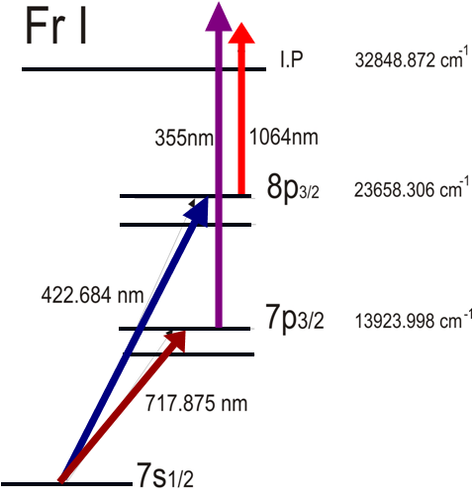
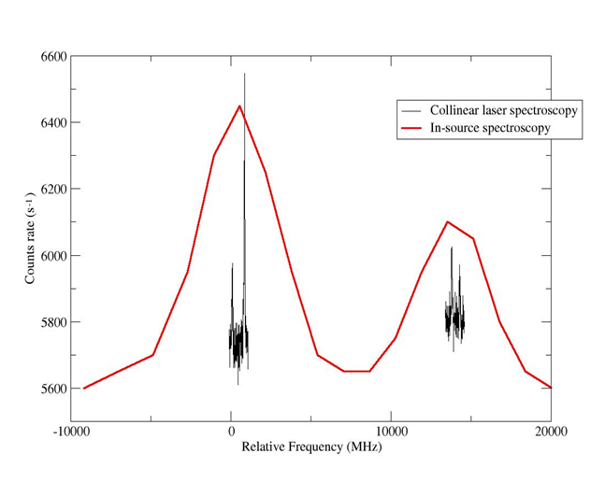
CRIS beam line and method
Combining high resolution
nature of collinear beams
method with high sensitivity
of in-source spectroscopy.
Allowing extraction of
B factors and quadrupole
moments.
⁶⁸Cu
Relative Frequency (MHz)

Slide 9
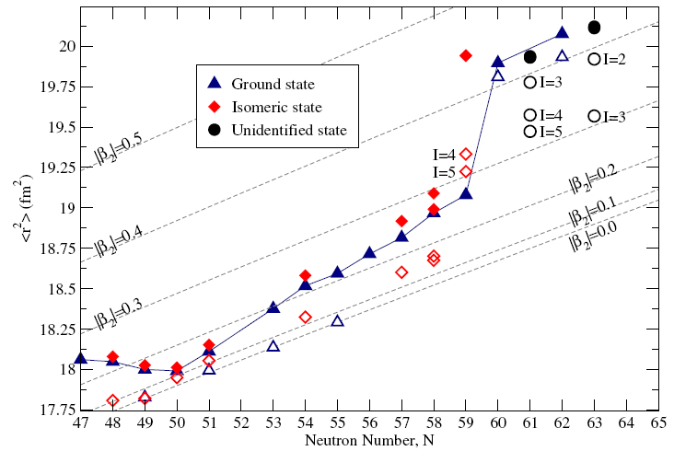
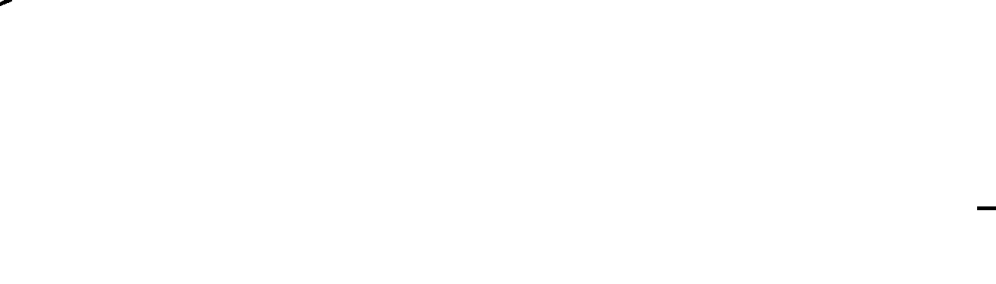
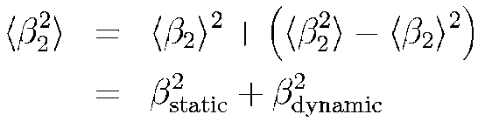
Changes in mean square charge radii
Shape coexistence ⁹⁸Y the δ<r²>^{g,m} occurs at the most extreme position where spherical and deformed potentials are almost degenerate.

Slide 10
A study of deformation in Y
Static:
Dynamic
Decreasingly
prolate which is
dominanted by
static deformation
Increasingly oblate with an increasing dynamic deformation
Open symbols indicate mean square charge radii calculated using only the contribution from the static deformation.

Slide 11
Proposal
We propose to carry out Coulomb excitation of ²⁰³Fr and ²⁰⁴Fr.This will allow us to:
  Identify excited (non-isomeric) states in these nuclei for the first time
  Probe collectivity and shape coexistence in these exotic proton-rich nuclei
  See the effect of the unpaired nucleons relative to the ²⁰²Rn core
  Complement laser spectroscopy measurements: The spin of the ²⁰³Fr and ²⁰⁴Fr isomers should be determined directly, in a parallel CRIS study, along with the associated quadrupole moments. This will help considerably in the Coulomb excitation analysis. We can therefore probe in detail the evolution of collectivity in these nuclei.
  Develop a novel technique of alpha-tagged Coulomb excitation, which will allow us to separate excitation of the different isomers and suppress isobaric contamination
Notes:
Just a reminder of what is in the proposal

Slide 12
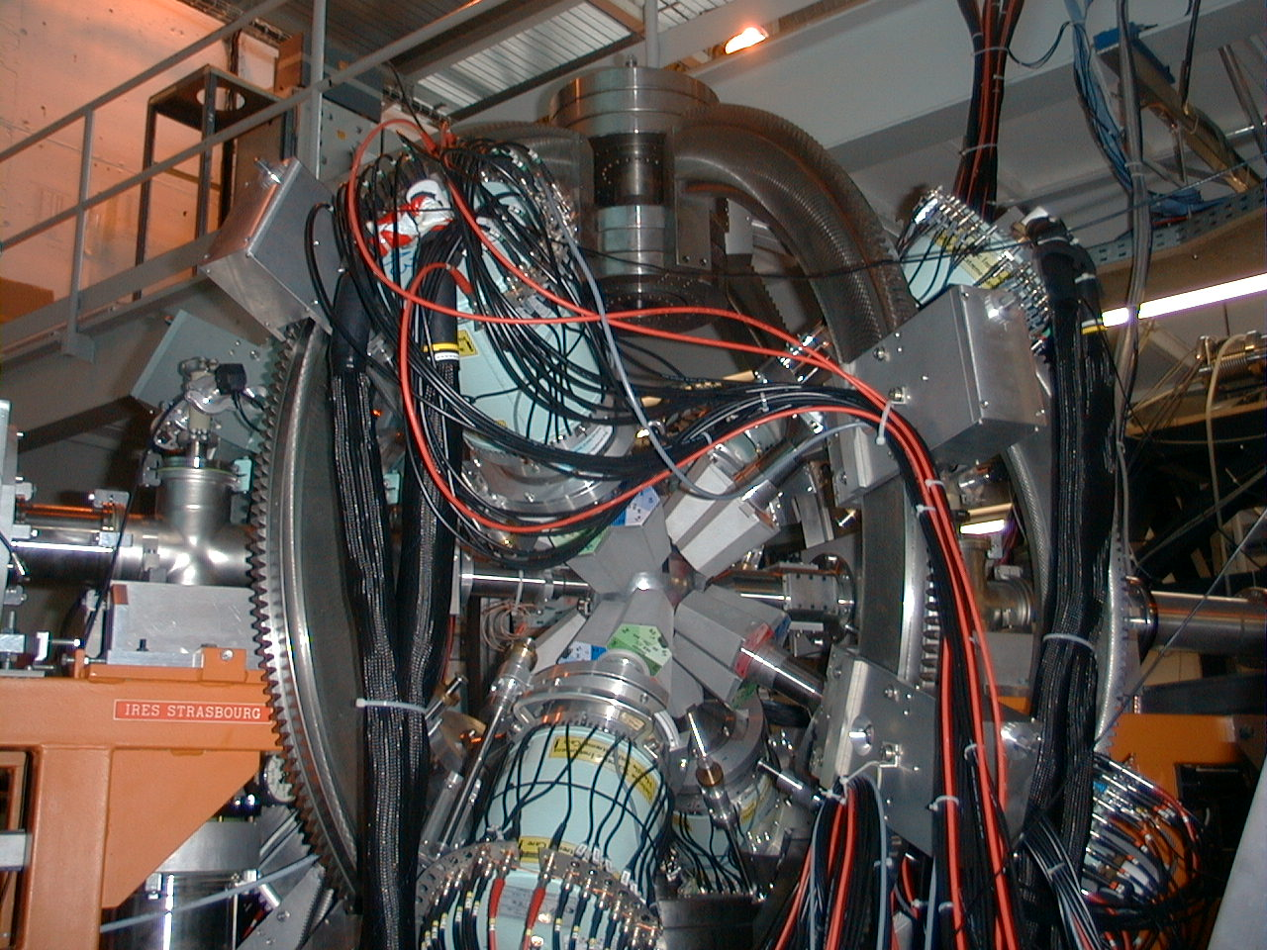
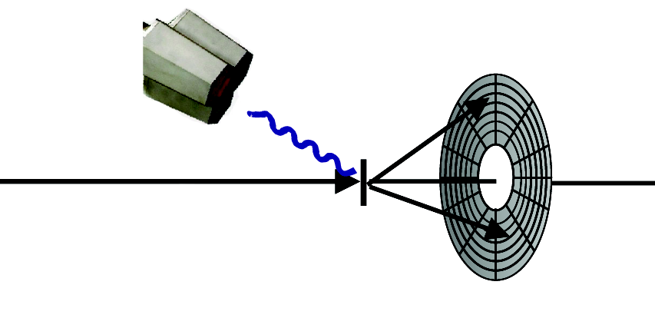
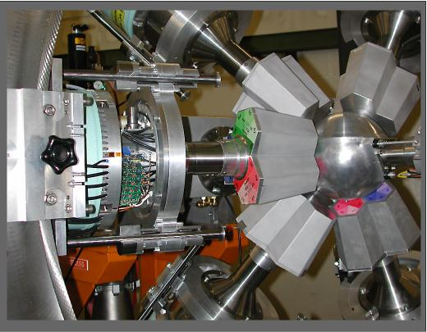
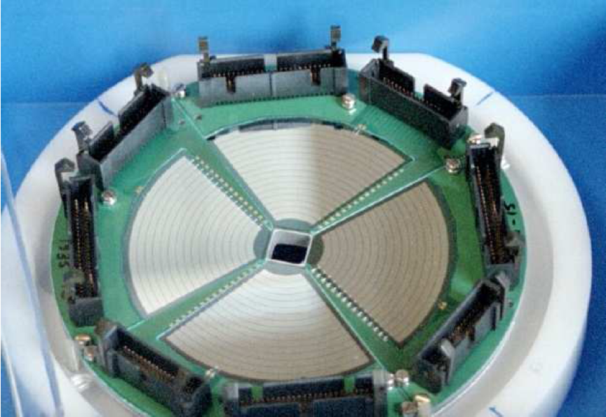
Proposed experiment
x8 Miniball clusters
CD detector
(16º-53º)
^{203,204}Fr from
REX-ISOLDE
¹²⁰Sn/Ag
2 mgcm⁻²
Notes:
Just a quick summary of the present proposal. We propose to use the same methodology as for the earlier Radon experiment. One can comment that the Francium beam should be extremely clean and that Tl contaminant may be readily suppressed.

Slide 13
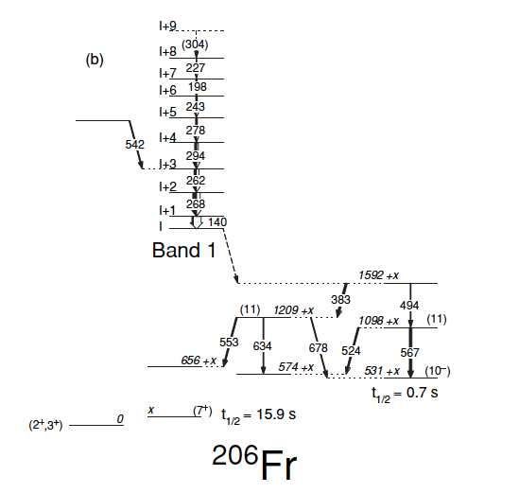
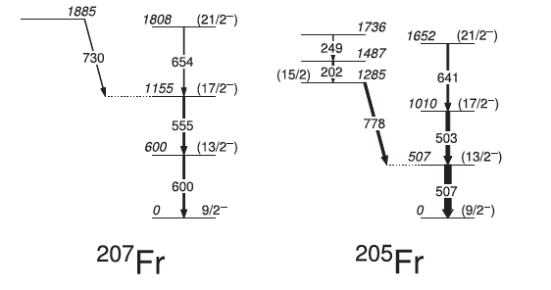
Structure of light Francium isotopes
Notes:
Here are typical level schemes for odd-A and odd-odd Fr isotopes. We have no experimental information on 203Fr and 204Fr as yet but can extrapolate from these heavier cases as well as from 202Rn. Essentially we expect one ground state for odd-A with 9/2- and multiple isomers for 204Fr. We don’t know the isomeric ratio but we will separate them using the alpha decay.

Slide 14
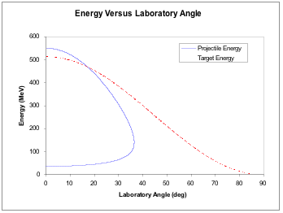
Kinematics
Not possible to distinguish projectile ions and target recoils in this angular range
Solution to tag projectile ions via their characteristic alpha decay
Notes:
The kinematics for the proposed Coulomb excitation show that it is not possible to separate kinematically the projectile ions from target recoils for the smaller lab angles (CD covers about 15 to 50 degrees in the lab). Hence, we propose to use alpha decay to separate the projectile-like. This also allows us to separate isomers.

Slide 15
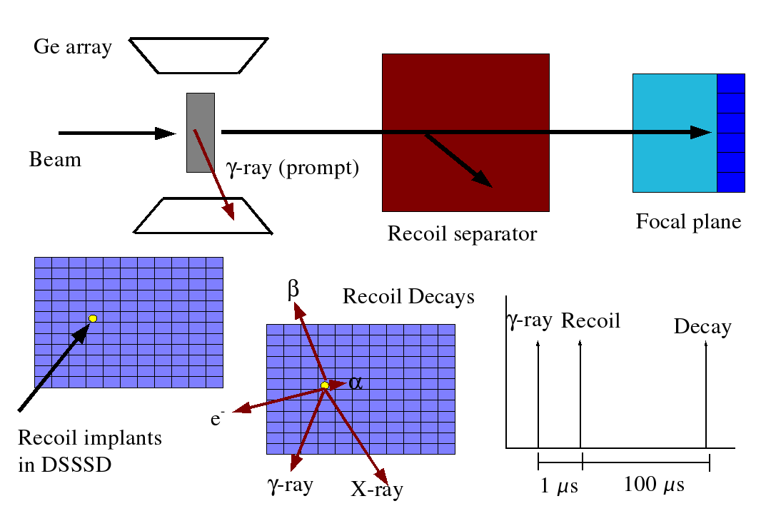
Recoil-decay tagging
Notes:
It is worth reminding about the RDT technique as this has become a key approach at JYFL and other places for tagging exotic proton-rich nuclei.

Slide 16
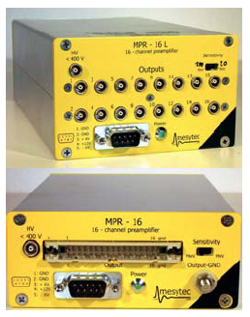
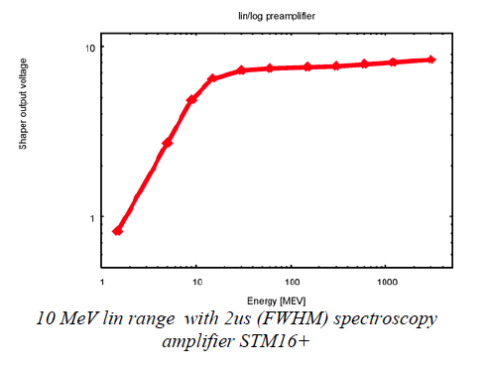
Mesytec lin-log preamplifiers
Notes:
We will use these special Mesytec lin-log preamplifiers. They give a linear response up to 10 MeV and logarithmic up to 3 GeV. This is perfect for tagged-Coulomb excitation as projectile ions have energies of about 500-600 MeV while alphas are around 6 MeV. We have access to these preamps.

Slide 17
Summary of beam request
6 shifts of ²⁰⁴Fr:
  2 X 10⁶/μC measured from ThC_{x} target
9 shifts of ²⁰³Fr:
  2 X 10⁵/μC measured from ThC_{x} target

Slide 18
Finis

Slide 19
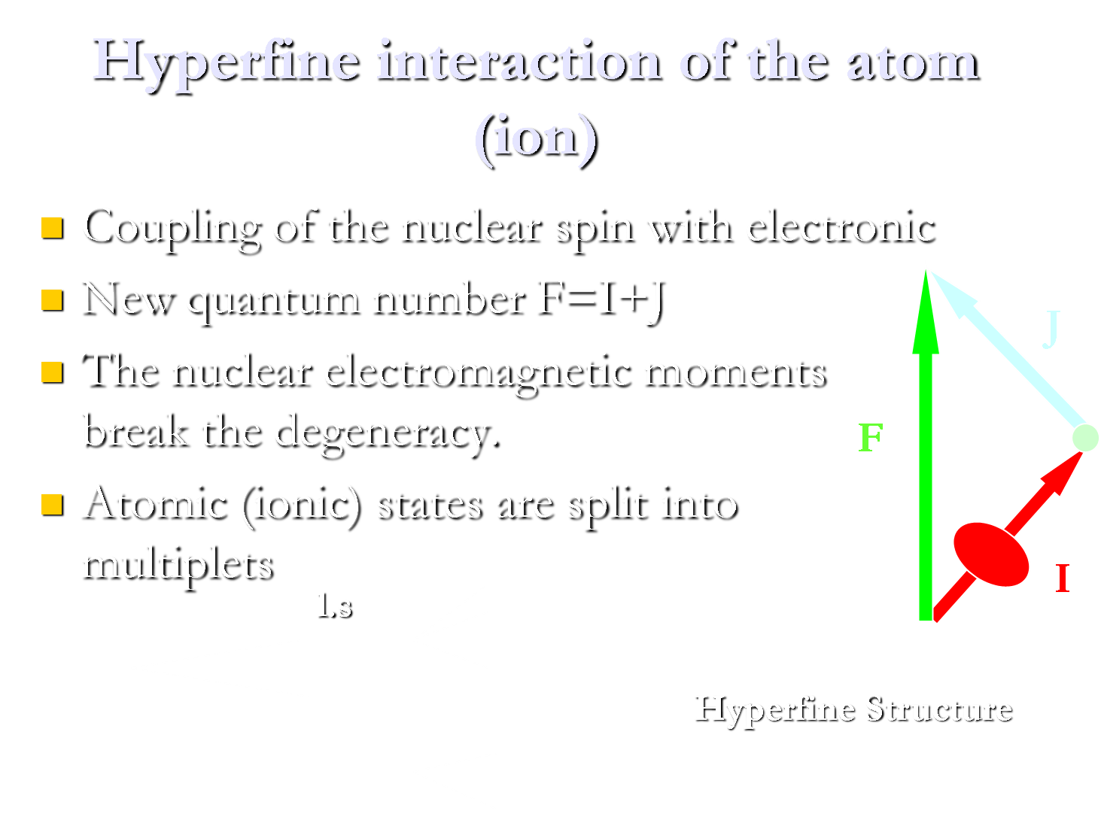

Slide 20
