Slide 1
This is not a balanced presentation, but rather collection of slides to illustrate the needs of detector R&D for CLIC

Slide 2
CLIC detector R&D, overview
CLIC hardware/engineering R&D (needed beyond ILC developments):
Vertex detector
  trade-off between pixel size, amount of material and timing resolution
Hadron calorimetry
  Tungsten-based HCAL (PFA calo, within CALICE)
Solenoid coil
  Large high-field solenoid concept, reinforced conductor (CMS/ATLAS experience)
R&D to support mechanical stability modeling
  In view of sub-nm precision required for FF quadrupoles (QD0)
  QD0 is located inside the experiment, but will be suspended from the accelerator tunnel floor.
  Model of a mechanical solution exist. Lab-tests will be carried out to test the model.
Time stamping
  Needed for (almost) all subdetectors (typically 5-10 nsec resolution required)
Power pulsing
  In view of the 50 Hz CLIC time structure => allows for low-mass detectors

Slide 3
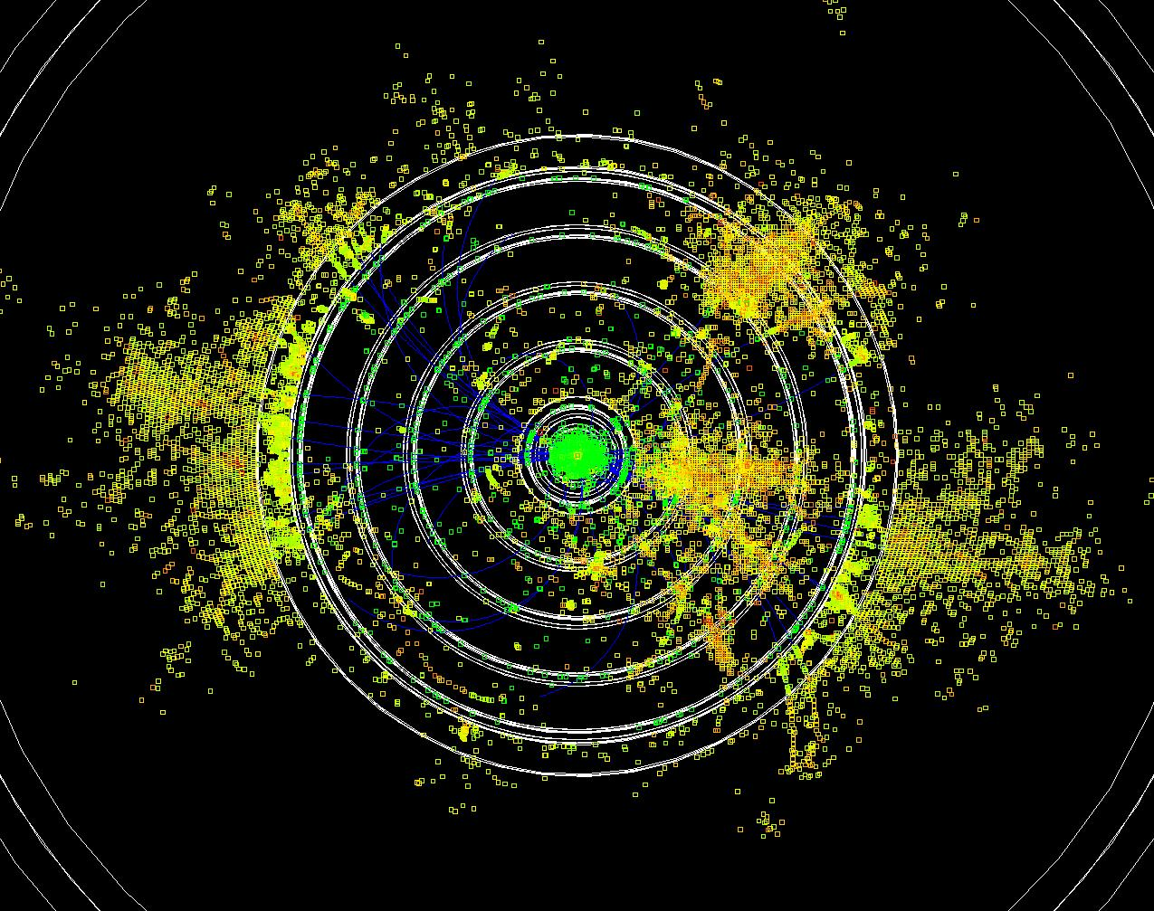
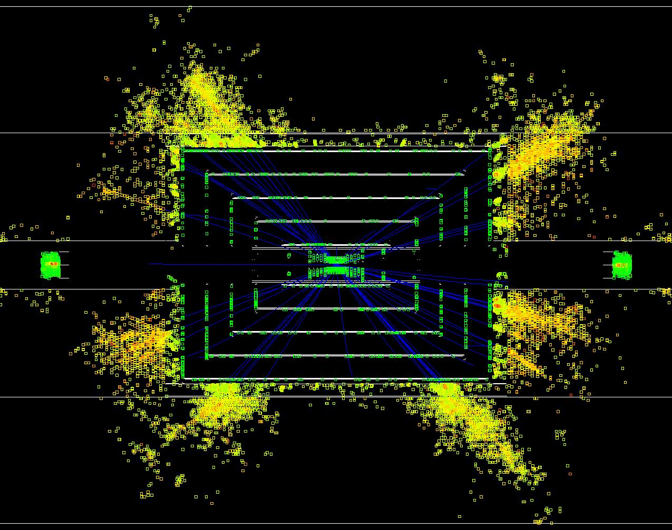
CLIC tracking/calorimetry issues
Due to beam-induced background and short time between bunches:
  High occupancy in the inner regions (incoherent, tridents)
  Jets scale and resolution are affected (γγ=>hadrons)
  Time-stamping is a must for almost all detectors
Narrow jets at high energy
  Calorimeter has to measure high-energy particles (leakage)
  Separation of tracks in dense jets
3TeV e⁺e⁻ ⎝ t t^{bar}

Slide 4
CLIC time structure
CLIC and ILC time structure
Train repetition rate 50 Hz
CLIC
CLIC: 1 train = 312 bunches 0.5 ns apart 50 Hz
ILC: 1 train = 2820 bunches 308 ns apart 5 Hz

Slide 5
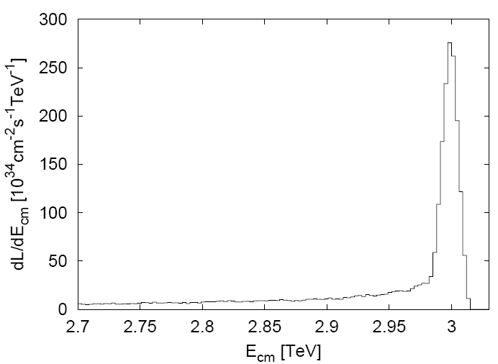
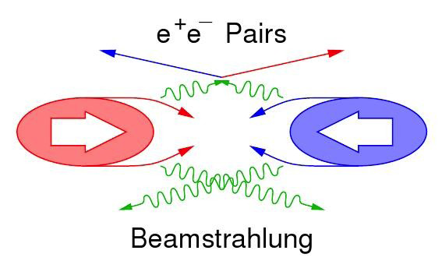
Beam-induced background (1)
Main backgrounds:
CLIC 3TeV beamstrahlung ΔE/E = 29% (10×ILC_{value})
  Coherent pairs (3.8×10⁸ per bunch crossing) <= disappear in beam pipe
  Incoherent pairs (3.0×10⁵ per bunch crossing) <= suppressed by strong solenoid-field
  “Tridents” <= give an impact “similar” to incoherent pairs
  γγ interactions => hadrons (3.3 hadron events per bunch crossing)
In addition: Muon background from upstream linac
CLIC luminosity spectrum
30% in “1% highest energy”

Slide 6
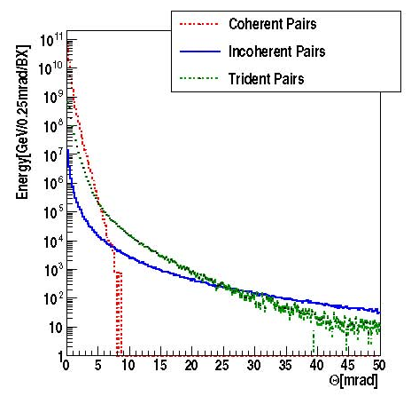
Beam-induced background (2)
CLIC beamstrahlung: coherent, incoherent + trident pairs
Impact on vertex detector radius
(vs. solenoid field),
+ very forward calorimeter radii,
+ choice of materials to reduce
backscattering,
etc.
governs opening angle of forward geometry
A. Sailer, CERN+Berlin

Slide 7
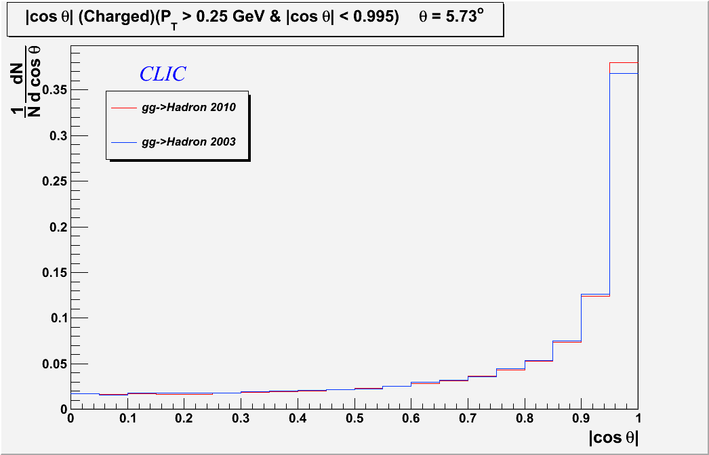
Beam-induced background (3)
CLIC beamstrahlung: γγ ➔ hadrons
Per bunch crossing:
3.3 such events
~28 particles into the detector
50 GeV
Forward-peaked
15 TeV dumped in the detector per 156 ns bunch train !
we need
TIME STAMPING !
O. Sahin, CERN

Slide 8
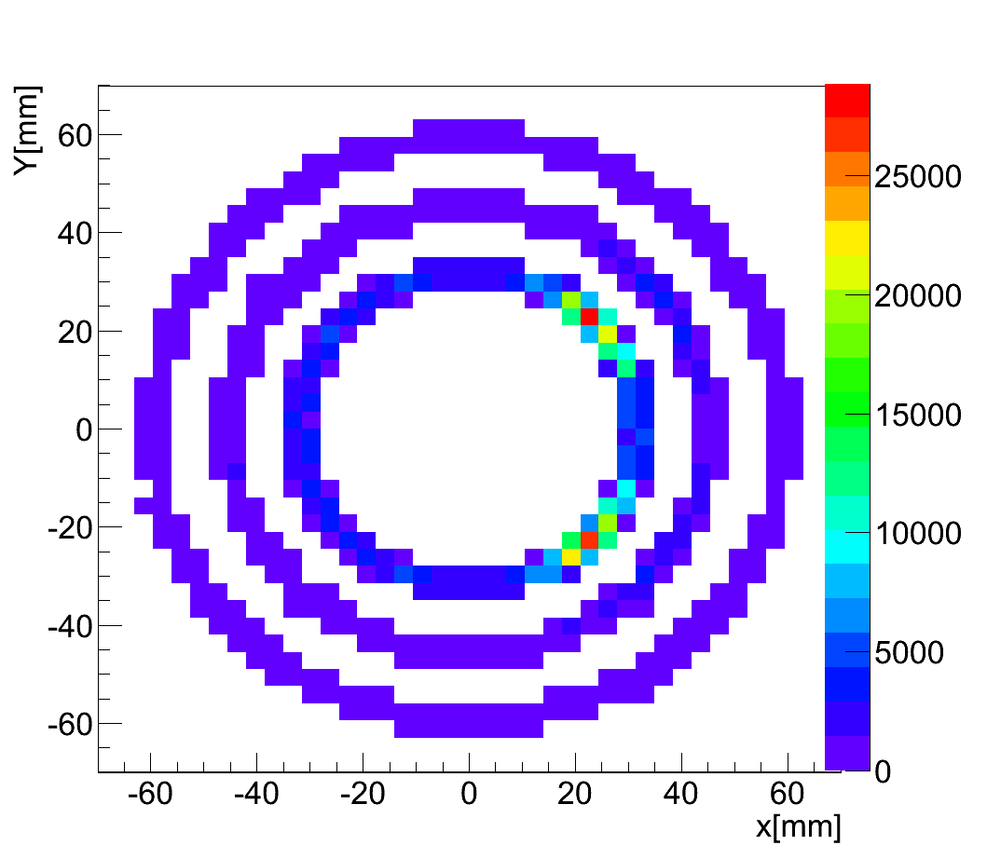
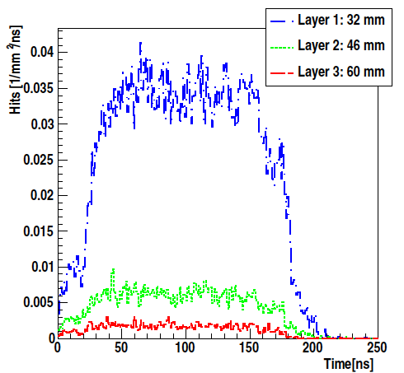
Vertexing - Background
incoherent pairs (and backscattering) hitting the CLIC vertex detector:
train
Hits for 312 BX
X-Y distribution of BG hits
in barrel vertex
time distribution of BG hits
=> ~0.036 hits/mm²ns average
A. Sailer, CERN+Berlin

Slide 9
CLIC vertex detector requirements
Requirements for the vertex detector need to be determined more precisely. However, we have already a global view on the needs:
Single-layer position resolution ~3μm – 5 μm
    Typically achieved with 20*20 micron pixels
Single-layer material thickness 0.1%X₀ – 0.2%X₀
Time-stamping ~5-10 ns (?)
  Still needs more study with full simulation
Occupancy
  Will be at the ~10% level for the innermost layer
  Therefore we need multi-hit capability
Triggerless readout over the 156 ns bunch-train
  With full data readout in less than 200-400 μsec to allow power-pulsing
Very challenging hardware project

Slide 10
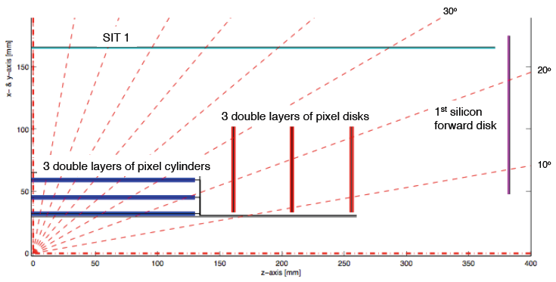
CLIC vertex detector
….first layouts are now being implemented in full simulation
This the layout we currently have in mind for CLIC_ILD

Slide 11
Tungsten-based HCAL and R&D
As a result of various simulations, an HCAL depth of 7.5Λ_{i} was chosen for CLIC.
For the absorber, we propose:
10 mm tungsten platen in the barrel (70 layers)
20 mm steel plates in the end-cap (60 layers)
The motivation for those choices is illustrated in the next slides.
The hadronic shower development in tungsten is slower than in steel, because the shower in tungsten has an important slow-neutron component.
It is important to understand the shower development precisely, because at CLIC we need to apply time-stamping in the calorimeter to suppress the γγ=>hadron background.
Ultimately, we hope to use time-resolved shower development modeling in the reconstruction software in order to separate the background and the signals in the HCAL.
This will drive some of the tungsten-based HCAL R&D, as we have to understand the shower development precisely.

Slide 12
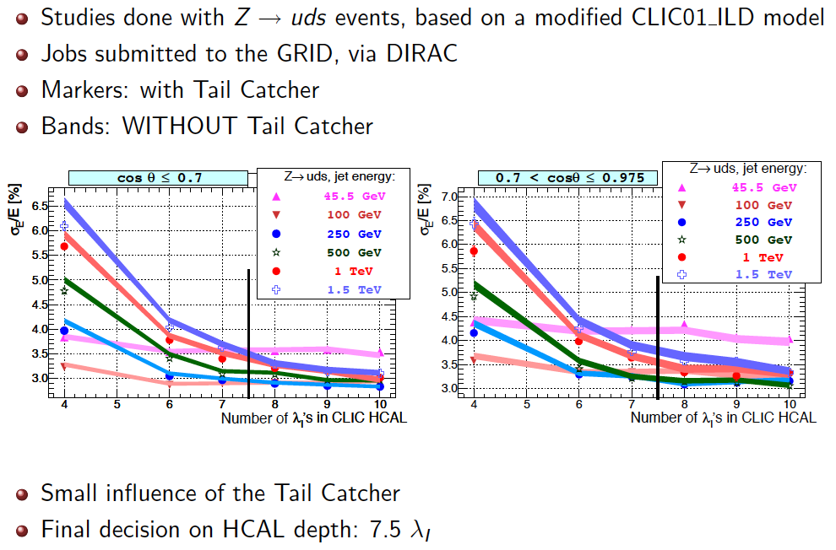
Pandora PFA studies of HCAL

Slide 13
Tungsten HCAL => prototype
Motivation:
  To limit longitudinal leakage CLIC HCAL needs 7.5Λ_{i}
  A deep HCAL pushes the coil/yoke to larger radius (would give a significant increase in cost and risk for the coil/yoke)
  A tungsten HCAL (CLIC option) is more compact than Fe-based HCAL, (ILC option) while Geant4 performance (resolution) is similar
  Increased cost of tungsten barrel HCAL compensates gain in coil cost
Prototype tungsten HCAL: check simulation in test beam
  Prototype tests performed within CALICE collab.
  Use 30-40 layers of Tungsten, 1 cm thick, 80 cm Ø
  Use different active materials
  Start in Nov 2010, with 30 W plates, and scintillator planes

Slide 14
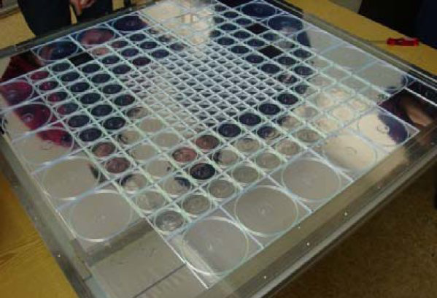
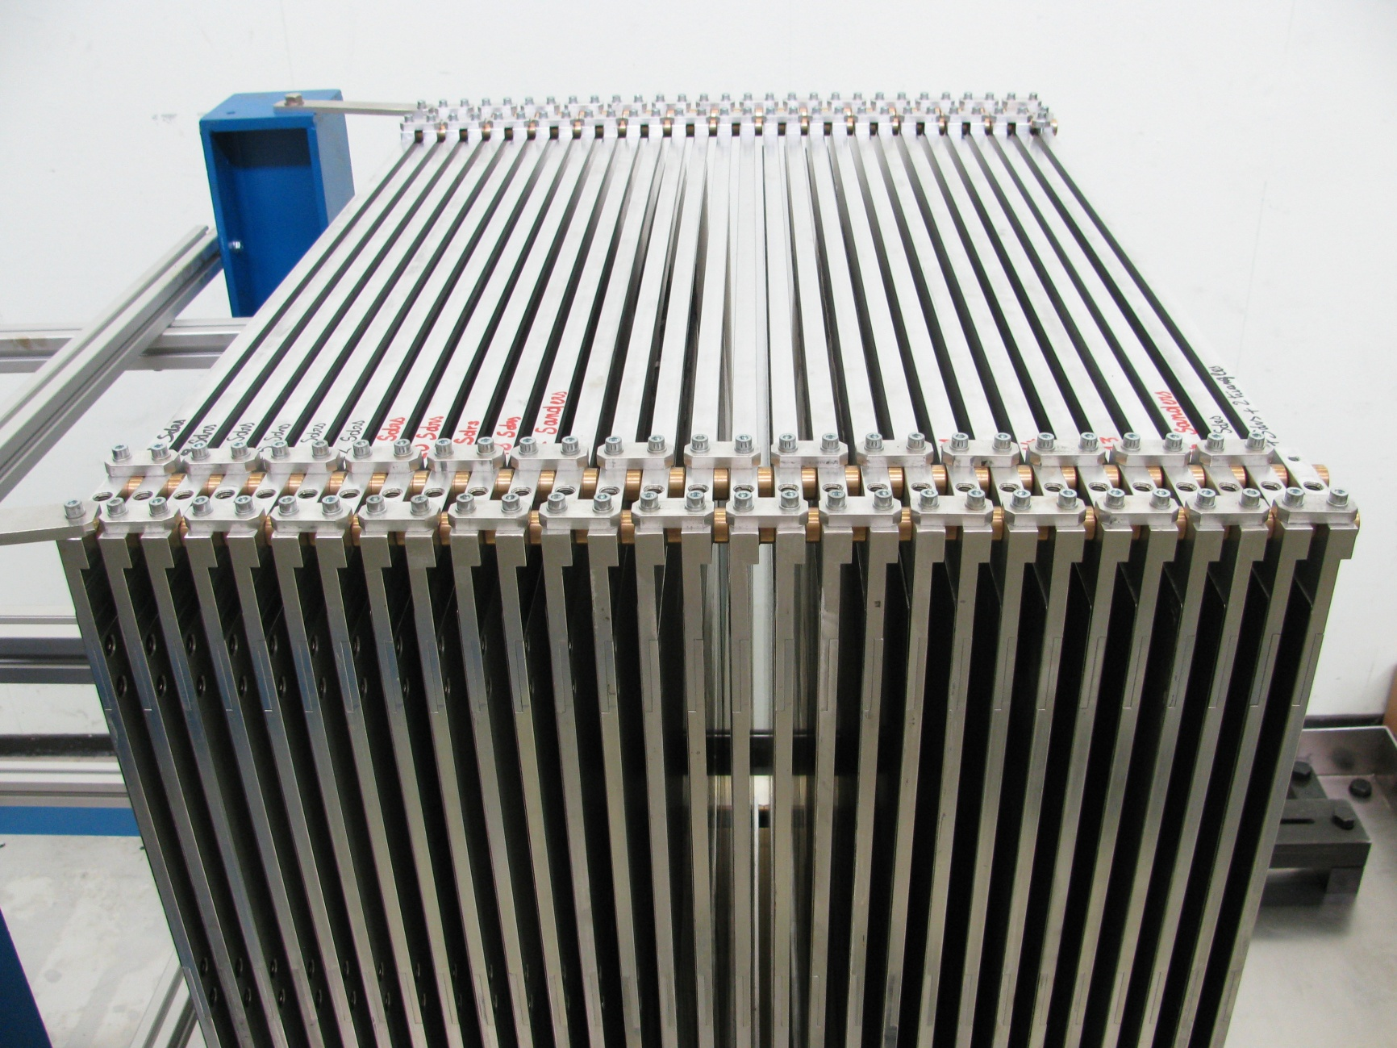
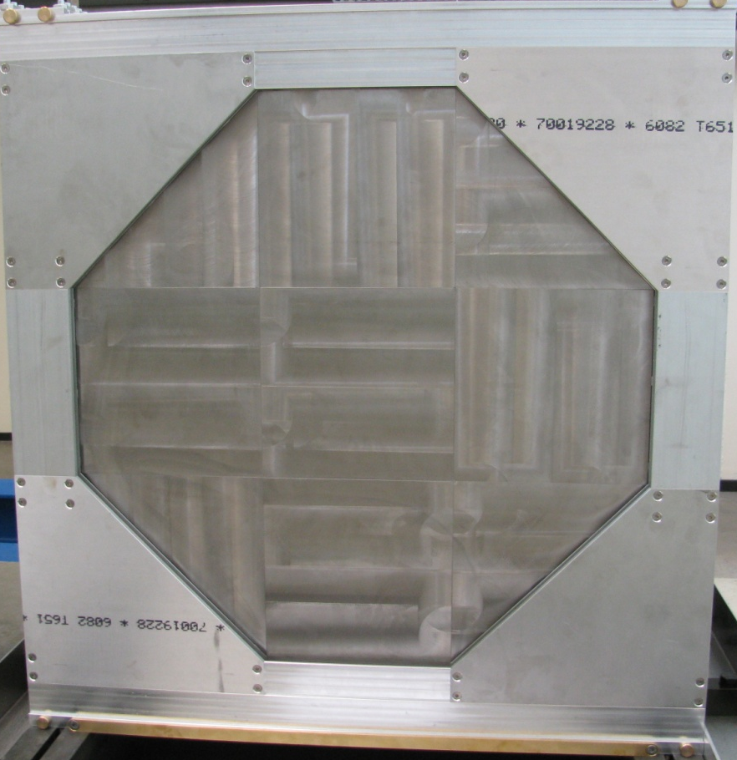
Tungsten HCAL prototype
Scintillator plane
Tungsten stack
W-plane

Slide 15
Tungsten HCAL, more info
For more information on time-development of the shower in tungsten HCAL, please look at the presentation of Christian Soldner at the High-Energy session of the last CALICE meeting:
http://ilcagenda.linearcollider.org/conferenceDisplay.py?confId=4776
For more information and pictures of the tungsten HCAL beam test, please look at the presentation of Nils Feege at the High-Energy session of the same CALICE meeting

Slide 16
DQ0 stability, more info
For a few slides on the QD0 stability, please look at slide 1-5 of this presentation:
http://indico.cern.ch/materialDisplay.py?contribId=25&sessionId=2&materialId=slides&confId=107327

Slide 17
CLIC magnet system R&D
Main solenoid R&D:
  CLIC-SiD: B=5 T, inner-bore radius ~2.8 m
  CLIC_ILD: B= 4 T, inner-bore radius ~3.4 m
  The hardware R&D for the main solenoid mainly focuses on re-inforced conductors (material studies and co-extrusion tests)
The CLIC detector also requires a strong anti-solenoid surrounding QD0. R&D is needed for the anti-solenoid as well (with similar requirements as the production magnets for the COMET and Mu23 experiments).

Slide 18
CLIC detector study
LINKS

Slide 19
Links
LCD project web page:
http://lcd.web.cern.ch/LCD/
LCD internal notes:
http://lcd.web.cern.ch/LCD/Documents/Documents.html
Wiki page with various documentation:
https://twiki.cern.ch/twiki//bin/view/CLIC/Detector
For example, in the wiki page you can find the SiD’ and ILD’ modified detector geometries for CLIC, and the software documentation
LCD indico pages:
http://indico.cern.ch/categoryDisplay.py?categId=1954

