Slide 1
Double Height Waveguide Choke Flange
Tolerance Study
Xiaowei Wu, Alexej Grudiev
3/11/2021

Slide 2
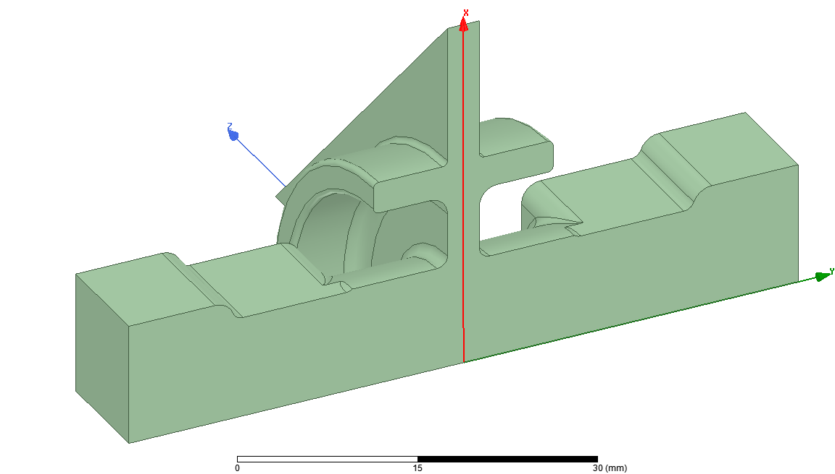
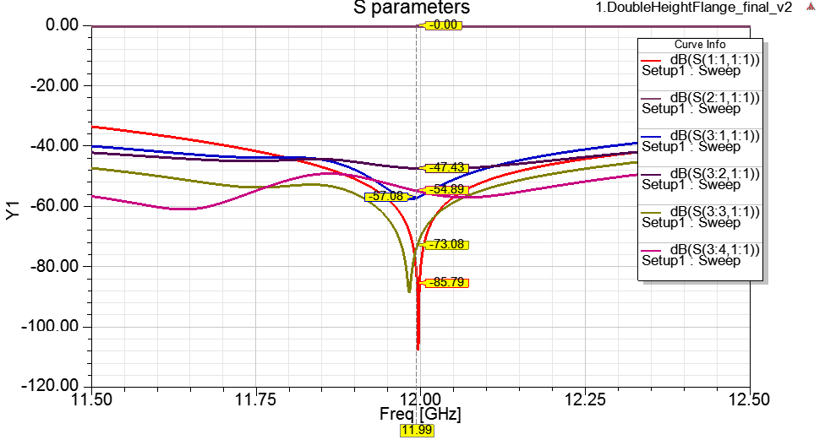
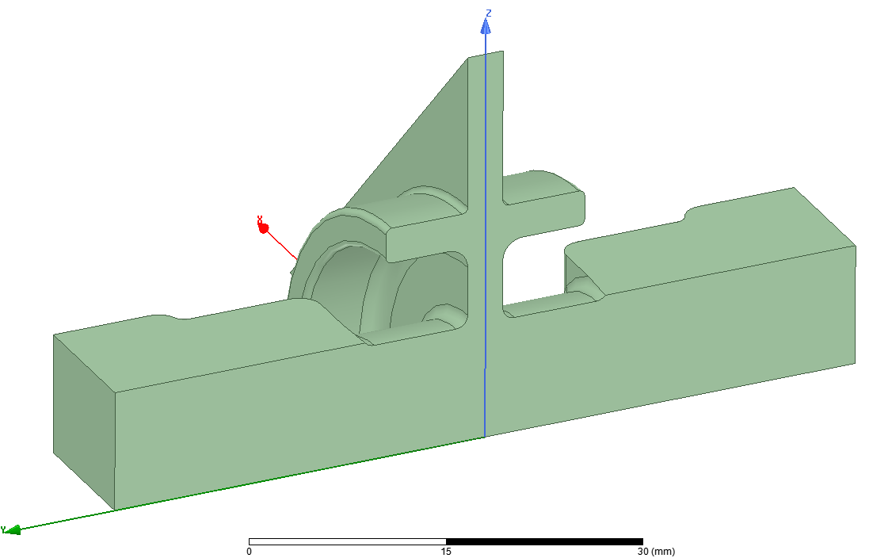
Information of the choke flange
port3
Dimension
ch | 7 | chr | 16.6
R_WG | 9.8 | Poc | 10.5
Mlen | 11.19 | trh | 9.65
slw | 3 | chw | 3
Rch | 0.5 | Rchd | 1.7
rr | 1 | rtool | 1.78
Rt1 | 1
Nominal value
S11 [dB] | -85.8
S21 [dB] | 0.00
S(3:1,1) [dB] | -57.1
S(3:2,1) [dB] | -47.4
S(3:3,1) [dB] | -73.1
S(3:4,1) [dB] | -54.9
slw
port2
ch
chw
port1
rr
rr
chr
R_WG
11.43
trh
Mlen
Poc
10.16
Rch
Rchd
rtool
Rch
rtool
Rch
Rt1
rr

Slide 3
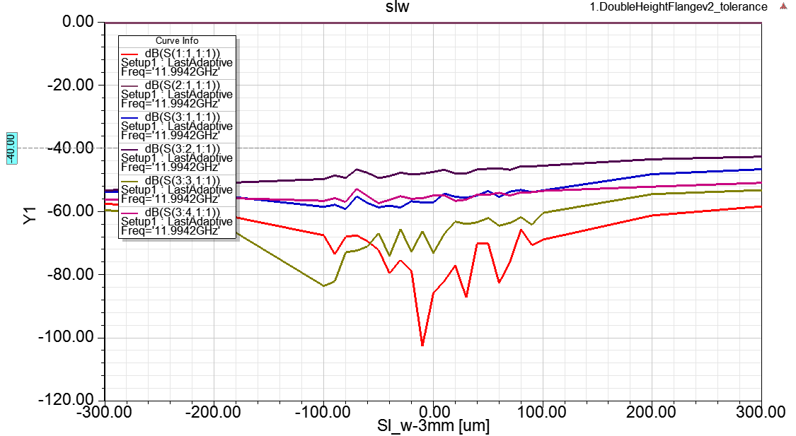
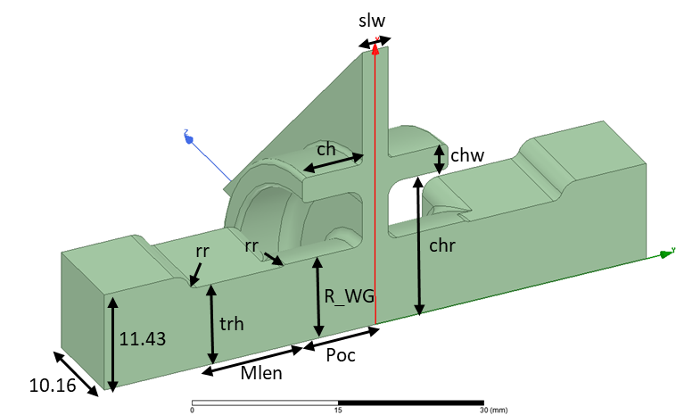
Dimension tolerance of the choke flange
Nominal value
S11 [dB] | -85.8
S21 [dB] | 0.00
S31 [dB] | -47.4
Δslw [mm] | S11/S31 [dB]
-0.3~+0.3 | <-40

Slide 4
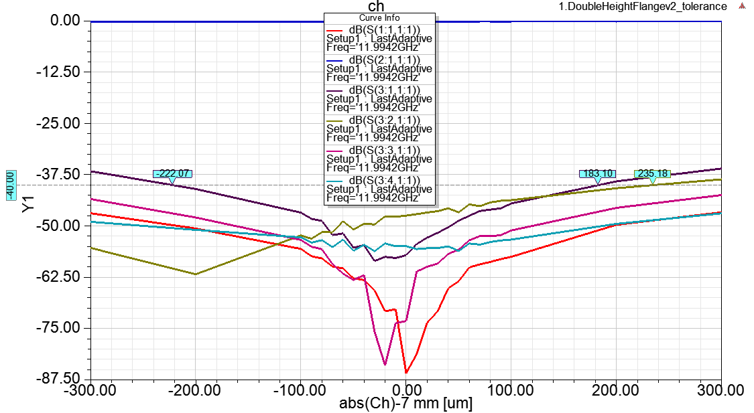
Dimension tolerance of the choke flange
Nominal value
S11 [dB] | -85.8
S21 [dB] | 0.00
S31 [dB] | -47.4
Δch [mm] | S11/S31 [dB]
-0.22~+0.18 | <-40

Slide 5
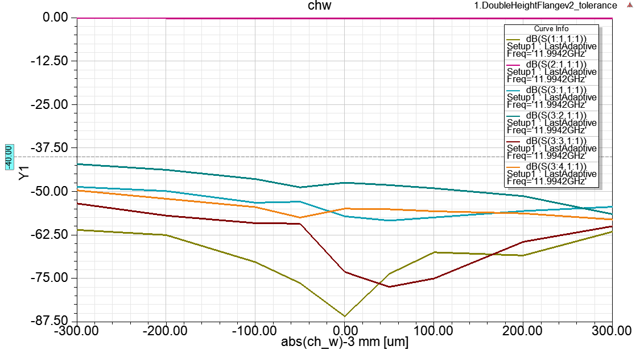
Dimension tolerance of the choke flange
Nominal value
S11 [dB] | -85.8
S21 [dB] | 0.00
S31 [dB] | -47.4
Δchw [mm] | S11/S31 [dB]
-0.3~+0.3 | <-40

Slide 6
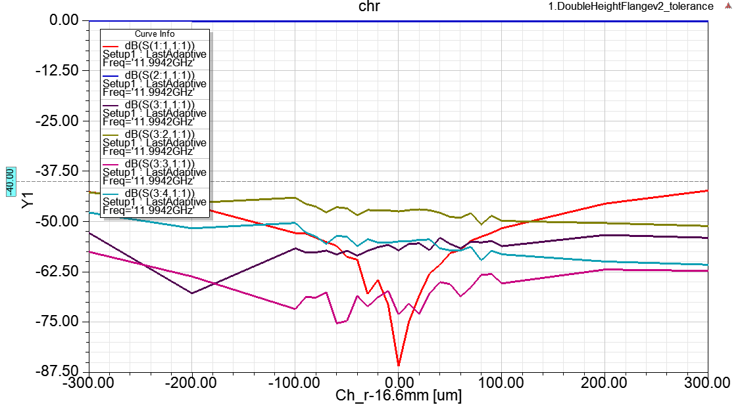
Dimension tolerance of the choke flange
Nominal value
S11 [dB] | -85.8
S21 [dB] | 0.00
S31 [dB] | -47.4
Δchr [mm] | S11/S31 [dB]
-0.3~+0.3 | <-40

Slide 7
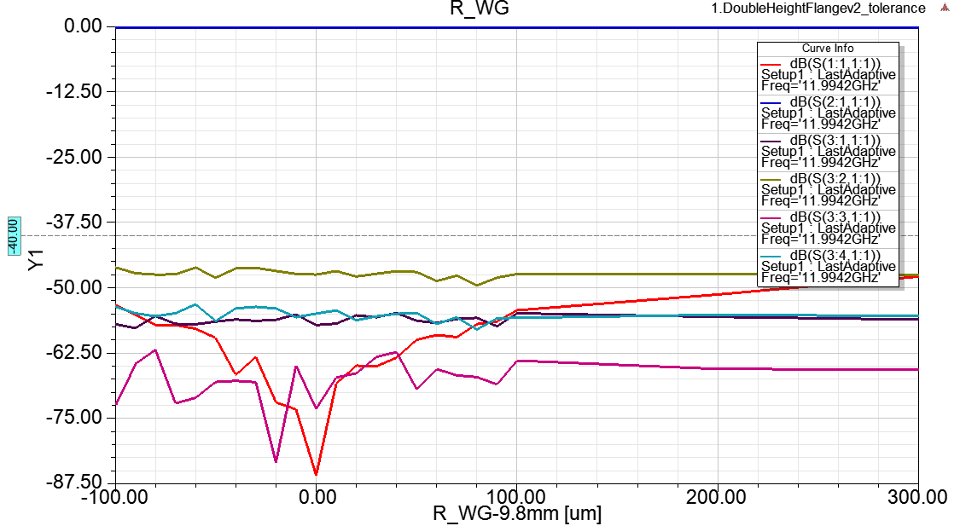
Dimension tolerance of the choke flange
Nominal value
S11 [dB] | -85.8
S21 [dB] | 0.00
S31 [dB] | -47.4
ΔR_WG [mm] | S11/S31 [dB]
-0.1~+0.3 | <-40

Slide 8
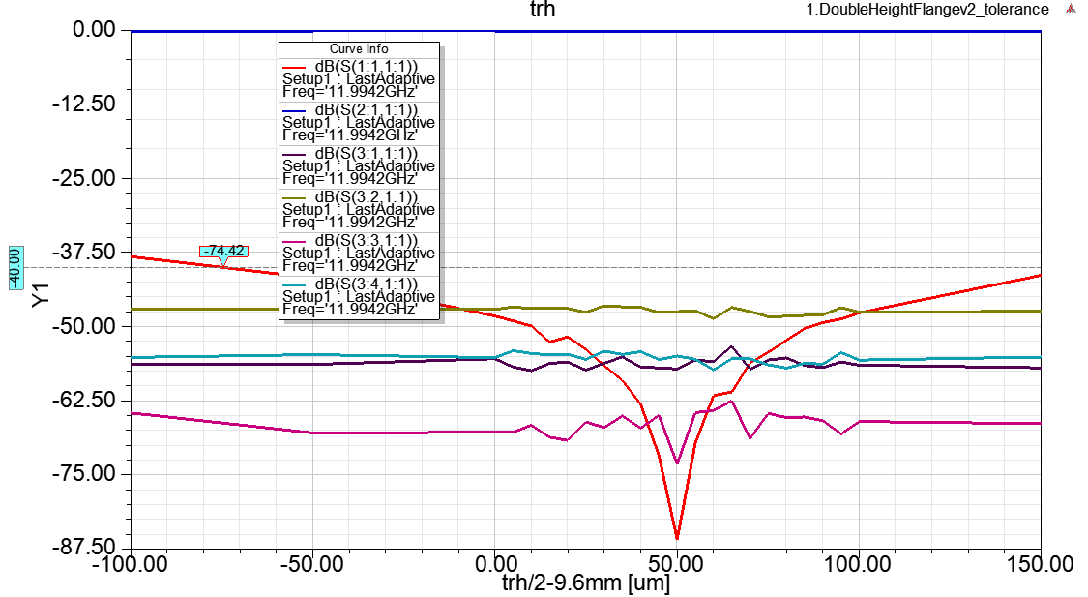
Dimension tolerance of the choke flange
Nominal value
S11 [dB] | -85.8
S21 [dB] | 0.00
S31 [dB] | -47.4
Δtrh [mm] | S11/S31 [dB]
-0.074~+0.15 | <-40

Slide 9
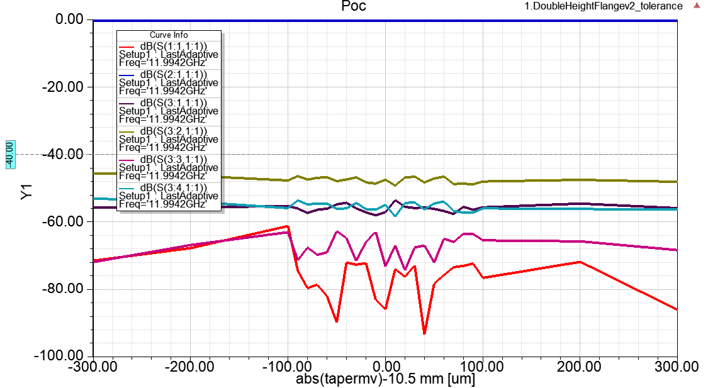
Dimension tolerance of the choke flange
Nominal value
S11 [dB] | -85.8
S21 [dB] | 0.00
S31 [dB] | -47.4
ΔPoc [mm] | S11/S31 [dB]
-0.3~+0.3 | <-40

Slide 10
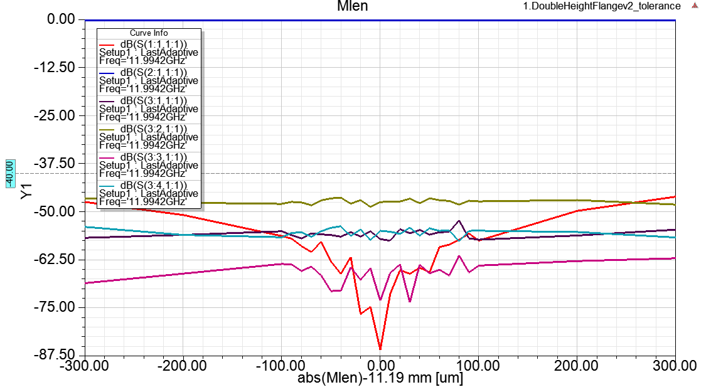
Dimension tolerance of the choke flange
Nominal value
S11 [dB] | -85.8
S21 [dB] | 0.00
S31 [dB] | -47.4
ΔMlen [mm] | S11/S31 [dB]
-0.3~+0.3 | <-40

Slide 11
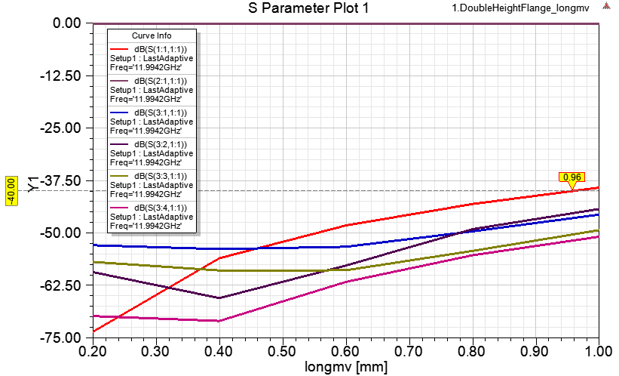
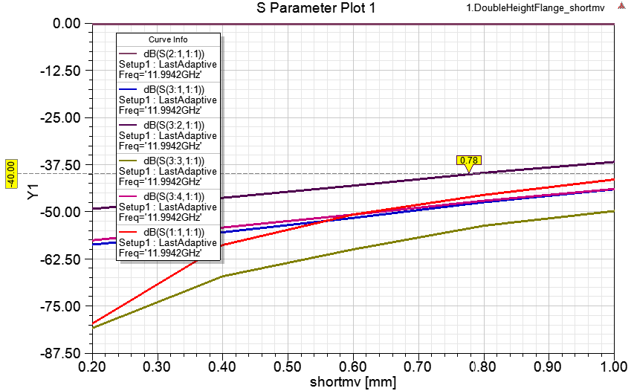
Misalignment of two flanges
longmv
11.43
shortmv
10.16
Nominal value
S11 [dB] | -85.8
S21 [dB] | 0.00
S31 [dB] | -47.4
longmv [mm] | shortmv [mm] | S11/S31 [dB]
0.96 | 0.78 | <-40

Slide 12
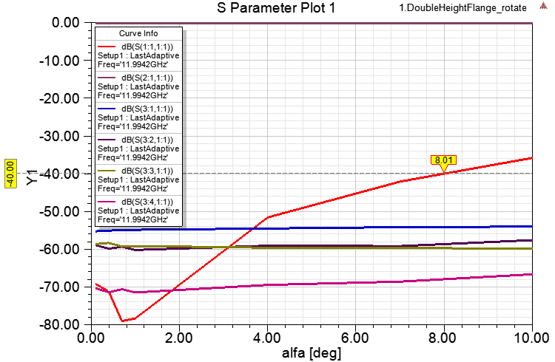
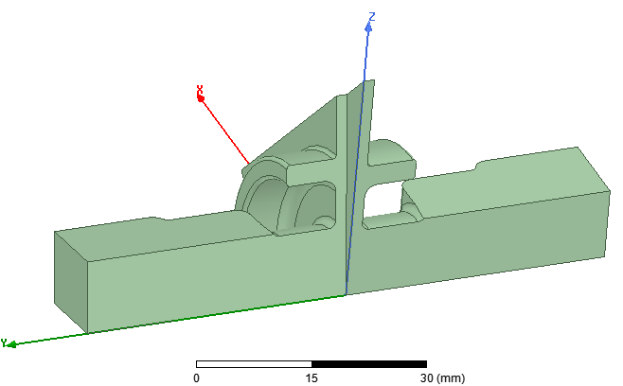
Twist of two flanges
11.43
alfa
10.16
Nominal value
S11 [dB] | -85.8
S21 [dB] | 0.00
S31 [dB] | -47.4
alfa [deg] | S11/S31 [dB]
8.01 | <-40

Slide 13
Summary of the tolerance study
port3
slw
port2
Dimension error | S11/S31< -40 dB
Δslw [mm] | -0.3~+0.3
Δch [mm] | -0.22~+0.18
Δchr [mm] | -0.3~+0.3
Δchw [mm] | -0.3~+0.3
ΔR_WG [mm] | -0.1~+0.3
Δtrh [mm] | -0.074~+0.15
ΔPoc [mm] | -0.3~+0.3
ΔMlen [mm] | -0.3~+0.3
longmv [mm] | 0.96
shortmv [mm] | 0.78
alfa [deg] | 8.01
ch
chw
port1
rr
rr
longmv
chr
shortmv
trh
R_WG
11.43
Poc
alfa
10.16
Mlen
Nominal value
S11 [dB] | -85.8
S21 [dB] | 0.00
S31 [dB] | -47.4

