Slide 1
Joint COMPASS-AMBER
Technical Board
06-December-2022
Stefano Levorato
06.12.2022

Slide 2
Agenda
Communications
  Approval of the minutes of the last TB
  TB Membership (AMBER)
  ECAL usage
  SciFi
  BMS ( upgrade ? )
  Network Infrastructure
  Spectrometer Shutdown
  Transition Apparatus
  AoB

Slide 3
Approval of the minutes of the last TB
Available at https://codimd.web.cern.ch/BmqDvxgQS0aRVjPboVvaNQ?view
REMINDER
Each speaker, presenting at the TB, will enter the minutes of its presentation, preferably before than the TB and maximum one week after the TB was held.
On the next TB Indico page ( https://indico.cern.ch/event/XXXXX/ ) you can already find the link to the minutes document (https://codimd.web.cern.ch/xxx).
You can find more information on the tool use and features at https://codimd.web.cern.ch/
https://codimd.web.cern.ch/LTPcSL9vSEyH1hRYOoI_UA?edit for last joint this TB

Slide 4
TB Membership (AMBER)

Slide 5
TB Membership (Calendar)

Slide 6
WEB pages AMBER
Start to build the Hardware related web pages
Indico as DB as we agreed, but a la COMPASS
A web page where the dates and indico pages of TB are listed
A web page where DE experts and responsible are listed
- A web page with visits to the experiments are listed ( more user friendly than the one we have for COMPASS)

Slide 7
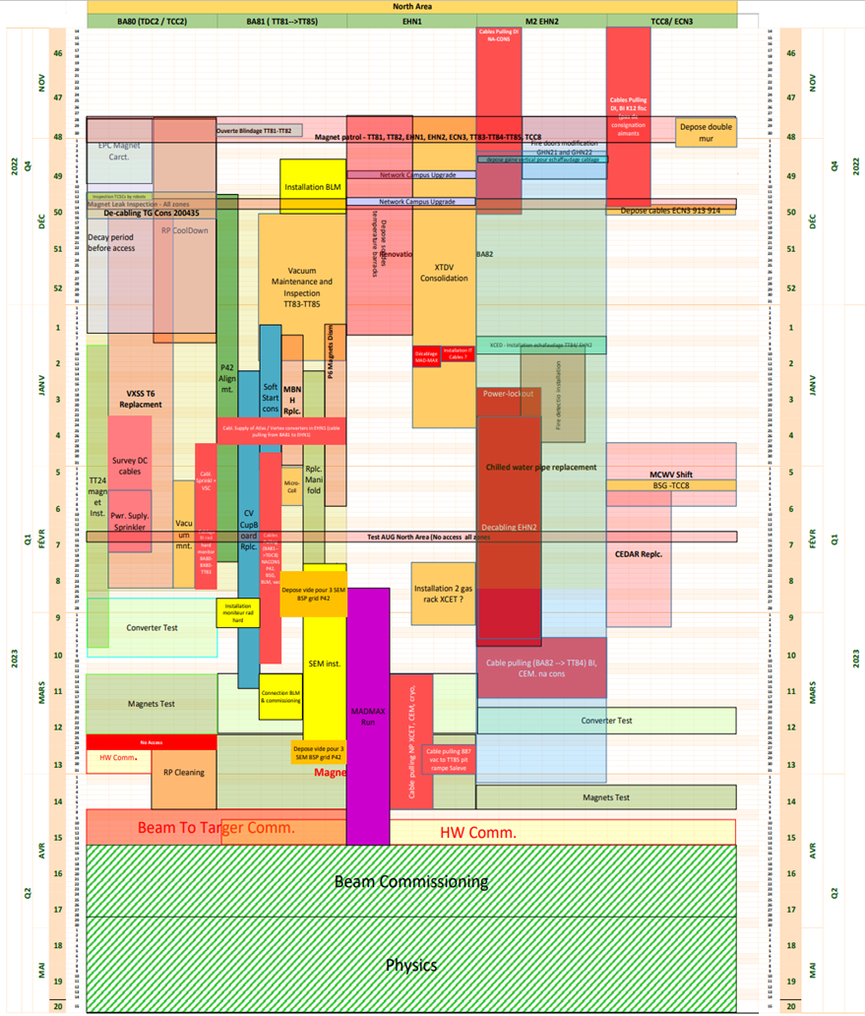

EHN2 activities during the YETS ( busy schedule in the hall )
North Area YETS22-23
Linear Planning
(extract 30.11.2022)
Important dates:
First activities began: 14.11.2022
Access to EHN2 after Yellow door: 14.11.2022
NA YETS22-23 began: 28.11.2022
Power Lock-out for de-cabling: 19.01.2023 -10.03.2023
De-cabling EHN2: 23.01.2023 -07.03.2023
EN-ACE Scheduling Tool - Gantt View (cern.ch)

Slide 8
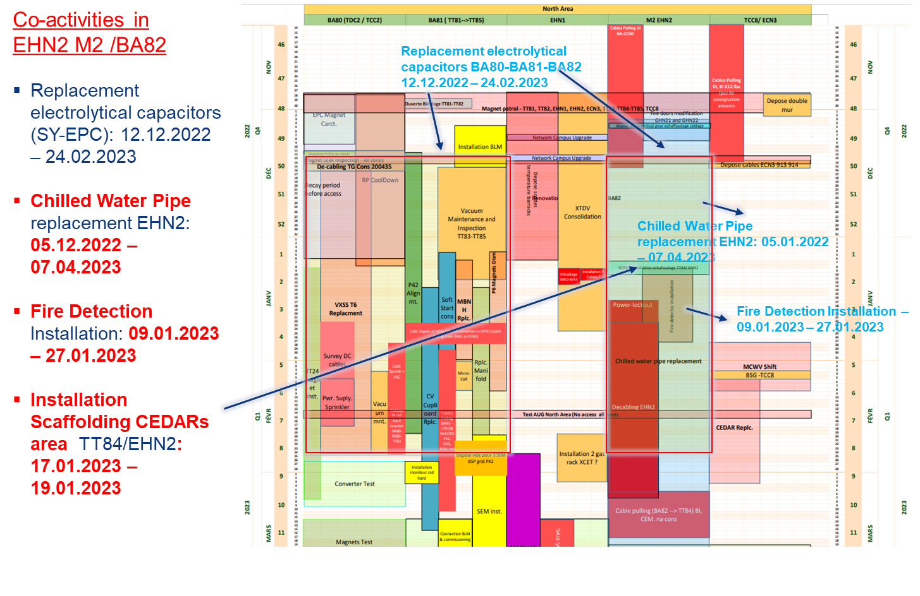
EHN2 activities during the YETS ( busy schedule in the hall )
Power Back in the hall on 10 March
Cooling water back in the beginning of April
  Helium availability for target
HW BEAM Commissioning: 27.02.2023 – 14.04.2023
Beam Commissioning: 07.04.2023 – 28.04.2023
NA Physics (Protons & Ions): 01.05.2023 – 26.10.2023
No crane usage till 10 of March
No request of intervention needing the crane received from AMBER DE!
If needed after 10 of March, it is important to plan it!

Slide 9
ECAL usage
We would like to have the ECALs included in the setup in 2023.
There are other possible interesting measurements that could eventually be done, a part from pbar xsec measurement, in which the ECALs would be needed, for example the pi0s xsec (indication from Fiorenza Donato)
Need of ECAL calibrations (?) → to be planned for 2023 and to be requested to SPS by R.C in terms of beam time and energy.
Renting cost ~ 250 CHF/month

Slide 10
SciFi
Request of Rainer to discuss the use of the SciFi detectors in 2023.
→ Which stations should be used in the existing position?
Is there the wish to position detectors elsewhere in order to increase redundancies.
→ It has been discussed to position FI15 and/or FI03 in a different position, e.g. inside of SM1 which will be off during the measurement
Information needed to
→ Plan the repair the missing channels of FI15 and exchange one weak PMT.
→ FI03 should then be properly repaired after the problems we had at the end of the run.

Slide 11
BMS ( upgrade ? )
Interest in using the BMS by different experiments
AMBER
NA64μ
MuonE
Preliminary meeting on 31 of October:
Equipping the BMS it with precise Si tracker planes, in order to improve significantly its momentum resolution. ( replacement or adding the planes)
Liverpool colleagues in MUonE are interested in this part of activity, being expert in the matter, and would like to describe a possible proposal.
Future meeting ( being organized) should discuss
- Compass experience: present performance, limits, application to physics
NA64mu , AMBER, MUonE : how an upgrade should serve each of the experiment (precision Dp/p, speed, DAQ integrations, ....)
Some of my considerations: it is of interest of different experiments
→ better under CERN responsibility
Expertise in case on malfunctioning during data taking, alignment, calibrations, on call/support / repair
A unique (CERN) DAQ which is shared between the experiments, and not vice versa
MuonE proposed as timeline 2024-25

Slide 12
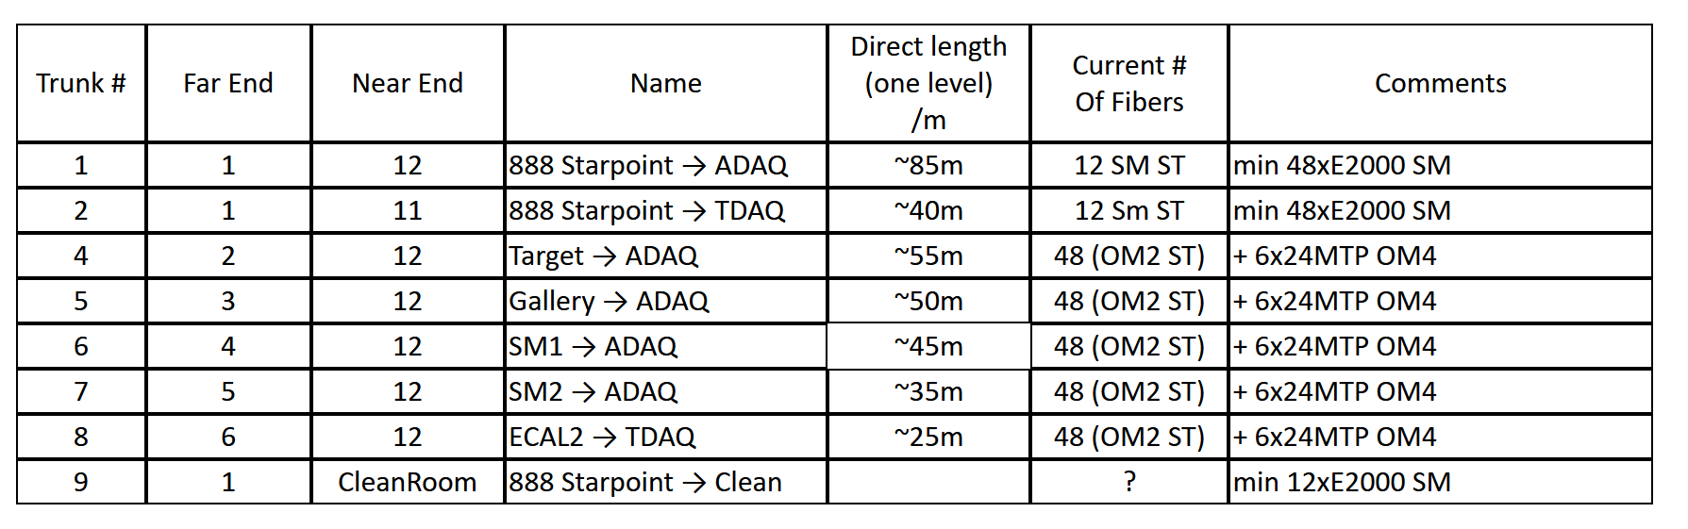
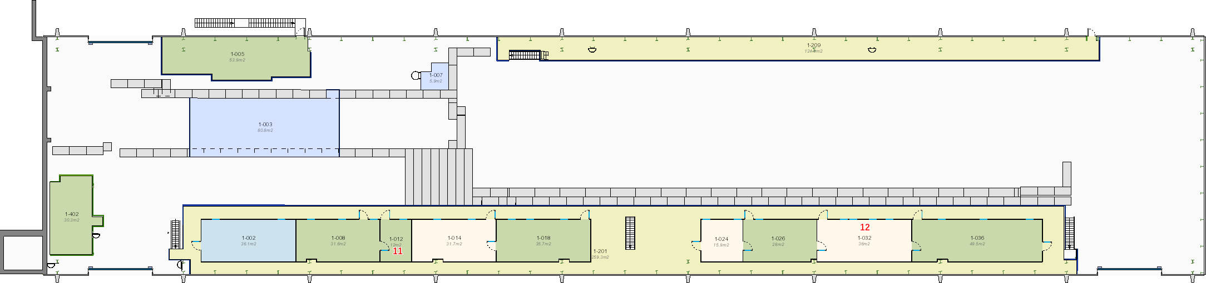
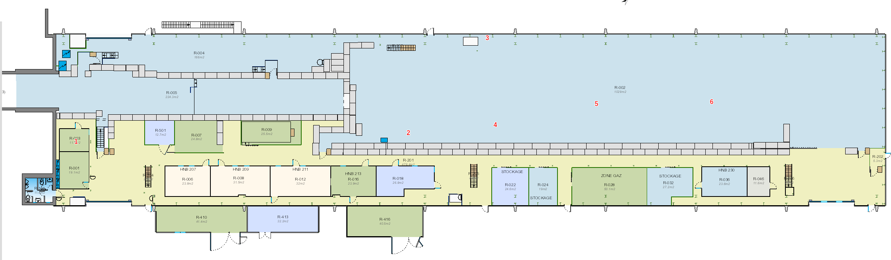
Optical Fibers: 2023 (Moritz)
Fiber needs in 888 to be installed after the lock out for decabling ~ mid of March 2023:

Slide 13
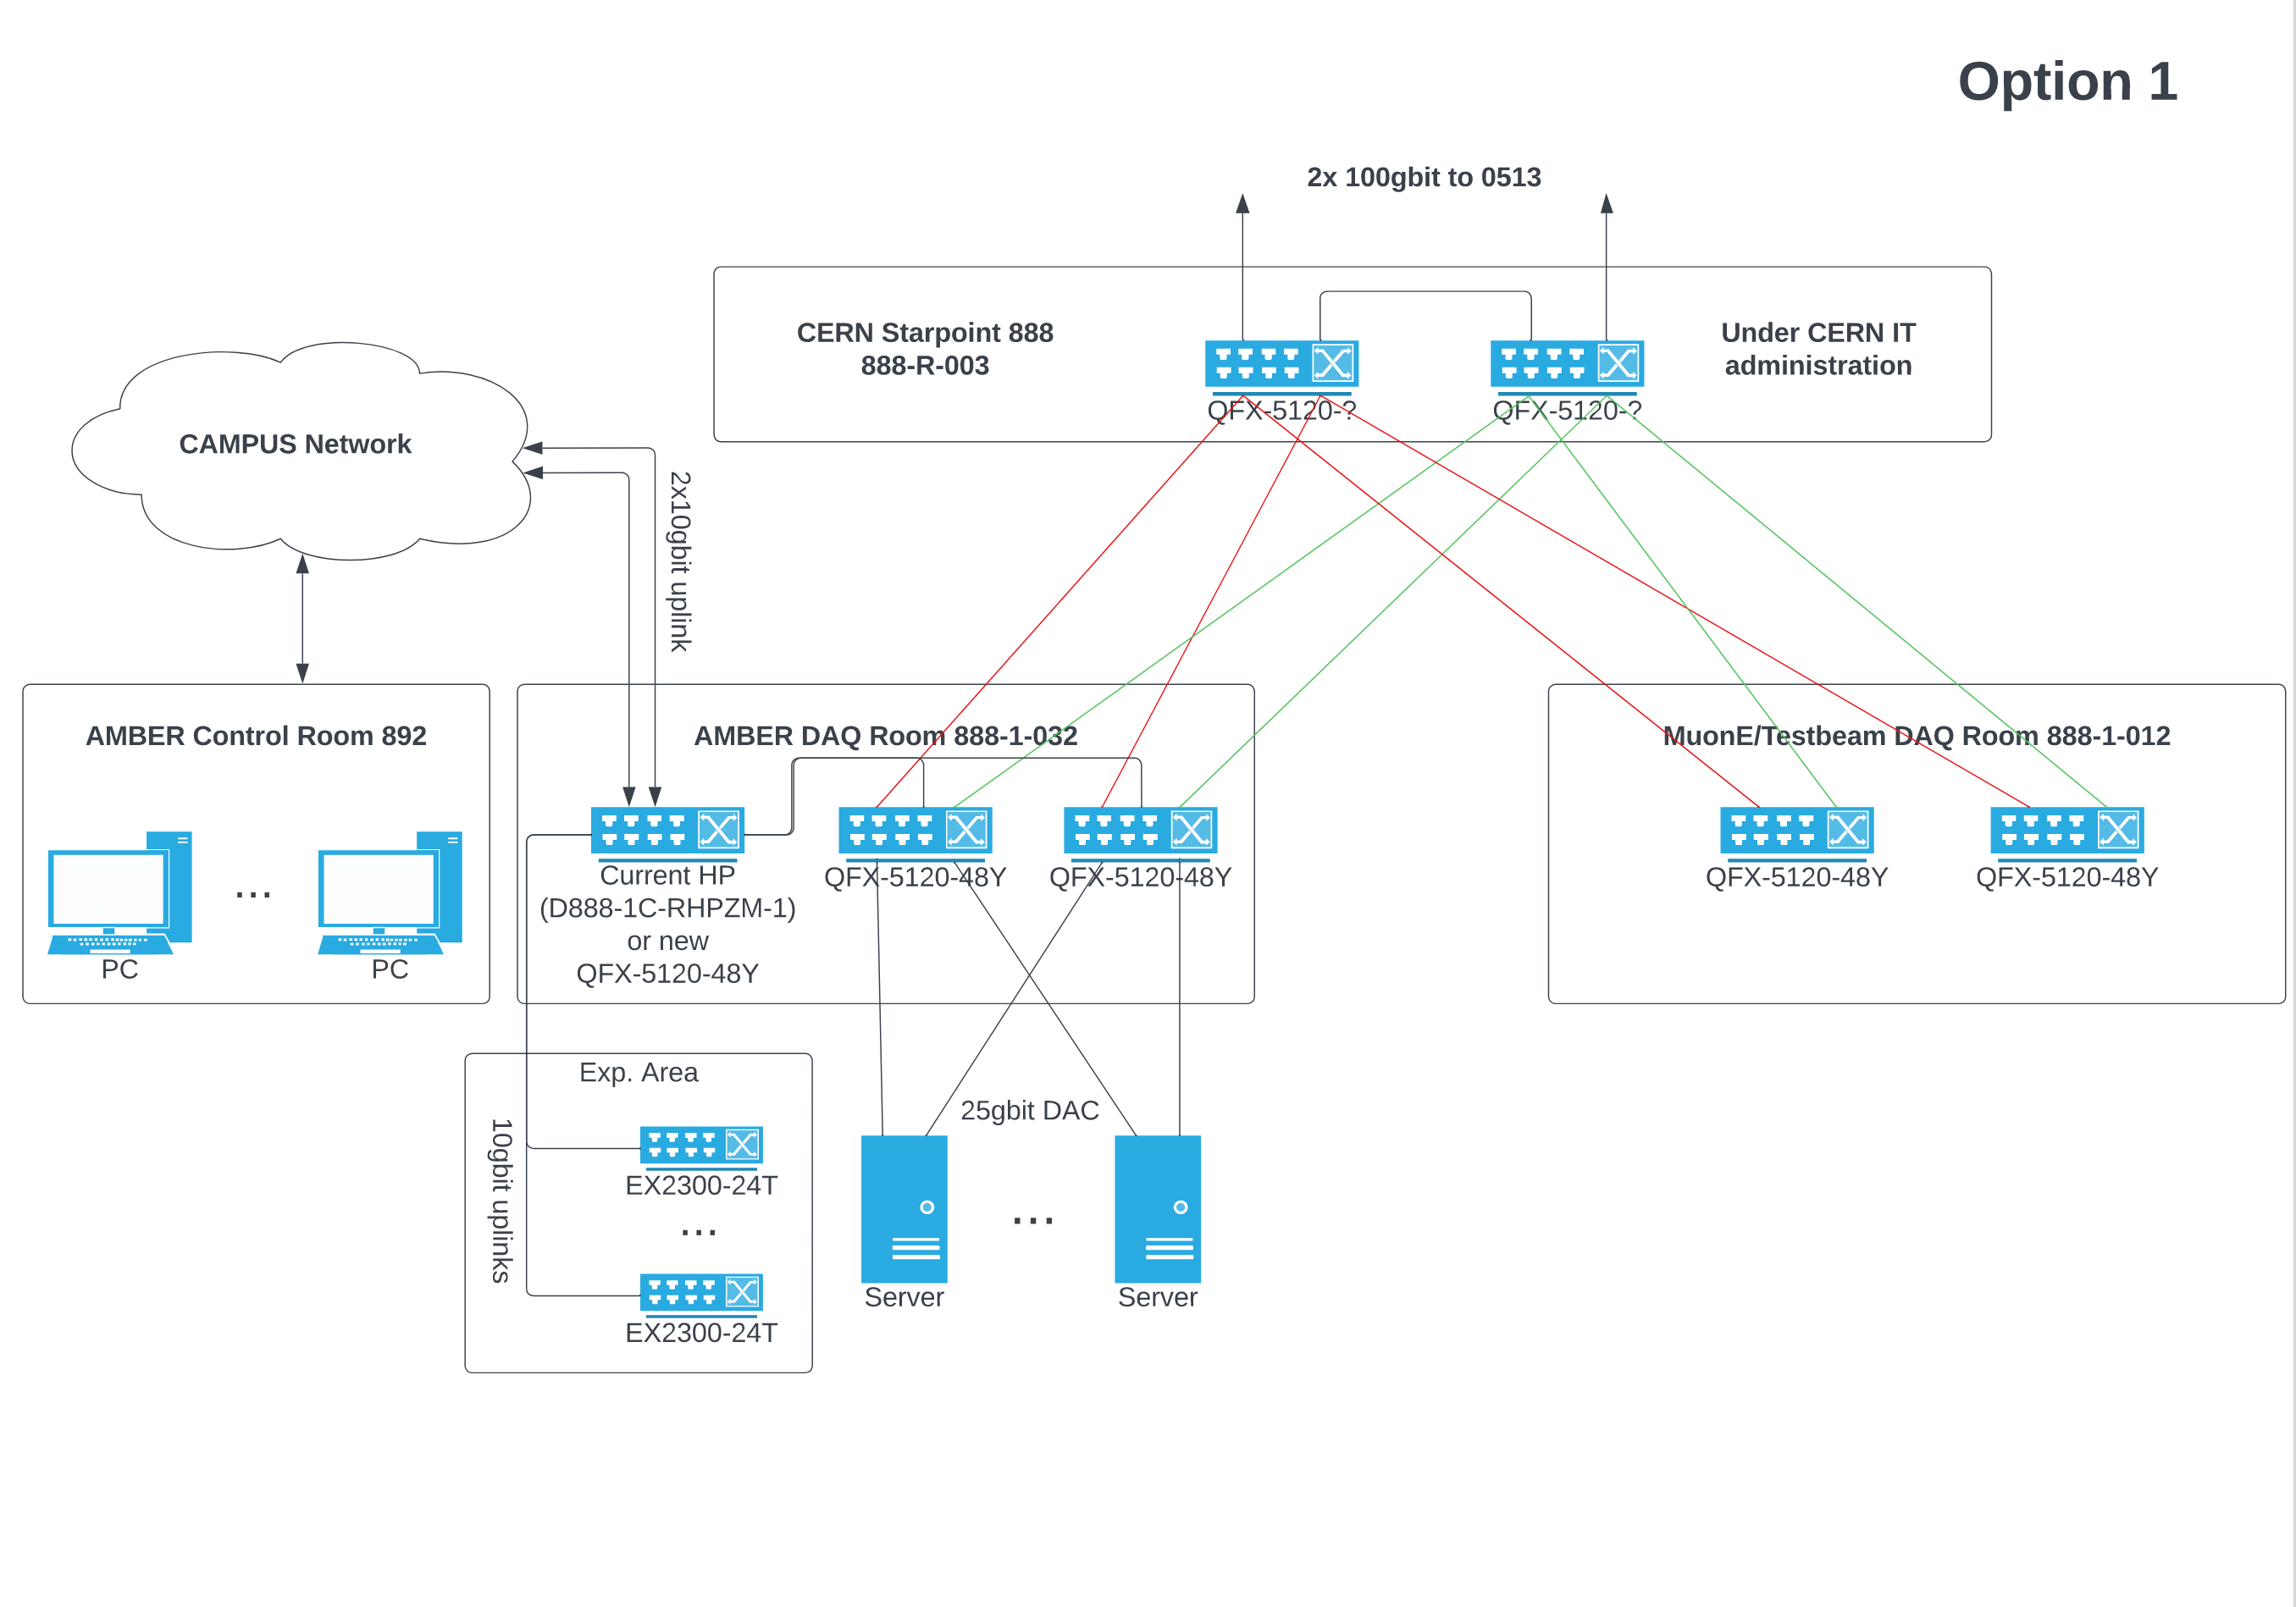
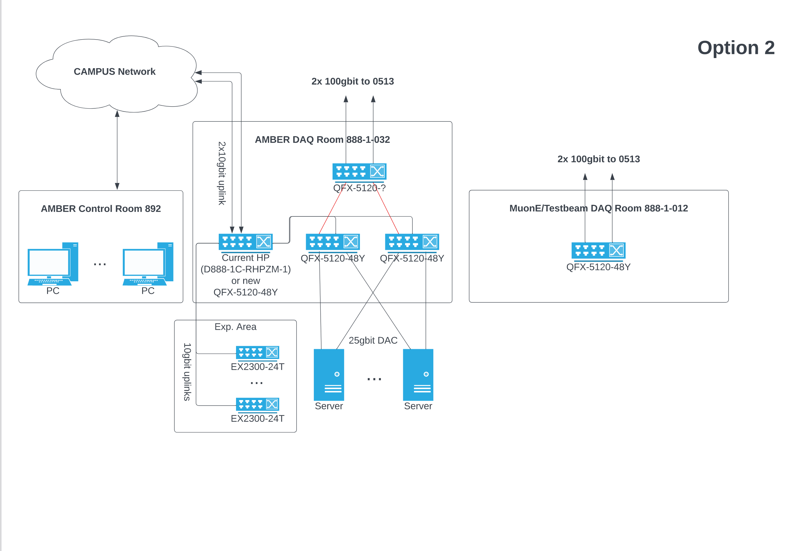
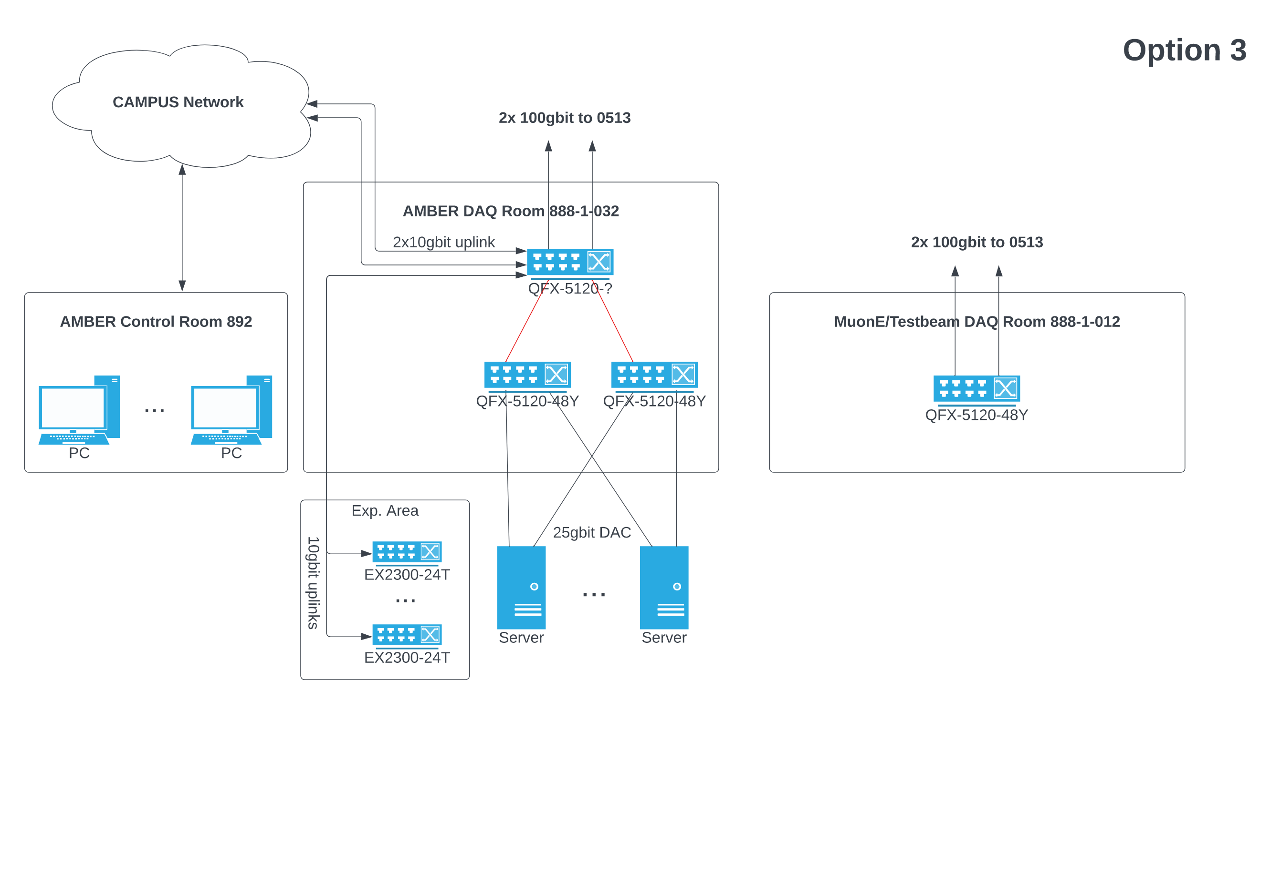
Network Infrastructure for EHN2 (Igor, Moritz)
- Common boarder router in 888-R-003 for all experiments in 888
- dedicated experimental router/switches in the two DAQ rooms
- Hardware in 888-R-003 would be under IT administration while dedicated experimental switches in 888-1-032 and 888-1-012 are under experiment administration
- Uplink to 0513 is shared between all experiments
- Current Uplink to 0513 is not shared -> second uplink for AMBER is needed
- No hardware will be installed in 888-R-003 fiber run between 888-R-003 and 888-1-032 is needed
- Separated networks between AMBER and other experiments
Like Option 2 but old HP Router in 888-1-032 is replaced against Juniper (QFX-5120-48Y)
This scenario is possible for option 1
Open general questions:
- For all three options new fiber runs between 888-R-003 and 888-1-032 as well as 888-1-012 are needed so we should place the request to EN-EL-FO as soon as possible
- How many fibers and which type of fibers + connectors should be installed to be future proof ?
- Which optics of the QFX-5120 router/switches are needed for the uplink to 0513?
- Traffic between 888 and control room in 892 runs over the CAMPUS network for the moment -> should it stay like this or should we forsee a dedicated link ?
The question if Option 1 or Option 2/3 (shared uplink to 513 or dedicated) has still to be discussed with experiments. BE-EA-LE offered budget for common infrastructure as well as dedicated uplinks to 0513.

Slide 14
Spectrometer Shutdown
The spectrometer is nearly off.
Several VME crates are still operative.
Soon no one will be around in case of emergency
Any need to keep em on? can DE switch them off or should/can we switch em off till next year

Slide 15
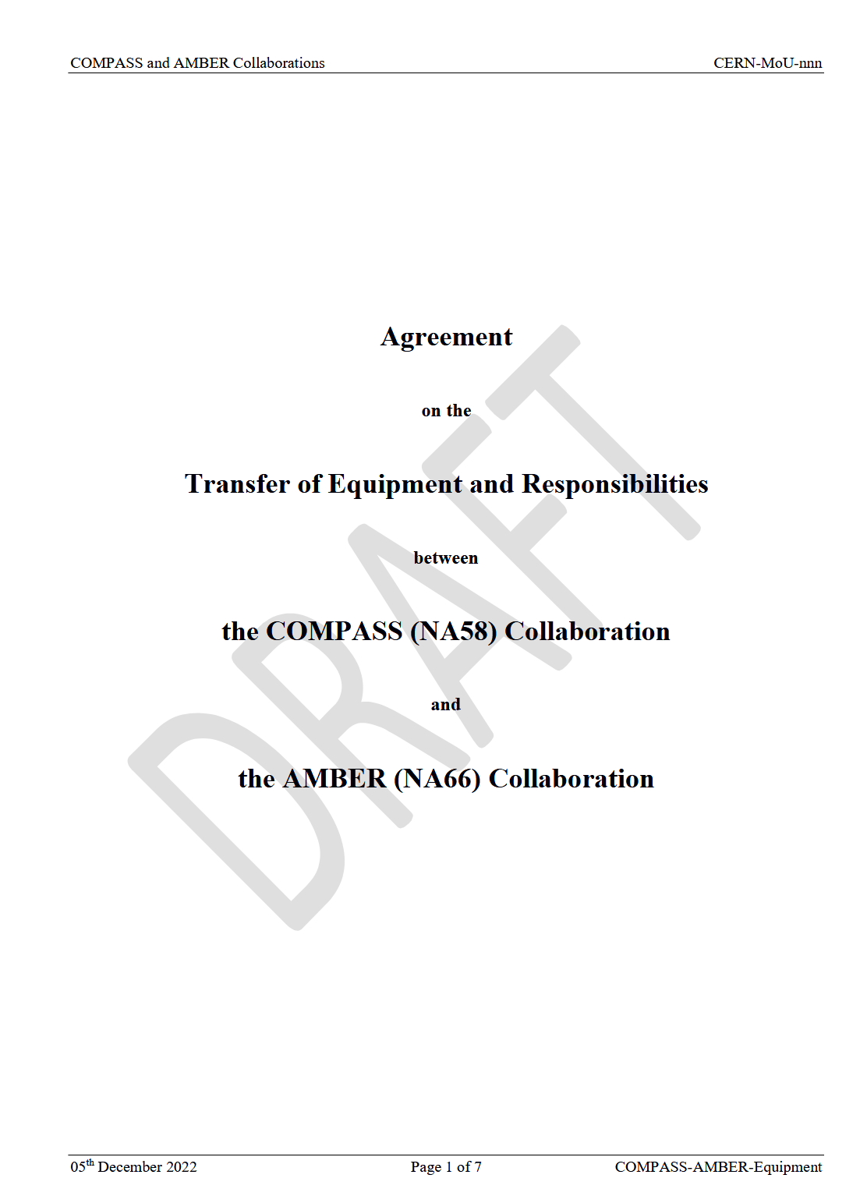
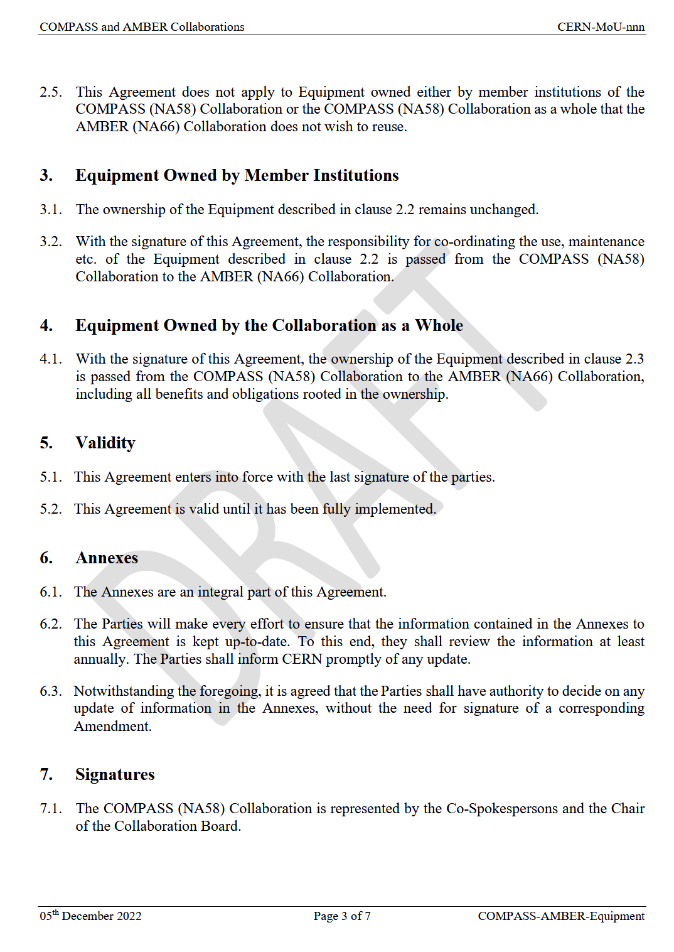
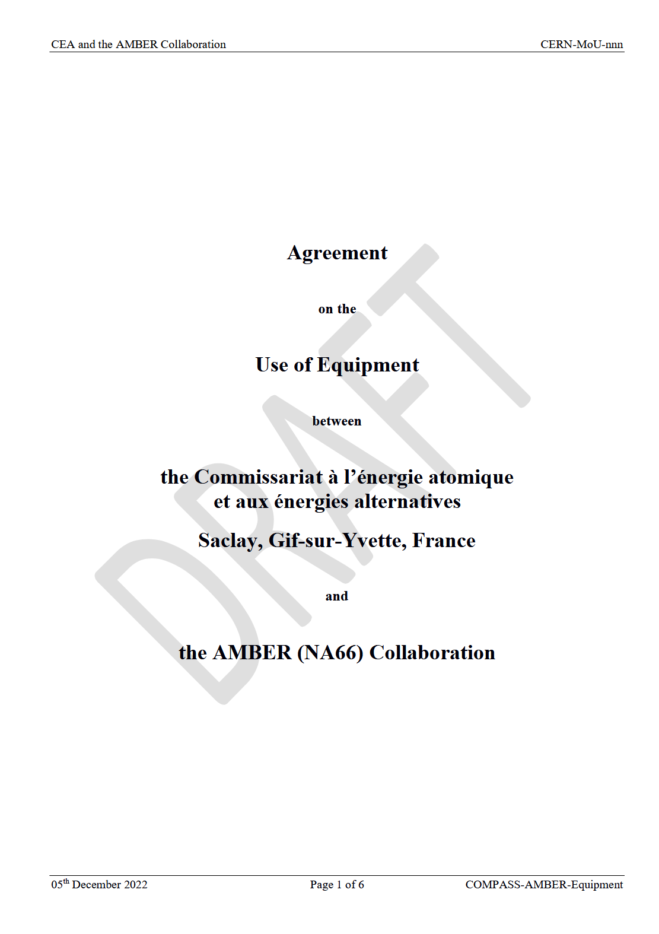
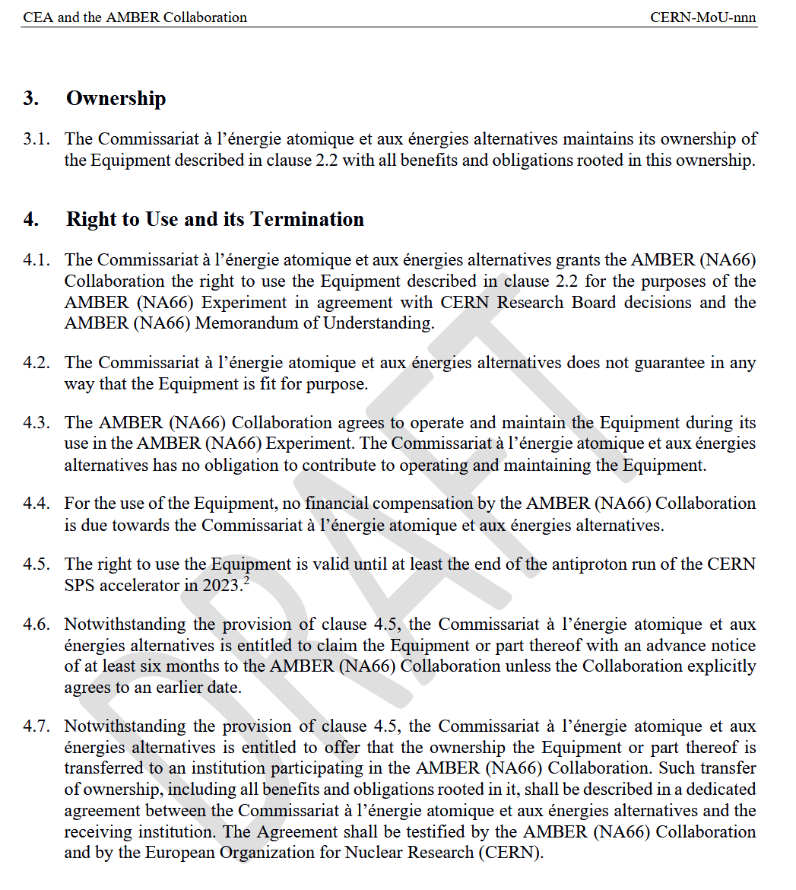
Equipment Transfer NA58→NA66
Received yesterday the DRAFT for the equipment transfer:

