Slide 1
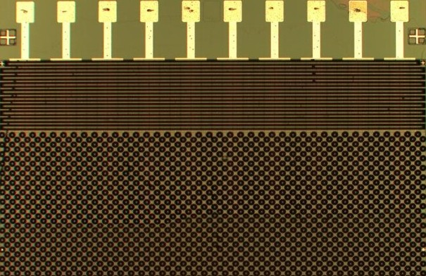



SiPM for LHCb SciFi Tracker
SiPM Radiation Workshop, 25.4.-29.4.2022 Cern, Geneva
Prepared by Guido Haefeli

Slide 2
Introduction
Radiation environment for the LHCb SciFi Tracker
Principle of the SciFi and the main requirements for the photo-detector
Results from neutron irradiation tests, DCR, PDE, gain
Characterisation of the production of 5500 SiPM arrays (700k channels)
Development for higher luminosity and higher radiation environment

Slide 3
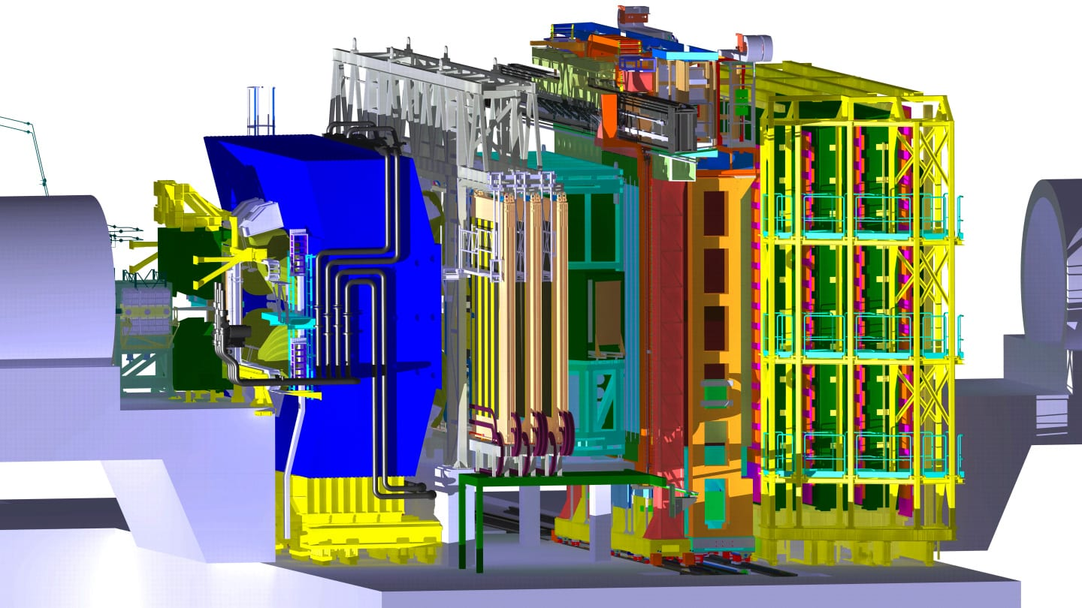
LHCb detector for Run 3
ECAL, HCAL Muon
SciFi Tracker
Interaction in the VELO
Charged particle flux

Slide 4
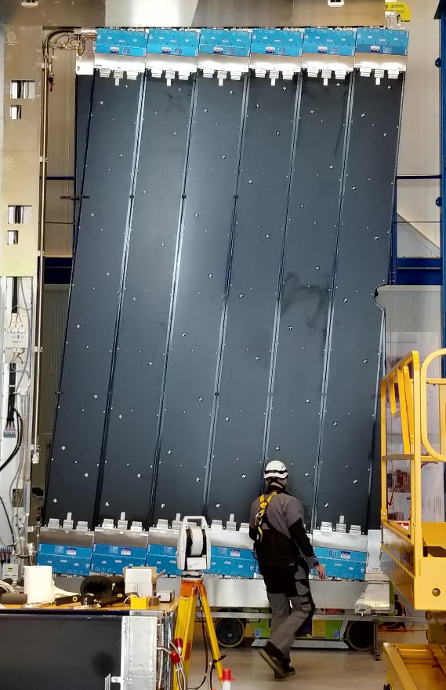
Radiation environment integrated for Run3 assuming an integrated luminosity of 50 fb⁻¹
SiPMs
Beam pipe
SiPMs
Neutron fluence (highest):
Φ =4.7×10¹¹ n_{eq}/cm²
This fluence is a simulated value and takes into account an efficient neutron shield of 10cm upto 30cm thickness (reducing the fluence by a factor 2.5 – 3.4)
Maximal charged particle induced dose:
D = 100 Gy
Close to the beampipe it is 30kGy but there are no SiPMs (problem for the plastic optical scintillating fibres…)!

Slide 5
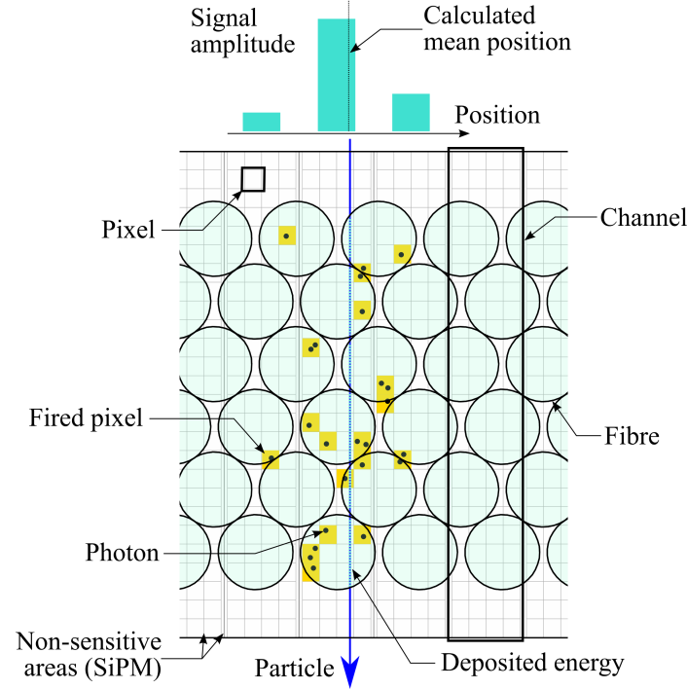
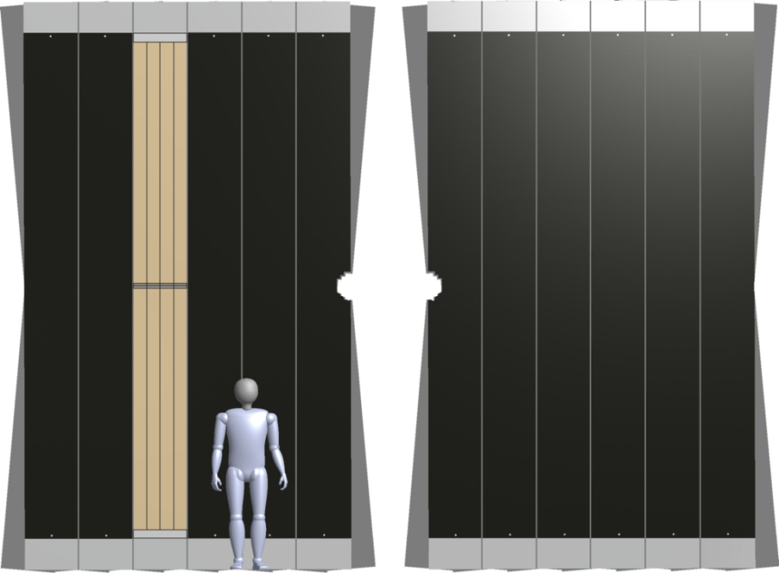
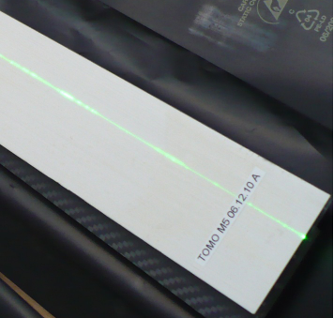
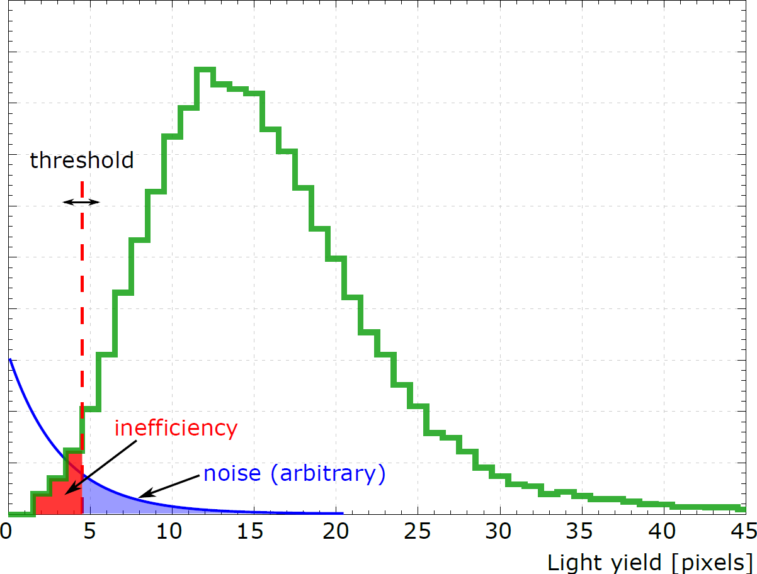
SciFi detection principle, requirements
Read-out box
SiPMs
mirrors
2× 2.5 m
SciFi module
fibre mats + mirrors
Requirements for the photo-detector:
Custom geometrical dimension imposed by the SciFi fibre arrangement
High PDE in blue to green, single photon signal distributed in 2.8 channels in average for a perpendicular track
Low correlated noise to allow for low noise cut
Lowest possible DCR after irradiation
Thin entrance window (max 100µm)
Low inefficient area between channels and modules, gap less tiling in one direction only
Don’t care:
Gain, dynamic range (100 pixels is sufficient)
2× 3 m

Slide 6
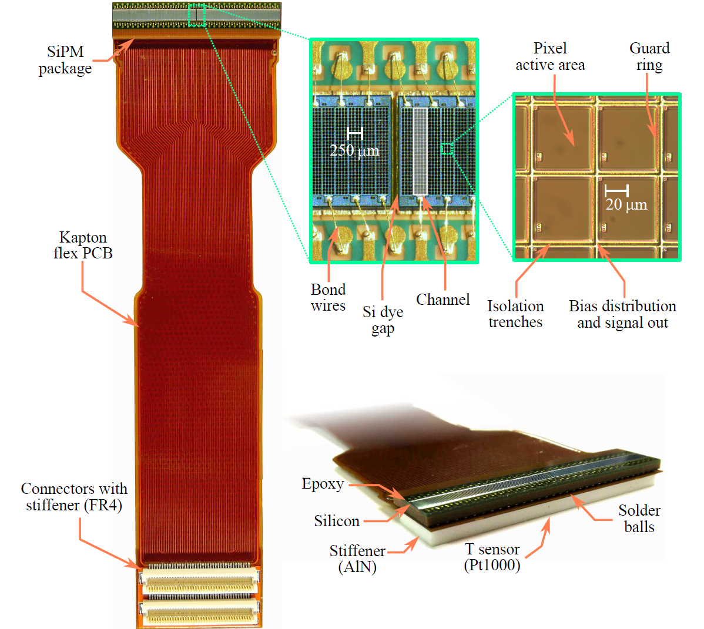
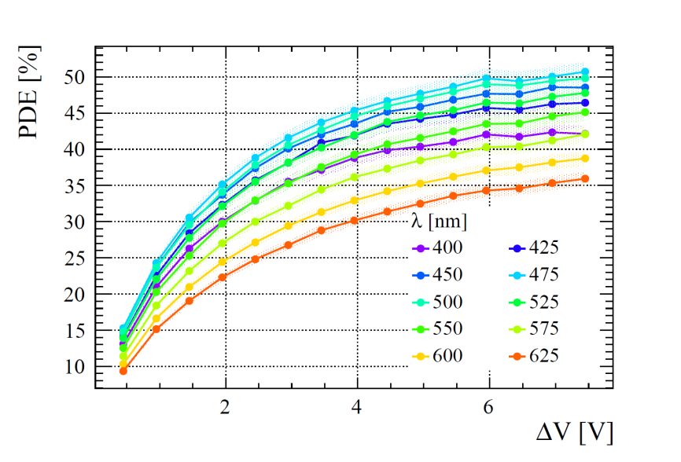
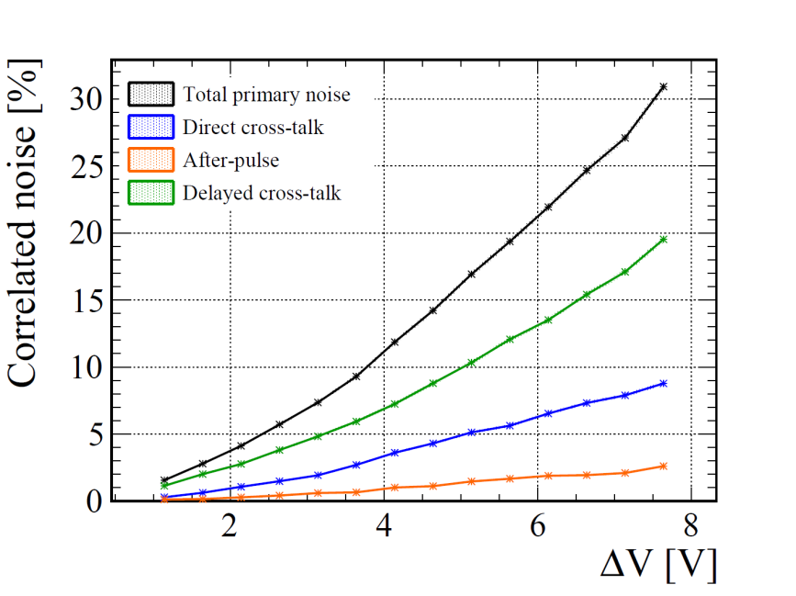
The SiPM array with 128channels (S13552)
Customised SiPM array:
Large pixels 57.5µm x 62.5µm
Optical isolation with trenches LTC5
Fast recovery time 70ns
Tight cutting and packaging tolerances
32.54 × 1.625 mm²
PhD thesis Olivier Girard
PhD thesis Axel Kuonen

Slide 7
Characterisation of the production batch
Correlated noise
Higher AP for batch 1
Higher delayed x-talk for batch 1
Both are within the specification
Low operation voltage to avoid high DCR and high correlated noise!
~9%
~7%
High PDE and low correlated noise advertised by the SiPM manufacturer are not at the same operation point!
Pre-production and production batch quite different.

Slide 8
Temperature coefficient
The specified value is 56mV/K, it seems that there is some difference due to thermal coupling
For the compensation of the temperature change it is important to take the package also into consideration. With the integrated temperature sensor it is the best choice to use the temperature coefficient obtained with the this measurement.
The specified (silicon only) value is 56mV/K, it seems that there is some difference due to thermal coupling
For the compensation of the temperature change it is important to take also the package into account. With the integrated temperature sensor it is the best choice to use the temperature coefficient obtained with the this measurement.
T sensor on module is important
Temperature coefficient can change if package is taken into account
T sensor on module an important luxury and certainly helpful
Temperature coefficient can change if package is taken into account

Slide 9
Irradiation tests with neutrons (Ljubljana)
SiPM area A=0.41mm²
Use current measurement with I-V scan
Measurements are based on average of 128 channels, automated multiplexer
At high DCR self heating and saturation is observed (104 pixels per channel)
For comparision:
A=1mm² , T=-40°C, ΔV=3.5V, p_{tot_cor}=7%, PDE=44%:
DCR = 34MHz
K_{1/2}=10.5K
DCR@3.5V = 14MHz
DCR@4.5V = 20MHz
Saturation due to self heating
Peak PDE@3.5V = 44%
Peak PDE@4.5V = 47%
1% dead time with 70ns recovery time @DCR=1.5GHz
DCR=1GHz results in P=26mW, important self heating!

Slide 10
Annealing
Low temperature annealing test at 35°C over two weeks
A reduction of a factor 2 is observed.
Annealing is foreseen in situ for LHCb SciFi Tracker (end of year shutdown of LHC)
To make the irradiation results consistent, annealing was applied before measurements of irradiation effects.
T=35°C
1 week

Slide 11
Comparison of the light yield (PDE) between non-irradiated with light and irradiated detectors
SciFi module stimulated with mono-energetic electron beam from Sr-90 source
Light injection system used for “DCR noise generator”
Light yield measurement with fast readout electronics
Gain verification with single photon peak amplitude
SciFi module stimulated with mono-energetic electron beam from Sr-90 source
Light injection system used for “DCR noise generator”
Light yield measurement with fast readout electronics
Gain verification with single photon peak amplitude
Repeat the measurement with irradiated samples, same setup at the same DCR
Use light with f_{light}=DCR to test:
Self heating effects
Gain change in the amplifier due to saturation and high current to sink
Reduced PDE observed for 1.2 x 10¹² n_{eq}/cm²
DCR=25MHz/channel results in P=80mW and produces important self heating!

Slide 12
Comparison of the amplitude spectrum
Random light injection at different frequency levels, equivalent to irradiated detectors
Add signal via fibre module, photon-peaks are visible up to 6 MHz
Important region at low number of photons is completely dominated by the DCR. High signal region is unchanged!

Slide 13
Gain at different irradiation levels
The gain was measured based on single photon peak amplitude.
For the highest irradiation level. only a limited over-voltage range could be used.
Gain reduction is visible in the order of 10% for the highest irradiation level.
The gain change needs to be taken into account for the PDE measurement!
ADC counts

Slide 14
SiPM production with Hamamatsu and integration into the detector some time line
After the prototype tests, the production of 5500 pieces (25% spares) was started:
Order date 9.2016 (start)
Delivery date 5.2017 (500 pieces)
Delivery date 9.2017 – 2.2018 (5000 pieces)
Mounted on Kapton flex 7.2018 – 4.2019
Gluing on cold bar 9.2018 – 6.2020
Assembly and installation of detector in IP8 5.2019 – 4.2022 (end)
Delivery schedule respected
Delay in assembly ~6 month
Delay Covid and other reasons 12 month
Summary:
From the order to the end of assembly 2.5 years.
From the order to the end of installation 5.5 years!

Slide 15
QA of the SiPM
Sample test of the bare chips without soldering. An adapter has been developed to allow electrical before assembly. (2/500, these detectors are stored without soldering (witness samples). PDE, IV for V_{bd} andR_{q}, noise analysis
Partial optical inspection before assembly
Thermal cycling after assembly (burn in) 3 cycles 80°C to -50°C)
Electrical testing for shorts and opens after assembly
Full sample characterisation for V_{bd} , measure 1K channels in one go!
Full sample measure the total thickness of the detector after assembly
Full sample optical inspection and cleaning

Slide 16
Design tests before production
Vibration test of the Kapton flex PCB, stress test
Scratch test of the optical surface when the detector is in contact with the fibre mat, pressure test
Gluing test of the ceramic stiffener
Thermal cycling test of the assembly (100 cycles 100°C – 55°C)
Connector reliability test, add glue on connector to reduce stress on solder joints
X-ray test of the assembly

Slide 17
V_{bd} spread, within one array and within 4 arrays
The spread of Vbd within one array is up to 0.6V
A maximum of 1V can be compensated by the FE ASIC
Number of units
V_{bd} spread over the production is 2V
Grouping is a lot of work but works

Slide 18
Thickness of assembly
The large aspect ratio L/W is 32mm/6mm leads to bending (banana shape during reflow)
Solder and gluing steps introduce variations in thickness important for the optical coupling

Slide 19
Largest loss during pre-production – many tests and some problems to setup the production!

Slide 20
Gluing of the SiPM arrays to the cold bar (20µm precision)
Optical pattern recognition helps to avoid large tolerances for the assembly!
Automated placement

Slide 21
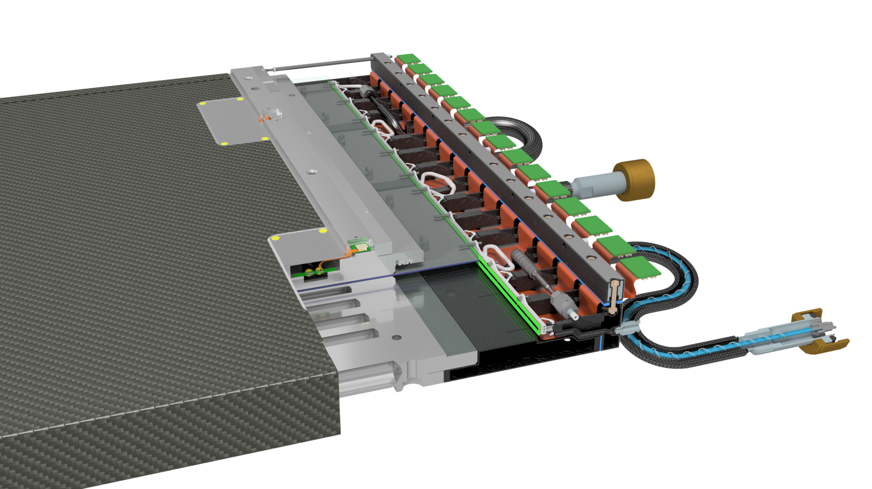
The SiPM integraton into the SciFi detector:
Light tight
Air tight (N2 flashed to create over-preassure to avoid humidity
Cold,T=-40°C specification
Tight space constraints
Light injection system
SiPM
Vacuum insulated cooling pipe
Fibre mat

Slide 22
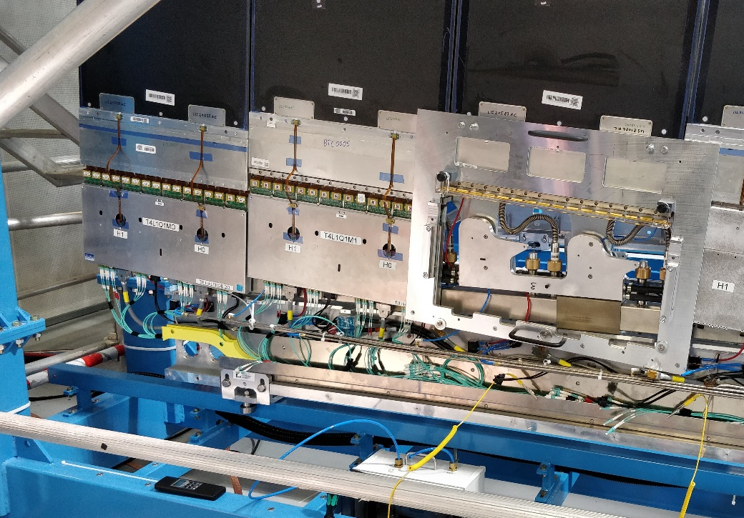

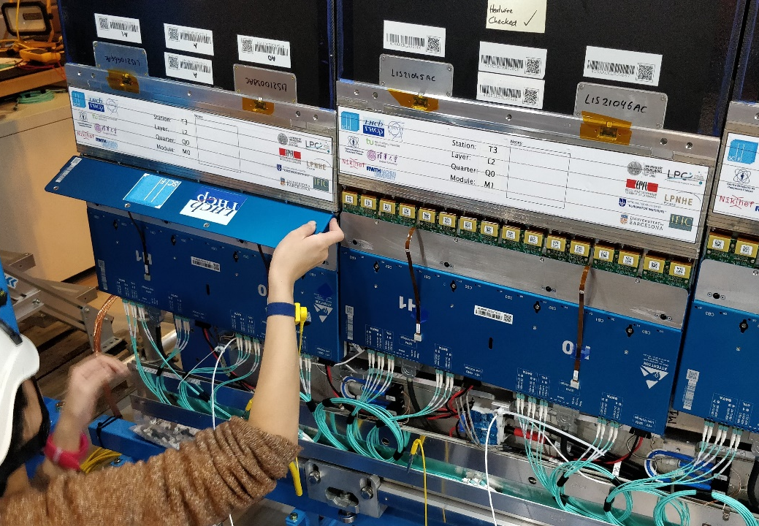
SiPM in integration, basically impossible to exchange the SiPMs!

Slide 23
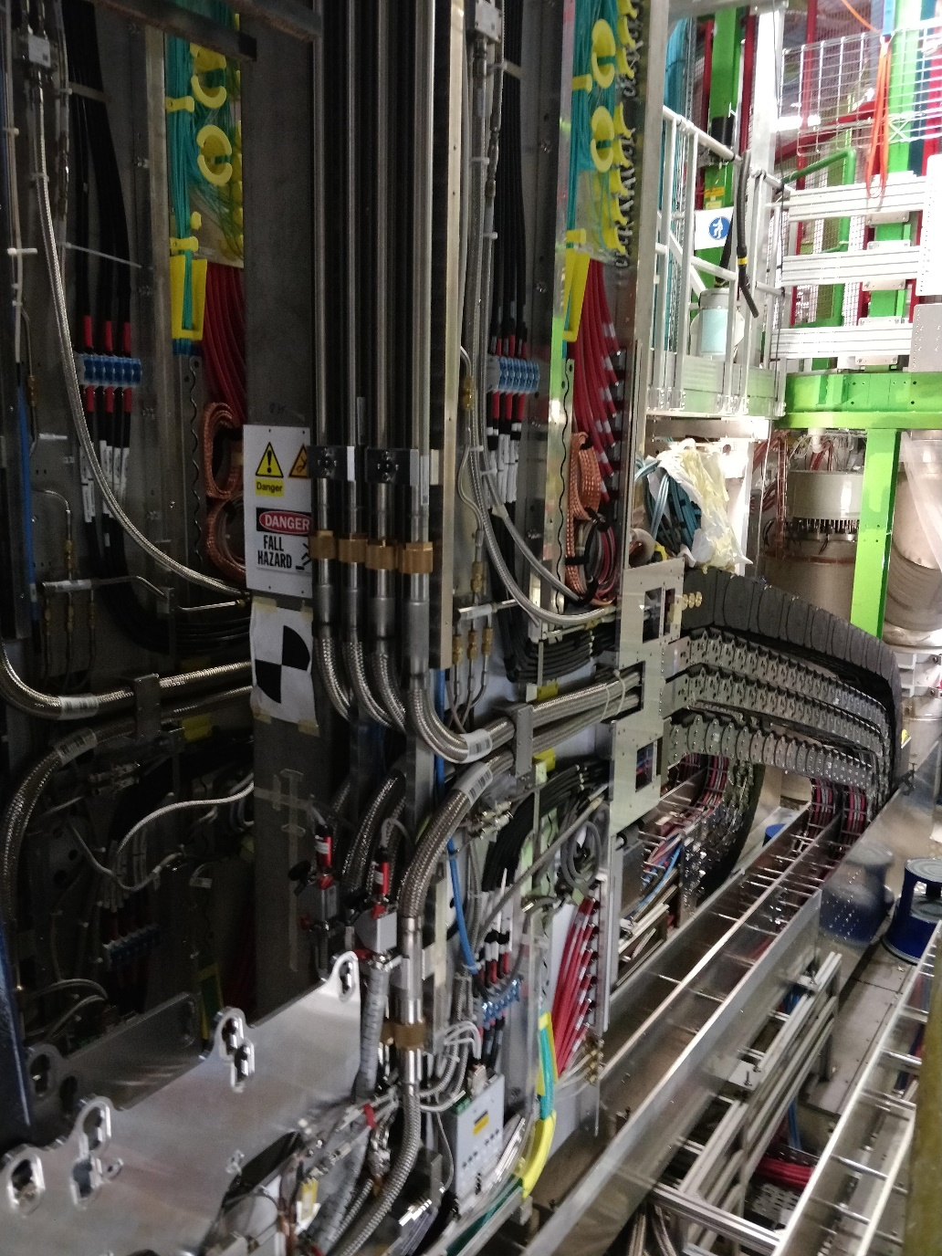
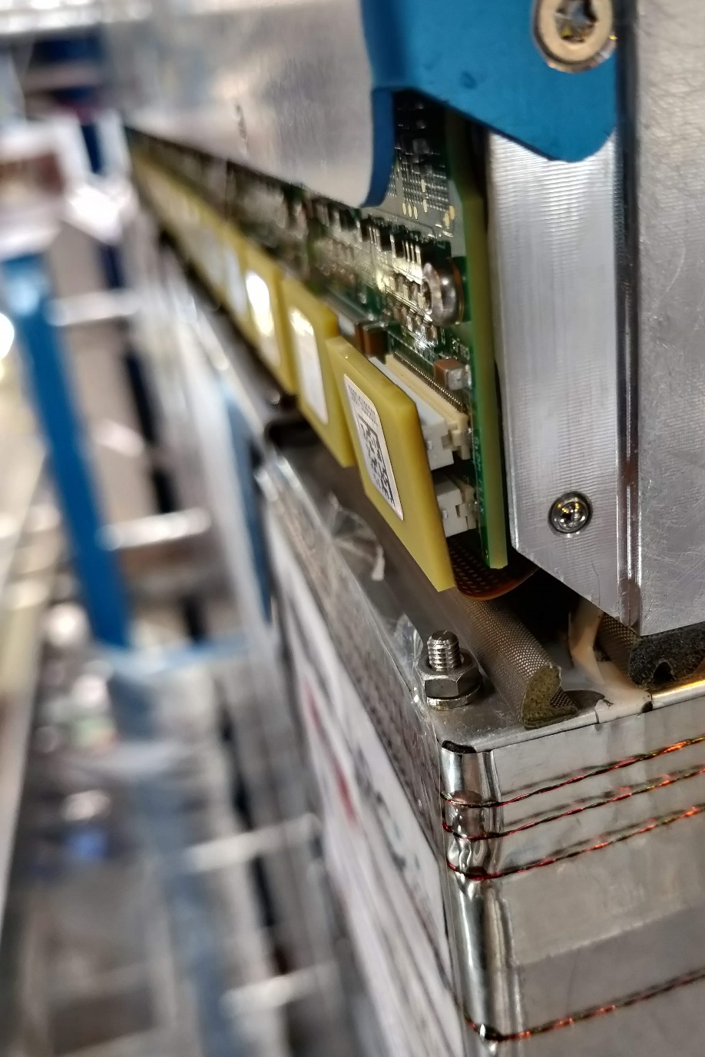
Cooling introduces large complexity for the detector integration
Cooling introduces large complexity for the detector integration
Conclusion: The SiPM array is in the center of the integration, exchanging is impossible!
Conclusion: The SiPM array is in the center of the integration, exchanging is impossible!

Slide 24
Development for future LHCb SciFi Tracker
Higher luminosity by a factor 10 is expected, increasing the neutron fluence to the level of: Φ =5×10¹² n_{eq}/cm² cooling to lower temperature is required
but
humidity and vapor tightness with conventional foam isolation is not possible beyond T=-40°C
and
decrease the thickness of the fibre layer to reduce cluster size and decrease occupancy
but
less signal requires lower thresholds.
Possible solutions
R&D on micro-lens enhanced SiPMs to increase signal
Cryogenic cooling for SiPMs at 77K to lower thresholds

Slide 25
Microlens-enhanced SiPM array
Two prototype iterations performed on 10 channel SiPM array from FBK
With a 40µm x 40µm pixel (83% GFF), the improvement expected is ~20% in light yield (15% at low ΔV for the first iteration measured)
Can also help to operate the SiPM at low ΔV since the light is focused into the center of the pixel
See talk from Carina VCI 2022:
Recovering dead area and avoiding low field region
Recovering dead area and avoiding low field region
Spherical lenses in the active region and cylindrical outside the light source.
Regular pattern for a sample of the 2nd iteration, spherical lenses in the active .

Slide 26
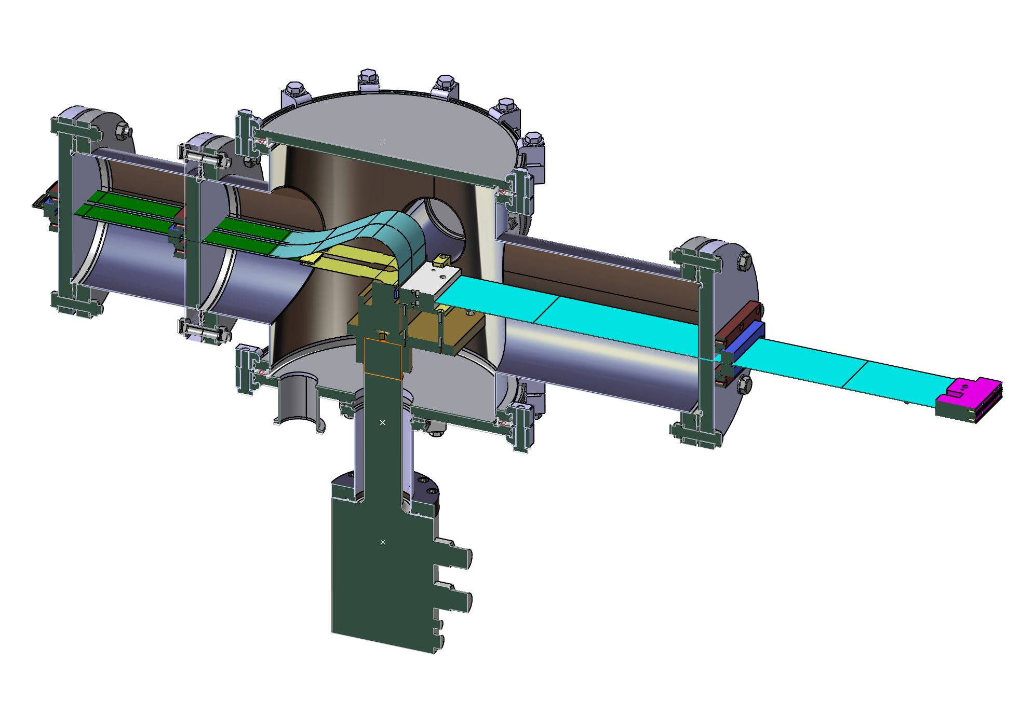
Cryogenic cooling with clear fibre interface
Setup in preparation to evaluate the feasibility of the different parts:
Long Kapton flex PCB for signal transmission
Clear fibre interface from SciFi module into the vacuum
Packaging of the SiPM and operation at 77K
Clear Fibre
Interface to SciFi module
Cryostat for lab test, temperature adjustable

Slide 27
Summary
Complex project requires long production and integration time
  2.5 years production
  3.0 years for integration
Cooling introduces a lot of complexity and the exchange of the SiPM can be impossible which in consequence requires a lot of QA
Micro-lenses and cooling to 77K are studied to make the SiPM “more radiation hard”
No significant changes in characteristics of the SiPM observed up to 6×10¹¹ n_{eq}/cm² (except DCR) and first indication of reduced PDE and change in gain at 12×10¹¹ n_{eq}/cm²

