Slide 1
YETS 21/22 key dates
YETS 21/22 will start on the 15th of November
LINAC3 15/11/2021=>28/02/2022
LINAC4 15/11/2021=>28/02/2022
LEIR 15/11/2021=>28/03/2022
PS 15/11/2021=>25/02/2022
PSB 15/11/2021=>25/01/2022
The planning per machine can be consulted in the following webpage
https://oss-coordination.web.cern.ch/gantt/latest

Slide 2
Business as usual:
Declare your activities(and create IMPACT) as soon as known
Contact the machine coordinators and myself in case of special needs
Leave the machine clean and tidy
Don’t leave material/instruments in the buffer zone but move them to their final destination
So far only 7 activities declared in the whole PS complex(see below), some other known and planned but not yet declared(AD BTVs, LINAC 4 new spare fibers pulled for the Laser EM, anything else?)

Slide 3
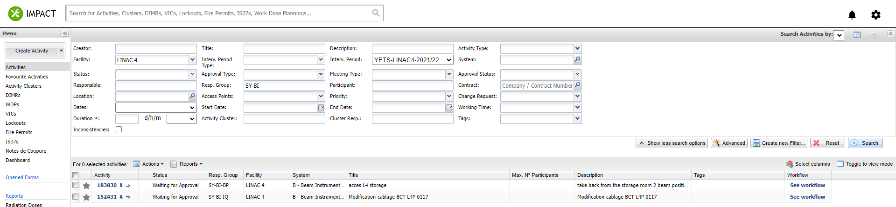
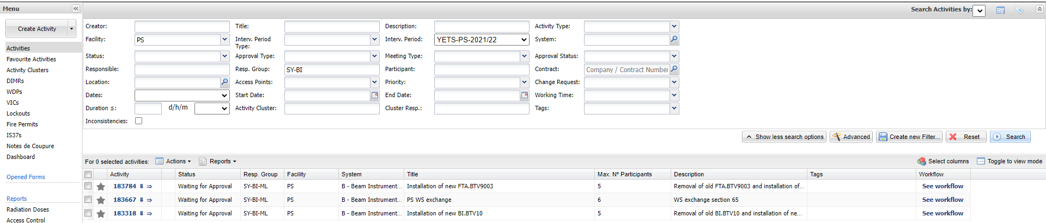
LINAC 4
PS

Slide 4

PSB

