Slide 1
PLANNING YETS SPS
SY/BI 2021/22
Morad Hamani

Slide 2
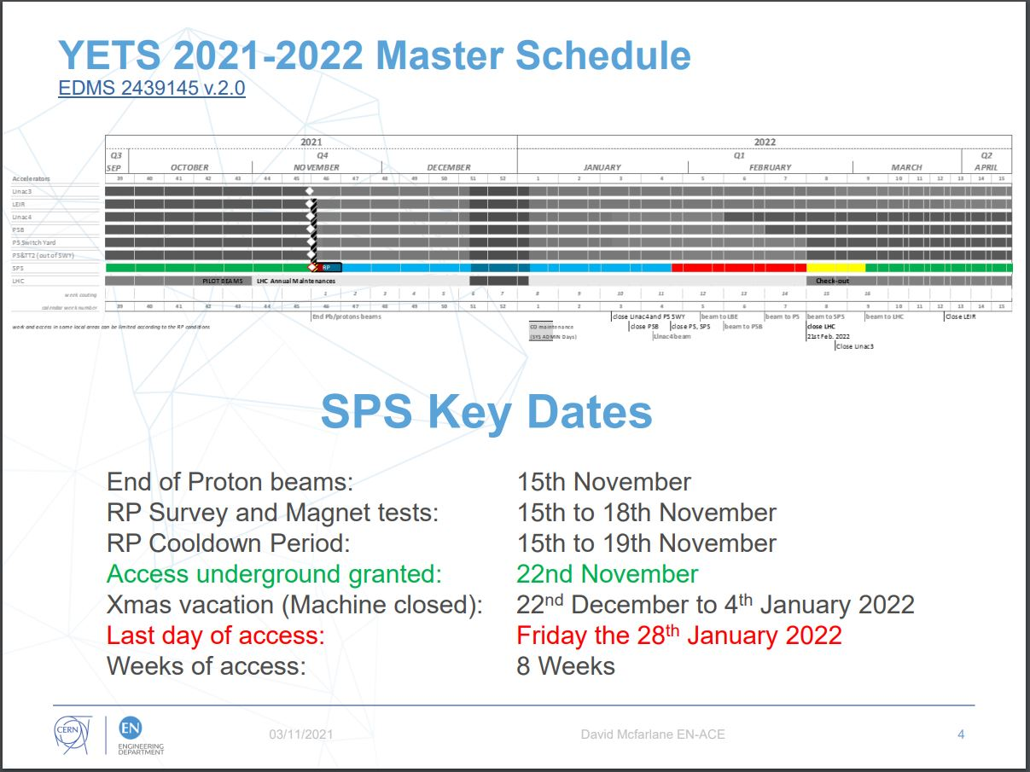

Slide 3
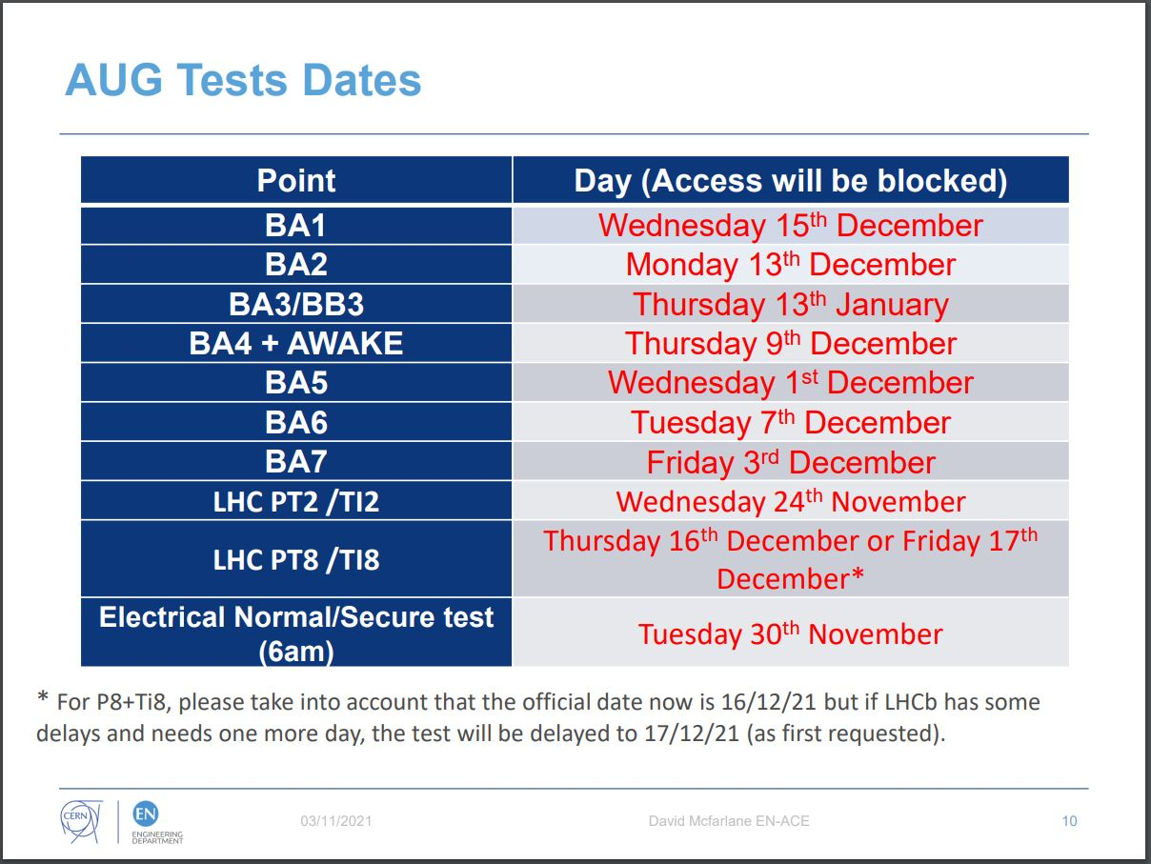

Slide 4
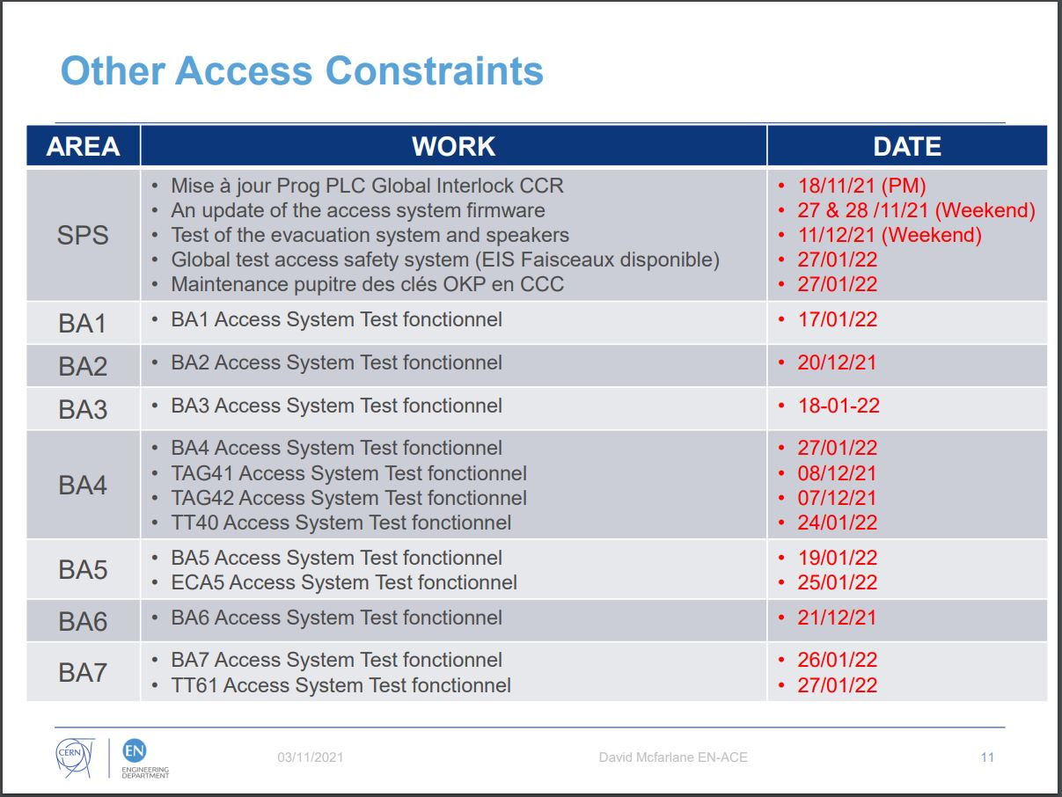

Slide 5
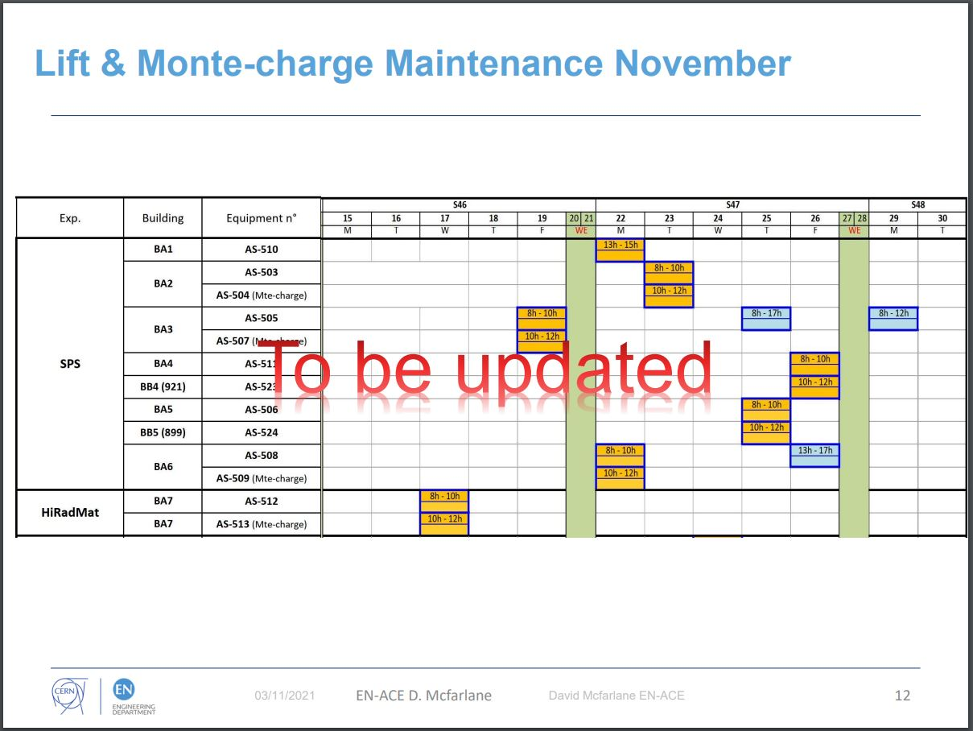

Slide 6
INTERVENTIONS SPS YETS 2021/22
SY/BI
Thierry Bogey: installation nouveau Rack BYBPM BA1
Tom Levens BCTFI_660516 relocation 17/01/2022
Tom Levens BPMEA_42172 13/12/2021
Alexandre Mariet BWSD_51639 wire exchange 22/11/2021
Sebastien Thoulet : BCT au BA5 06/12/2021
Stephane Burger : Câblage BA80 et maintenance BTV
Stephane B / Morad H : TPSC4 BTV

Slide 7
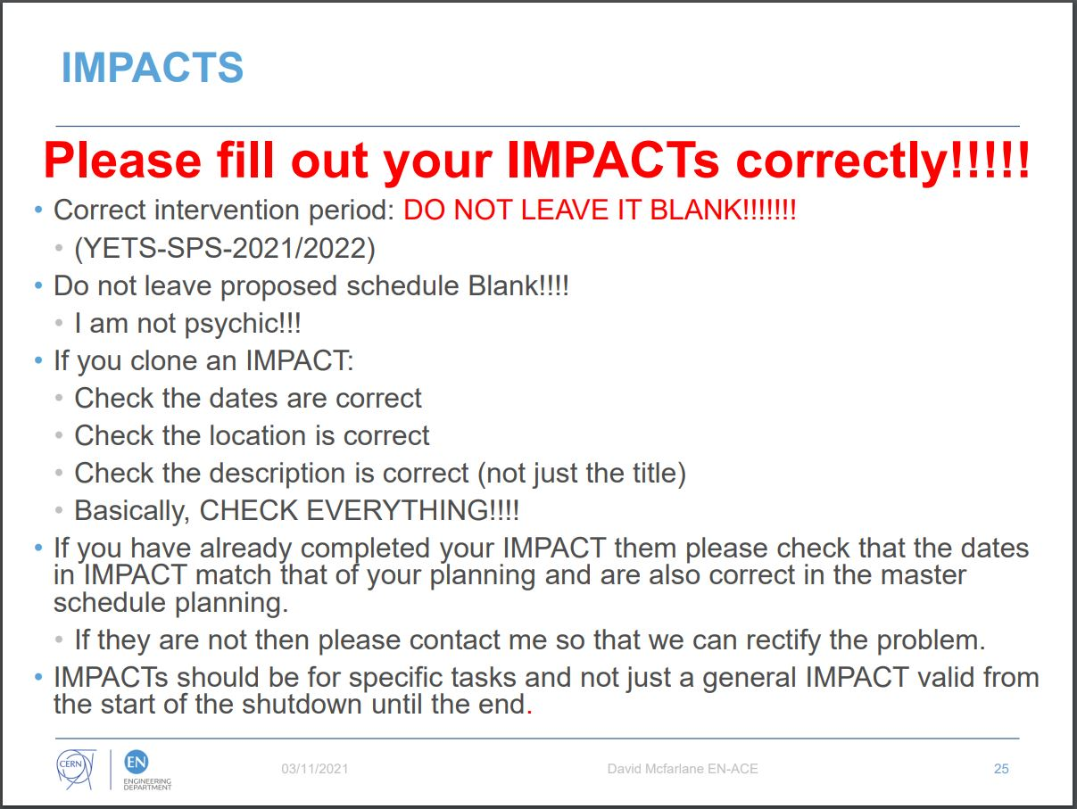

Slide 8
