Slide 1
SY-BI ACTIVITIES for YETS 2021/22
G. Schneider

Slide 2
Content
LHC YETS general and organisation information
BI Activities
Workframe authorisations to be done now

Slide 3
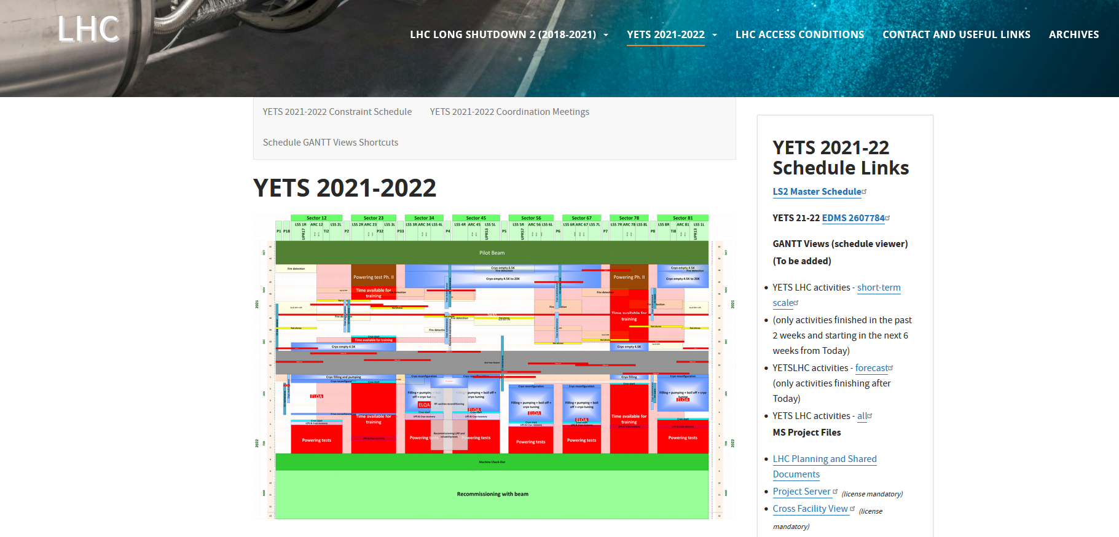
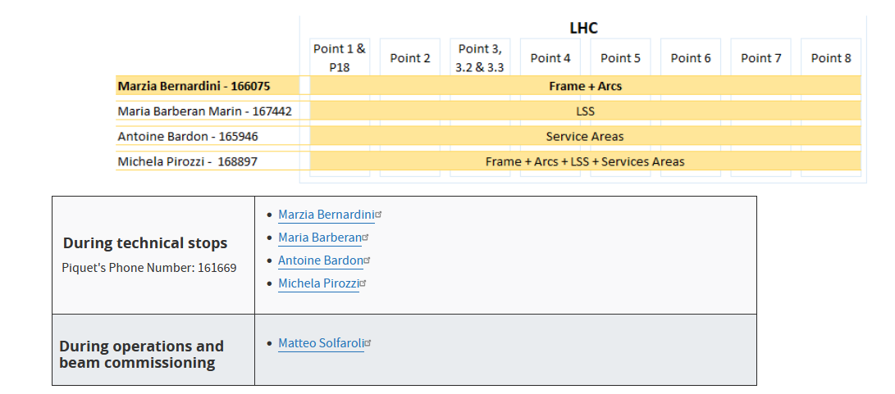
Useful informations for Coordination
https://lhc-coordination.web.cern.ch/
EDMS : Master Schedule YETS 2021-2022 ACC-PM-MS-0005 v.2.0
LHC YETS 21-22 Schedule link

Slide 4
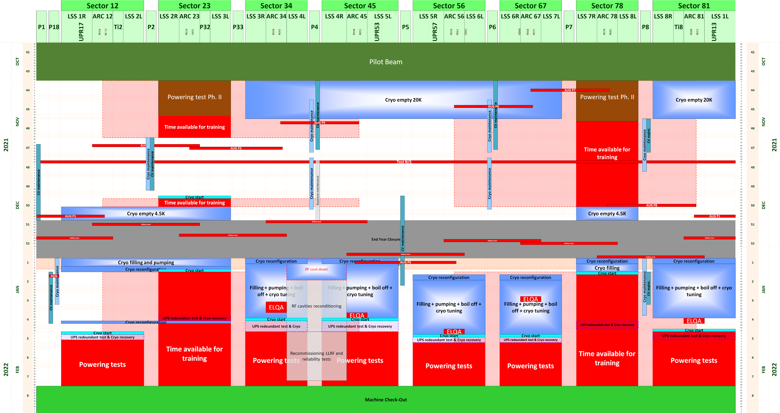
YETS 2021-22: Frame
EDMS: LHC-PM-MS-0019 v.0.1
Cryogenic status:
  S. 12, S. 23 and S. 78 filled with liquid Helium
  S. 34, S. 45, S. 56, S. 67 and S. 81 at 20K
Electrical status: electrical lockout except sectors under training
Access conditions:
  S.23 and S. 78 in training quenches→ LHC patrolled according to access matrix
  Outside powering and training periods→ LHC in general access mode (closed during Year End Closure)

Slide 5
Activities Types
New Installations
Maintenance
Debugging
Instrument calibration and preparation for Run 3

Slide 6
BSRT Point 4 on-going now
Installation new BSRTM tank
Change of mirror in BSRT 4L

Slide 7
BGC Point 4
Connect BGI gas injection to BGC main chamber (VSC action related to BGC)
Installation of camera optics
Prepare for YETS 2022/23 full BGC installation with on-site visits

Slide 8
BLMs
BLM maintenance at all LHC Points
BLM calibration

Slide 9
BPMs
Remaining BPM maintenance at some LHC surface buildings
Final installation of the interlock BPM test at BPMSX.B4R6.B2
  no vacuum intervention or other major activities
  mainly electronics hardware installation in the UA.
Upgrade of the power distribution of the surface BPM racks.
  Service managed by EN, still under evaluation if this actually will happen during the YETS
  No tunnel access is required, all activities happen at the surface building
  Four LHC points are remaining for this upgrade.
Possible debugging / interventions following pilot beam test

Slide 10
DOROS preparation for Run 3:
DOROS work:
  electronics checks and maintenance
  all LHC points except P3
  Galleries
  LHC tunnel access in RR13 + RR17

Slide 11
For BTVs, BWS, BRAN, BSRT, BCT
Maintenance
Debugging
Preparation for Run 3
BRAN D installation foreseen in week 3 2022

Slide 12
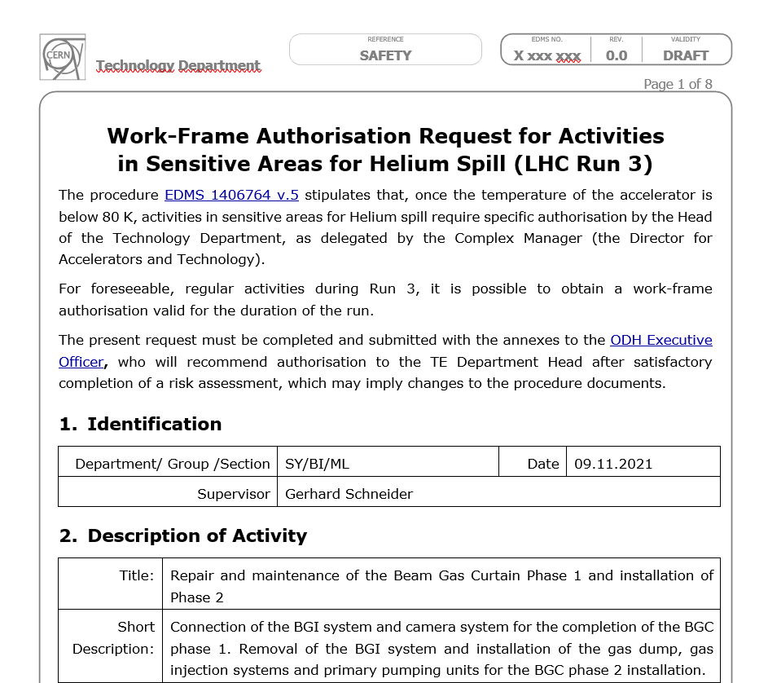
Work-Frame Authorisations
To be done (or up-dated with new template and persons for all activities under beam pipes or close to cryogenic equipment

Slide 13
Questions?

