Slide 1
The European superconductors for ITER magnets
T. Boutboul,
ITER Delivery Department, Fusion for Energy
CERN, TE-MSC Technical seminar, November 11th, 2021
Notes:
Use preferably the corporate colours
Use the Calibri or Arial fonts
Don't centre text. All body text should be aligned left.
Don't enlarge pictures beyond their actual size/resolution
Make sure you understand how bulleted lists work.

Slide 2
Outline
Introduction: ITER project and Magnets
European contribution to ITER magnet conductors
TF and PF conductor supply strategy
TF conductor
Strand (copper, Nb₃Sn strand)
Cabling
Jacketing
PF conductor
NbTi strand
Cabling
Jacketing
Some lessons learnt from EU ITER conductors
Conclusions

Slide 3
ITER Project: introduction
ITER (International Thermonuclear Experimental Reactor) is an international project being built in the south of France (close to CEA of Cadarache).
The main purpose of ITER is to demonstrate the technological feasibility of fusion power.
Fusion reaction: fusion of light elements (as Deuterium, Tritium) to form heavier element while releasing energy, in a way similar to energy production in stars).
Aims to produce thermal power of 500 MW, corresponding to 10 times the power injected into plasma.
ITER project driven by ITER IO and 7 parties (China, EU, India, Japan, Korea, RF, US).
Seven parties established Domestic Agencies to manage their contributions (90% in-kind contribution of components and 10% in cash).
Fusion for Energy (F4E) is the Domestic Agency of EU (45% of total project budget).
First plasma scheduled for December 2025 and plasma in D-T phase in 2035.

Slide 4
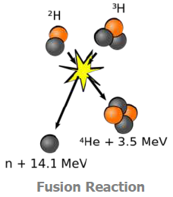
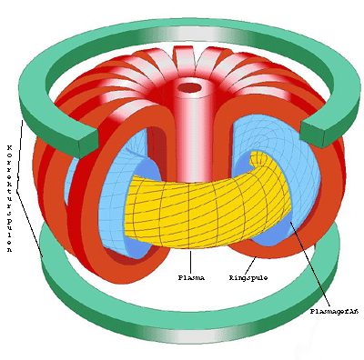
ITER Magnets: why?
To get the fusion reaction very drastic conditions of density and temperature (~ 150 millions of ºC!!) needed.
In such conditions the matter state is plasma and it needs to be confined to keep conditions.
What is needed in ITER Tokamak:
Creating a plasma current
Holding the ions & electrons away from the wall forming a magnetic bottle
Stopping energy/particle loss from the plasma
In ITER Tokamak:
CS creates and drives the plasma current,
TF coils squeezes the plasma to reach critical density for fusion reaction and
PF coils shapes and stabilizes the plasma.
In order to minimize power consumption and magnets dimensions superconducting magnets used at ~ 4 K.

Slide 5
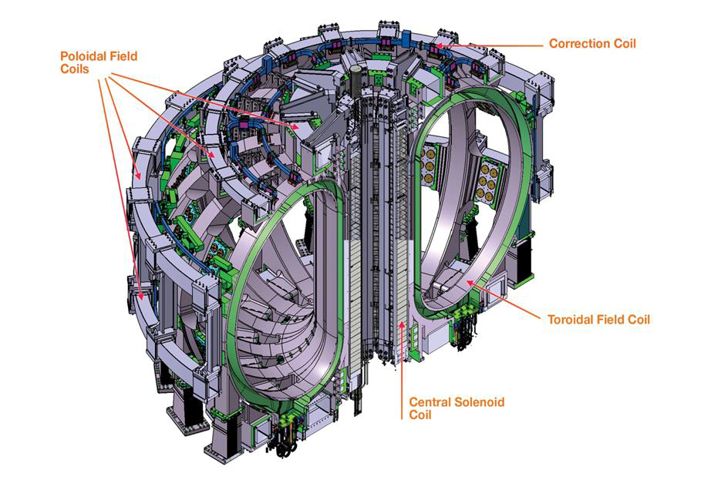
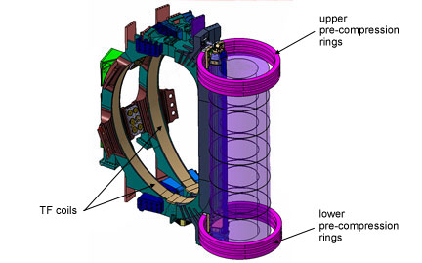
ITER Magnet system: what?
Needed for ITER magnet system:
19 (18+1 spare) Toroidal Field (TF) coils, 10 by EU, 9 by Japan
6 Poloidal Field (PF) coils, 1 by Russia, 5 by EU
1 Central Solenoid (CS) made of 6 modules, by US
Correction Coils (CC), by China
9 Pre-Compression Rings (3 upper, 3 lower, 3 spares), EU
Total stored energy of 51 GJ for the ITER Magnet system!

Slide 6
European conductor contribution
F4E share to ITER magnet conductors:
27 TF conductor unit lengths (~ 20 % of total) and extra super/dummy conductors (for about four TF coils): 19 regular lengths (760 m each) and 8 side lengths (415 m each). This needed about 97 tons of superconducting Nb₃Sn strand and 62 tons of Cu strand.
10 PF conductor unit lengths (720 m each) and extra super/dummy conductors for PF6 (~ 11 % of Total for PF), which needed about 45 tons of superconducting NbTi strand.

Slide 7
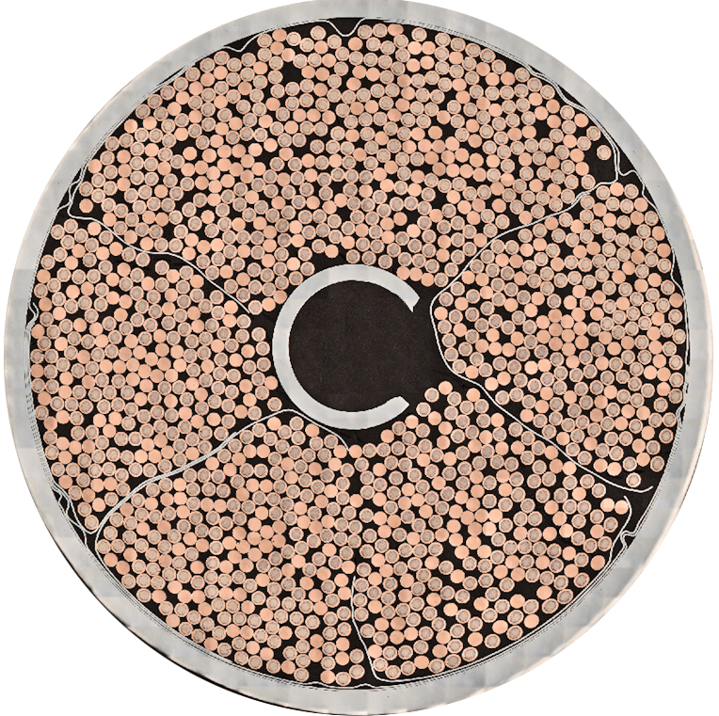
ITER TF conductors
TF coil operation: 68 kA, 11.8 T, 5 K
TF superconductors are Cable-In-Conduit Conductors (CICCs).
~1400 Nb₃Sn superconducting and Cu strands cabled together (in 5 stages) with stainless steel wraps (for final cable and sub-cables) and around a central cooling spiral.
Then cable inserted into circular long jacket made of butt-welded austenitic stainless steel to form final conductor.
Cable-In-Conduit Conductor for ITER TF

Slide 8
ITER PF6 conductors
PF6 coil operation: 52 kA, 6 T, 4.5 K;
All PF superconductors are CICCs as well.
~1400 NbTi superconducting strands cabled together (in 5 stages) with stainless steel wraps (for final cable and sub-cables) and around a central cooling spiral.
Then cable inserted into “round-in-square” long jacket made of butt-welded AISI 316L stainless steel to form final conductor.
Cable-In-Conduit Conductor for ITER PF6 coil

Slide 9
TF conductor supply strategy
For TF conductor 4 supply and 3 characterization contracts:
BEAS contract (Germany) for the supply of 40 % of the Nb₃Sn SC strand.
OST contract (USA) for the supply of 60 % of the Nb₃Sn SC strand (two contracts to mitigate risks).
Luvata contract (Finland) for the supply of the copper strand.
ICAS contract (Italy) for the cabling and the jacketing of the conductor), including all components but the strand.
ICAS is a consortium composed of ENEA (contract management), Tratos (cabling) and Criotec (jacketing).
Durham University contract (UK) for the verification tests of the TF strand to cross-check supplier results on a regular way.
Twente/Durham grant (NL/UK) for the strand extended characterization (critical current as function of T, B, strain).
SULTAN contract for the testing of full conductor samples with SPC (CH) to validate various conductor production phases.

Slide 10
PF6 conductor procurement strategy
PF conductor procurement strategy based on PIA (Procurement Implementation Agreement, bi-lateral agreement with RF DA) for sake of synergy.
EU PF6 NbTi strand and cables supplied by RF DA
In exchange F4E in charge of jacketing 8 PF6 and 16 PF1 RF lengths
NbTi strand produced at ChMP (Glazov, RF)
PF cables manufactured at VNIIKP (Podolsk, RF) and shipped to EU.
ICAS contract, used for TF conductor, for PF conductors (both PF1 and PF6, EU and RF), ICAS in charge to procure PF jacket sections.
A contract for verification and extended strand characterization with Durham University.
SULTAN contract for the testing of full conductor samples with SPC (Switzerland).

Slide 11
TF conductor: Copper strand
Cu strand – Luvata contract
Contract for 62 t of Cr-plated Cu strand,
As expected, no problem during the execution of this contract,
Very high RRR values: RRR(average) = 363 (min. value of 280),
Production completed in advance (6 months!).
However, problem of strand storage at the cabling supplier since copper fully produced and a few tons of Nb₃Sn manufactured before launching ICAS contract.

Slide 12
TF conductor: Nb₃Sn SC strand
For the fabrication of TF strand, two main challenges:
Before ITER project, worldwide Nb₃Sn strand production: ~15ton/year, more than 100 tons per year have been needed for ITER and ~20t/year for EU and two companies only: industrialization challenge,
High strain sensitivity due to filament cracking following Lorentz forces and warm-up/cooldown inducing thermo-mechanical loads on cable/jacket system in CICC. “Wind and React”: heat treatment reaction done on TF WPs.

Slide 13
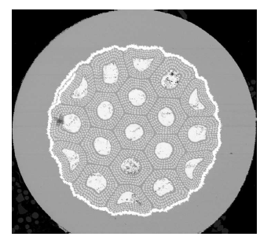
TF conductor: Nb₃Sn strand (OST)
Nb₃Sn strand – OST contract
59.7 t of Nb₃Sn strand (~60% of total).
Produced by Internal Tin way
19 sub-elements per final billet
156 filaments (142 Nb, 12 NbTi) per sub-element, 6µm.
Ternary Nb₃Sn (Ti doping)
Ta barrier (diffusion), ~8µm.
X-section of OST strand
1143 strand production billets needed for contract completion!

Slide 14
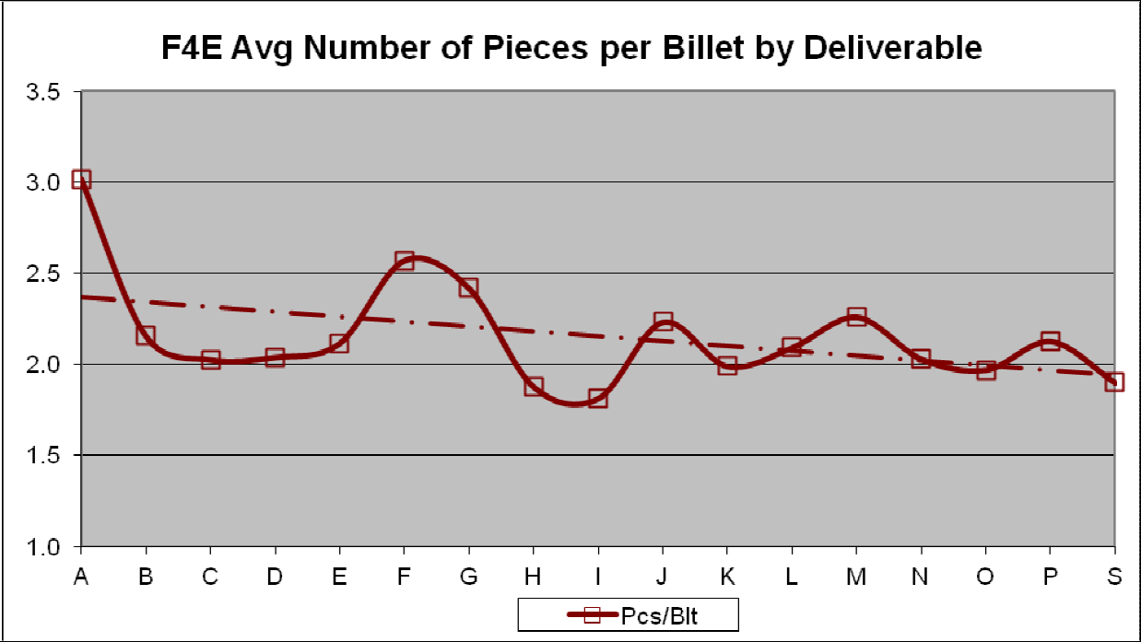
TF conductor: Nb₃Sn strand (OST)
Ramp up phase took 13 months (upgrade of facilities for mass production).
During ramp up (first strand batch) several billets with low yield (< 50 %) due to Ta barrier and inclusions but workability improved quickly with the average number of strand pieces passing from 3 at the beginning to 2 per billet:

Slide 15
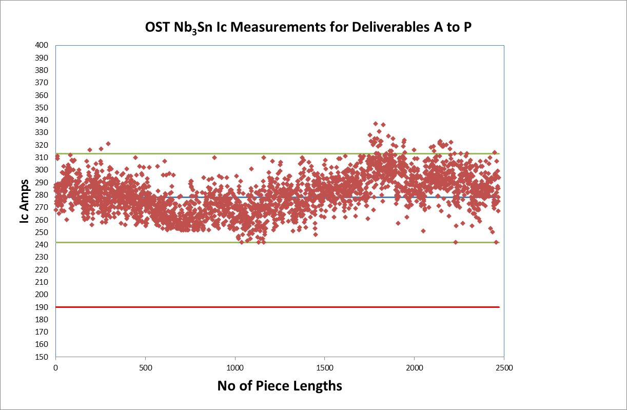
Nb₃Sn OST Deliverable A-P (60 t)
Ic values @ 4.22 K, 12 T, OST values
Average = 281 A
σ = 15 A

Slide 16
OST: Supplier data statistics (60 tons)
parameter | Ic [A] | n | RRR | Loss [mJ/cc] | Cu/non-Cu | Cr thickness [µm]
Average | 281 | 39 | 158 | 264 | 1.00 | 1.3
Standard deviation | 15 | 6 | 31 | 51 | 0.05 | 0.1
Critical current in average 50% higher than minimum specified value!
All loss values within specification with the highest value being 19% below the maximum specified value.

Slide 17
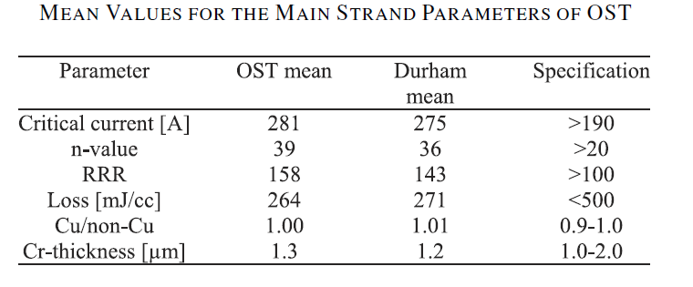
OST: Supplier data vs Durham (60 t)
In general, all parameters as measured at OST consistent with Durham measurements in average within a few %, to the exception of RRR where DU data lower by 9% in average.

Slide 18
OST: RRR issue
In general, RRR of OST strand was quite high (158 in average) and this was confirmed by the verification measurements at Durham/Twente University.
However, in the middle of the production, Durham measured for some billets RRR out of spec (< 100) whereas OST values were high as usual.
Re-tests at both OST, Durham and Twente confirmed the discrepancy between OST and DU/UT values. Moreover, US DA verification measurements presented for some billets the same trend.
Thorough investigations were launched. First, the setups have been cross-checked: OST and Durham appeared to be consistent on same physical samples within very few %.
Then Heat Treatment has been considered. OST used N₂ gas whereas Durham used Ar.

Slide 19
OST: RRR, heat treatment impact
Two ~ 1 km lengths have been cut every 50 m and adjacent samples have been reacted and tested at OST (1 under Ar and 1 under N₂) and reacted at CERN (under vacuum) and tested at DU. The results as averaged over the ~ 20 samples are quite surprising:
Strand | OST, N₂ | OST, Ar | DU, vacuum (CERN)
F0796 | 144/11 | 81/16 | 88/21
F0825 | 146/14 | 131/18 | 134/17
RRR average and standard deviation over the length
Samples treated in Ar or vacuum provide quite consistent results. However, if samples reacted in N₂ have a higher RRR than those in Ar for F0825 by ~ 10 %, the discrepancy goes up to 78 % for the other length…
Last but not least this RRR issue was localized over a few batches.

Slide 20
OST: RRR, heat treatment impact (2)
An analysis of oxygen residues present in heat treatments could explain discrepancy: 2 ppm for N₂ as compared to 10 ppm for Ar.
In addition, small oxygen amounts in N₂ gas could create at beginning of HT oxide layer on the strand able to act as a diffusion layer to prevent further oxygen contamination of the copper matrix.
Anyway, OST changed the HT environment gas from nitrogen to argon till the end of the contract in order to be more conservative and consistent as well with ASG, the European TF coil manufacturers using Ar in HT of the TF double pancakes.

Slide 21
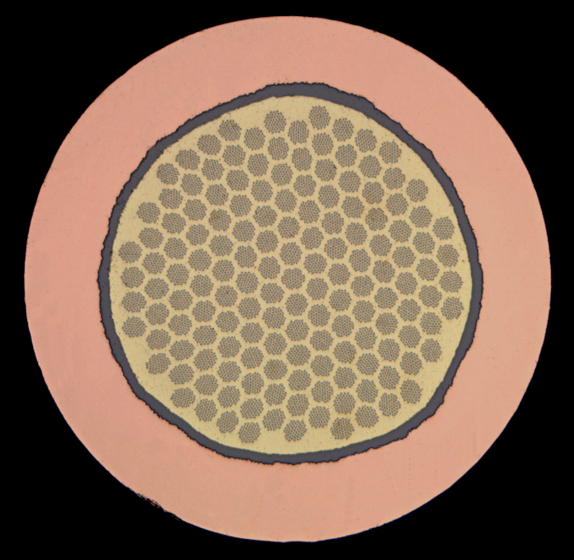
Nb₃Sn – Bruker EAS Contract
37.7 t of Nb₃Sn strand (~40% of total)
Manufactured by Bronze Route
151 sub-elements per final billet
55 filaments (NbTa), 3µm, embedded in bronze matrix (CuSnTi) per sub-element.
Quaternary Nb₃Sn (Ta and Ti doping)
Ta barrier (diffusion barrier), 13µm.
During drawing, intermediate annealing steps needed for the bronze due to work hardening: long process.
X-section of Bruker EAS strand
380 billets needed for contract completion.

Slide 22
Nb₃Sn – Bruker EAS Contract
Ramp up phase took 13 months (upgrade of facilities for mass production).
At the beginning of the strand production, breakages caused by foreign particle contamination: problem rapidly solved. Over the full production 2.8 piece lengths per billet in average.
More than 90 % of billets with yield > 80 %: good workability of the process.
Heat Treatment schedule: ITER technical specification for TF strand heat treatment foresees two options Cycle A and Cycle B:
Cycle A
210 ˚C for 50 hrs,
340 ˚C for 25 hrs,
450 ˚C for 25 hrs,
575 ˚C for 100 hrs,
650 ˚C for 200 hrs.
Cycle B
210 ˚C for 50 hrs,
340 ˚C for 25 hrs,
450 ˚C for 25 hrs,
575 ˚C for 100 hrs,
650 ˚C for 100 hrs.

Slide 23
Nb₃Sn – Bruker EAS Contract
However, both Cycles A and B provided strand Ic very close to specification (~ 190 A). In addition, qualification SULTAN conductor sample showed current sharing temperature ~ 5.9 K after cycling, near minimum specified value (5.7 K + 0.1 K error bar).
Thus HT modified: HT schedule of 595 C/160 h + 620 C/320 h typically provided strand Ic ~ 200 A.
This HT schedule allowed to have all the billets produced (except two at the beginning of production) within critical current specification and all the SULTAN conductor samples tested to be just in specification (Tcs ~ 5.8-5.9 K).

Slide 24
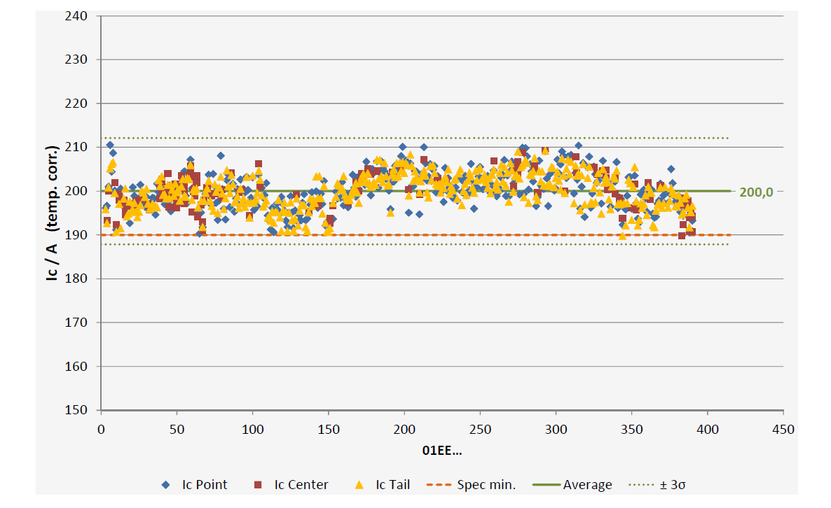
Nb₃Sn BEAS deliverables A-Q (38 t) Ic values @ 4.22 K, 12 T, BEAS data
Average = 200 A
σ = 4 A
All values are within ± 5 %!!

Slide 25
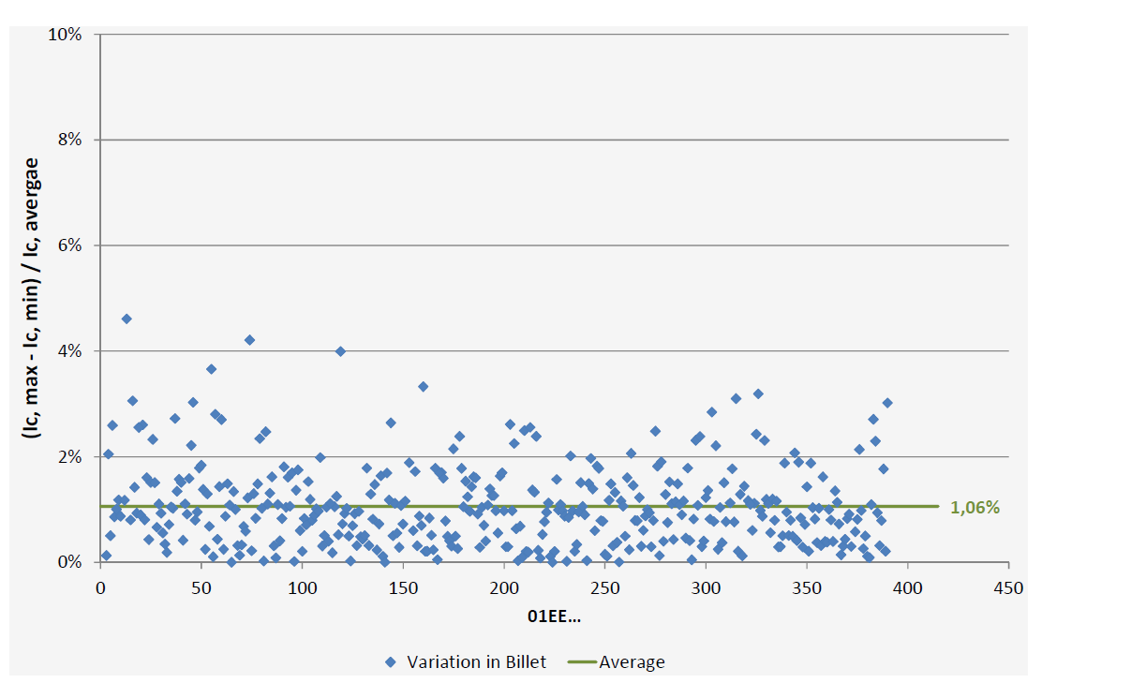
BEAS: Ic variations within a single billet
The critical current scatter for a given billet is within ± 2% and generally better than within ± 1%: remarkable!!

Slide 26
BEAS: Supplier data statistics (38 tons)
parameter | Ic [A] | n | RRR | Loss [mJ/cc] | Cu/non-Cu | Cr thickness [µm]
Average | 200 | 44 | 117 | 65 | 0.94 | 1.3
Standard deviation | 4 | 2 | 12 | 15 | 0.02 | 0.2
Although Ic values close to minimum specification, low variability for all measurements (± 5%) and impressively low scatter for a given billet (generally within ± 1%).
Ic scatter for given billet remarkable since integrates testing setup reproducibility and repeatability, sample mounting and Cu/non-Cu variations along the billet.
RRR variability in a billet obviously larger than that of Ic due to RRR sensitivity to local copper impurities or Ta barrier defects. Scatter within 10% for most cases (can reach 30% in very few cases).
Losses very low due to very thin filaments (~ 3µm) and relatively low Jc.

Slide 27
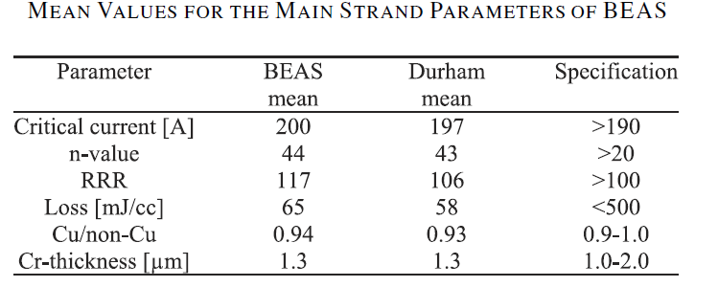
BEAS: Supplier data vs Durham (38 t)
Generally and in average, BEAS and Durham data are consistent within few %.
However, for RRR, Durham values lower on average by almost 10% than Bruker data. More explanations on next slide.

Slide 28
BEAS: RRR issue
There was an issue with RRR slightly below specification due to strand surface contamination during drawing but this issue has been quickly solved by BEAS.
However, in this case too, there was a discrepancy of around 10 % between the supplier and the verification RRR data where the supplier values were generally higher.
Cross-checks made on same physical samples showed that BEAS, Durham and Twente setups provided data consistent within 1-2 %.
Nevertheless, for batch E adjacent samples have been cut and:
a. reacted and tested at BEAS (Ar)
b. reacted and tested at Durham (Ar)
c. reacted at CERN (vacuum) and tested at Twente
In average the RRR of BEAS samples was 114, whereas that of Durham samples was 102 and that of Twente 93….
Once again, impact of the environment during the heat treatment is decisive for RRR performance (interplay between atmosphere and contaminants).

Slide 29
TF conductor: cabling at Tratos Cavi
Triplets (first cabling stage and Cu triplets) cabled on Machine A (65 m/min),
Machine B for stages 2 and 3 (21 and 15 m/min),
Machine C for last two stages (typically a few m/min).
On Machine C pulling force produced by a motorized capstan (OD 3000mm) at end of line. Pulling system, properly balanced by brakes of sub-cable de-spooling system: able of applying very accurate payoff tension (<1 kg/strand).

Slide 30
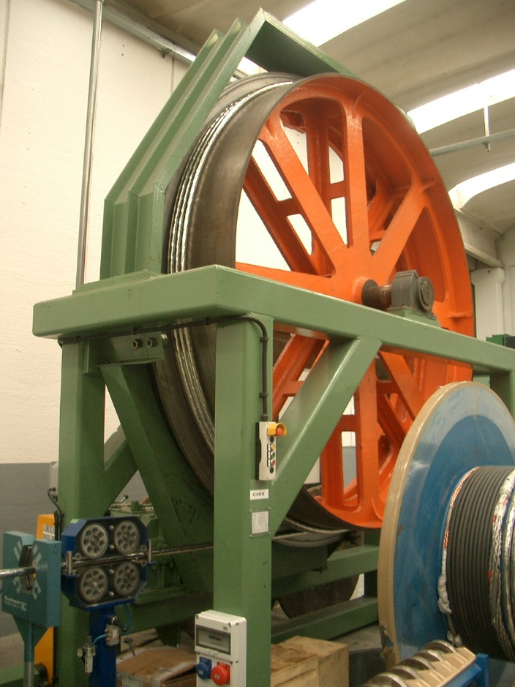
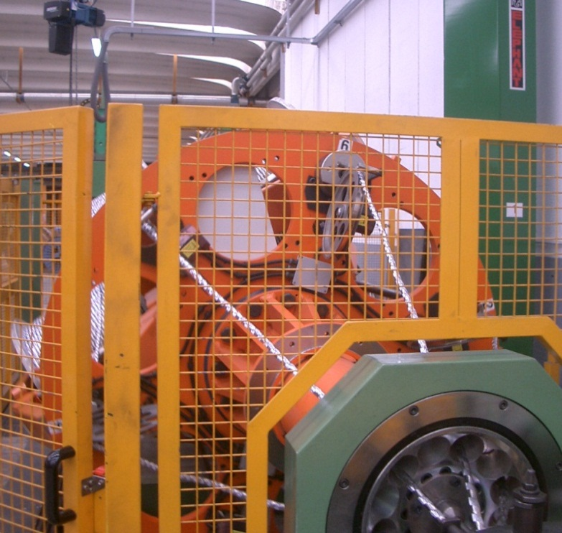
TF conductor: cabling at Tratos Cavi
All components (but strand) supplied by supplier: spiral, wraps.
No serious technical issue but BEAS Bronze Route strand more difficult to cable (bronze stiffer than copper): cabling qualification took more time for Bronze Route than for Internal Tin.
Final TF cable formation
Capstan (end of line)

Slide 31
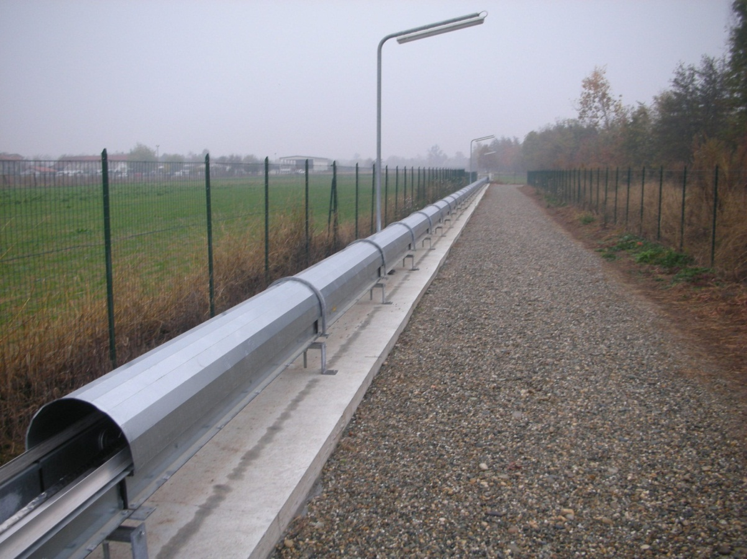
TF conductor: jacket assembly, Criotec
Jacket sections (~13 m) butt-welded by a TIG, fully-automatic, orbital machine.
NDT of weld (endoscopic visual, X-ray, leak test, dye penetrant).
If NDT fine, jacket assembly pushed towards the jacketing line (800 m!!!) and new weld till full jacket length reached.
A view on the jacketing line (800 m)

Slide 32
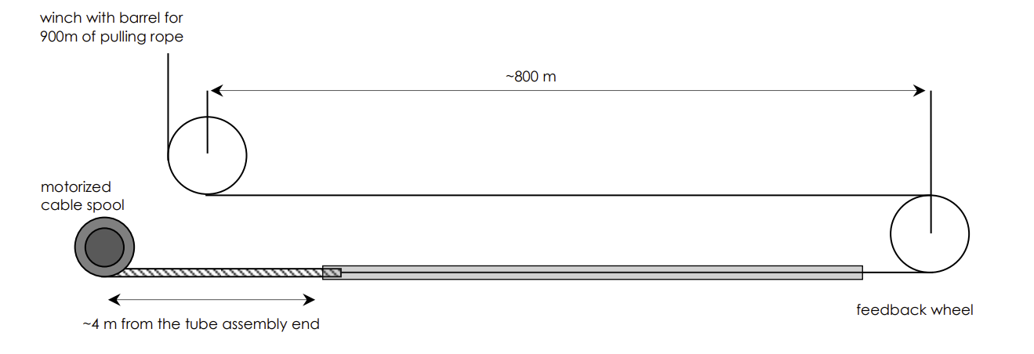
TF conductor: Cable insertion, Criotec
Once the jacket assembly completed, the cable insertion can begin…
The cable is then simply inserted into the conduit by pulling it by means of carbon fiber rope (2-6 m/min).
Maximum pulling force around 40 kN for 760m cable insertion and around 25 kN for 415m cables.

Slide 33
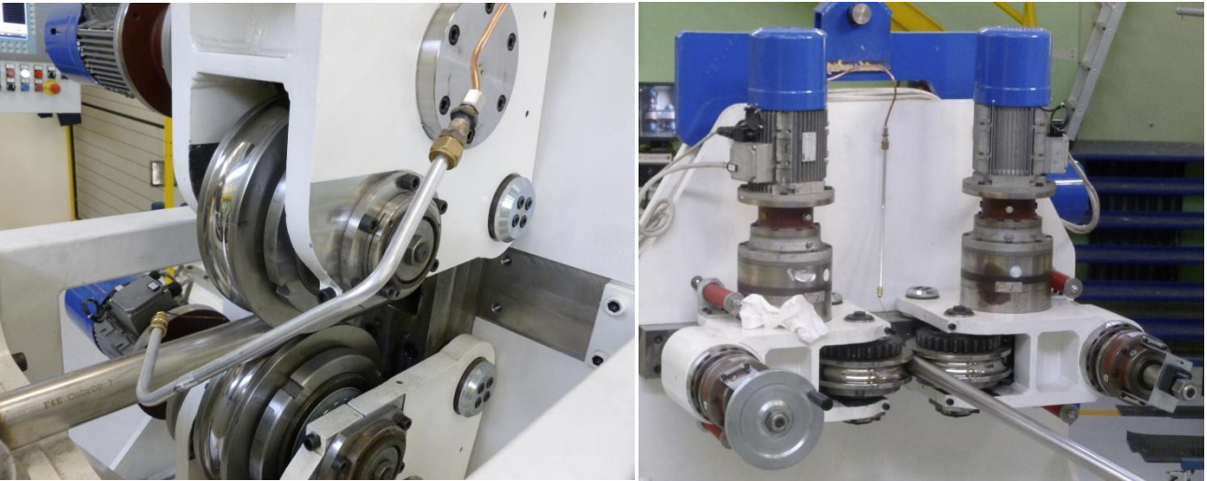
TF conductor: Compaction, Criotec
After cable insertion, conductor compacted by means of dedicated compaction machine consisting of 3 pairs of rollers (first for ovalization, second for compaction, third for shape correction back to circular).
Typical speed for compaction/spooling: 1-3 m/min.
Second pair of compaction rollers
Third pair of compaction rollers

Slide 34
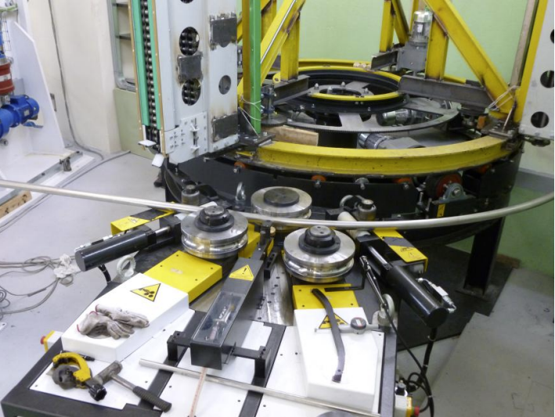
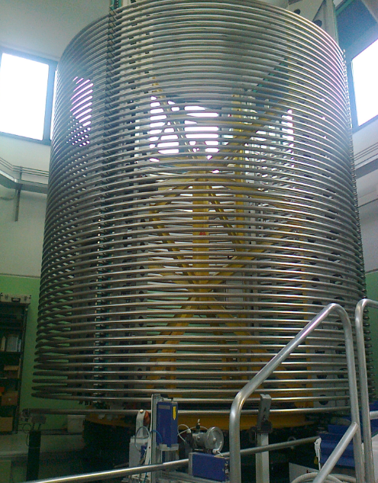
TF conductor: Spooling, Criotec
At exit of compaction machine conductor enters bending machine to be properly curved and spooled (4m inner diameter).
Dedicated bending machine consists of three rollers.
Bending machine for spooling
Final conductor

Slide 35
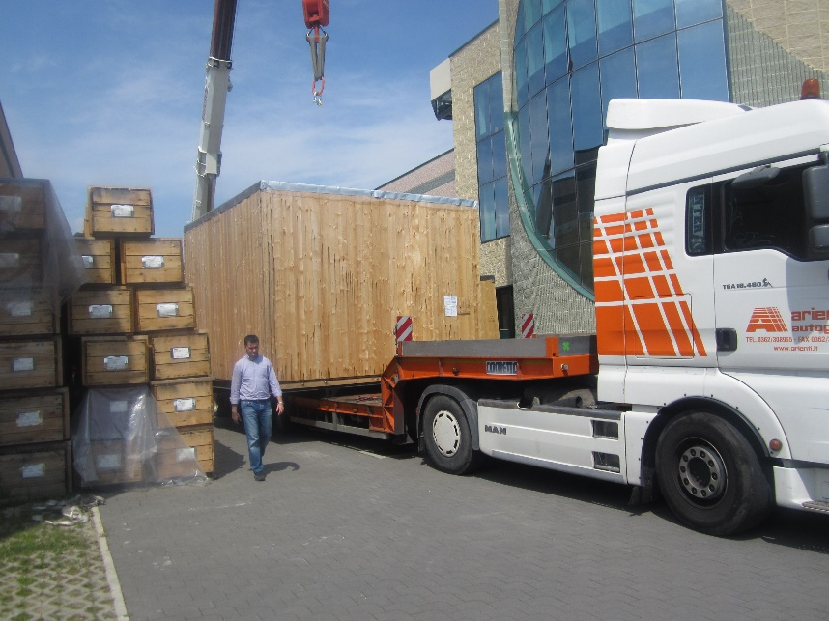
TF final conductor: global tests
After conductor completion, global tests to be performed.
Global tests:
Dimensional cross-check (OD 43.7 ± 0.3mm)
Dye Penetrant testing of welds.
Pressure test (1 hour at 30 bar).
Flow rate and pressure drop measurements
He leak test (30 minutes at 30 bar).
After successful testing of conductor length, conductor transferred to the transportation jig, packed and shipped to ASG, the European TF winding pack contractor.
Final conductor moving to ASG

Slide 36
TF conductor: jacketing challenges
Before ITER project a single long length has been jacketed by Russia. However, no serious technical difficulties for TF jacketing but:
Mechanical properties of jacket: due to longer HT schedule for BEAS conductor, POSCO jacket have a maximum elongation slightly below specification (20 % minimum) for this HT. Therefore, POSCO jacket used for 50 % of the lengths; new jacket supplier SMST has been qualified for second half: elongation of 30 %! But schedule impact of several months (not critical for TF coils)…
Transportation jigs: since no transportation jig foreseen in the ITER technical specification, around a year necessary to agree between all the parties (ITER, F4E, ASG, ICAS) after contract signature.

Slide 37
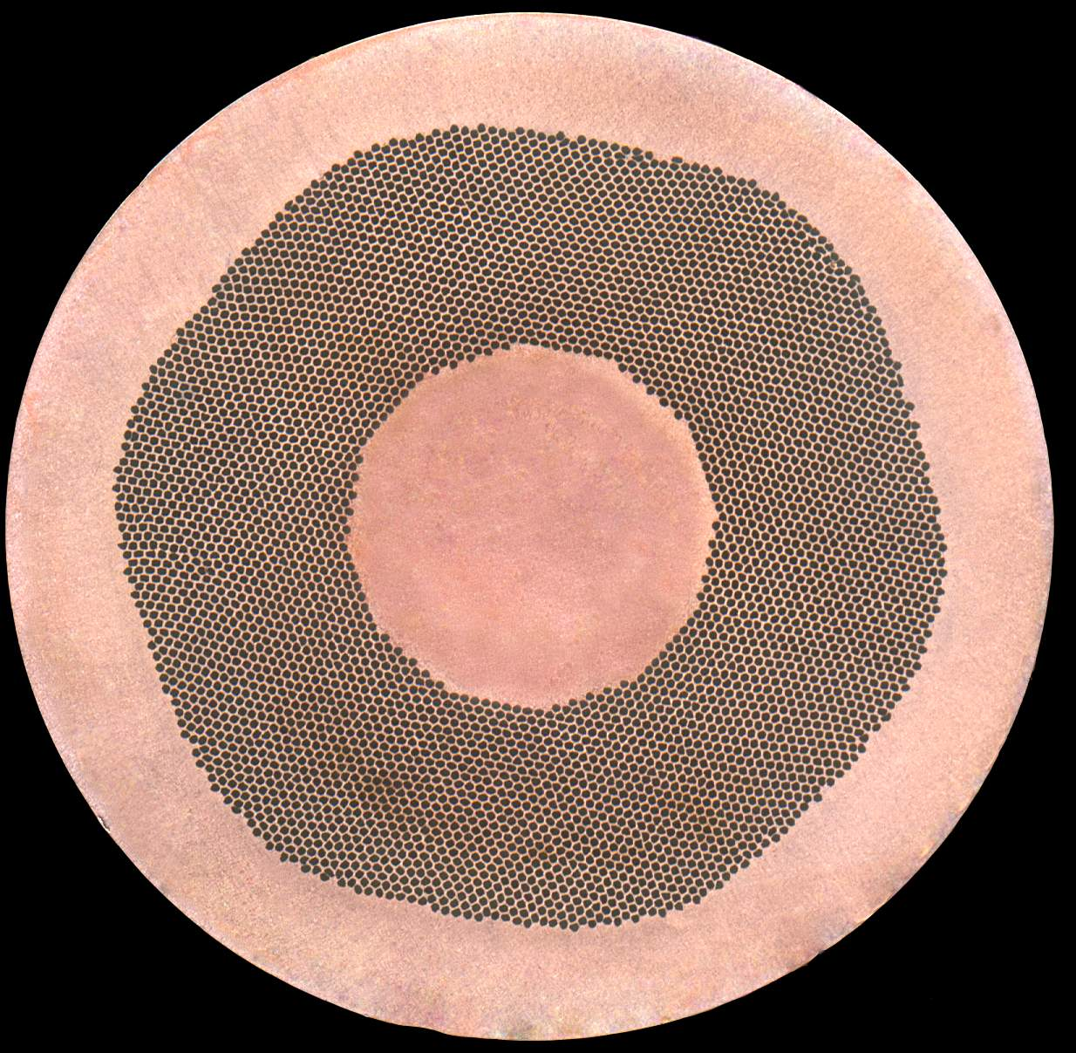
PF conductor: NbTi Strand
Bi-lateral agreement: EU NbTi strand production (45 tons) by Russia.
NbTi Strand manufactured by Chepetsky Mechanical Plant (Glazov, RF) and Ni-plated by VNIIKP (Podolsk, RF).
Strand includes around 4500 NbTi filaments (~7 µm, single stack).
Cross-section view of PF6 NbTi strand (courtesy RF DA)

Slide 38
PF conductor: NbTi Strand
317 billets necessary for the full production.
At beginning of production three billets discarded due to low yield.
However, after ~1 year of production 89% of billets had yield > 80%. End of production: 95% of billets with yield > 85%.
All supplier and verification data within specification!

Slide 39
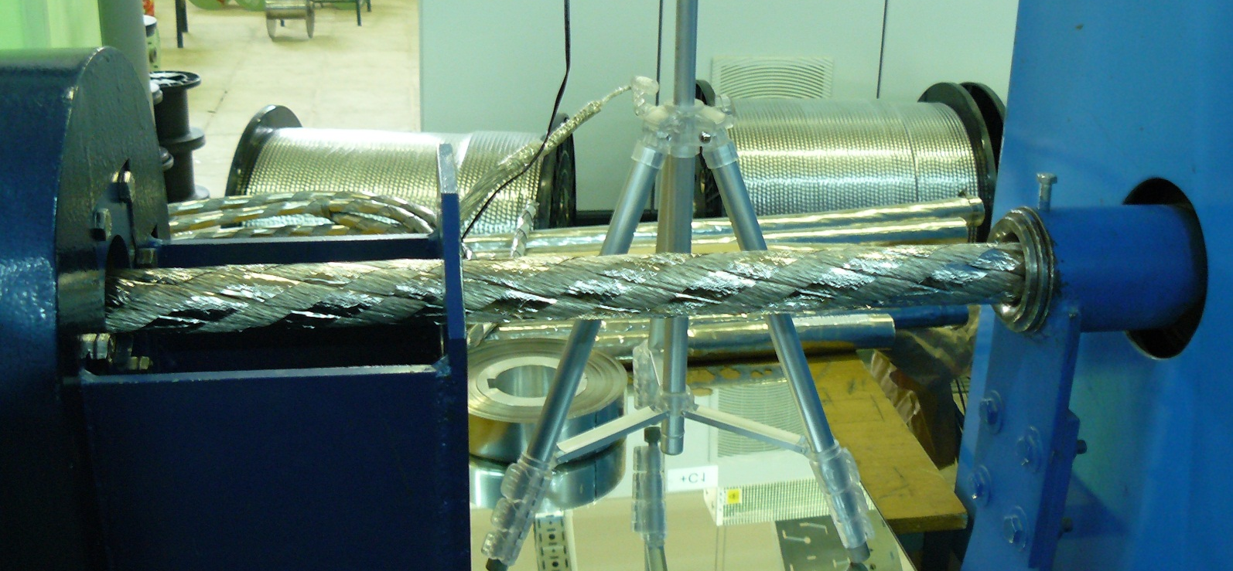
PF conductor: Cables
EU PF6 cables managed by Russia; fabrication of the 5-stage cables at VNIIKP (Podolsk).
Fabrication of 13 EU PF6 cables (3 dummies + 10 production lengths) completed at the beginning of 2013,
No big issue during cable manufacturing.
Final cabling stage of a PF6 length

Slide 40
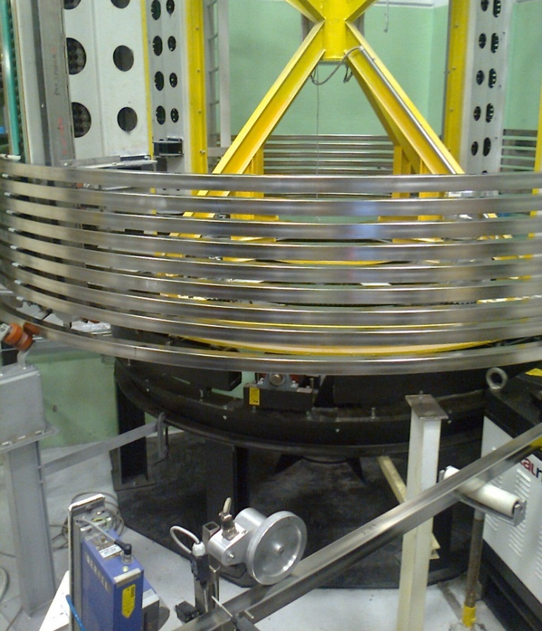
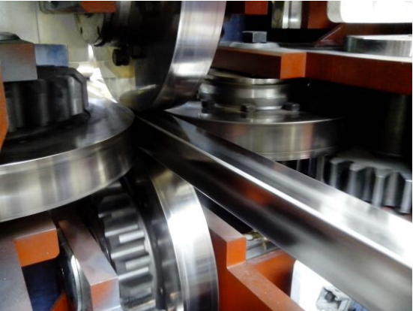
PF conductor: jacketing at Criotec
PF6/PF1 cables shipped to Criotec for insertion and compaction.
Process quite similar to that of TF conductor. Maximum pulling force around 27 kN for PF6 cable insertion.
Dedicated compacting machine for PF1/6 designed to perform the square-to-square compaction (4 rollers).
Compaction (left) and spooling (right) of a PF6 conductor length

Slide 41
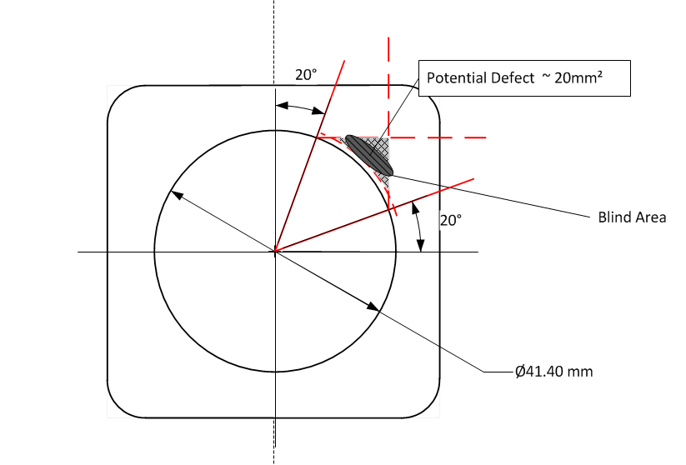
PF conductor jacketing: challenges
Technical challenges
PF jacket Non-Destructive Testing (NDT)
Due to the PF jacket section “round-in-square” geometry and despite intensive efforts, the Phase-Array Ultrasonic Testing (PAUT) had difficulties to detect transverse defects in inner surface corner areas; difficulties shared by CN PF and JA CS.
Therefore, an Eddy Current Testing (ECT) has been added to PAUT. Thanks to collaboration of all parties (SMST, ICAS, ISQ, CERN, IO CT, …) this combined testing provides adequate solution but 2 years, many technical discussions and trials to reach that.

Slide 42
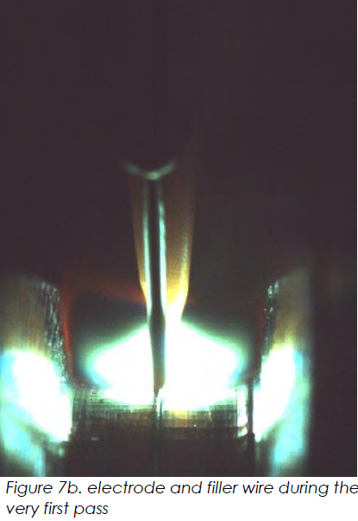
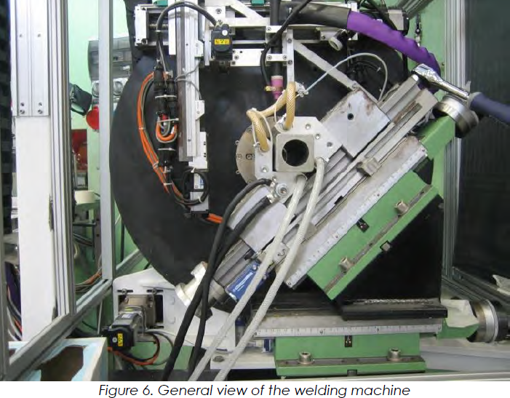
PF conductor jacketing: challenges (2)
PF jacket assembly: welding
The PF jacket welding is a complex process (“round-in-square” geometry). Done with an automatic TIG welding machine. The welding semi-automatic procedure qualification lasted around 1 year.

Slide 43
PF conductor jacketing: challenges (3)
Interface challenges
PF cable storage
Since the PF1/PF6 cabling well in advance regards to jacketing schedule problem of cable storage. Problem solved thanks to an additional storage at ICAS and good will of RF DA/VNIIKP to postpone cable shipments to Criotec.
Transportation jigs
since no transportation jig foreseen in the ITER technical specification, around a year necessary to agree between all the parties (ITER, F4E, RF DA, ASIPP, ICAS).
Difficulties with customs
First shipments of PF6 conductors to China and PF1 conductors to Russia characterized by problems during the customs clearance.

Slide 44
Some lessons from EU ITER conductors
Technical difficulties
Qualification often longer than expected (strand mass production, PF welding),
Be careful with Nb₃Sn strand RRR and with its HT environment!
PF jacket NDT procedure should have been addressed in advance.
Interface issues (international complex project)
Storage crucial (TF strand, cables, conductors): to be accounted for!
Always customs difficulties (OST strand to Italy, PF cables from Russia to Italy, PF1 conductors to Russia and PF6 to China): more efforts to put on customs (dedicated person on project level for example, organization of dummy shipments in advance),
Interface requirements to be well defined to save time and money (TF/PF transportation jigs).

Slide 45
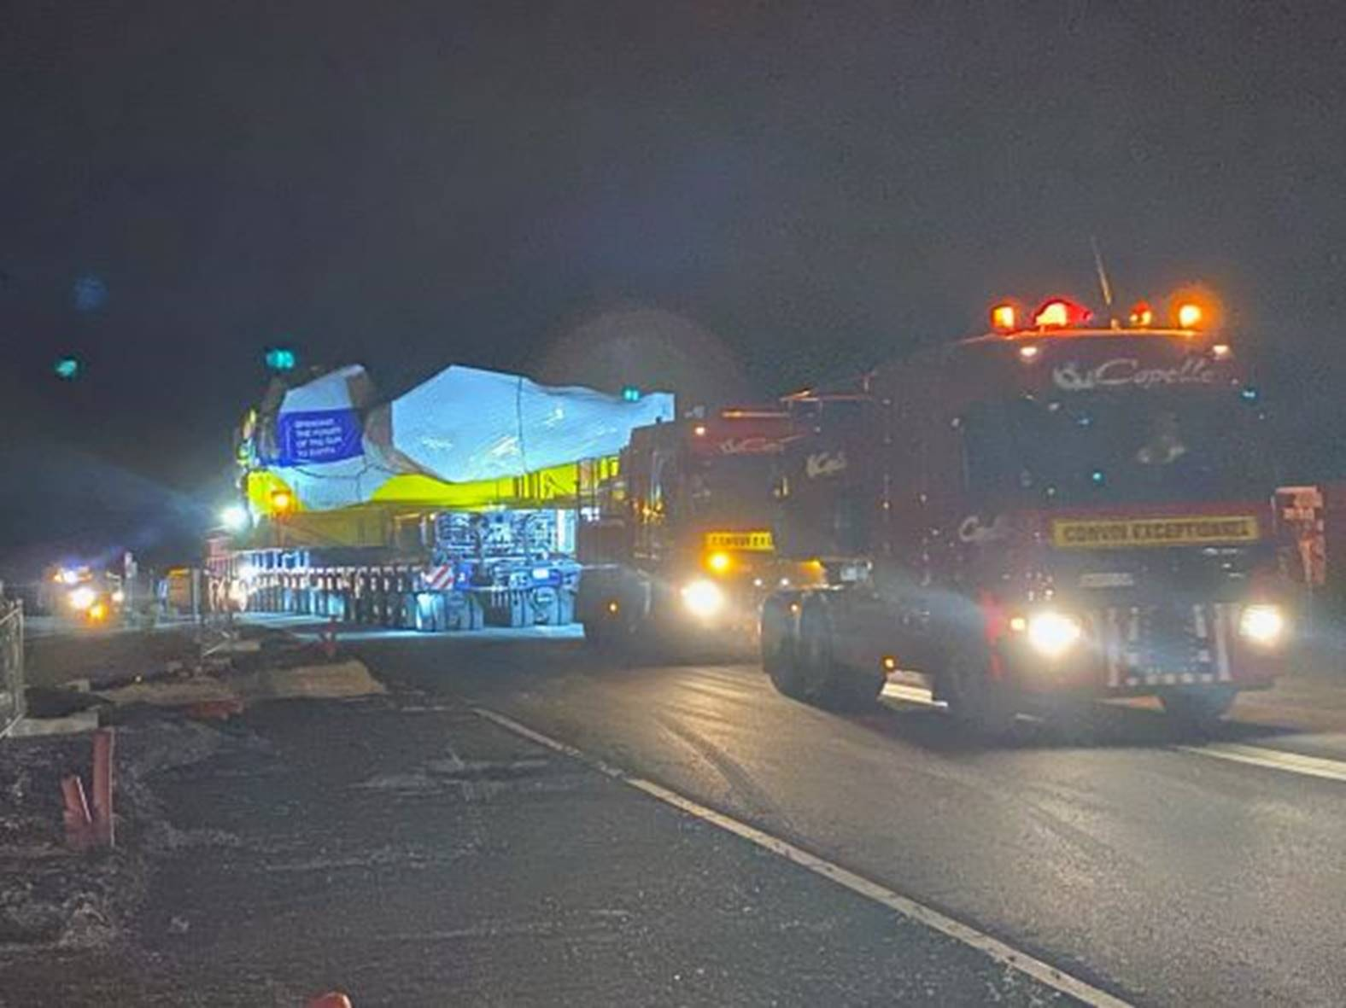
Conclusions
The TF and PF conductor adventure in Europe lasted 9 years (from 2009 with start of strand production to 2018 with the jacketing of last PF1 length for RF) and hundreds of technical visits at suppliers.
All TF conductors already wound in 10 Winding Packs at ASG and 5 out of 10 TF coils completed at SIMIC and delivered to ITER:
5th European TF coil delivered to ITER on 3rd of September 2021

Slide 46
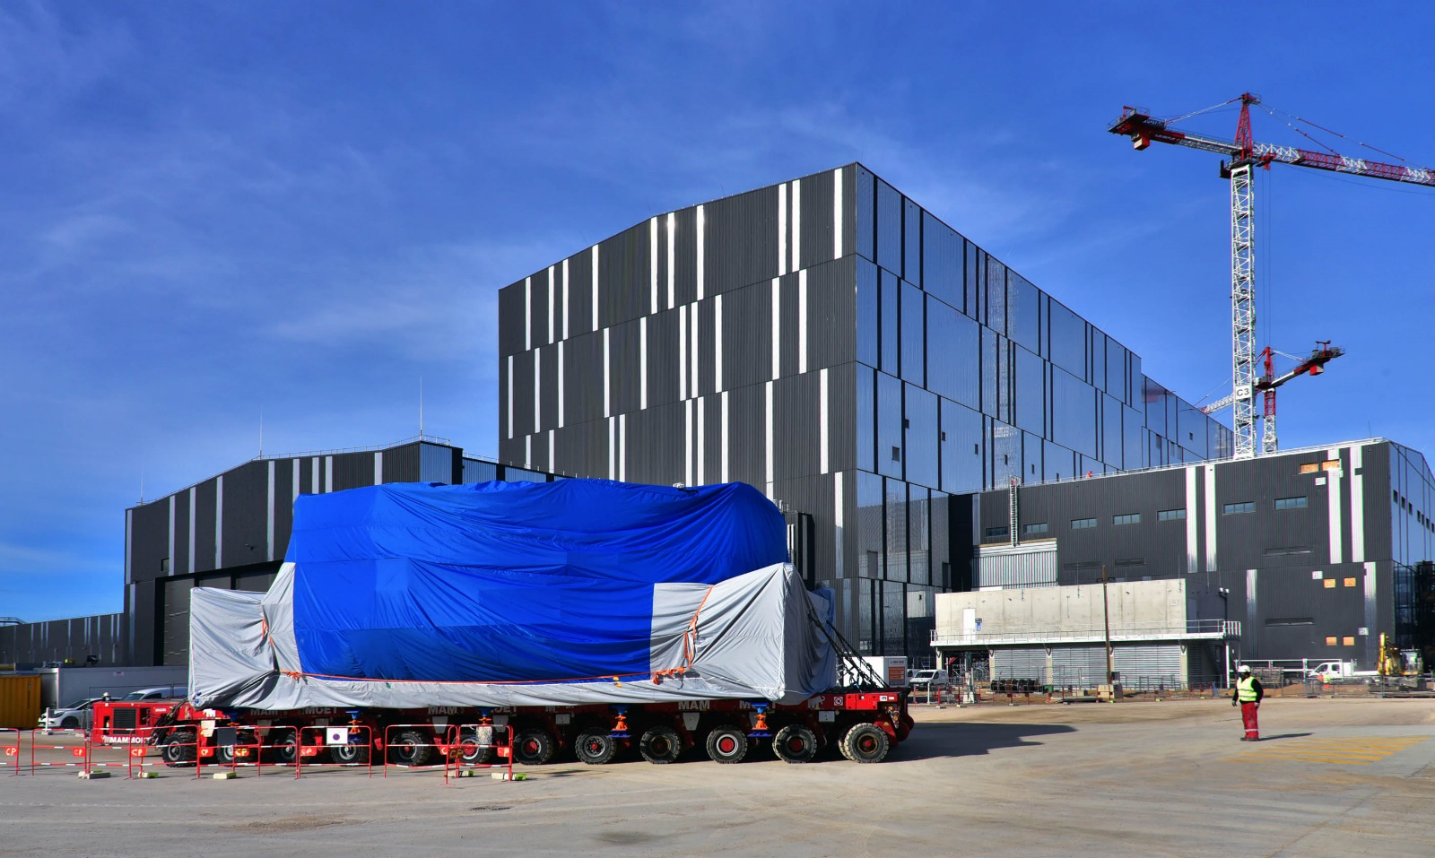
Conclusions
The 18 PF6 lengths have been wound and the PF6 coil manufactured at ASIPP (Hefei, China) following a European-China agreement.
The PF6 coil has been shipped to F4E PF coils building in ITER site for cold testing (80 K) and final assembly, then delivered to ITER in January 2021:
The PF6 coil delivered to ITER in January 2021

Slide 47
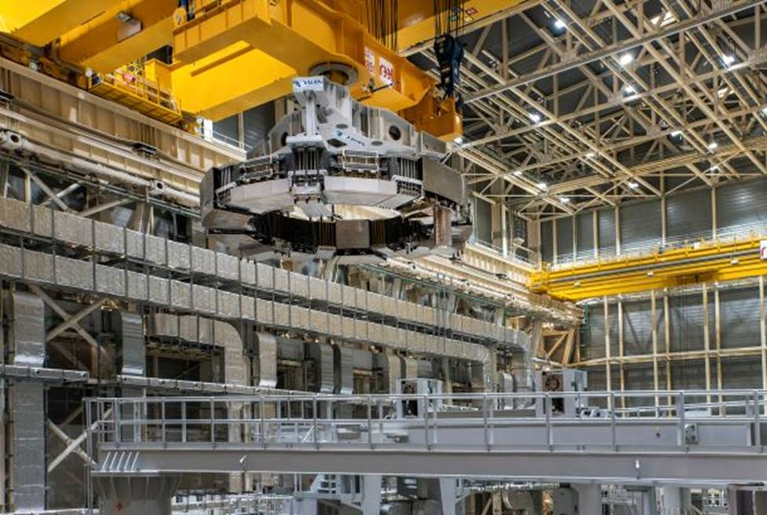
Conclusions
And then, in April 2021, PF6 coil has been lowered into the ITER Tokamak pit
The PF6 coil lifted for insertion into ITER pit in April 2021

Slide 48
Acknowledgments
Last but not least I would like to acknowledge all EU conductor collaborators for their very professional work and collaborative way:
Luvata Pori
OST
BEAS
ICAS including ENEA, Tratos, Criotec, SMST and POSCO
SPC
Durham University
University of Twente
CERN
KIT
ISQ
TWI
RF DA
ChMP and VNIIKP
ITER IO

Slide 49





Thank you for your attention
Follow us on:
www.f4e.europa.eu
www.twitter.com/fusionforenergy
www.youtube.com/fusionforenergy
www.linkedin.com/company/fusion-for-energy www.flickr.com/photos/fusionforenergy

