Slide 1
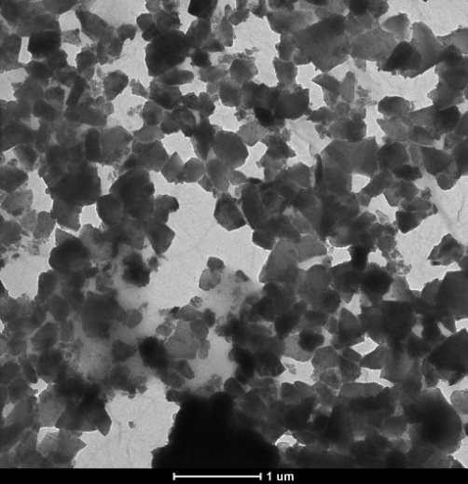
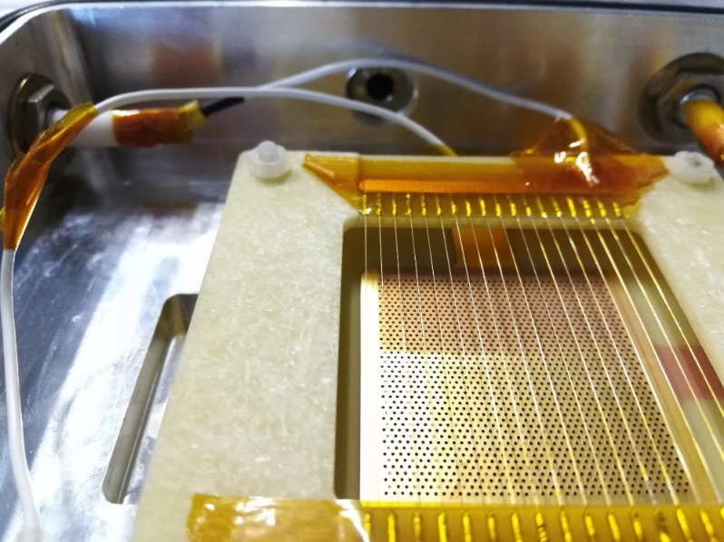
Progress on coupling MPGD-based PDs with nanodiamond photocathodes
Fulvio Tessarotto
  On behalf of the nanodiamond-THGEM group
  (Trieste-Bari-CERN)
Motivation for the R&D
H-ND: production and spray coating
Photoemission measurements
THGEMs with nanodiamond coating
Measurements in different gas mixtures
Aging studies
Conclusions

Slide 2
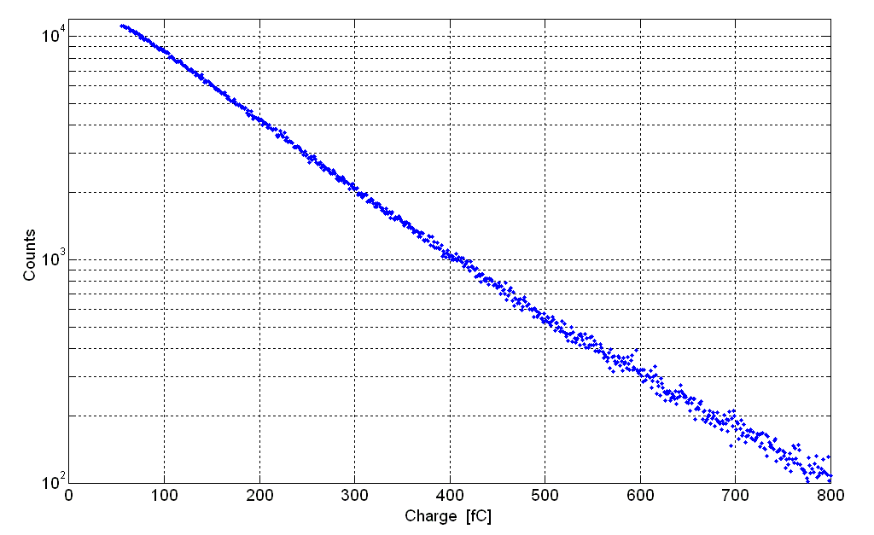
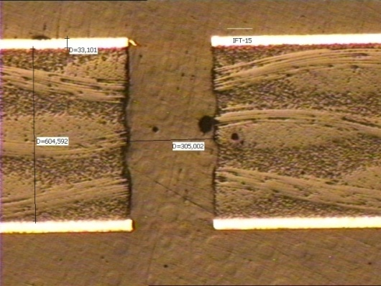
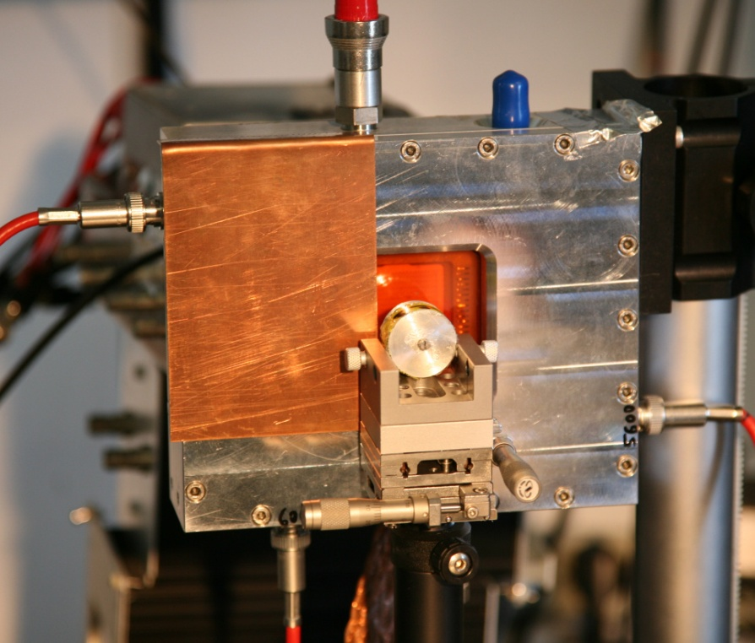
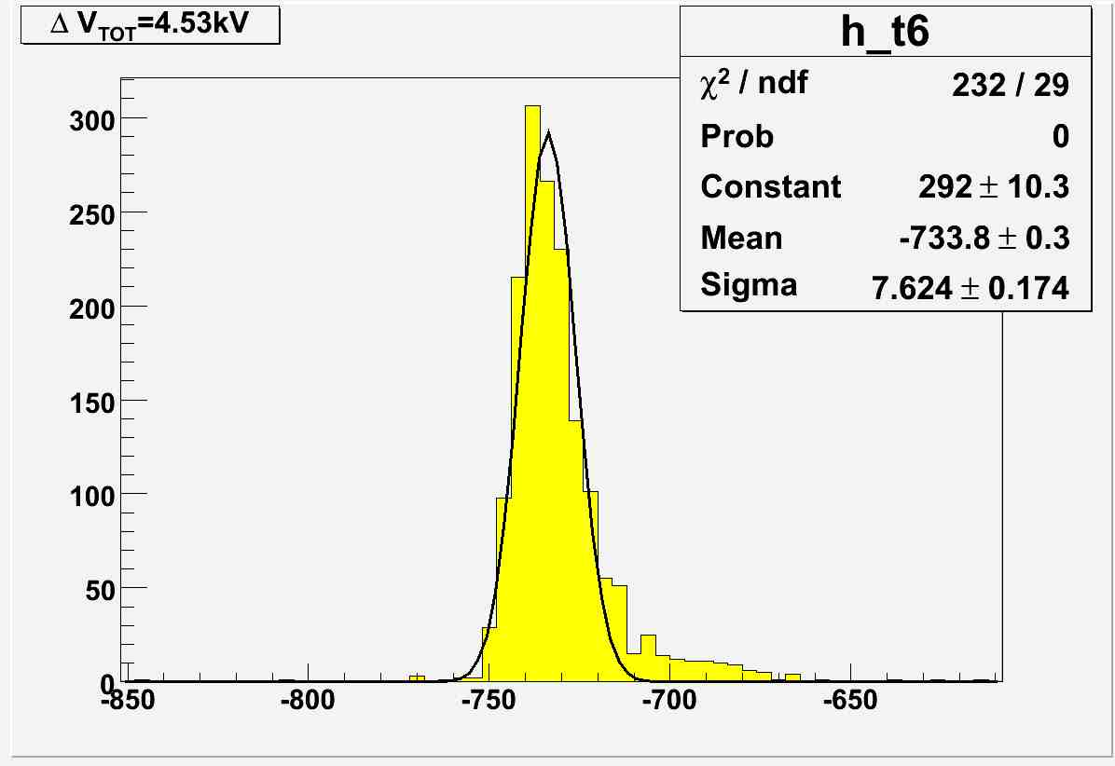
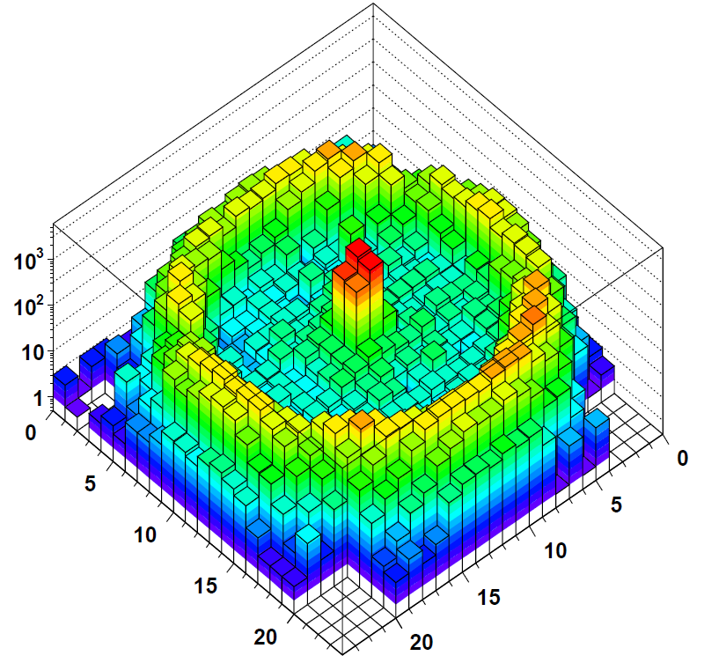
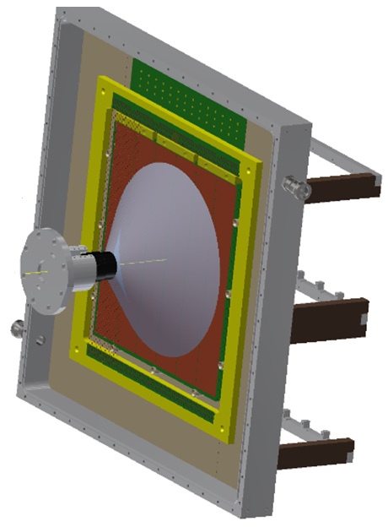
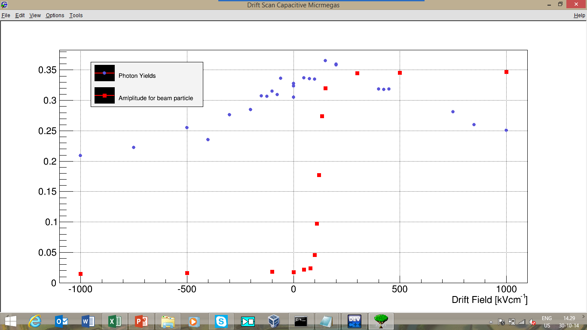
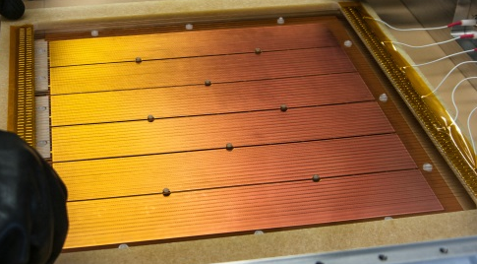
THGEM+CsI: 8 years of dedicated R&D
Effective gain = 0.91 · 10⁶
Ar/CH₄: 50/50
PARAMETERS:
Diam. = 0.4 mm
Pitch = 0.8 mm
Thickn. = 0.4 mm
Rim = 10 μm
Photon yield & Charged Particles vs Drift Field
a. u.
Difficult mastering of the technology to cover very large area: el. stability and reproducibility issues

Slide 3
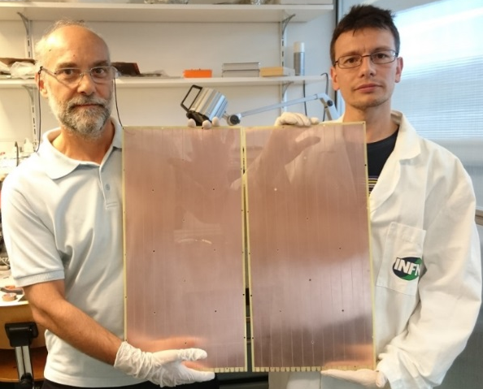
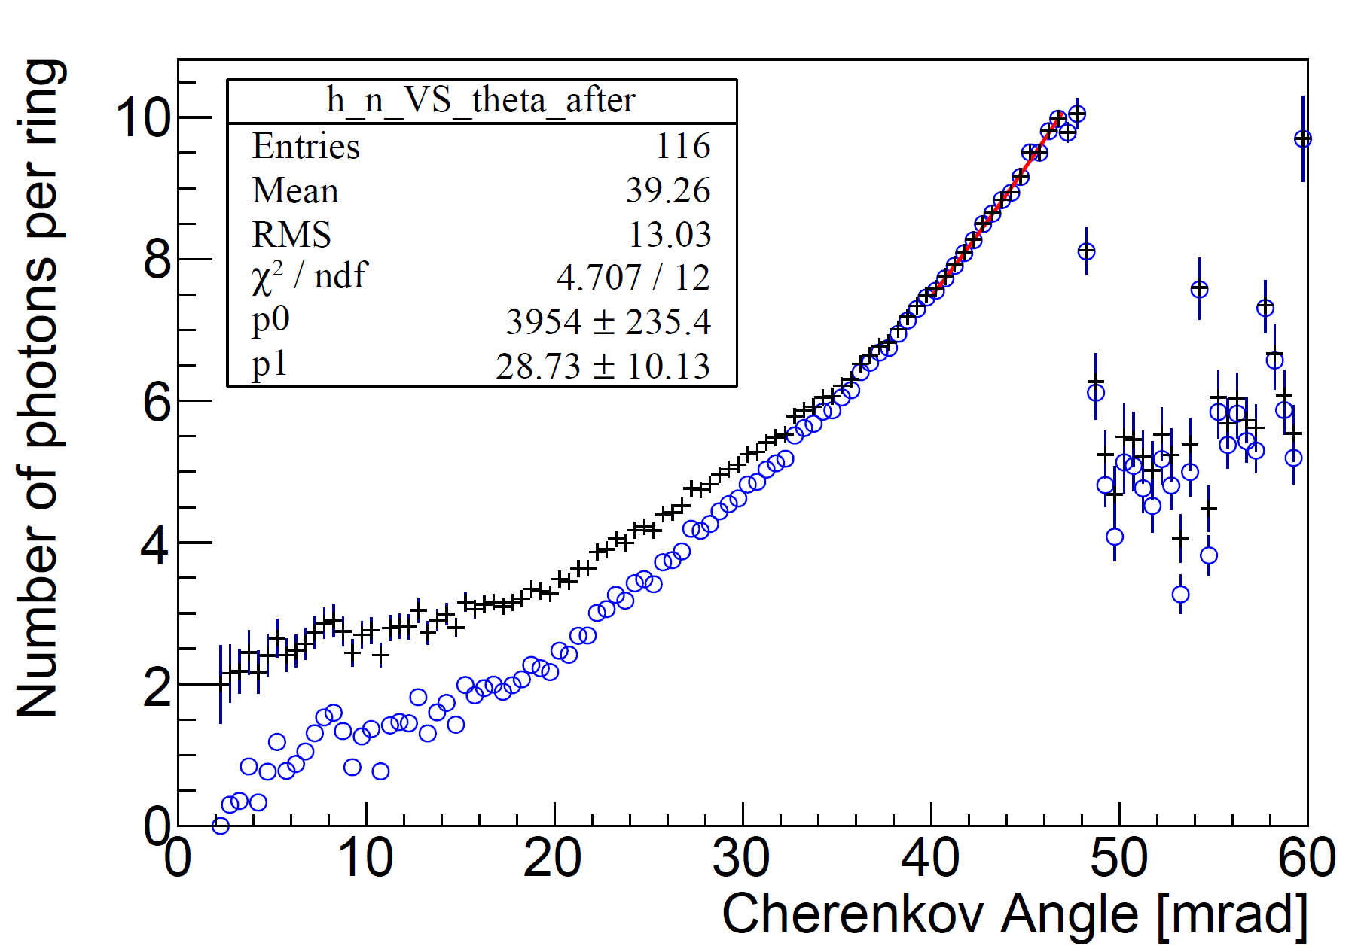


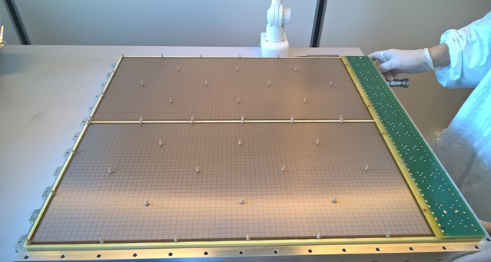
COMPASS Hybrid THGEM+MM PDs
Hybrid PD scheme
IBF = 3%
successfully
implemented in 2016 on
COMPASS RICH-1
active area = 1.4 m²
eff. gain ~ 15000,
gain stability 5% (p/T corr.)
single γ ang. res. 1.8 mrad
THGEMs
CsI
staggered
THGEMs
Standard Bulk Micromegas (CERN)
at ß=1 N_{ph} = 12.9
S = 11.5, B = 1.4
N(ϴ_{Ch}) = p₀sin²ϴ_{Ch}+ p₁ϴ_{Ch}
S. Dalla Torre, NIM A 970 (2020) 163768

Slide 4
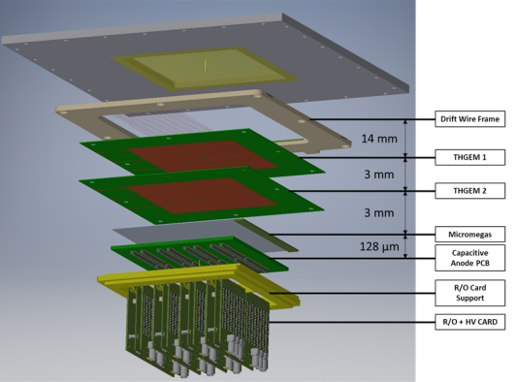
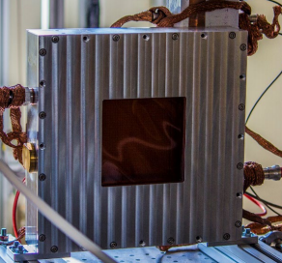
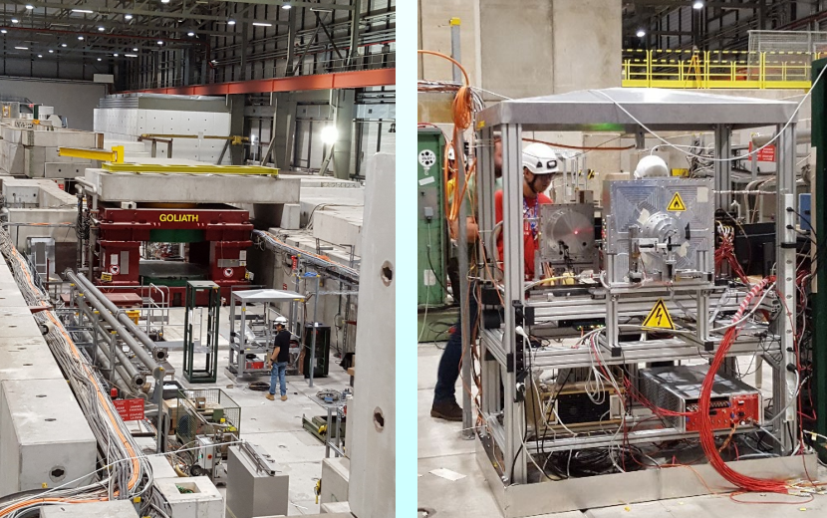
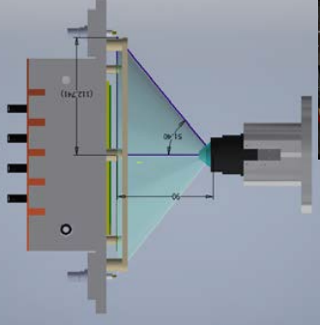
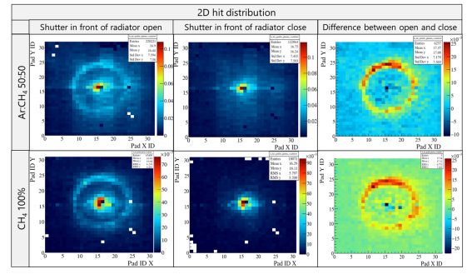
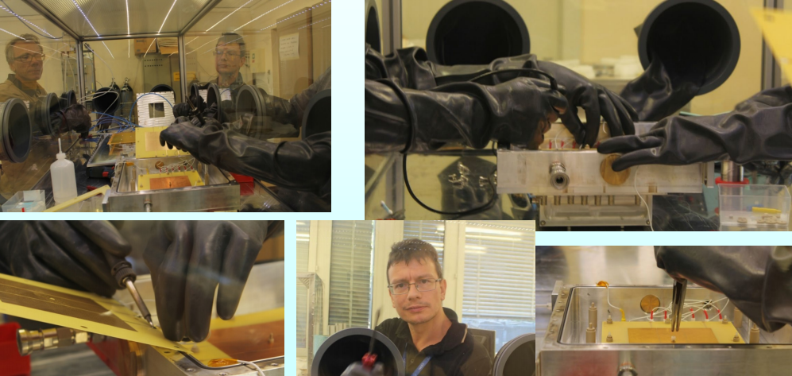
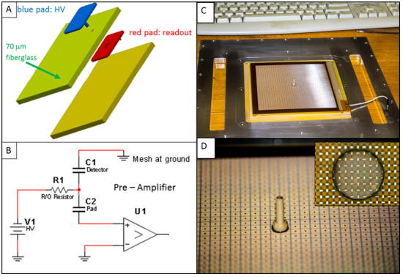
Minipad Hybrid THGEM+MM PDs
Modular Hybrid THGEMs + Micromegas Minipad prototype
“after the positive experience with COMPASS RICH”
Prototype with 10x10 cm² active area.
1024 square pads of 3x3 mm² with 0.5 mm inter-pad space
AIDA-2020-NOTE-2020-006
JINST 15 (2020) C09052

Slide 5
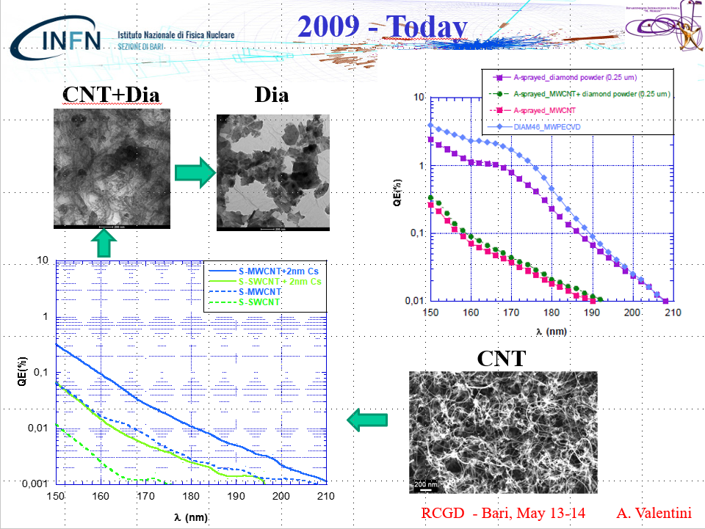
Nanodiamonds: the beginning in Bari
Antonio Valentini studies on carbon nanotubes led to identify diamond nano-grains as the most promising robust and efficient photoconverter

Slide 6
Rich-graphite Nano-Diamond film
CsI bandgap: 6.2 eV; electron affinity: 0.1 eV; hygroscopic; ages by ion bombardment (~mC/cm²)
Diamond bandgap: 5.5 eV; chemically inert and robust; if hydrogenated: electron affinity -1.27 eV
Hydrogenated chemical vapor deposited diamond films (4-6 μm) known to have QE ~15% @ 140 nm.
47 %
Heterogranular-structured diamond-gold nanohybrids proposed as stable field emission cathode material
Nano-Diamond grains (size: ~250 nm), with variable sp² (graphite phase) and sp³ (diamond phase) hybridized carbon contents treated in H2 microwave plasma show large QE: >40% @ 140 nm
L.Velardi, A.Valentini, G.Cicala, Diamond & Related Materials 76 (2017) 1
Photocatodes: diamond film obtained with Spray Technique
Spray technique: T ~ 120° (instead of ~800° as in standard techniques)

Slide 7
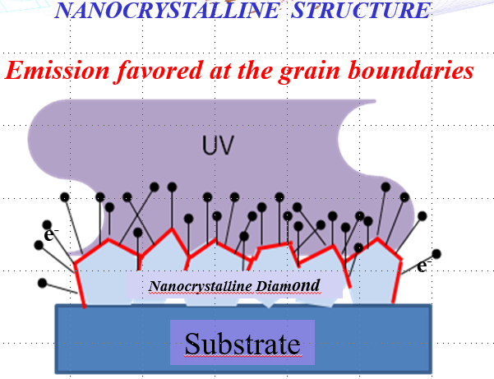
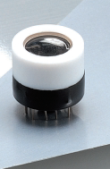
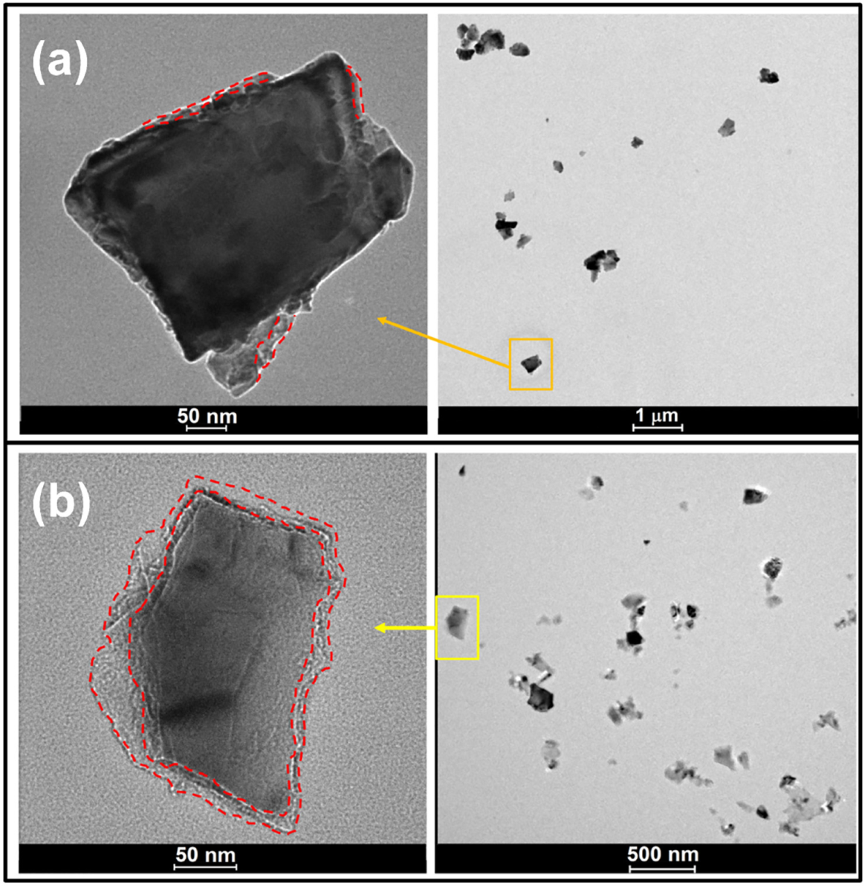
Nano-Diamond Q.E.
Phototube
Hamamatsu
Hydrogenated powder
Hydrogenated powder
Phototube Hamamatsu
As received ND powder
PCD_MgF2
Photocathode area φ 6 mm
Spectral response 110÷ 220 nm
L. Velardi, et al
Diamond & Related Materials 76 (2017) 1–8

Slide 8
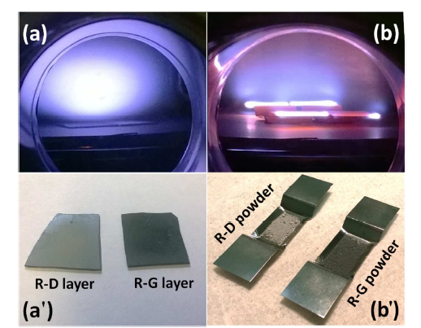
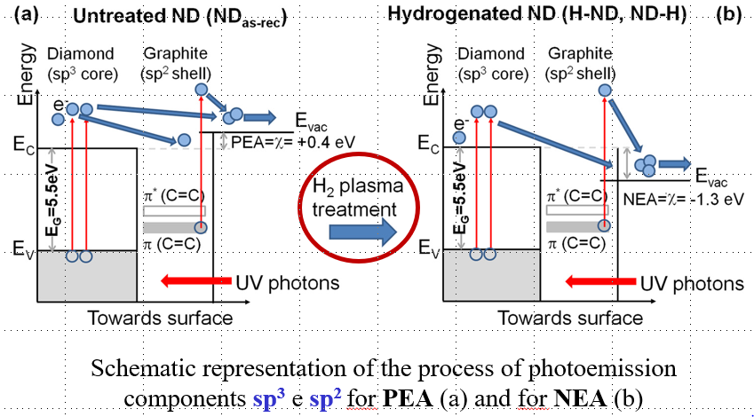
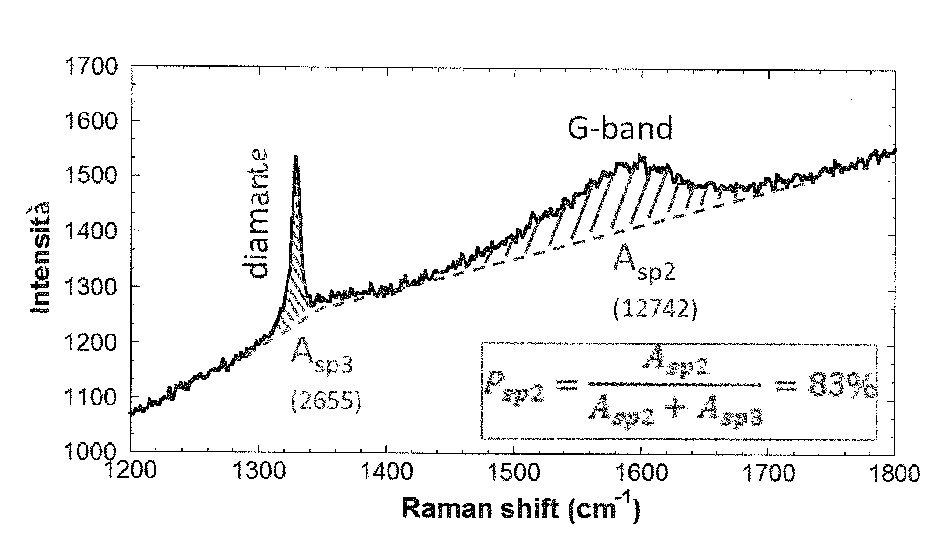
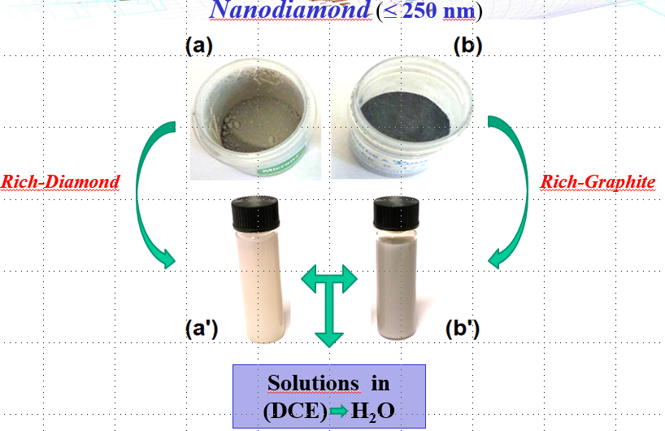
Hydrogenated Nano-Diamond

Slide 9
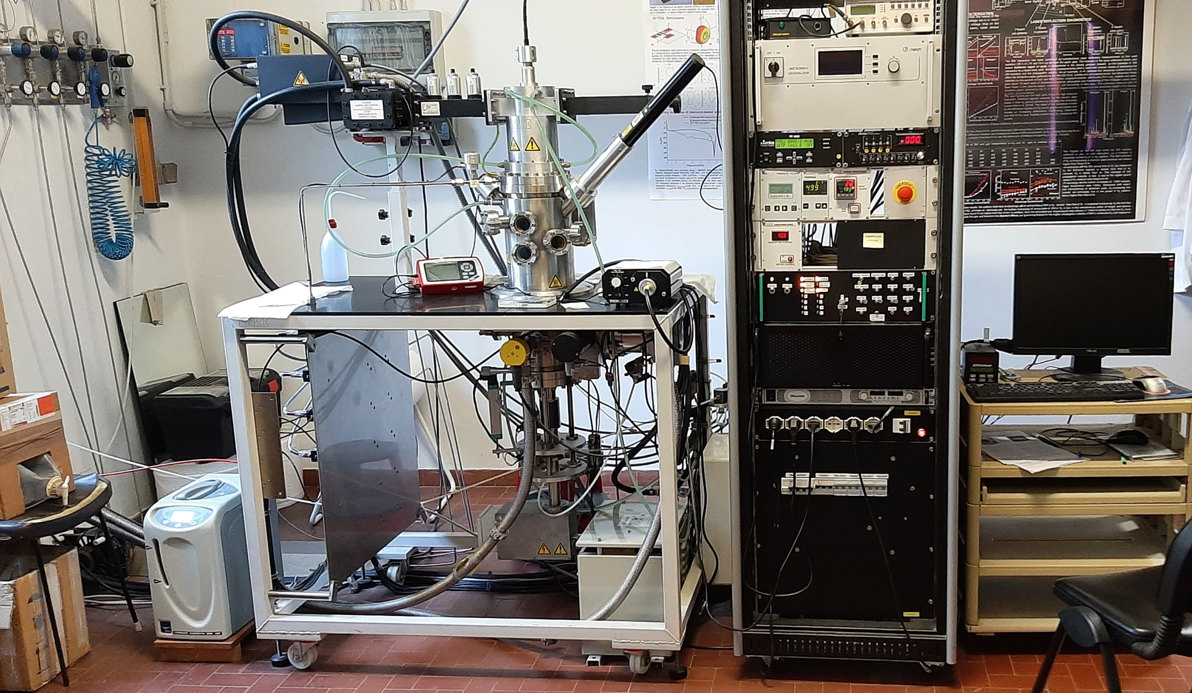
Hydrogenation: MWPECVD setup in Bari
Hydrogenation details:
Vacuum: ~6.5x10⁻⁶ mbar.
70 mm between H₂ source and ND powder.
H₂ gas generated by electrolysis from distilled water. H₂ gas flow rate controlled to 200 sccm.
Hydrogenation of ND powder: 1 hour at 43 mbar.
1380 W microwave power → 1000 ⁰C temperature with 830 ⁰C substrate holder temperature.
1250 W microwave power → 810 ⁰C temperature with 650 ⁰C substrate holder temperature.

Slide 10
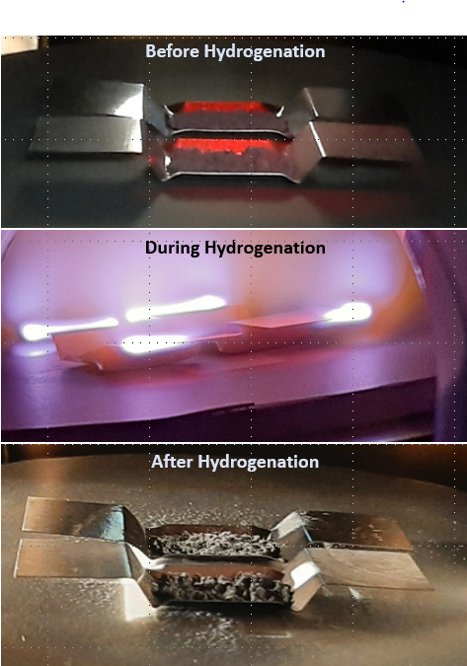
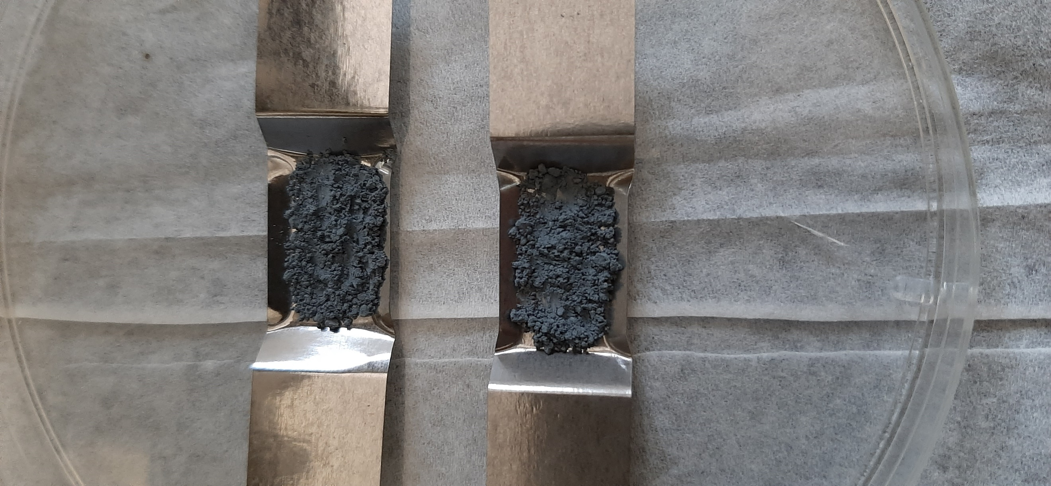
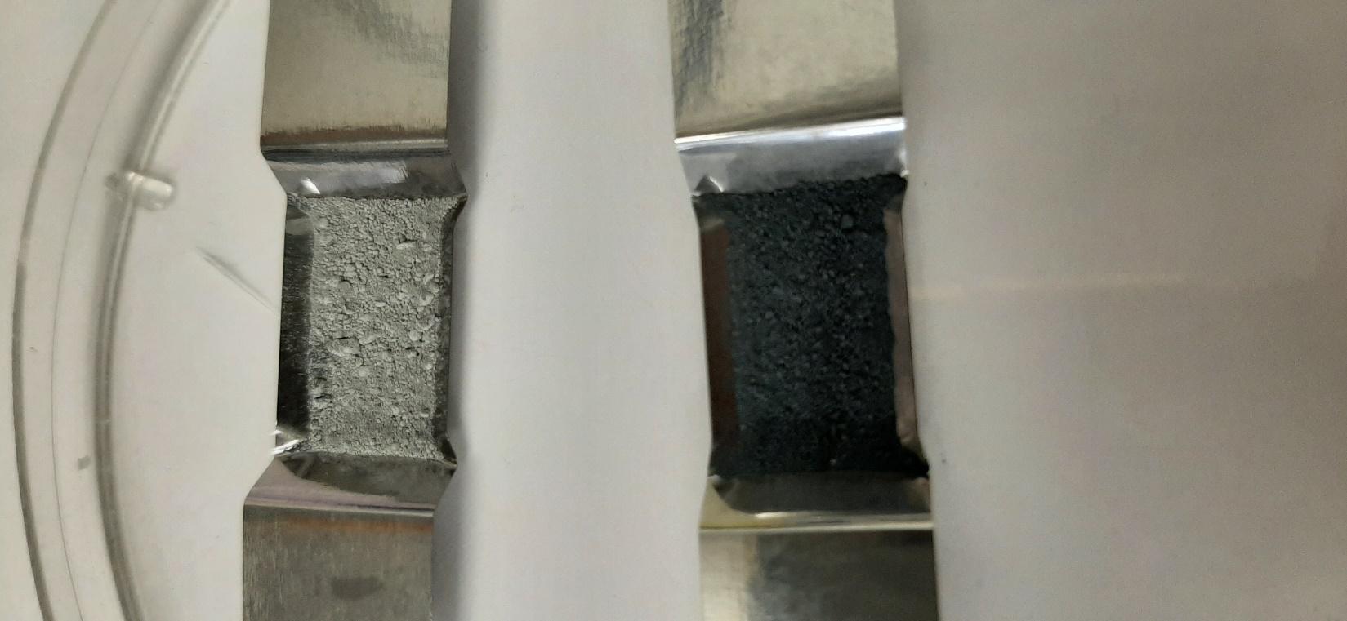
Different ND and H-ND
As-Rec_ND_BDD 0.5 Micron
Hydrogenated_ND_D&T
Hydrogenated_ND_E6

Slide 11
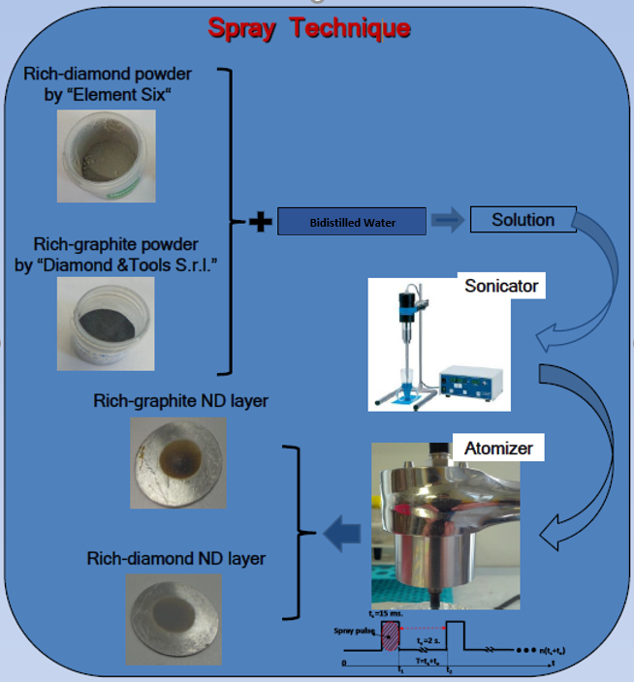
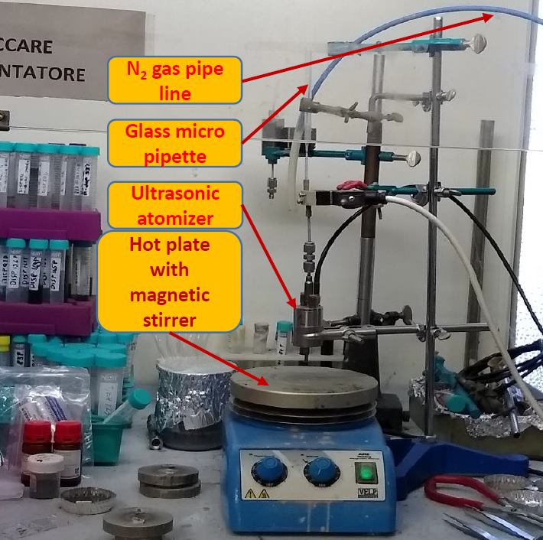
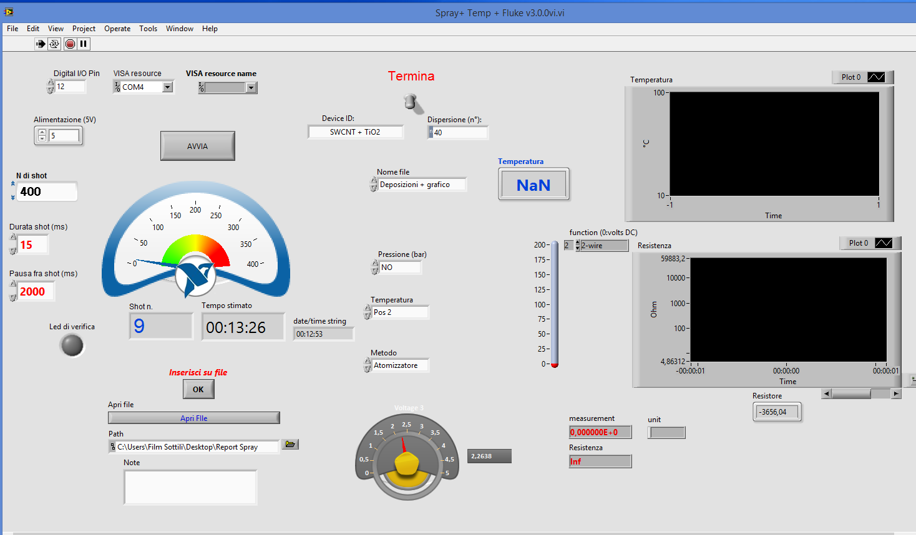
Pulsed spray coating in Bari
Low Temperature Deposition ( ≤ 120 °C)
Good reproducibility technique
Scalable to cover large areas
Spray Control Interface

Slide 12
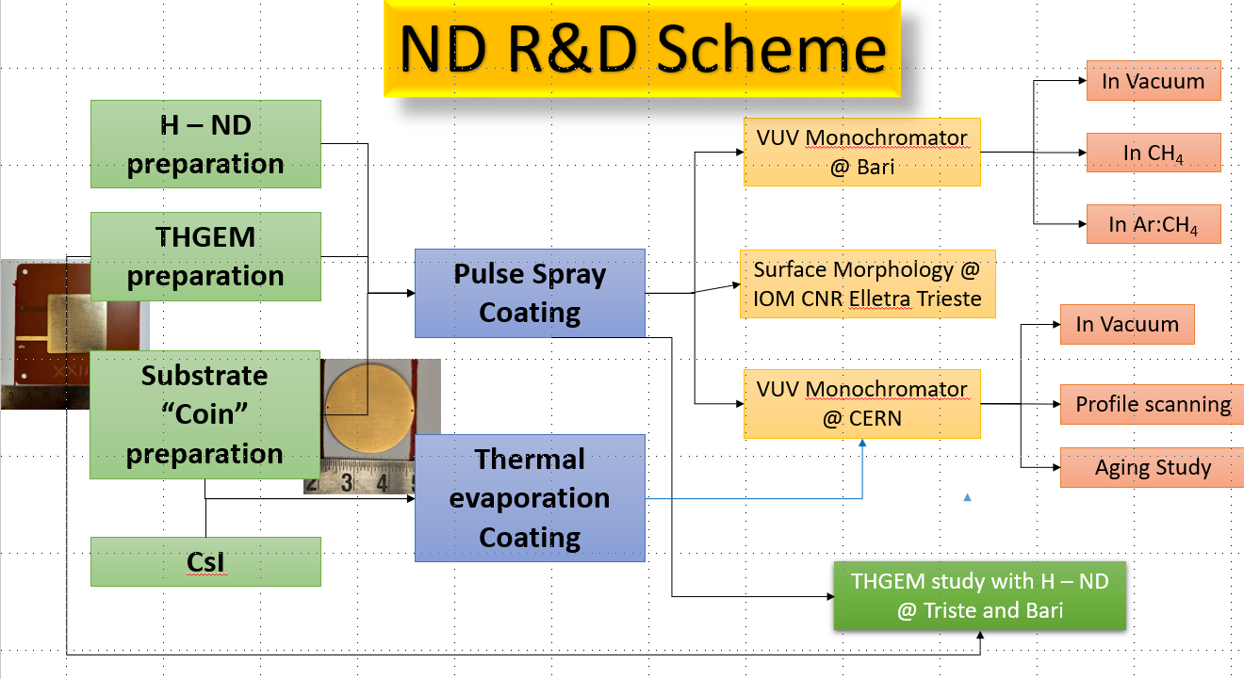
Basic questions about H-ND and TGEM coupling
Is the H-ND layer on the THGEM:
- Reducing the electrical stability?
Changing the gain response?
Providing the same PDE as on PCBs?
Uniform and stable?
- More robust with respect to CsI?

Slide 13
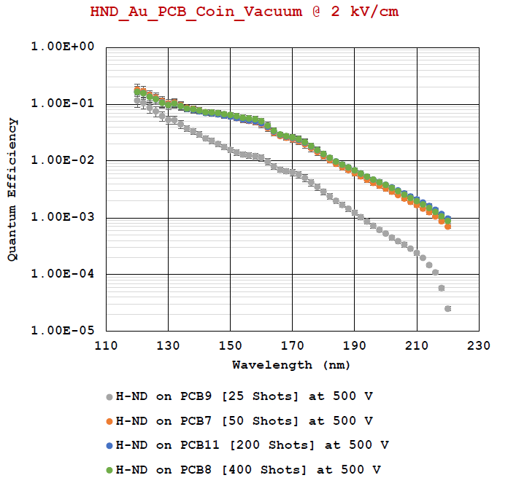
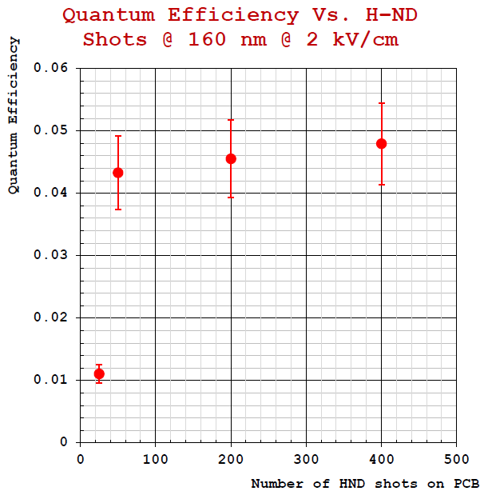
“Thickness” study
Sufficient surface coverage is reached with “100 shots” thickness

Slide 14
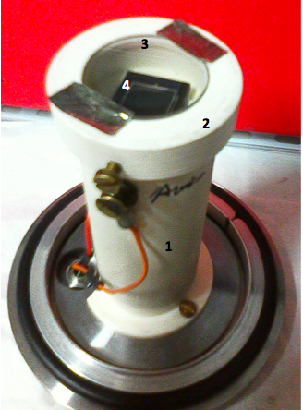
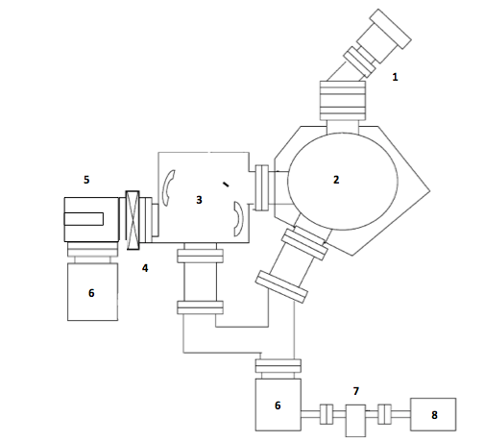
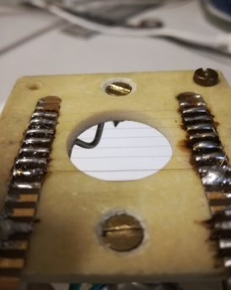
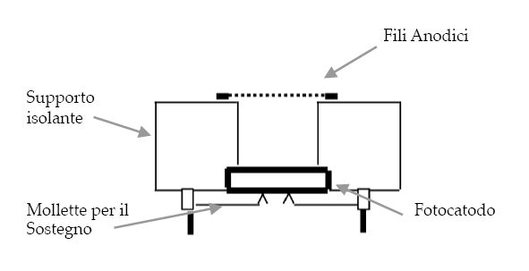
Q.E. measurement setup in Bari
Deuterium Lamp
Lock
Gate
Collimator
NIST Photodiode
Monochromator
NIST PD
or
Photocathode
Trap
Multiwire Proportional Chamber(MWPC)
Anodic wires
Insulating support
Turbo Pumps
RotativePump
Support clips
Photocathode

Slide 15
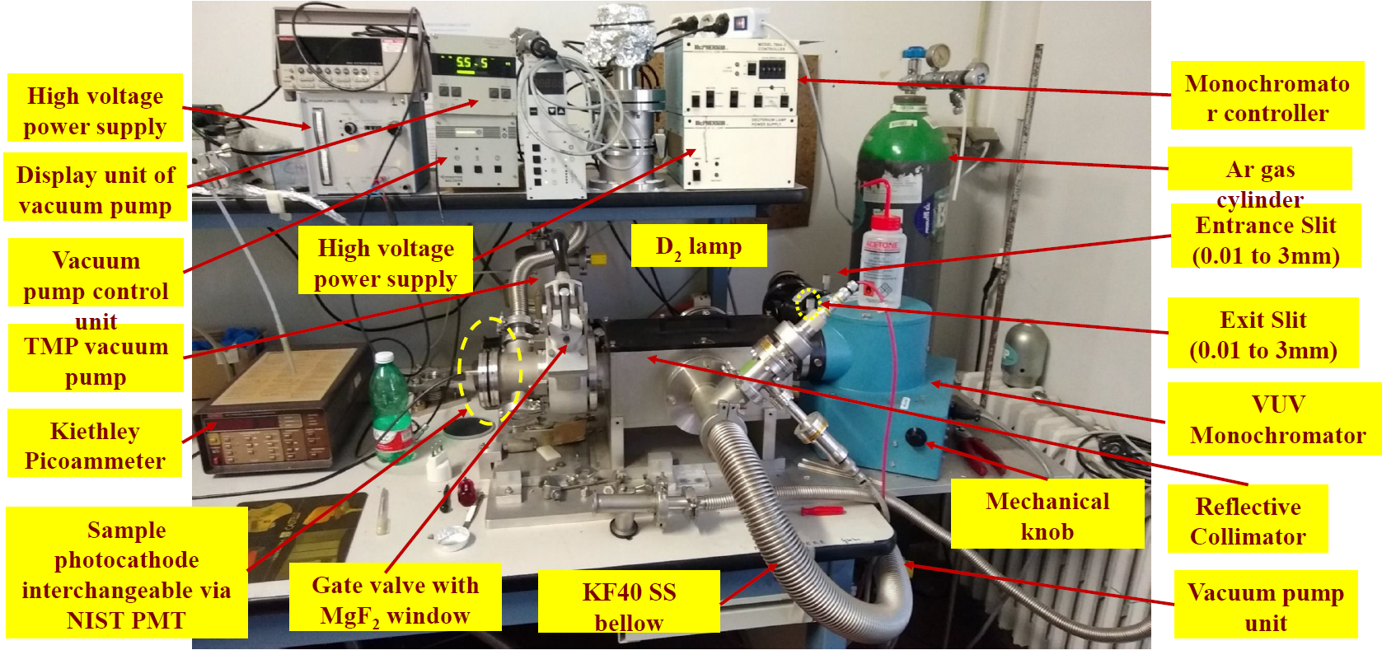
Q.E. measurement setup in Bari

Slide 16
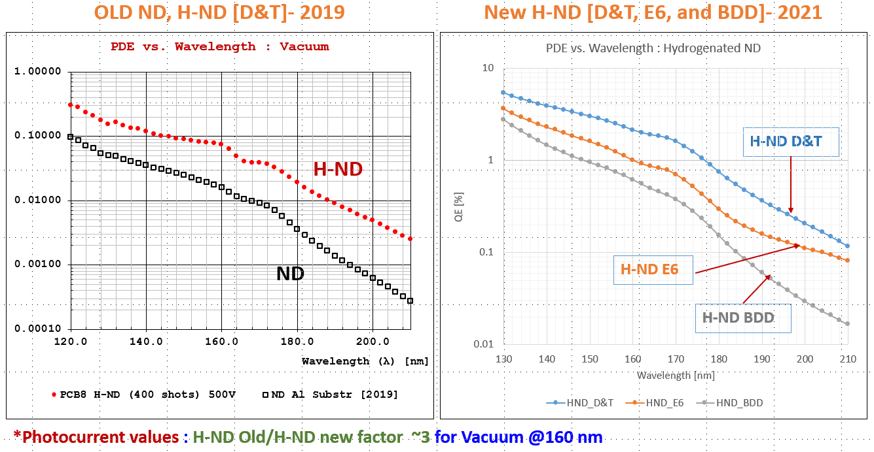
Photoemission of different NDs and H-NDs

Slide 17
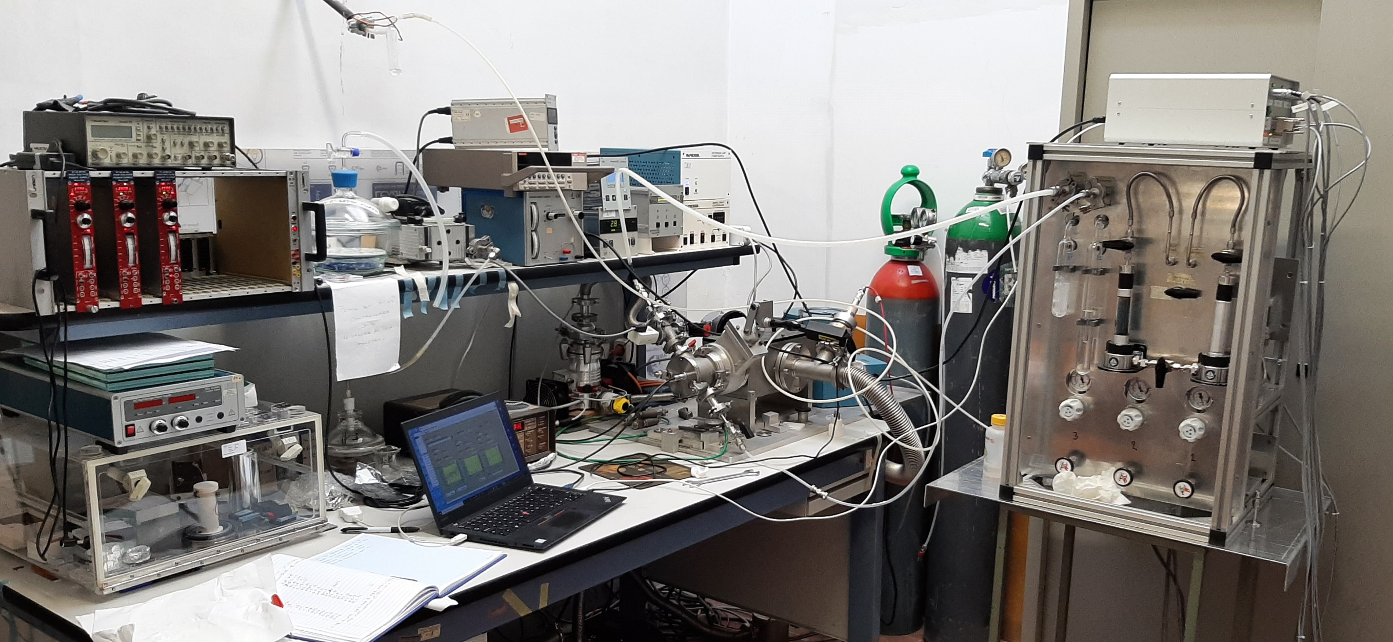
Q.E. measurement setup with gas
ATEX compliant gas mixing unit

Slide 18
Photocurrent vs λ in Ar/CH₄ gases

Slide 19
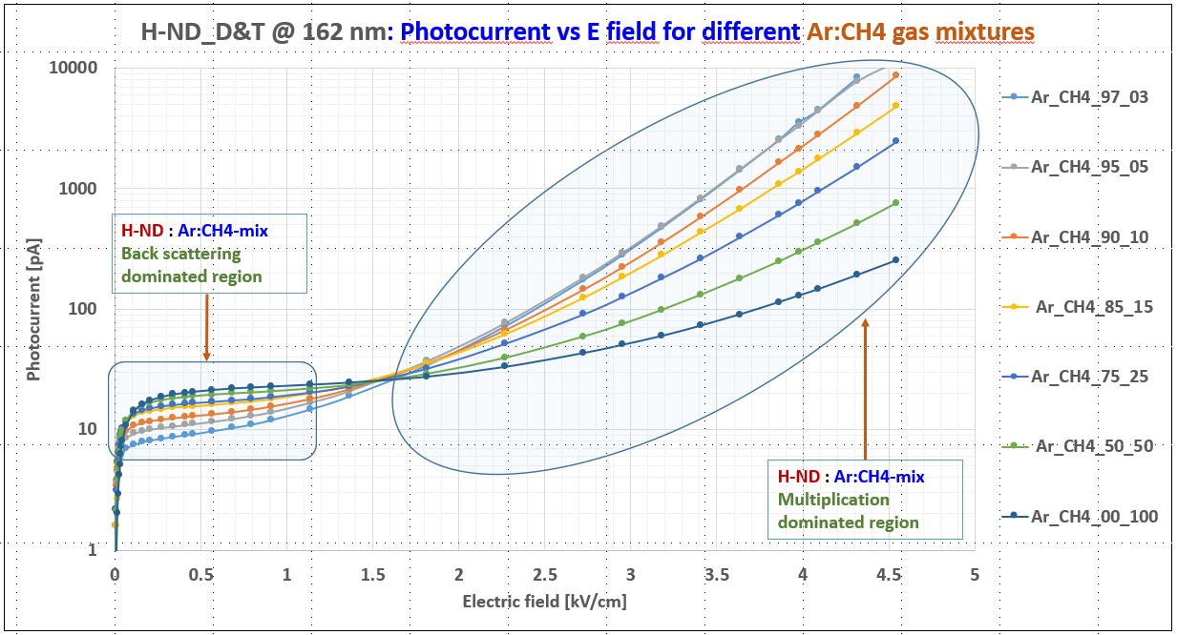
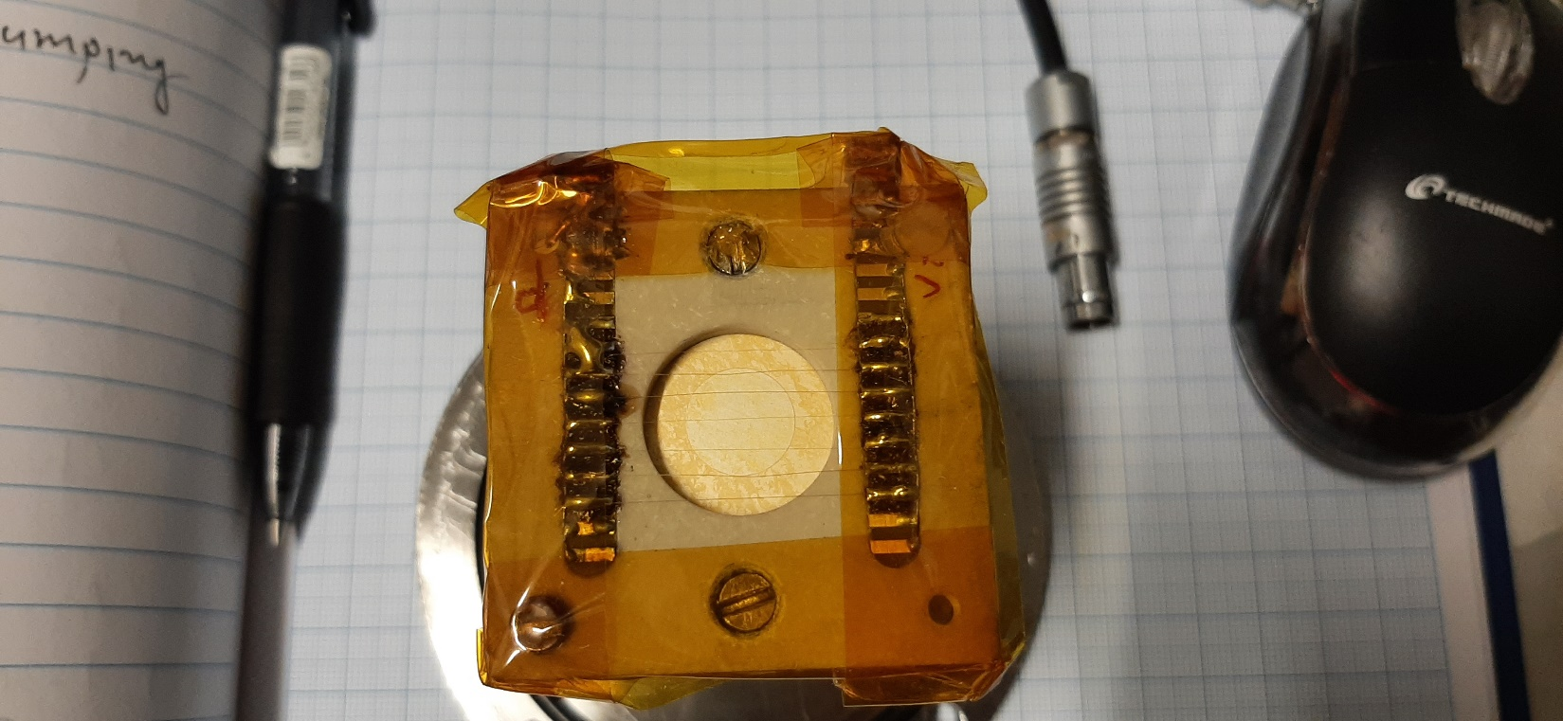
λ = 162 nm
H-ND D&T
Photocurrent vs electric field
Substrate holder for
photocurrent measurement
Gap between substrate and electric wire: 4.4 mm.
Scan performed with MgF2 window in vacuum and various Ar:CH₄ gas mixtures

Slide 20
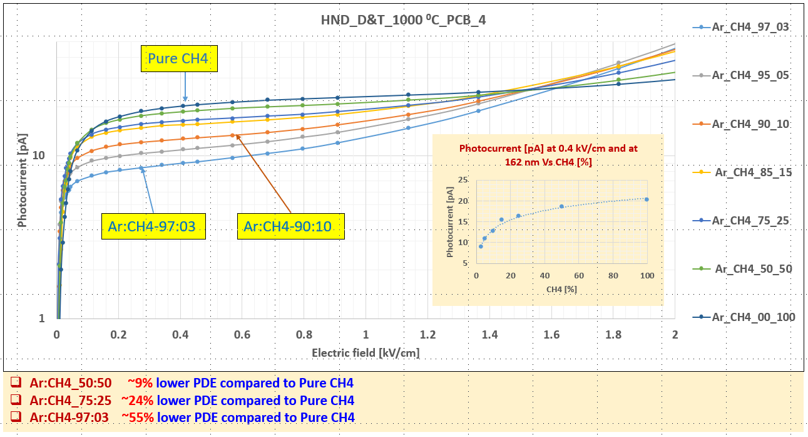
Photocurrent vs E in Ar/CH₄ gases

Slide 21
ASSET at CERN RD51 Lab
Aging tests performed thanks to the possibility to irradiate the sample inside the setup

Slide 22
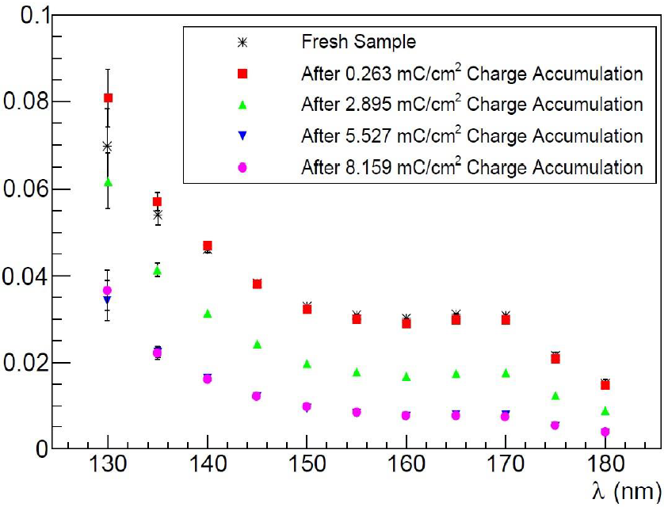
First aging measurements
Q.E.
preliminary indication:
H-ND is at least ten times more robust than CsI
against irradiation and ion bambardment
300 nm CsI
H-ND D&T

Slide 23
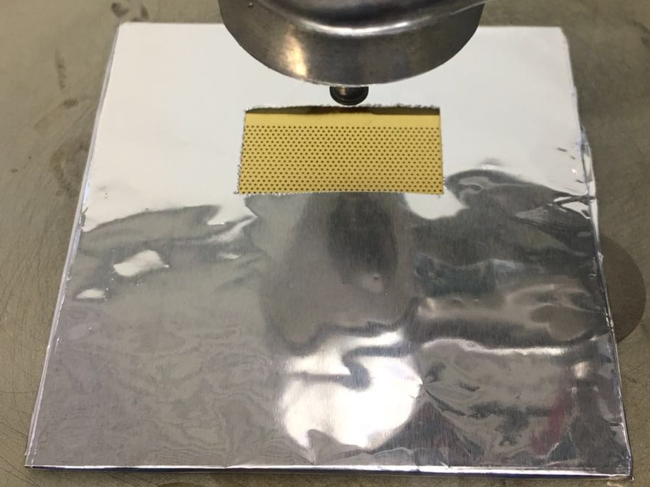



THGEMs + H-ND
First trial of THGEM + H-ND not successful: coated THGEMs lost electrical strength.
Second trial: both full and half-coated THGEMs

Slide 24

THGEMs H-ND
First results were puzzling:
Systematic studies: 15 THGEM samples characterized
J. Agarwala, et al.
Nuclear Inst. and Methods in Physics Research, A 952 (2020) 161967

Slide 25



THGEM characterization
Full characterization including charging up measurements before and after H-ND coating
Voltage Applied:
Drift = 2250 V
T_top = 1750 V
T_bot = 500 V
Anode = 0 V
Gas Mixture:
Ar = 70 %
CO2 = 30 %
@ 10 l/h flow rate
X-ray Source:
Fe-55
THGEM active area:
30 mm x 30 mm
Electronics used:
CAEN N1471H HV PS
CREMAT CR-110 Pre Amp
ORTEC 672 Amp
CREMAT CR-150 Eva Board
AMPTEK MCA 8000A

Slide 26

THGEMs are H-ND compatible
heat treatment after coating
and p/T corrections + charging-up are essential
The response of THGEMs as electron multipliers is unaffected by H-ND coating

Slide 27
CONCLUSIONS
Exploratory investigation on H-ND photocathodes
  Promising values of Q.E. in the far UV but no clear reproducibility.
  High robustness against moisture, light irradiation, ion bombardment
Perspective of coupling H-ND with THGEM-based PDs
  Full compatibility (same electron multiplication response if correctly coated)
  Systematic study for gas, HV config. and detector geometry started
Potentially interesting for windowless gaseous PDs, Picosec, fire detection, …

