Slide 1
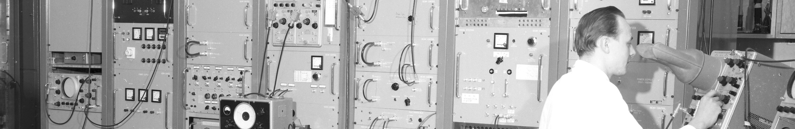
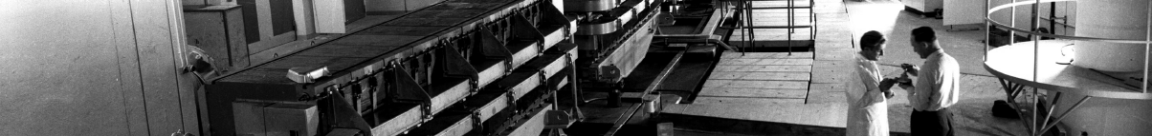
PS Report W43-44
Many thanks to the PS operations and coordination team
as well as all related equipment and support teams

Slide 2
Main issues during the week
PSB ring 2 kicker problem on Sunday → ~6h to re-establish good conditions
TOF bunch moved to ring 3 for TOF from ring 3
Degraded beam quality for AD → Until Monday midday
DC magnet FTA.BVT9045 power converter → 7h without beam to AD
on Monday/Tuesday
Acquisition frozen at ‘correct’ value
Difficult to diagnose: many thanks to AD-OP!
EAST area magnets tripped multiple time → ~2-3h lost for EAST beams
on Tuesday afternoon
Issue with interlock signal from flowmeters
Temporarily bridged until end of run

Slide 3
Main issues during the week
Unexpected timing system reboot → ~1h45 without beam
on Wednesday morning, 9h43
Interventions on three RF systems (impacted by sudden stop)
PS ready for beam by 10h40, but POPSB difficult to restart
Beam back at 11h30

Slide 4
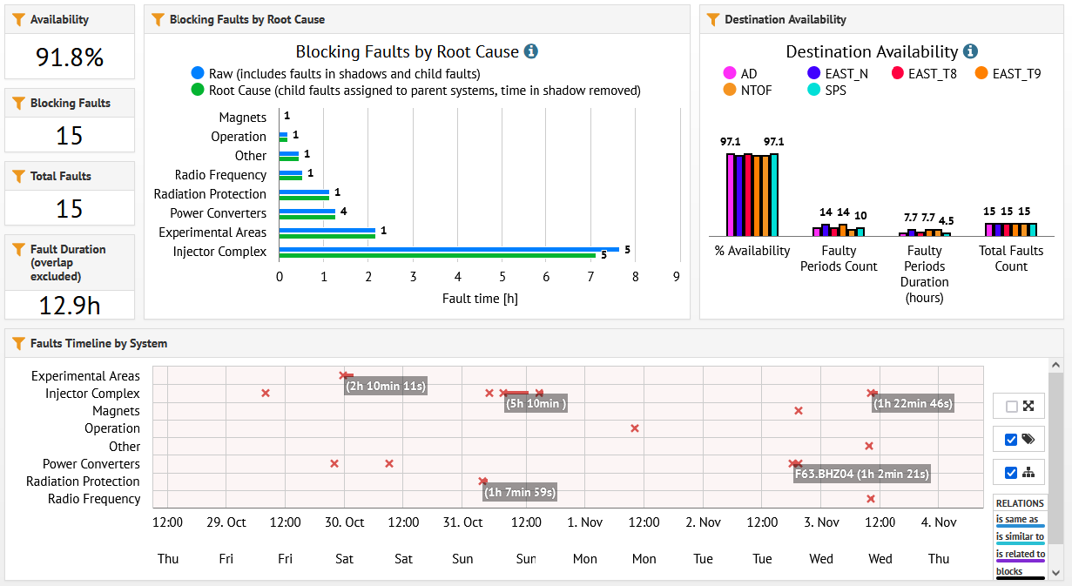
Accelerator Fault Tracking (AFT)

Slide 5
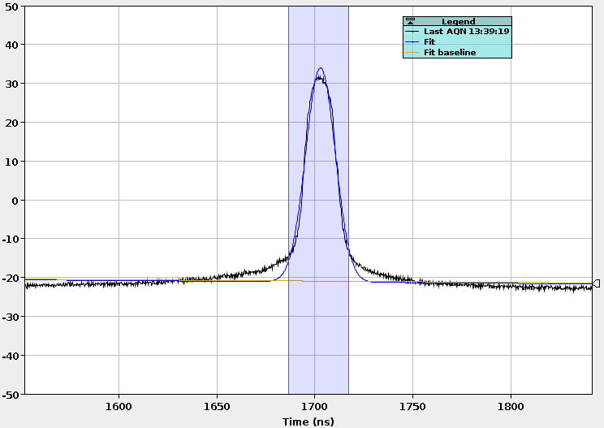
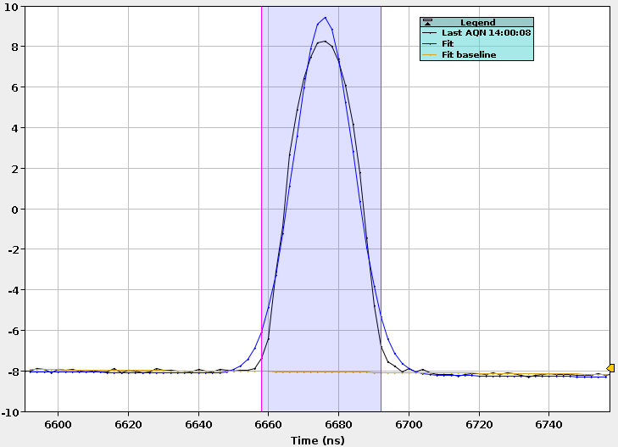
Dedicated and parasitic TOF bunch length checks
Dedicated TOF cycle
Parasitic TOF bunch
4σ ≈ 30 ns
4σ ≈ 33 ns
Parasitic TOF bunch has less tails, thanks to smaller longitudinal emittance
Bunch rotation of EAST_N_21 found disabled (bunch length was > 50 ns)

Slide 6
Upcoming
Dedicated optics measurements in FTN line this (Thursday) afternoon, 14h00-20h00
Beam on target but with changing beam size, position and intensity
  15/11/2021, 6h00: end of 2021 run

Slide 7
Status of operational beams
MD planning for this week (link)
Fixed target beams | Status | Comment
SFTPRO (MTE 5 turn extraction) | Operational | Up to ~2 ∙ 10¹³ p/p delivered to SPS
AD | Operational | 1.55 ∙ 10¹³ p
TOF | Operational | Delivered at 8.5 ∙ 10¹² p/b with pre-LS2 optics
EAST | Operational | Up to 6 ∙ 10¹¹ p/p to EAST dump, T8 (slow and fast), T9 and T10/11 Fast and slow extracted ions to EAST dump
LHC-type beams | Status | Comment
LHCPROBE, LHCINDIV | Operational
LHC25 (72b) | Operational | Polished up to 1.3 ∙ 10¹¹ ppb; set up up to > 2.6 ∙ 10¹¹ p/b ε_{h} / ε_{v} (FT) ≈ 1.2 / 1.1 mm mrad (for 1.3 ∙ 10¹¹ p/b)
LHC25 (12 to 48b) | Operational | Settings synchronized with high-intensity variant
LHC25 BCMS (48b) | Operational | Available up to 1.3 ∙ 10¹¹ p/b (3 basic periods)
AWAKE | Operational | 3 ∙ 10¹¹ p/b
Ion beams | Status | Comment
EARLY | Operational | ~1.5 ∙ 10¹⁰ p/p
NOMINAL | Operational | 8 ∙ 10¹⁰ p/p

Slide 8

PS Supervisor of week 44 – Heiko Damerau week 45 – Benoit Salvant
Questions and Comments
8:45 Daily Zoom meeting during beam commissioning
Web address: https://cern.zoom.us/j/9372114100?pwd=L29BcmlHUENCdFBRSytXYVcrM1B4Zz09
Meeting ID : 937 211 4100
Passcode: 525463

