Slide 1
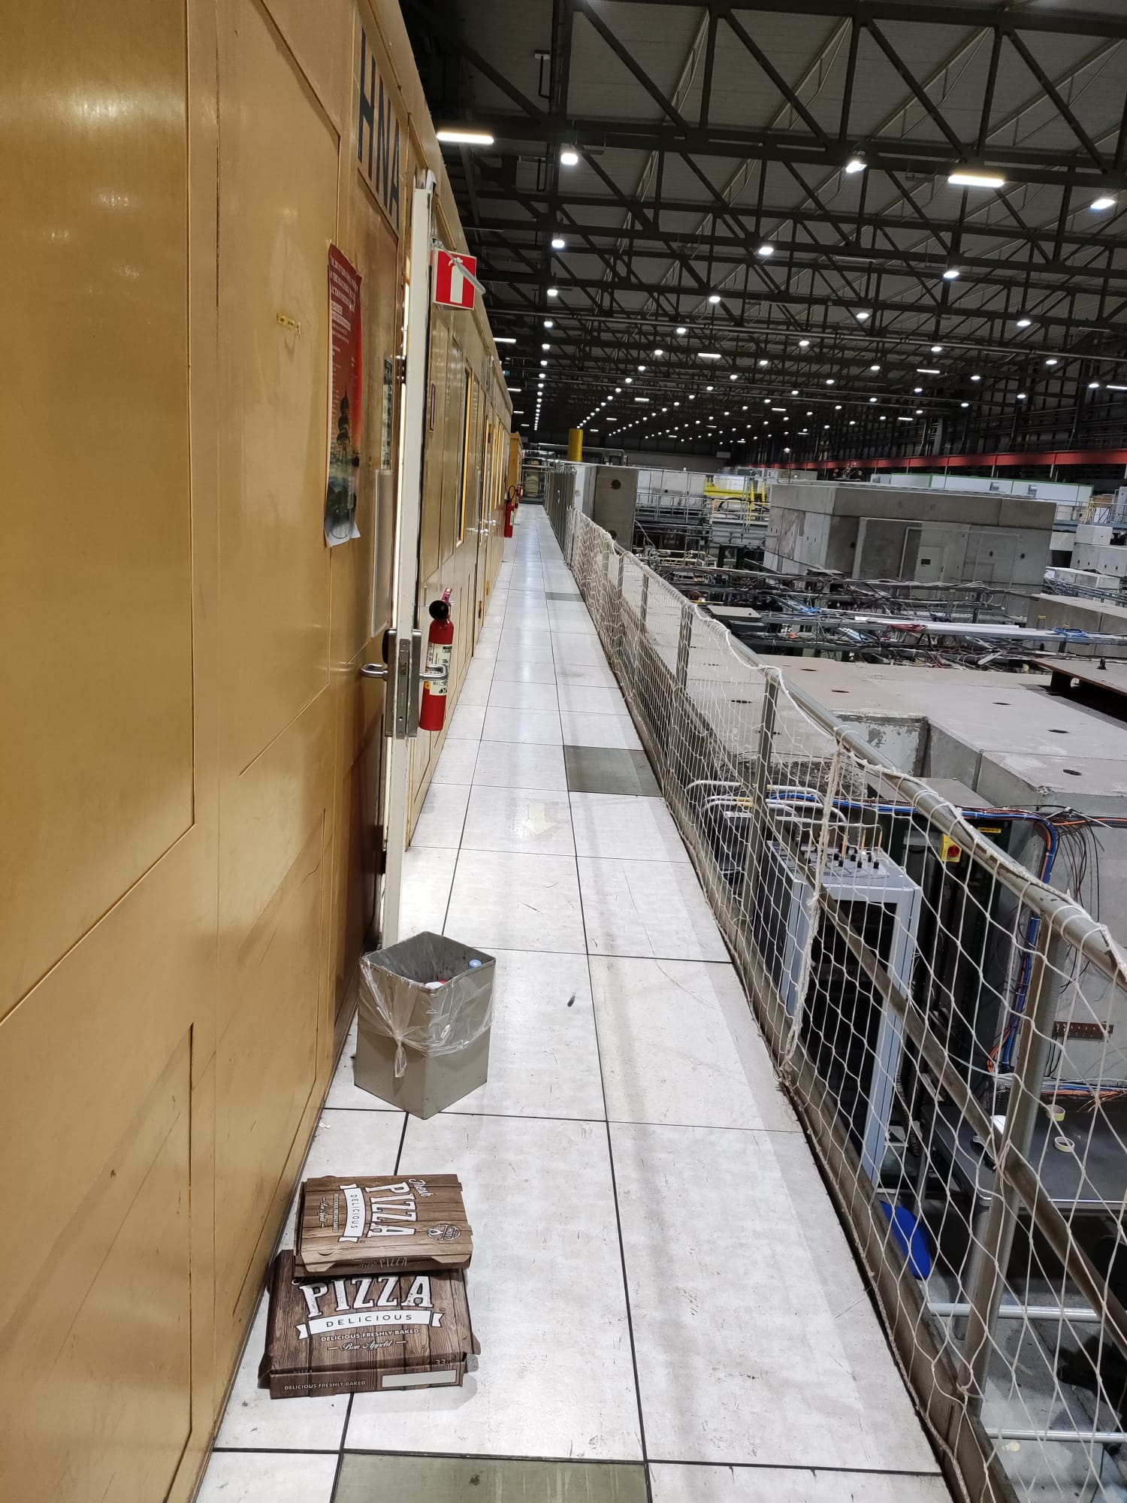

157 and EHN1 are supervised radiation areas.
Eating is prohibited.
For EHN1 please go to the break rooms in 892.
We are investigating a break room for 157.

Slide 2


ISIEC forms: Please send them in at least 48h before you need your inspection.
Here is the link: https://ep-th-safety.web.cern.ch/form/isiec-form-v2
Experiment construction – please do not use wood or cardboard to construct your experiment.
These are not ideal for many reasons, including fire risk and potential activation from radiation exposure.
Reminder: Power cuts planned in EHN1 next year for decabling. During YETS 19/01/22 to 23/02/22.
Special arangements are in progress for GIF++, NA61 and Neutrino Platform.

