Slide 1
KE4738 Technical Meeting : Adhesion
December 16th, 2021
Activity at CERN
Bharti Verma, CERN

Slide 2
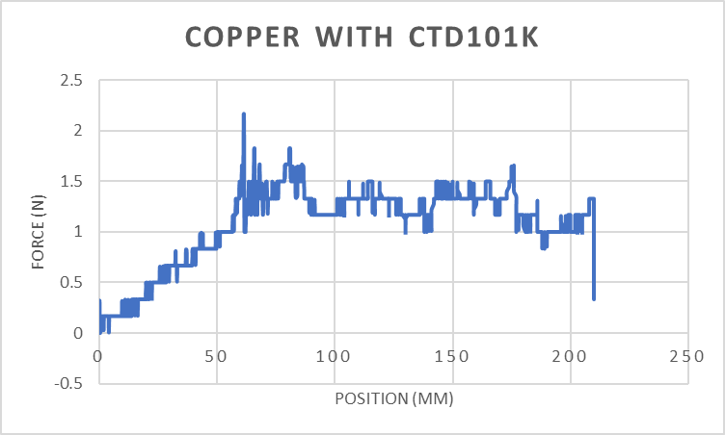
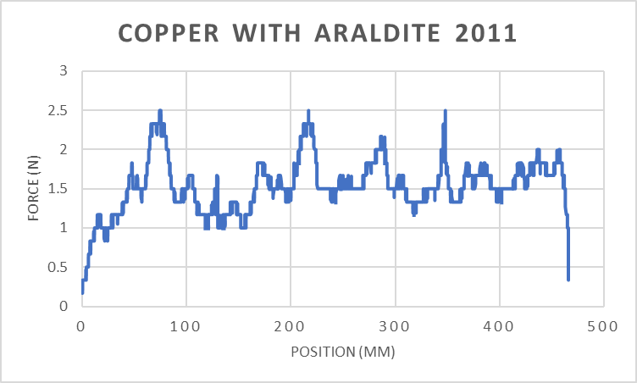
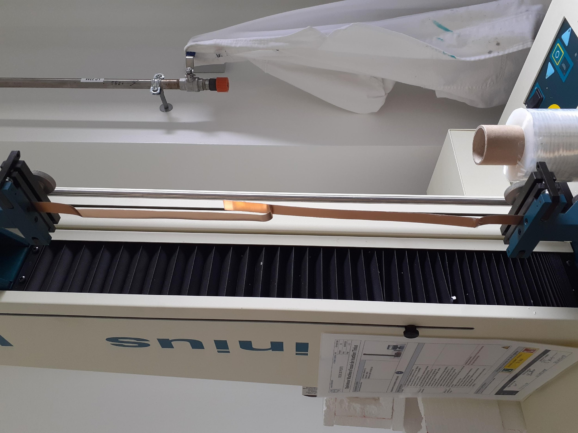
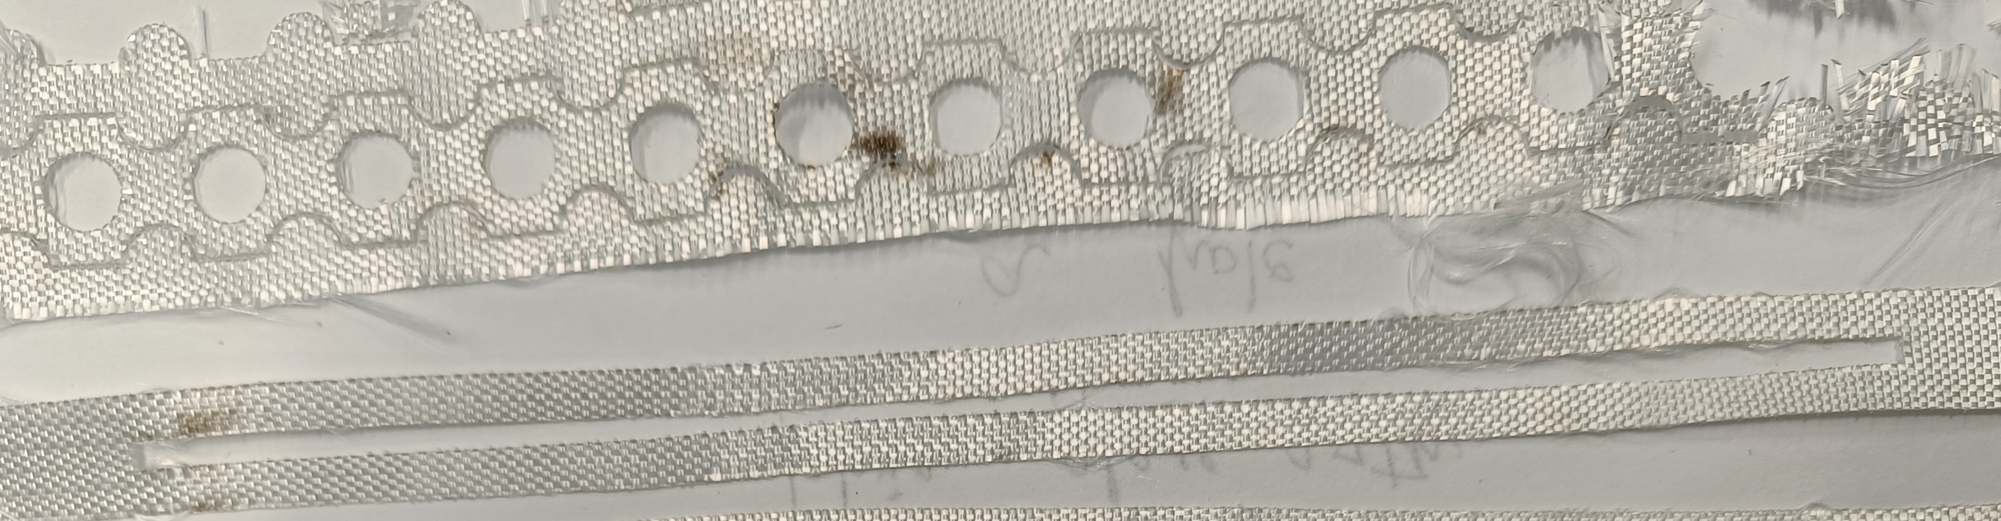
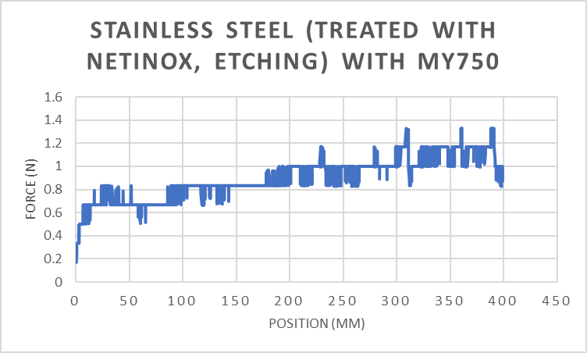
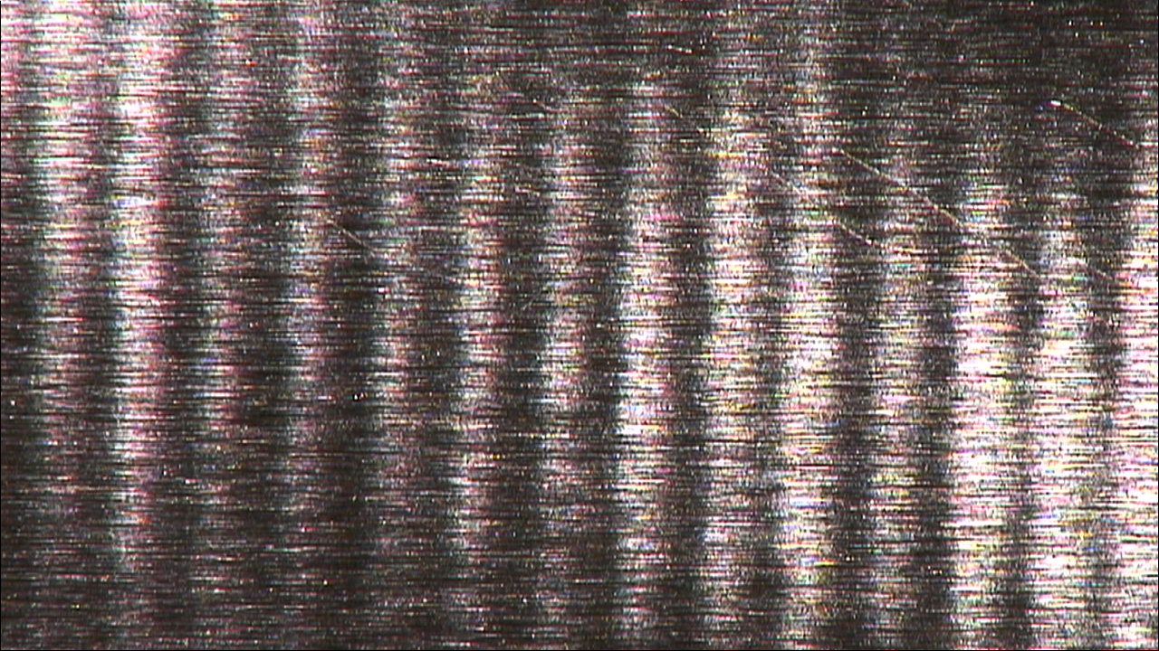

Challenges faced
Adhesion of metals with resins was tested by following ASTM D1876 T-peel standard.
The adhesion was disappointing and mode of failure was usually adhesive failure.
We tried to make holes in the fiber glass (honeycomb structure and rectangular holes). It made the fiber glass difficult to handle, and there was no increase in the adhesion.
We treated the metallic tapes with Netinox (chemical etching) and rubbing with sand paper, but there was no improvement.
Some of the samples to represent the adhesion strengths we were receiving earlier.
Copper surface before peel test
Copper surface after peel test
Mode of failure: Adhesive

Slide 3
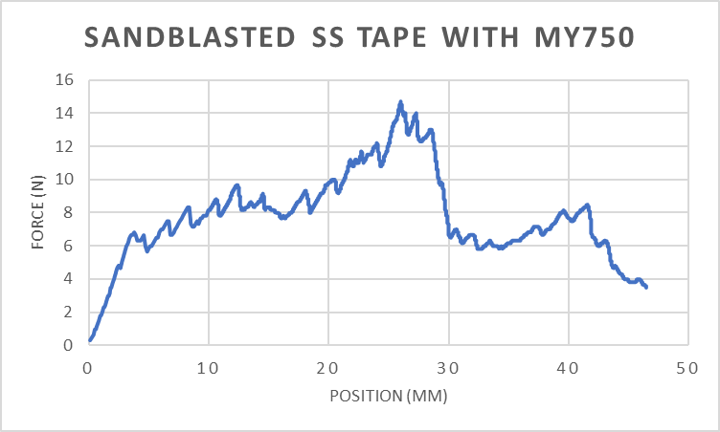
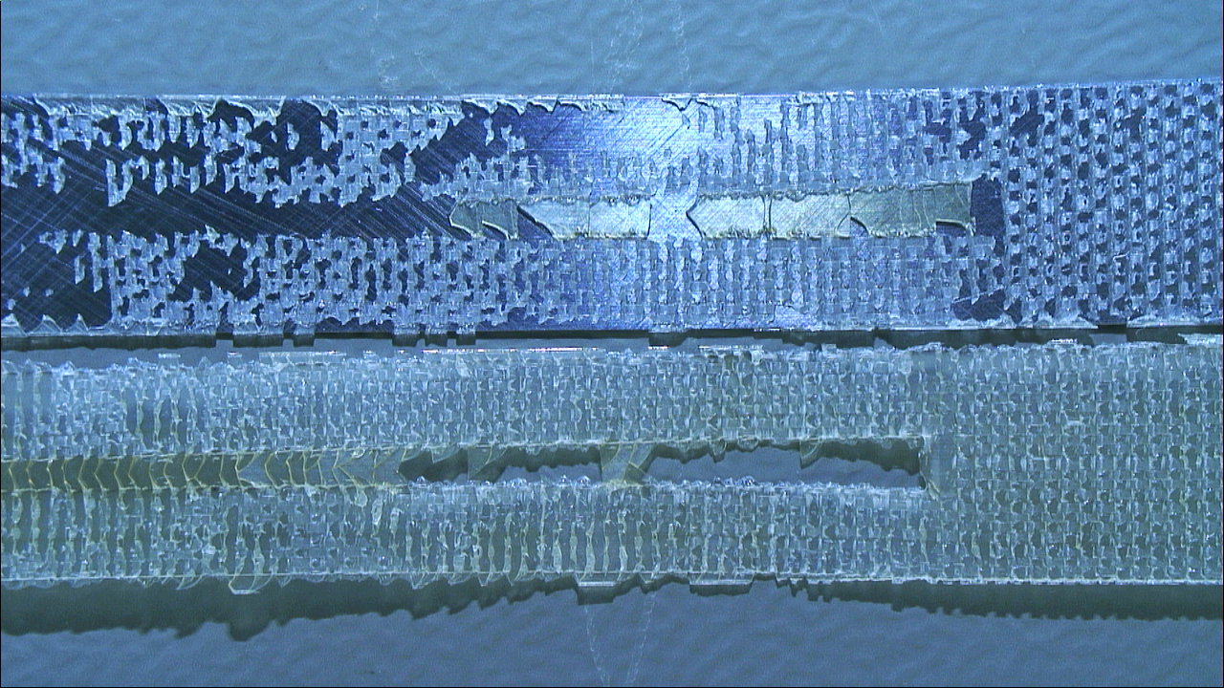
Learnings
If the resin is not wetting the metal surface, there are two potential issues:
The surface is contaminated, and the resin is not capable of wetting the metal surface
There truly is not enough resin to thoroughly wet the surface
Inspiration from the ASTM standard D2651 “ Standard Guide for Preparation of Metal Surfaces for Adhesive Bonding.” The wide variety of individual alloys,, the fact that certain adhesives exhibit specific compatibilities with surface preparation and the complexity and nature of parts being bonded preclude the use of an all-inclusive procedure for a metal group.
Shifted from ASTM D1876 (T-peel test) to ASTM D3167 (Standard Test Method for Floating Roller Peel Resistance of Adhesives).
Started testing the adhesion of resin to the metal, and not resin between two metal strips.
Interesting observation of stainless steel sandblasted with MY750 but it was not clear why it stuck to one part of tape and why not other.
Sandblasted Stainless steel tape with MY750

Slide 4
Electron microscopy of surface
Good Adhesion surfaces →
Poor Adhesion surfaces →
“Good” and “bad” adhesion surfaces were examined by electronic microscopy. It appears that the “good” areas exhibit a surface that is slightly more rough with cavities than “bad” areas. The sandblasting process may be improved to get something more rough and homogeneous.

Slide 5
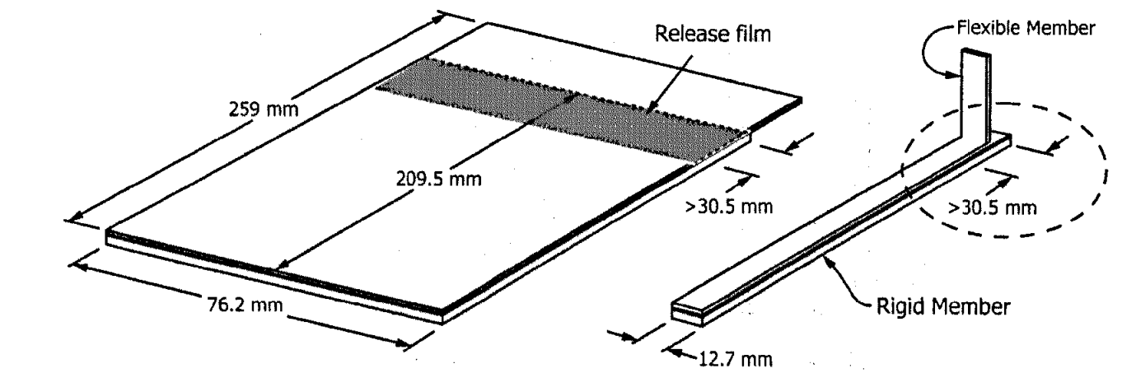
Our new methodology
1. Sample Preparation
Specially prepared test panels 12.7 mm wide by 259 mm long and 2 mm thick.
Treated the samples in the three ways:
Plasma
Sandblasting
Sandblasting + Plasma
2. Assembly preparation
Prepared the resin, degassed it and applied on the metal plate.
Placed Teflon on the top and put weights for better adhesion.
Put the assembly in the oven for curing.
 | CTD101K | MY750 | Mix61 | Araldite 2011
Preparation | A:B:C= 100:90:1.5 | MY750:HY5922= 100:55 | Tactix 123:Aradur 5200: Jeffamine D2000: Dibutyl phthalate: 100:48.4:21.7:10
Curing | 5h @ 110 °C + 16h at 125 °C | 6h @ 40 °C + 3h @ 80 °C | 16h @ 60 °C + 24h @ 100 °C | 3h @ 50 °C

Slide 6
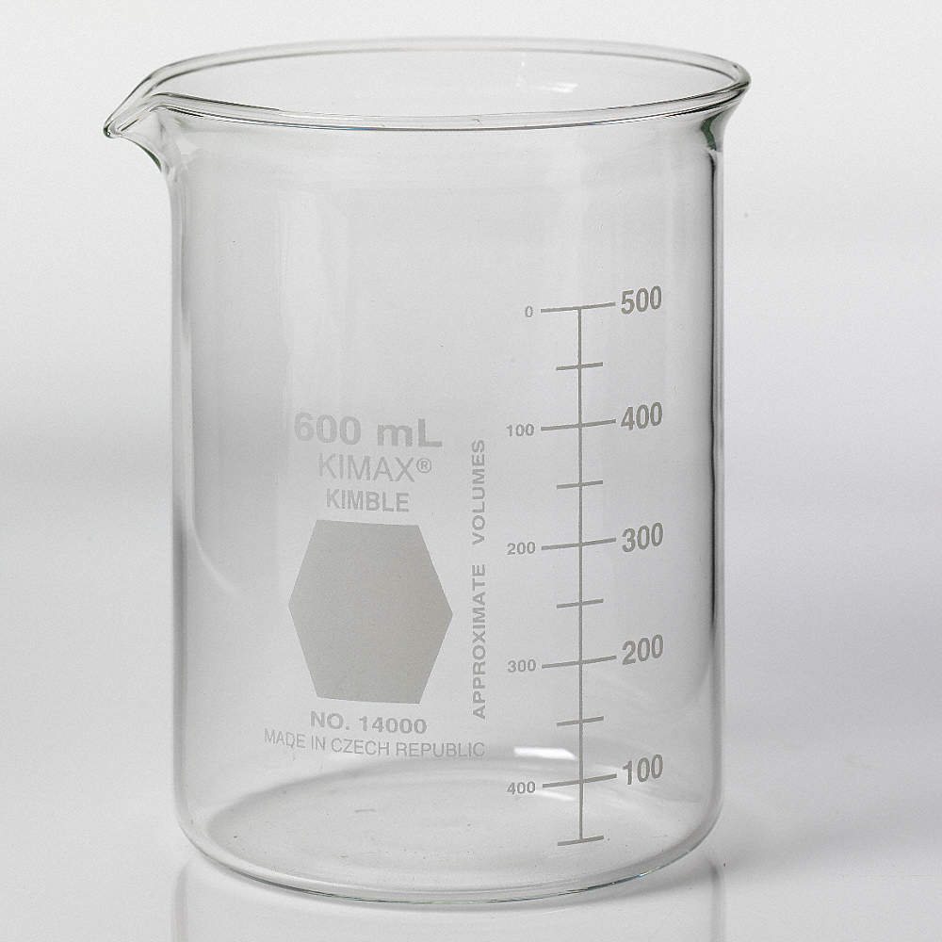
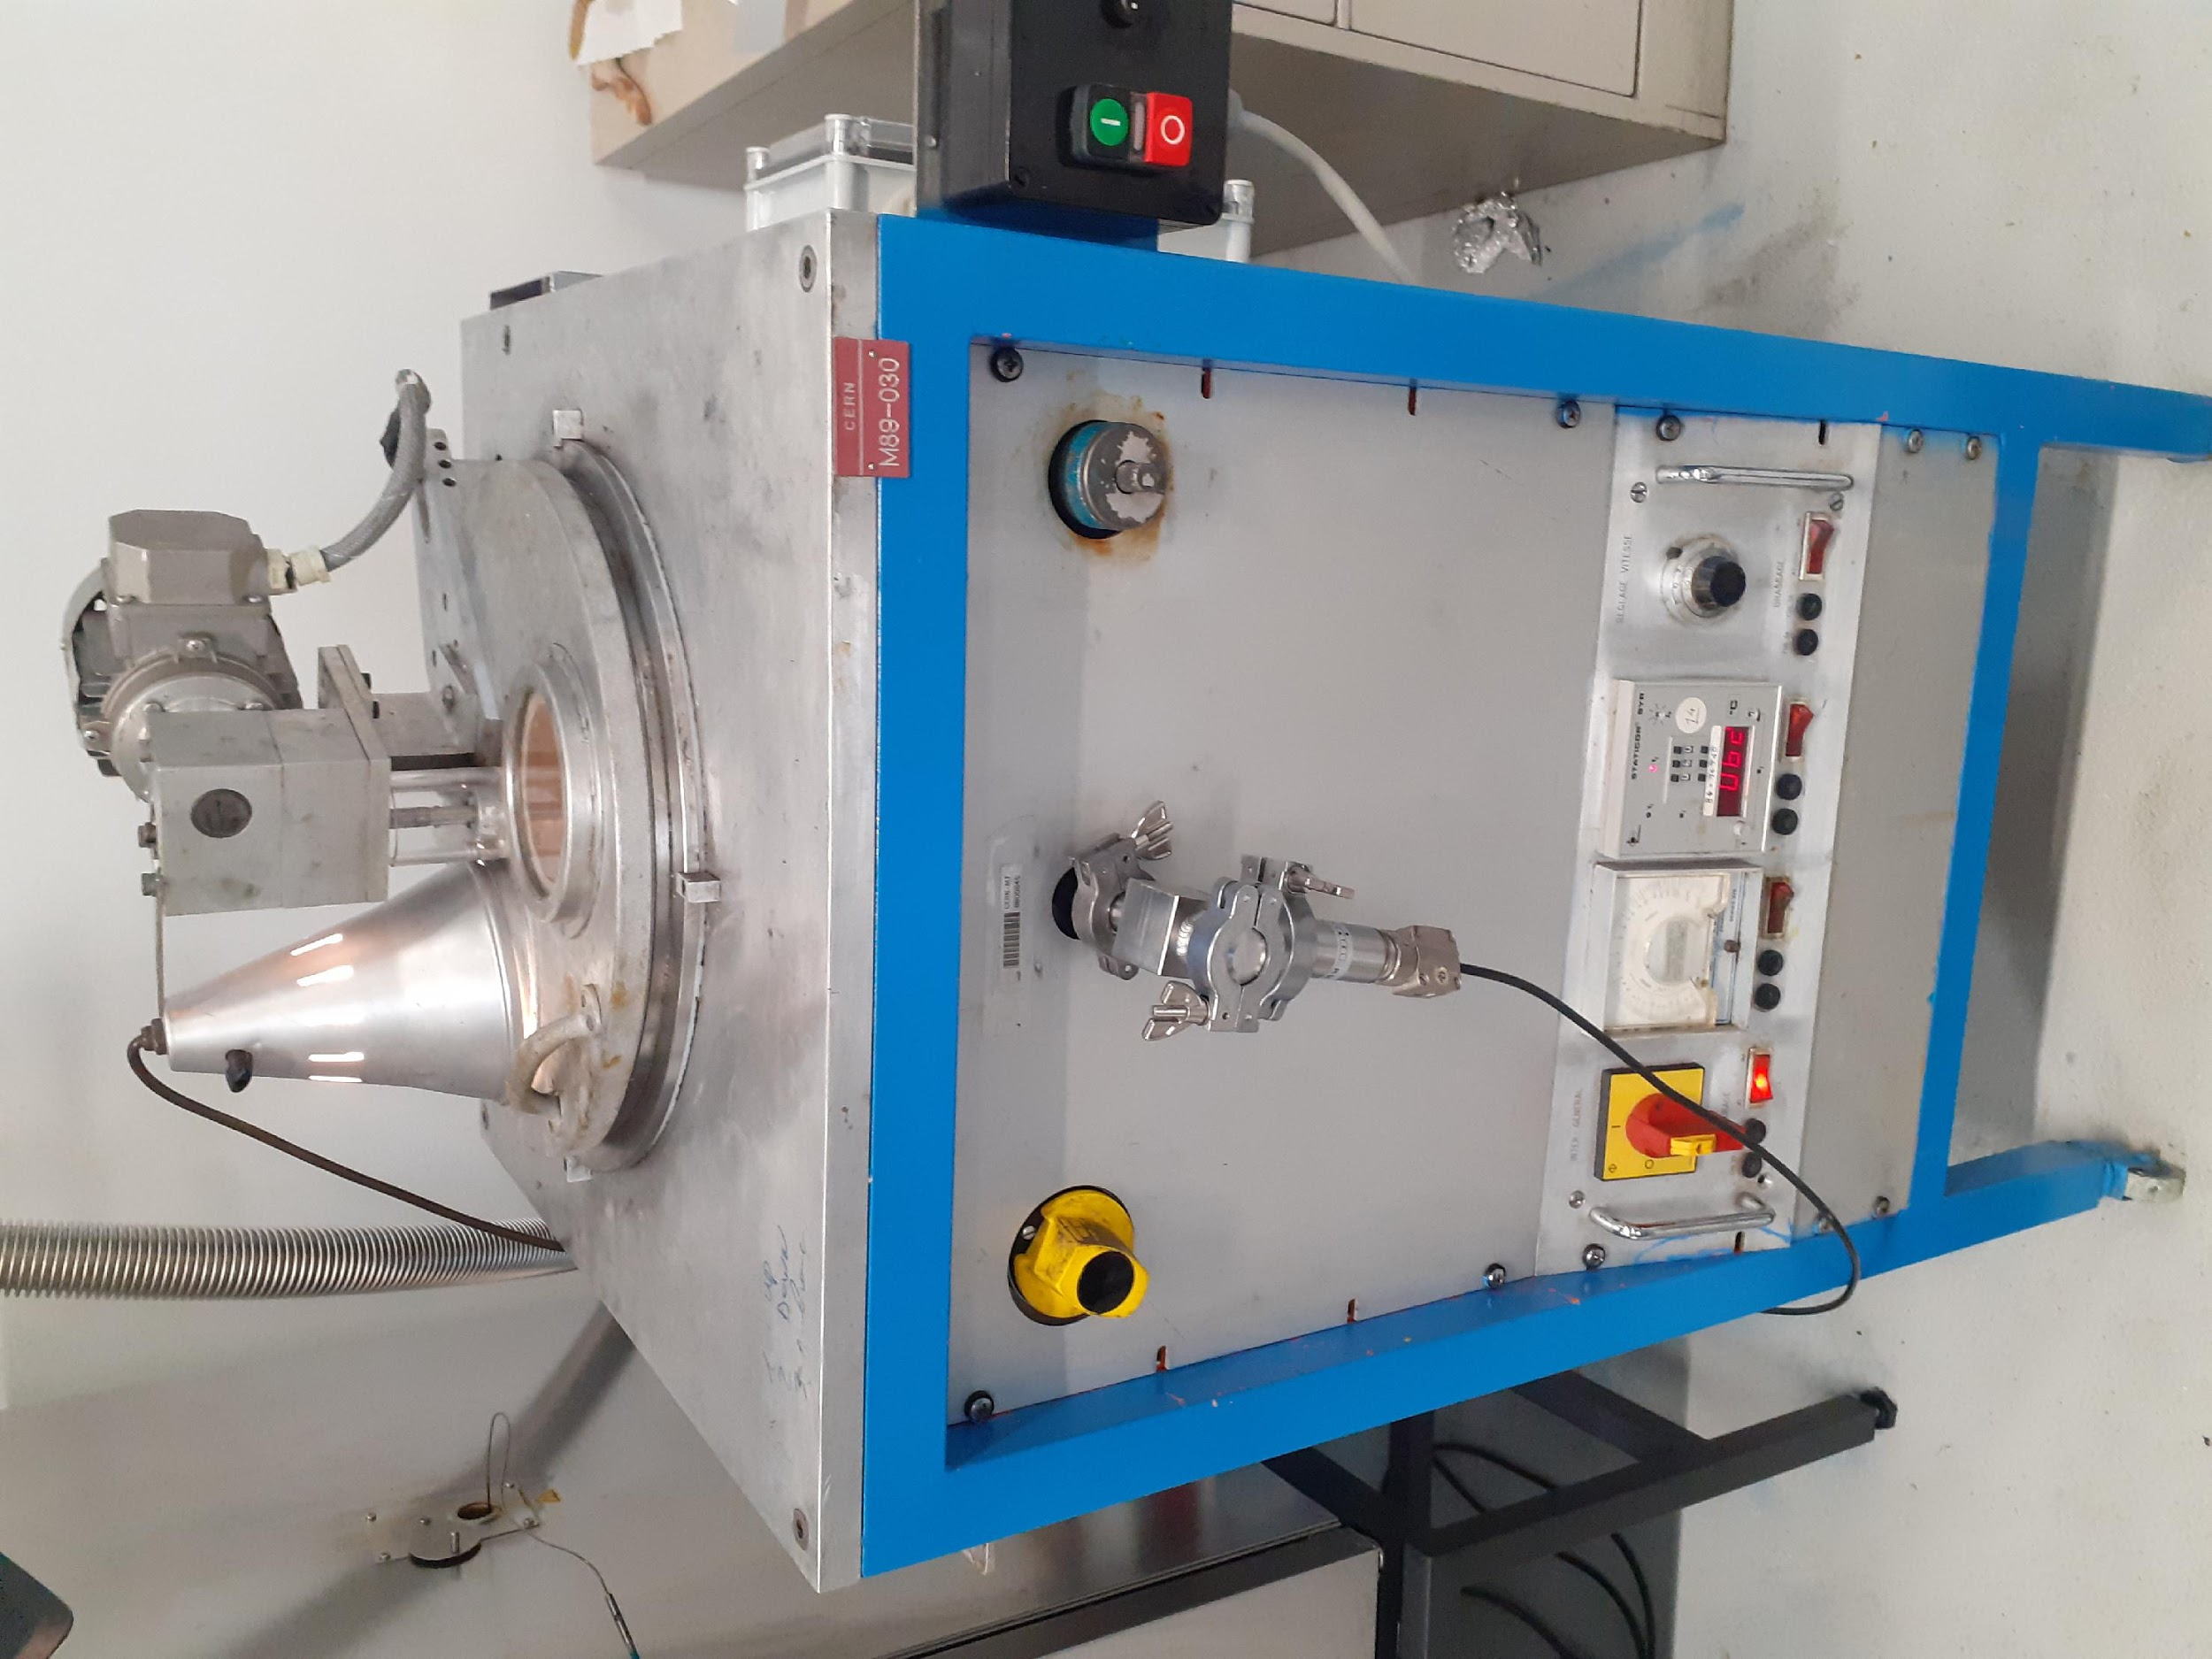
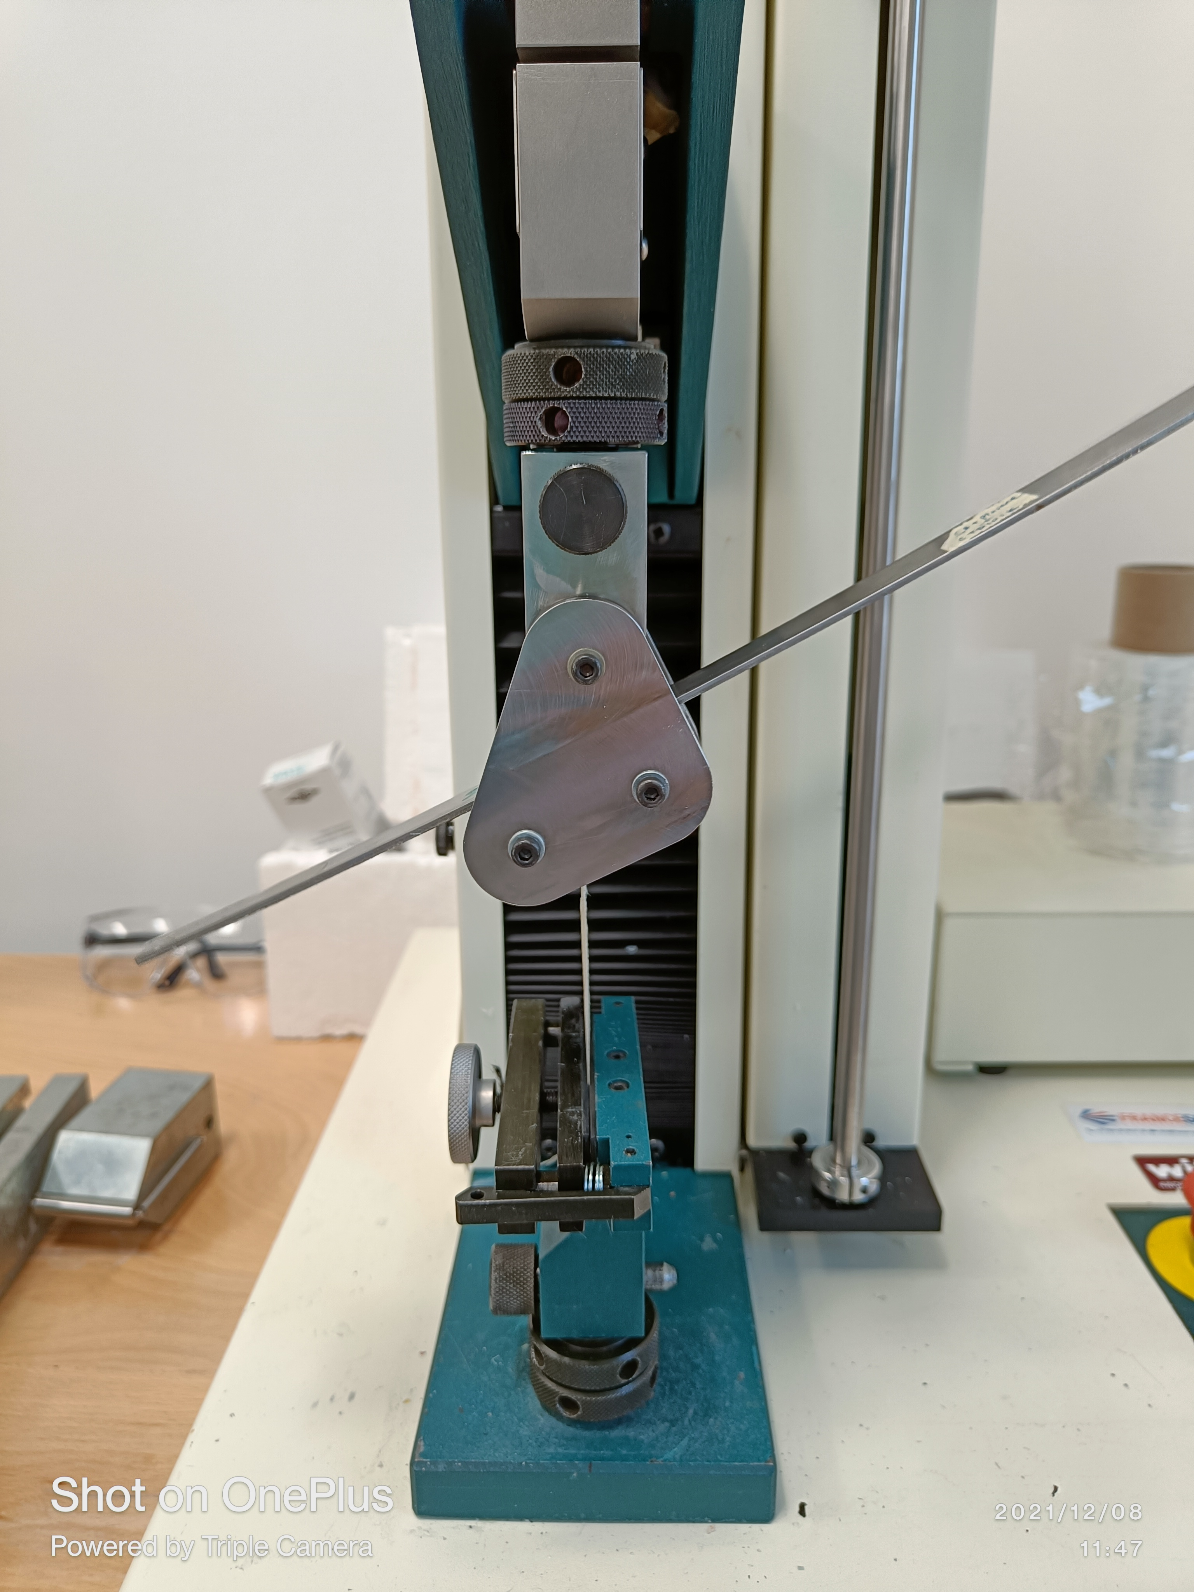
Methods
3. Resin Preparation
Part A at 60°C
Part B at 60°C
Part C
Mixing
Vacuum degassing till all bubbles are gone
4. Testing
The testing has been performed in accordance with the ASTM standard (D3167) which is the standard test method for floating roller peel resistance of adhesives.
Tinius Olsen H5kT universal testing machine was used for conducting tests.
The unbonded end of the test specimen was clamped in the test grips of the tension testing machine.
The load was applied at a constant head speed of 152 mm/min.
Inside of a vacuum impregnation system

Slide 7
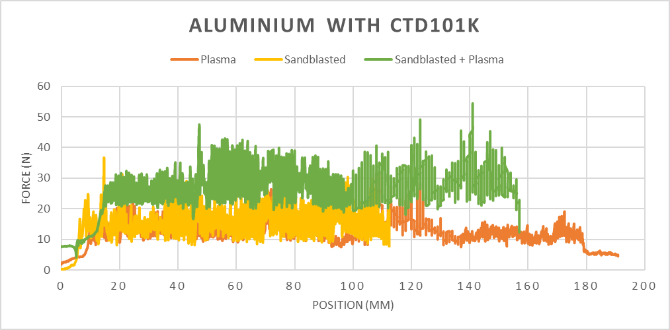
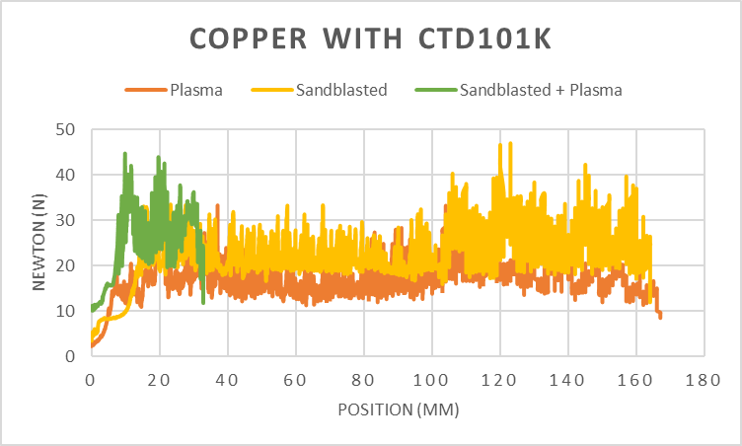
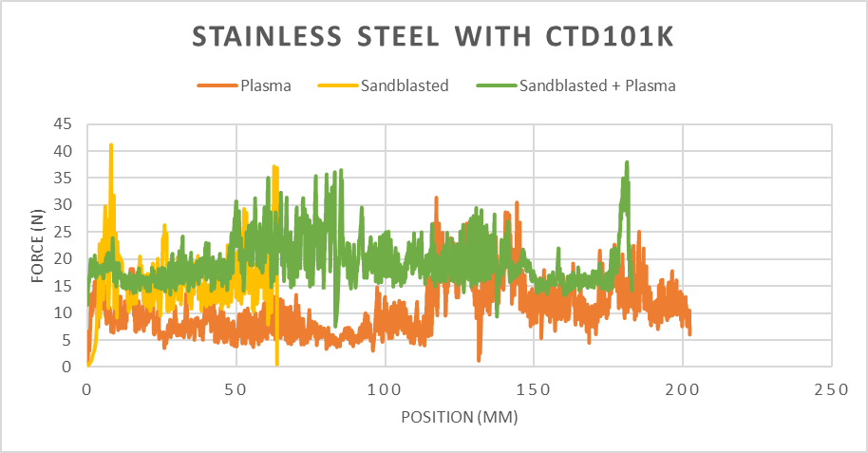
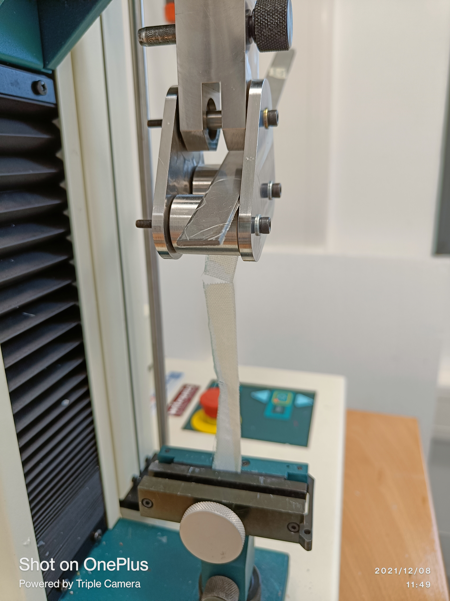
CTD101K
Take away points:
Plasma treatment enhances the ability of metals greatly to bond with CTD101K even without sandblasting.
The samples which were first sandblasted and then plasma treated showed better adhesion strengths.

Slide 8
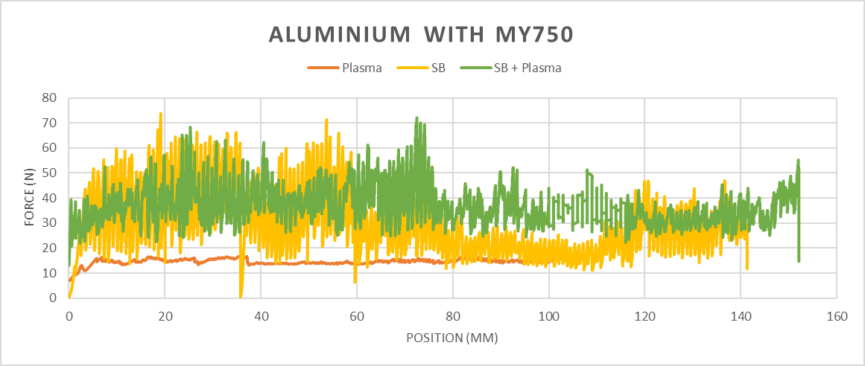
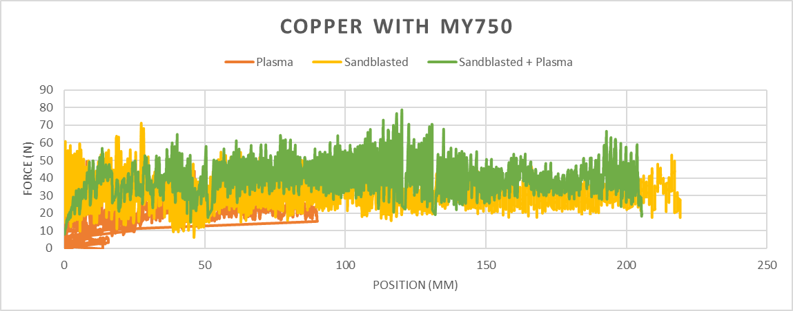
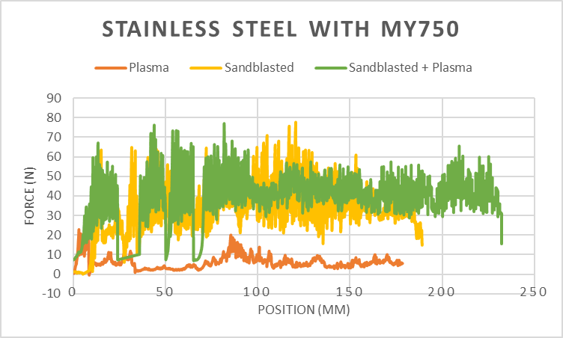
MY750
Take away points:
1. Plasma treatment enhances the ability of copper adhesion by almost 30-40 times. (as compared to the non-treated surfaces).
2. On an average, it could be said that MY750 bonds better to all the substates as compared to CTD10K

Slide 9
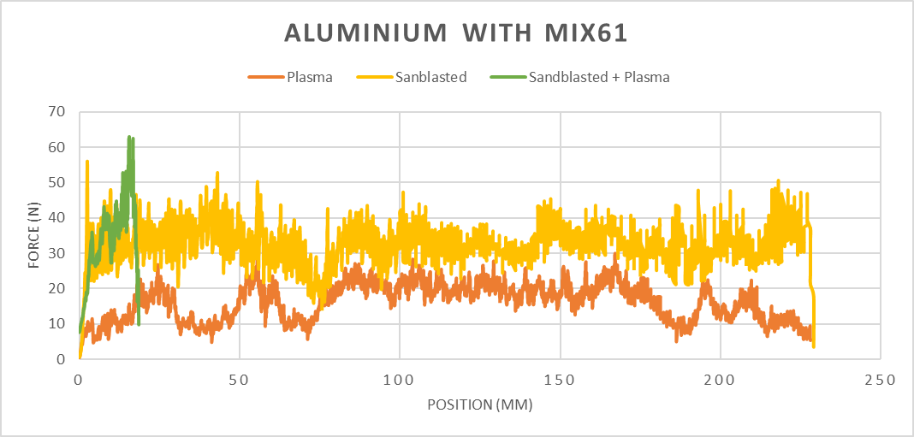
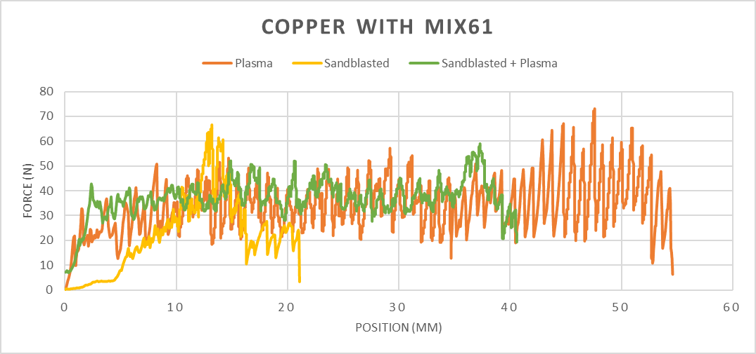
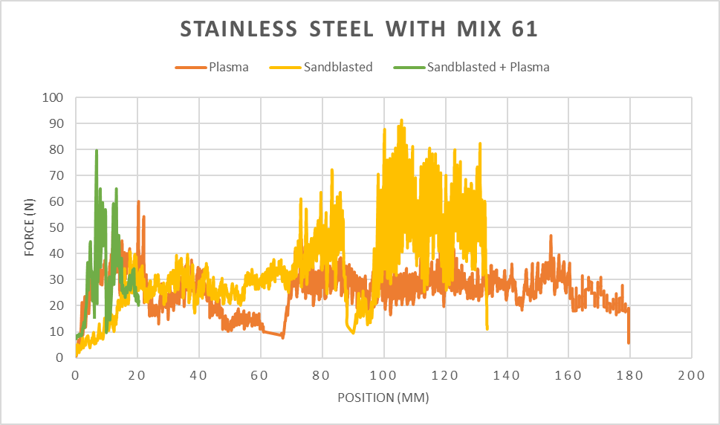
Mix 61
Take away points:
Only plasma treated copper was also able to bond strongly with Mix61 showing a maximum peak at 73 N. (even without sandblasting)
For Mix 61, on an average, stainless steel and copper performed better than aluminum.
The best adhesion for Mix 61 was seen for sandblasted SS and one peak touched 91 N.

Slide 10
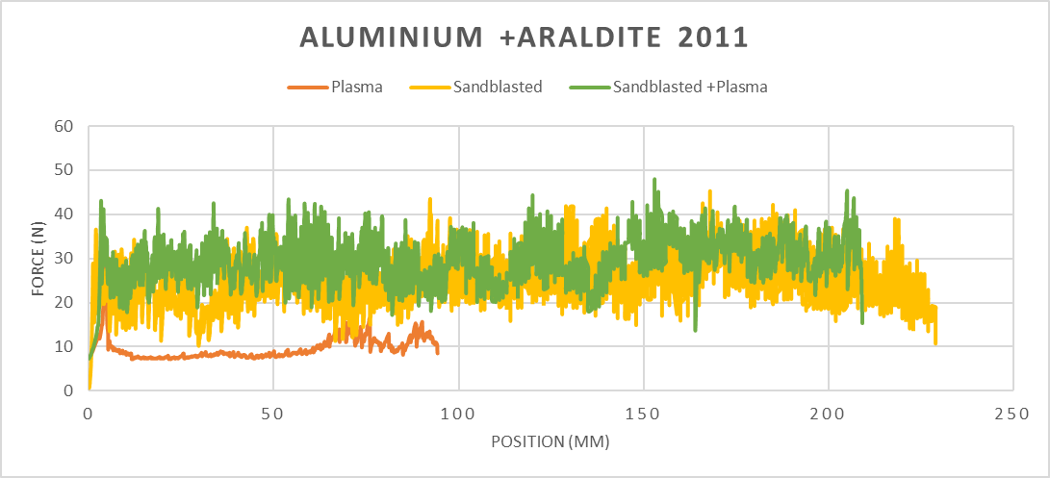
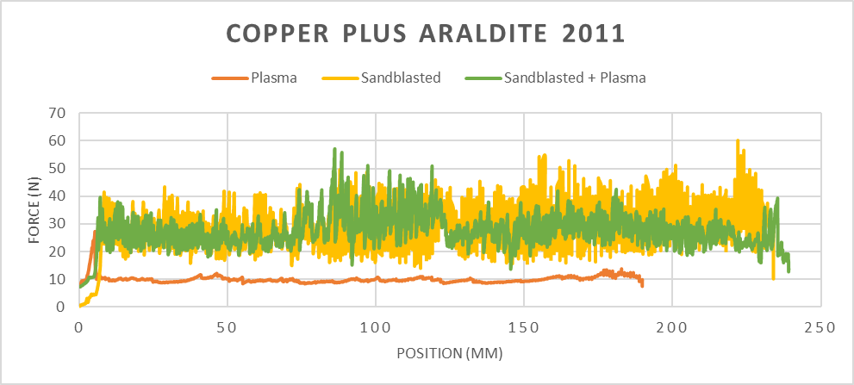
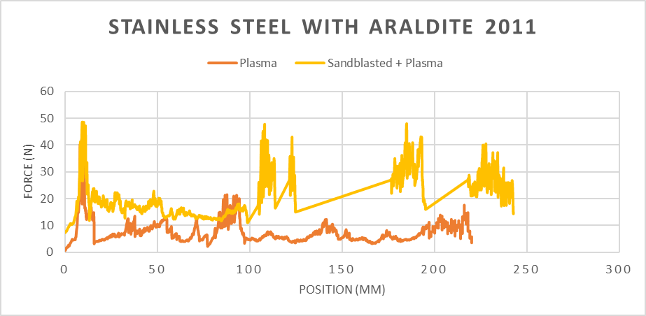
Araldite 2011
Take away points:
Plasma treated copper and aluminum showed homogenous peeling.
Araldite 2011 showed similar bonding strength as CTD101K but lower than MY750 and Mix61.

Slide 11
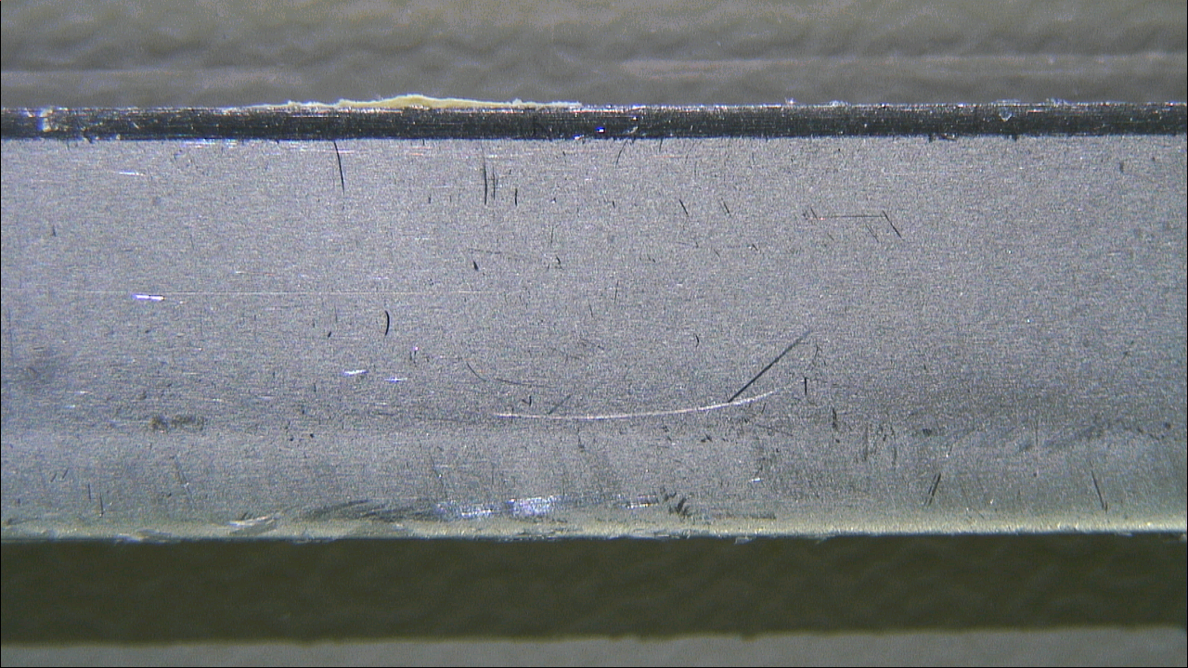
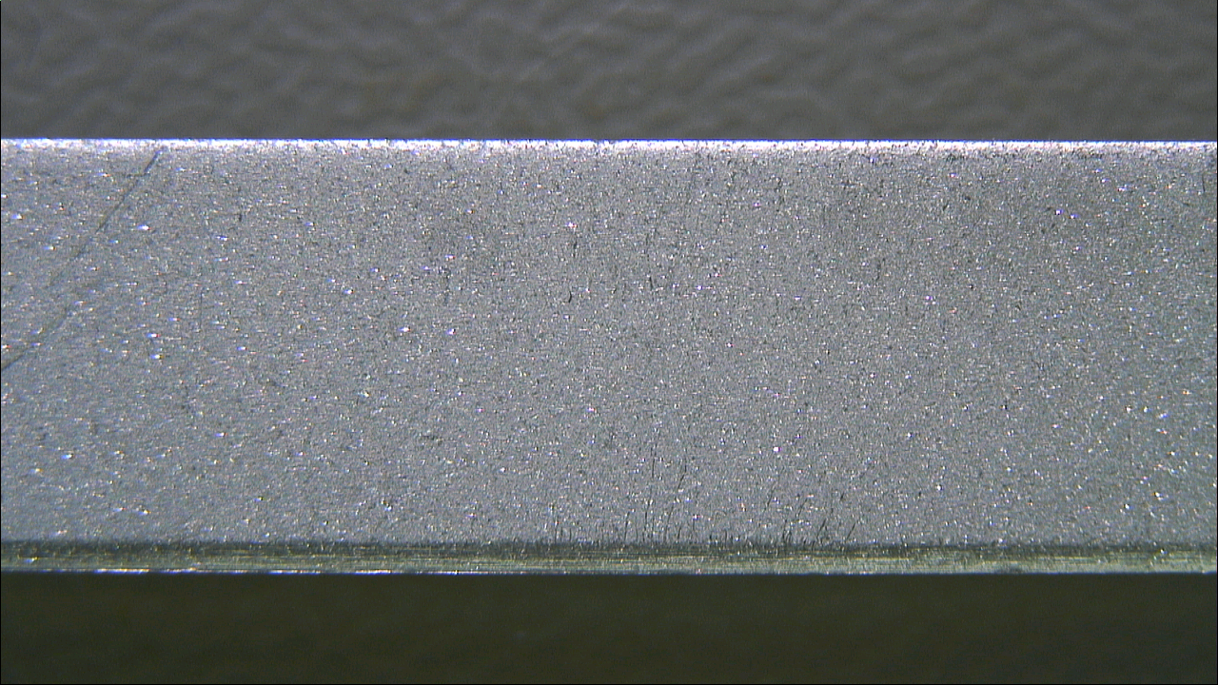
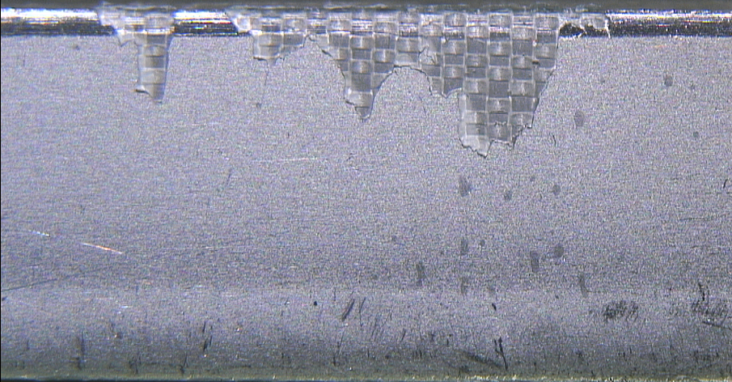
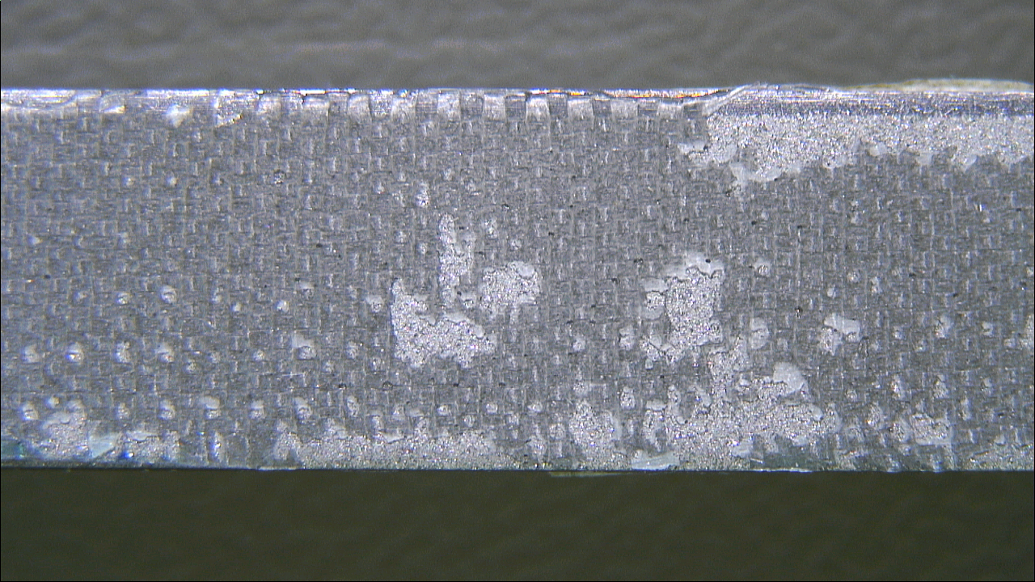
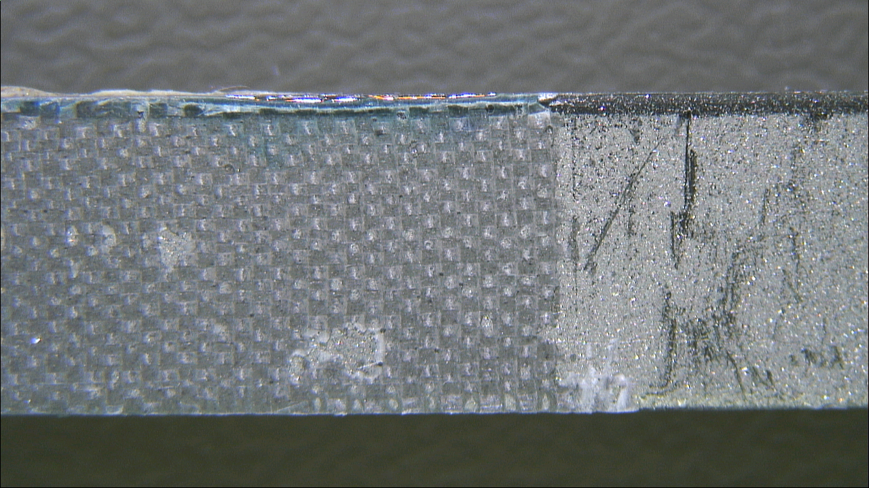
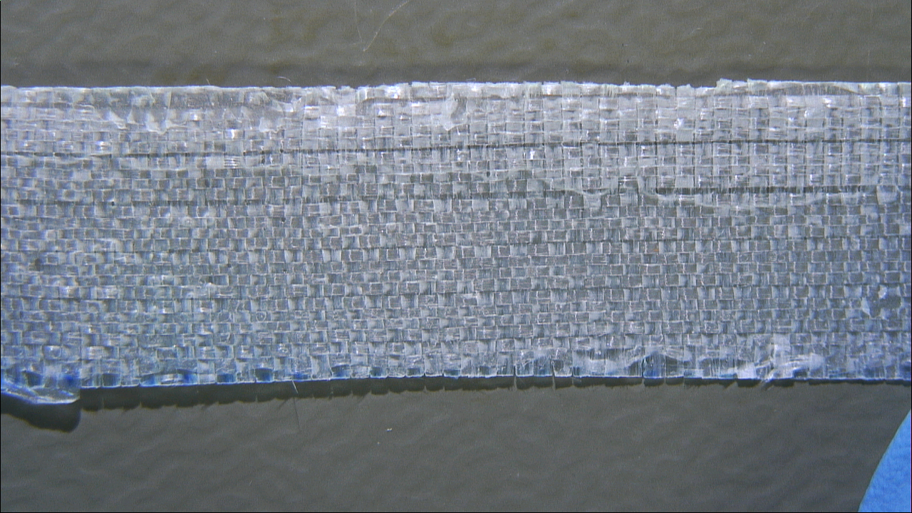
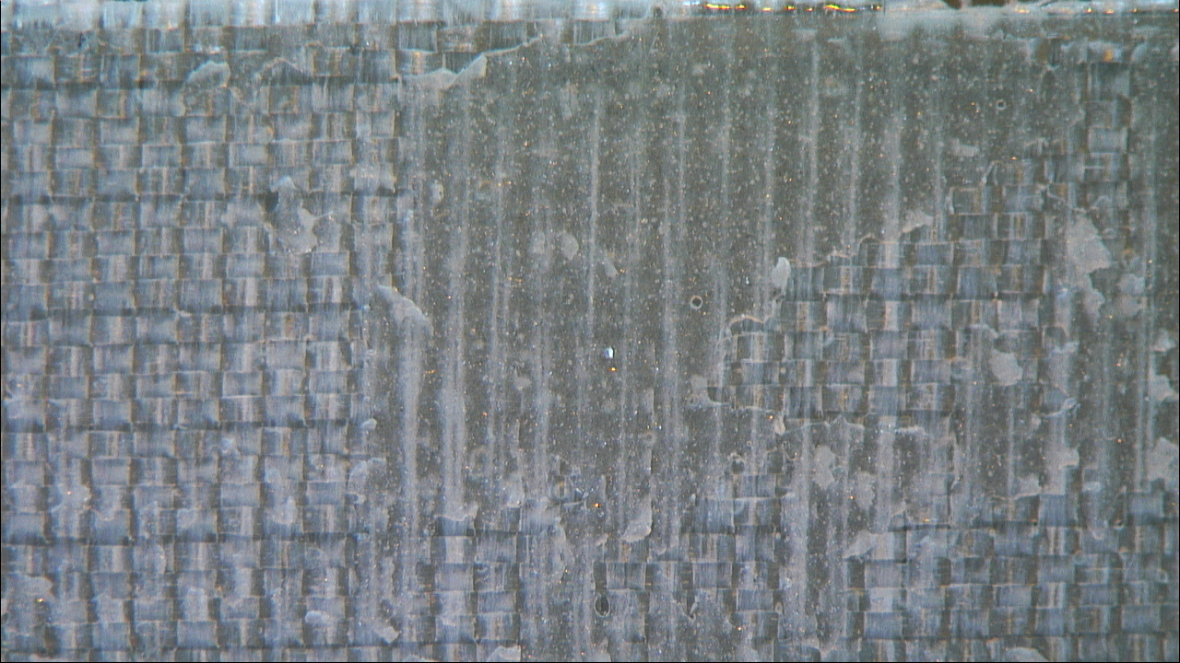
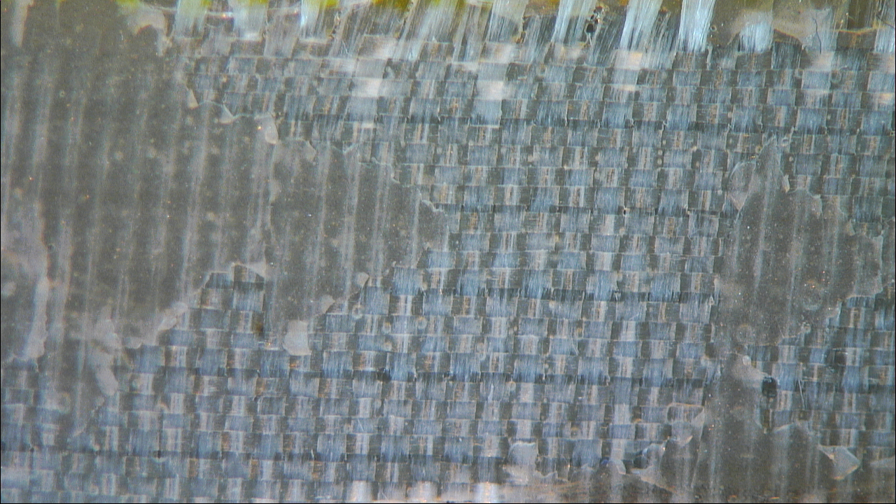
Mode of failure- Stainless steel& MY750
Plasma
Sandblasting
Sandblasting + Plasma
Plasma treated surface
Plasma treated surface
Plasma treated surface
Sandblasted surface
Sandblasted + Plasma
Area covered by Teflon tape
Surface after roller-peeling
Surface after roller-peeling
Surface after roller-peeling
Fiber glass after roller-peeling
Fiber glass after roller-peeling
Fiber glass after roller-peeling

Slide 12
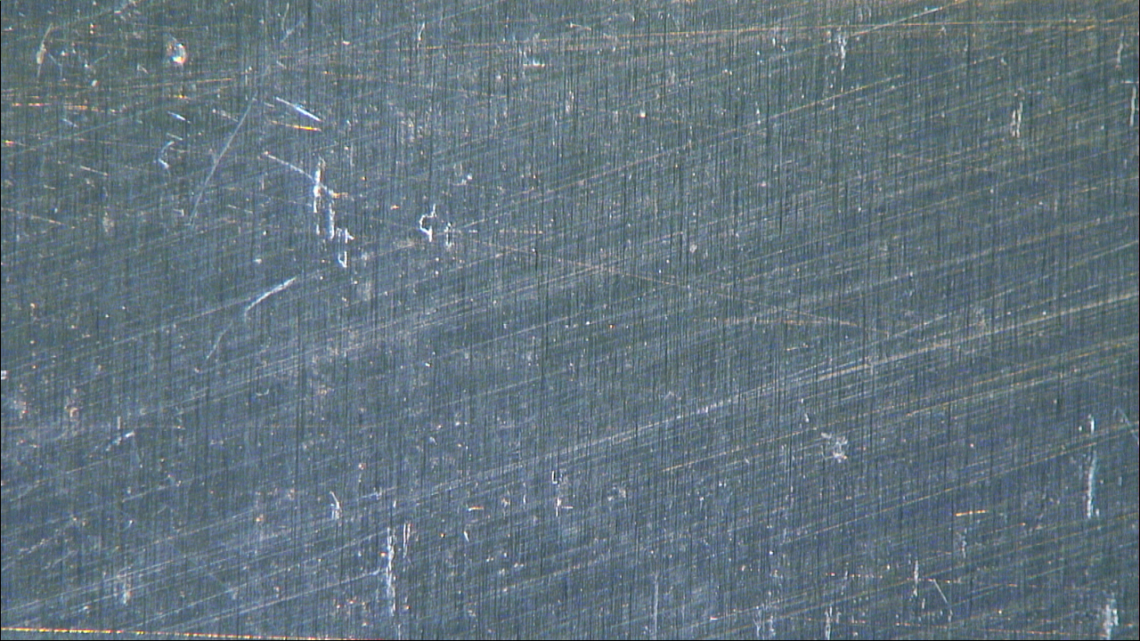
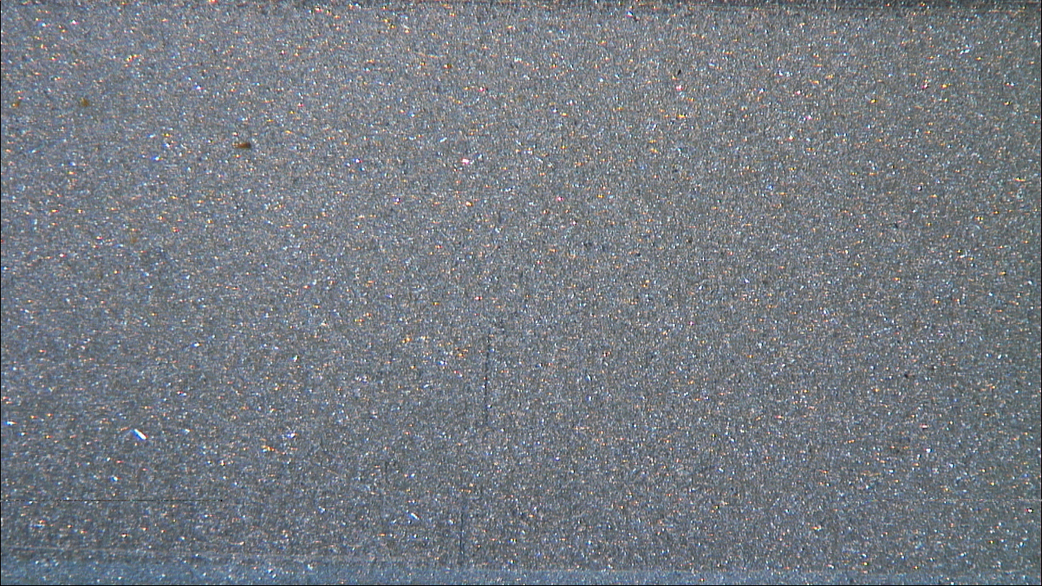
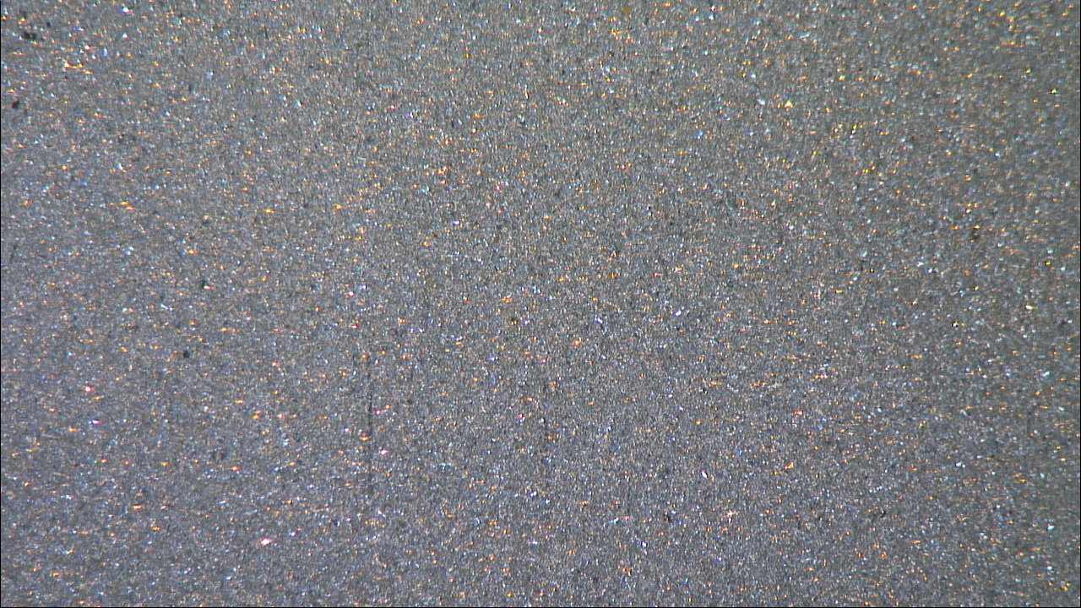
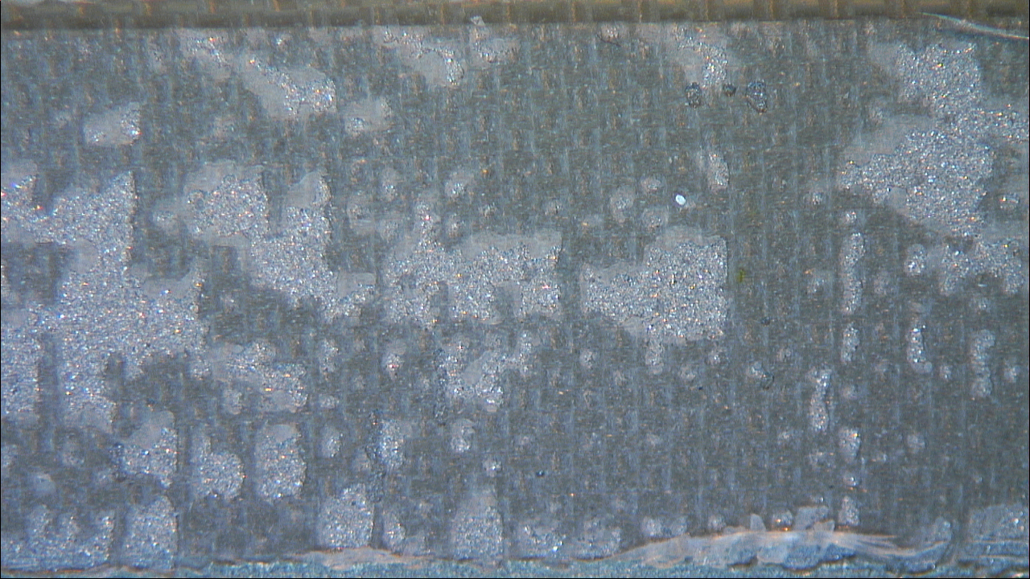
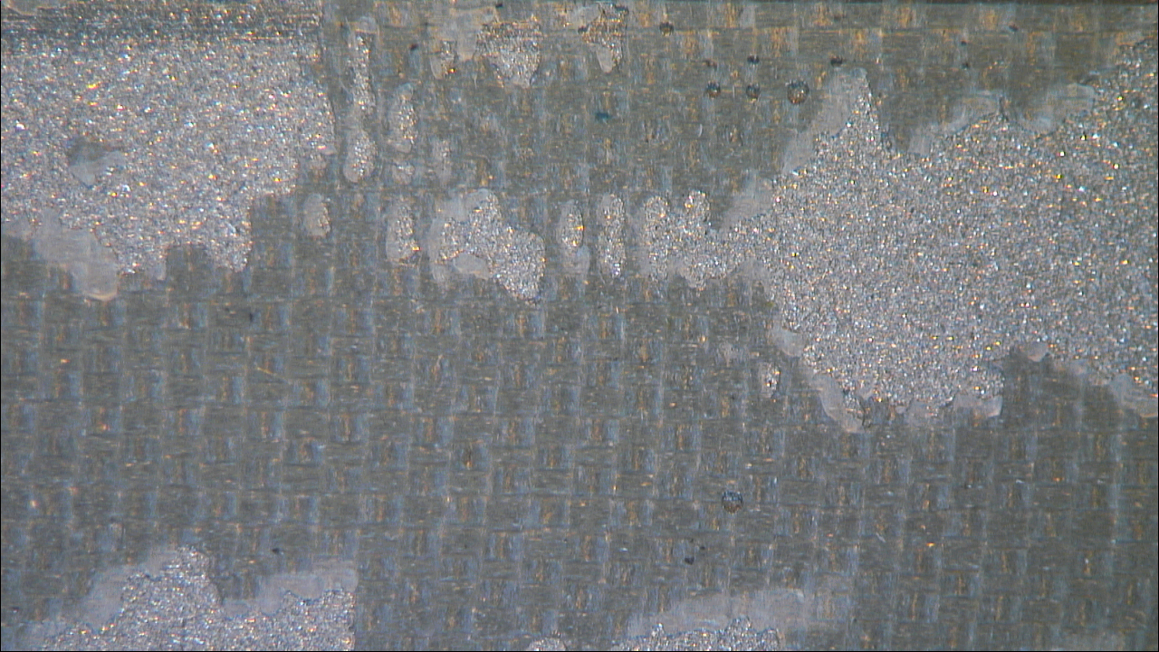
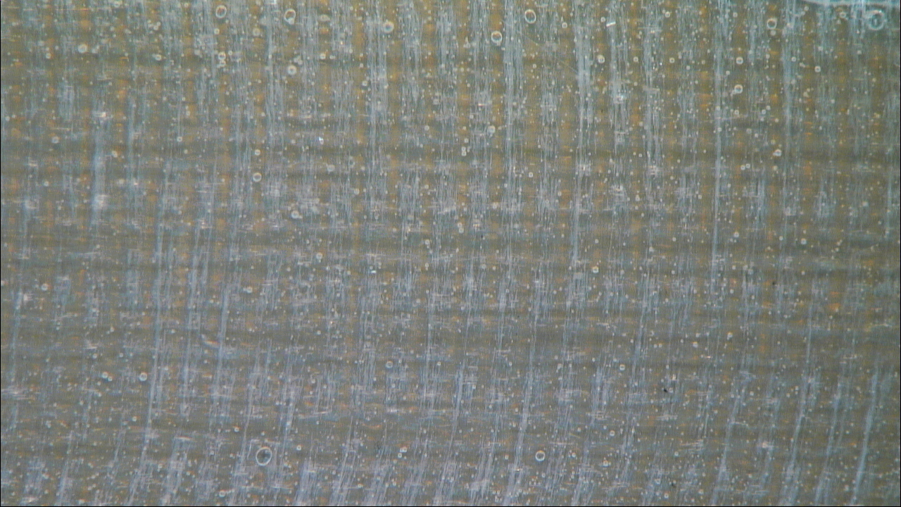
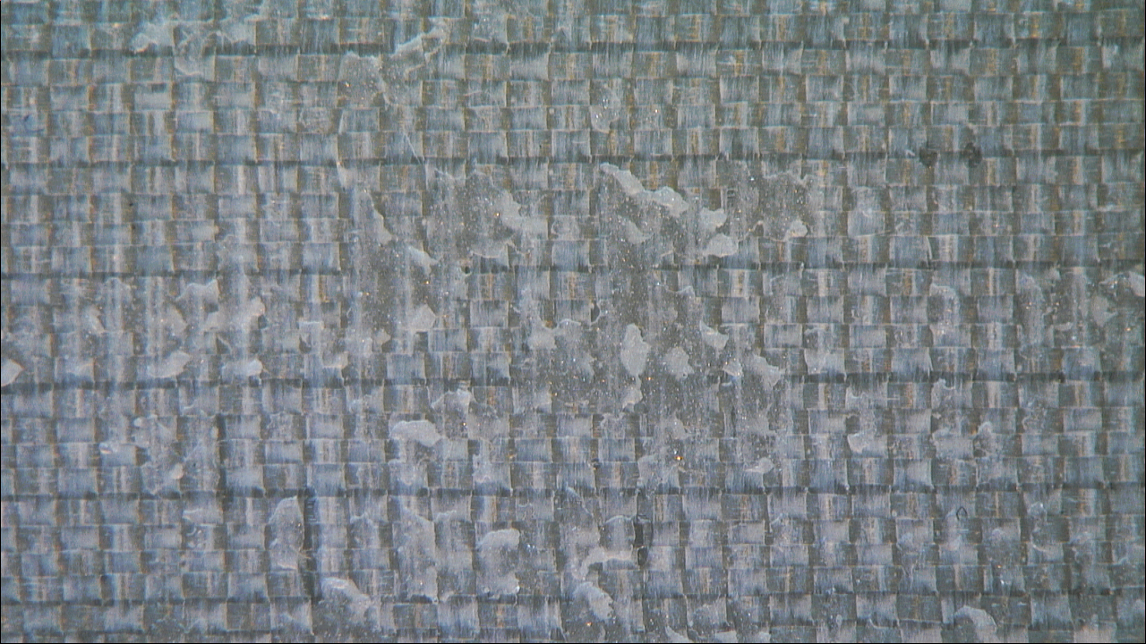
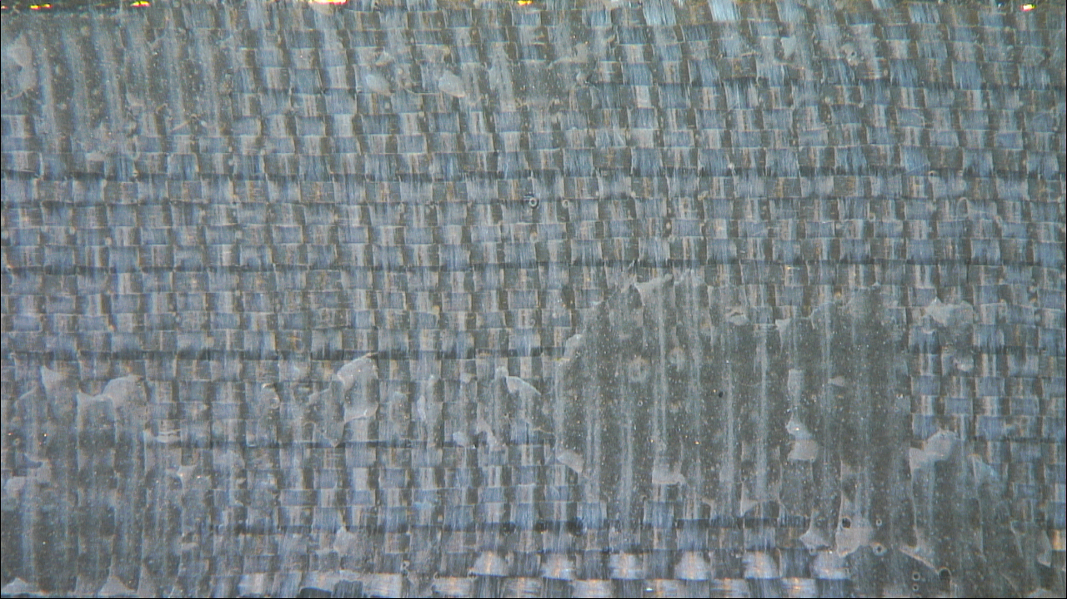
Mode of failure- Aluminum&MY750
Plasma
Sandblasting
Sandblasting + Plasma
Plasma treated surface
Sandblasted surface
Sandblasted + plasma
Surface after roller-peeling
Surface after roller-peeling
Surface after roller-peeling
Fiber glass after roller-peeling
Fiber glass after roller-peeling
Fiber glass after roller-peeling

Slide 13
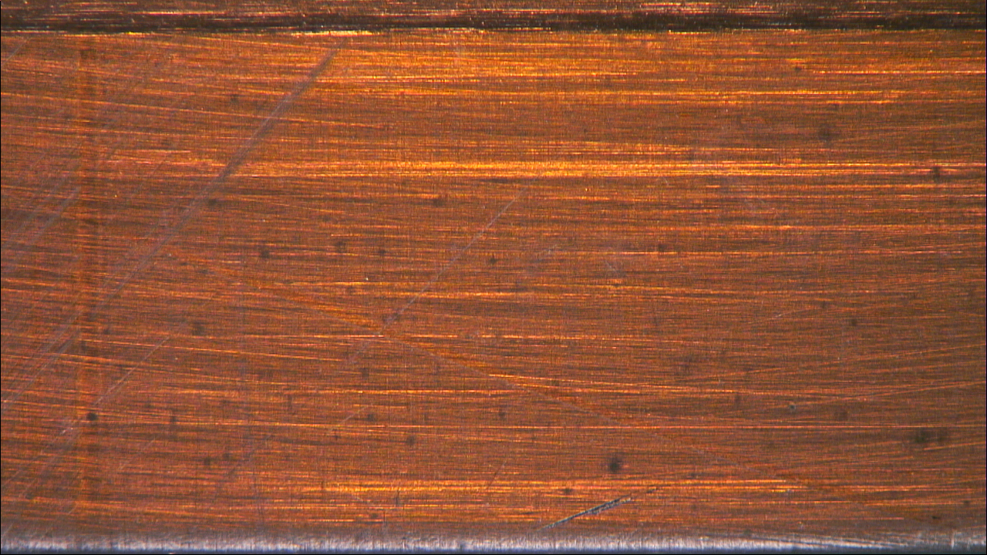
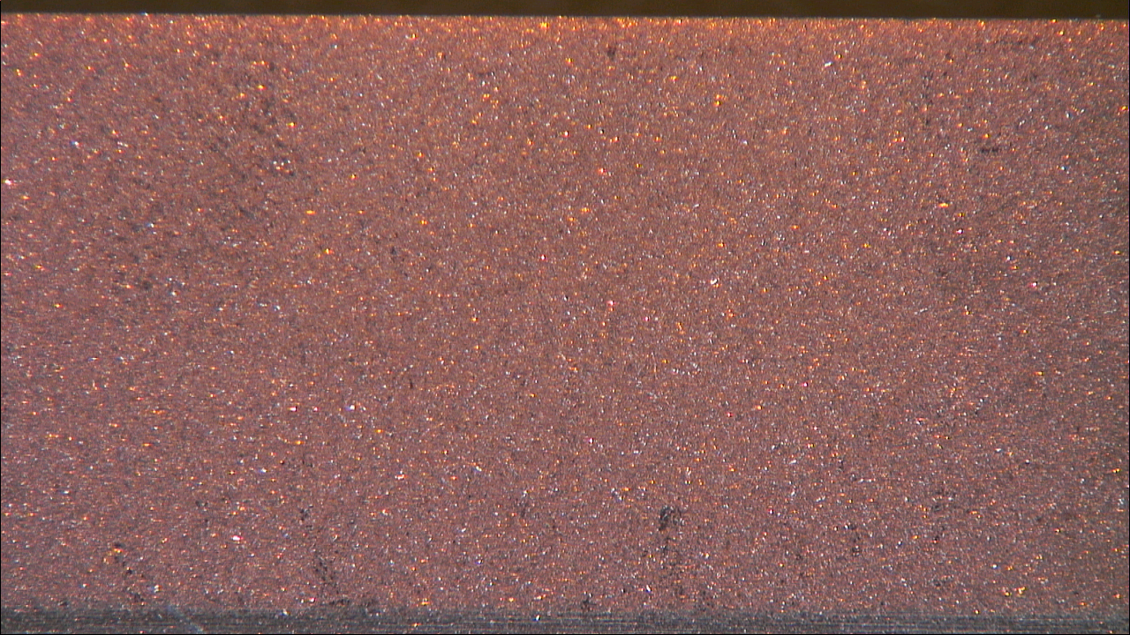
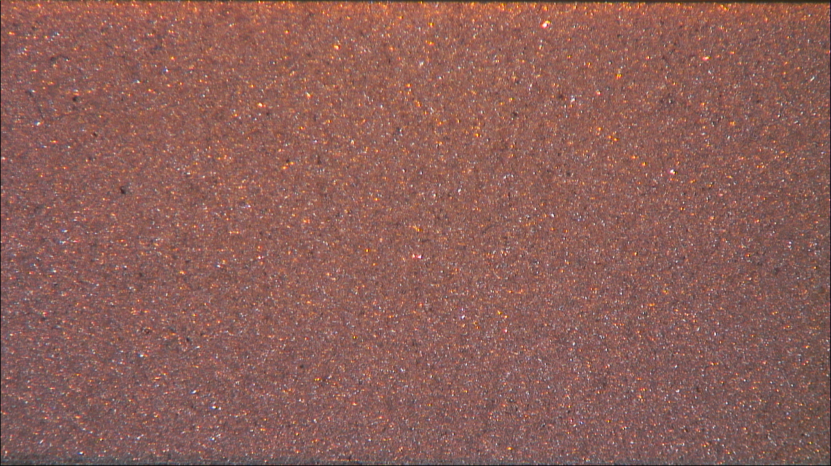
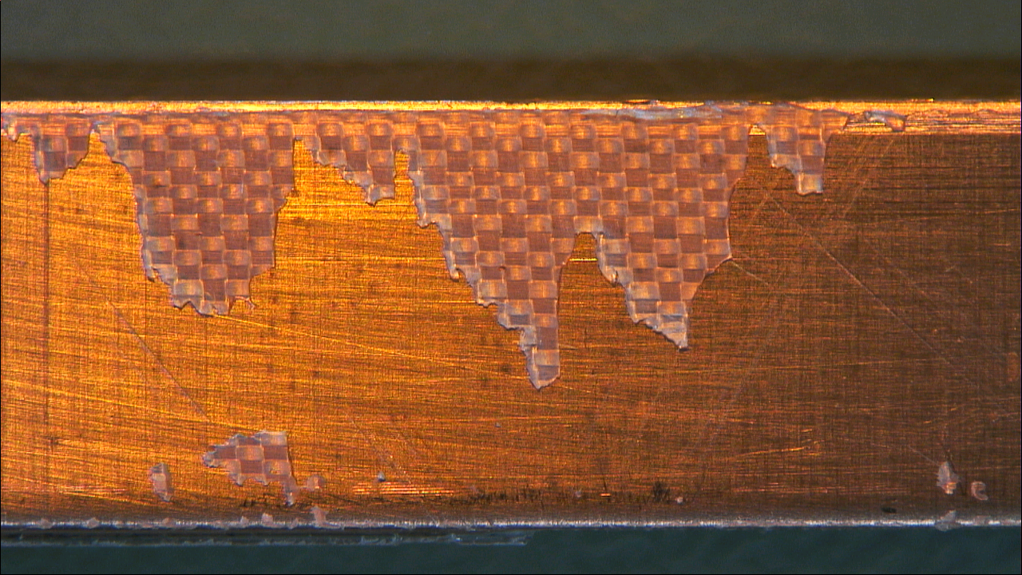
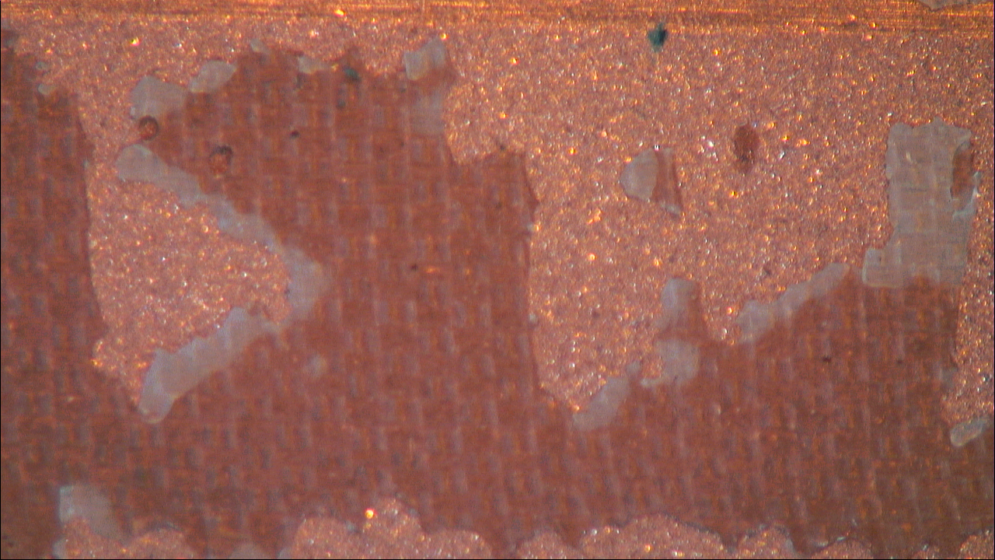
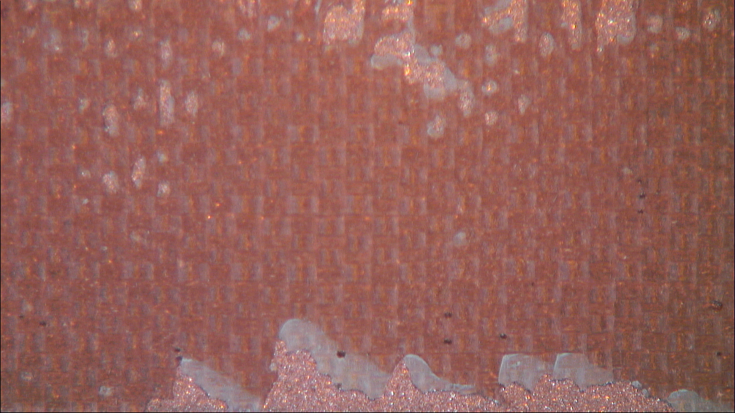
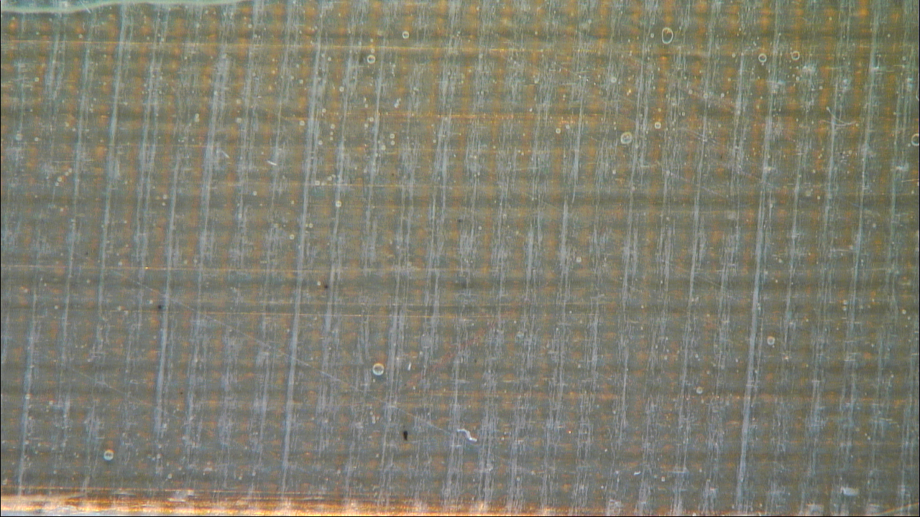
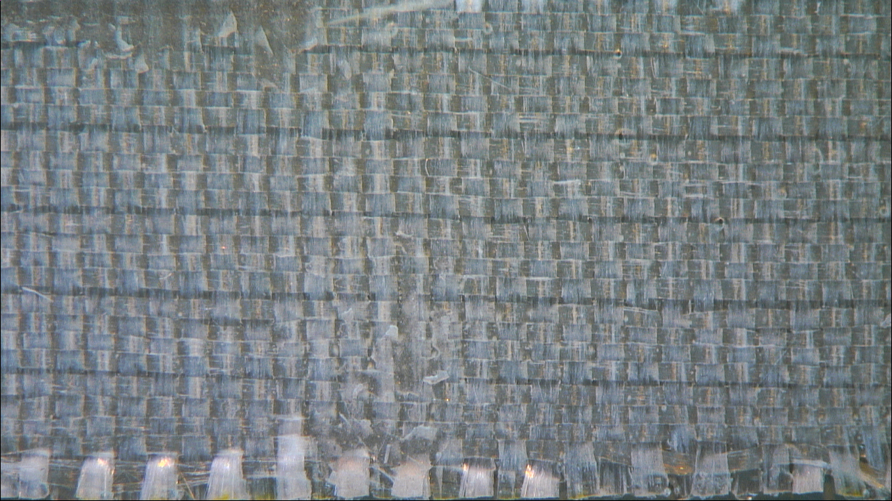
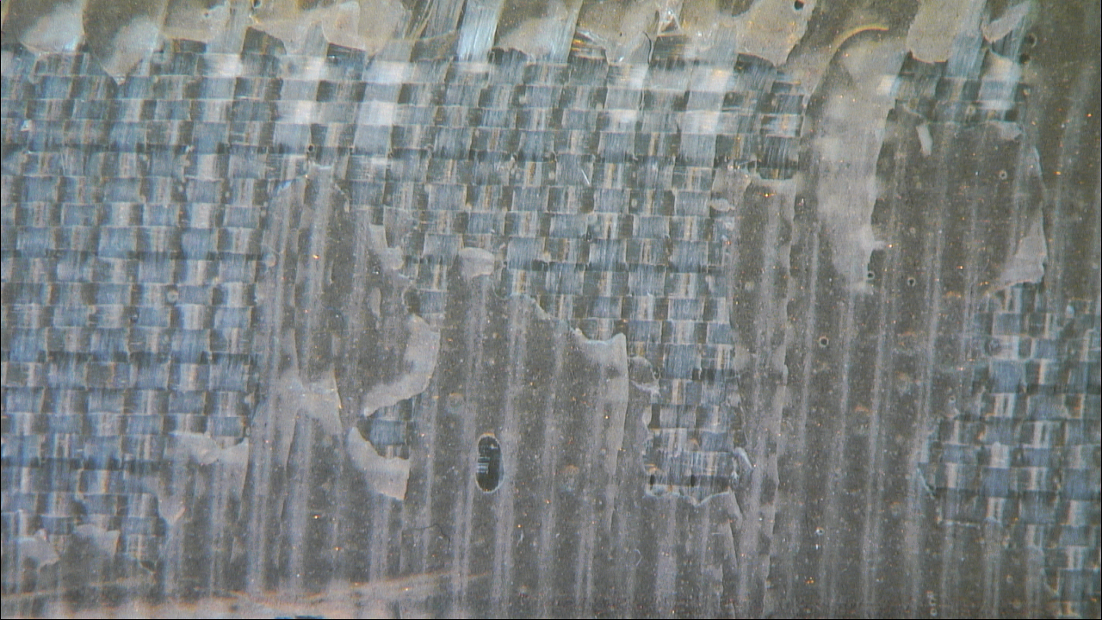
Mode of failure- Copper&MY750
Plasma
Sandblasting
Sandblasting + Plasma
Plasma treated surface
Plasma treated surface
Sandblasted surface
Sandblasted + Plasma
Surface after roller-peeling
Surface after roller-peeling
Surface after roller-peeling
Fiber glass after roller-peeling
Fiber glass after roller-peeling
Fiber glass after roller-peeling

Slide 14
Work in progress and future goals
A mold for making the samples for the roller peel resistance test is in the manufacturing phase. This will provide us with more reproducible samples and same quantity of resin in every sample.
We now have a plasma processing apparatus in the polymer laboratory, so it would be better, since the ideal time to do plasma treatment is right before bonding.
Since fiber glass is extremely fragile and breaks sometimes while peeling-off, we would be testing the samples by using Kevlar, carbon fiber.
Testing with heat treated fiber glass, to see if the adhesion properties are different after treatment.
Testing with more substrates and resins for more statistics.

Slide 15
Conclusion
Plasma cleaning produces a pristine surface, ready for bonding and aims to convert low energy surface to higher energy surface.
The surfaces first Sandblasted and then plasma treated gives better results for all the experiments.
MY750 and Mix61 bonds better to substrates than CTD101K and Araldite 2011.
The cohesive failure in all the cases demonstrate very good adhesion of the resin to the substrate.

