Slide 1



Tape Challenge Review
Alastair Dewhurst, on behalf of the RAL Tier-1

Slide 2
Context
RAL is deploying CTA to replace Castor.
  Project has been heavily affected by Pandemic.
To avoid confusion for RAL local users, we are calling our CTA instance Antares.
  It’s just a name and you can also use CTA at RAL if you prefer.
  We are trying to copy CERN deployment model as closely as possible.
Antares has been tested internally for quite a while.
The RAL Tier-1 is replacing its network.
  The new network is being rolled out currently with almost daily changes.
  CTA has been deployed on the new network but during the tests still needed to access Echo and LHCOPN via the old network.
    Many aspects of both the Data and Tape challenges were network bottlenecked to 40Gb/s.

Slide 3
Requirements
Requirements taken from Tape Challenge document.
We did not have time to get ALICE authz to work with Antares and so they tested Castor.
50:50 split of tape hardware between Castor and Antares.
  10 x TS1160 drives each.
 | Reads (DT) GB/s | Writes (DT) GB/s | Reads (A-DT) GB/s | Writes (A-DT) GB/s | Castor / Antares
ALICE | - | 0.08 | 0.05 | 0.08 | Castor
ATLAS | 0.4 | 1.4 | 1.2 | 0.7 | Antares
CMS | 0.1 | 0.9 | 1.5 | 0.1 | Antares
LHCb | - | 2.92 5.84 | 1.12 | - | Antares

Slide 4


Castor
Notes:
The abstract pattern can be removed or repositioned if required. Be careful to ‘Send to Back’ so that it does not obscure any important information.

Slide 5
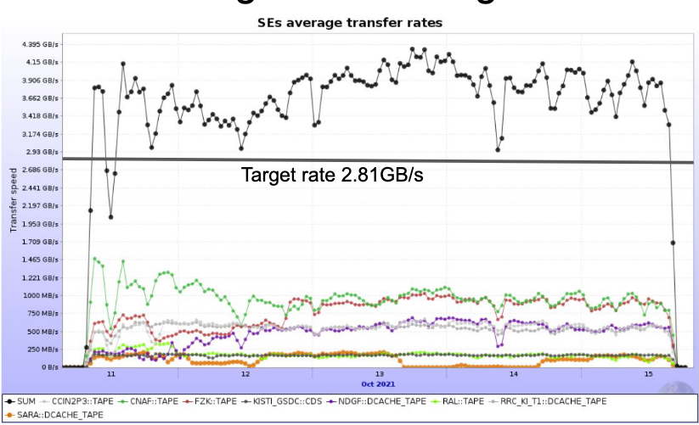
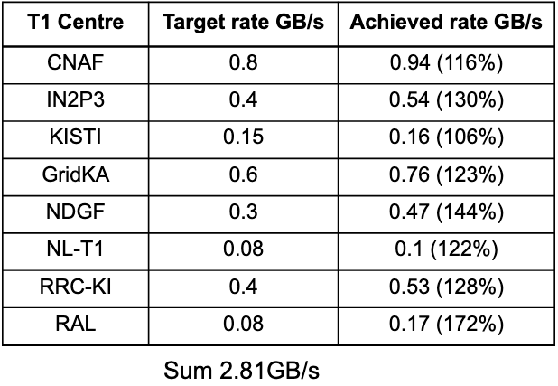
ALICE
Slides taken from Latezchar’s talk.
Comfortably managed to hit target.

Slide 6
Antares
Notes:
The abstract pattern can be removed or repositioned if required. Be careful to ‘Send to Back’ so that it does not obscure any important information.

Slide 7
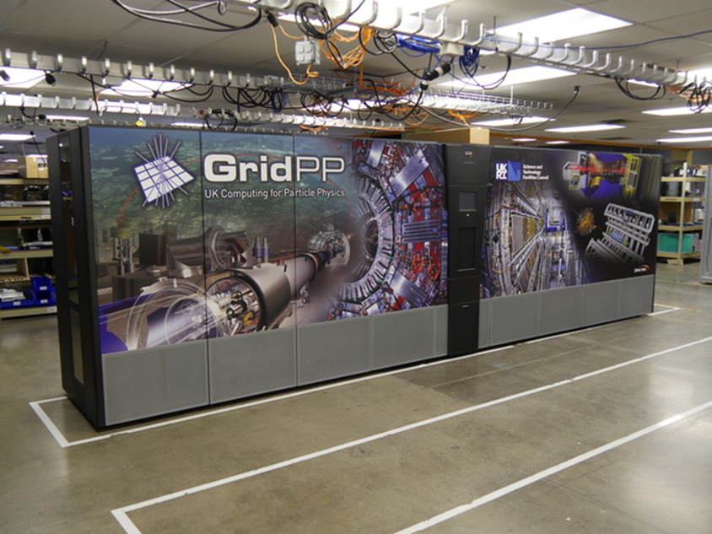
Planned Antares setup
XRootD Client
Data
Communication
Data
EOS cluster
CTA Frontend/CTA CLI
x7
x1
CTA Catalogue
Tier-1 Spectra Logic
Tfinity tape library
TS1160 Tape Drives
CTA Tape Servers
CTA object store
x5
x4
x10

Slide 8
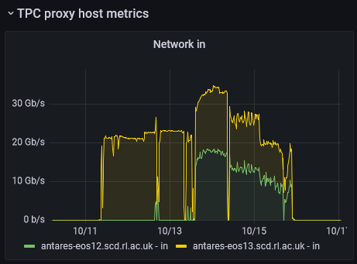
Actual Antares setup
XRootD Client
Started with one proxy (25Gb), increased to two on Wednesday the 13th
TPC proxies
Data
Communication
Data
EOS cluster
CTA Frontend/CTA CLI
x7
x1
CTA Catalogue
Tier-1 Spectra Logic
Tfinity tape library
TS1160 Tape Drives
CTA Tape Servers
CTA object store
x5
x4
x10

Slide 9
XRootD TPC proxies
We were unaware we would need these
Need to understand the correct hardware for these
  Used spare EOS nodes for the Tape challenge
Single TPC proxy allowed us to reach 25Gb/s throughput, second one allowed us to reach 40Gb/s.
The RAL firewall caused issues with stalled transfers, disabling TCP selective ACKs resolved this.
  Firewall will be completely bypassed once in full production.

Slide 10
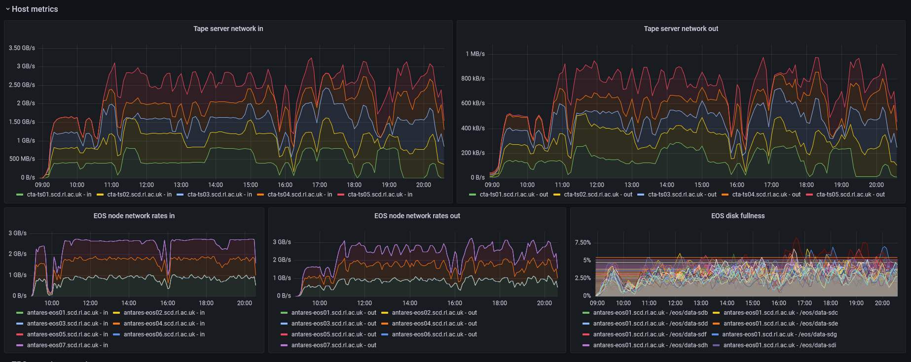
Day 1 – ATLAS and LHCb Archiving
0900 – 2100 11th October
Notes:
Atlas started at 9AM, LHCb at 11AM
Single TPC proxy was saturated from the start
Eos ingest capped at ~3GB/s, but the rate out to tape doubled when LHCb started writing, due to the extra tape drives (max 4 per VO for archive, AND max 4 per VO for retrieve)
EOS disk worked as expected, buffer remained practically empty throughout the day. The 3GB/s in and out was easily supported by the 3 nodes in the default space

Slide 11
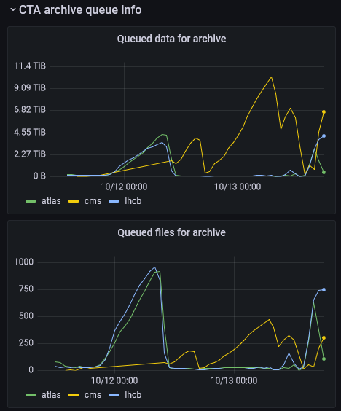
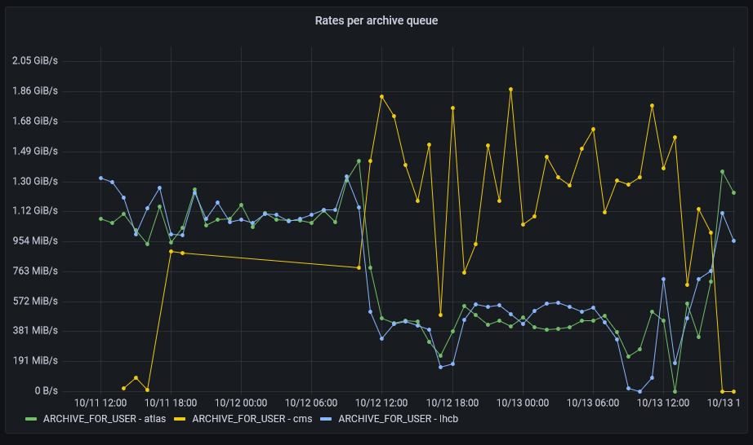
Day 2 – CMS archive starts
CMS had much larger file sizes
  The limited number of transfer slots on the TPC proxy meant they could get more data into EOS and therefore more data to tape
We needed more bandwidth in, time for another proxy
1100 11th – 1300 13th October

Slide 12
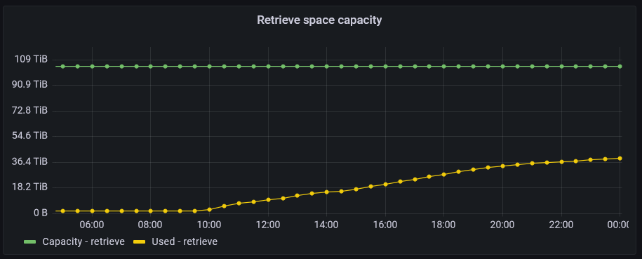
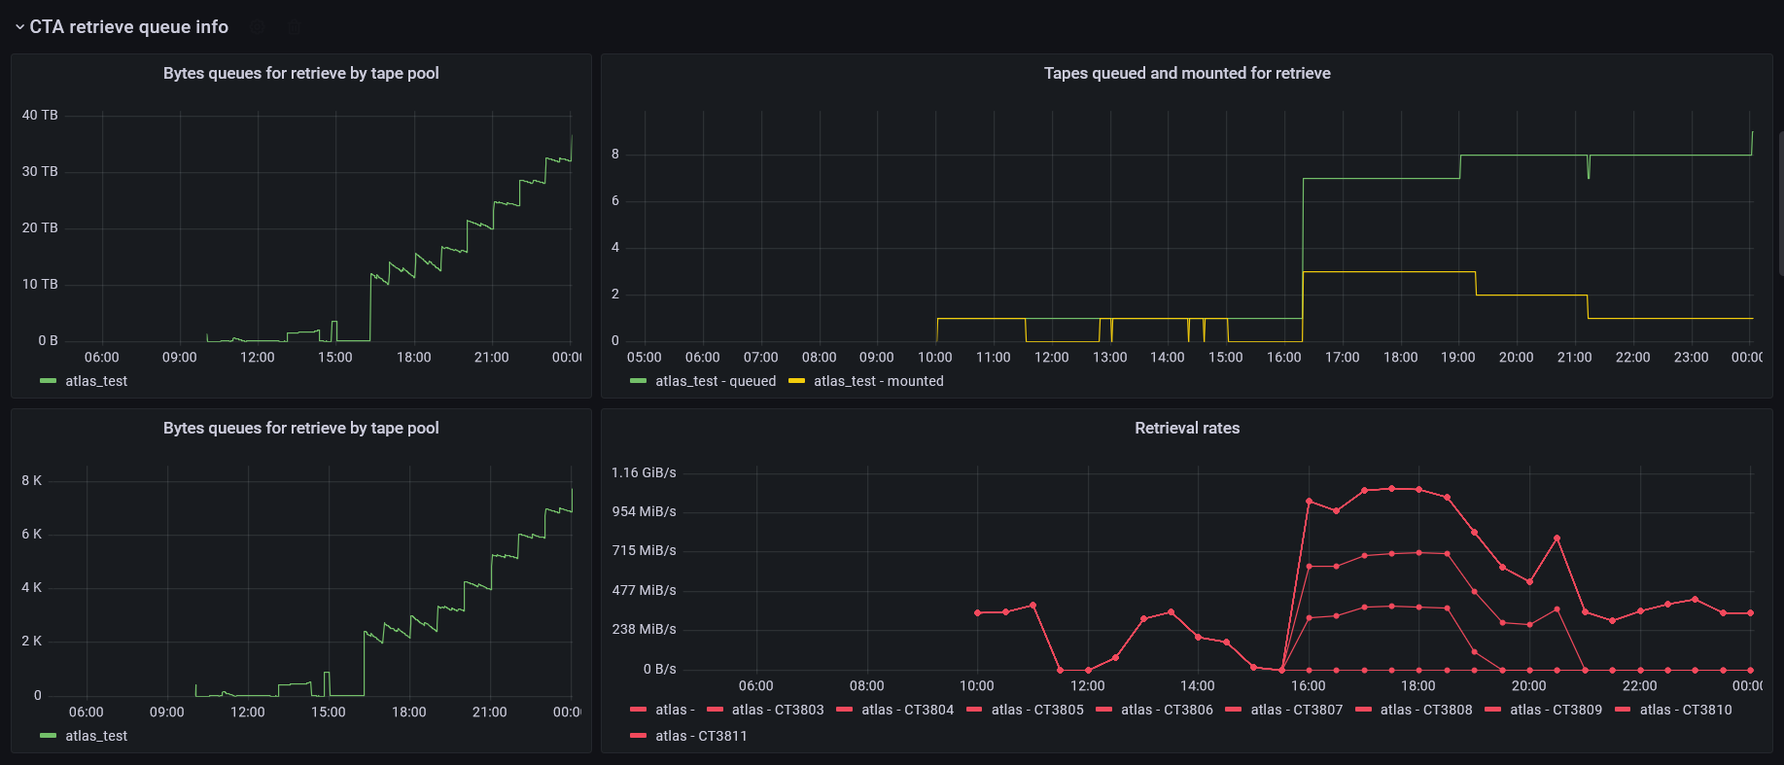
Day 3 – Atlas recall starts
0500 – 2300 13th October
Retrieval started well, rates looked good.
This lasted for a few hours, but tape drive demand from the archive queues stopped the retrieval.
Notes:
Retrieval started well, rates looked good.
This lasted for a few hours, but tape drive demand from the archive queues stopped the retrieval

Slide 13
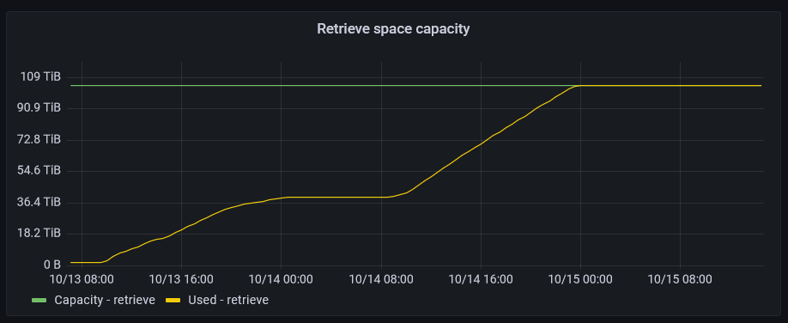
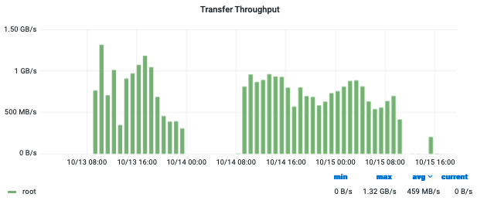
Recall buffer fills up
0800 13th – 0800 15th October
Atlas recalls continued when they could get tape drives, and the rates to ECHO looked good.
The retrieve buffer was not being emptied.
  Later discovered Garbage collection settings were incorrect.
  FTS had not been “told” to delete files.
DDM monitoring of transfers to Echo
Notes:
Atlas recalls continued when they could get tape drives, and the rates to ECHO looked good
The retrieve buffer was not being emptied. It was not clear why this was the case.

Slide 14
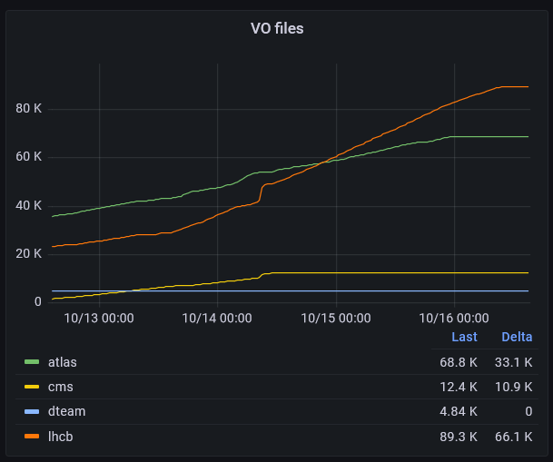
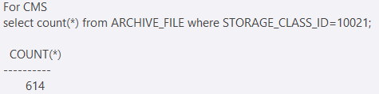
Where did CMS’ files go?
On Thursday, CMS reported that large numbers of files in Rucio were not present on Antares
The data was still on the tapes and were not in danger of being deleted.
Further investigation found that most CMS files were in the CTA recycle bin.
  Tools to remove things from the recycle bin are still in development!
It is believe that CMS triggered the deletion when they removed the Rucio rule used to copy the files in.
Notes:
Atlas recalls continued when they could get tape drives, and the rates to ECHO looked good
The retrieve buffer was not being emptied. It was not clear why this was the case.

Slide 15
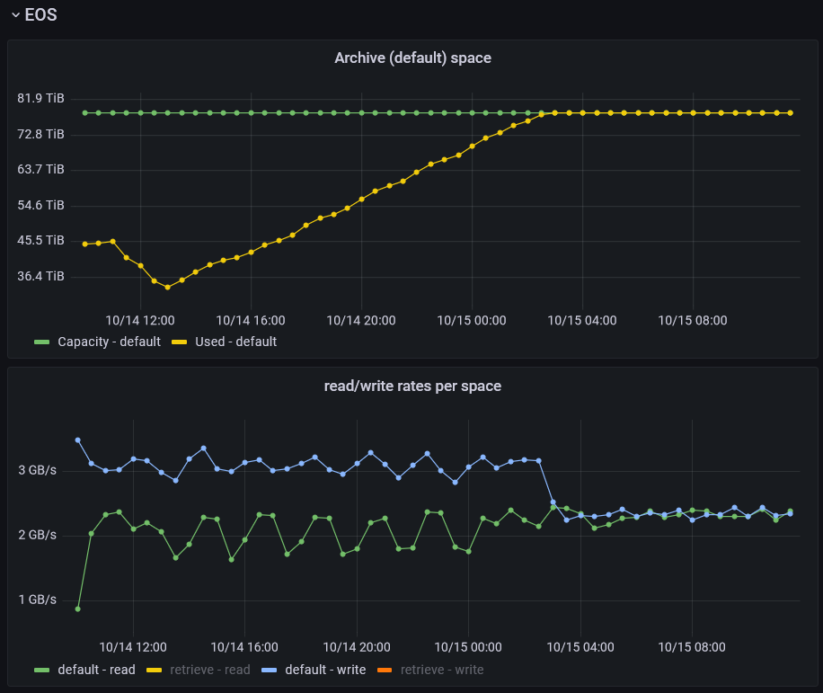
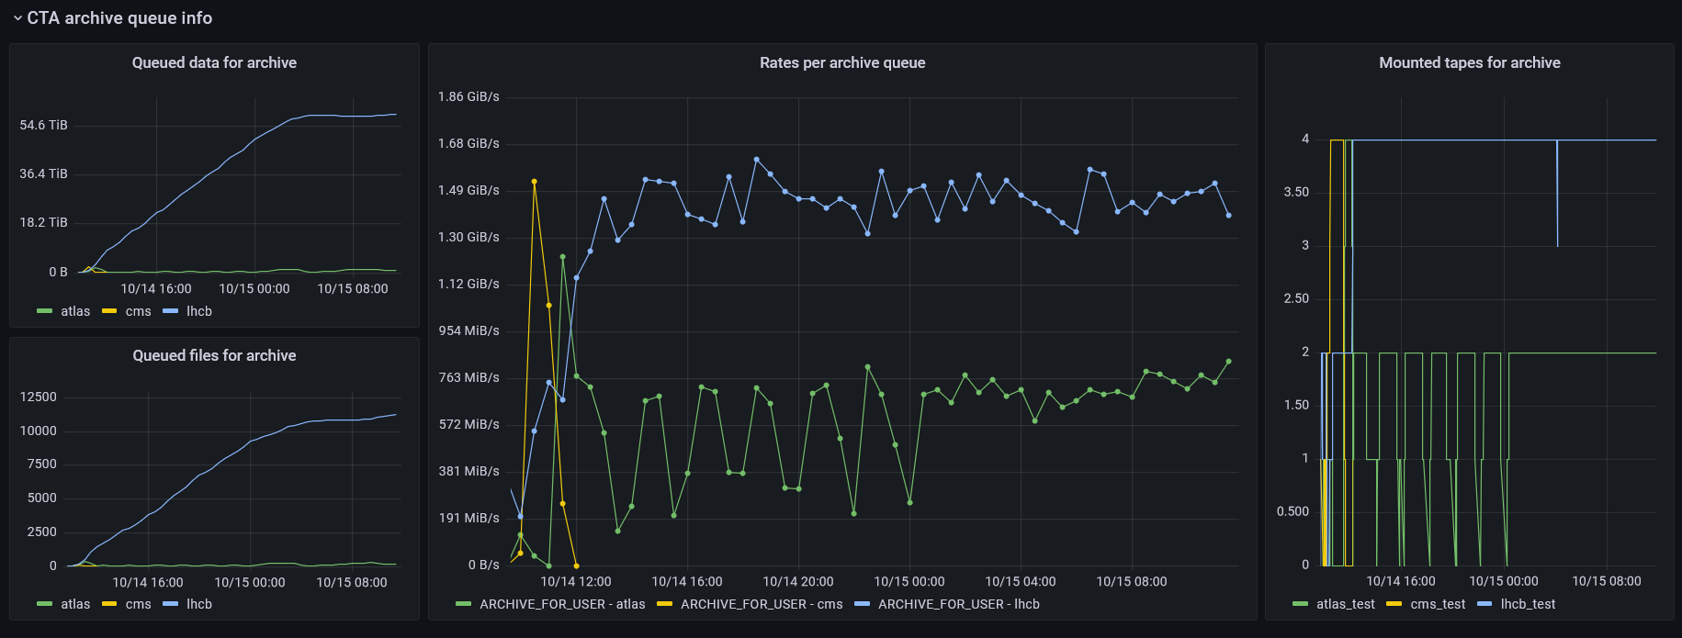
Day 5 – LHCb writes
On Friday, LHCb were the only ones writing into EOS, and so were writing in at over 3GB/s
They were writing to tape 4x drive speed, but also filled up the buffer in 17 hours. At this point reads and writes into EOS default space were matched.
The buffer quickly cleared after LHCb stopped writing.
Notes:
On Friday, LHCb were the only ones writing into EOS, and so were writing in at over 3GB/s
They were writing to tape 4x drive speed, but also filled up the buffer in 17 hours. At this point reads and writes into EOS default space were matched.
The buffer quickly cleared after LHCb stopped writing.

Slide 16
Further testing
Notes:
The abstract pattern can be removed or repositioned if required. Be careful to ‘Send to Back’ so that it does not obscure any important information.

Slide 17
CMS
Because CMS lost their data, they were unable to perform a recall test during the tape challenge.
  Katy Ellis ran additional tests between 1st and 10th November.
Started with a write test: 275TB / 40k files from CERN-EOS to Antares.
Some initial test recalls did not work well, it took several days to resolve these issues.
On 8th November a full recall of the 275TB data to Echo was made.
  This completed on the 10th November.

Slide 18
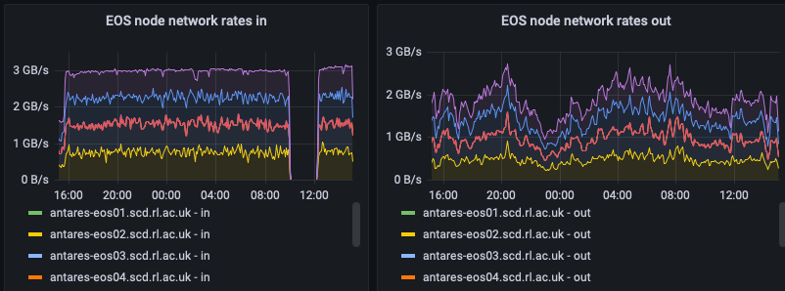
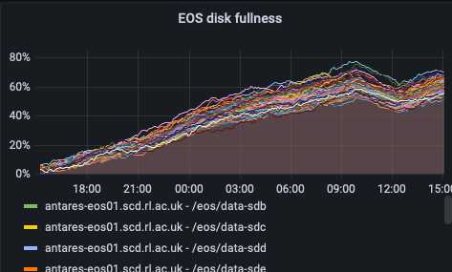
CMS Recalls from Antares
Recall test used (up to) 8 tape drives.
  Consistent recall rate of 3GB/s (out of maximum 3.2GB/s), however it should be noted that all 275TB of data was being recalled.
EOS disk buffer filled up slightly as the rate out of EOS could not keep up.

Slide 19
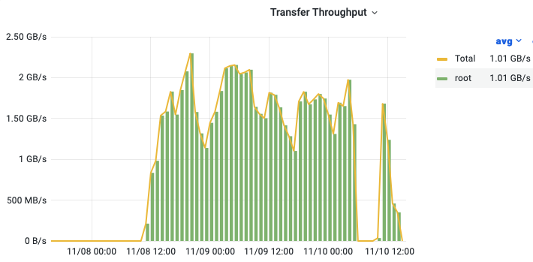
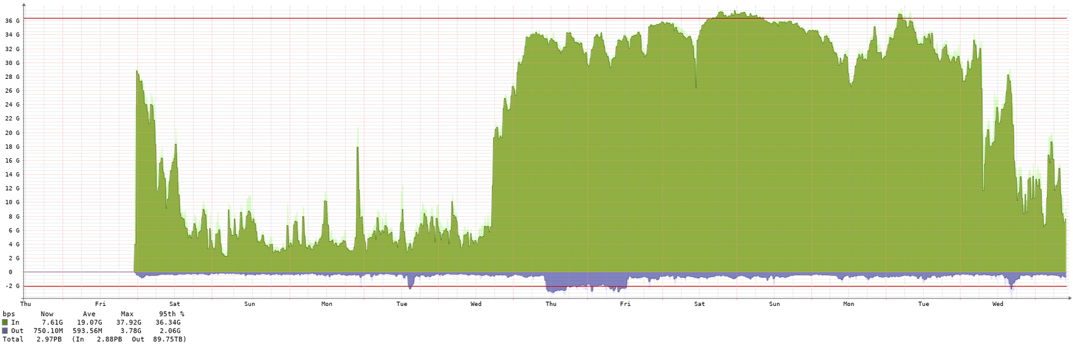
CMS Recalls to Echo
The new 800Gb/s network link between Echo and Antares has not yet been commissioned.
  Defaulted to using old 40Gb/s link which had significant amounts of other traffic on.
CMS monit plot of Antares to Echo transfers
RAL plot of current link between Antares and Echo

Slide 20
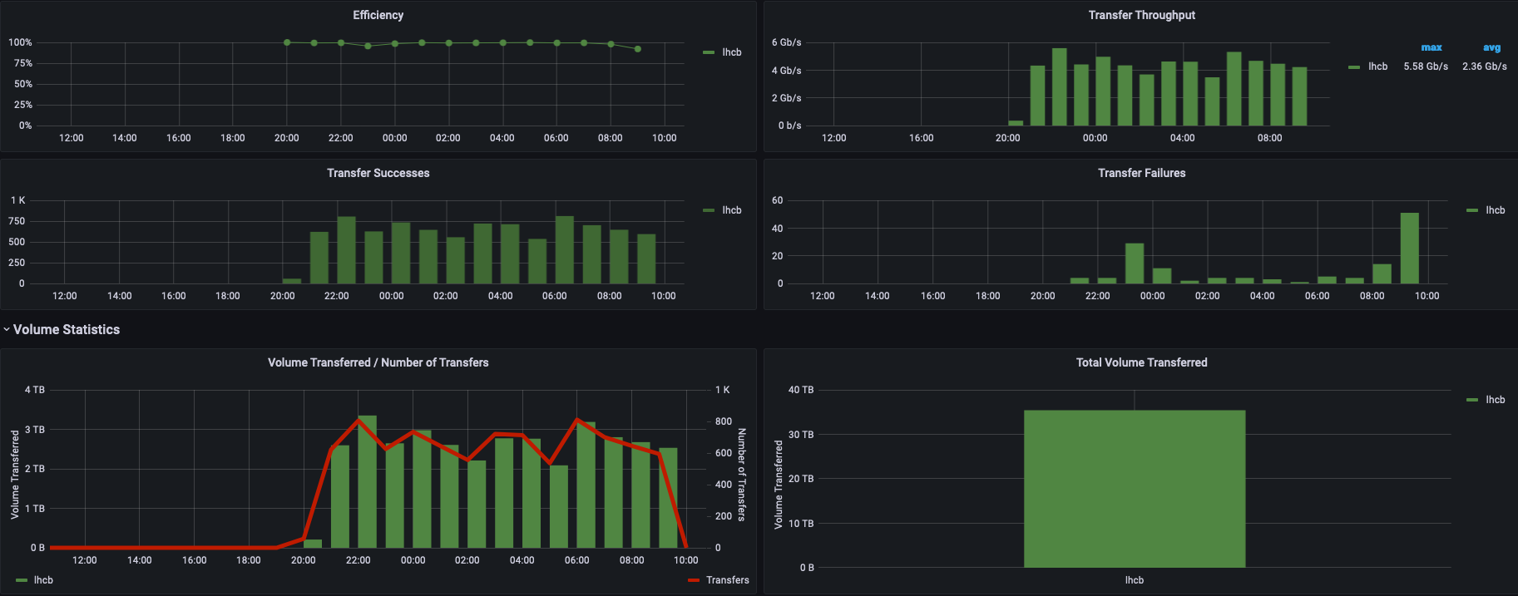
LHCb recall test
LHCb started doing their recall test last night.
  Not yet had a chance to analyze what is happening.
  Transfers between Antares and Echo are now going over 800Gb/s link.

Slide 21
Future plans
The new network is being rolled out currently.
  Majority of improvements should be apparent by December.
  Completion expected before end of January.
We are currently focused on testing the migration procedure from Castor to CTA.
  Database change from Castor to CTA
  Database to EOS namespace change.
Migration plan:
  Aim for at least one dry run before Christmas
  All VO migrated simultaneously during long downtime at the start of 2022.
We need to work with ALICE (soon) to ensure that they can use Anatares successfully.
  Functionality is more of a concern as the required data rate is so low.
For Run 3:
  The number of tape drives should double when we migrate from Castor.
  Additional drives and media are currently being procured as well.
We have no ETA on when Antares will support webdav. It is an experimental feature currently.
  Use XrootD directly or WebDav via multi-hop through Echo.

Slide 22
Conclusion
Antares performed extremely well for writes given the hardware available.
Antares also performed extremely well for reads, although this is likely to have been an unrealistic scenario as all files were located on a small number of tapes.
Antares should have almost 3 times as much tape hardware available at the start of Run 3.
We are focusing on testing migration currently.
We still need to work with ALICE to ensure they can use the endpoint.

