Slide 1

IMC Steering meeting:
Nov. 12, 2021
New Masterclasses:
How many colors does a quark come in?
HENRIK JUNKERKALEFELD*, SVENJA GRANDERATH, SEBASTIAN LÜLSDORF, BARBARA VALERIANI-KAMINSKI, FLORIAN BERNLOCHNER
Based on previous work of JANNIK STAMMNITZ, CHRISTIAN WESSEL, ECKHARD VON TÖRNE
* = junkerkalefeld@physik.uni-bonn.de

Slide 2
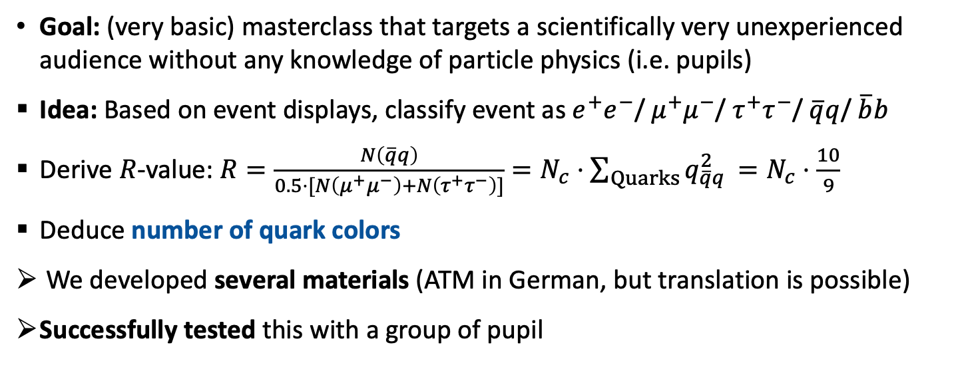
New event-display based masterclass
Goal: (very basic) masterclass that targets a scientifically very unexperienced audience without any knowledge of particle physics (i.e. pupils)
Idea: Based on event displays, classify event as $e^{+}e^{−}$/ $μ^{+}μ^{−}$/ $τ^{+}τ^{−}$/ $\overline{q}q$/ $\overline{b}b$
Derive $R$-value: $R=\frac{N\left(\overline{q}q\right)}{0.5⋅[N\left(μ^{+}μ^{−}\right)+N\left(τ^{+}τ^{−}\right)]}=N_{c}⋅\sum_{Quarks}{q_{\overline{q}q }^{2}}=N_{c}⋅\frac{10}{9}$
Deduce number of quark colors
We developed several materials (ATM in German, but translation is possible)
Successfully tested this with a group of pupil

Slide 3
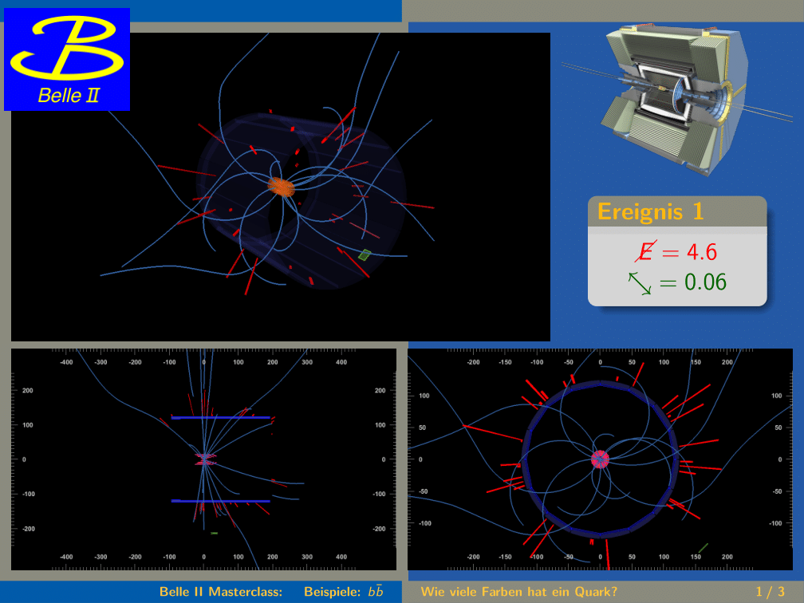
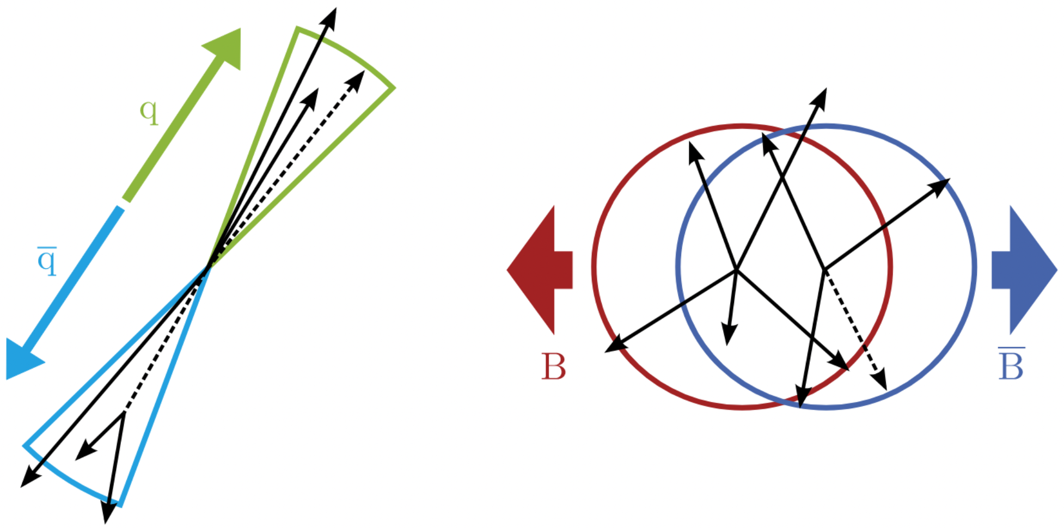

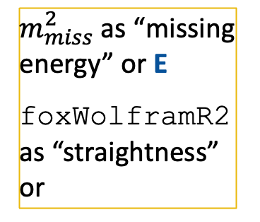
Example
Event display
$$e^{+}e^{−}→Υ\left(4S\right)→\overline{b}b$$
$m_{miss}^{2}$ as “missing energy” or E
foxWolframR2 as “straightness” or

Slide 4
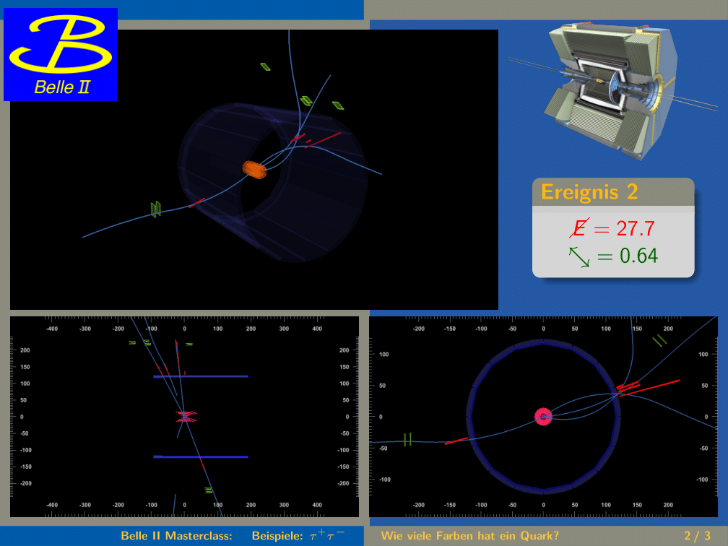
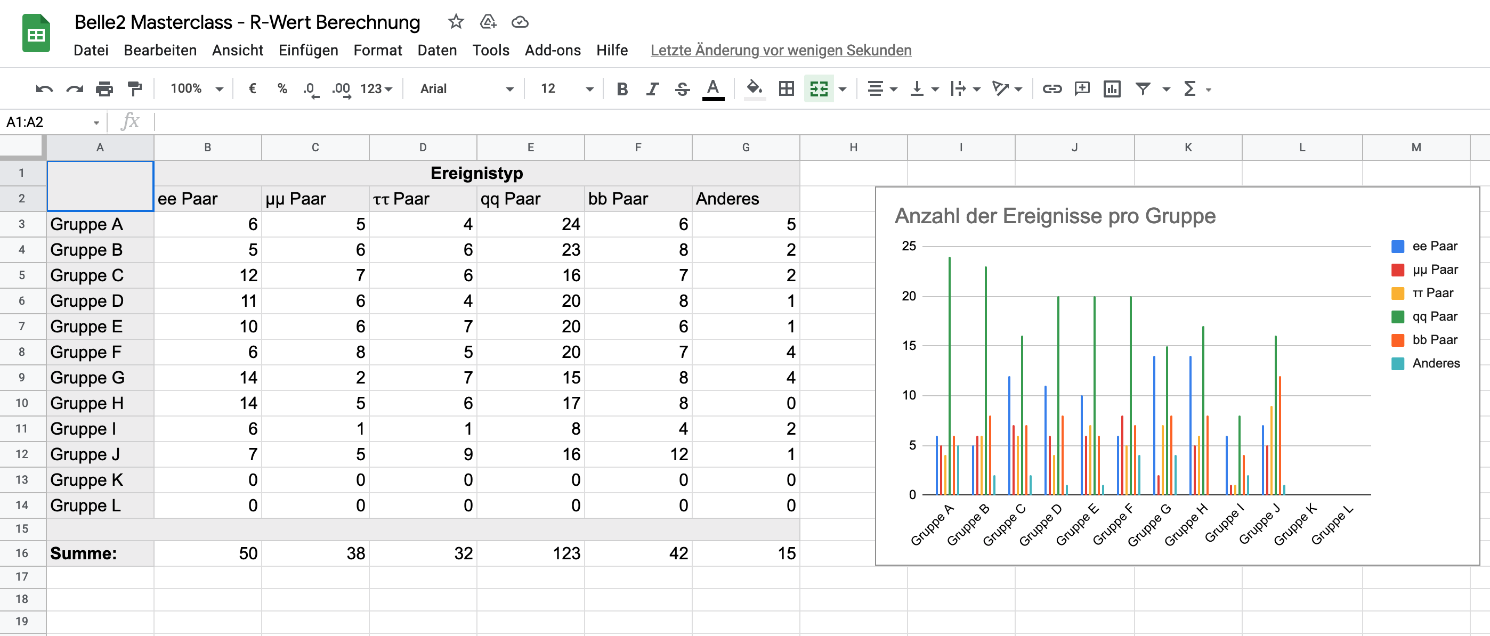
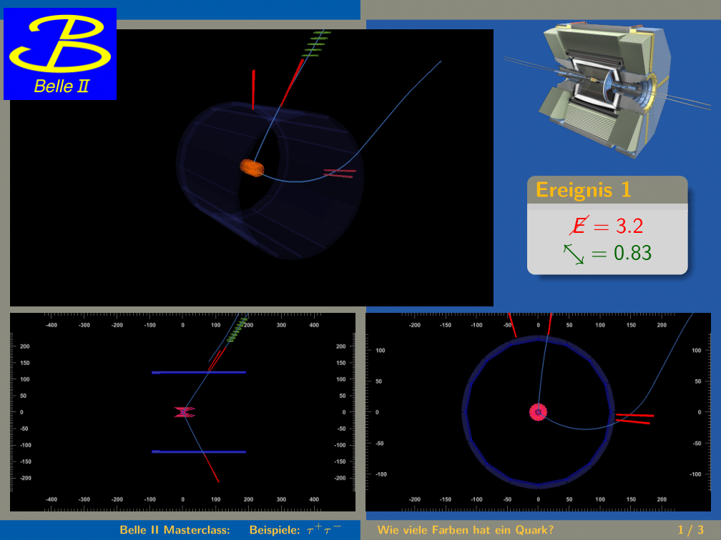

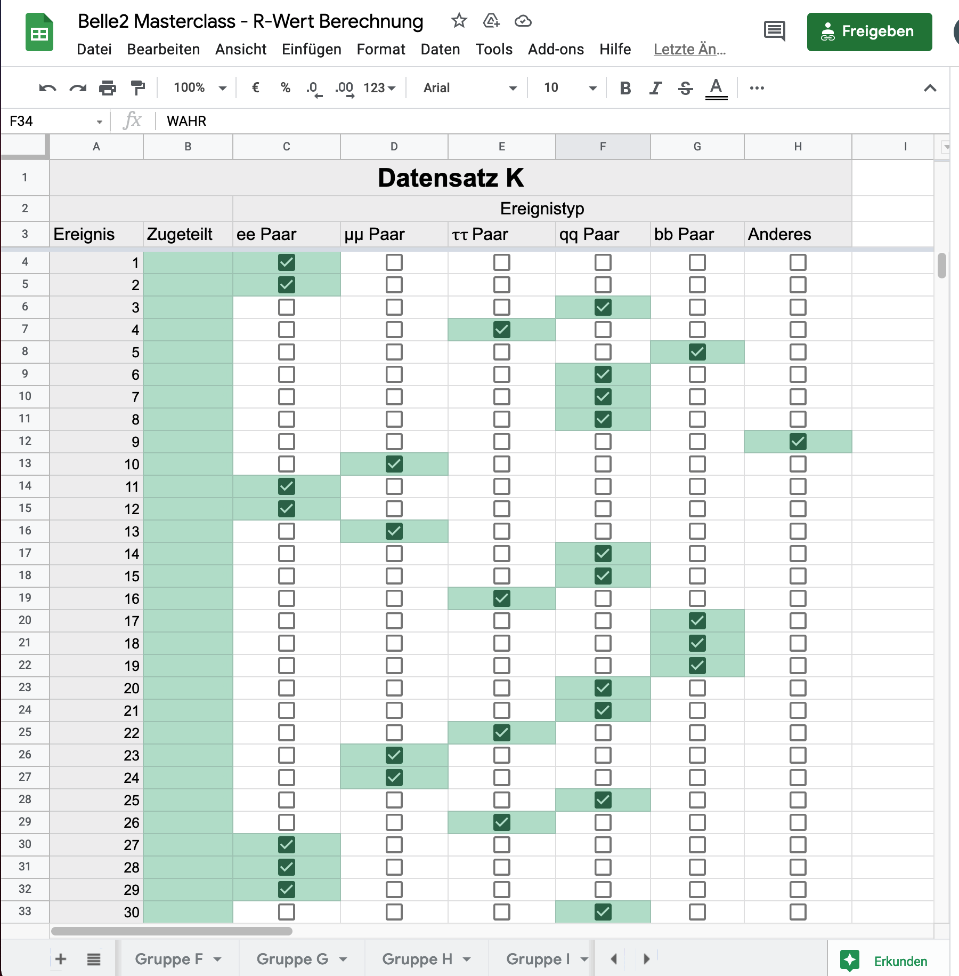
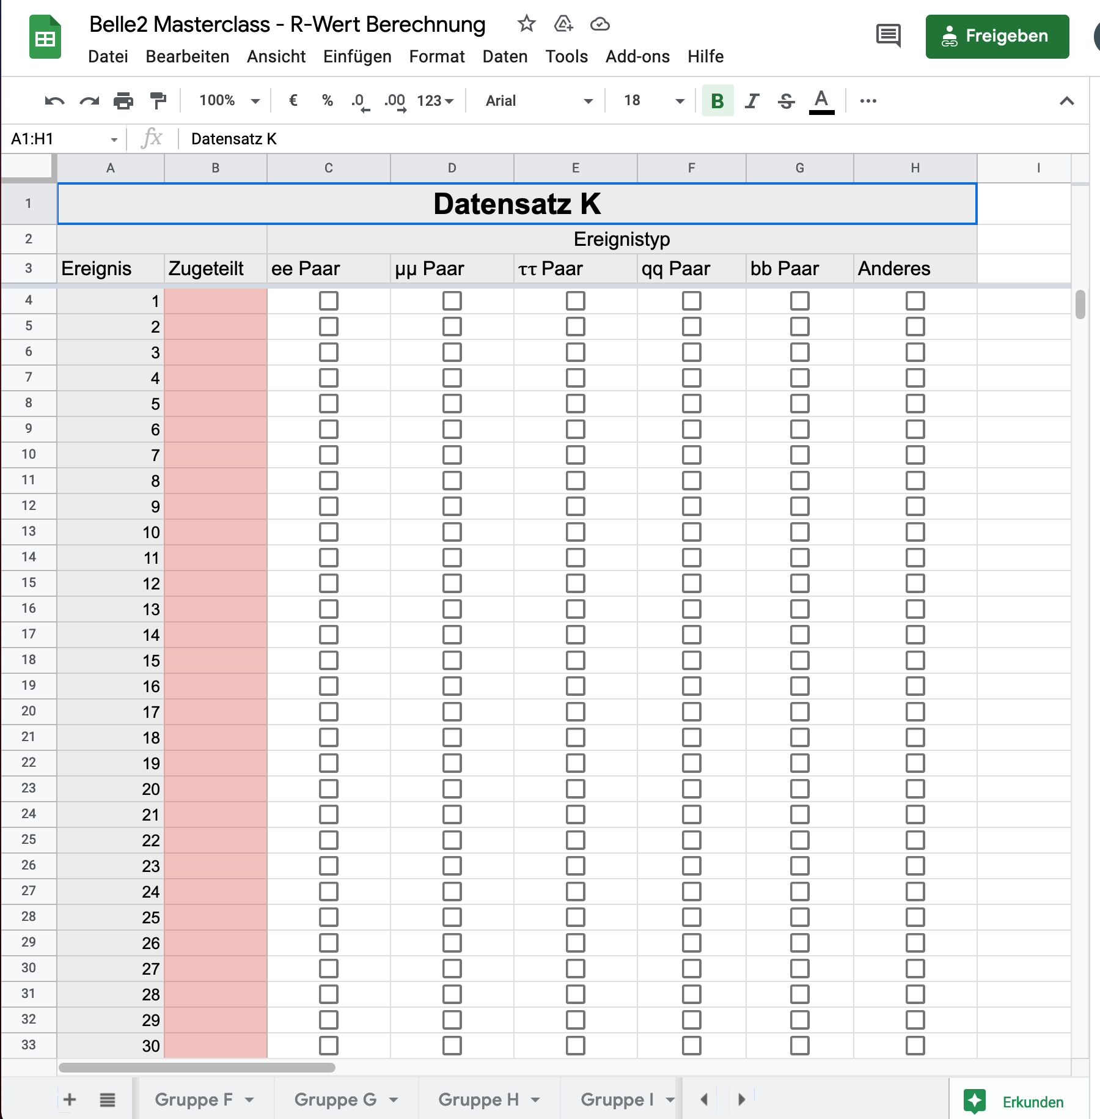
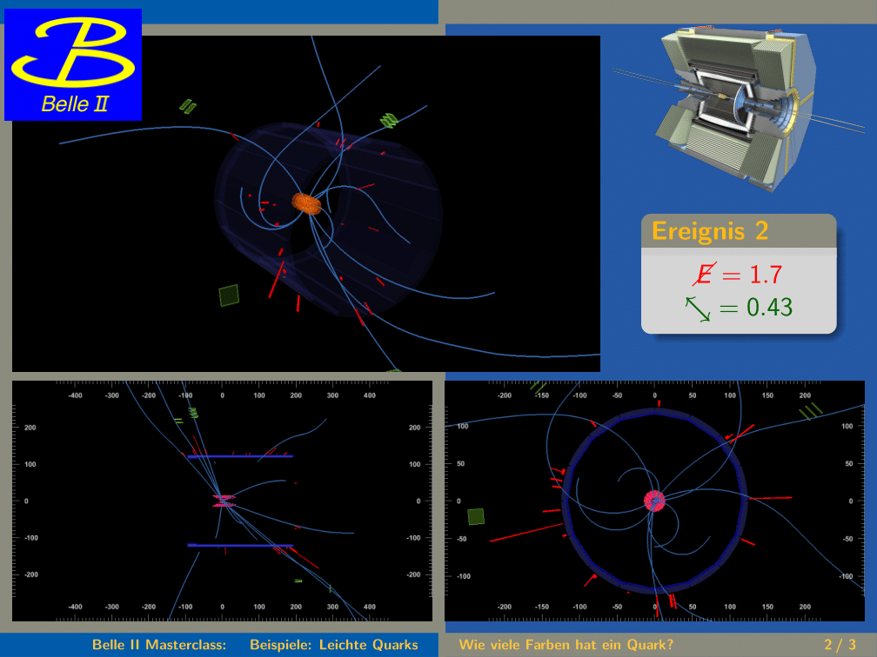
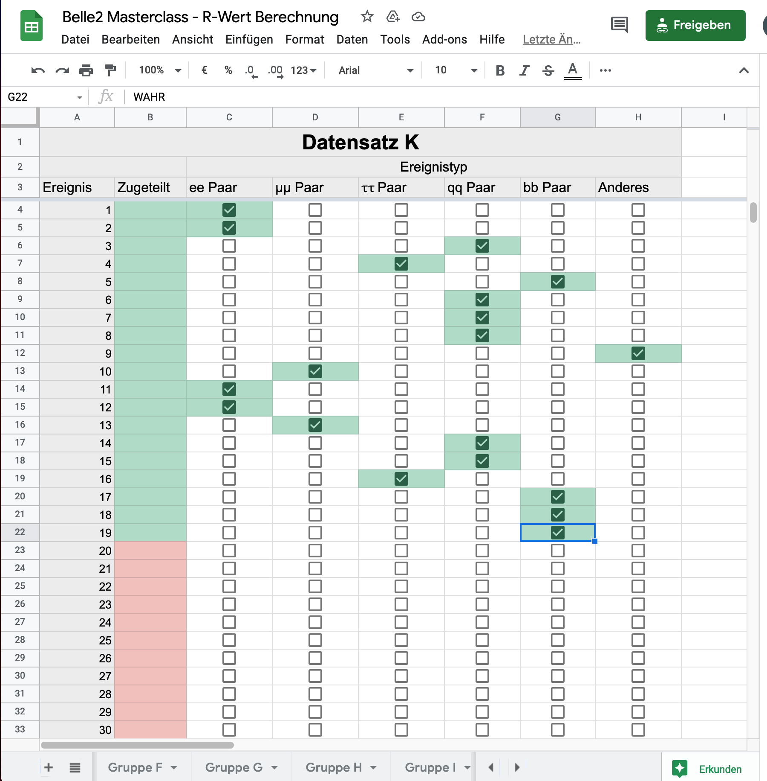
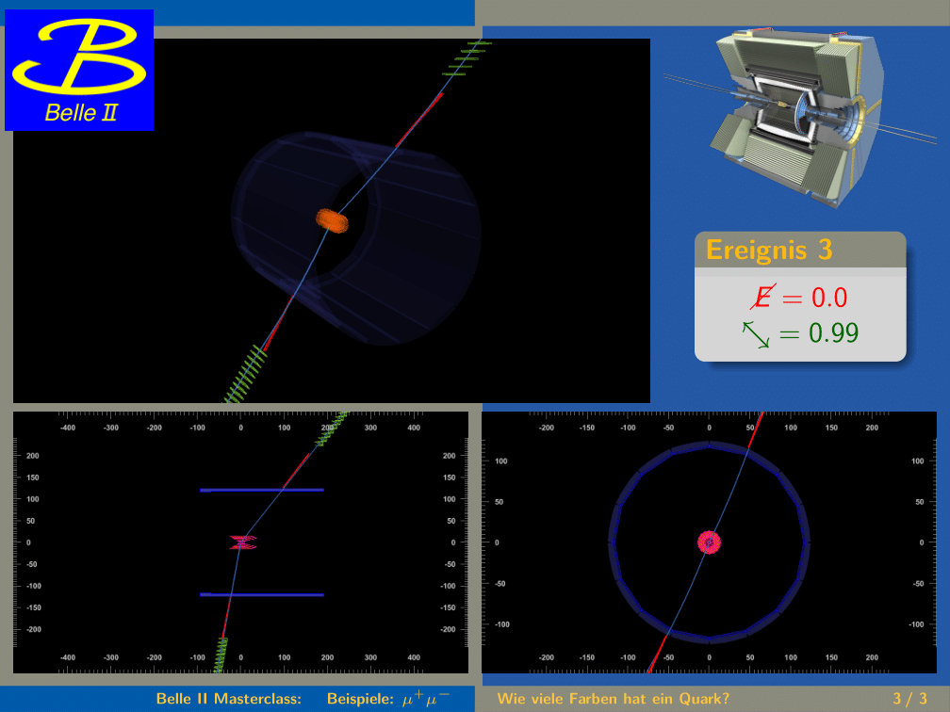
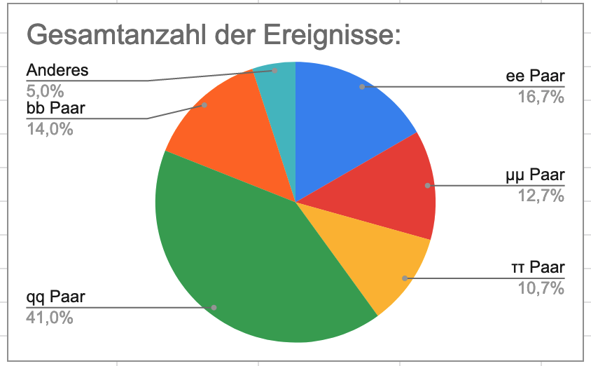
Process classification and quark color extraction
Result website: All entries are automatically summarized and counted
Events are classified and filled in online
Pupils get sets of 50 – 100 events

Slide 5
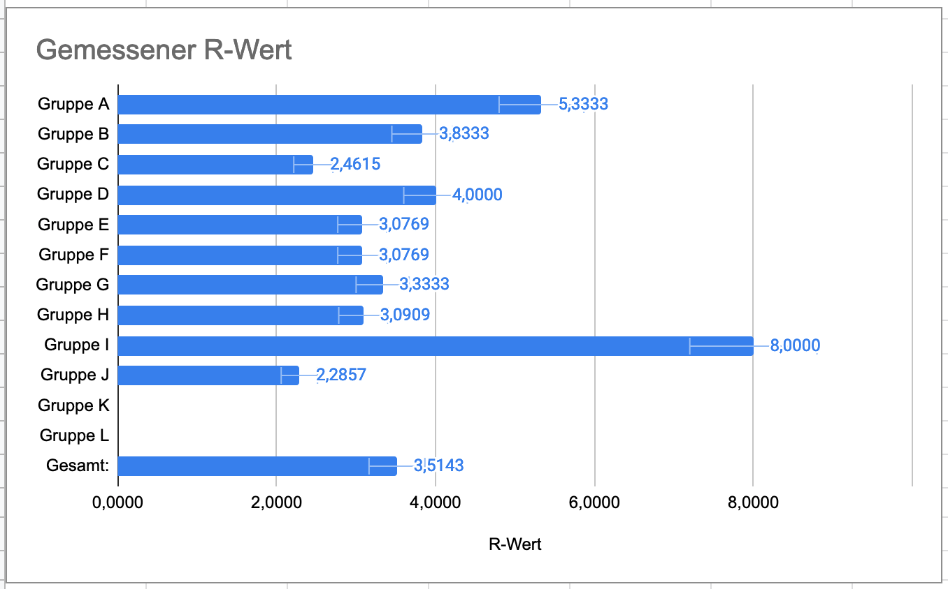
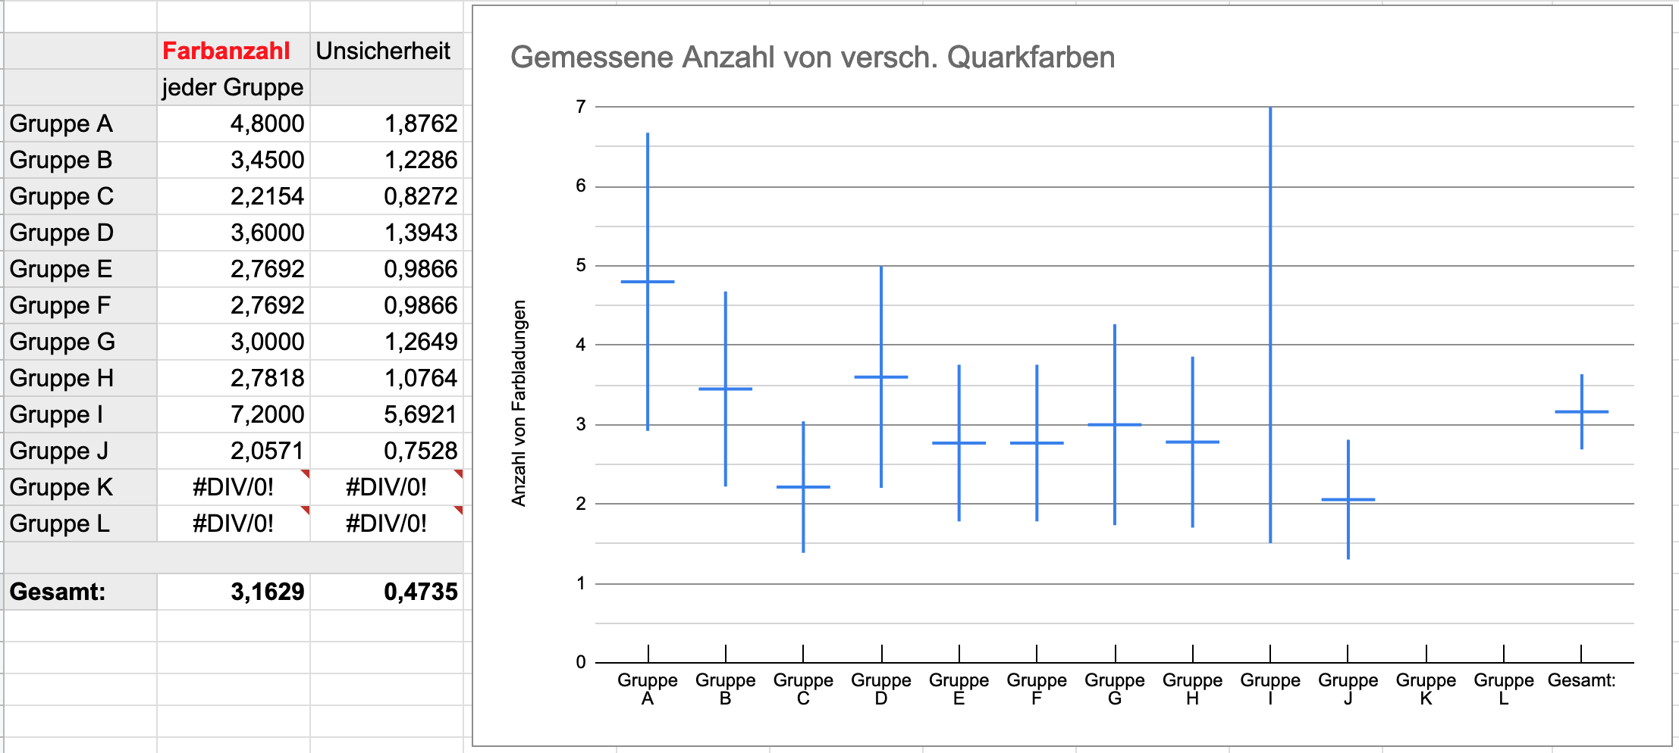
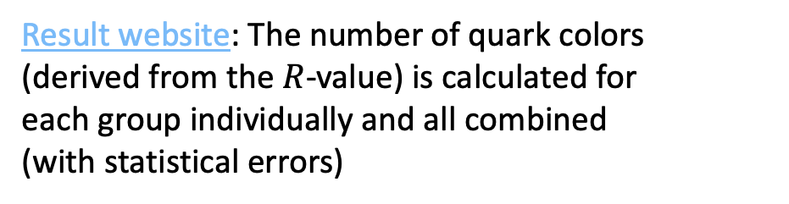
Process classification and quark color extraction
Events are classified and filled in online
Result website: The number of quark colors (derived from the $R$-value) is calculated for each group individually and all combined (with statistical errors)
Pupils get sets of 50 – 100 events

Slide 6
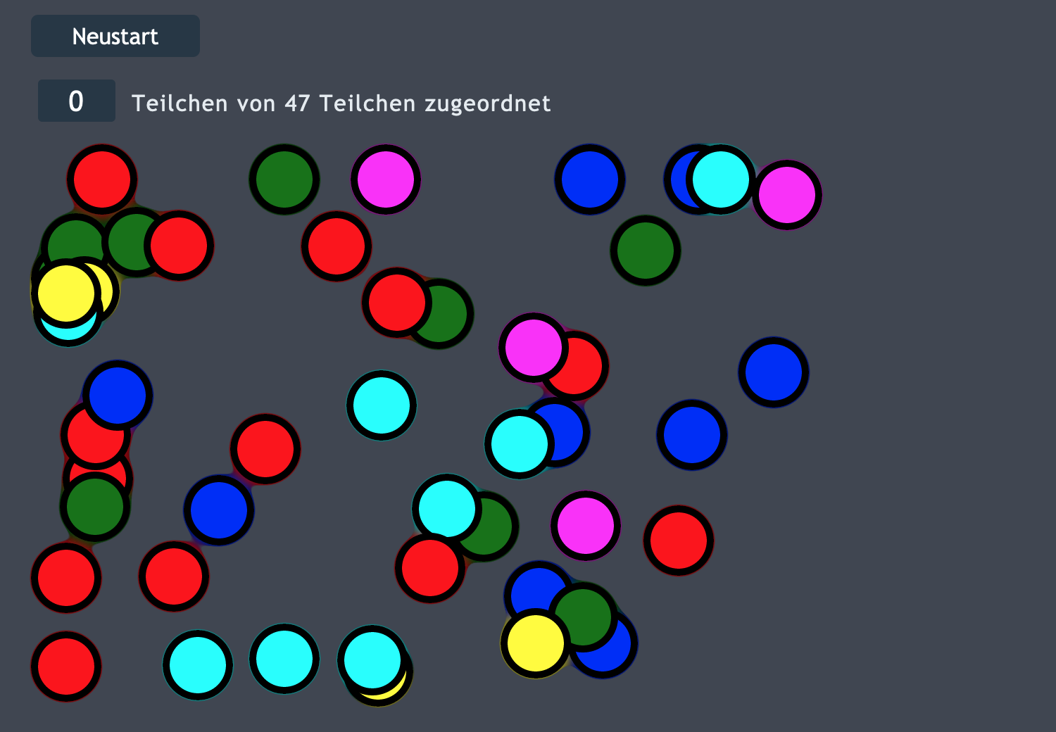
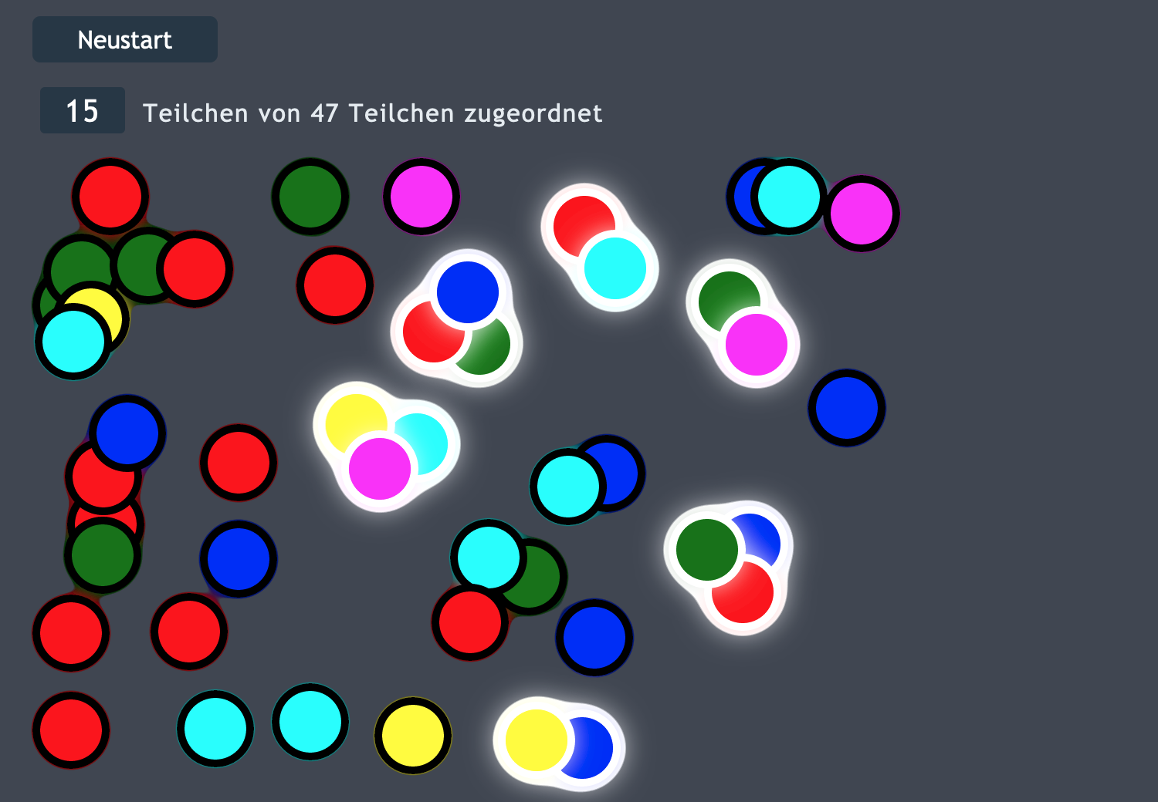
Process classification and quark color extraction
Events are classified and filled in online
Pupils get sets of 50 – 100 events
Interactive color-combination minigame:
Directly learn what “three colors” mean

Slide 7
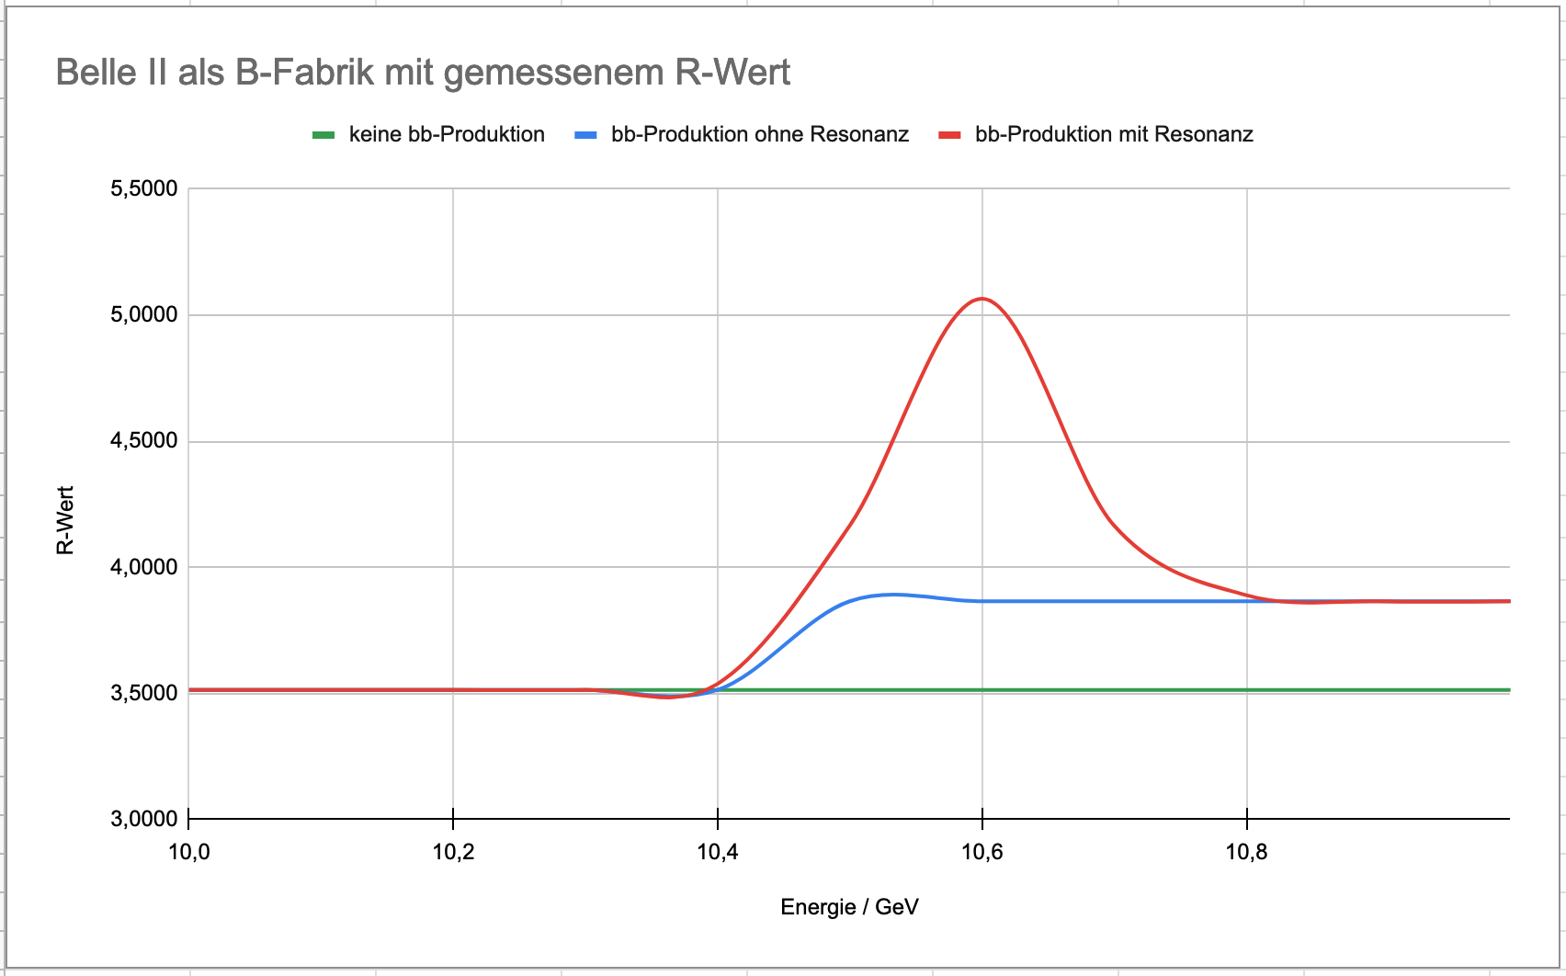
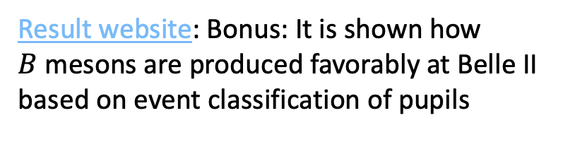
Process classification and quark color extraction
Events are classified and filled in online
Result website: Bonus: It is shown how $B$ mesons are produced favorably at Belle II based on event classification of pupils
Pupils get sets of 50 – 100 events

Slide 8
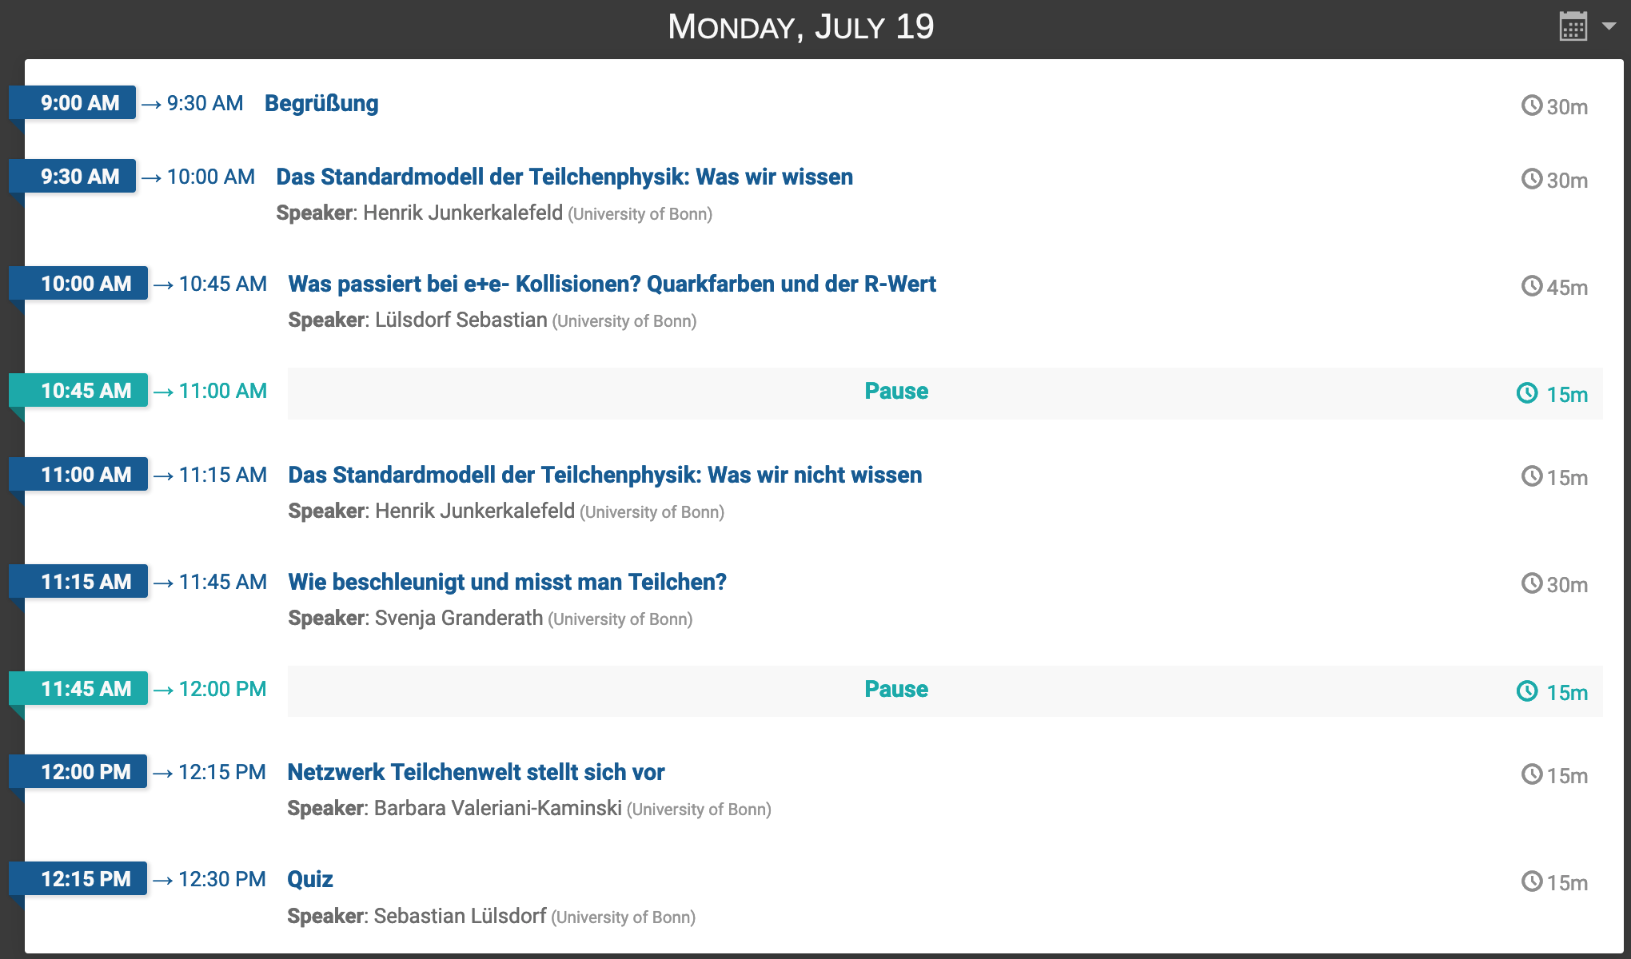
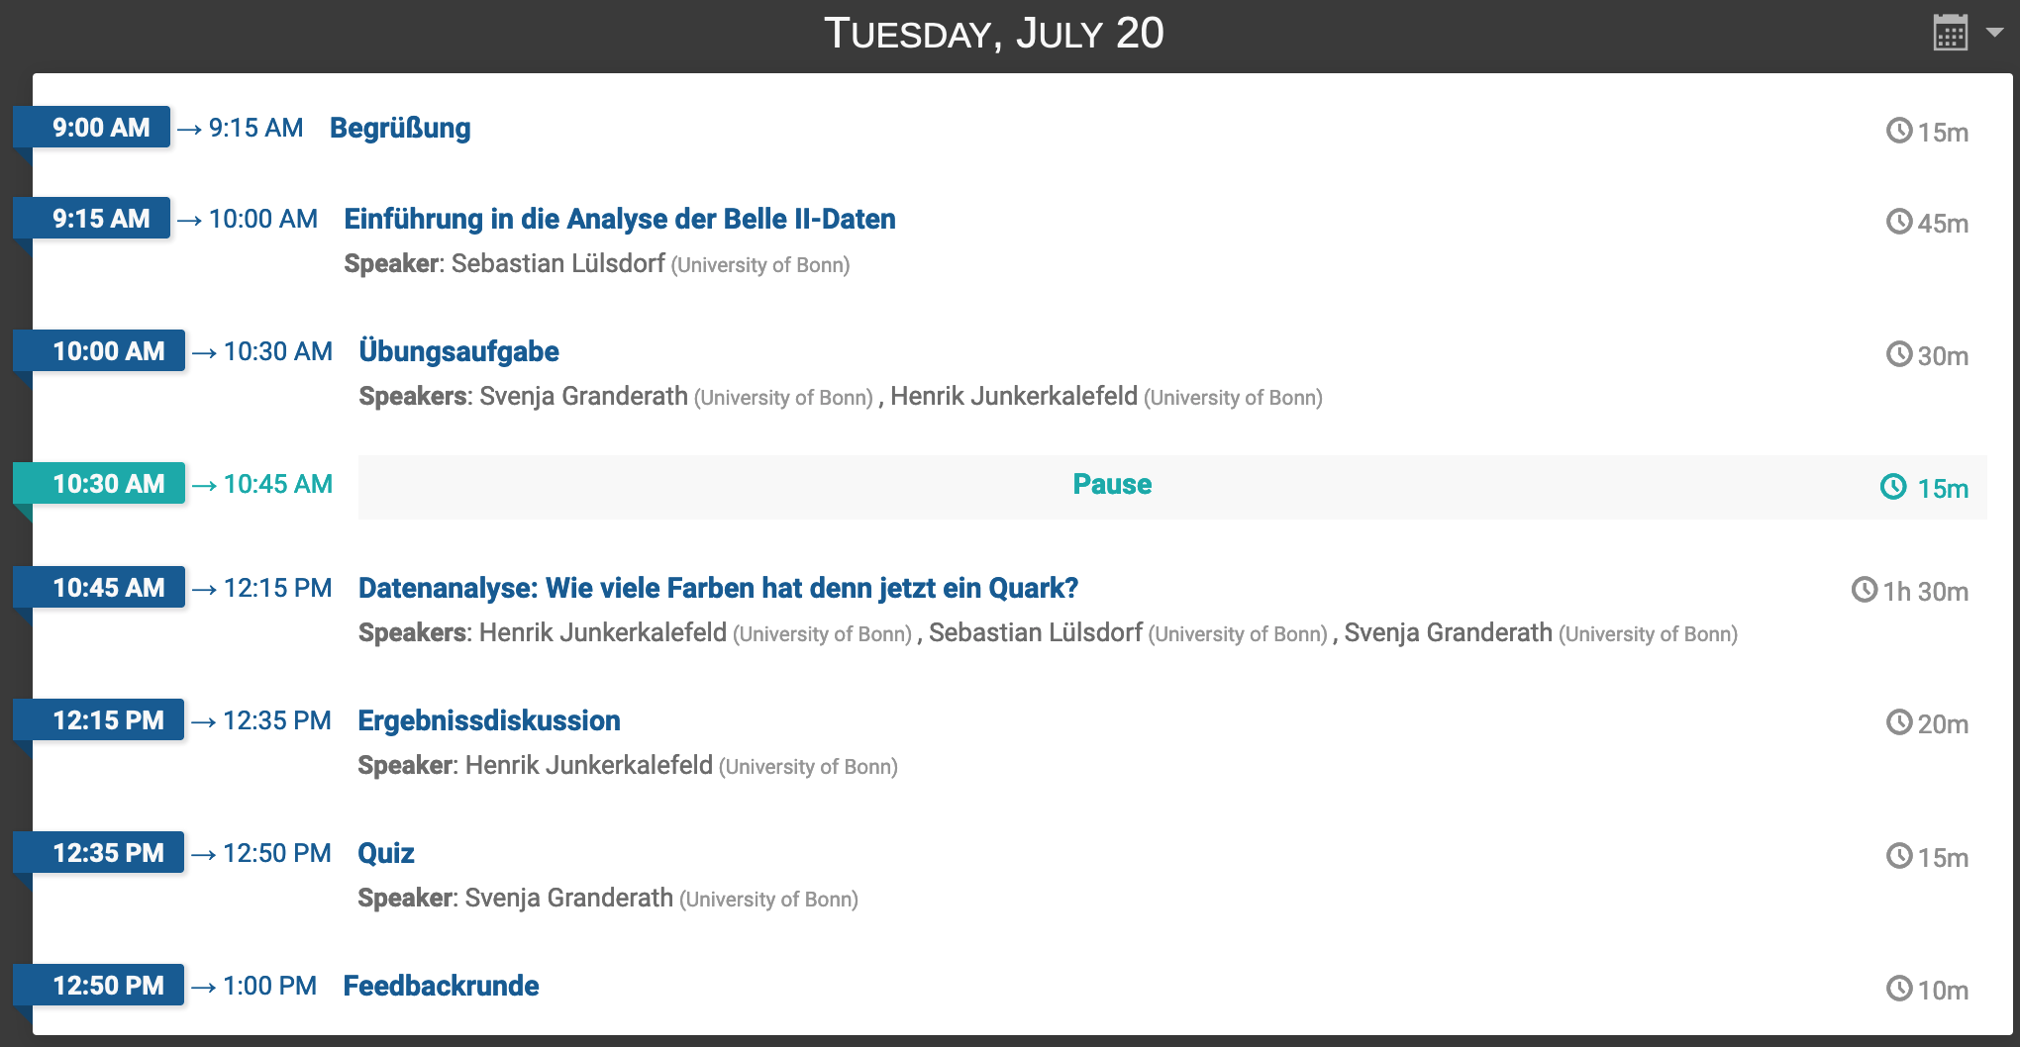
Masterclass schedule (indico) and additional material

Slide 9
Two introductory talks
Introductory presentation:
Why particle physics?
What do we know? (introduction of important particles and forces)
How (often) are they produced?
What is still a mystery?

Slide 10
Two introductory talks
Second presentation:
What is a particle accelerator/collider?
How do we measure and distinguish particles?

Slide 11
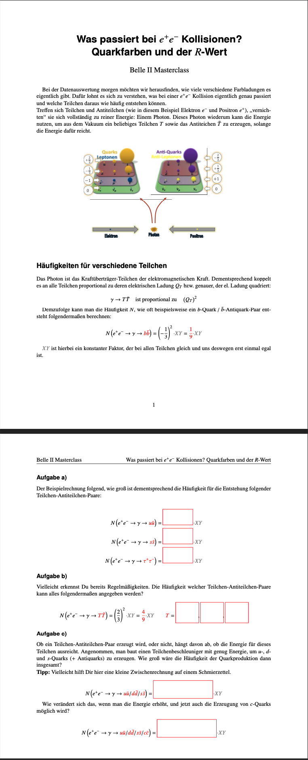
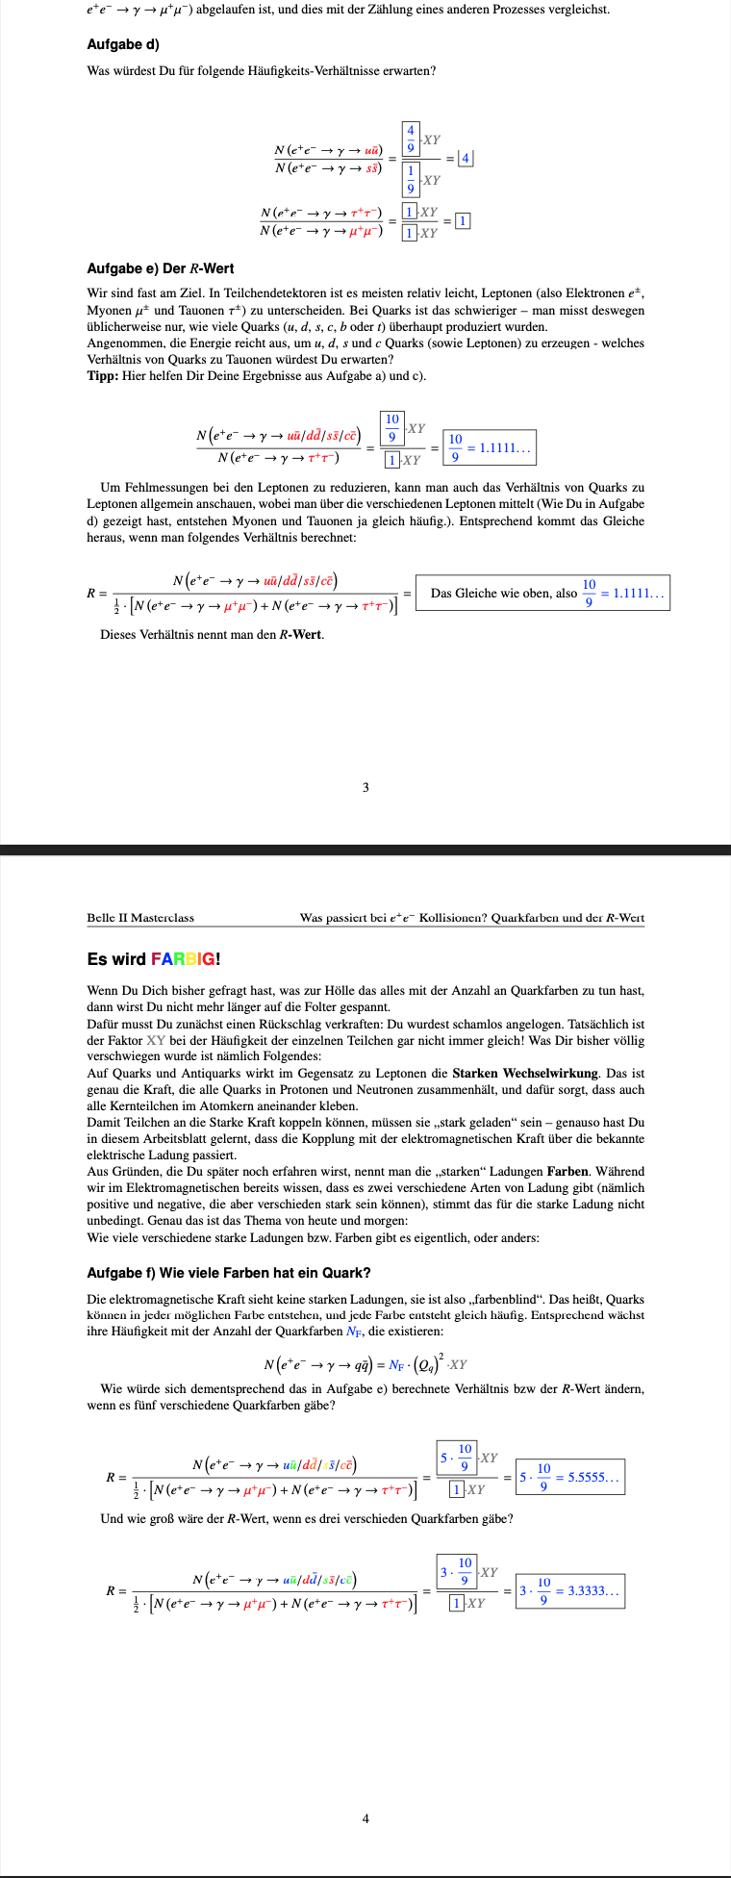
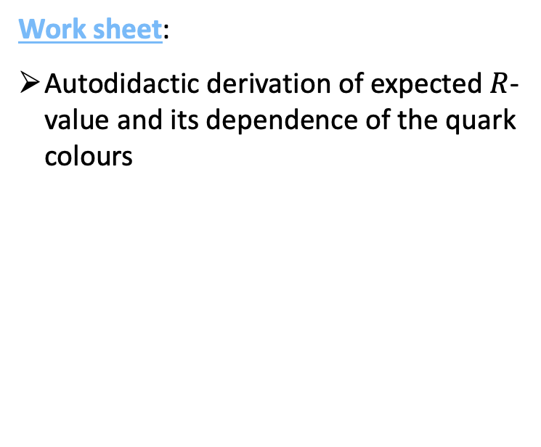
Interactive work sheet
Work sheet:
Autodidactic derivation of expected $R$-value and its dependence of the quark colours

Slide 12
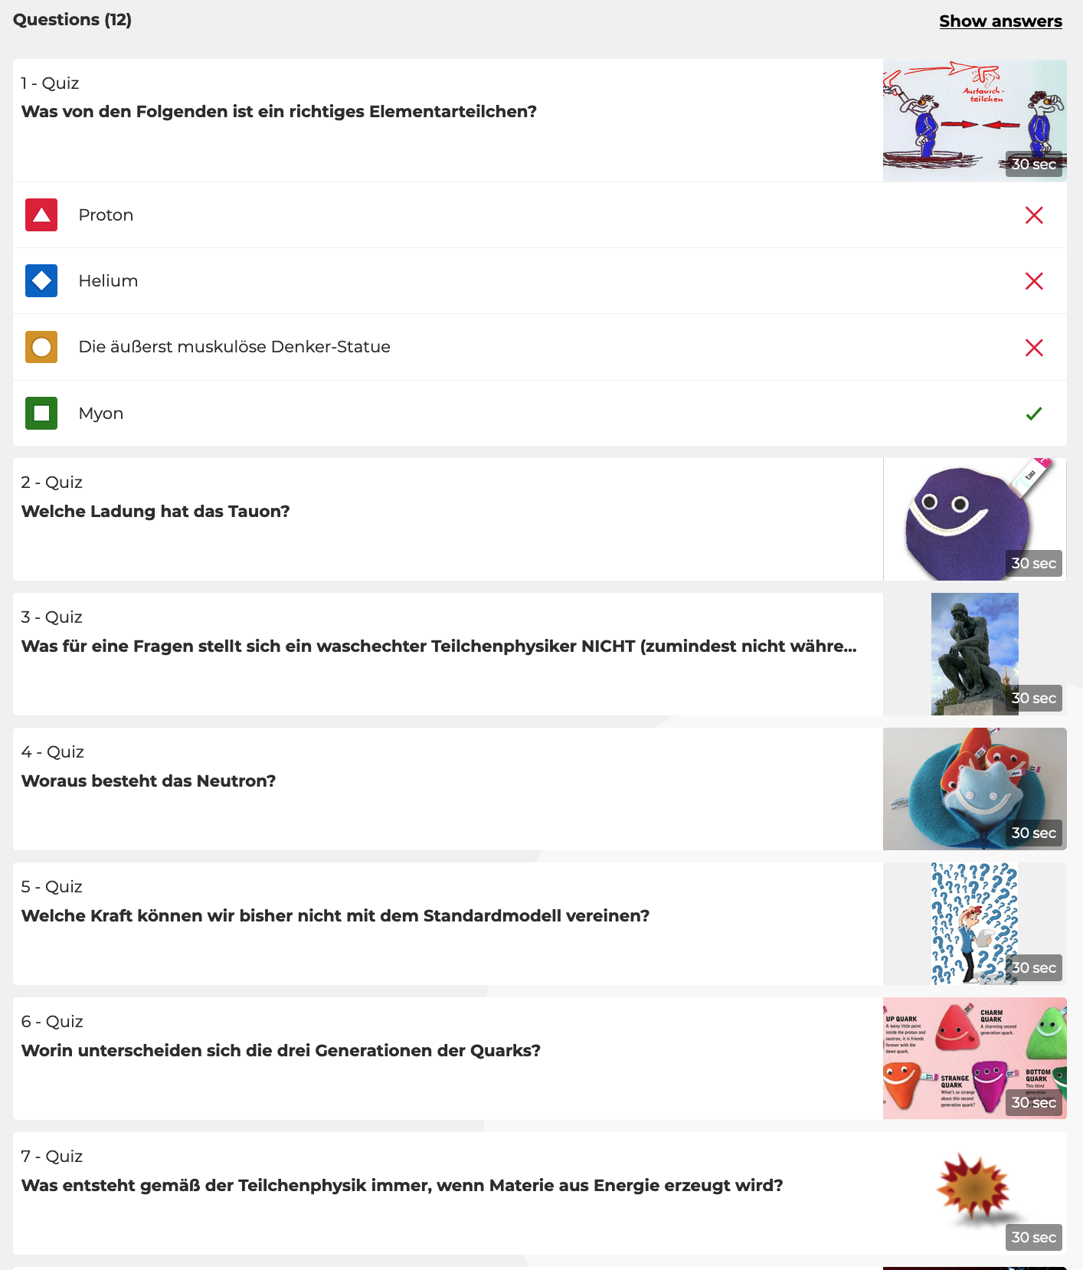
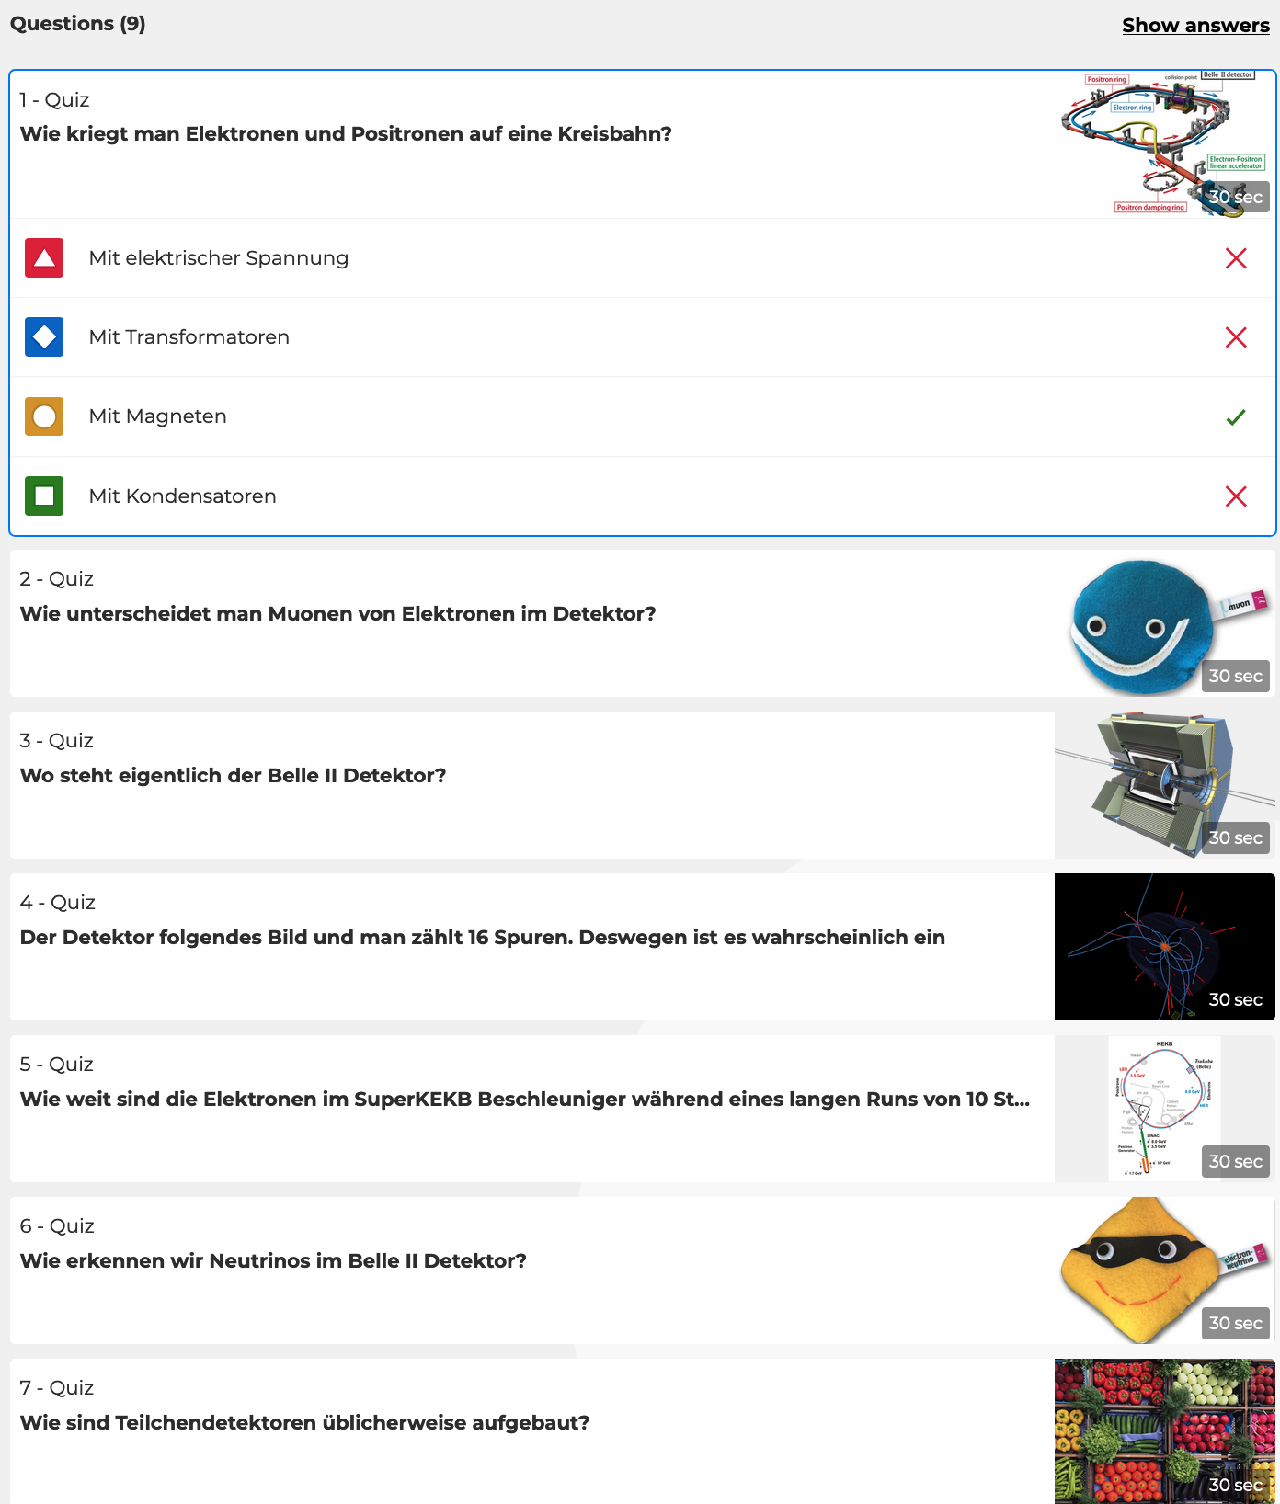
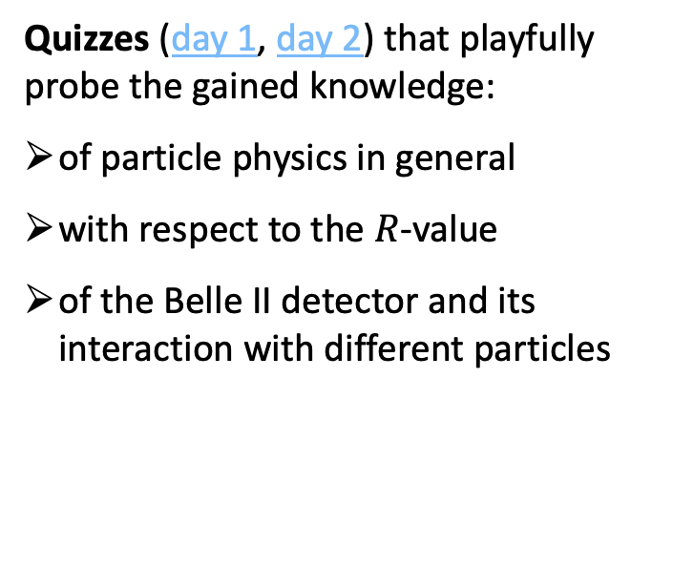
Kahoot quizzes
Quizzes (day 1, day 2) that playfully probe the gained knowledge:
of particle physics in general
with respect to the $R$-value
of the Belle II detector and its interaction with different particles

Slide 13
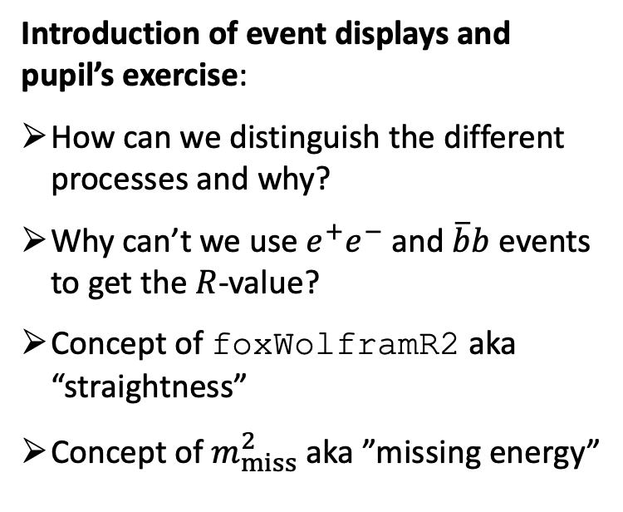
Material to introduce different processes
Introduction of event displays and pupil’s exercise:
How can we distinguish the different processes and why?
Why can’t we use $e^{+}e^{−}$ and $\overline{b}b$ events to get the $R$-value?
Concept of foxWolframR2 aka “straightness”
Concept of $m_{miss}^{2}$ aka ”missing energy”

Slide 14
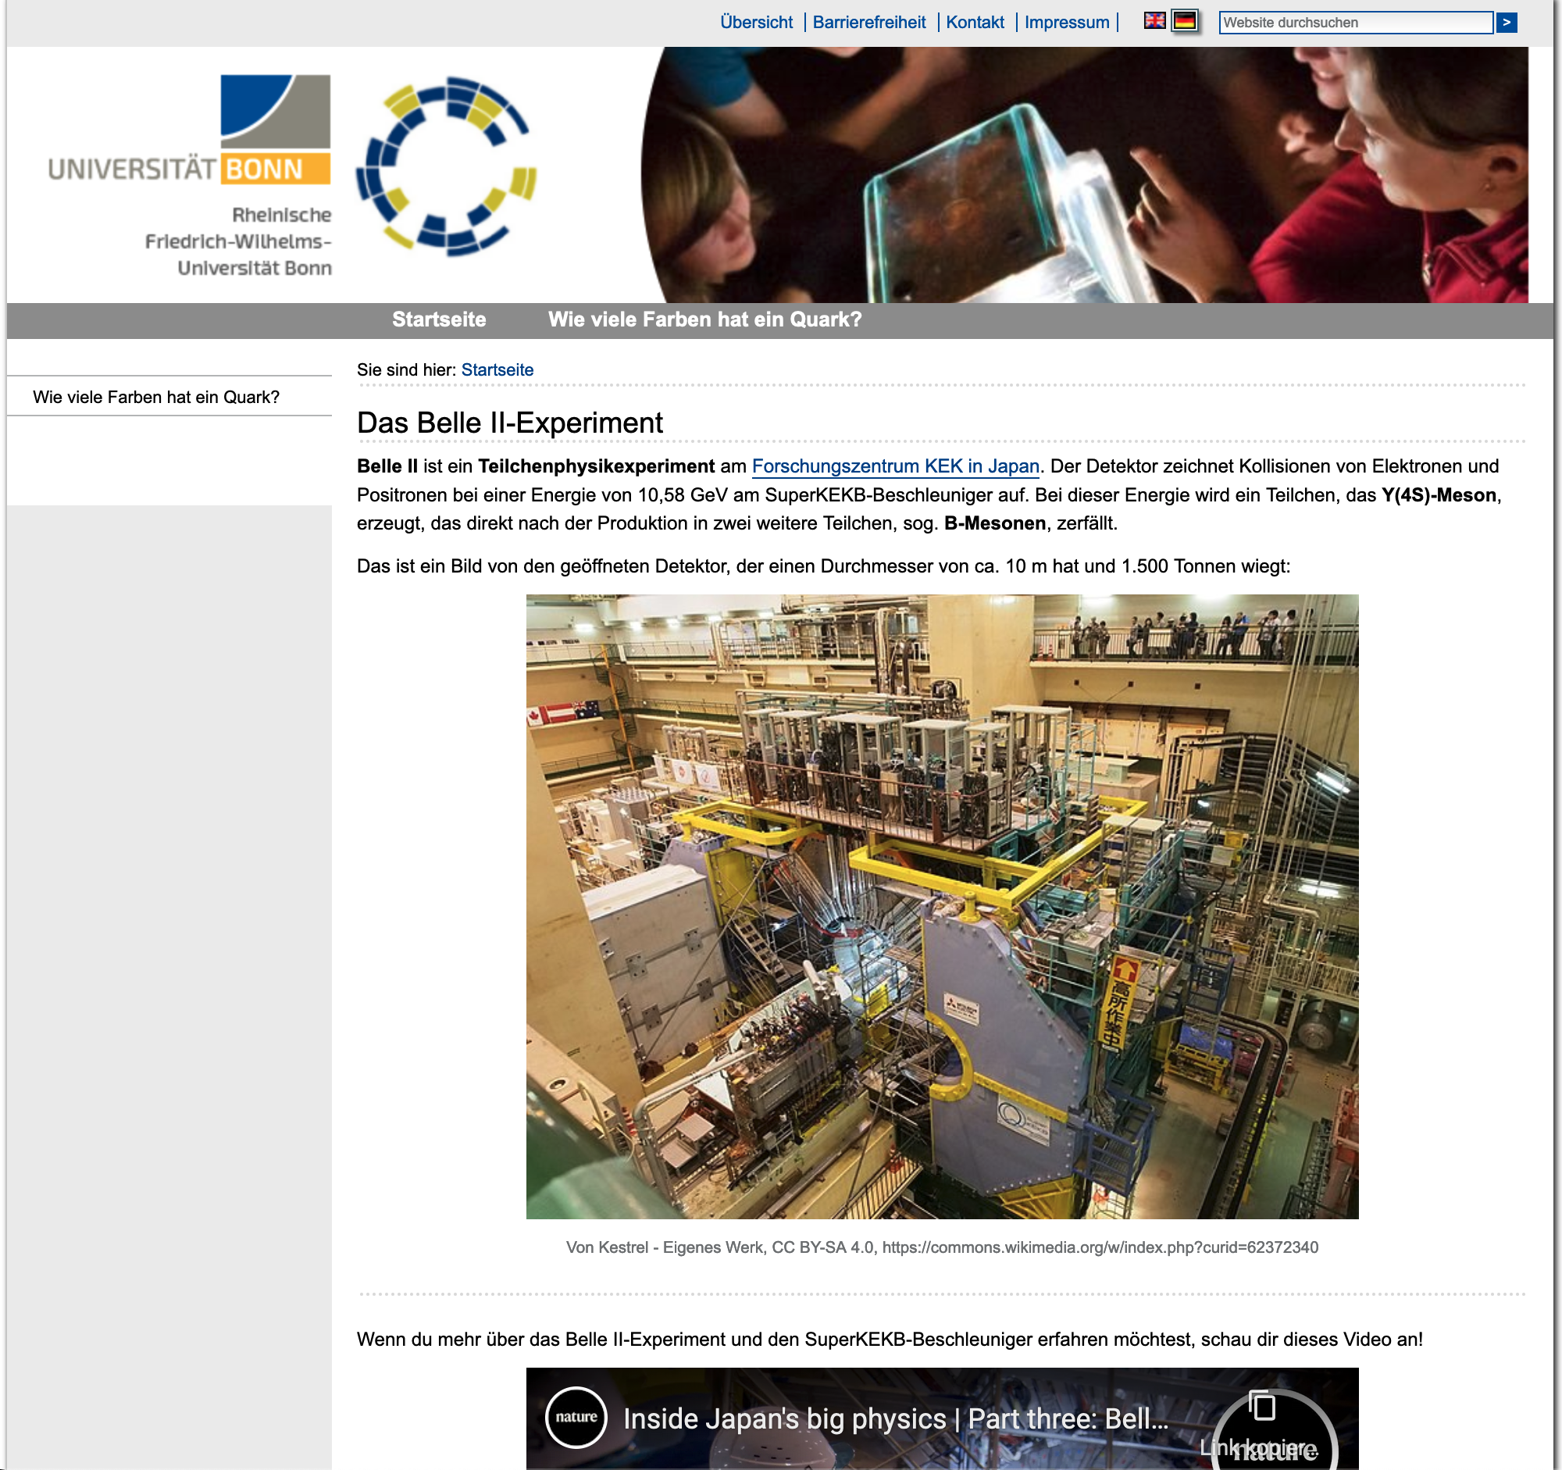
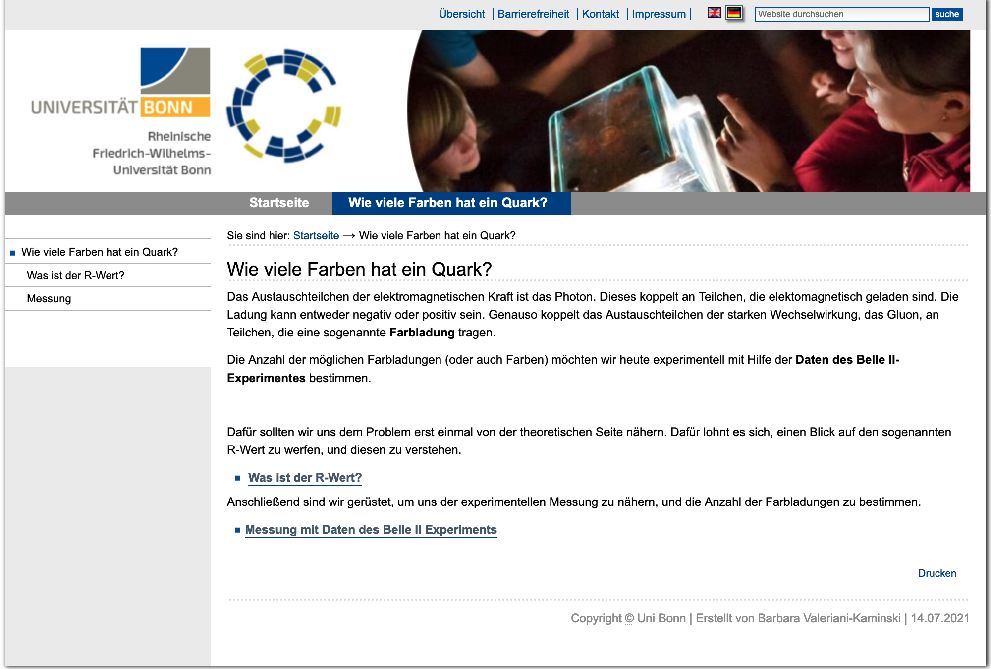
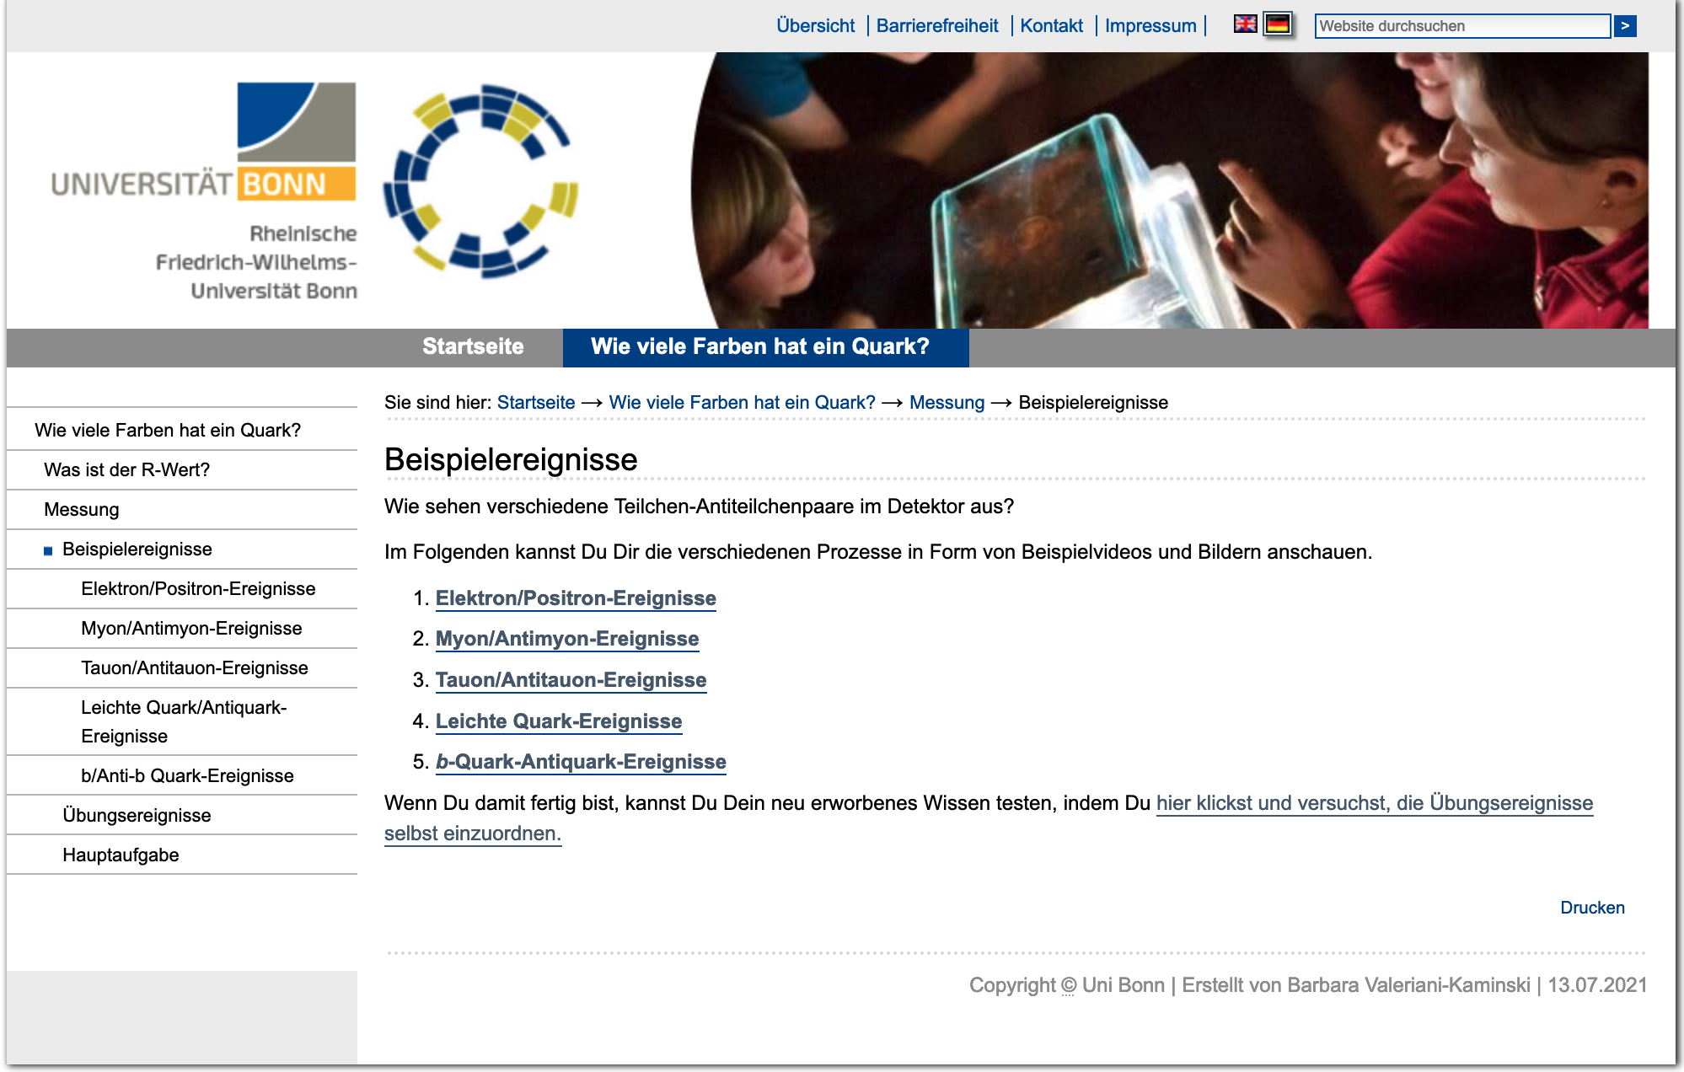

Self-explanatory Website
Pupils are guided through the exercise by a website that links the tasks
The general task (measuring the number of quark colors) is quickly presented
The $R$-value is introduced in a work sheet
Example events are presented in which the differences are explained and outlined (event displays and stopmotion videos)

Slide 15
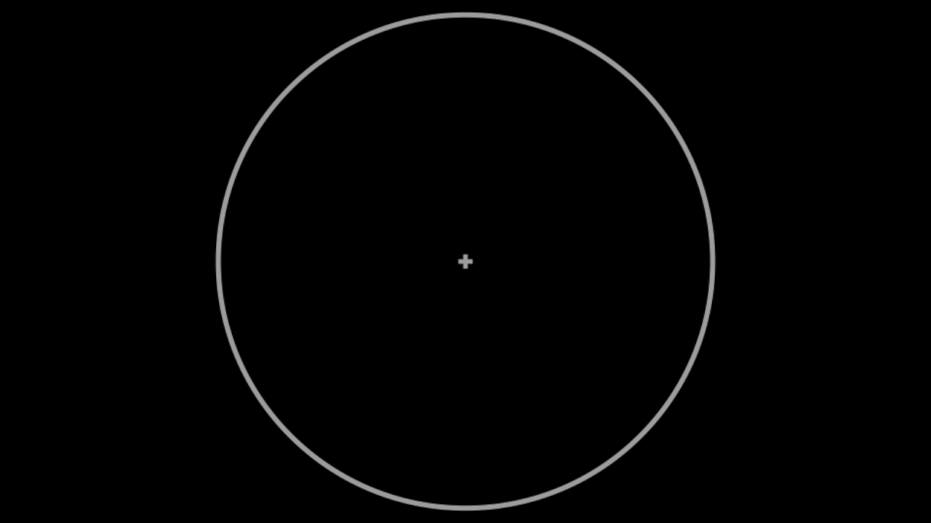


$$e^{+}e^{−}→γ→ℓ^{+}ℓ^{−}$$
$$e^{+}e^{−}→γ→\overline{q}q /\overline{b}b$$

Slide 16
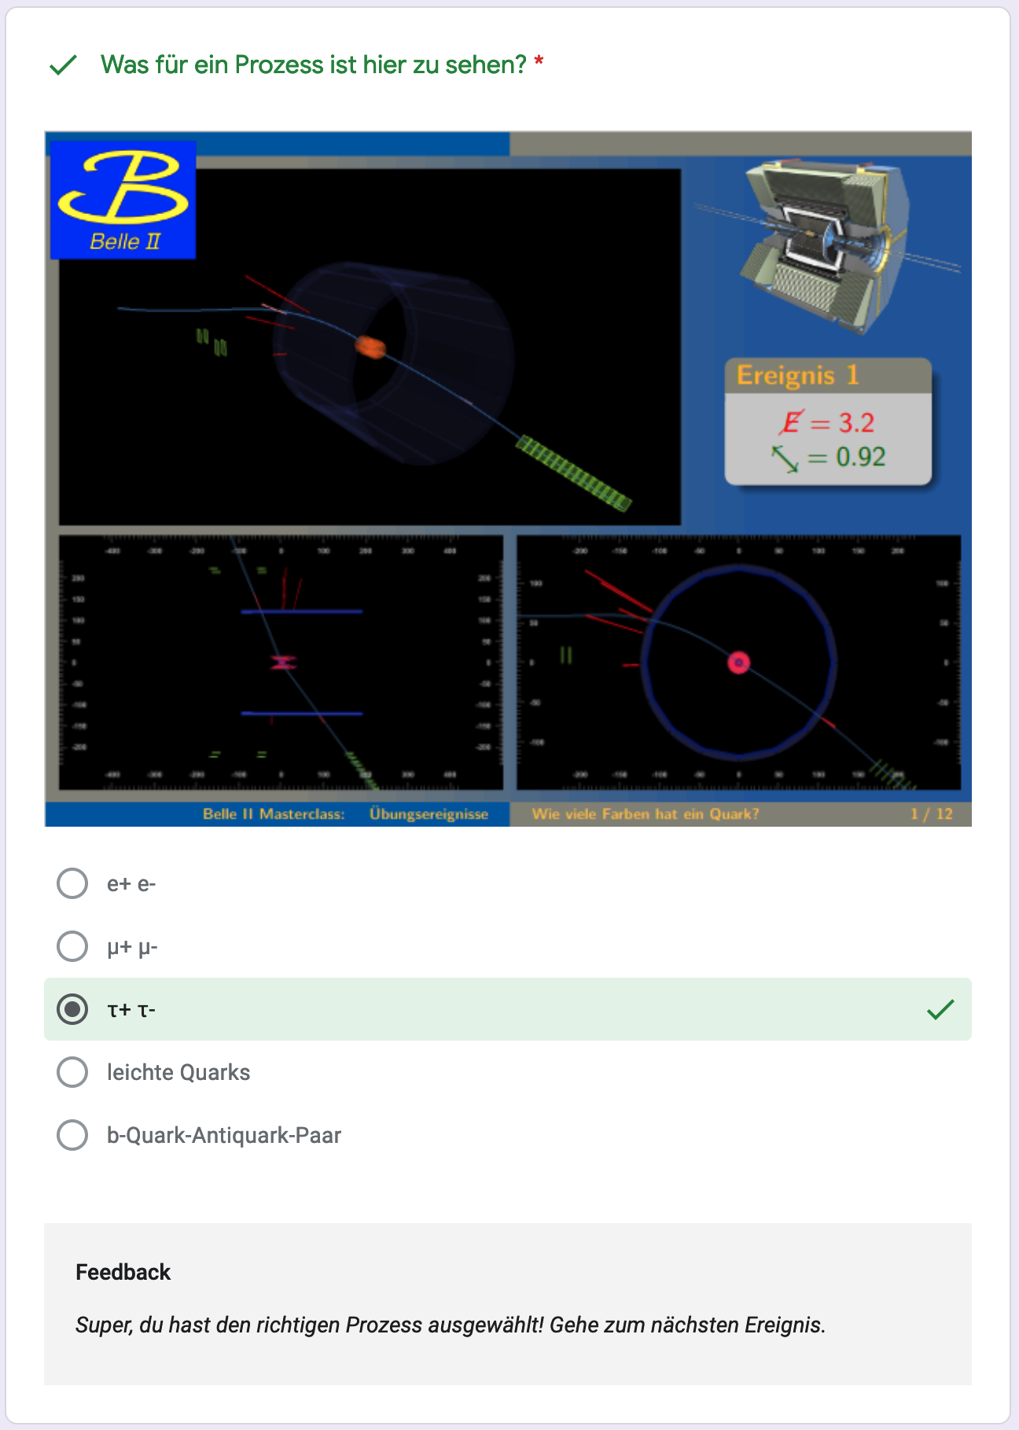
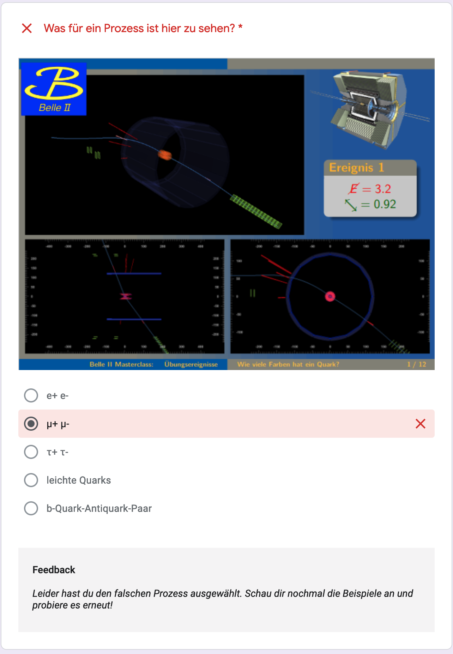
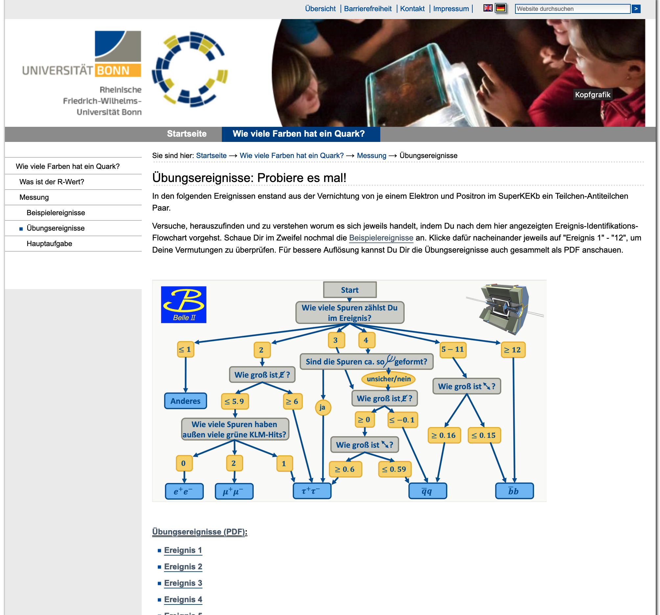

Website content
Pupils are guided through the exercise by a website that links the tasks
The general task (measuring the number of quark colors) is quickly presented
The $R$-value is introduced in a work sheet
Example events are presented in which the differences are explained and outlined (event displays and stopmotion videos)
12 practice events are available with direct feedback
Several datasets for the main exercise are available and can be evaluated

Slide 17

Summary
Complete masterclass is developed and finished. It ran like a clockwork.
Several materials & different tasks are available to ensure variety for pupil
Measurement is based on statistics, so the results actually improve the more events are evaluated $⇒$ encourages joint work in international masterclasses

