Slide 1
Progress with
ALICE MasterClasses
Yiota Foka
on behalf of the WG
Pavle Vulanovic (summer student)
Piotr Nowakowski; Lukasz Graczykowski, Małgorzata Janik (WUT)

Slide 2
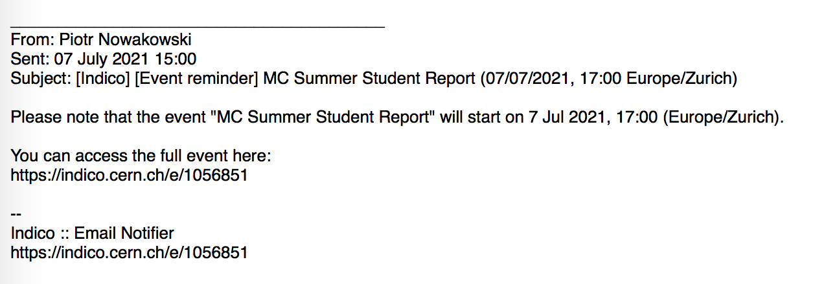
Summary
Updates with ALICE Strangeness MC: by Piotr/WUT
New MC on femtoscopy source size measurement by SumStud/WUT
Demo/Tutorial for Summer Students on Fri 30 July at 10:30
Presentations and Recordings are here
https://indico.cern.ch/event/1063426/
Regular meetings every Monday
With participation of Leo/CBM (who left):
CBM status as before
(these updates were not implemented for CBM)

Slide 3
New ALICE MC on measurement of QGP source size
“Femtoscopy masterclass”
New measurement prepared as a CERN summer student project
by Pavle Vulanovic from the New York University Abu Dhabi,
who worked under WUT supervision
financed by private sponsor EO “Three Physicists foundation”.
This is a standard measurement/tool related to obtaining the source size
of the QGP droplet created during the lead collisions.
It is based on the analysis of two-particle (two-pion) correlations in momentum space (based on momentum differences of two particles).
Because the source size is very small, at the scale of femtometers, it is called femtoscopy.
The difficulty can be tuned to address university students or in a very simplified way high school students.
A first prototype was presented during summer for several summers students (ALICE summers students plus the dozen supported by EO
https://indico.cern.ch/event/1063426
Instructions delivered as summer student report in CDS

Slide 4
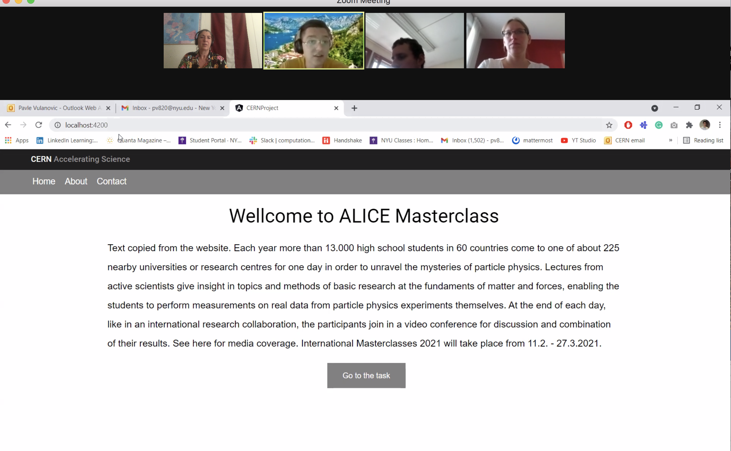
Source Size (femtoscopy) measurement
Explanation, Instructions, Presentations via the web page: example

Slide 5
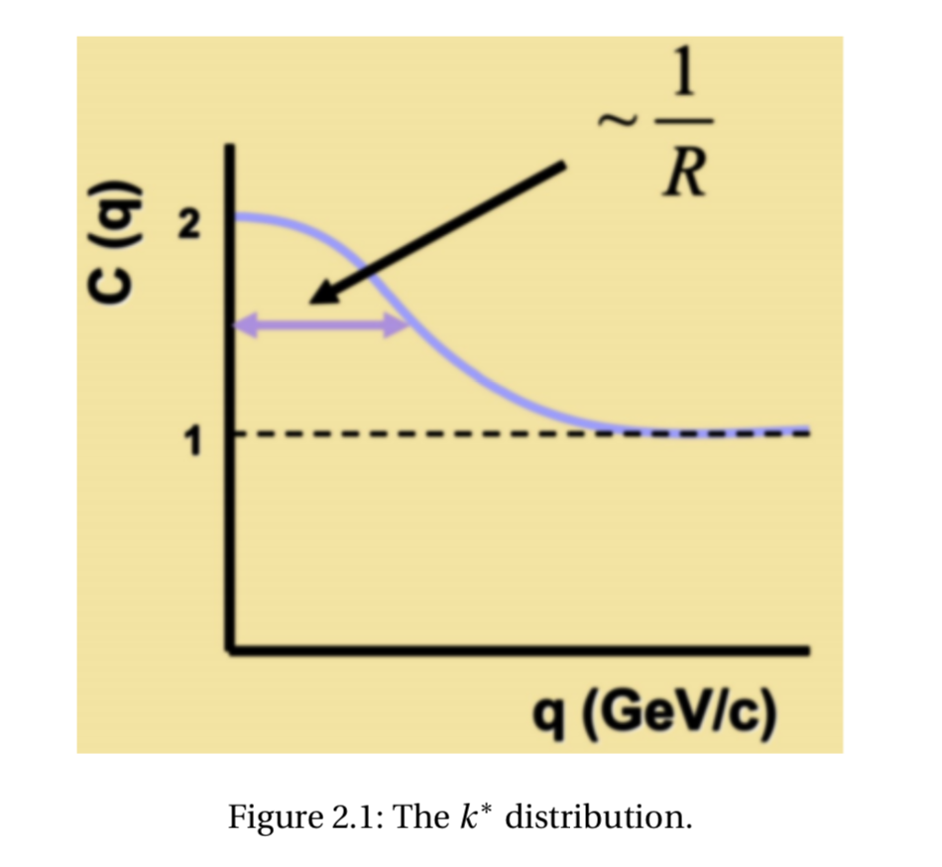
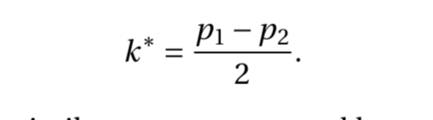
Correlation function: how to get the radius of the source

Slide 6
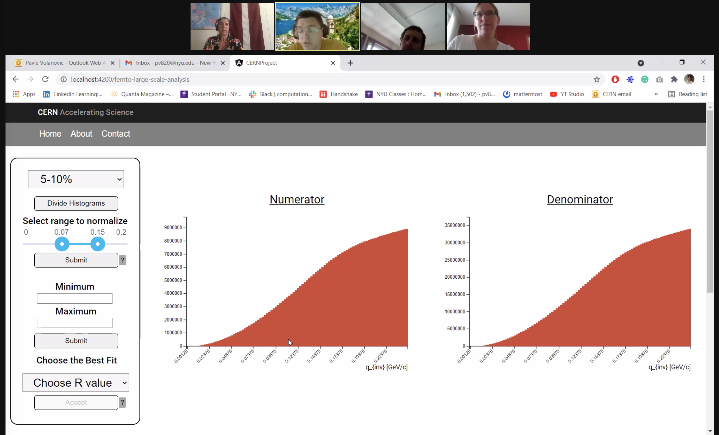

Slide 7
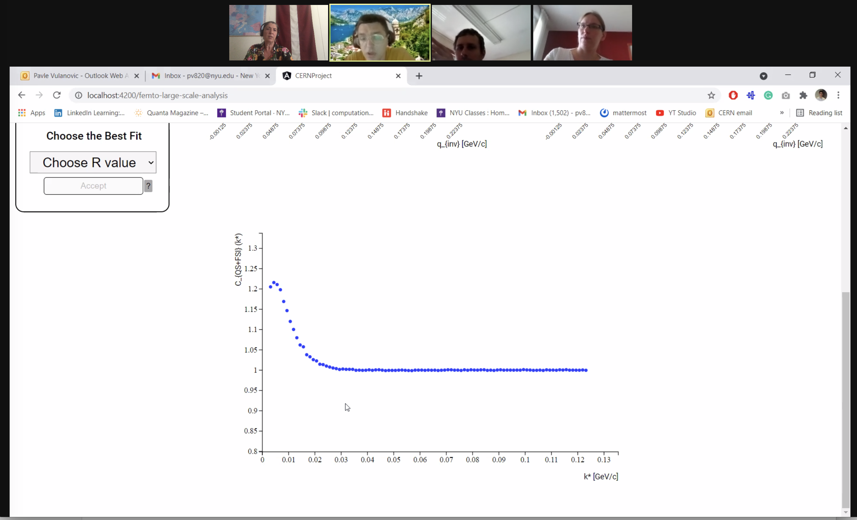

Slide 8
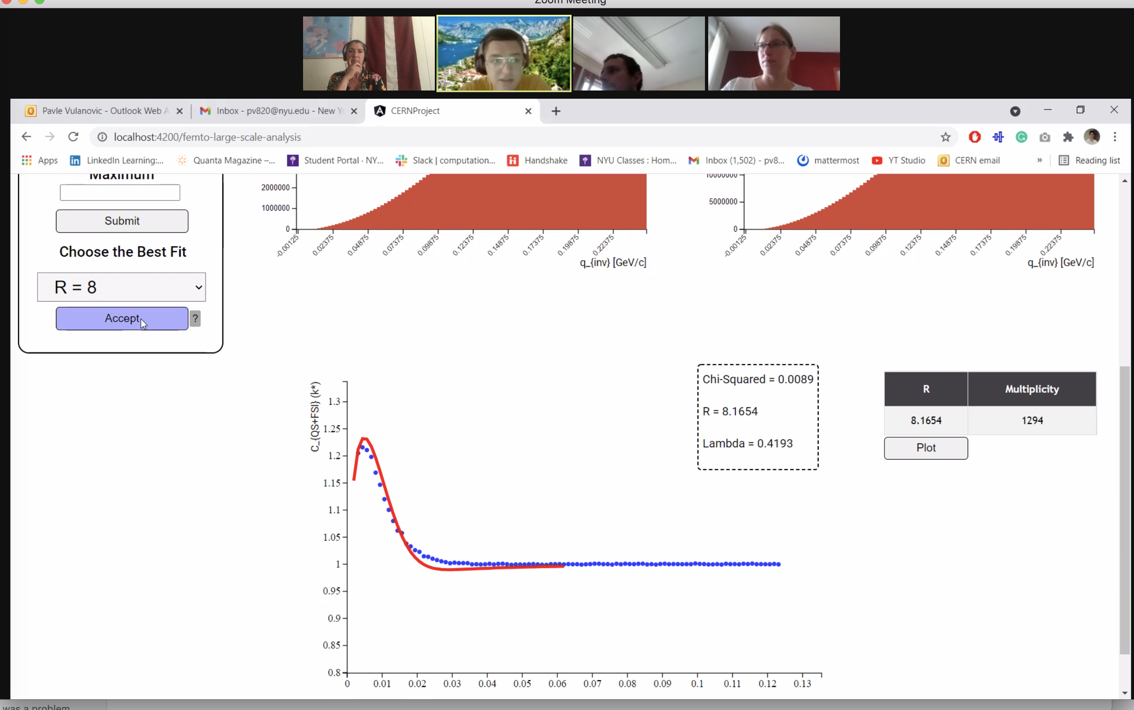

Slide 9
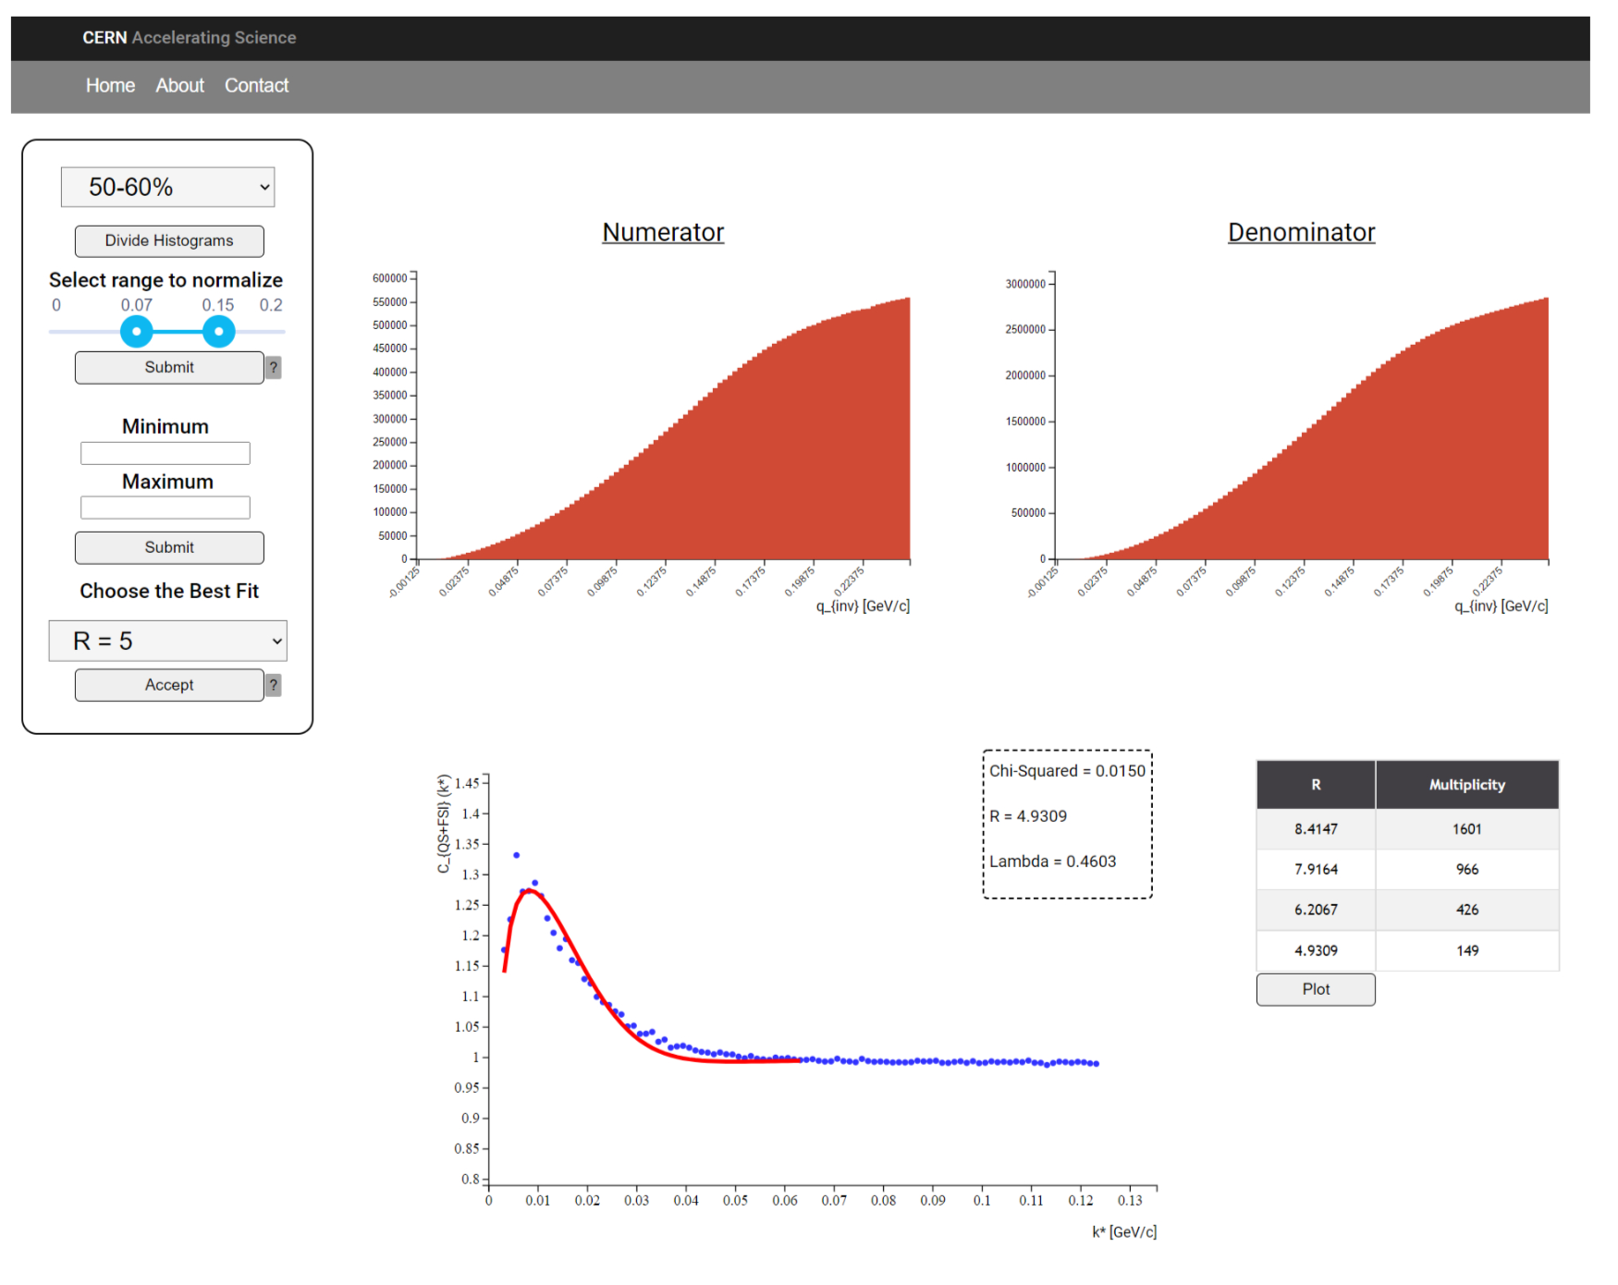

Slide 10
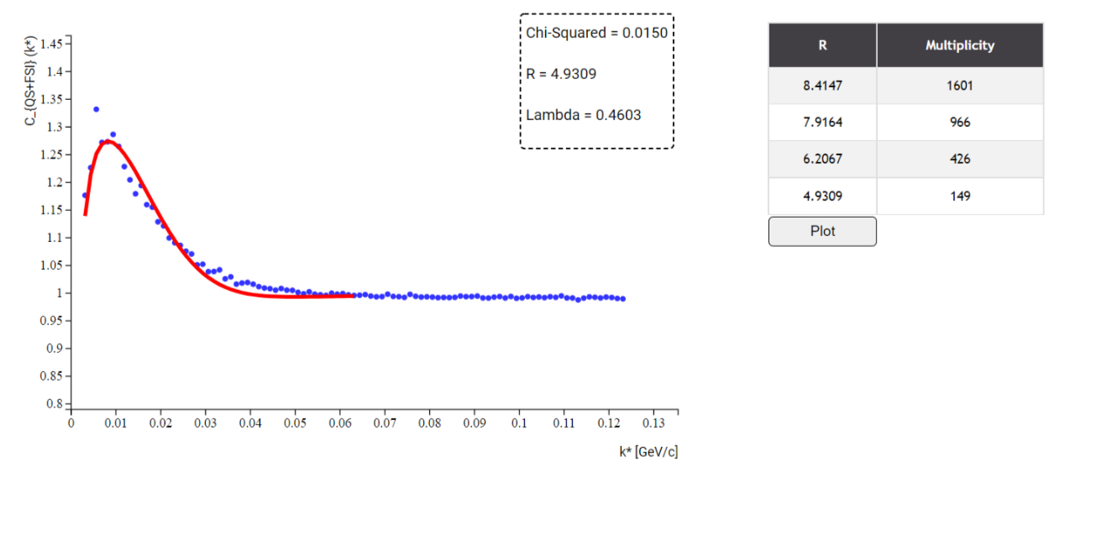
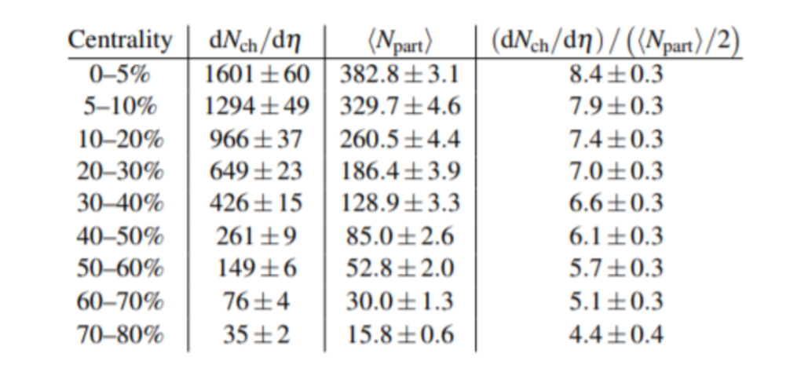
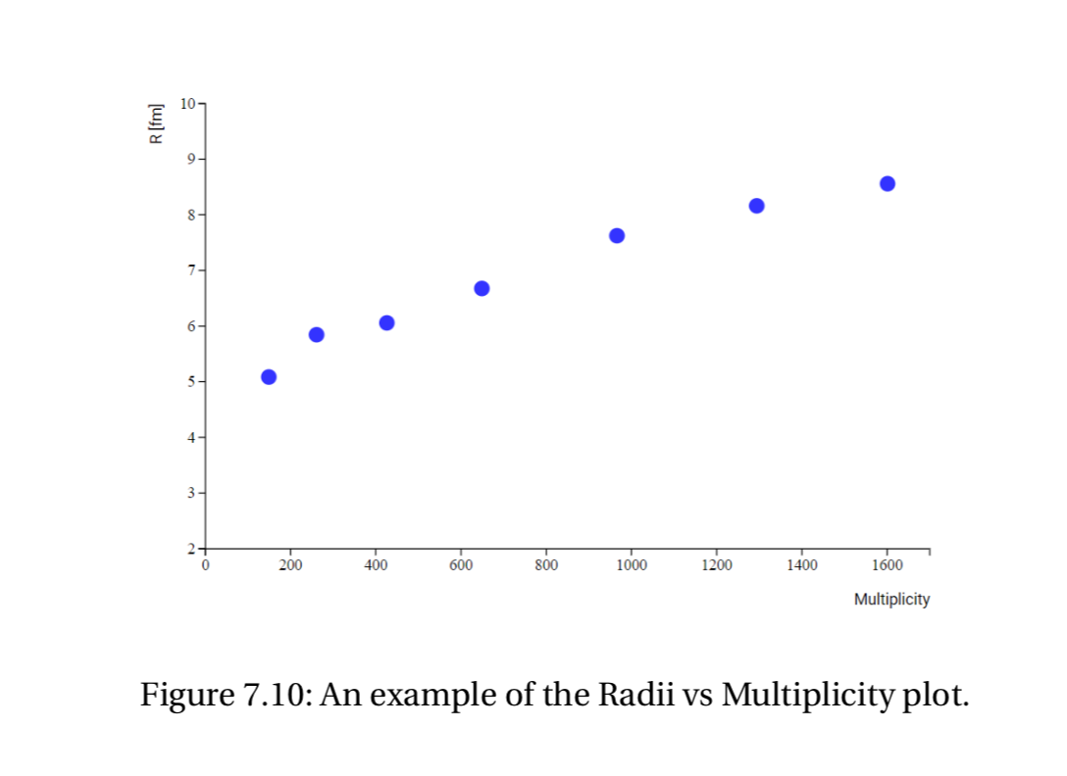

Slide 11
Strangeness MasterClass New Developments
New and much more advanced online version now, with student and teacher's modes:
- student mode: https://alice-web-masterclass.app.cern.ch
- teacher's mode: https://teacher-alice-web-masterclass.app.cern.ch/
The application contains now a back-end database for storing events (i.e. event at a given institute)
and sessions (i.e. multiple rooms to which students are divided within one event).
All the results are being pushed automatically to the database and can be stored permanently.
The teacher's mode contains a front-end administration GUI of the database.
It can be accessed only with CERN login and allows for creation of events and sessions.
For each session an automatic link and password is generated which can be provided to students.
All the results which are pushed by students to the database can be visualized live in the teacher's mode.
All the calculations for combining the results are done in the teacher's mode now.
The final result is no need for use of any Google Docs or other external tools
for storing the results.

Slide 12
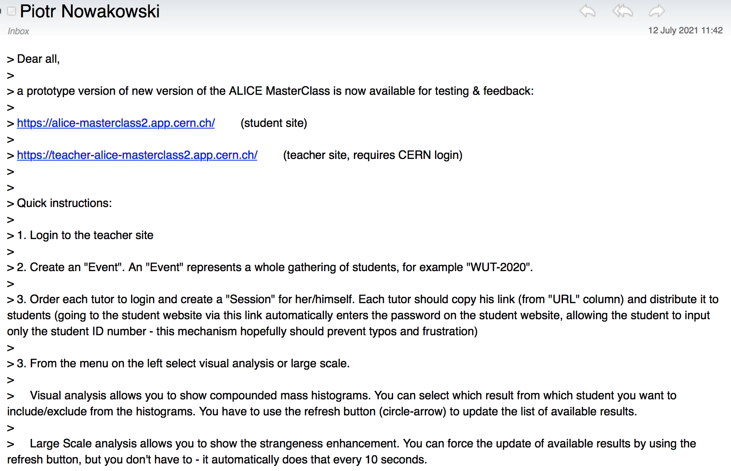
Updates on ALICE Strangeness: prototype for testing

