Slide 1
Solid
Decentralized social media

Slide 2
Content
Status of social media
How does decentralization help?
Linked Data 101
Solid
  What is it?
  Demo
  Applications
  Challenges
  Solid in practice
  Solid at CERN

Slide 3
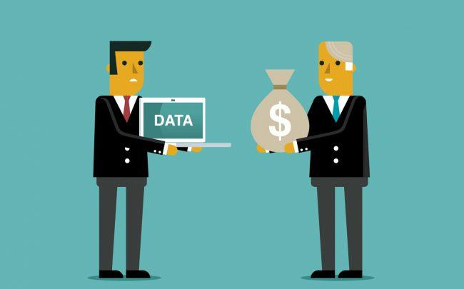
Status of social media
Notes:
Data is sold for whatever purpose
Most often, it’s for profiling and advertising

Slide 4
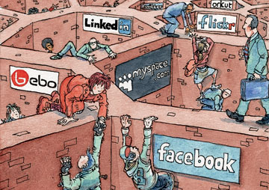
Status of social media
Notes:
Information silo’s
Very hard or impossible to copy information to another social network

Slide 5
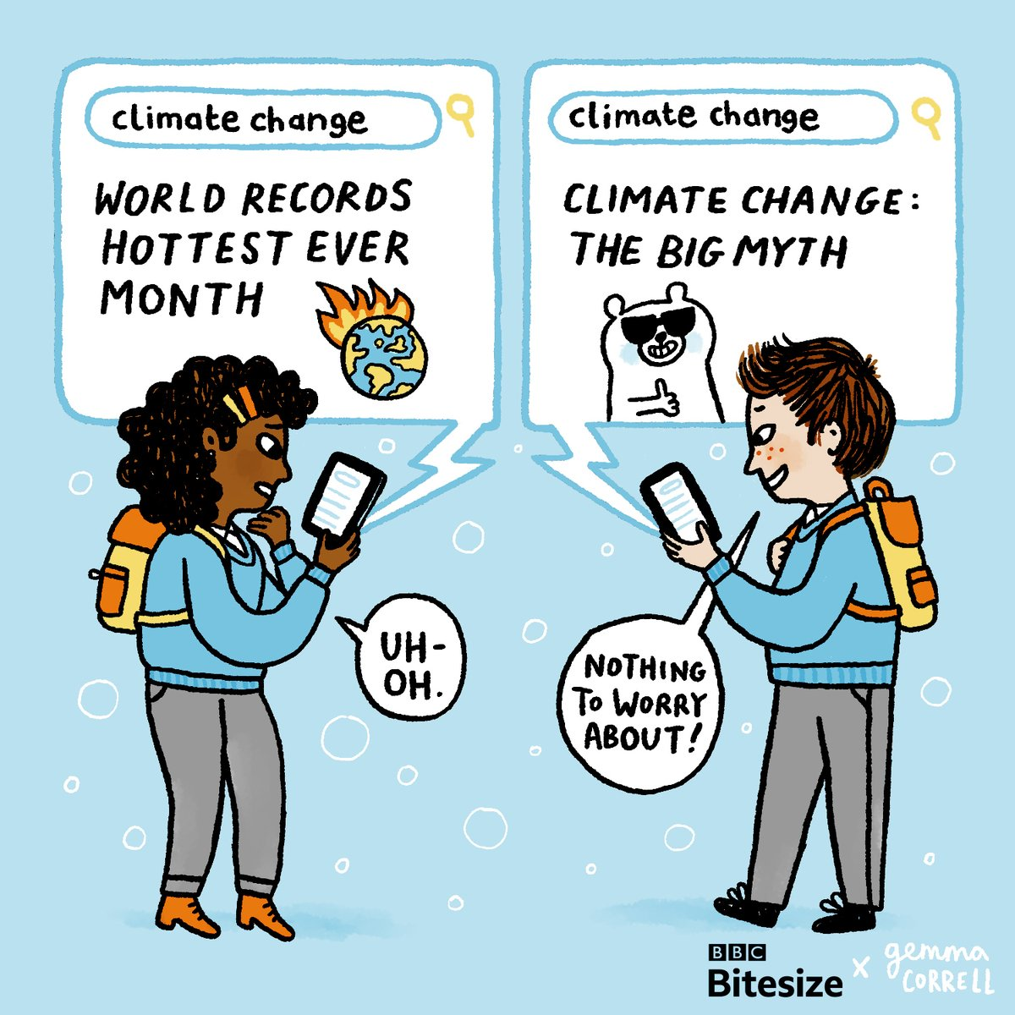
Status of social media
Notes:
The filter bubble

Slide 6
Status of social media
Recent development: “The metaverse”
Do all your daily stuff in VR
Feed the Zuck

Slide 7
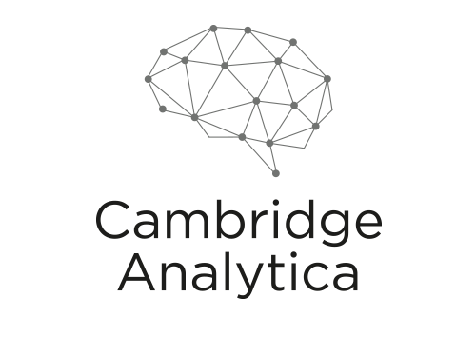
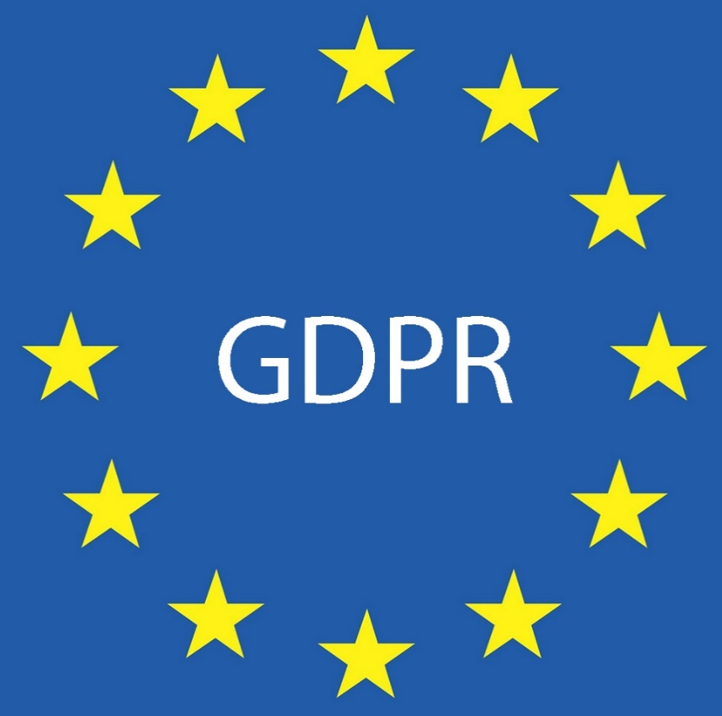

Status of social media
Data Transfer Project
Notes:
Data of 87 million Facebook accounts. Used among others for manipulation of elections.
GDPR not only limits what companies can do with your data, it’s also supposed to make it possible for you to request your data in a readable format so that it can be reused in other applications. However, data that is generated does not need to be made available. Also, there’s no incentive to REALLY make this data interchangeable with other social networks.
Data Transfer Project (DTP) is a collaboration of organizations committed to building a common framework with open-source code that can connect any two online service providers, enabling a seamless, direct, user initiated portability of data between the two platforms.

Slide 8




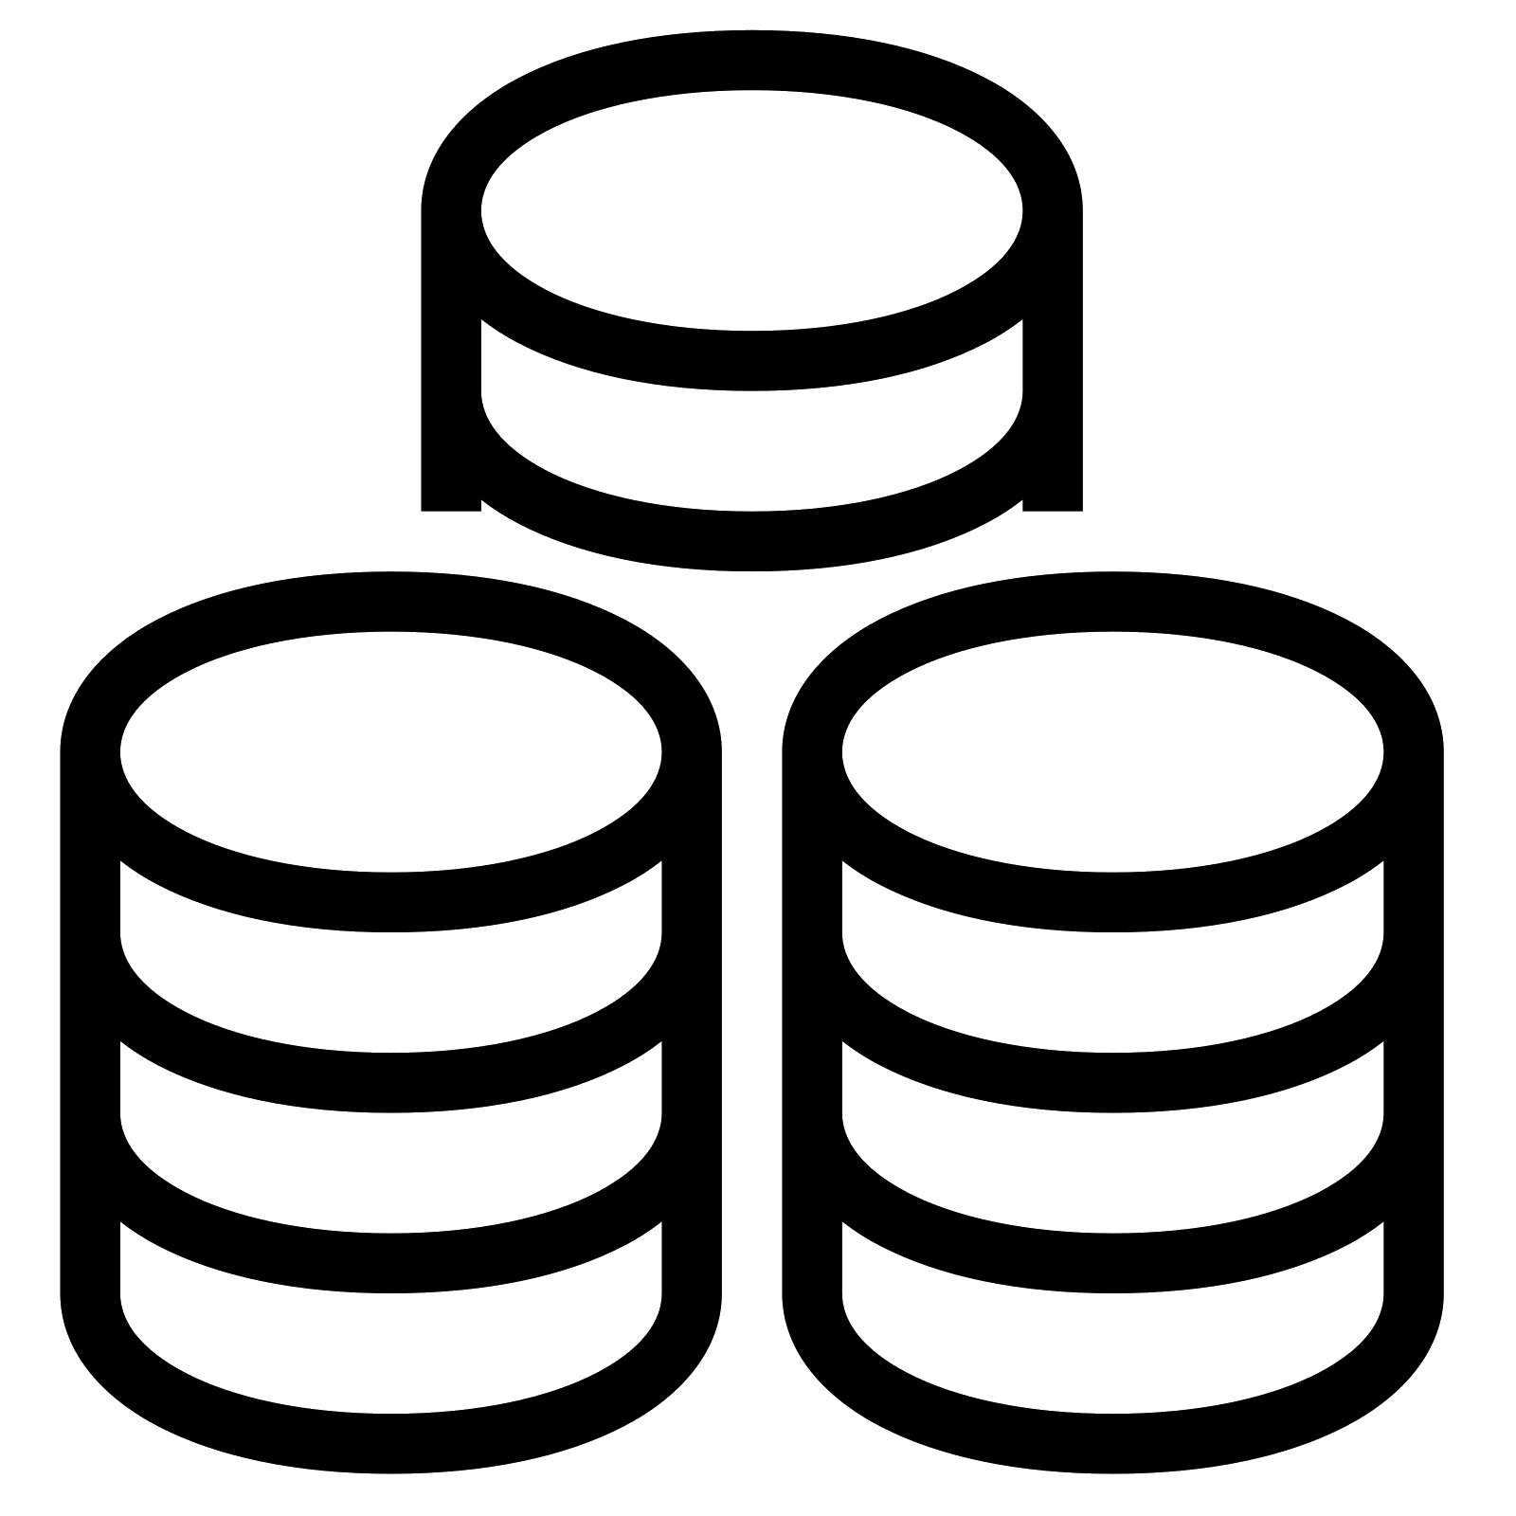


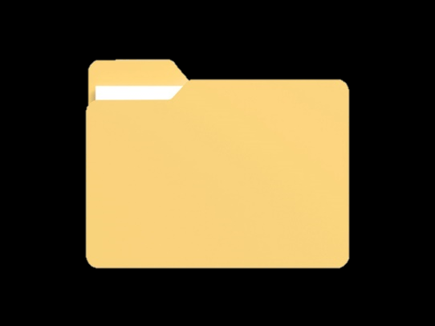




Centralized scenario
Request picture of Bob
Notes:
Assume only data servers are shown, no webservers etc.
Data and application: one entity, no separation
Use Alice and Bob as names for the two users
Scenario: Alice requests a photo of Bob

Slide 9
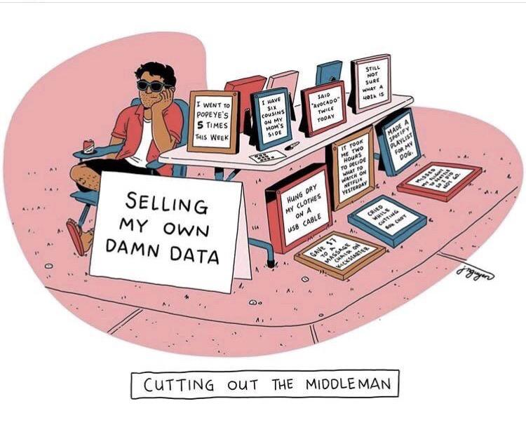
Improvement: decentralization
Decouple data from the application
  Privacy: user decides who can access their data
  Ownership: Legally, someone cannot use your data without your consent
  Dissemination: User decides who to share data with
Notes:
Mastodon

Slide 10
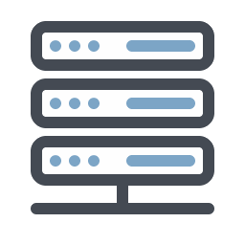


Decentralized scenario
Application
Own datapod
Other’s datapod
Notes:
Data and application are now separated
All users have their own datapod. A datapod server can host multiple datapods.
The social application may have its own datapod (e.g. to have a list of annotations), but can also be fully decentralized when there is no datapod! Datapod may be on the same server, or somewhere else.
Blue lines: application communication
Yellow lines: data communication
Scenario:
Alice has her own datapod, so does Bob. They use the DecentralizedFacebook (better/funnier name?) for the interface, but all data transactions happen between Alice’s computer (client) and her and Bob’s datapod.
Alice requests a photo of Bob
Bob wants to add a friend, and will therefore query the DecentralizedFacebooks datapod, which will respond with a WebID of the other user
The other user has a datapod in a shared datapod server. It will for instance send a friendship request to this person’s datapod.

Slide 11
Improvement: Reusability
Re-use data across applications
  There’s a need for a common data format
  Linked Data is perfect for this, and it’s decentralized!
Notes:
= Interoperability

Slide 12
Linked Data
Describe data
Make connections between data
Machines should be able to read it, and ideally be able to reason with it
  E.g.
    Known facts:
      A is the brother of B
      C is the mother of B
    Deduced facts:
      C is the mother of A

Slide 13
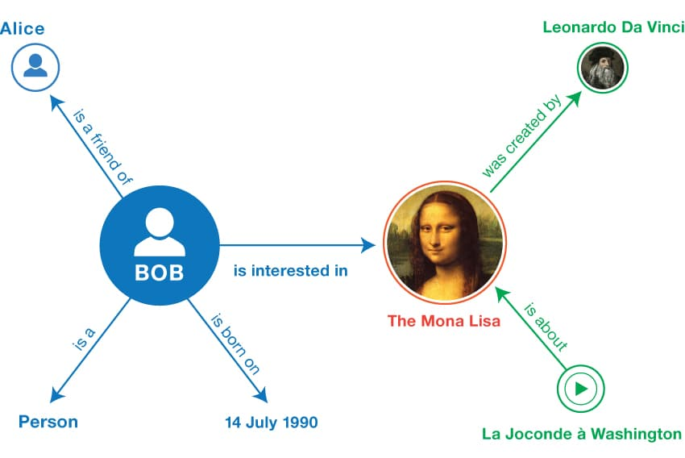
Linked Data
Resource Description Framework
  Triples
<Bob> <is a> <person>.
<Bob> <is a friend of> <Alice>.
<Bob> <is born on> <the 4th of July 1990>.
<Bob> <is interested in> <the Mona Lisa>.
<the Mona Lisa> <was created by> <Leonardo da Vinci>.
<the video 'La Joconde à Washington'> <is about> <the Mona Lisa>
Notes:
Triples
https://www.w3.org/TR/rdf11-primer/

Slide 14
Linked Data
Resource Description Framework
  IRIs: International Resource Identifiers
    Example: URI
Subject: < http://dbpedia.org/resource/Mona_Lisa >
Predicate: < http://dbpedia.org/property/artist >
Object: < http://dbpedia.org/resource/Leonardo_da_Vinci >
Notes:
Triples
https://www.w3.org/TR/rdf11-primer/

Slide 15
Linked Data
Resource Description Framework
  IRIs: International Resource Identifiers
    Not required in Object position
Subject: < http://dbpedia.org/resource/Mona_Lisa >
Predicate: < http://dbpedia.org/property/material >
Object: Oil on poplar panel (en)
Notes:
Triples
https://www.w3.org/TR/rdf11-primer/

Slide 16
Linked Data
Resource Description Framework
  Vocabularies / Ontologies
    A way of grouping resources
    Provides additional semantic information
Subject: < http://dbpedia.org/resource/Mona_Lisa >
Predicate: < http://dbpedia.org/property/artist >
Object: < http://dbpedia.org/resource/Leonardo_da_Vinci >
Notes:
Triples
https://www.w3.org/TR/rdf11-primer/

Slide 17
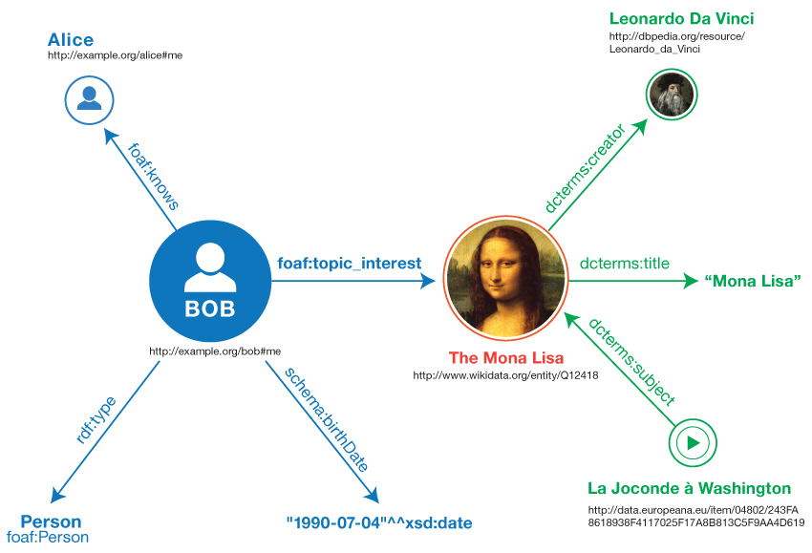
Linked Data
Resource Description Framework
  Vocabularies / Ontologies
    Prefixes make it more readable
    and it reduces the size
Subject: < dbr:Mona_Lisa >
Predicate: < dbp:artist >
Object: < dbr:Leonardo_da_Vinci >
Notes:
Triples
https://www.w3.org/TR/rdf11-primer/

Slide 18
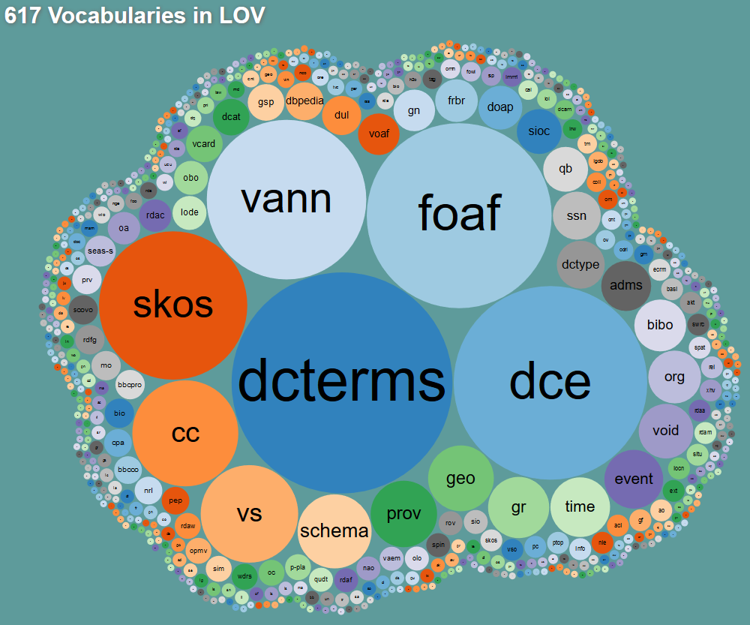

Slide 19
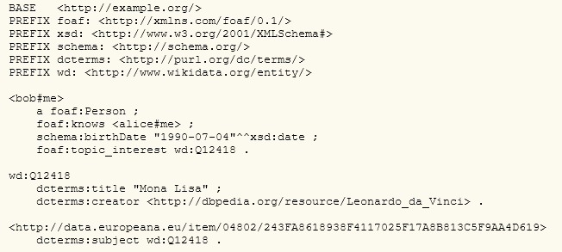
Linked Data
Resource Description Framework
  Representing triples
    E.g. “Turtle”
Notes:
Triples
https://www.w3.org/TR/rdf11-primer/

Slide 20
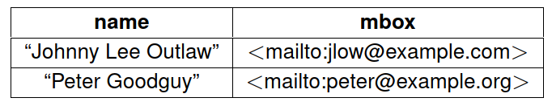
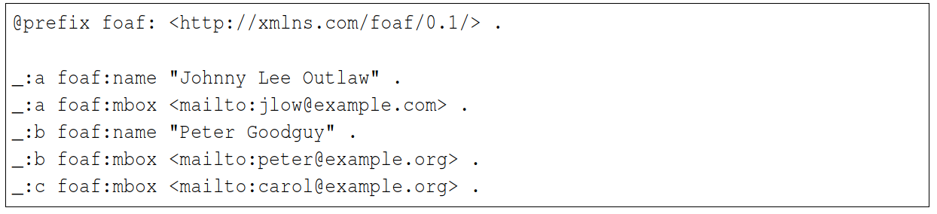
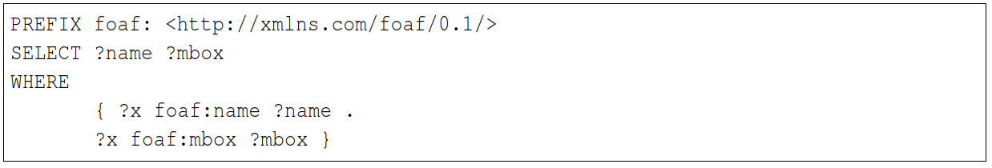
Linked Data
Querying Linked Data
Notes:
Triples
https://www.w3.org/TR/rdf11-primer/

Slide 21
Linked Data
Linked Data is decentralized
It’s not supposed to be stored in one “graph”
Everyone can combine resources and add them to any graph
Quads = Triples with extra Graph information
Without graph info, we assume that the graph is the location where the triple is stored
<http://dbpedia.org/resource/Leonardo_da_Vinci> owl:sameAs <http://viaf.org/viaf/24604287/> .
Notes:
Triples
https://www.w3.org/TR/rdf11-primer/

Slide 22
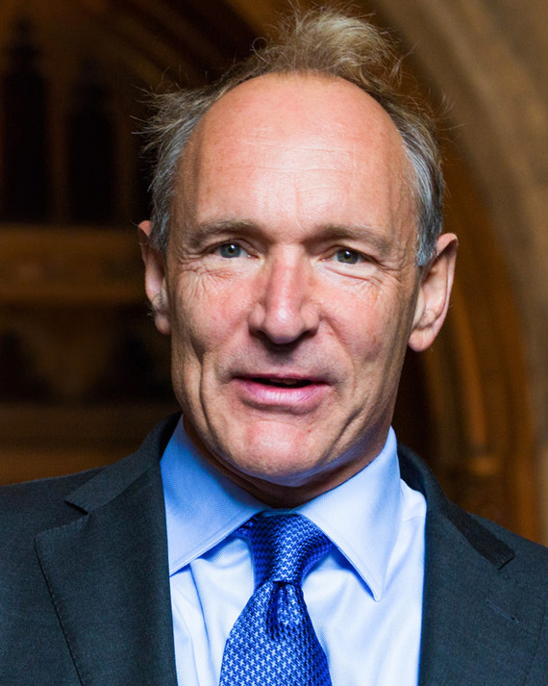
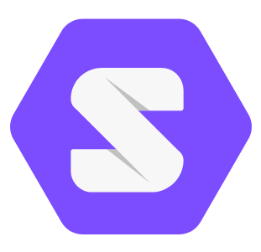
Solid: Social Linked Data
Specification for decentralized Linked Data stores (called pods)
  Can contain structured data: RDF
  And unstructured data: Any file (e.g. images, videos, etc.)
Implementation of a platform for linked data applications (“LDP”)
  WebID
  Access Control (Solid-OIDC)
  Tools to develop decentralized applications
  Standards to ensure interoperability
Tim Berners-Lee
Notes:
Tools include:
Server
Libraries (e.g. for RDF manipulation, or for ACL)
Testing framework
In multiple programming languages
https://solid.github.io/solid-oidc/

Slide 23
Solid: Demo
https://lukkie.be
https://dimou.solidcommunity.net/profile/card#me
https://solidproject.org/users/get-a-pod
https://solidproject.org/apps
Notes:
Make 2 accounts, use poddit, show chess game (that doesn’t work 😐)

Slide 24
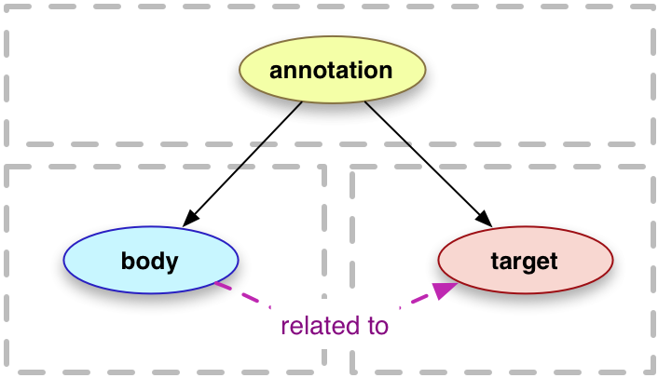
Example application: Annotations
Notes:
Common model (standard)
(Shape)

Slide 25
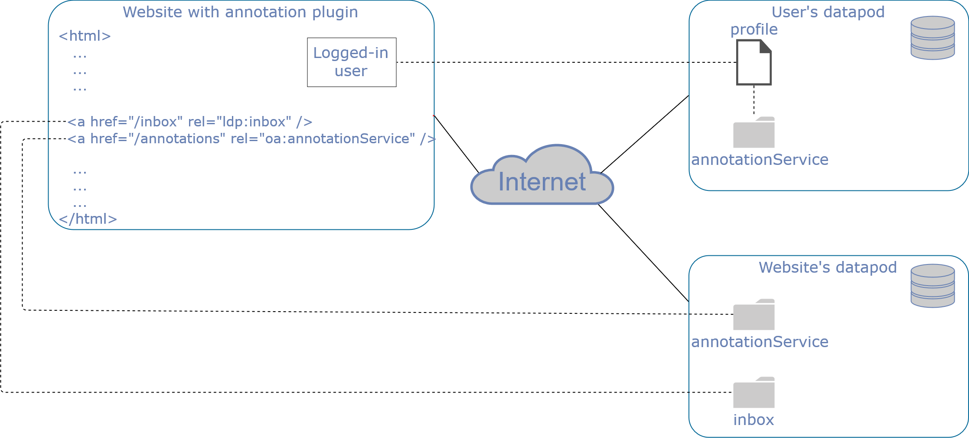
Decentralized annotations
Architecture
Linked Data Notifications (LDN)

Slide 26

Decentralized annotations
Adding an annotation
POST
LDN
(incl. Annotation URL)
Annotation URL
Annotation URL

Slide 27
Decentralized annotations
Collecting an annotation
GET
GET
Annotation
Annotation
GET
Annotation URL 1
Annotation URL 2
Annotation URL 3
Notes:
Note that the annotation usually does not reside in the logged-in user’s data pod, but this is just a demonstration.
Other option is that the server/website collects the annotations instead of the user. (caching!)

Slide 28


Other applications

Slide 29
Solid applications
Community Solid Server (CSS)
SolidOS
Notes:
CSS is the back-end, your pod.
SolidOS is more of a front-end to your pod.
https://github.com/solid/solidos
https://solidos.solidcommunity.net/

Slide 30
Challenges
Adoption
  People are still ok with traditional social media / no motivation
  Too few people involved in the project
  Less financial incentives to create decentralized app
Notes:
May need some kind of government stimulus
Public datapod stores are available, but no guarantee that your data is not sold (although likely not legal)
Security: easier to break into one pod, but harder to get data of everyone (Cambridge analytica)

Slide 31
Challenges
Tech knowledge / barrier of entry
  Improve UI (example: https://dubzed.inrupt.net/profile/card#me)
  Make it easier to create a local datapod
  Prevent data loss
  Managing data pod (e.g. manual data edits) requires technical knowledge
Notes:
May need some kind of government stimulus
Public datapod stores are available, but no guarantee that your data is not sold (although likely not legal)
Security: easier to break into one pod, but harder to get data of everyone (Cambridge analytica)

Slide 32
Challenges
Security
  Hard to get data of everyone
  Isolated attacks are easier
  Strength or weakness: One password/account for all your apps
    Note: You can have multiple accounts
  Solid doesn’t enforce encrypted data
Notes:
Security: easier to break into one pod, but harder to get data of everyone (Cambridge analytica)

Slide 33
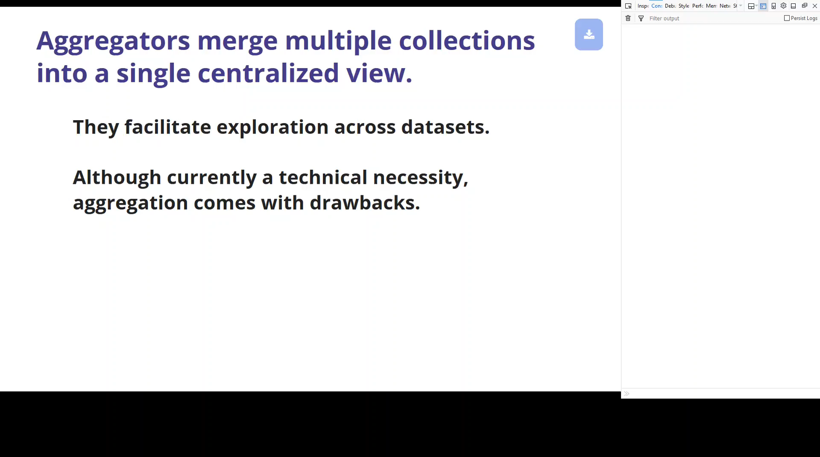
Challenges: performance

Slide 34
Challenges: caching
Collecting an annotation
Annotation
Annotation
GET
GET
GET
Annotation URL 1
Annotation URL 2
Annotation
Annotation
Potential problem: ACL
Notes:
Note that the annotation usually does not reside in the logged-in user’s data pod, but this is just a demonstration.
Other option is that the server/website collects the annotations instead of the user. (caching!)

Slide 35
Challenges: offline usage
What if you want to see data of a pod that is offline?
Notes:
Is it possible to use Solid offline (at least partially)?
Eventually, yes. The Solid long term vision includes local first and a flexibility of different topologies of patch-passing sync networks. However, there are no implementations yet.
Also, caching

Slide 36
How is data stored?
Depends on pod provider
Only requirement: comply with the Solid specification
File-based vs Query-based access
  Usability
  Performance
Notes:
I did a thesis on this subject
At the moment, file-based access is way easier to administrate, to set up, to make applications for (think about a python script that looks for new files that are created in a dir), and handles other files better
But if you would be using a single SPARQL graph, the performance is way better. E.g. you can do performant queries over all your data at once. With a good UI, you could abstract away most of the downsides.

Slide 37

Solid in practice
Notes:
Solid is open-source and non-commercial by default.
Inrupt enables them to move forward with the project while being funded etc.

Slide 38
Solid in practice
Mysilio
Dutch Digital Heritage Network
Notes:
Some small projects:
Mysilio is not only a pod-provider, but it allows you to create your own communities and website on top of your pod (not super clear though, could be wrong)
The Dutch Digital Heritage Network organizes their whole system using Linked Data, and allows other people to access it through Solid. (Not necessarily social, just a good application for it)

Slide 39
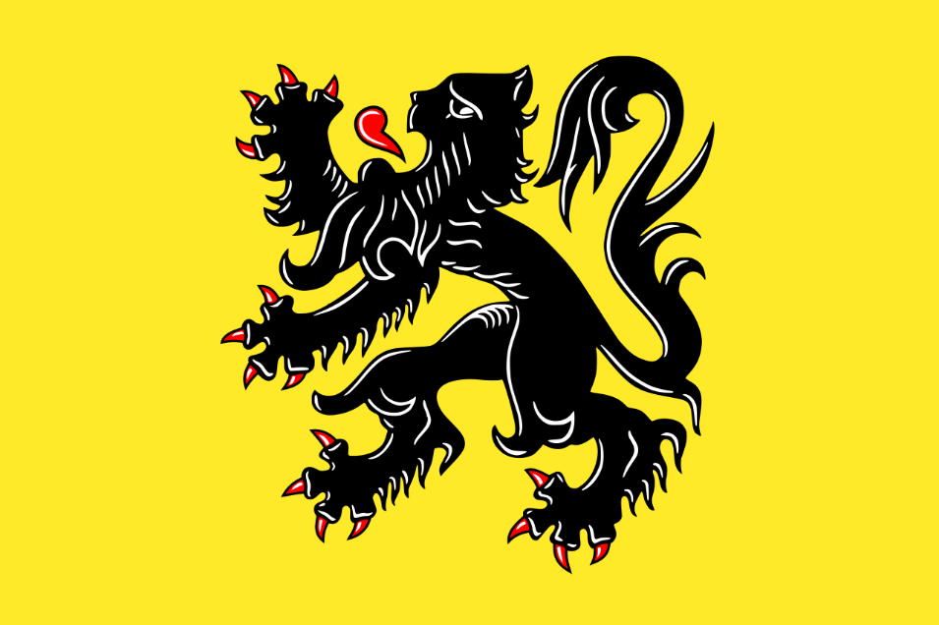
Solid in practice
https://inrupt.com/flanders-solid
https://inrupt.com/blog/flanders-innovation-economy
One person can have multiple pods. Your government data will be stored in a pod created by the government but assigned to you. You will not have full control over it. But you can give consent.
  (WHY do you need this specific data?)
Notes:
Interoperability between governmental institutions / applications through common data format and single source of truth
Allow 3rd party applications to access governmental data about people
Allow sharing data even with other governments
Ontologies are being developed for all kinds of data related to this.

Slide 40
Solid @ CERN
Web was born at CERN
http://solid.cern.ch/
https://gitter.im/cern-solid/community
2 Thesises
  Jan Schill: PoC to add decentralized comments to Indico
  Théo Martin: Hosting Solid pods at CERN, integrating with our SSO
Notes:
The web was a crazy idea back then. Solid is a crazy idea right now, reinventing the Web.

Slide 41
Solid @ CERN
What can we do at CERN to help the Solid project?
- Migrate user profiles to CERN ?
- Build a nice UI ?
Notes:
Migrate user profiles to Solid? That way, we are people that implement Solid and having a bigger community for user testing wouldn’t hurt.
Address data protection issues
https://it-student-projects.web.cern.ch/projects/cern-solid-and-slides-app
Build a nice UI ourselves
We need resources, for which we don’t have a sponsor.

Slide 42
FAQ
https://solidproject.org/faqs

Slide 43
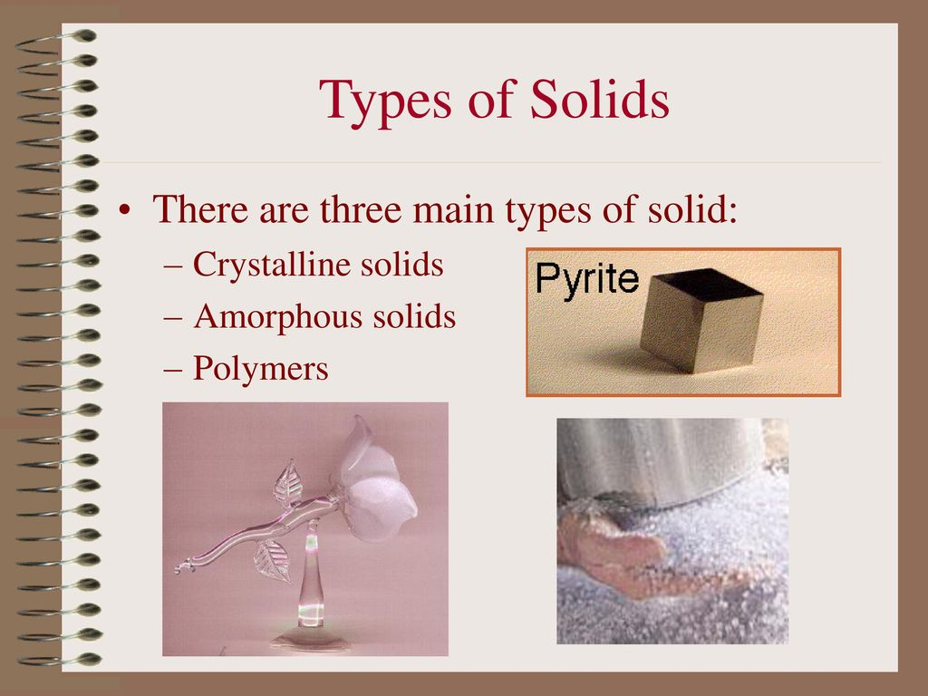
The end of my Solid presentation
Notes:
Time for discussion

