Slide 2
Topic of Interests Discussion
CTTB Industrial Controls Forum
Jean-Charles Tournier
Rodrigo Ferreira

Slide 3
A two steps process
Today
  Identification of topics of interest
  Common understanding of the different topics
Next week
  Online survey on the different topics
  Allows everyone to participate

Slide 4
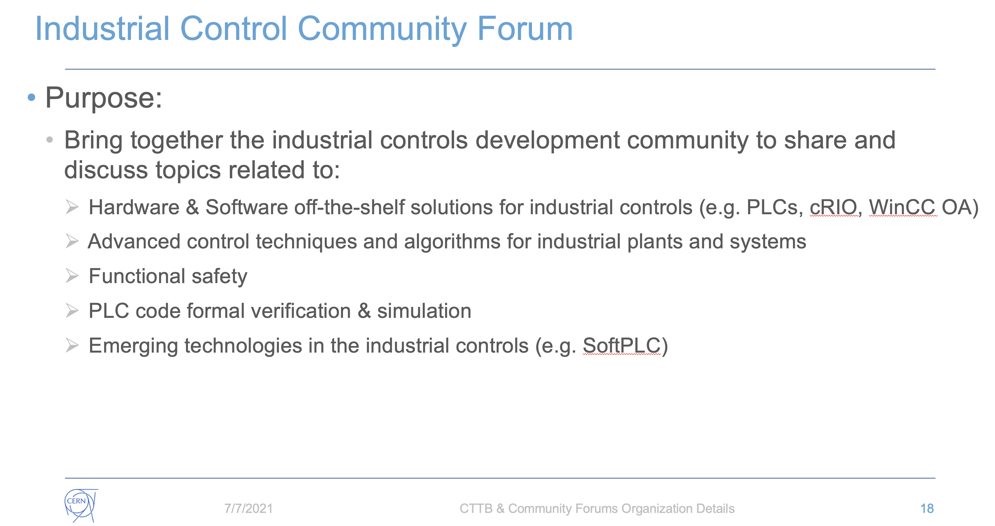
Industrial Controls Forum Scope

Slide 5
Potential Topics
Field buses current offer vs needs
Wireless field buses
DI/OT integration in industrial controls as radiation tolerant I/O
Advanced controls for industrial plants
Functional safety
Maintenance and predictive maintenance tools
Formal verification of PLC programs
How can industrial controls help reduce environmental impacts
  Noise, water quality, energy consumption
Version control and CI/CD for SCADA applications
Asset management of industrial systems
Engineering and upgrade of applications
  Could be split into SCADA and PLC
Specification of industrial control applications
Alarm management overview
  Standards vs. current practices at CERN
  Monitoring of alarms, notifications
Web access for industrial control systems
  Application on the web, dashboards, etc.
Machine learning for industrial control systems
Integration of industrial control systems to CERN control system
  DIP, CMW
Local and mobile operations and interventions of industrial control systems
  Needs, solutions, strategies
Distributed controls PLC applications
  Standard, current use cases and needs

Slide 6
Additional Topics
…

