Slide 1
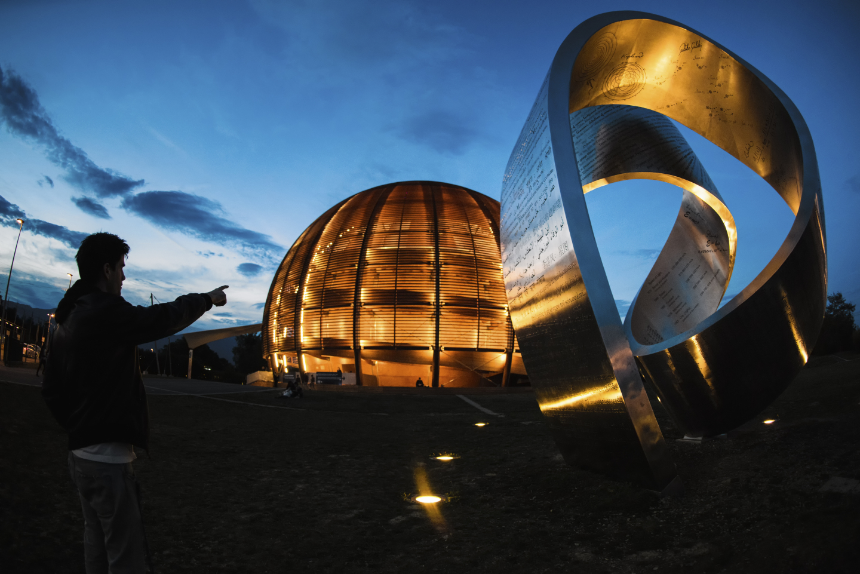
PLC Code Versioning at TE/VSC
Vacuum Group – Interlocks Controls and Monitoring
Rodrigo Ferreira on behalf of TE-VSC-ICM
rodrigo.ferreira@cern.ch

Slide 2
PLC Code Versioning at TE/VSC
Current State
The Vacuum Framework PLC baseline is a collection of FCs / FBs / OBs which are present in all our PLCs.
We often have several versions of the same FBs/FCs depending on the CPU or Project Type (SIMATIC Pro or TIA Portal)
  SCL syntax slightly different between SIMATIC Pro and TIA Portal
  Different SFBs and memory access methods across CPUs (mainly 400/300 Vs 1500/1200)
Current state of PLC code versioning at TE/VSC is very primitive
  One Simatic Manager Project with all S7-300/400 related code
  One TIA Portal Project with all S7-1500/1200 related code
  Projects archived to native IDE format and committed to SVN repo (changes described in commit message)

Slide 3
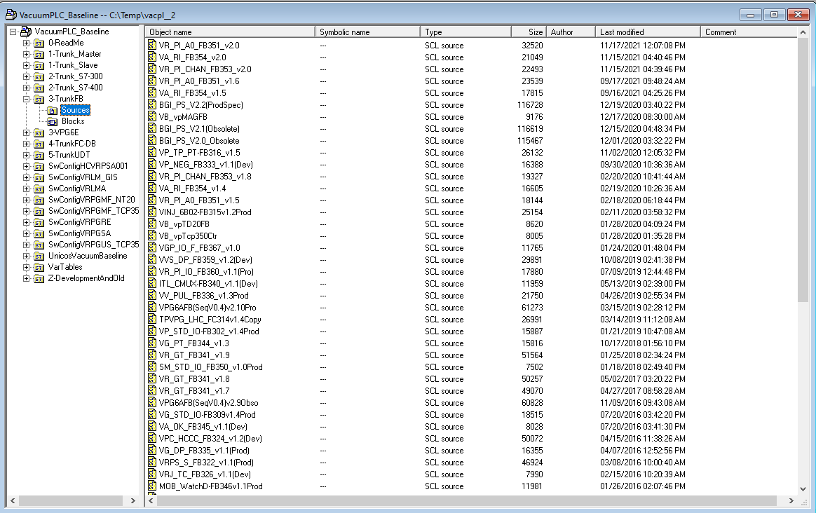
PLC Code Versioning at TE/VSC
SIMATIC Pro Project
(EDMS 1576467)

Slide 4
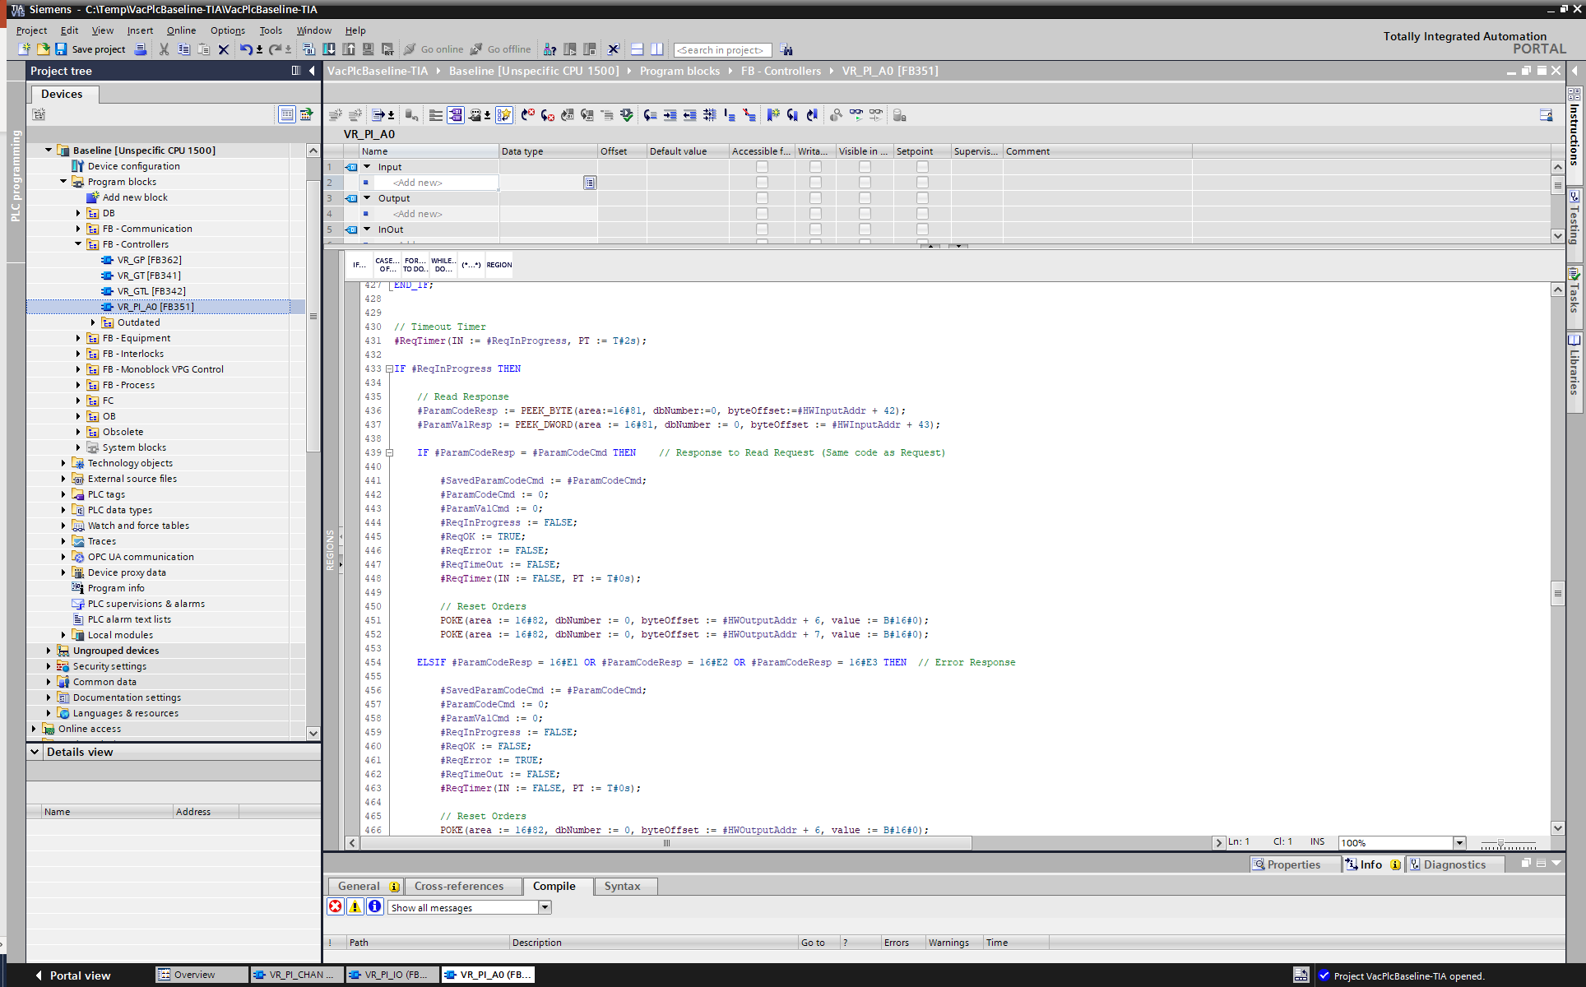
PLC Code Versioning at TE/VSC
TIA Portal Project
(EDMS 1576467)

Slide 5
PLC Code Versioning at TE/VSC
Possible Improvement
The current plan for 2022
  Export all FCs / FBs / OBs as text and organize the whole codebase as a filesystem, not in SIMATC Pro or TIA Portal Projects
  Commit the whole codebase to a single git repository (keeping SVN only for production projects or moving to Versiondog)
  Looking into what other groups are doing ;)

