Slide 1
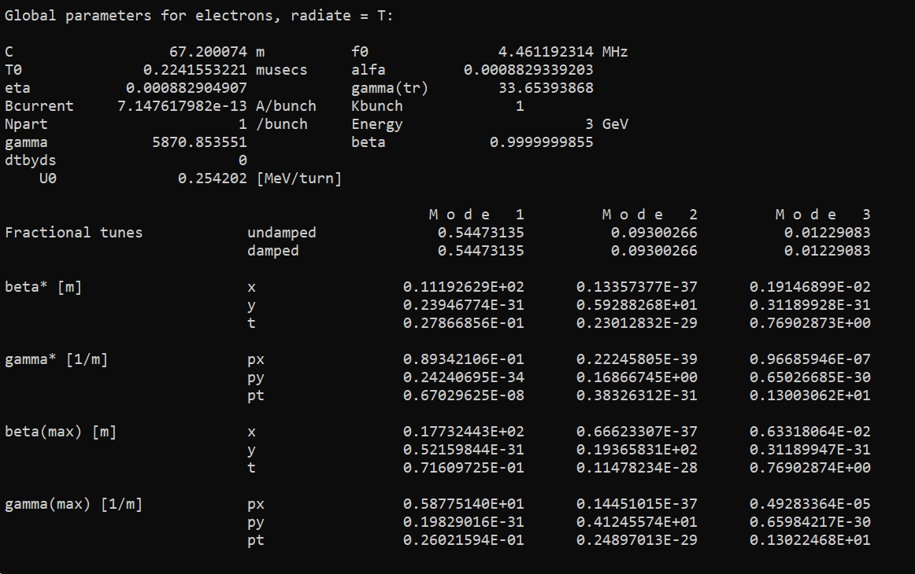
Emit output only in the standard output

Slide 2

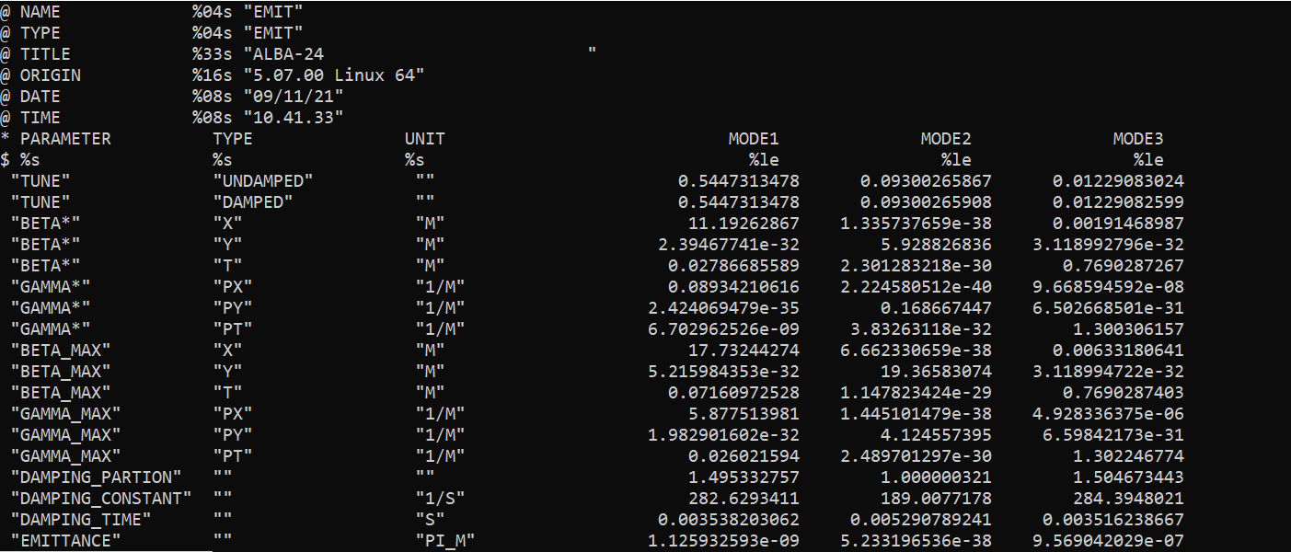
Now possible to get it into a table

Slide 3
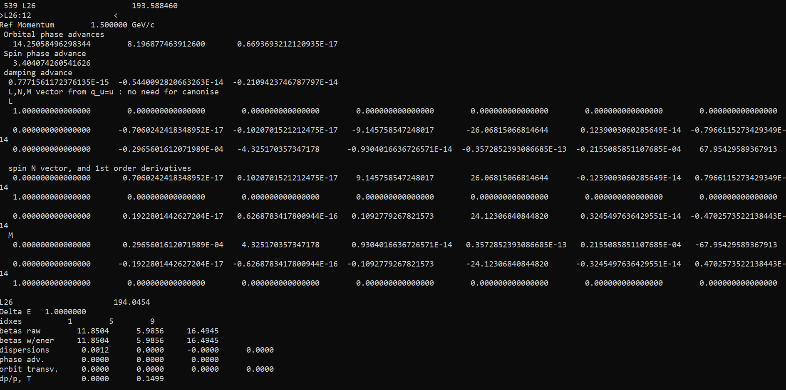
Spin
Piotr has connected spin from PTC to MAD-X
Output is at the moment only the standard output
In a special branch: ptc_spin

Slide 4
Many small issues and have been fixed and requests implemented
E.g. Npart beam-beam, bug in plotting
A special thanks to some external collaborators that have been helpful in debugging and proposing solutions:
  J. Scott Berg, T. Glässle, Y. Levinsen

